Slide 1
Progress of Injector Linac
Kazuro Furukawa
for Injector Linac

Slide 2
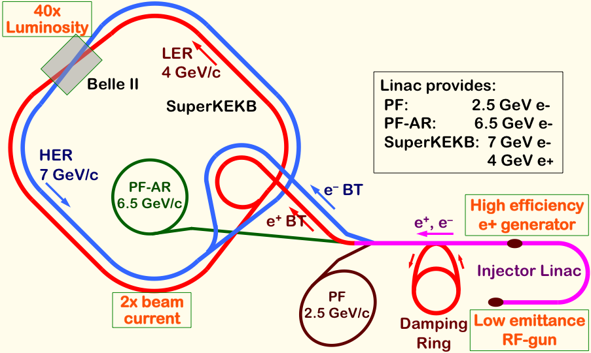
Mission of electron/positron Injector in SuperKEKB
Linac Overview
40-times higher Luminosity
Twice larger storage beam → Higher beam current at Linac
20-times higher collision rate with nano-beam scheme
→ Low-emittance even at first turn → Low-emittance beam from Linac
→ Shorter storage lifetime → Higher Linac beam current
Linac challenges
Low emittance e-
with high-charge RF-gun
Low emittance e+
with damping ring
Higher e+ beam current
with new capture section
Emittance preservation
with precise beam control
4+1 ring simultaneous injection
Notes:
Higher Injection Beam Current
To Meet the larger stored beam current and shorter beam lifetime in the ring
4~8-times larger bunch current for electron and positron
Reconstruction of positron generator, etc
Lower-emittance Injection Beam
To meet nano-beam scheme in the ring
Positron with a damping ring
Electron with a photo-cathode RF gun
Emittance preservation by alignment and beam instrumentation
Quasi-simultaneous injections into 4 storage rings
SuperKEKB e–/e⁺ rings, and light sources of PF and PF-AR
Improvements to beam instrumentation, low-level RF, controls, timing, etc

Slide 3
Injector Linac Operational History

Slide 4
Operation Statistics
FY2013 Statistics
Operation time: 5315 hours (FY2012 -0.3%)
PF/PF-AR Injection and Commissioning for SuperKEKB
Failure rate: 0.43% (FY2012 -0.87 point)
Failures include stand-by devices
Not all of failures affected the injections
Failure rate was the best in these 20 years
Earthquake recovery goes well
Old devices do not reach their lifetimes yet
Commissioning for SuperKEKB is performed deliberately

Slide 5
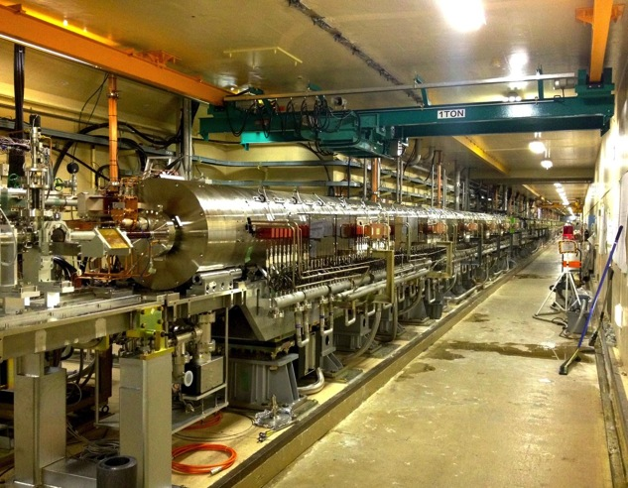
Positron Generation
4-times more positron is required at SuperKEKB than KEKB
Safety measure was taken after cable fire during the test of Flux Concentrator (FC)
New components in 100-m capture section were tested in steps
High voltage tests in tunnel in April
Beam tests with electron in May

Slide 6
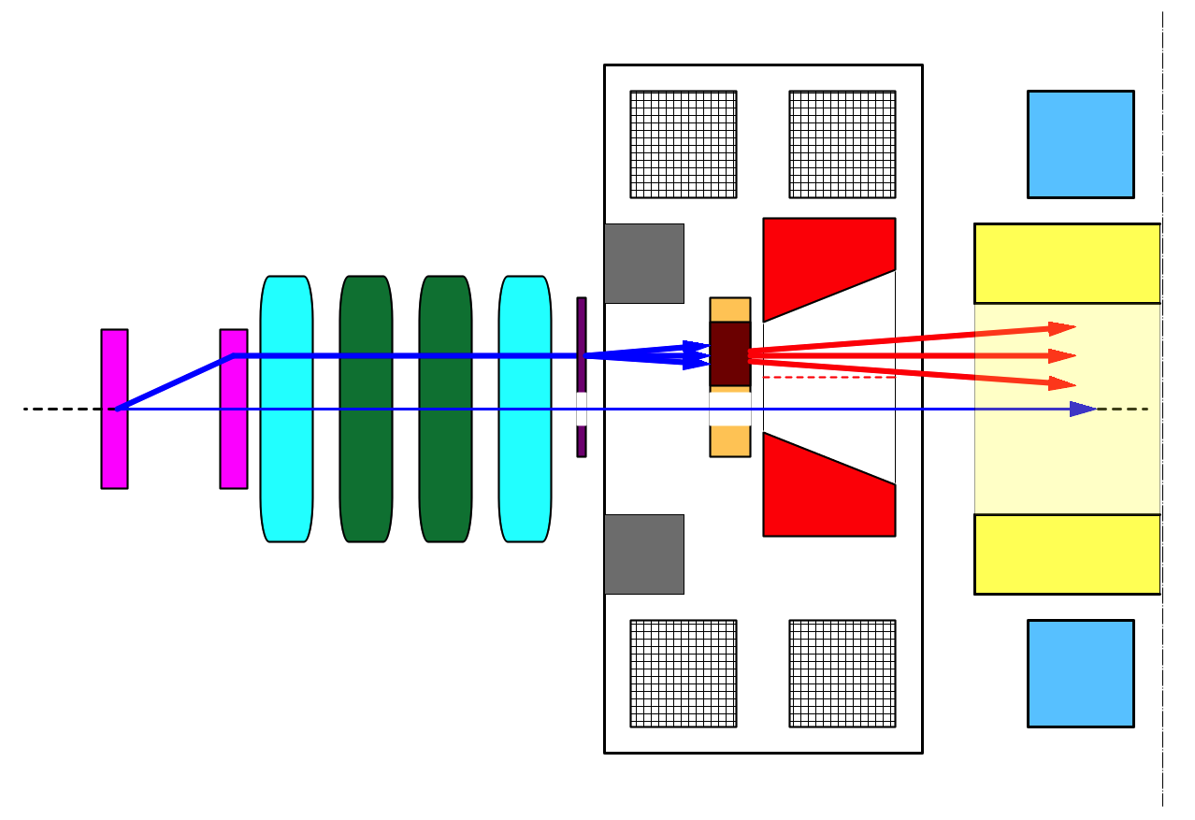
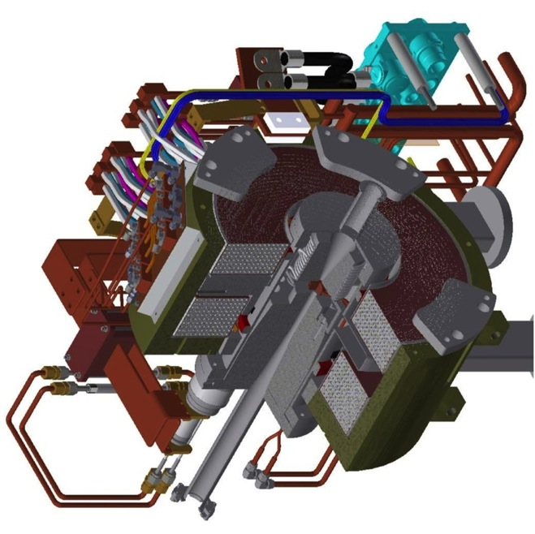
Positron generation for SuperKEKB
bridge coils
solenoid
side view
primary
e- beam
10 nC
primary e-
DC QM
spoiler
LAS Accel.
structure
target
e+
positron
production
Target
beam
hole
5 nC injection e-
Flux
Concentrator
pulsed ST
pulsed QM
Flux
Concentrator
Bridge
Coils
e+ beam
New positron capture section after target with Flux concentrator (FC) and large-aperture S-band structure (LAS)
Satellite bunch (beam loss) elimination with velocity bunching
Pinhole (2mm) for electrons beside target (3.5mm)
Beam spoiler for target protection

Slide 7
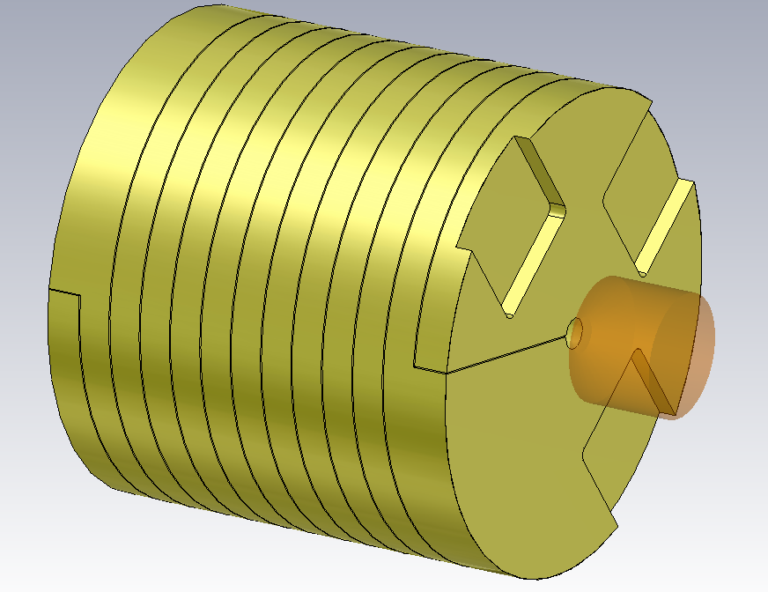
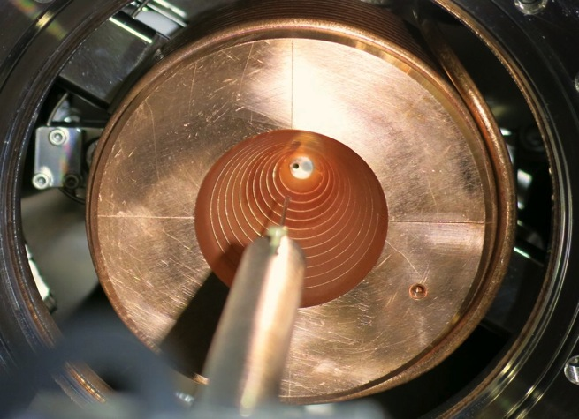
Flux Concentrator (FC)
T.Kamitani
外周の一次コイルにパルス電流を流して導体内に誘導電流を発生させると、磁束(flux)が開口部内に圧縮(concentrate)され強いソレノイド磁場ができる。
FC | parameters
length | 100 mm
outer diameter | 100 mm
inner diameter (min.) | 7 mm
inner diameter (max.) | 52 mm
peak current | 12 kA
pulse width | 6 μs (half-sine)
peak field | 3.5 T
inductance | 1.0 μH

Slide 8
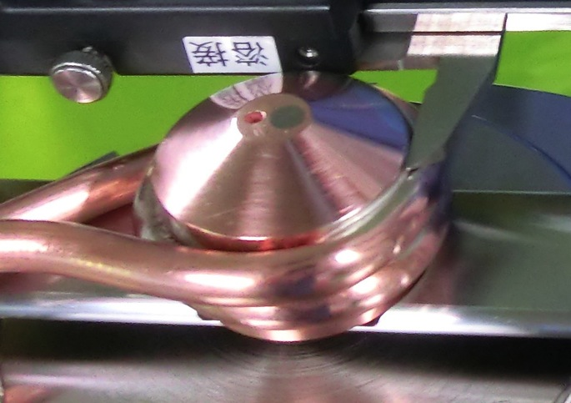
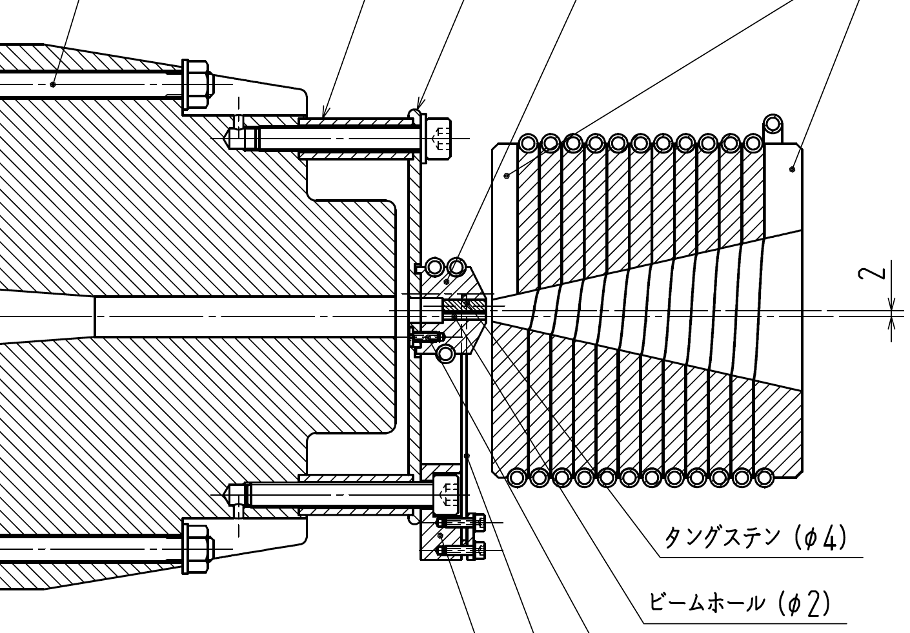
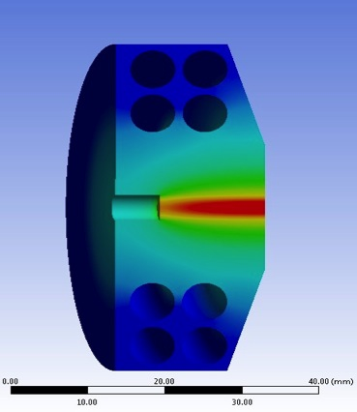
陽電子生成標的
T.Kamitani
標的材料 タングステン 14 mm長 (= 4.0 X₀)
タングステンと銅の胴体はHIP加工で接合
標的
ビーム通過孔
flux
concentrator
return
yoke
tungsten
beam hole
標的内の熱分布

Slide 9
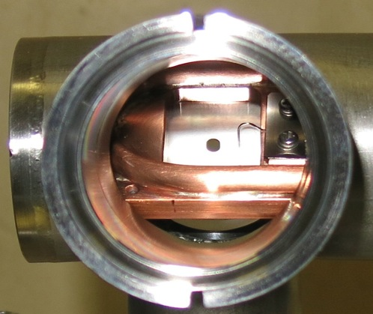
標的破壊防止用 Beam spoiler
T.Kamitani
3m distance
target上でのbeam spot sizeを σ_{x ,}σ_{y}> 0.7 mm に拡げてpeak energy密度を下げ、破壊を防ぐ
スクリーン兼用 Al₂O₃ 板 (0.14 mm thick) + Al 散乱板 (0.25 mm thick) [総物質量 = 0.05 X₀]
spoiler上にも beam hole 有り
target
screen & scatterer
e+
primary e-
injection
e- beam
hole
hole
spot size
camera
Front
Rear

Slide 10
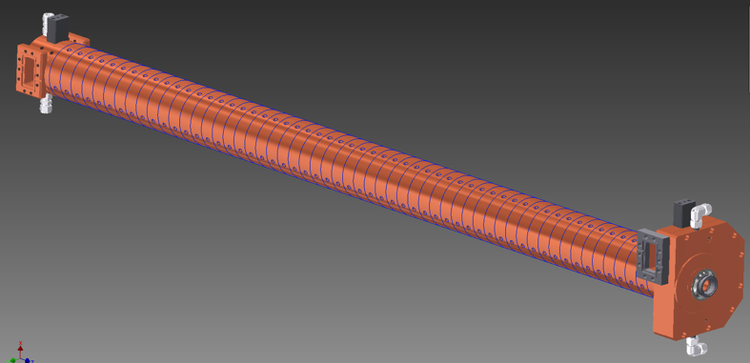
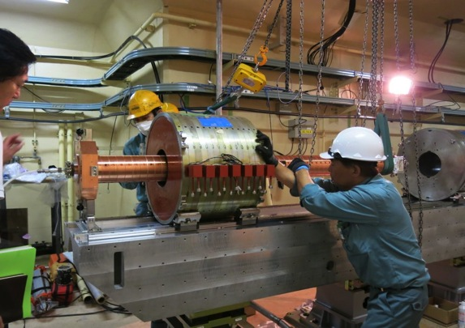
陽電子捕獲部 (e+ capture section)
T.Kamitani
SLED
SLED
KLY
1-5
KLY
1-6
FC:
FL_15_T
BC:
FC_15_T
LAS加速管
Solenoids: FC_15_11
Solenoids: FC_16_21
LAS 10 MV/m [SLED off]
減速位相capture &
RF位相スリップ &加速位相に乗る
LAS 12 MV/m [SLED on]
加速位相
DC solenoid
LAS : Large Aperture S-band 加速管
開口直径30mm：通常の 1.5倍
LAS
加速管

Slide 11
陽電子捕獲部@Linacトンネル
T.Kamitani
この中にFC、標的
ブリッジコイルが
収められている。
DCソレノイド
電子ビーム
2014年4月に陽電子捕獲部
をビームラインの設置し、
5月より陽電子のコミッショニング
を開始した。

Slide 12
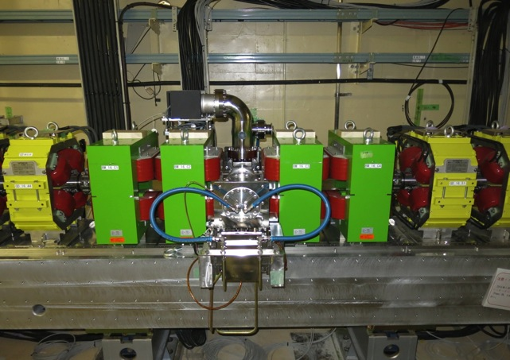
電子陽電子セパレータ
T.Kamitani
bending
magnet
陽電子ビーム
二次電子ビーム
入射電子ビーム
二次電子ストッパーブロック
FCの広いアクセプタンスのため 捕獲部の出口まで、陽電子とほぼ等量 の二次電子がやってくる
ビーム位置モニターの信号が電子と陽電子 で混ざってしまい正しい情報が得られない
二次電子はシケイン中のストッパブロックで 止め、陽電子のみ通す。
入射電子ビームは真ん中を通る。

Slide 13
Qマグネット収束系
T.Kamitani
64mの領域にわたって、
加速管のレイアウトを変更し
Qマグネットを増設して
アクセプタンスを拡張した。

Slide 14
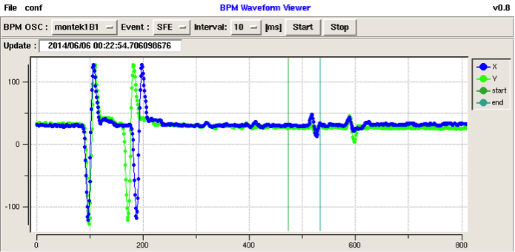
First Positron Observation from New Generator
Devices and primary electron beam studied
First positron signal confirmed on Jun.5
Positrons transferred to the beam dump on Jun.6
Consistent with simulation designs
Expect design achievement after full constructions
Signal from primary electron
Signal from positron with opposite polarity

Slide 15
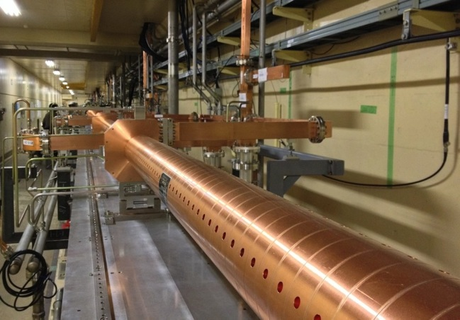
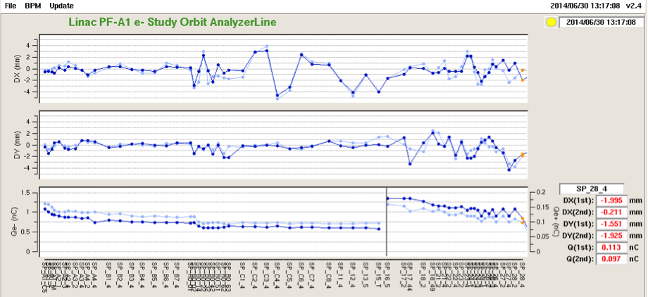
Positron from New Positron Capture Section
Generated positron ~0.1nC was transferred to the entrance of damping ring
With higher magnetic and electric field, 4-nC positron will be generated
Target shield (40cm x 6m long) will be finalized
Alignment will be improved 3mm → 0.1mm
Flux concentrator and
following solenoid/quad
Large aperture S-band structure before solenoid & quad installation
400 m
Beam position
Horizontal
Vertical
~0.1 nC
Beam charge
Primary Electron
Positron
W target

Slide 16
(1) FC current
T.Kamitani
6kAより大きな電流値でもまだ saturationせずに順調に伸びていくと 期待される
新型電源では12kAまで上がる予定。
snubber回路無しではさらに上がる
可能性あり。
FC currentがzeroでも
ある程度のyieldがある
FCでの実電流値は1.07倍
plot上の6kA => 6.42 kA
CT測定値

Slide 17
(2) Bridge Coil current
T.Kamitani
[1] 650A以上ではほぼ一定。
電源最大値は750A。現在はケーブルの
発熱より600A以下で運転している
なお、FC currentに比べて最大到達値
が低いのは、このデータの方が早い
時期に取られたがその後チューニング
によりyieldが向上したためである。
[2] zero currentではyieldが低い。

Slide 18
(3) DC solenoid 1-5 current
T.Kamitani
Yieldがややsaturationの傾向？
FC currentが高くなるとこれも もっと向上するかもしれない
本来の電源最大値は650Aであるが
電力系の制約より370A以下で運転
している。2014年秋以降改善予定
現在のBPMでは0.02nC以下は
backgroundに埋もれて測れないので
yieldも0.06以下はfakeのゲタ。

Slide 19
(4) DC solenoid 1-6 current
T.Kamitani
320A付近がoptimumでそれより
上では悪化する
FC currentが高くなるとこれも もっと向上するかもしれない
本来の電源最大値は650Aであるが
電力系の制約より370A以下で運転
している。2014年秋以降改善予定

Slide 20
(5) e+ RF phase [1-5と1-6の位相関係は固定]
T.Kamitani
FCの広いアクセプタンスのおかげで減速捕獲でもほぼ同じ収量が得られる。
減速捕獲の方が陽電子のバンチ長、エネルギー広がりが小さい。
減速捕獲
加速捕獲
測定値
simulation
シミュレーションに比べて絶対値には
すこしズレがあるが位相依存性について
はよく再現されている。

Slide 21
(6) Acc-field grad./phase at 1-5
T.Kamitani

Slide 22
(6-2) Acc-field grad. [MV/m] at 1-5
T.Kamitani
SLED を使用し、14MV/m 程度まで向上する予定

Slide 23
Positron Generation
T.Kamitani
Installation of positron generator for SuperKEKB in April 2014 (Beamline construction since summer 2013) (positron target, spoiler, Flux Concentrator, bridge coils, LAS structures [x6], DC solenoids [16+13], e+/e- separator, quads [>90])
Commissioning of positron beam, observation of the first positron after reconstruction for SuperKEKB, further improvements expected
Oct.~Dec.2014 : Linac commissioning Jan.~Mar.2015 : Construction Apr.~Jun. : Linac commissioning Jul.~Sep.2015 : Construction Oct. : LER injection
 | Primary e- [nC] | Positron [nC] | Efficiency | Parameters
June 2014 | 0.6 | 0.12 | 20% | FC 6.4kA, Solenoids 370A, LAS capture field 10 MV/m
Specification (at SY2) | 10.0 | 5.0 | 50% | FC 12kA, Solenoids 650A, LAS capture field 14 MV/m
DR injection (2016?) |  | 4.0 | 40% | Energy spread acceptance 0.5%
x17
x42
x2.5

Slide 24
Facility for Electric Power and Cooling Water
Linac needs electricity and cooling water extensions, especially for positron generator upgrade, that was planned in FY2012
Separate building construction in FY2013 not to impact PF/PF-AR
Facility extensions performed during summer 2014
SuperKEKB injector
50 Hz (e+ or e-)
pulse-by-pulse
mode switching
low emittance
RF gun
1.1 GeV
Damping Ring
circ. 136 m
PF
AR
6.5 GeV e-
2.5 GeV e-
0.1nC x 1
Bunch
Compressor
LER
3.5 GeV
10nC x 2 (prim. e-)
5nC x 2 (inj. e-)
Energy-spread
Compression System
S-band
linac
4.0 GeV e+
4nC x 2
3T
RF gun
HER
ECS
e+ target &
LAS capture section
7.0 GeV e-
5nC x 2
[1] Sector 1,2
Electricity and cooling water addition for new positron generator
+920 kVA, +900 L/min
[2] Sector 2,3
Electricity addition for new damping ring
+310 kVA
[3] Sector 5
Electricity and cooling water addition for energy compression, beam diag., injection beamlines
+300 kVA, +460L/min

Slide 25
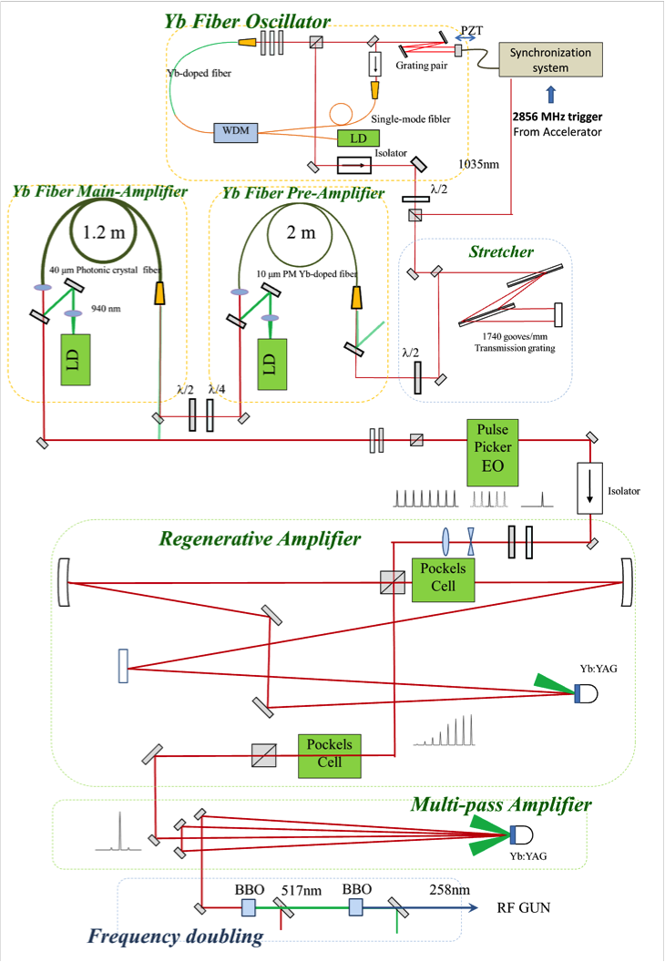
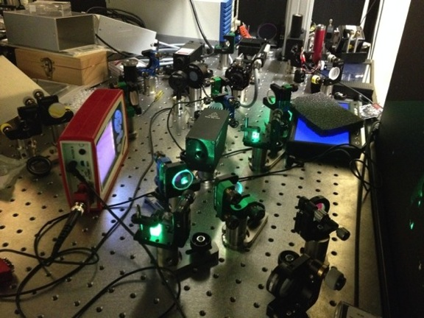
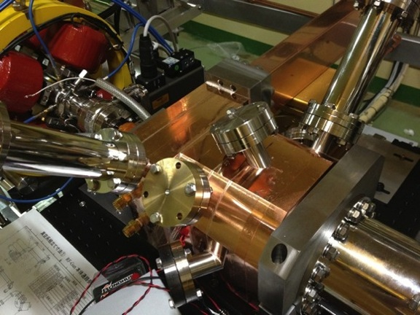
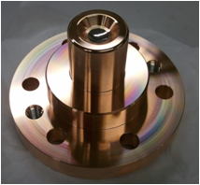
Photo cathode RF gun development
Cascaded frequency doublers
Quasi traveling wave side couple cavity
Yb fiber and Yb:YAG think disk laser
Ir₅Ce Cathode
5.6 nC / bunch was confirmed
Next step: 50-Hz beam generation & Radiation control
Ir5Ce photo cathode

Slide 26
Photo cathode RF gun improvement
Crucial for high-current low-emmittance beam
New Ir5Ce cathode and new cavity QTWSC were successful
Basic features were confirmed at 2 ~ 5 Hz
Expect beam parameter and stability performance at 50 Hz
Staged laser system improvements with beam measurements
Regenerative amplifiers were replaced with multi-pass amplifiers for their heat to achieve 25 Hz then 50 Hz

Slide 27
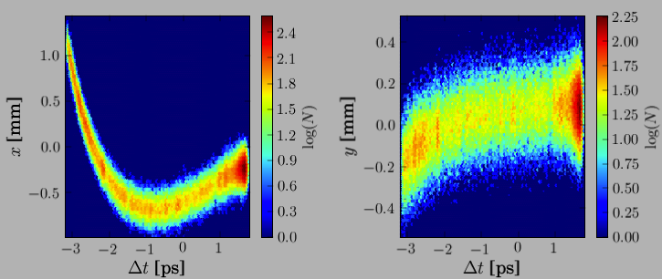
Emittance Preservation and Alignment
If Device is off center of the beam
Focusing magnet (quad) kicks the beam bunch
Accelerating structure (cavity) excites wakefield, to bend the tail
Distorted bunch in banana shape
Emittance dilution or blow-up, even 100 times larger
Depending on the beam optics and the beam charge
Alignment and orbit correction is crucial to preserve the emittance
Sugimoto et al.
Beam
Focusing Magnet
Accelerating Structure
Transverse beam distribution in time direction

Slide 28
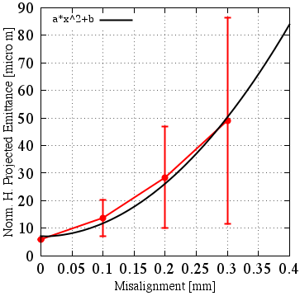
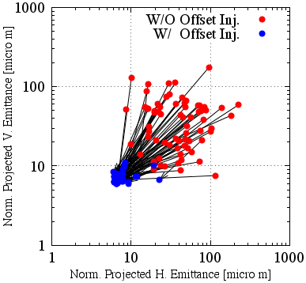
Emittance Preservation
Offset injection may solve the issue
Orbit have to be maintained precisely
Mis-alignment should be <0.1mm locally, <0.3mm globally
Mis-alignment leads to Emittance blow-up
Orbit manipulation compensates it
100 samples
Sugimoto et al.

Slide 29
Alignment
High-precision alignment was not necessary in PF and KEKB injections, and it was much damaged by earthquake in 2011.
Instead of flexible-structure girder before earthquake, rigid-structure was adopted with jack-volts and fixed supports.
Reflector pedestals are mounted onto quad magnets and accelerating cavities for laser-tracker measurement.
Iterative measurement and adjustment with 500-m straight laser and position sensors should enable 0.3-mm global alignment.
Laser tracker should enable 0.1-mm measurement within 10-m girder unit.
Displacement gauges, hydrostatic leveling, inclinometer are also employed.
Remote measurement system and girder mover system will be necessary for longer term, and are under development.

Slide 30
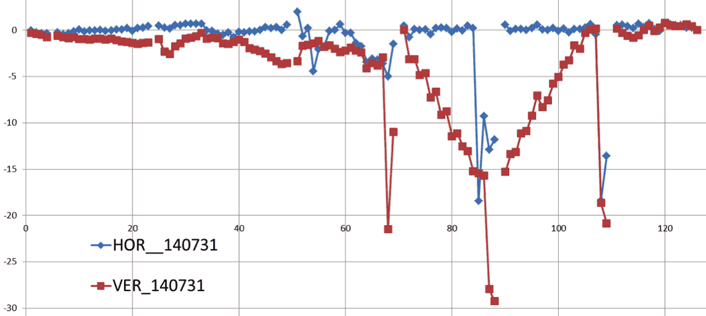
Alignment work at summer 2014
For the first time at 3-5 sectors
Horizontal axis: sensor number from sector C, 1-4, to sector 5 (~80 m/sector)
Vertical axis: voltage (~displacement at 0.25~0.5mm/V)
Some girders were not yet upgraded
Moved up to 3 mm not to break vaccuum

Slide 31
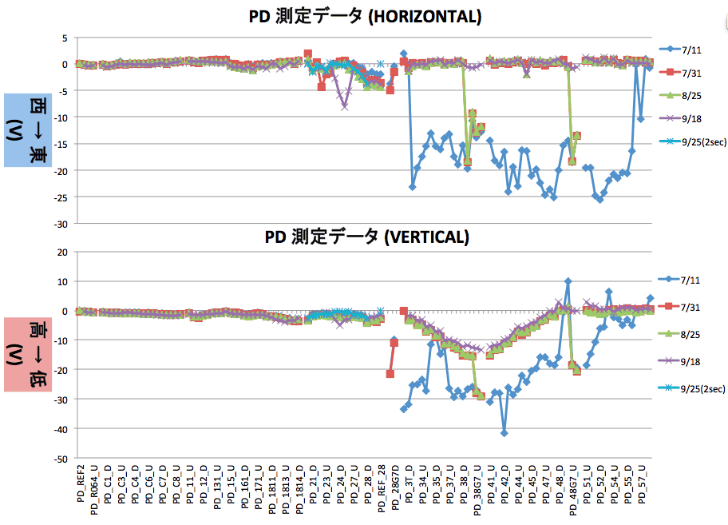
Alignment work during summer 2014
Several measurements during summer
Measurement reproducibility was confirmed up to ~0.2 mm
While there existed many conflicting measurements, consistent scheme has been established
Movement of tunnel by several 10’s of micrometer was observed (→ mover)

Slide 32
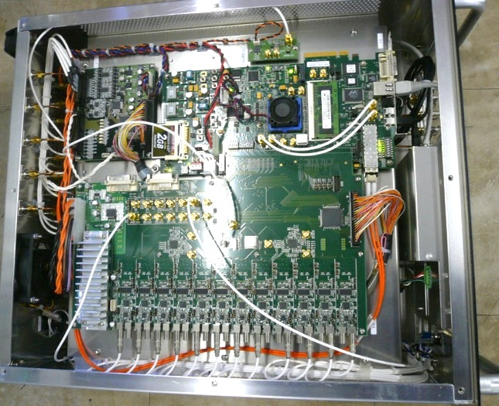
Instrumentation
RF stability is crucial for the beam
LLRF monitor is being developed
60 high-power klystrons and 10 middle-power systems
50Hz synchronized data acquisition with event (beam-mode) recognition
0.1% amplitude and 0.1degree phase resolution
BPM precision improvement
100μm → 50μm → < 10μm
Event recognition
Mass production is underway
Other beam monitors

Slide 33
Staged Radiation Control License towards SuperKEKB
Two licenses were approved in June 2014
[1] Beam diagnostic station at #A2 just after gun
for 1250nC/s at 50Hz 2bunches
[2] Beam dump at #28 just before damping ring
for 10nC/s with positrons
Radiation measurements especially at positron generator
Indispensable to estimate radiation at >100 times higher beam
Both approved
Soon apply for the next license at ~May.2015

Slide 34
Linac Schedule Overview (as of Mar.2014)
RF-Gun e- beam
commissioning
at A,B-sector
Qe- = 5nC
e- commiss.
at A,B,J,C,1
Qe- = 5nC
e+ commiss.
at 1,2 Qe+ = 0.5nC (FC, DCS, Qe- 50%)
e- commiss.
at 1,2,3,4,5 Qe- = 5nC
1 nC
2 nC
4 nC
: Electron
non damped e+ commiss.
at 1,2, 3,4,5 sectors
e- commiss. at A→5 sectors
damped e+ commiss.
at 1→5 Qe+ = 1~4nC
e- commiss.
at A→5 Qe- = 1~5nC
PF-AR e-
commiss.
: Positron
: Low current electron

Slide 35
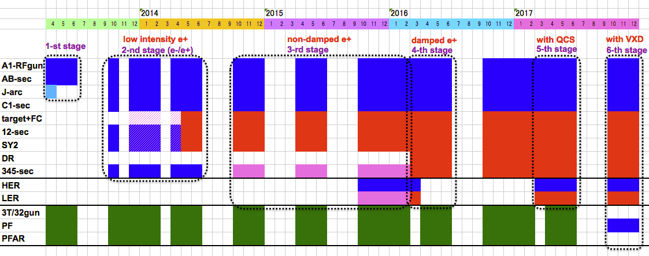
Linac Schedule Overview (Newer)
RF-Gun e- beam
commissioning
at A,B-sector
Qe- = 5nC
e- commiss.
at A,B,J,C,1
Qe- = 5nC
e+ commiss.
at 1,2 Qe+ = 0.5nC (FC, DCS, Qe- 50%)
e- commiss.
at 1,2,3,4,5 Qe- = 5nC
1 nC
2 nC
4 nC
: Electron
non damped e+ commiss.
at 1,2, 3,4,5 sectors
e- commiss. at A→5 sectors
damped e+ commiss.
at 1→5 Qe+ = 1~4nC
e- commiss.
at A→5 Qe- = 1~5nC
PF-AR e-
commiss.
: Positron
: Low current electron

Slide 36
Summary
Steady progress towards first MR injection in 2015
Will finish earthquake disaster recovery in 2014
Will make staged improvements before 2017
Will balance between final beam quality and stable/staged operation
Will select optimized route depending on available resources

Slide 37
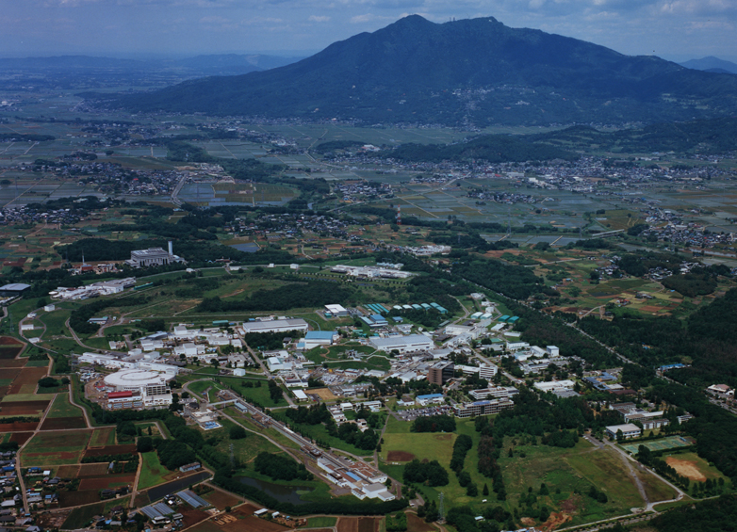
Mt. Tsukuba
Thank you
SuperKEKB
dual rings
PF-AR
PF
Injector Linac

Slide 40
Positron Source
High current positron is required
Positron capturing with flux concentrator (FC) and large aperture s-band structure (LAS)
Deceleration field to reduce satellite bunches
Pinhole beside target for electron beam
Protection system with beam spoilers

Slide 41
Positron beamline under construction
SLED
SLED
KLY
1-5
KLY
1-6
target
+FC
LAS : Large Aperture S-band structure
LAS 14 MV/m
deceleration & phase slip & acceleration
LAS 10 MV/m
acceleration
Solenoids
primary e- 3.2 GeV, 10 nC x 2 bunch, 50 Hz
tungsten target
AMD system (5.0 T x 200mm + 0.4 T x 15m) Flux Concentrator DC solenoids
KLY1 2m LAS x 2 (14 MV/m), aperture 2a = 32 -> 30 mm (typical S-band ~20 mm)
KLY2 2m LAS x 4 (10 MV/m), aperture 2a = 32 -> 30 mm
e+ beam energy at capture section exit : 110 MeV
Deceleration capture
e+ yield: N(e+)/N(e-) = 49 % at 1.1 GeV DR

Slide 42
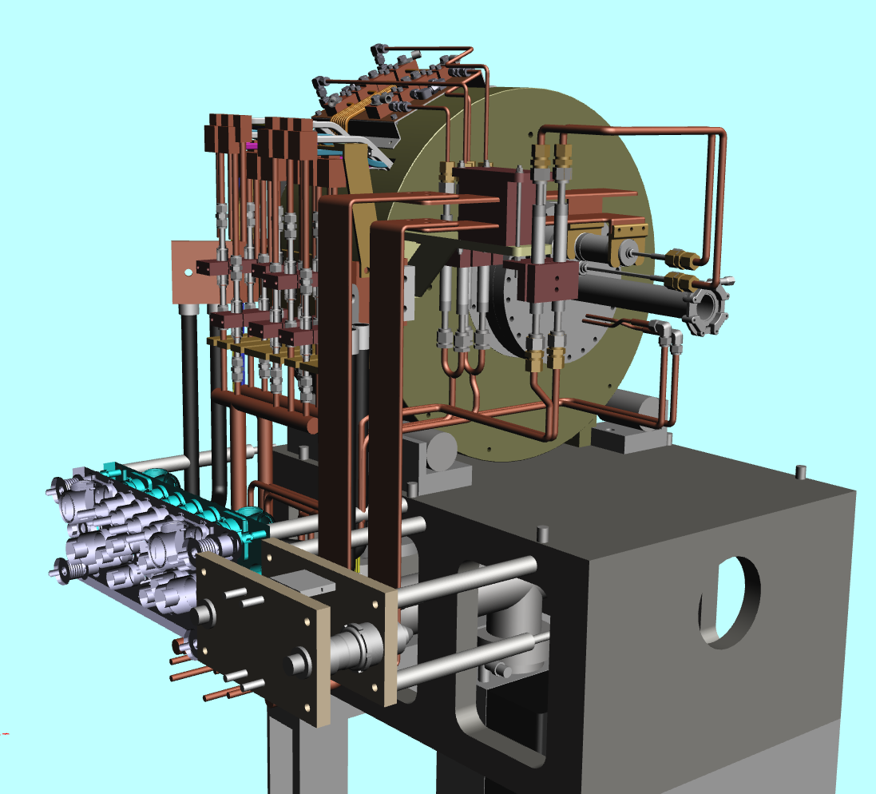
Flux Concentrator Assembly
FC assembly
primary
e- beam
positron
production
Target
quick detachable power & water connection
to minimize worker's radiation dose
Flux
Concentrator
Bridge
Coils
e+ beam

Slide 43
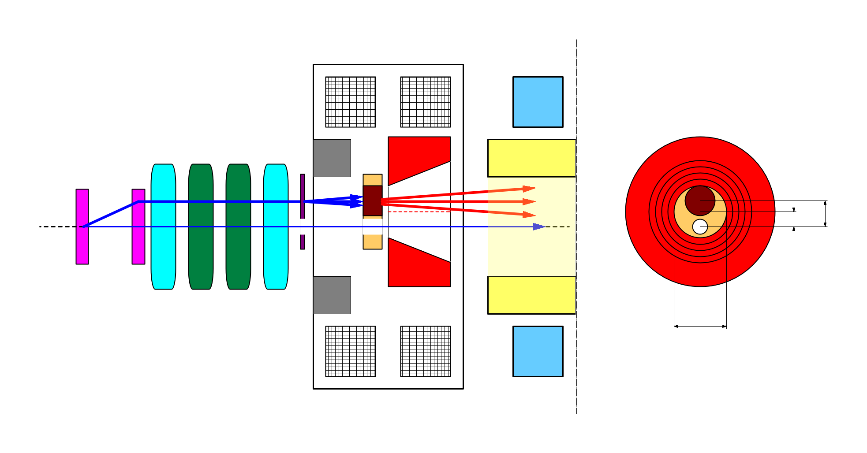
e+/e- beam switching at target
side view
bridge coils
rear view
solenoid
target
diameter
4.0 mm
10 nC
primary e-
DC QM
LAS Accel.
structure
spoiler
target
offset
3.5 mm
target
e+
beam
hole
5 nC injection e-
2.0 mm
FC offset
hole
diameter
2.0 mm
Flux
Concentrator
pulse ST
7.0 mm
FC aperture
pulse QM
Two possible schemes of beam switching by orbit bump
e+ on-axis, e- offset -> e- emittance growth by solenoid kick induced orbit
e- on-axis, e+ offset -> e+ yield degradation (50% -> 20%)
we take this scheme.
T.Kamitani

Slide 44
Energy profiles and beam properties
B
A
10 nC x 2 (for LER)
5 nC x 2 (for HER)
0.3 nC x 1 (for AR)
0.3 nC x 1 (for PF)
e-/e+ beams are delivered to 4-rings with different current & energy.
Beam acceleration modes must be switched by 50 Hz pulse-by-pulse for top-up injection.
low emittance
RF gun
1.5 GeV e-
1.1 GeV
DR
C
1
2
3
4
5
e+ target
e-:Chicane
HER: 7 GeV e-
5 nC x2
AR: 6.5 GeV e-
4.219 GeV
Decelerate
0.3 nC x1
same energy
e-
LER: 2.5 GeV e+
4 nC x2
e+ target
e+
1.1 GeV
PF: 2.5 GeV e-
0.3 nC x1
1.5 GeV
C
1
2
3
4
5
Beam optics should satisfy the fast beam-mode switching.

Slide 45
Pulse-to-pulse modulation
Event-based Control System
Four PPM virtual accelerators for SuperKEKB project maybe with additional PPM VAs for stealth beam measurements based on Dual-tier controls with EPICS and event-system
Every 20 ms
F.B
e⁻ Gun
F.B
ARC
PF Injection
e– (2.5GeV, 0.2nC)
F.B
e⁻ Gun
Damping ring
SuperKEKB-LER Injection
F.B
ARC
e– (3.5GeV, 10nC)
F.B
e⁺ Target
e⁺ (4GeV, 4nC)
e⁻ Gun
ARC
SuperKEKB-HER Injection
F.B
F.B
e– (7GeV, 5nC)
e⁻ Gun
F.B
ARC
PF-AR Injection
e– (6.5GeV, 5nC)

