Slide 1
Injector Linac Status
Takuya Natsui

Slide 2
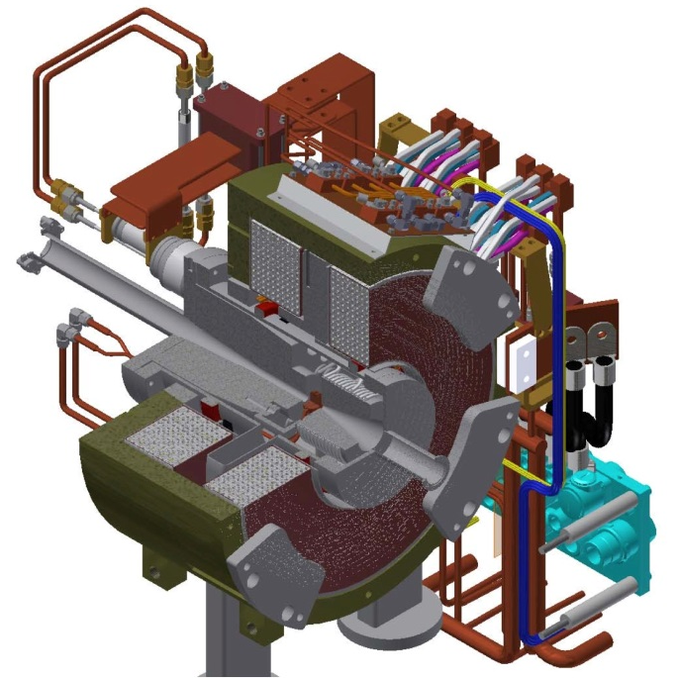
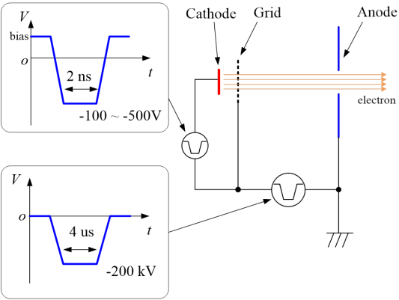
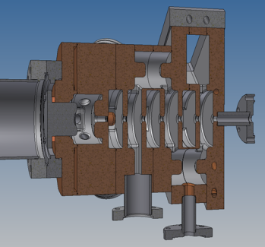
Injector Linac
Injector
Pulse magnet
Flux Concentrator (FC)
and Positron Target
Thermionic DC Gun
Photo cathode RF gun
Notes:
This is brief introduction of injector linac. We use J-Linac. It consists with 8 sectors and J-arc.
Two types electron gun are used for electron generation.
Photo cathode RF gun is used for electron beam generation.
Thermionic DC gun is used for positron primary electron generation.
It is converted to positron with target and Flux Concentrator.

Slide 3
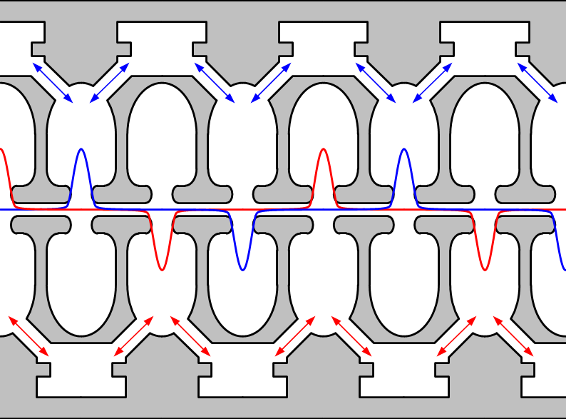
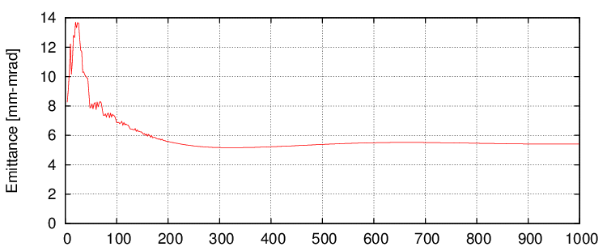
Electron beam
4 nC electron beam
Pulse magnet
4 nC, 7.0 GeV
Quasi-traveling wave
side coupled cavities
Emittance is 6 mm-mrad in simulation
Notes:
RF gun and laser system generates low emittance single bunch beam.
This RF gun has Quasi-traveling wave side coupled cavities.
In simulation, normalized emittance is under 6 mm-mrad in 5 nC.
It is enough spec for SuperKEKB.

Slide 4
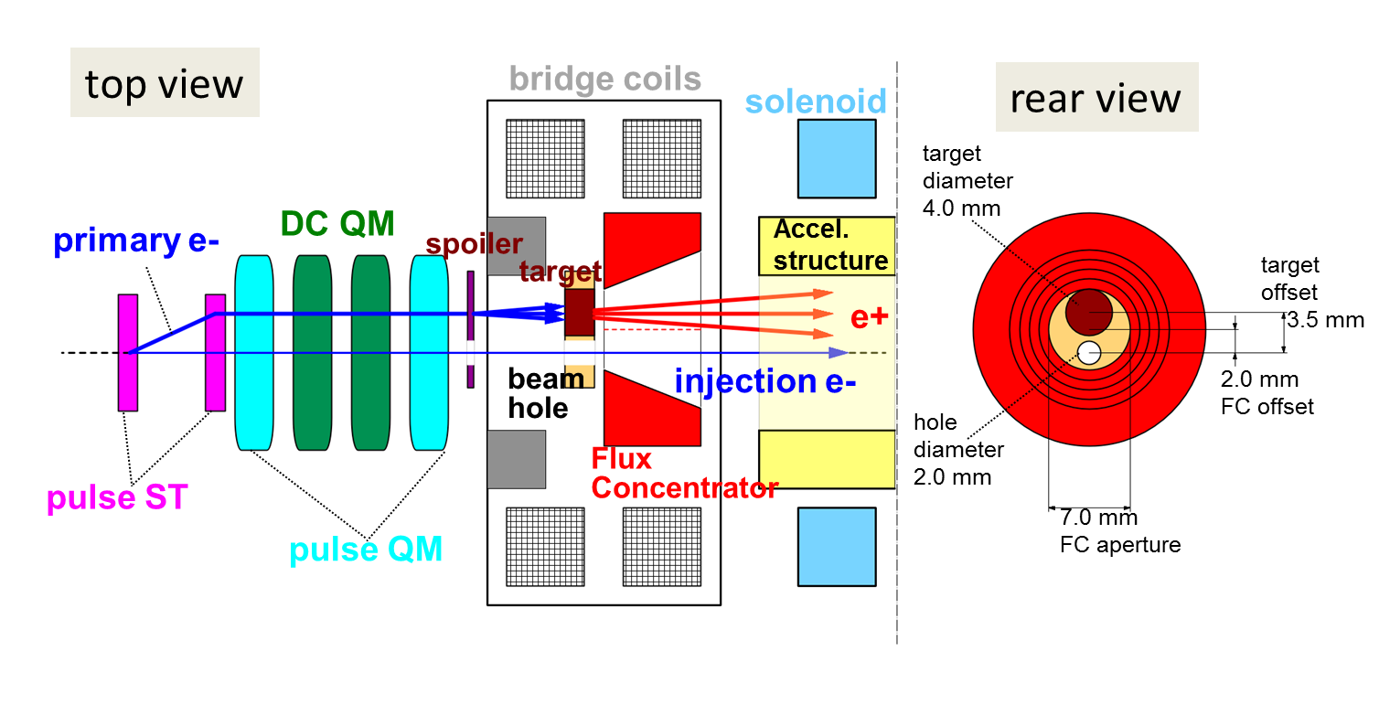

Positron beam
10 nC electron beam
10 nC, 3.3 GeV
Electron beam
4 nC, Positron beam
4 nC, 4 GeV
Flux Concentrator(FC), Positron target
Notes:
Positron beam is converted from 10 nC electron beam.
This 10 nC electron beam is generated with thermionic DC gun.
Accelerated 3.3 GeV 10 nC electron hit the target and focused with Flux Concentrator.
Converted 4 nC positron beam is injected to dumping ring.
Finally, low emittance 4 GeV 4 nC positron is generated.

Slide 5
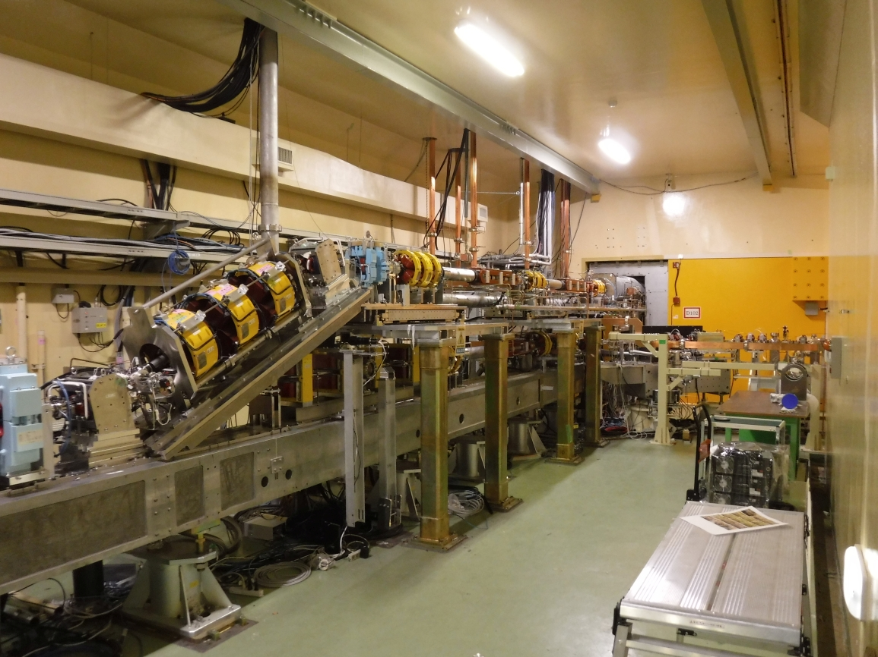
Injector line
We have two lines in injector sector for positron and electron beam.
Pulse Bend Magnet
10 nC primary electron
4 nC electron beam
Notes:
Injector line is little bit complex.
We have two guns. Thus two lines are needed.
Primary beam from thermionic gun, electron beam from RF gun.
Those are merged with pulse bend magnet.
By using this 2 stories beam line, we can use two guns.

Slide 6
Beam status
 | 2021c |  | Final goal
Beam | e+ | e- | e+ | e-
Energy | 4.0 GeV | 7.0 GeV | 4.0 GeV | 7.0 GeV
Bunch charge 1st , 2nd [nC] | 3.0 , 2.5 | 2.0 , - | 4.0, 4.0 | 4.0, 4.0
Normalized emmittance [mm-mrad] | 120, 5 (Hor. , Ver. ) | 50-20, 50-20 (Hor. , Ver. ) | 100, 15 (Hor. , Ver. ) | 40, 20 (Hor. , Ver. )
Simultaneous top-up injection | 4+1 rings (LER, HER, DR, PF, PF-AR) |  | 4+1 rings (LER, HER, DR, PF, PF-AR)
Notes:
This is beam status of final goal and current status.
Energy is of course ok.
Beam charge is still not achieved. But it was almost enough in 2021c.
Emittance was improved step by step.
Simultaneous injection to 4 rings and dumping ring is already achieved.

Slide 7
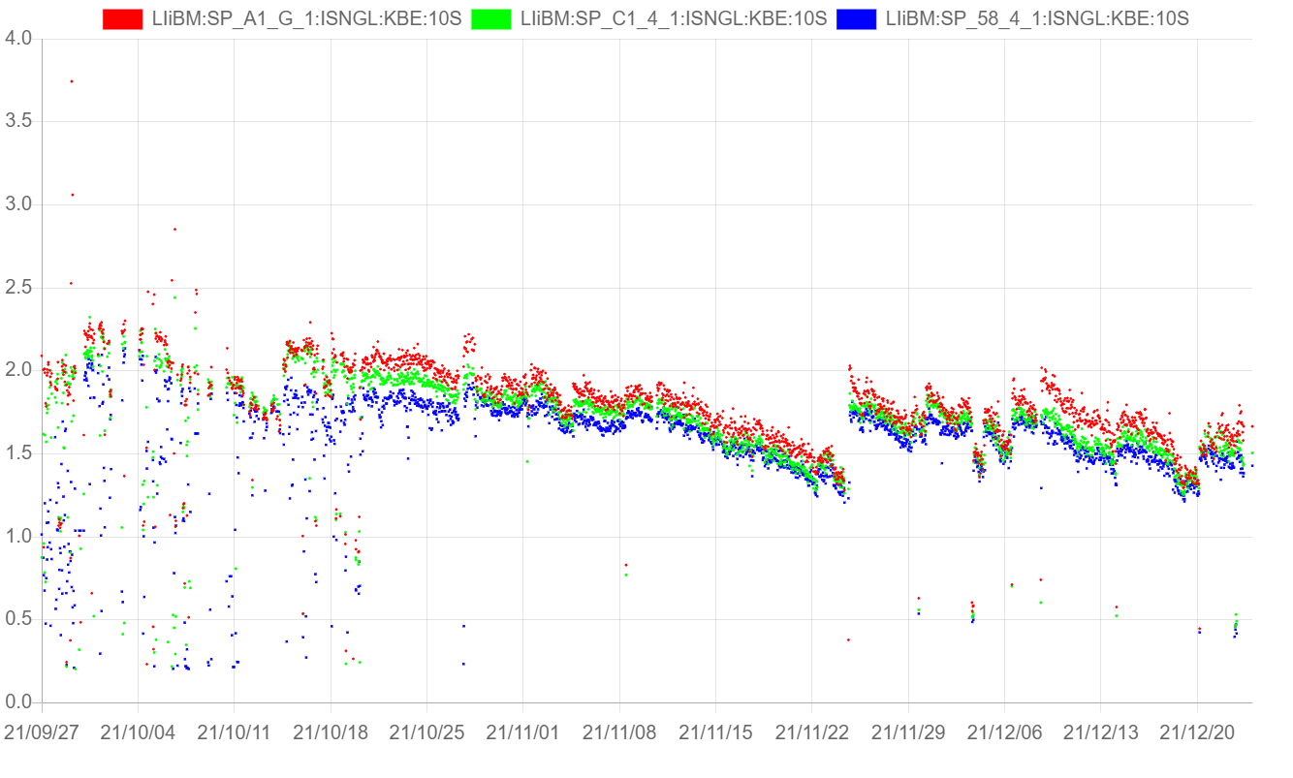
Electron beam charge 2021c
RF Gun generation
Linac end
Notes:
This is rf gun electron beam charge history.
No loss in linac.
In long term operation, charge was gradually decreased due to Quantum efficiency decrease or laser window transmission decline.
We need laser adjustment sometimes.
So we have still laser power margin to get higher charge.

Slide 8
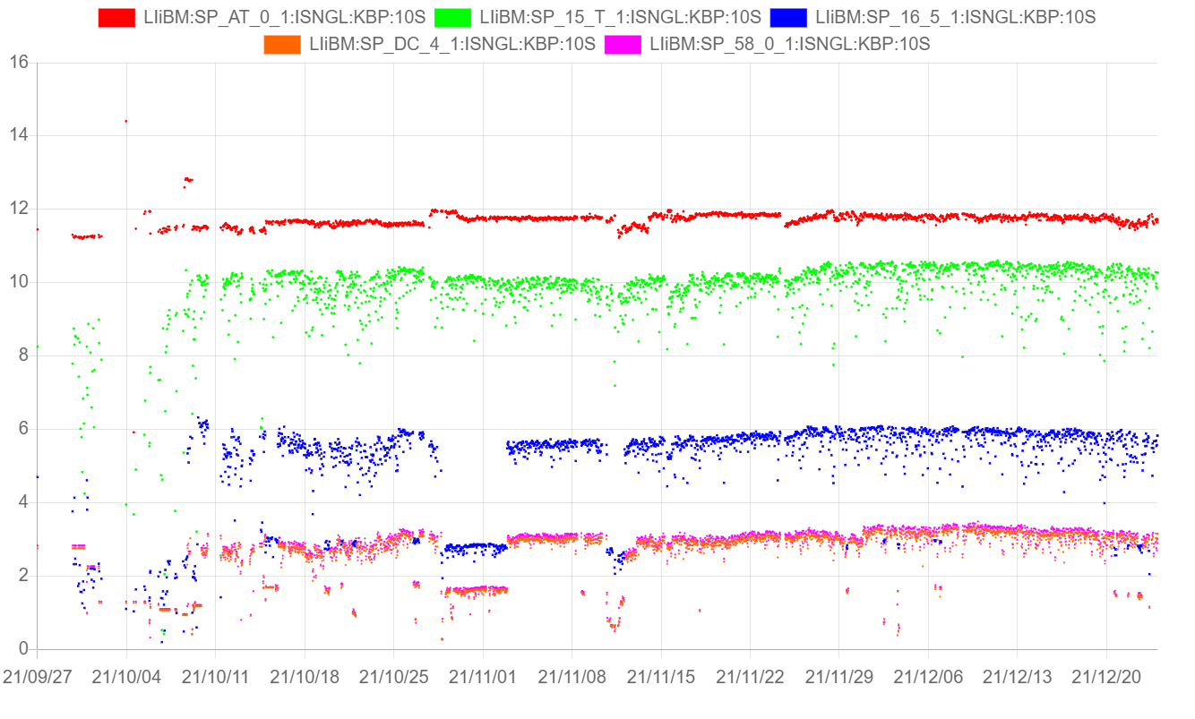
Positron beam charge 2021c
Electron
Gun generation
Primary electron at target
Positron after target
Linac end positron
Positron
Notes:
This is history of positron beam charge.
Thermionic gun generates about 12 nC electron. And transport to target as 10 nC.
But this transport beam becomes sometimes unstable. I will talk about it.
Conversion ratio is over 50 %. It means FC performance is very good.
In linac end, charge was 3 nC.
We must improve transport of positron beam.

Slide 9
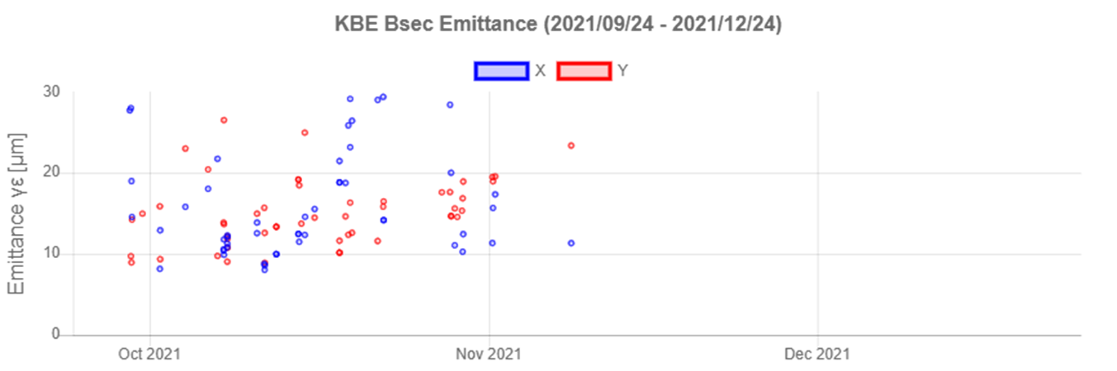
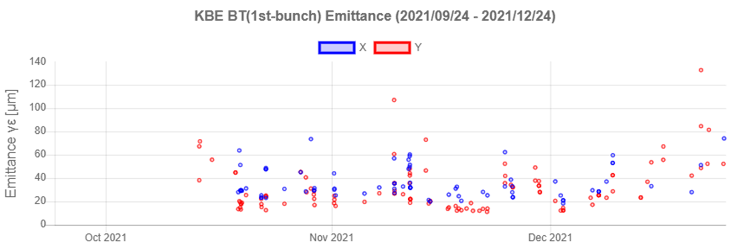
Electron beam emittance 2021c
In upstream of Linac
10 to 20 mm-mrad
Under 20 mm-mrad in good condition.
In BT line
Notes:
This is history of electron beam emittance.
In upstream of linac, emittance is very good, it’s about 20 mm-mrad.
It is almost target value.
And next graph is BT line, it is same mean of end of linac.
Sometimes emittance growth to 60 micron, Sometimes very good emittance, it is very good condition.
We must maintain good condition always.

Slide 10
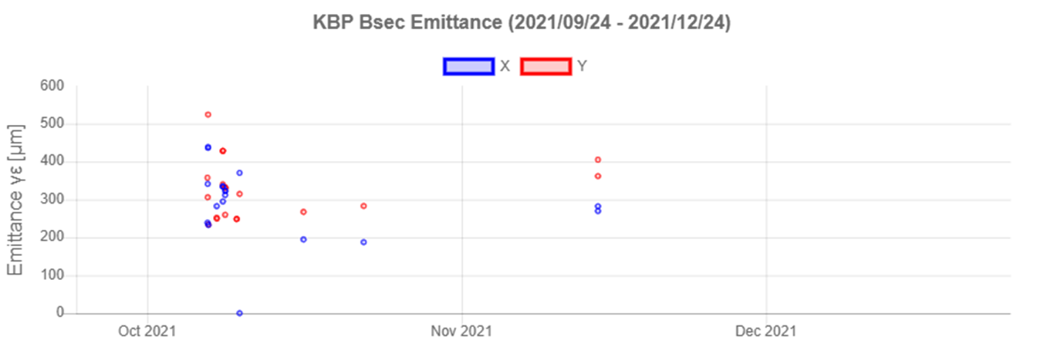
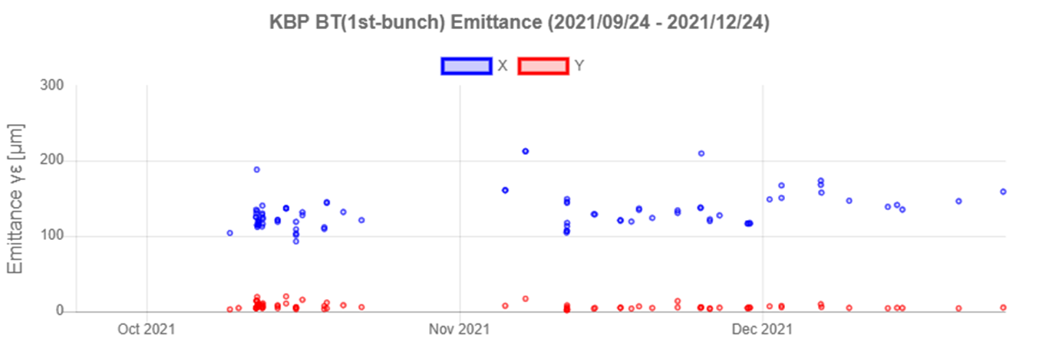
Positron beam emittance 2021c
Primary electron beam
In BT line
After dumping positron beam
Hor. 120 mm-mrad
Ver. 5 mm-mrad
Notes:
This is positron beam history.
1st graph is primary electron beam emittance, it is not so important.
2nd graph is end of linac.
After dumping, emittance become very good.

Slide 11
FC modulator improvement
In the past, FC was damaged by breakdown, but the damage was avoided with improved FC.
However, the spike voltage that could induce breakdown still remained.
Spike voltage sometimes caused malfunction of control equipment.
In last summer, we modified the FC modulator and succeeded in significantly reducing the spike voltage.

Slide 12
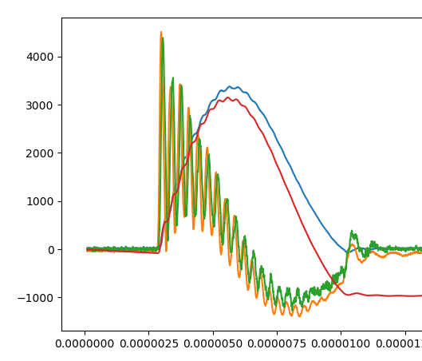
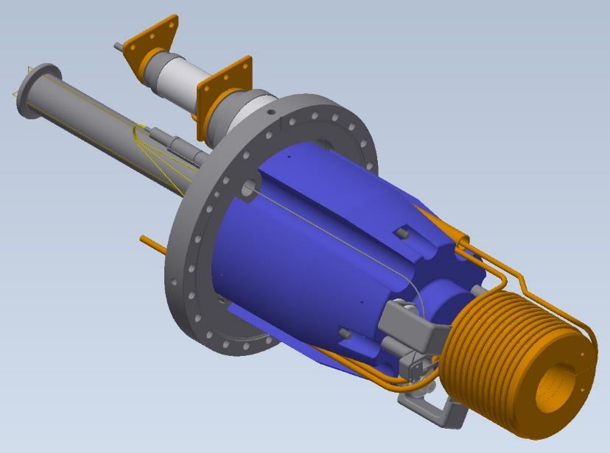
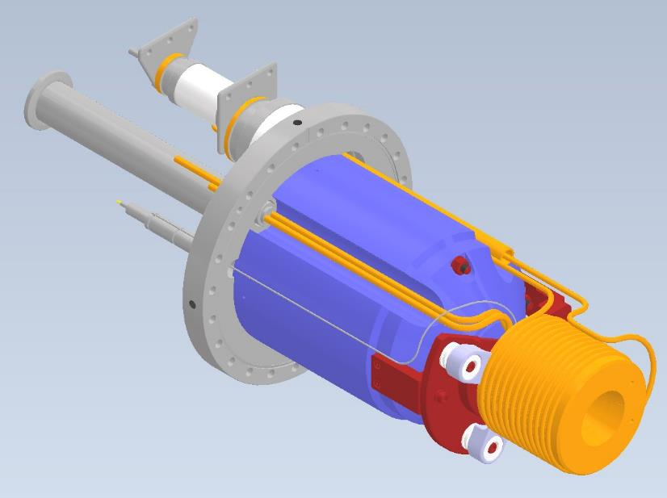
FC head improvement (2020c)
Spike high voltage had been damaging to FC head
New FC is very robust.
No break down.
Before Base 7
Base 8
・yoke shape optimization
・Insulator improvement
Y. Enomoto
Notes:
FC need high current pulse.
We apply high voltage to FC. But the spike voltage was unexpected.
Spike voltage damaged FC.
So FC head was improved. Now FC is no damege.

Slide 13
Circuit simulation of FC modulator for reduce spike voltage
We investigate a source of spike voltage and reduction method
Spike voltage
caused by parasitic capacitance of transmission cable
Reduce spike voltage
Notes:
But spike voltage sometimes caused malfunction of control equipment.
I found the cause of spike voltage.
It caused by parasitic capacitance of transmission cable.
It is resonance of FC and cable.
We found the method of reducing the resonant voltage with simple circuit simulation.
It only need a additional RC circuit.

Slide 14
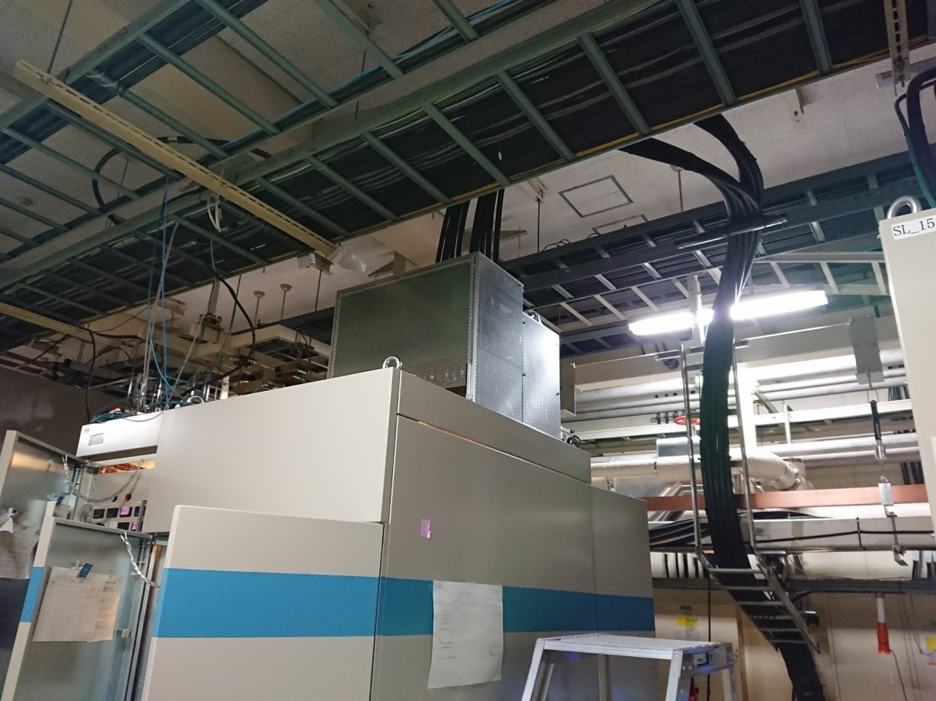
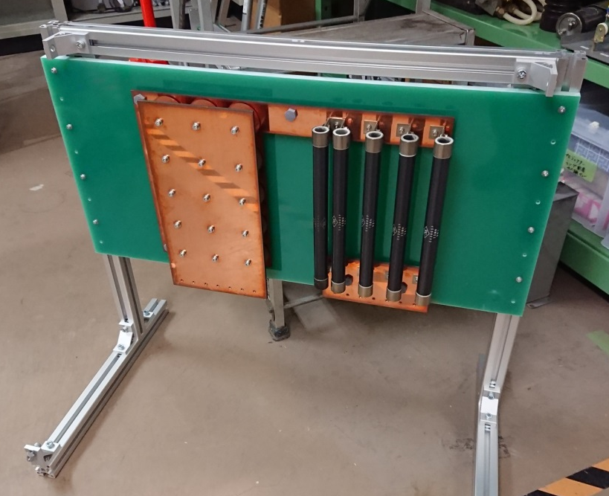
Set RC circuit to the FC modulator
RC circuit
Notes:
Circuit is very simple.
But hardware upgrade is not so easy.
In last summer, we modified the FC modulator and add the RC circuit.
It was component of 20 kV high voltage, we worked very carefully.

Slide 15
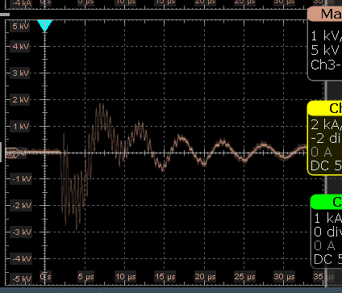
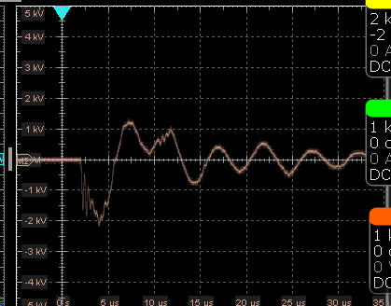
Result of modified FC modulator
Measured reduction of spike voltage was almost same of simulation result.
We have no trouble of FC noise in 2021c.

Slide 16
Issue of unstable positron primary beam
Positron primary beam was often unstable beam charge at target.
It caused by energy unstable at injector line.
Source of energy jitter is HV pulse shape and HV timing jitter.
We adjust positron primary beam to stable operation.

Slide 17
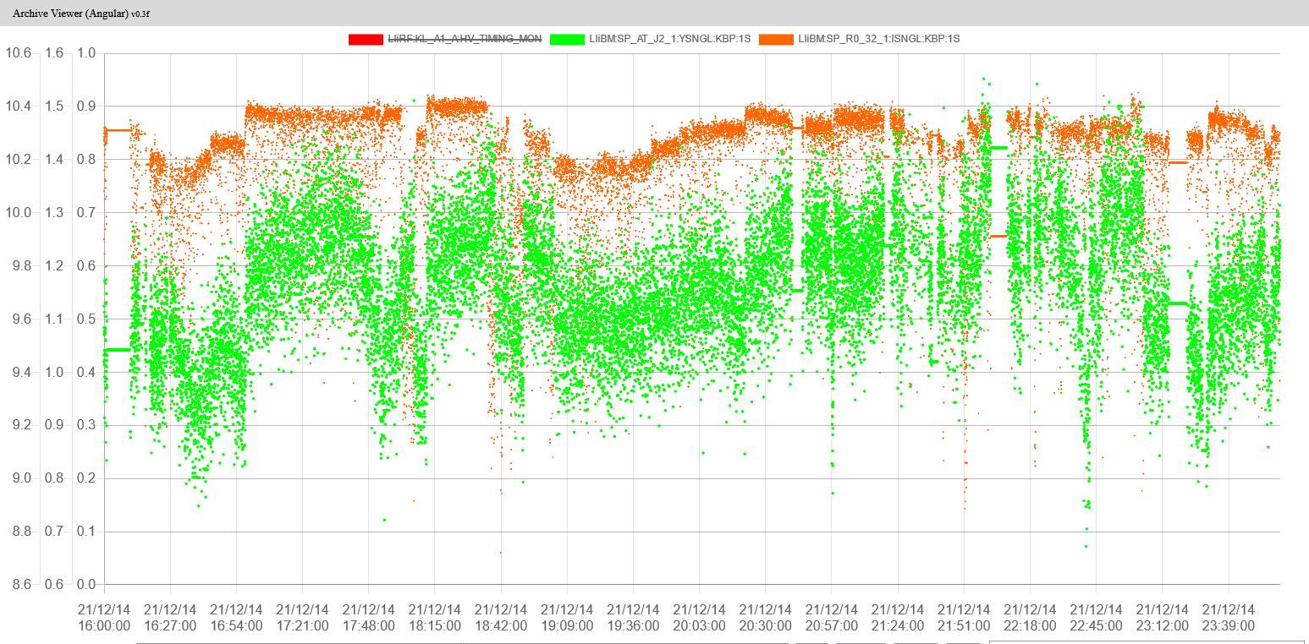
Energy jitter of AT line (Thermionic gun injector line) cussed beam loss at J-arc
R0_32 Charge
AT_J2 Energy

Slide 18
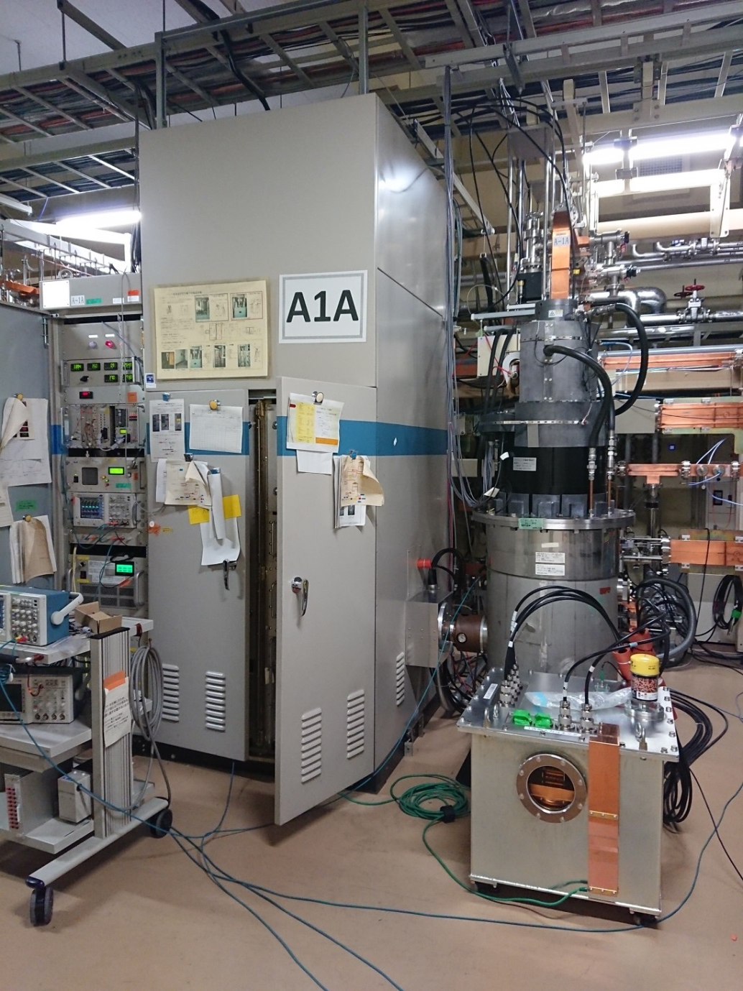
Thermionic gun modulator had been removed. Currently, one modulator feed HV pulse to two devices which is klystron and gun.
We use klystron modulator with parallel connection.
It is abnormal usage.
Notes:
Originally We should not use an thermionic gun.
However, since the RF gun is used only for the electron beam, both are needed.

Slide 19
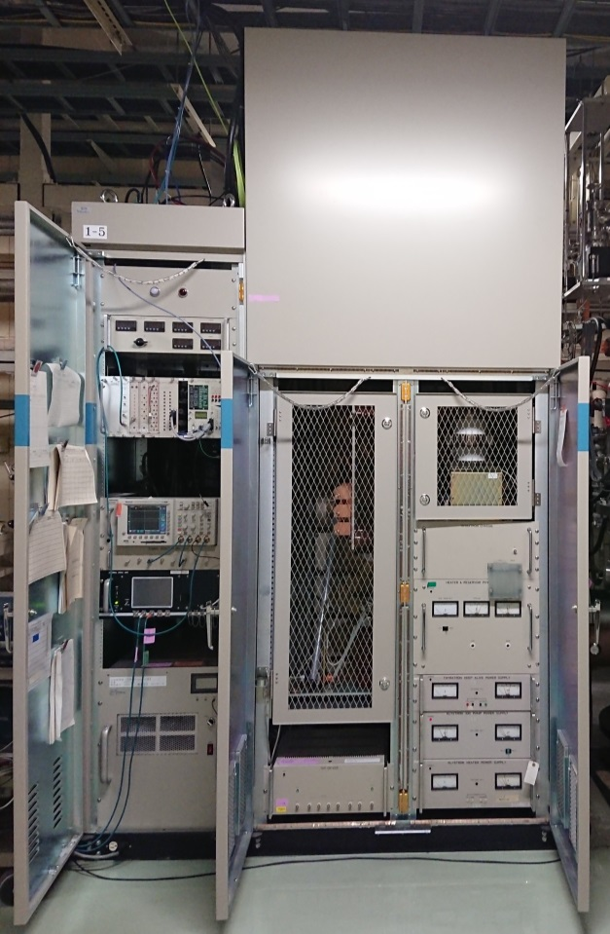
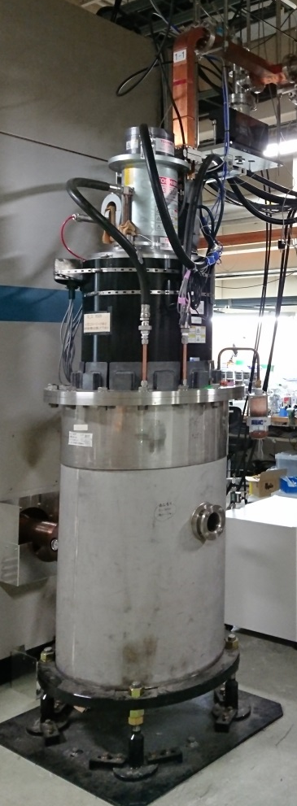
Modulator feed pulse HV.
Flat pulse is necessary.
Normal usage
Notes:
Normally, modulator used for one device.

Slide 20
Modulator feed pulse HV.
Flat pulse is necessary.
Parallel connection
At injector, gun was connected.
Notes:
But we connect two device to one modulator.
Klystorn and thermionic gun.
Normally, modulator makes flat pulse.
But,

Slide 21
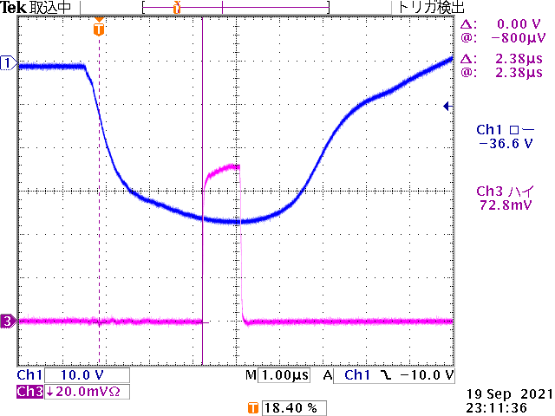
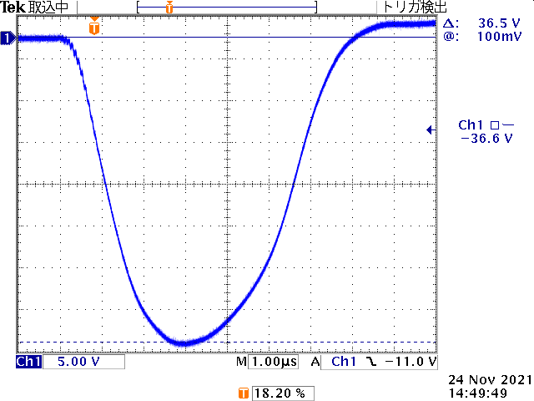
Sensitive to timing jitter
Modulator feed pulse HV.
Flat pulse is necessary.
Pulse shape was broken !!
Modulator pulse timing jitter is 10 ns
Parallel connection
At injector, gun was connected.
Notes:
Pulse shape was broken.
As a result, klystron RF output was very sensitive to timing jitter.
Modulator jitter is about 10 ns. It come from thyratron.
This timing jitter courses RF jitter.
If pulse shape is flat, 10 ns jitter is no problem.

Slide 22
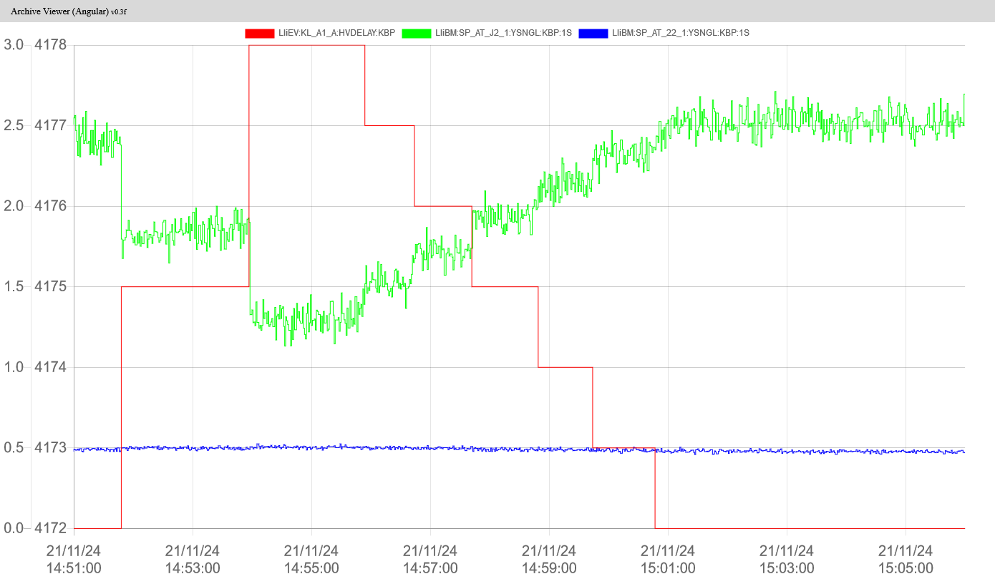
Operation delay timing is sensitive point for beam energy.
2022/01/17 study
HV delay
Energy
(AT_J2 Y)
HV delay
1 step = 8.8 ns
AT_22 Y
It was also experimentally confirmed that the timing of the voltage pulse greatly affects the beam energy
Notes:
This is experimentally results.
I studied last week.
And I found that HV timing affects the beam energy.
It was also experimentally confirmed that the timing of the voltage pulse greatly affects the beam energy.

Slide 23
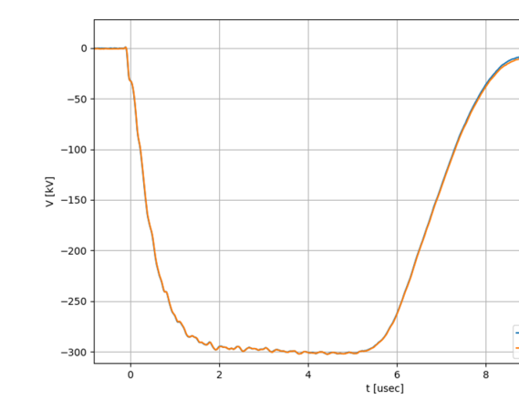
Source of beam instability
Modulator has 10 nsec timing jitter
Normally, flat pulse is no problem.
Exceptionally, A1_A klystron is greatly affected due to the broken pulse shape.
10 nsec timing jitter
A1_A klystron pulse
Normal pulse

Slide 24
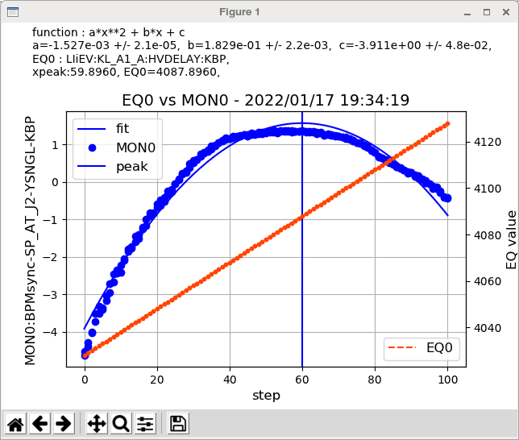
We found a delay timing that reduces the effect on beam energy.
We will adjust a positron primary beam to stable injection for 2022 SuperKEKB
Notes:
Next operation term, positron beam will be more stable.

Slide 25
Conclusion 2021c
Beam charge is still not achieved to final goal. But it is enough charge in 2021c.
Positron charge is almost achieved. We will improve transmission ratio.
We can increase electron beam with laser power margin and 2nd bunch operation.
Emittance is sometimes achieved final goal value. But good condition is breaking easily. We must make an effort to maintain stable conditions.
We are making various improvements every day to stabilize the beam. Hardware maintenance in shutdown term and beam study in operation term.

