Slide 1
Workshop on Accelerator Operations 2012
RIKEN Nishina Center’s Response to Fukushima Daiichi Nuclear Disaster
-Radiation Screening at Fukushima, How We Dealt with Electrical Power Shortage and Other Hardship-
Tadashi Fujinawa

Slide 2
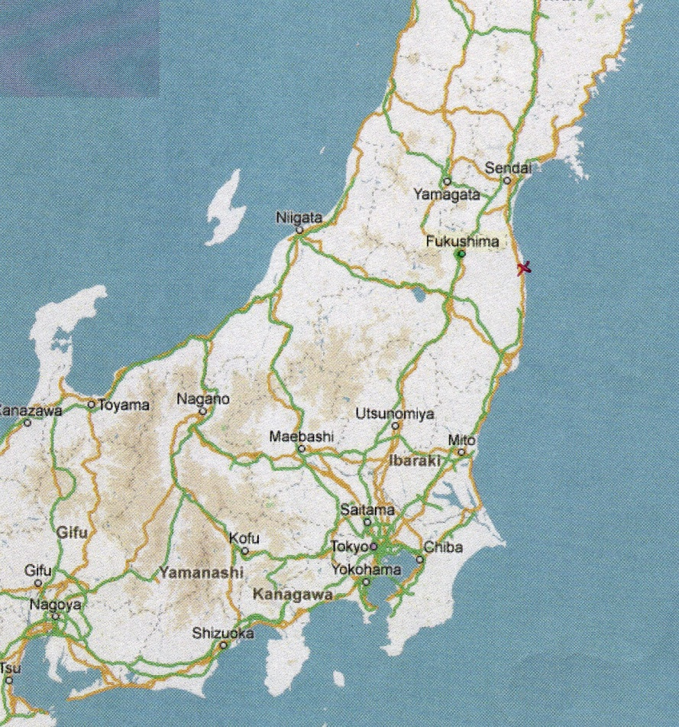
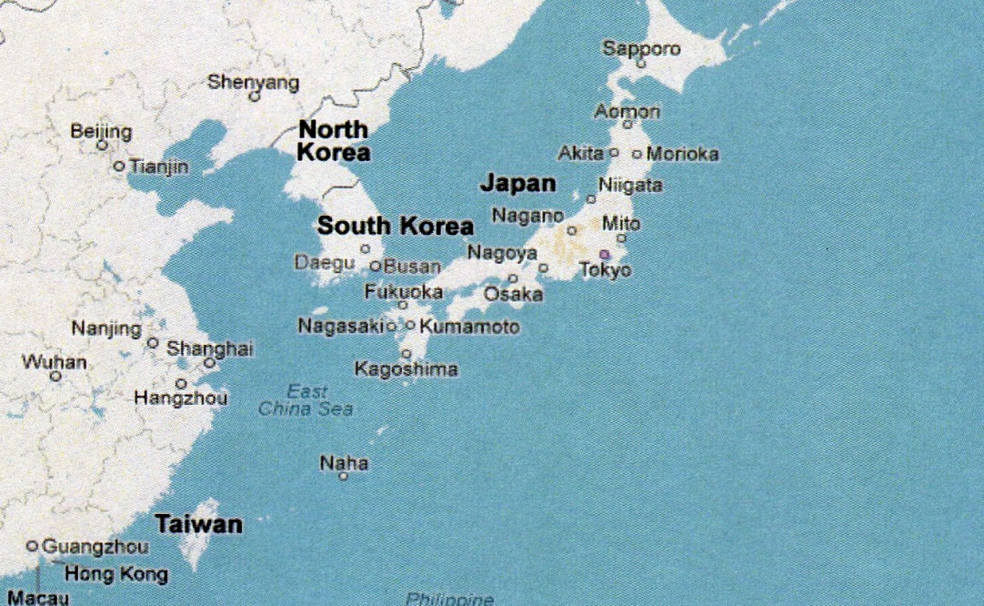
Fukushima prefecture
JAPAN
EAST JAPAN
Notes:
RIKEN Nishina Center is in Saitama

Slide 3
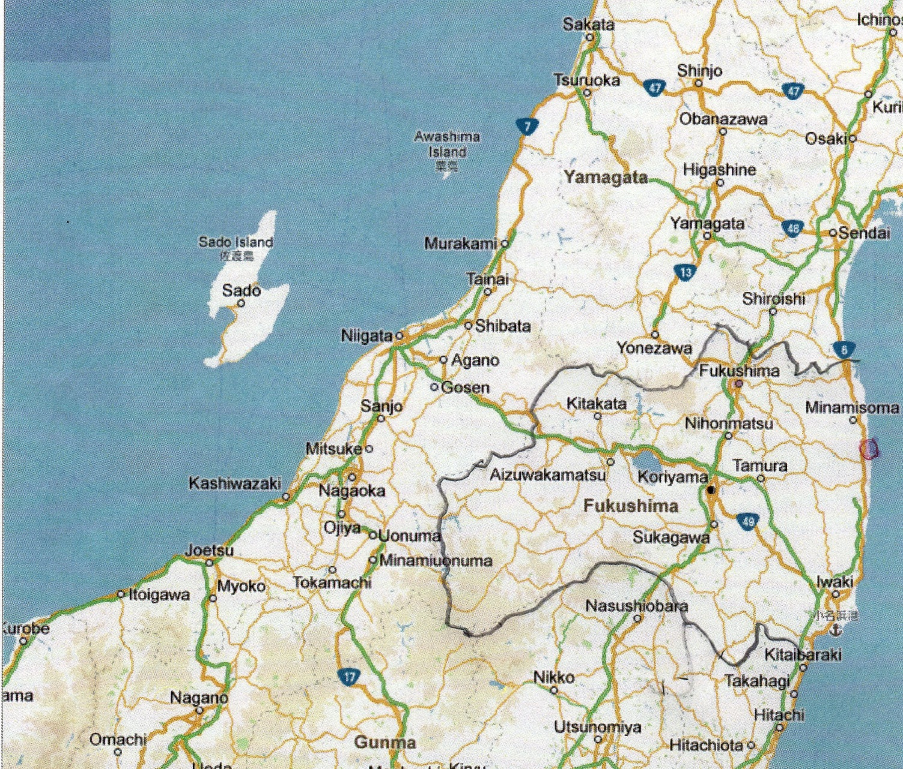
Fukushima prefecture
Notes:
Fukushima prefecture is the 3rd largest in Japan

Slide 4
Mega-quake
March 11^{ｔｈ}, 2011 14:46
Magnitude 9.0
Seismic Intensity 7 （7 is the highest on Japan’s scale)
All power transmission lines for Fukushima Daiichi NPS were brought down!

Slide 5
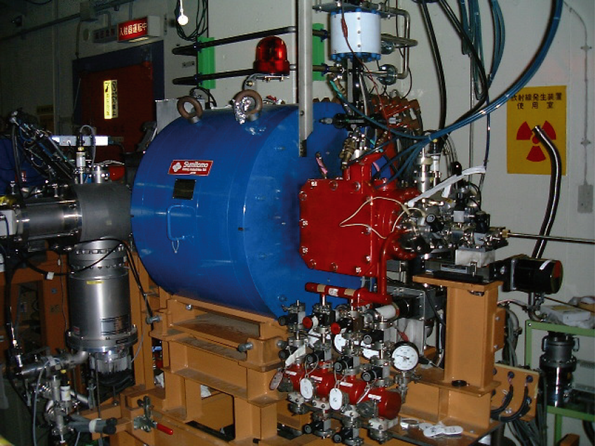
Just after the earthquake at RNC
28Ghz ECR Ion Source (in operation)
Vacuum was broken.
Aluminum beam ducts were broken.
That’s all of the damage.

Slide 6
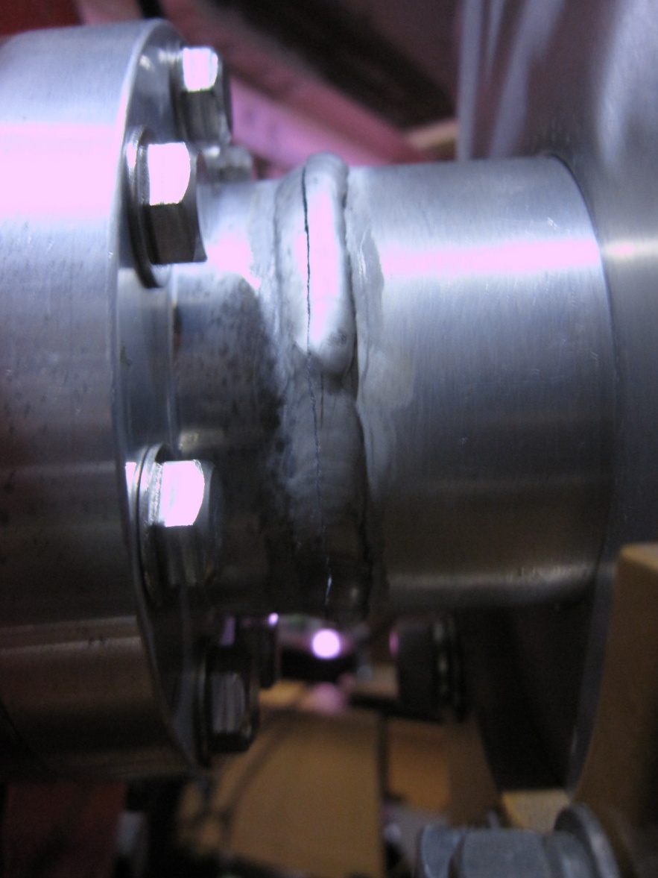
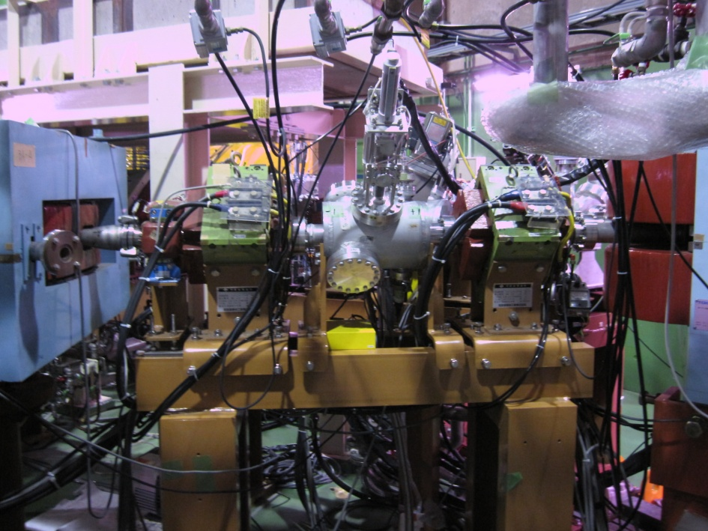
The weld point were damaged

Slide 7
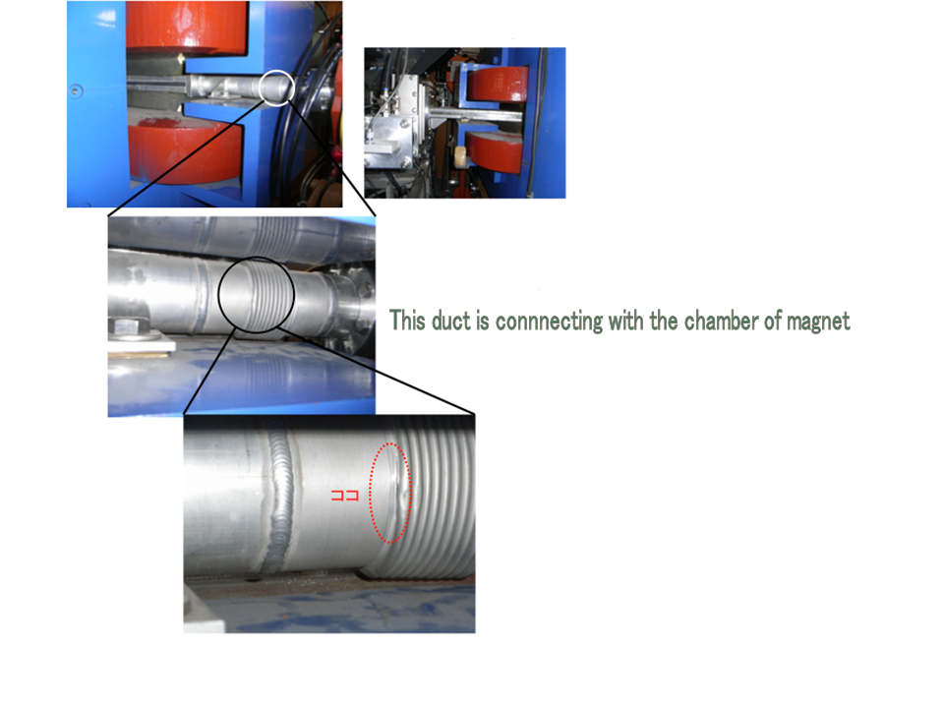
Flexible duct had a crack

Slide 8
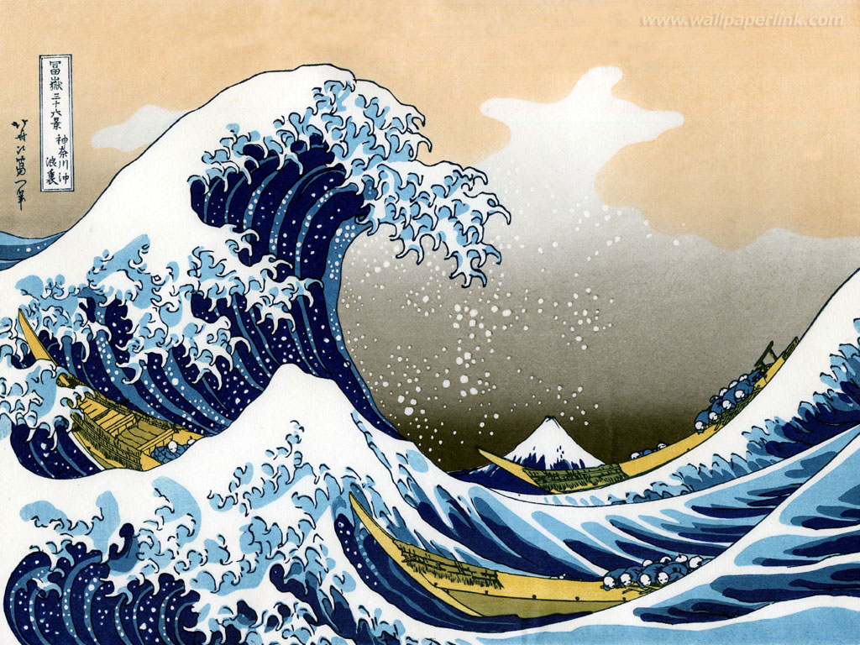
Tsunami

Slide 9
Disaster
About 20,000 people died or were missing.
At Fukushima Daiichi NPS
3 reactors melted-down
3 reactor houses had hydrogen explosions
4 units were heavily damaged out of 6

Slide 10
3 days after the earthquake
RI contamination came to RNC.
The all radiation controlled area was closed.

Slide 11
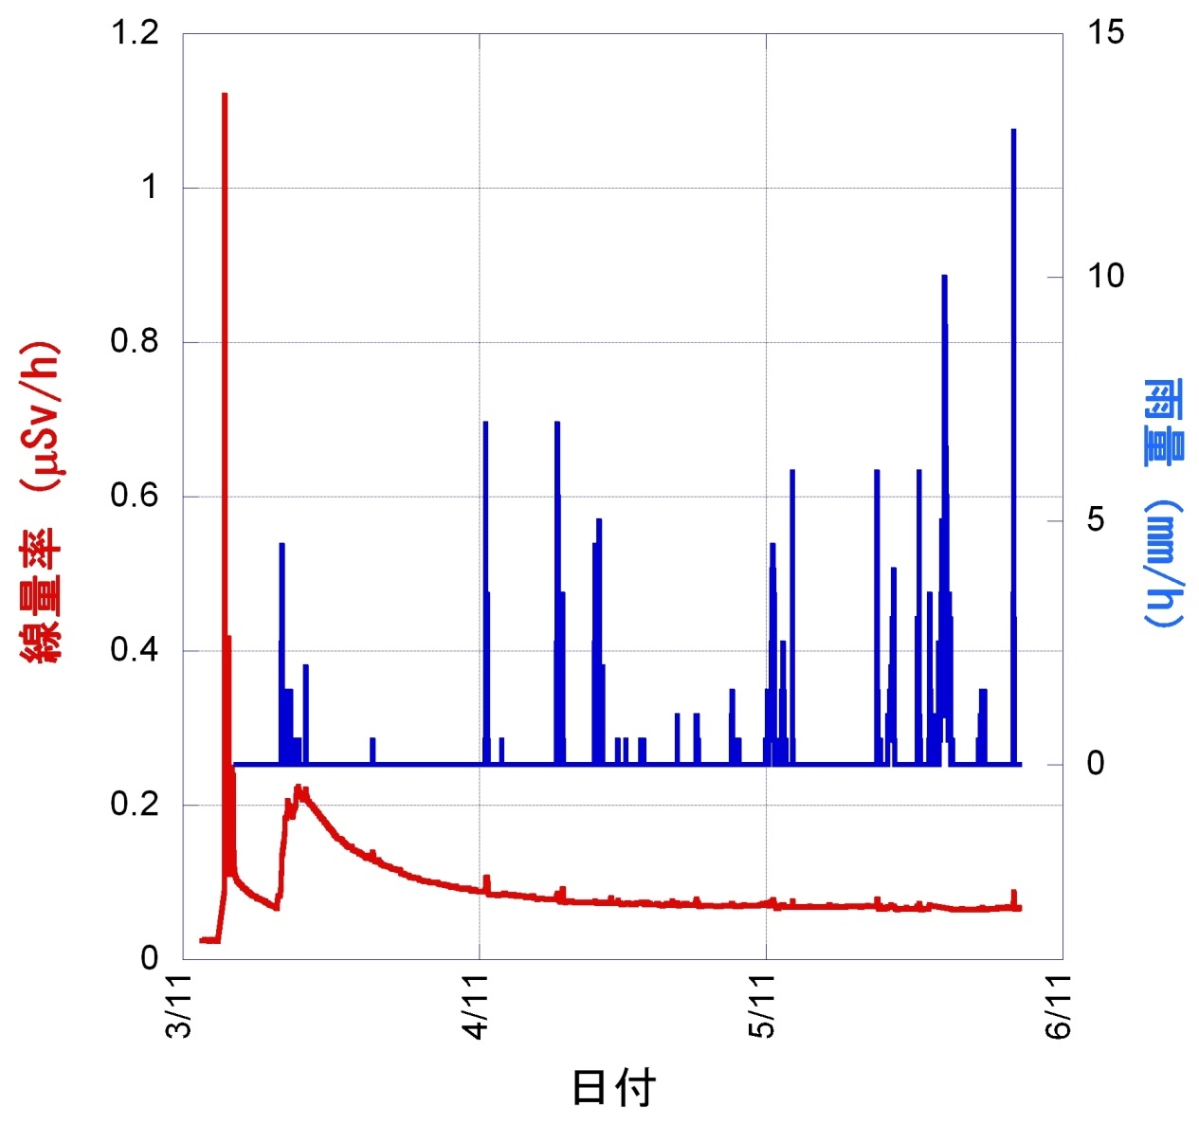
RIKEN Monitoring Post
⁹⁰Sr,²³⁹Pu
¹³³Xe
¹³²Te
¹³⁷Cs
¹³¹I

Slide 12
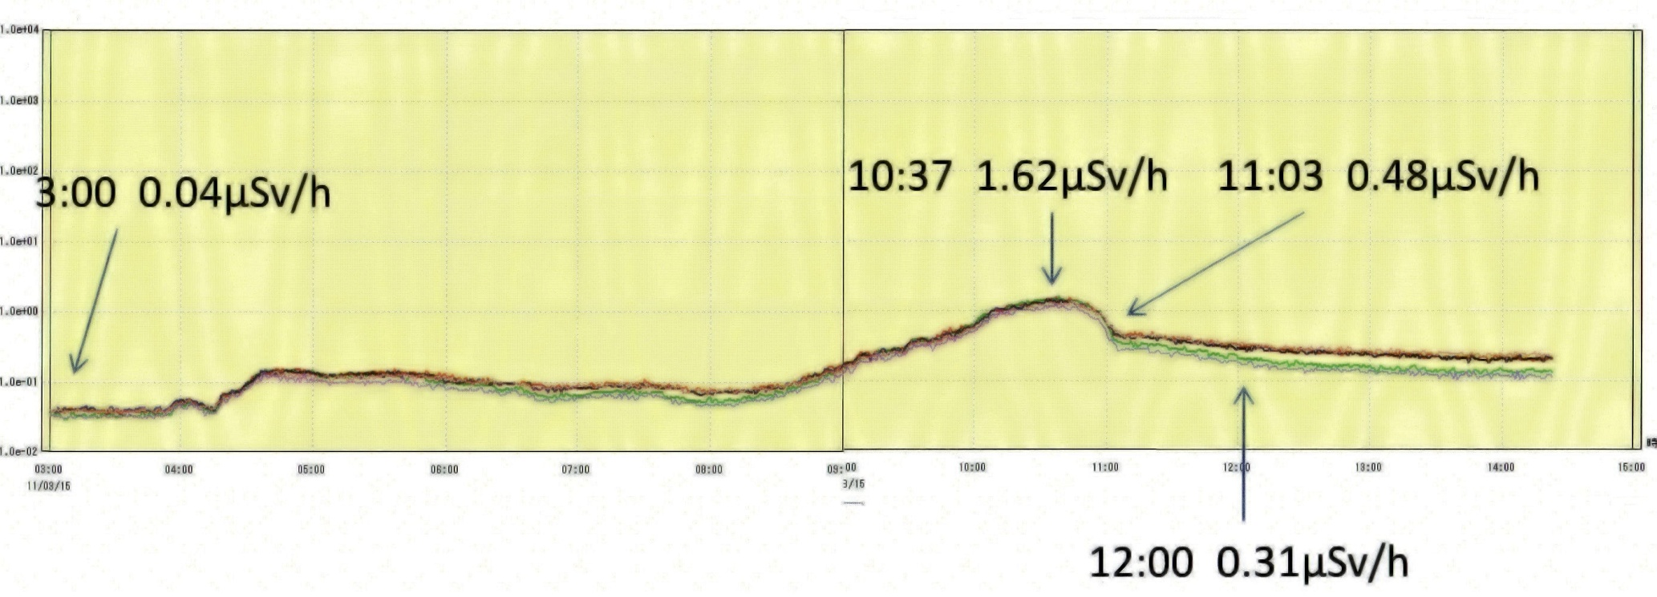
March 16 at RIKEN Nishina center

Slide 13
Tokyo Electric Power Corporation (TEPCO)
Established 1889
Fukushima Daiichi NPS
The world’s largest with 64 GW.
17 BWR plants with capacity of 17.3 GW.
“Daiichi” means “Number one” and there is No.2 NPS in Fukushima as well.
TEPCO dote GE.
Toshiba and Hitachi are licensee of GE.

Slide 14
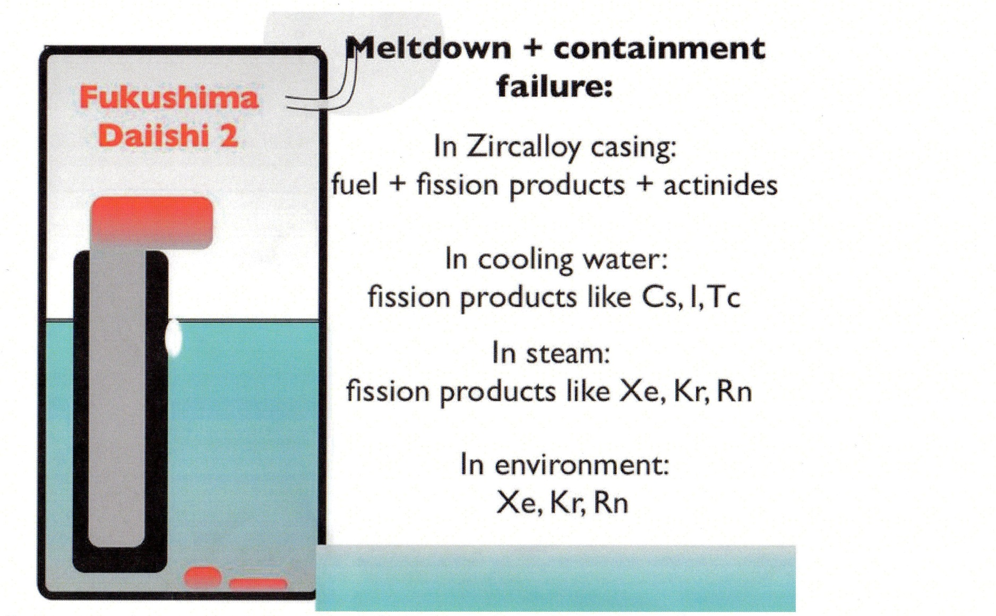
Prof. Ben Monreal on Mach 16
UCSB Department of Physics

Slide 15
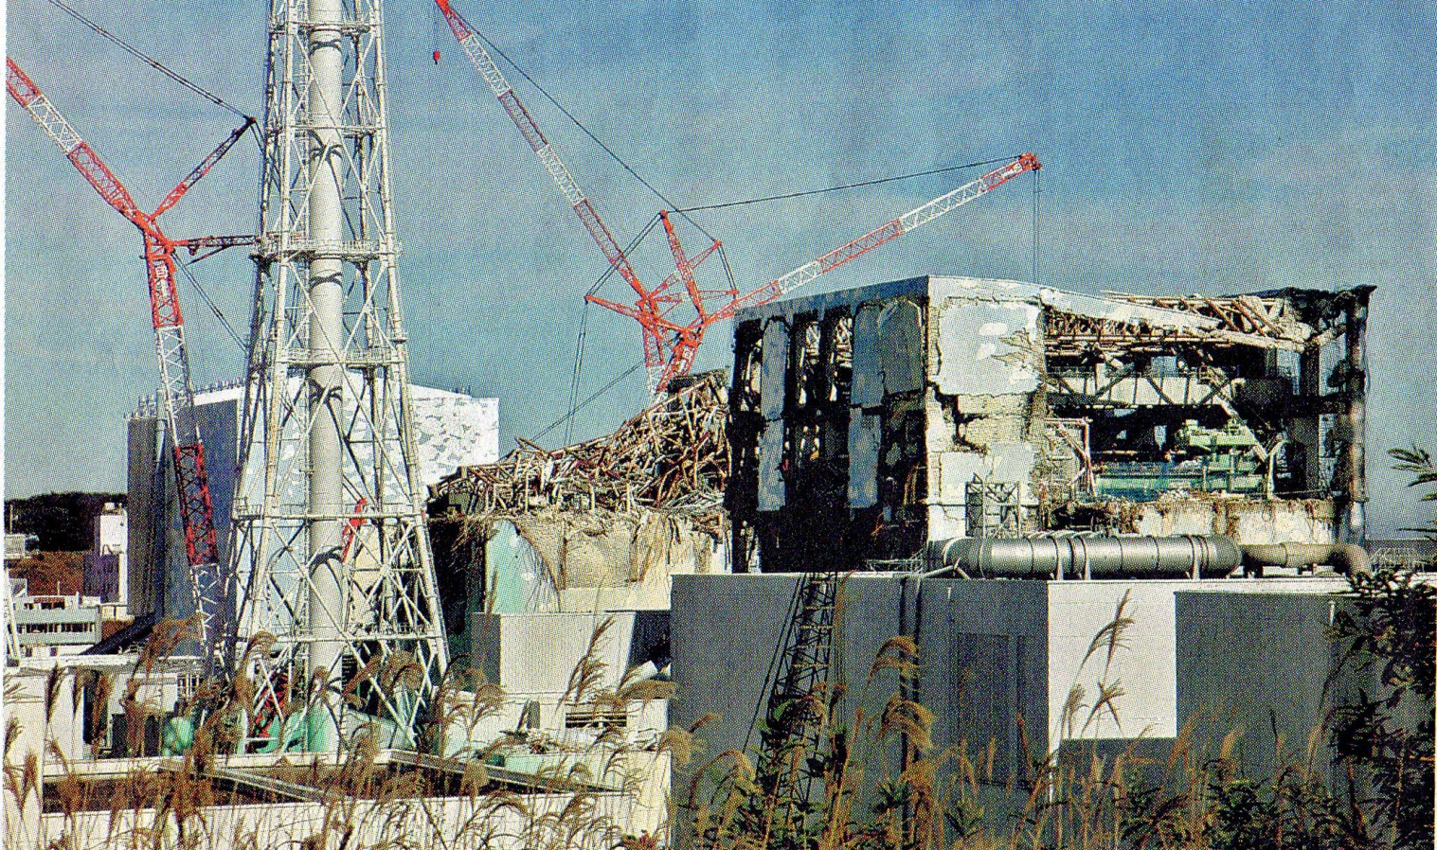
After hydrogen explosions

Slide 16
Manpower spent in Fukushima
I visited 3 times for a total of 16 days.
Mar.29-April 2 ⇒18 μSV, 3.6 μSV/day (50km)
May 4-8 ⇒ 20 μSV, 4.0 μSV/day (40km)
July 28-Aug.2 ⇒ 25 μSV, 4.1 μSV/day (22km)

Slide 17
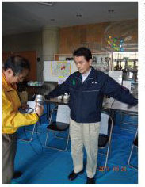
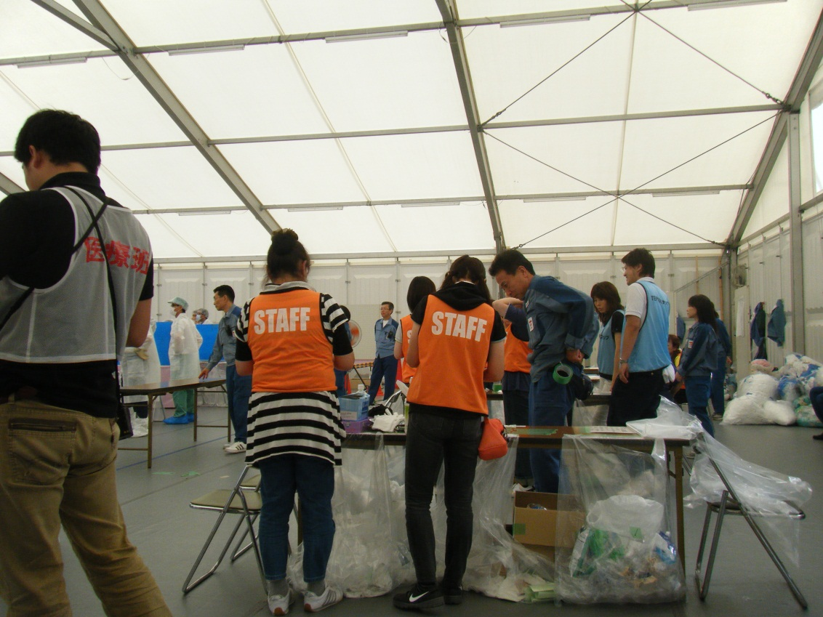
Screening

Slide 18
Total

Slide 19
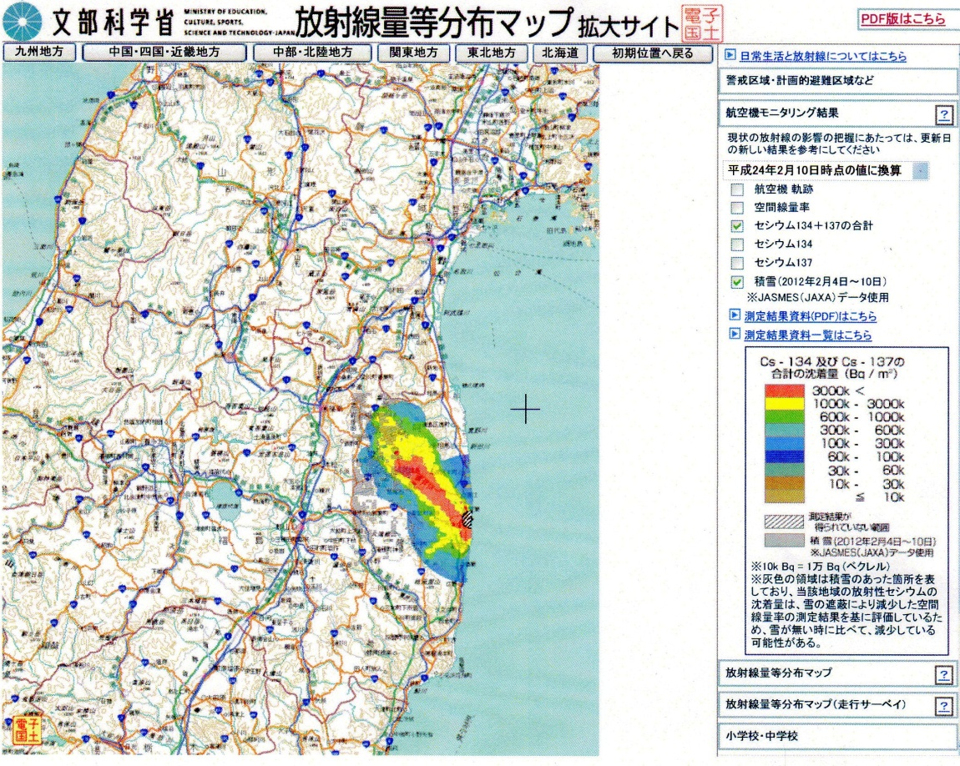
Soil sampling and measuring
RNC measured 294 soil samples for 30 person-days.
http://ramap.jaea.go.jp/map/

Slide 20
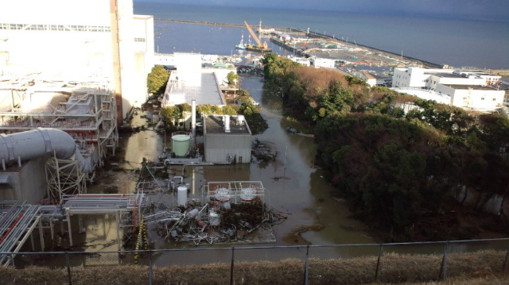
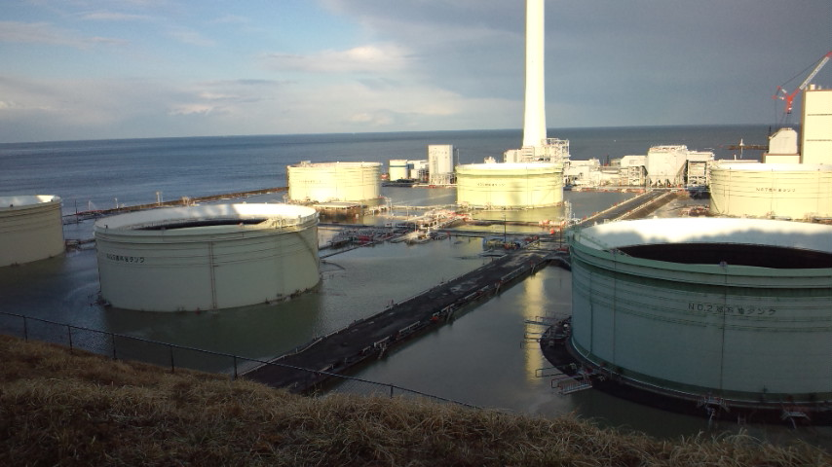
Electrical power shortage
Sunken TEPCO’s
Hirono thermal power station

Slide 21
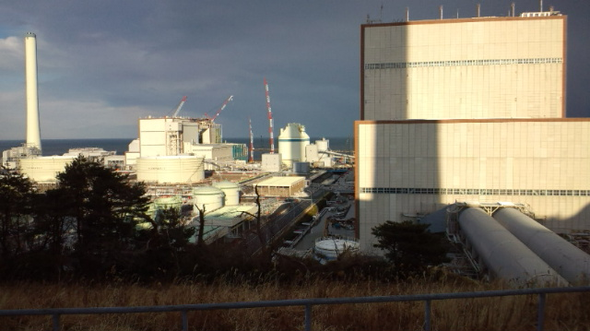
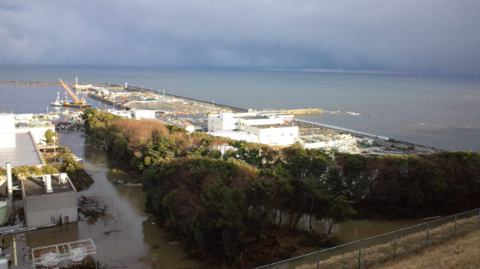
Hirono power station (25km)
Test operation of all accelerators.

Slide 22
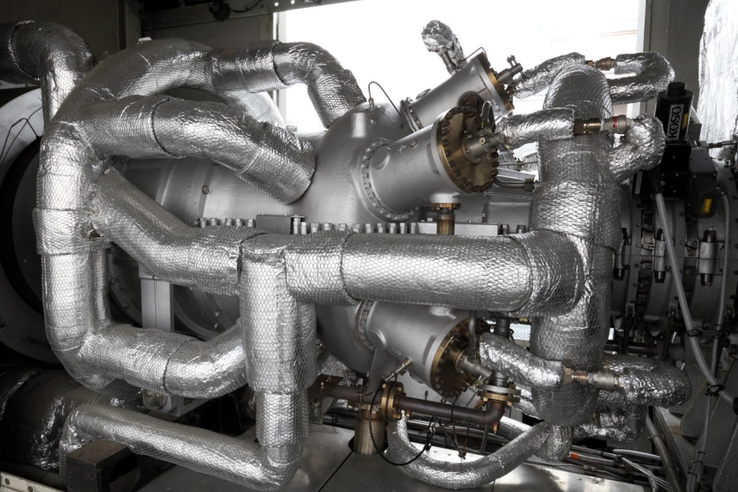
Power shortage
Scheduled Blackout
We have co-generation
Actually no official Schedule
50Hz and 60Hz
15% cut legally in summer
Special contract 30% off 68 days (Normal 16 days)
RIKEN Energy Saving committee 25% CUT
Tokyo Disneyland built 4 x 5.5MW PS before summer
None stop operation
6.5MW output

Slide 23
Consumption
In autumn, normal operation started
Notes:
CGS output incresed

Slide 24
New CGS
Too Little, too late, But better than nothing.
TYPE:MWN TCG2020V 16K
2 x 1.5 MW

Slide 25
Conclusion
Experiments were done well under the power shortage.
Many numbers of RNCs did a good job of screening and etc., as volunteer.
CGS was very useful in such condition too.
Earthquake-resistant level :Horizontal 0.3G and Vertical 0.15G (both at ground level) is sufficient !

Slide 26
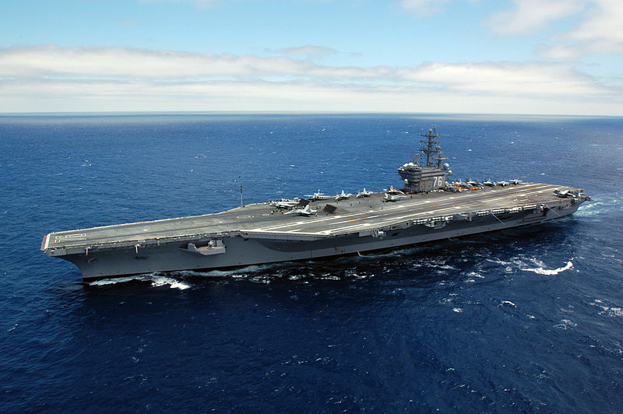
Thank you for your kind supports
Operation “Tomodachi”
Thai EGAT supply GTGs
Taiwan’s donation was the Largest
Thank you all of you!

Slide 27
