Slide 1
Skill Management
for accelerator operation and maintenance.
Hiromi Inokuchi
National Institute of Radiology Sciences, Japan
e-mail : inokuchi@nirs.go.jp

Slide 2
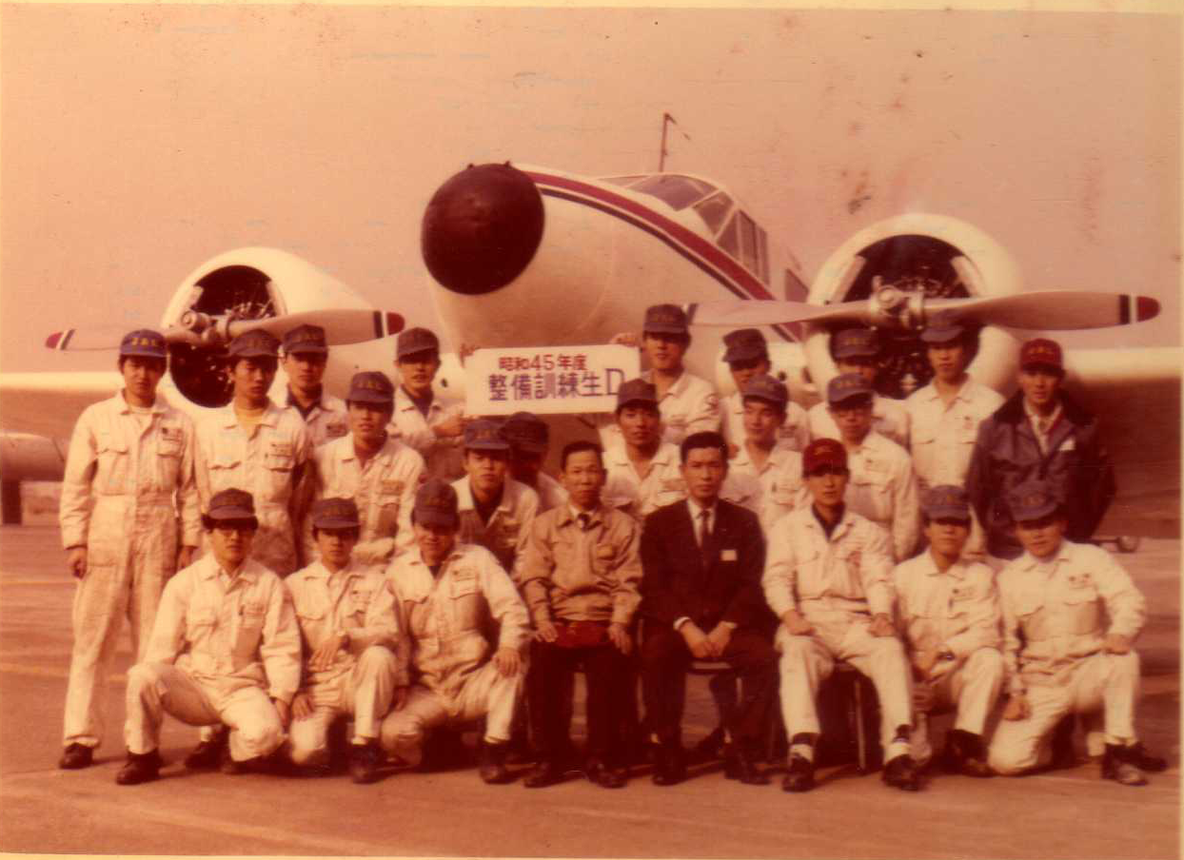

Slide 3

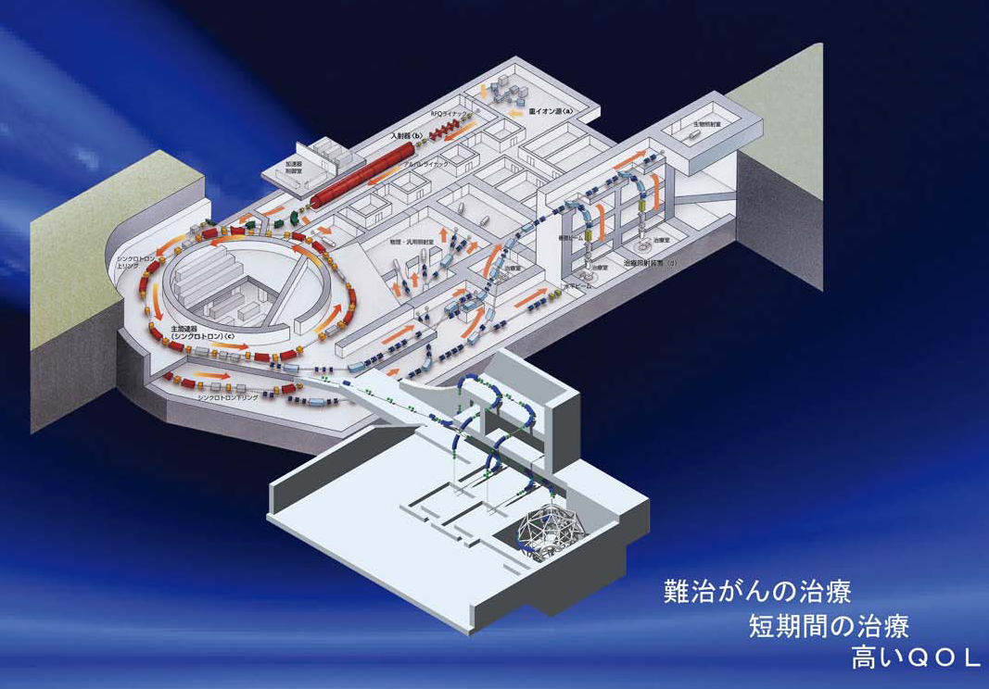
It seems to be different, but there is a lot of common
Such as ・・・
✓ It is assembled with many parts or components.
✓ Many people are cooperate and work together.
✓ Various skills are required.

Slide 4
Objective
Introduce our Skill Management Program
Discuss with other operator experience

Slide 5
Outline
・Background
・Our facility
・The supporting partner
・Introduction
・What is the SMP, skill management program,.
・Schematic design of the QMS
・Overview (Skill Management Program)
・ How can we use the SMP ?
・ What dose SMP give ?
・ The SMP for Aircraft Maintenance
・ About our SMP
・ How do you measure a skill ?
・Sample of the Skill Map and the Skill Matrix
・Conclusion and focus of discussion

Slide 6


Background

Slide 7
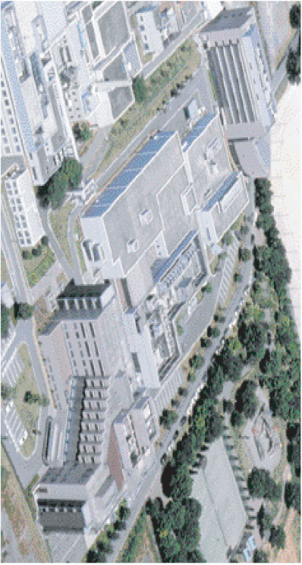

Our Facility
Heavy Ion Medical Accelerator in Chiba, HIMAC,.
・The size of the building is 23,000㎡
/ The facility was completed in 1993.
/ The clinical trails were started in 1994.
/ In the present,
・Using for therapy and research
・About 600 patients/ 6,000 hours operation
・Periodic maintenance is twice a year

Slide 8





The supporting partner
AEC, Accelerator Engineering Corporation, is our partner .
Approximately 100 employees are supporting the following task.
Treatment planning
Operation and maintenance for the HIMAC
Development of the product
Going to install
the Skill Management Program

Slide 9





Introduction

Slide 10


What is the SMP ?
The SMP, Skill Management Program, is a part of the QMS, Quality Management System,.
Similar to ISO 9001
What is a QMS ?
But, more flexible design
Based on Aircraft Maintenance

Slide 11
Schematic design of the QMS
Risk Management Program
(Evaluate a risk)
Designer (NIRS)
Information of an analysis data
Reporting
Technical information
Reliability Monitoring Program
(Data analysis)
Technical Order
Revise a document
Improve the program
Documentation
Instruction Manual
Skill Management Program
Manufacture
Work Sheet
Tool & Equipment Control Program
Procedure manual
Part & Stock Control Program
Modification
Repair or
Periodic maintenance
Production control
Operation and Maintenance Task
(Obtain a data, such as failure mode, defective part etc,)
Any data

Slide 12






Overview
Skill Management Program
（SMP）

Slide 13




How can we use the SMP ?
Hi
Motivate
Delegate
3
1
Will
Skill
Management
Ability – will－Competence
Instruct
Educate
4
2
Low
Willingness － will － Motivation
Hi

Slide 14


What dose the SMP give ?
・ Disclosing every skill
・ Easy planning for training
・ Fostering of skilled person
・ Clear aim for skill-up
・ Creating professionalism
For management
For individual
Easy job allocation ?
I Know my level・・
performance Improve ?

Slide 15
The SMP for aircraft maintenance
Skill
Partitions
Arrival /
Departure
Engine
Overhaul
Component Overhaul
Airframe /
Structure
Skill
Level
layer
Inspector
1st class Mechanic
2nd class Mechanic
Basic class Mechanic
Typical case of Engine Overhaul
Duty ＆
Responsibility
2nd class
mechanic
Basic class
mechanic
1st class
mechanic
Inspector
Inspector
Work
Step
Incoming
inspection
Disassembly
Cleaning
Assembly
Performance test /
Return to service

Slide 16
About our SMP
A skill is separated to 6 block, called skill partition.
A personnel skill is consist of 3 levels layer
Skill partitions
Functional partitions
Injection
Synchrotron
Irradiation support
Personnel skill
Operation
Operation
Operation
Operation
Top Grade
Job type partitions
2nd Grade
Maintenance
Maintenance
Maintenance
Basic Grade
Maintenance

Slide 17
How do you measure a skill ?
SKILL ?
Measuring function of skill is
✓ Knowledge
✓ Technique
✓ Experience
Measuring tools
✓ The skill map is useful to assume individual skill
✓ Interview and/or audit to each person to confirm skill
✓ Management judge the skill level of personnel

Slide 18
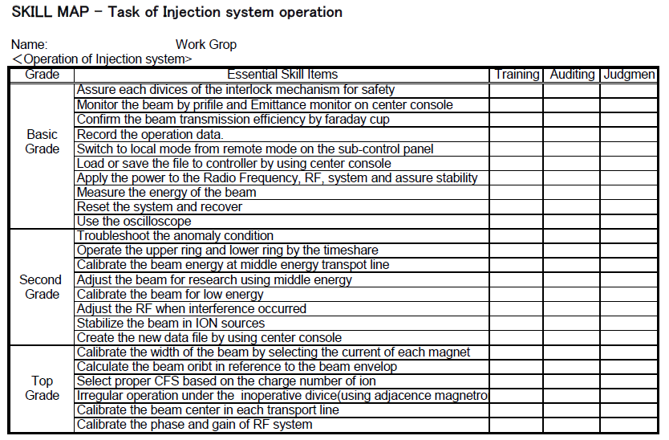

Slide 19
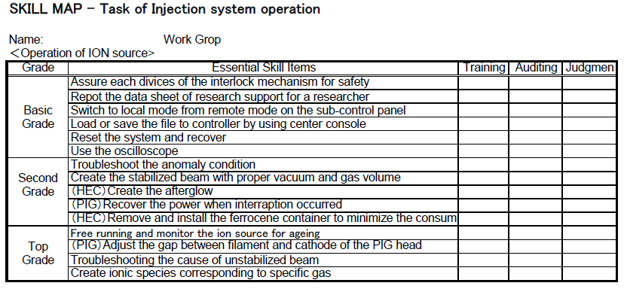

Slide 20
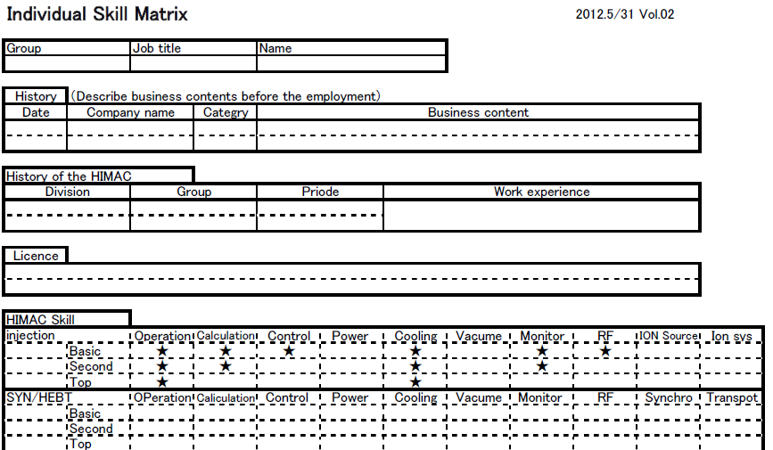

Sample of the Skill Matrix for individual
My skill
The partition is separated by the functions
Certification is given to each sub partition

Slide 21
Conclusion
・The SMP is a part of Quality Management System that give us a number of benefit .
・The SMP gives motivation to an Operator or maintenance person .
・ Also, the SMP gives the improving of the team performance to a management.
The focus of Discussion
・How do you maintain operator ‘s skill ?
・How do you give the incentive to the operators ?

Slide 22

Thank you
for your attention！

