Slide 1
How J-PARC recovered from
the big earthquake
KEK / Fujio Naito
Outline
About J-PARC
The earthquake
Damage on J-PARC
Recovery plan
Beam study results
Summary

Slide 2
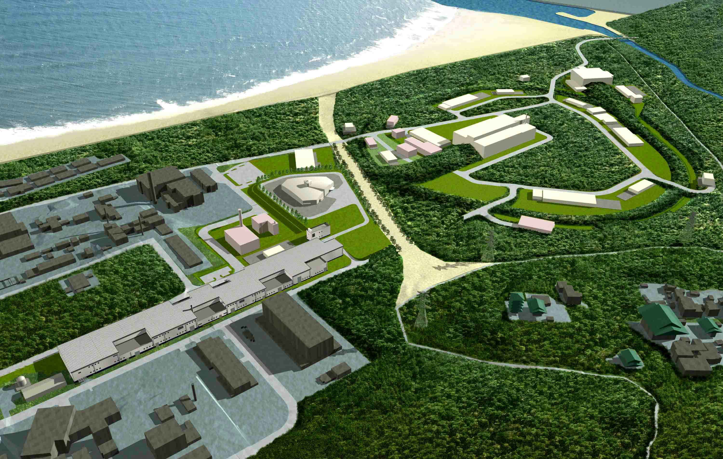
J-PARC
(Japan Proton Accelerator Research Complex)
Joint Project between KEK and JAEA
Pacific Ocean
Hadron Beam Facility
Materials and Life Science
Experimental Facility (MLF)
Nuclear Transmutation
(Phase 2)
５００ｍ
Neutrino to Kamiokande (T2K)
3-GeV Rapid Cycle Synchrotron (RCS)
(25 Hz, 270kW (1MW) )
30(50)-GeV Main Synchrotron Ring (MR)
( 200kW (0.75 MW) )
Linac
181MeV(400MeV)
2

Slide 3
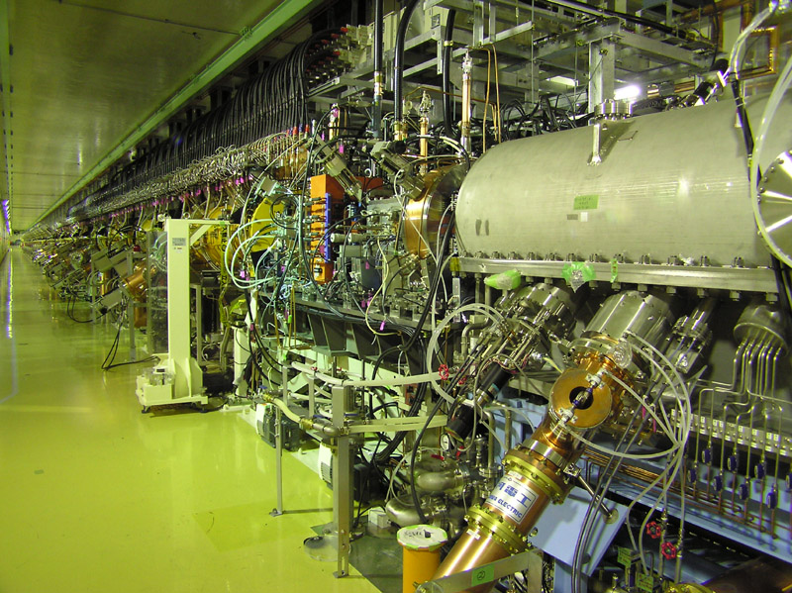
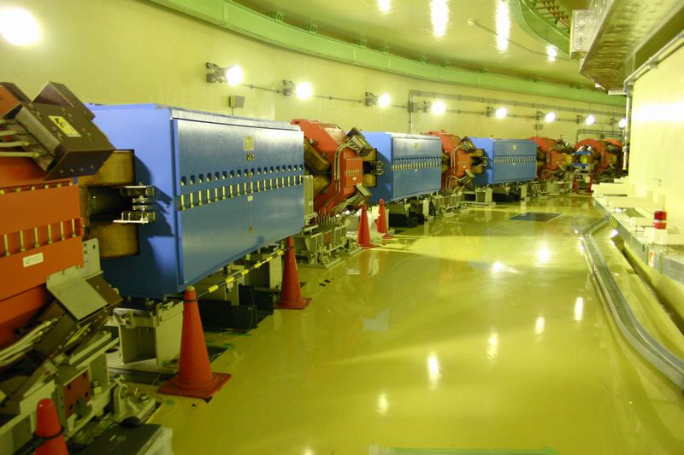
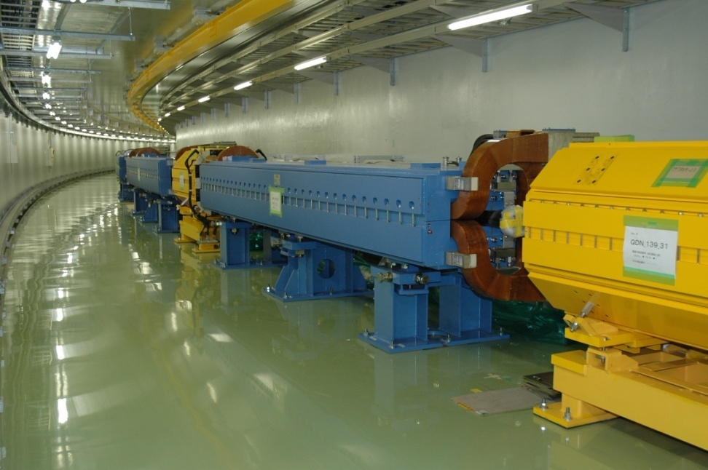
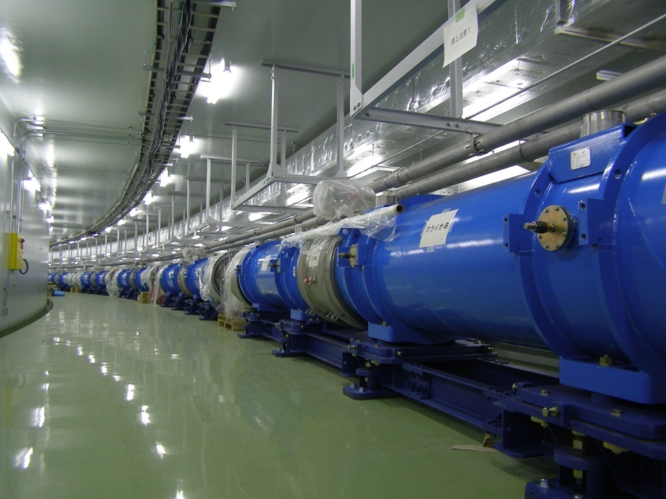
Linac（E:181MeV-> 400MeV (2013)
L:120m -> 25０m ）
Rapid Cycle Synchrotron (RCS)
（3GeV, 25Hz, φ100ｍ）
Main Synchrotron Ring (MR)
(30 (50) GeV, Period: 2.6~6.0sec, φ500ｍ）:
ν-beam line（Super Conducting Mag.）

Slide 4
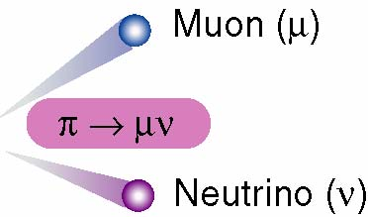
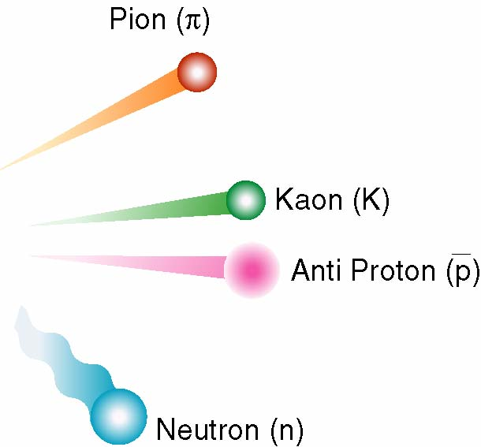
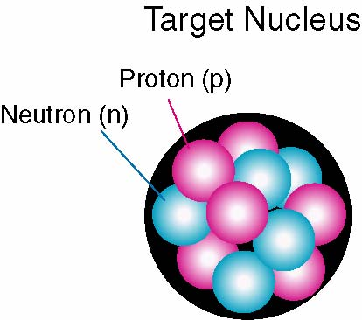

Goals at J-PARC
Proton (p)
3 GeV, 30 GeV
Materials & Life Sciences at 3 GeV
Nuclear & Particle Physics at 30 GeV
→ Design beam power : 1MW for MLF & 750kW for T2K
(current beam power is 0.2 MW for both experiments)

Slide 5
Beam was provided to all users from April 2009.
Users run of JFY2010 was stopped as scheduled at 7:00 on March 11, 2011.
Just linac group continued the beam study in the daytime…..
Disaster we had in March 2011
The biggest earthquake (Mar., 11, 14:46)
Tsunami near J-PARC (Mar., 11, 16:52)
First hydrogen explosion of the nuclear power plant in Fukushima (Mar., 12, 15:36)

Slide 6
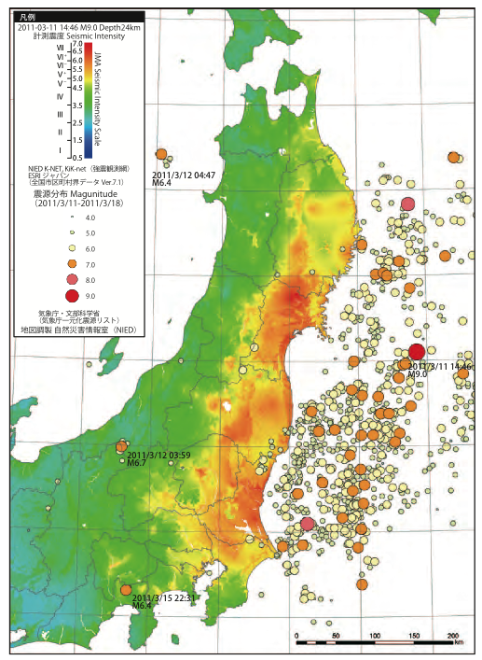
The Great East Japan Earthquake
March 11, 2011
1st 01:54
2nd 06:45
3rd 07:44
4th 14:46
.
.
78th 23:56
Seismic intensity map of the main shock on March 11, 2011, and epicenter distribution from March 11 to 18, 2011.
by National Research Institute for Earth Science and Disaster Prevention (NIED)

Slide 7
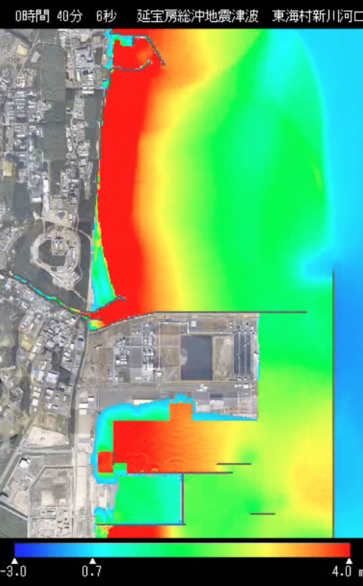

Tokai nuclear power plant
Tsunami max height : 5.4 m
Tsunami Protection : 6.1m
(On Mar. 09 2011, 3.3m -> 6.1m)
Tsunami
simulation result
near J-PARC
J-PARC
Tsunami max height : 6.6 m
Tsunami Protection : 8m

Slide 8
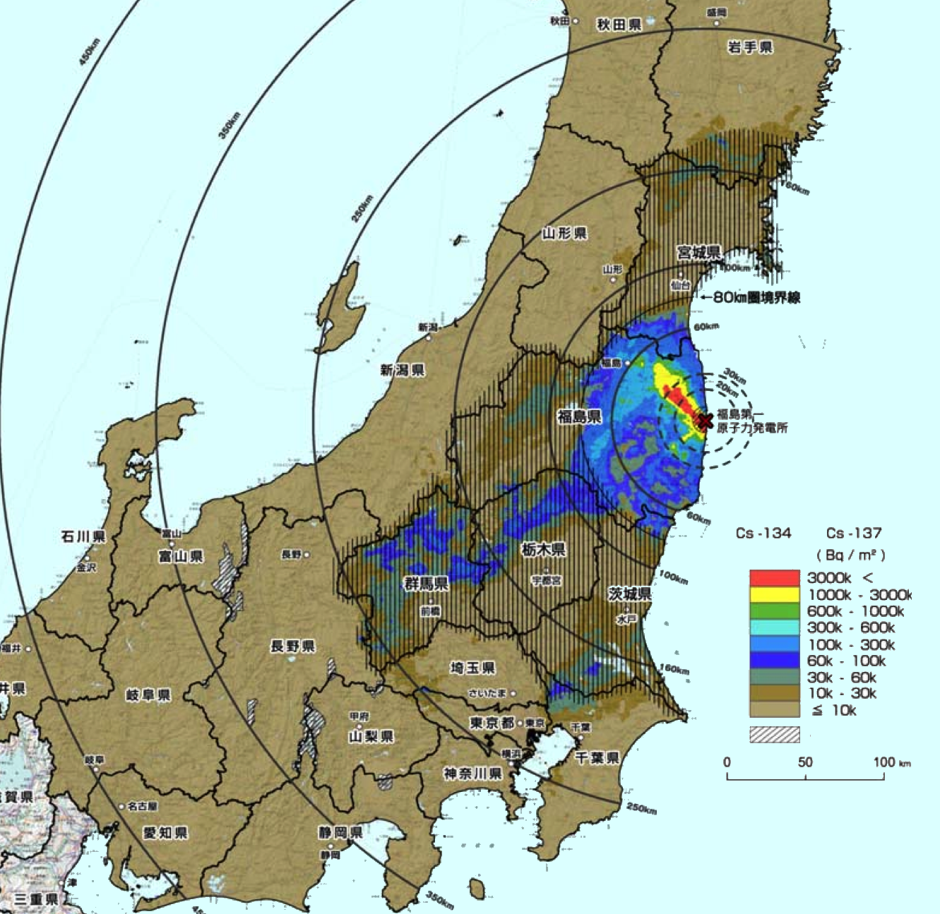
Air dose rate measured by an airplane
(April 2011)
Broken
reactors
J-PARC
Riken

Slide 9

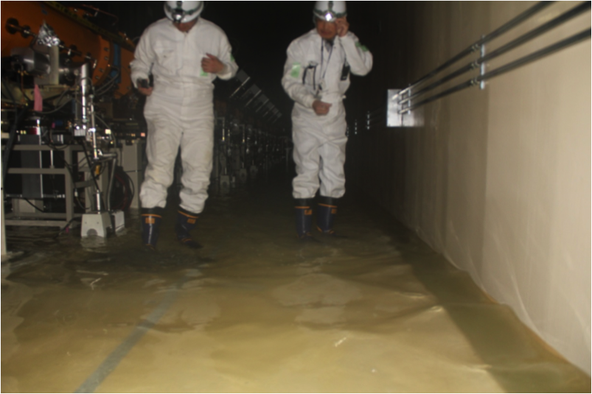
Linac Tunnel on March 24, 2011
On March 17 the water level was only 1 cm, but it increased to 10 cm (100 tons) on March 24. The water was pumped out with a rented electric generator. PH=11 and tons of acid were necessary to neutralize water.

Slide 10
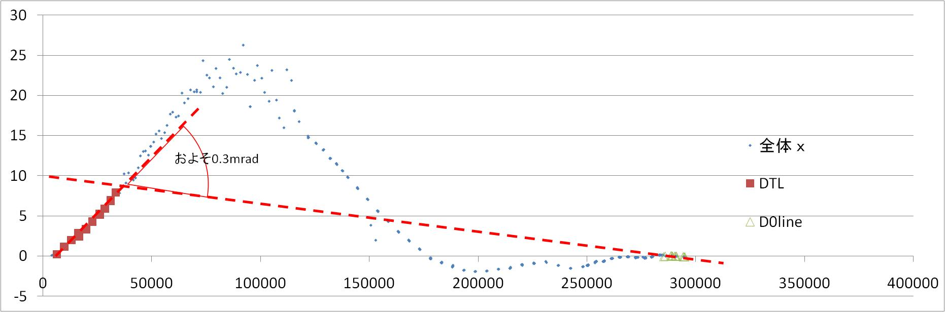
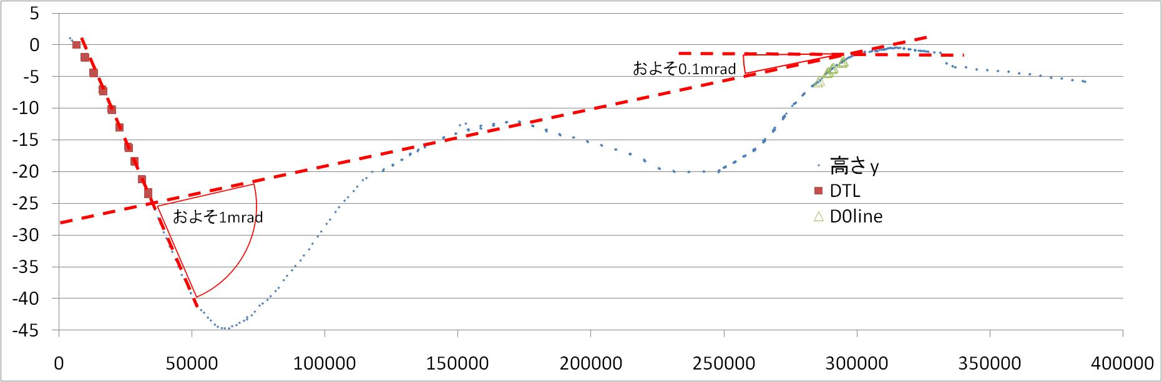
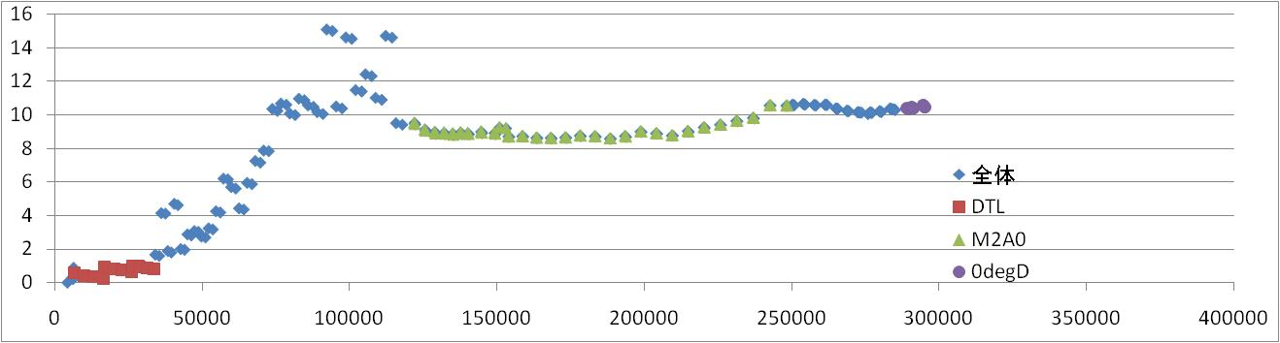
Linac measured position (Apr. 2011)
Red broken line：New beam line after the earth-quake
Horizontal direction [mm]
~0.03mrad
Vertical direction [mm]
Longitudinal direction[mm]
Beam axis[mm]

Slide 11
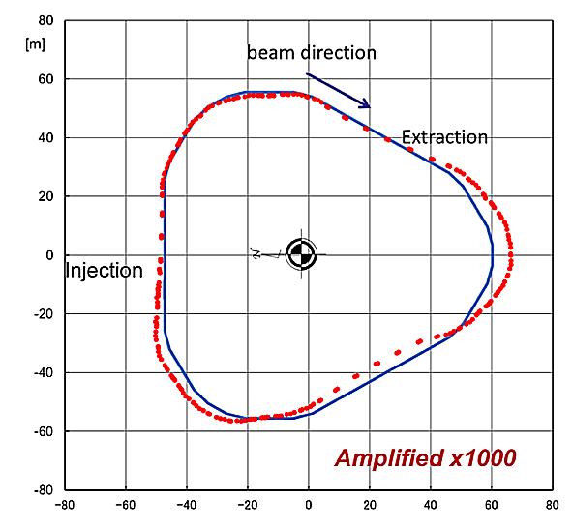
Rapid Cycle Synchrotron (RCS, 3GeV)
4177 左の影が大きい
No serious damages on the equipment/instruments in RCS tunel.
Position of all equipment/instruments were measured.
The maximum displacement is 3.7mm vertically & 10mm horizontally.
Blue : Reference positions of the magnet
Red: Measured positions after the earthquake
(Please note the magnitude of displacement is amplified x2000.)

Slide 12
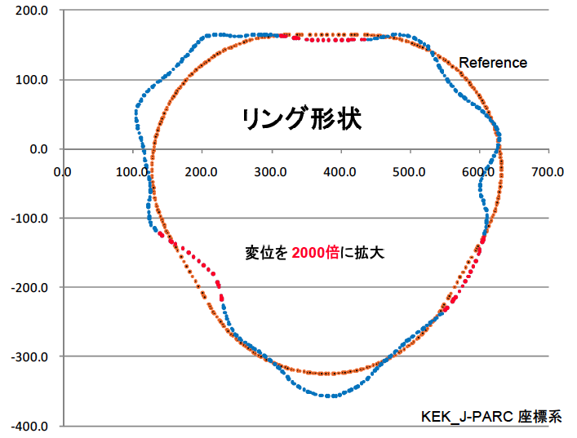
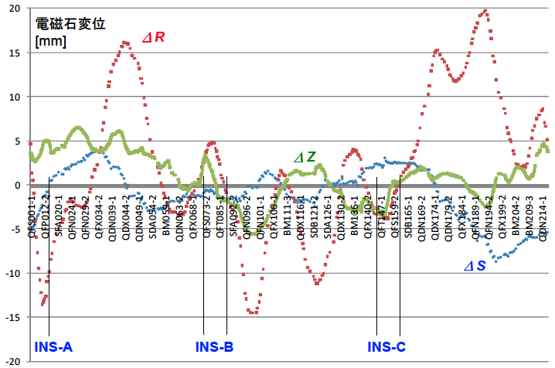
Main Synchrotron Ring (MR, 30GeV)
4177 左の影が大きい
・ There were no serious damages on all MR equipment/instruments, such as magnets.
It, however, appeared they misaligned in both vertical and horizontal directions.
・ Some magnets misaligned greatly are re-aligned with replacing a stage.
・ Inspection of the RF power amplifying system has been completed.
Amplified x2000
Orange : Reference positions of the magnet
Blue & Red: Measured positions after the earthquake (Please note the magnitude of displacement is amplified x2000.)
Magnet displacement from
the reference line
Green : vertical direction
Red : horizontal direction
Blue : beam deirection

Slide 13
Demand
from users (MLF, T2K) and the law fixed the MLF budget:
Beam must be supplied to users during JFY2011 at least approximately two months.
Beam simulation
to keep the beam loss as same as before:
Results:
*Linac must be re-aligned but V-shape is approved.
*RCS is usable without re-alignment if power ≤ 300kW
*MR must be re-aligned.
>> Minimum repair of the broken building has been done to resume the beam acceleration as soon as possible.
Notes:
J-PARC has the fund supported by the special law in Japan that promotes the usage of beam for users of big accelerators. It requires the results that users have gotten the beam in any fiscal year. If there is no such result, the fund is cut off.

Slide 14
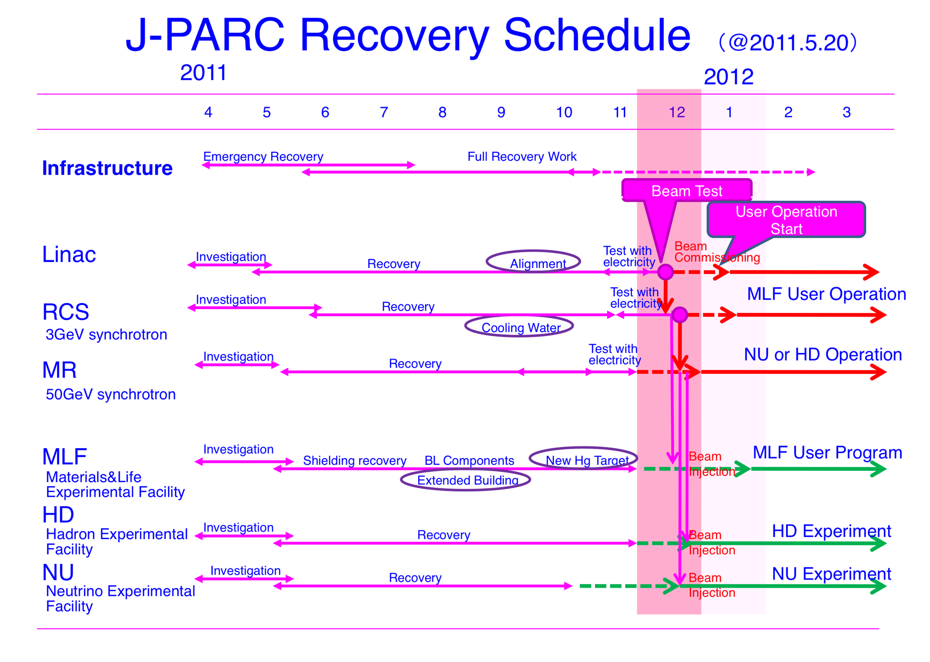

Slide 15
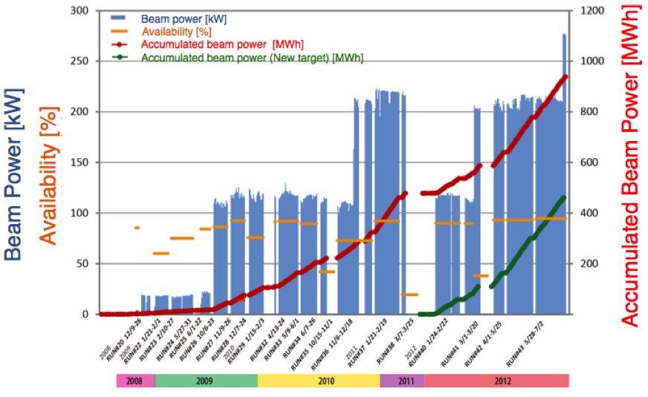
History of beam delivery from RCS to MLF
In the last three days, 275 kW beam was delivered to MLF.
Stable operation of 275 kW was successfully demonstarted.

Slide 16
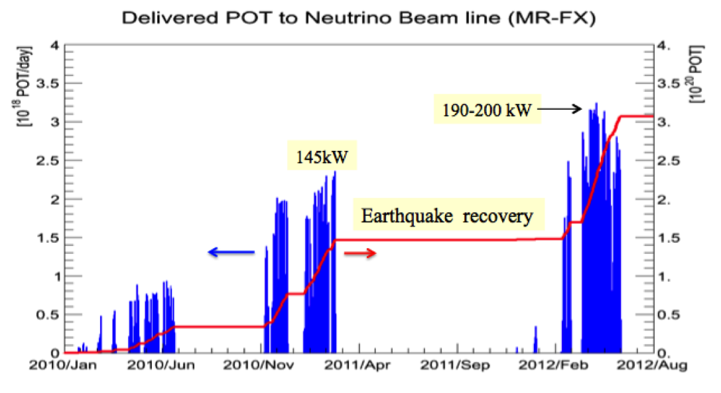
History of beam delivery from MR to the T2K experiment
Operation for beam delivery to the T2K before summer 2012 was finished on June 9.
T2K accumulated the beam of ~3x10²⁰ POT.

Slide 17
Summary
Although J-PARC had the big damage by the earthquake, it has been fixed in minimum to accelerate the beam.
J-PARC resumed to accelerate beam from Dec., 2011.
Experiments by user restarted in Jan., 2012.
However a lot of troubles of the earthquake origin(?) still happen in the accelerators.
Damage on the accelerator buildings of linac (wall, doors, cranes, floor) and MR (expansion joints, ground-water leakage) is not fixed yet.
RCS will realign the all magnets in the summer of 2013.

Slide 18
Thank you very much!

Slide 19
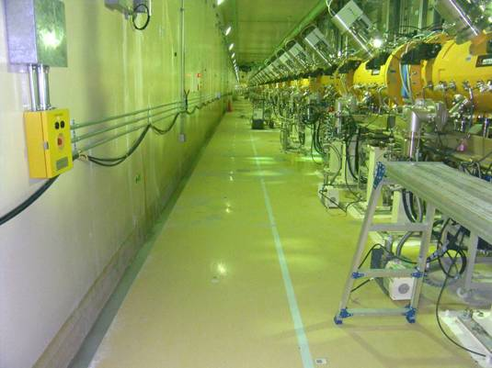
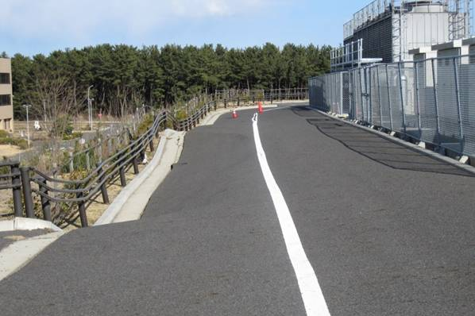
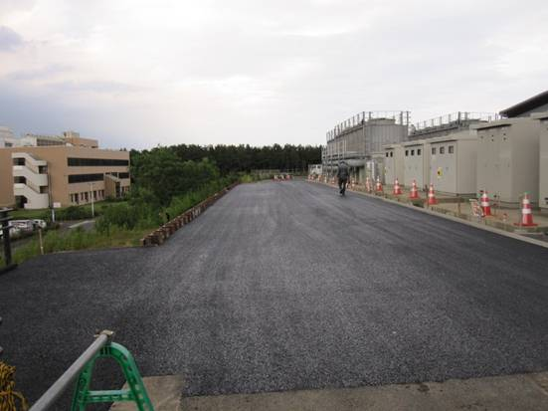
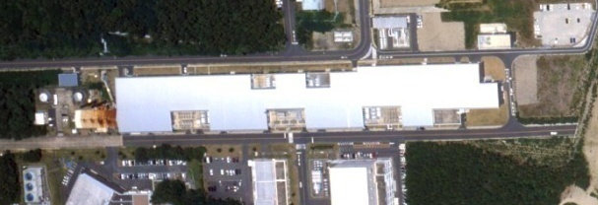

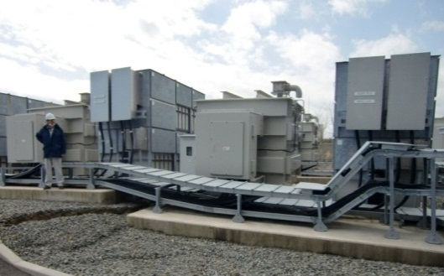
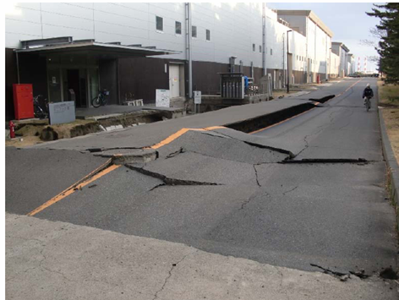
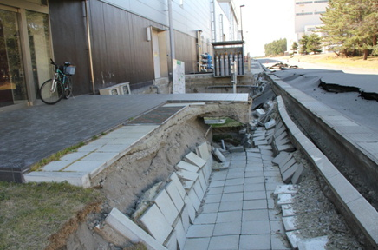
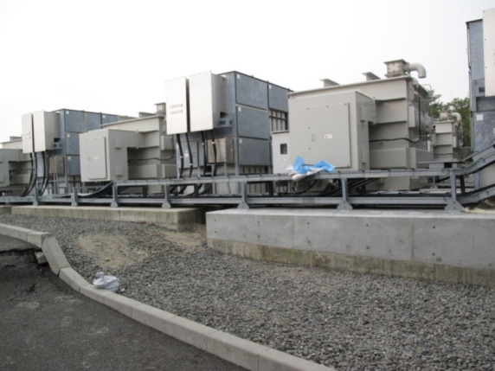
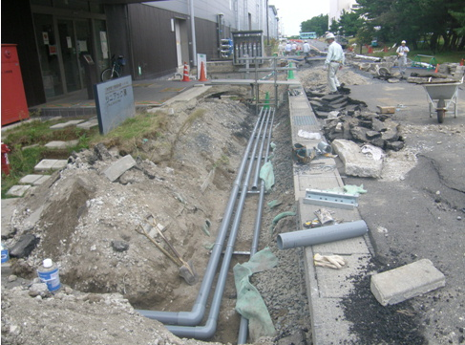
Recovery Status of J-PARC from Damages by the 3.11 Earthquake
Fortunately no victims at J-PARC, but severe damages on the facilities, such as piping systems, power devices, and instruments. We also had land subsidence at many places around buildings, water leaks, and misalignment of electromagnets and shielding blocks.
Damages and Recovery Status of Accelerator Facilities
Leaking water depth in the LINAC tunnel reached to 10 cm.
The road around the 3 GeV subsided more than 1 m at many places.
After recovery
After recovery
LINAC
3 GeV Synchrotron
The basis for transformers subsided ~1 m.
added concrete basis
The approach to the LINAC entrance subsided more than 1 m. In contrast, the front road raised a few 10s cm.
Still under the construction
Re-leveled the basis

Slide 20
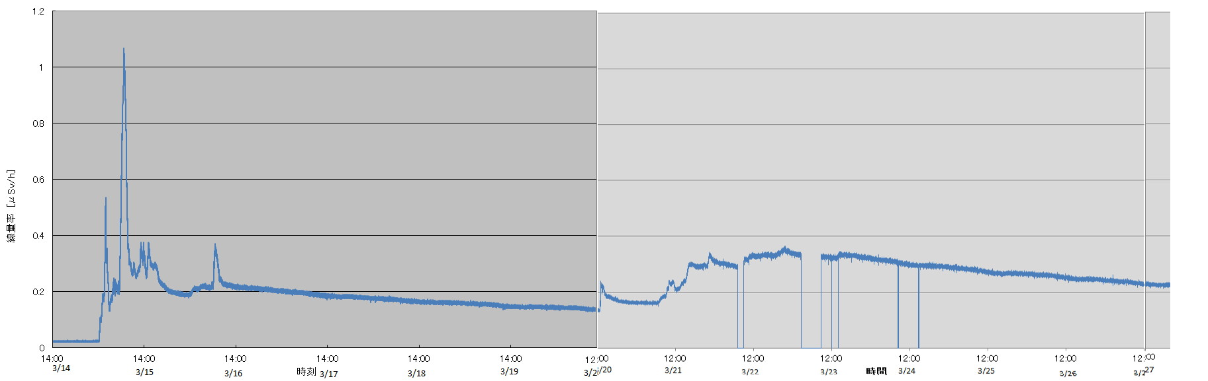
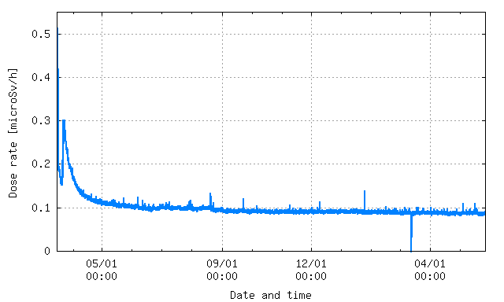
Dose rate in KEK Tsukuba campus
NaI -survey meter
GM-survey meter

Slide 21
Linac major parameters
  Accelerated particles: H⁻ (negative hydrogen)
  Energy: 181 MeV, The last two SDTLs are debunchers
  (400 MeV for ACS, 600 MeV for SCL)
  Peak current: 30 mA (50 mA for 1MW at 3GeV)
  Repetition: 25 Hz (additional 25 Hz for ADS application)
  Pulse width: 0.5 ms (Beam), 0.6 ms (RF)

Slide 22
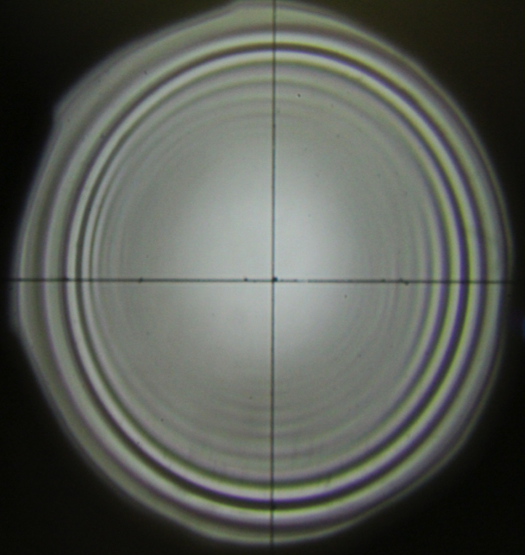
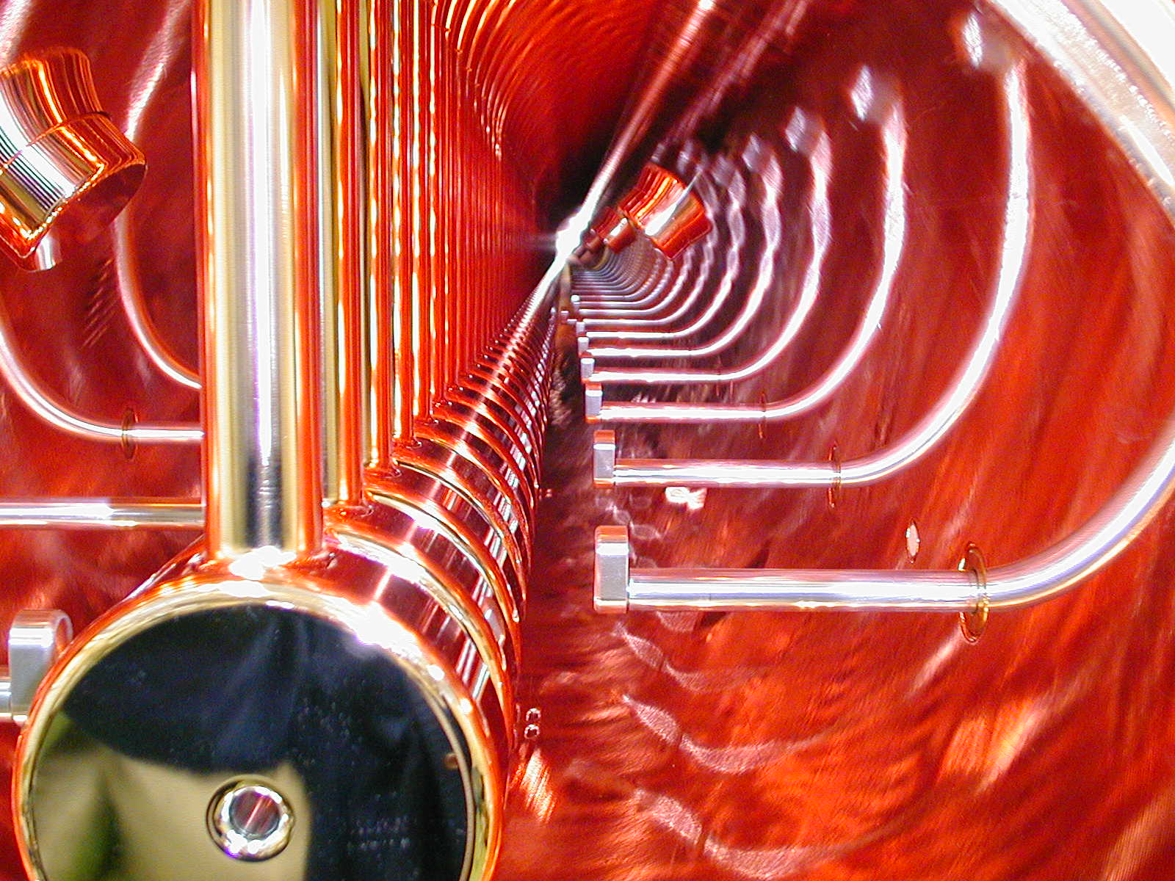
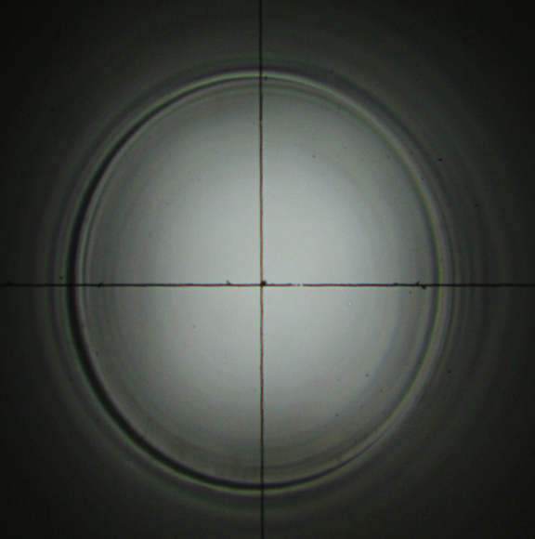
Drift Tubes in DTL
Observation of the shadow of
the DT by an alignment telescope
Normal
Inside view of the DTL
before installation
Displacement ?

Slide 23
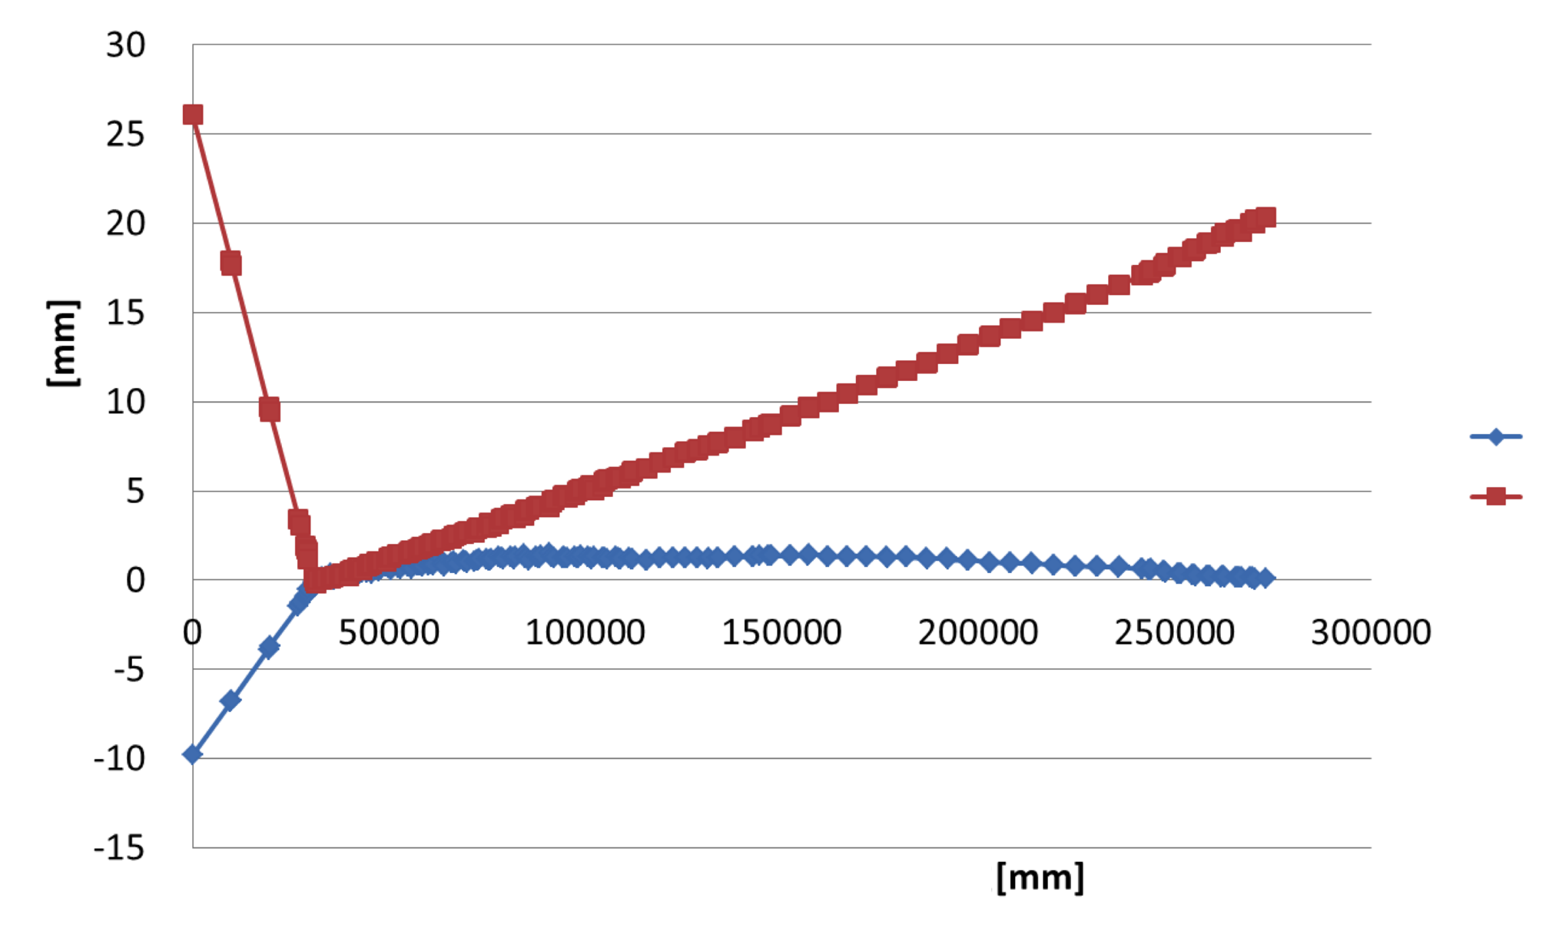
Alignment result of the linac
DTL
SDTL
MEBT2
A0BT
L3BT
Horizontal
Vertical
Position
Z
Bending angle at DTL end : 0.91-mrad horizontaly, 0.28-mrad vertically.
In the SDTL & A0BT section, the displacement is 1.5-mm in maximum for horizontal direction.

Slide 24
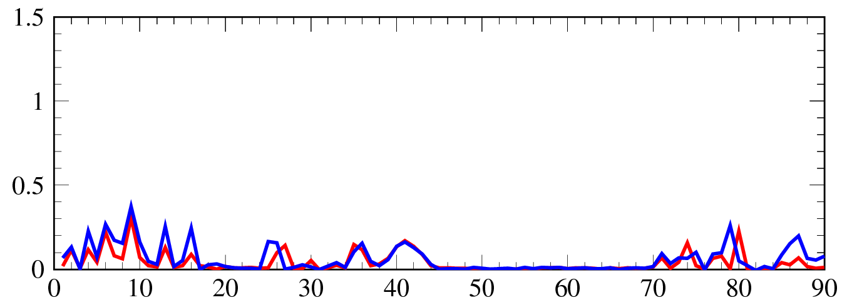
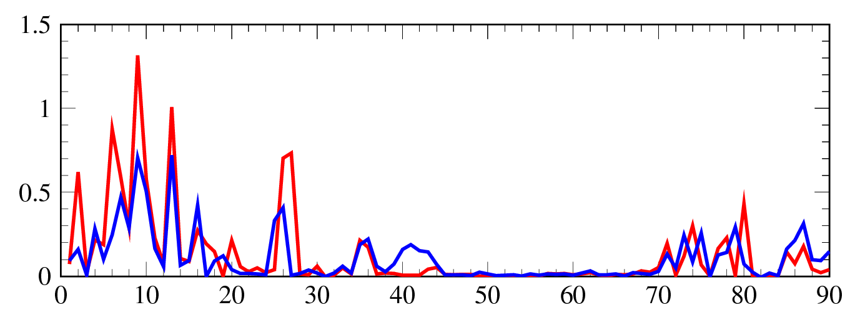
Beam loss in RCS with the beam > 400 kW
P-BLM signals
Collimator
Arc
Extr.
Arc
RF
Arc
Inj.
Before the earthquake
300 kW
After the earthquake
P-BLM signal (V)
No large difference
in beam loss
420 kW
P-BLM signal (V)
Significant difference
in beam loss
BLM ID#
Beam loss increased after the earthquake for 420 kW
Particle loss before the earthquake：~ 0.4%
Particle loss after the earthquake： ~ 0.8%
In the summer of 2013, the entire
adjustment of the RCS will be done

Slide 25
Problems after the beam resumption
Linac:
* HV terminals of Ion pump have the discharge problem.
* Almost temperature sensors were corroded.
* A HV rectifier in the oil tank for the Klystron was broken.
* Humidity in the tunnel is still high by the leakage of ground water.
* Cranes are still not usable.
* Floor is broken and tilted.
RCS:
MR:
* New leakage of the ground water found in the tunnel.
*Twisted expansion joints of the tunnel are not fixed.
Exp:
* Power supply of the magnetic horn for T2K was broken.

Slide 26
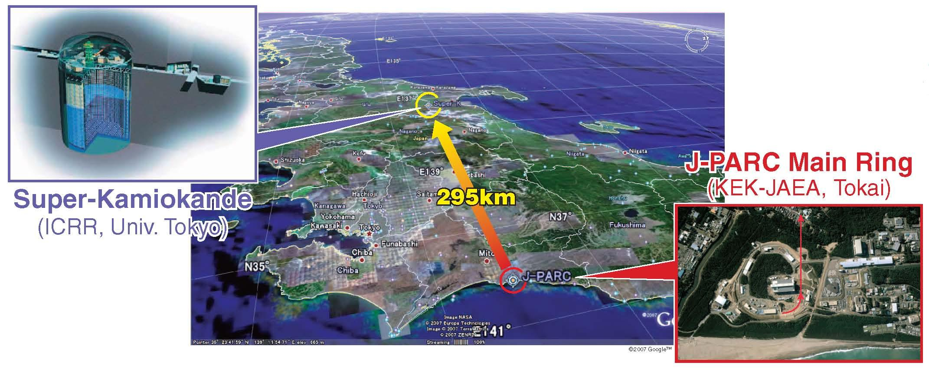
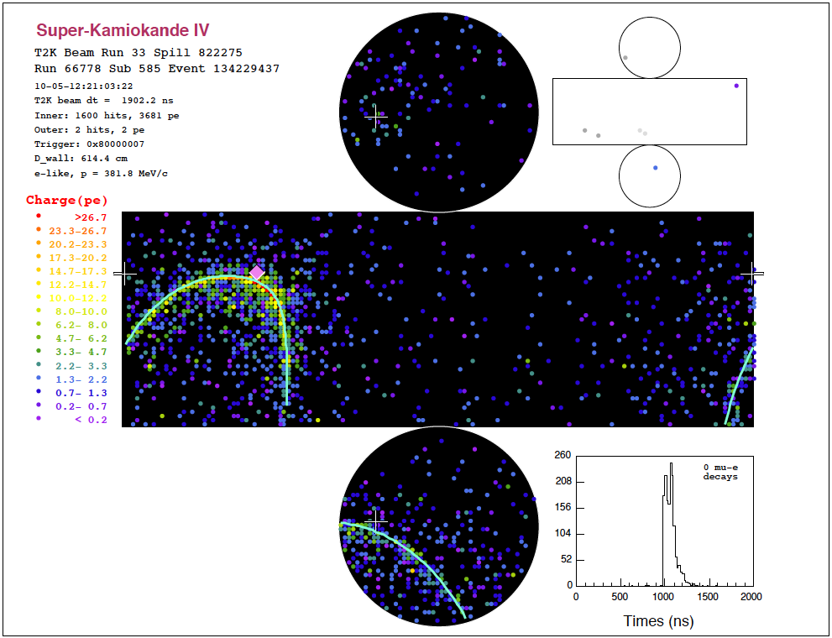
Neutrino Oscillation (T2K) Experiment
Atmospheric Neutrino
Electron neutrinos
Mu neutrinos
Accelerator Neutrino
ν
θ₁₃ Mixing between the 1st and 3rd generation
Kamioka,
K2K,
MINOS,
etc.
μ
Goal is to measure sin²2θ₁₃ down to 0.01
KamLAND, SNO
T2K
Solar Neutrino
Competition with Double Chooz, Daya Bay, FNAL, etc.
ν
τ
ν
e
Reactor Neutrino

Slide 27
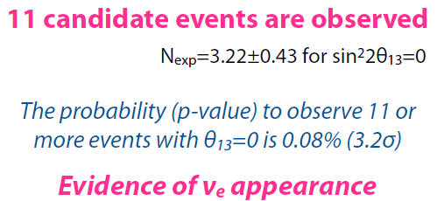
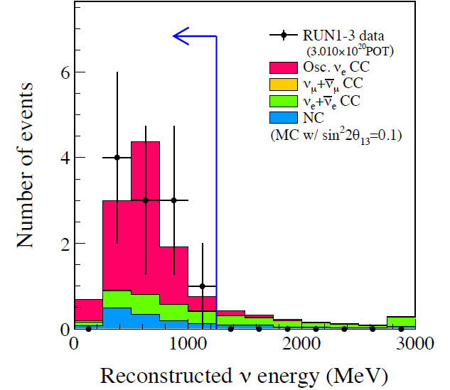
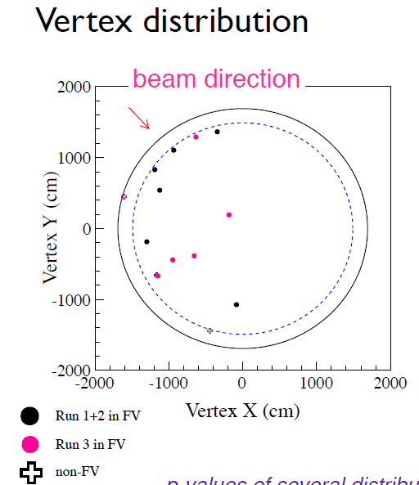
T2K electron neutrino candidates

