Slide 1
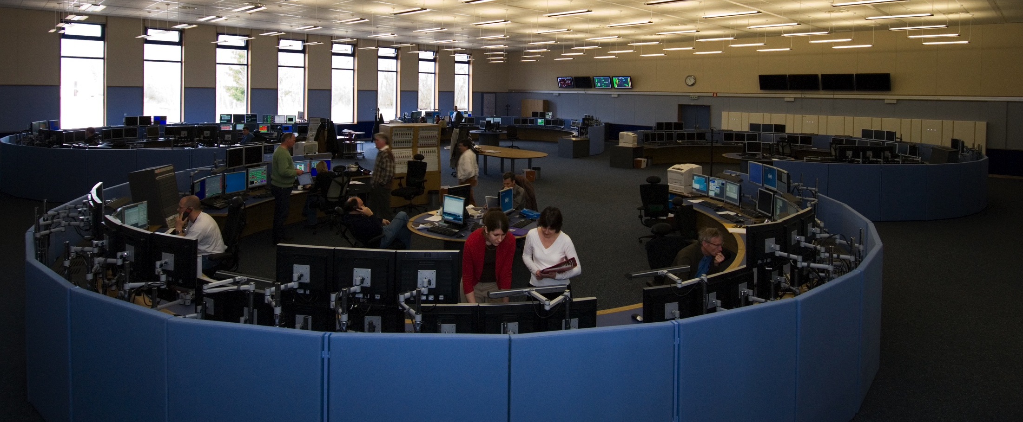
When disaster strikes – intr0
Jesper Nielsen
“Procedures and safeguards developed after 29 July 2006, when CERN suffered a total black-out for the first time in its history”
Notes:
I am Jesper, I’m 32 years, Danish and came to CERN in 2003 as Technical Infrastructure operator.
Since 2 years I’ve been shiftleader in the technical infrastructure control room.

Slide 2
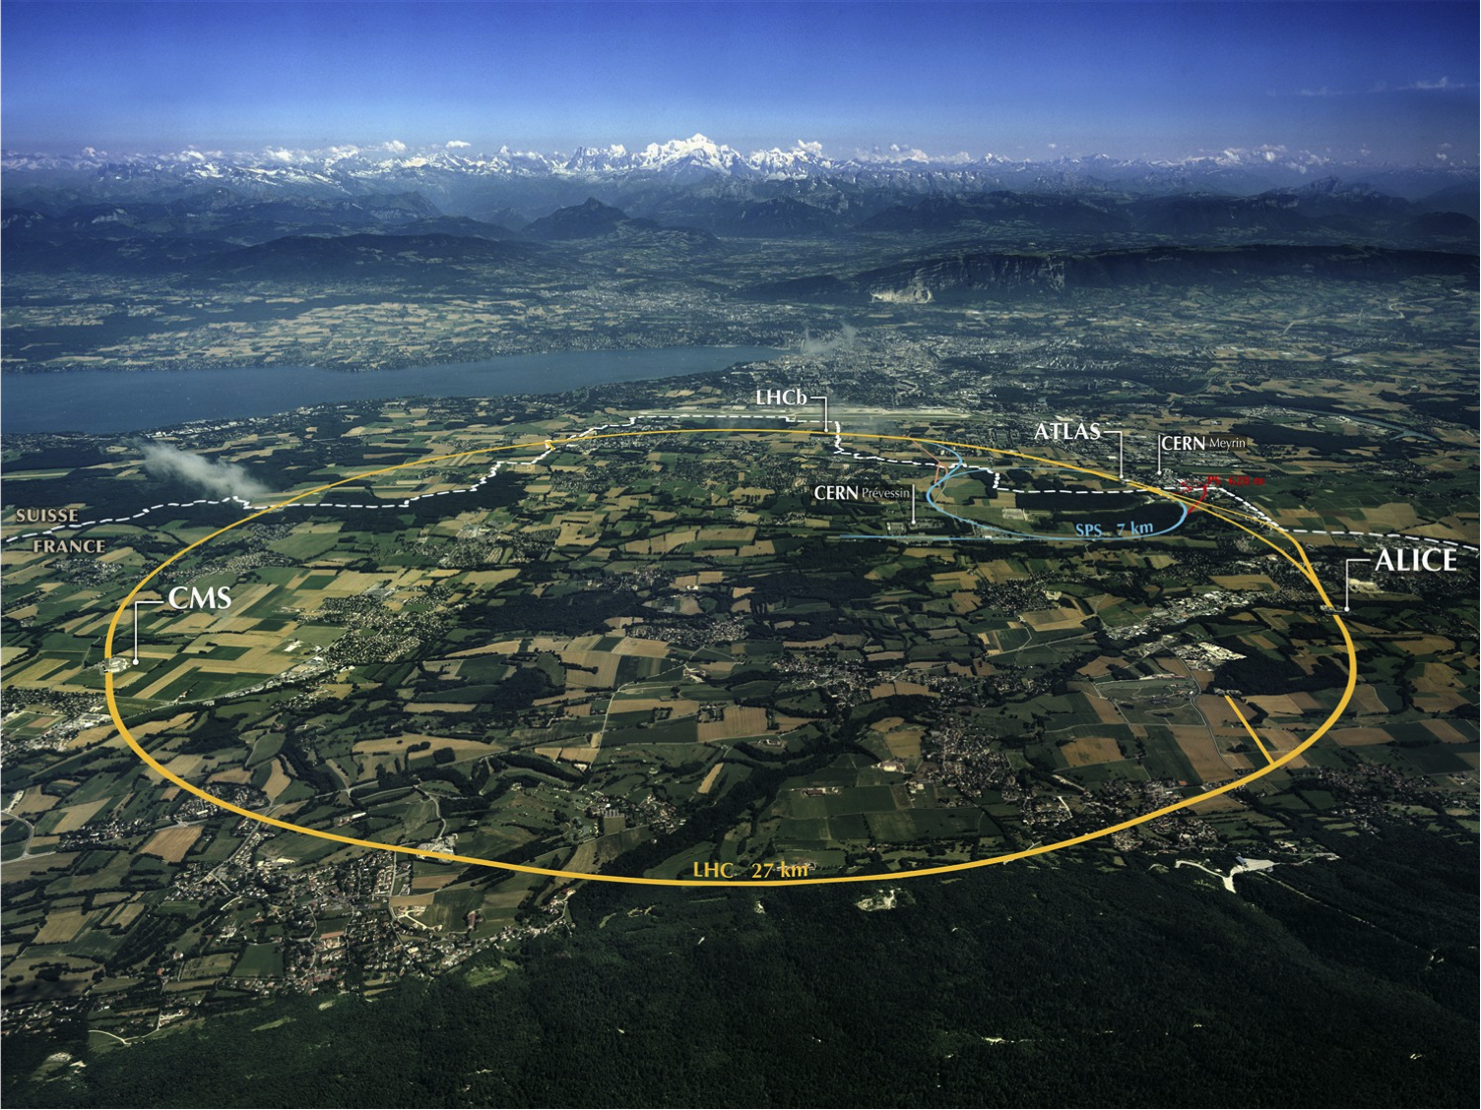
Outline
A few words about CERN
The CERN Control Centre
Technical Infrastructure operation
CERN's electrical distribution
29/7/06: 18kV breaker explosion – blackout!
Where we were at – What really happened
Safeguards and procedures implemented post 2006
Future, new crisis management team for events where existing procedures are not applicable
Notes:
I will start with a few words about CERN, our new control room and Technical Infrastructure operations.
Then I will introduce you to our electrical network, and what happens when it fails!
And last but not least – What we’ve learned from this.

Slide 3
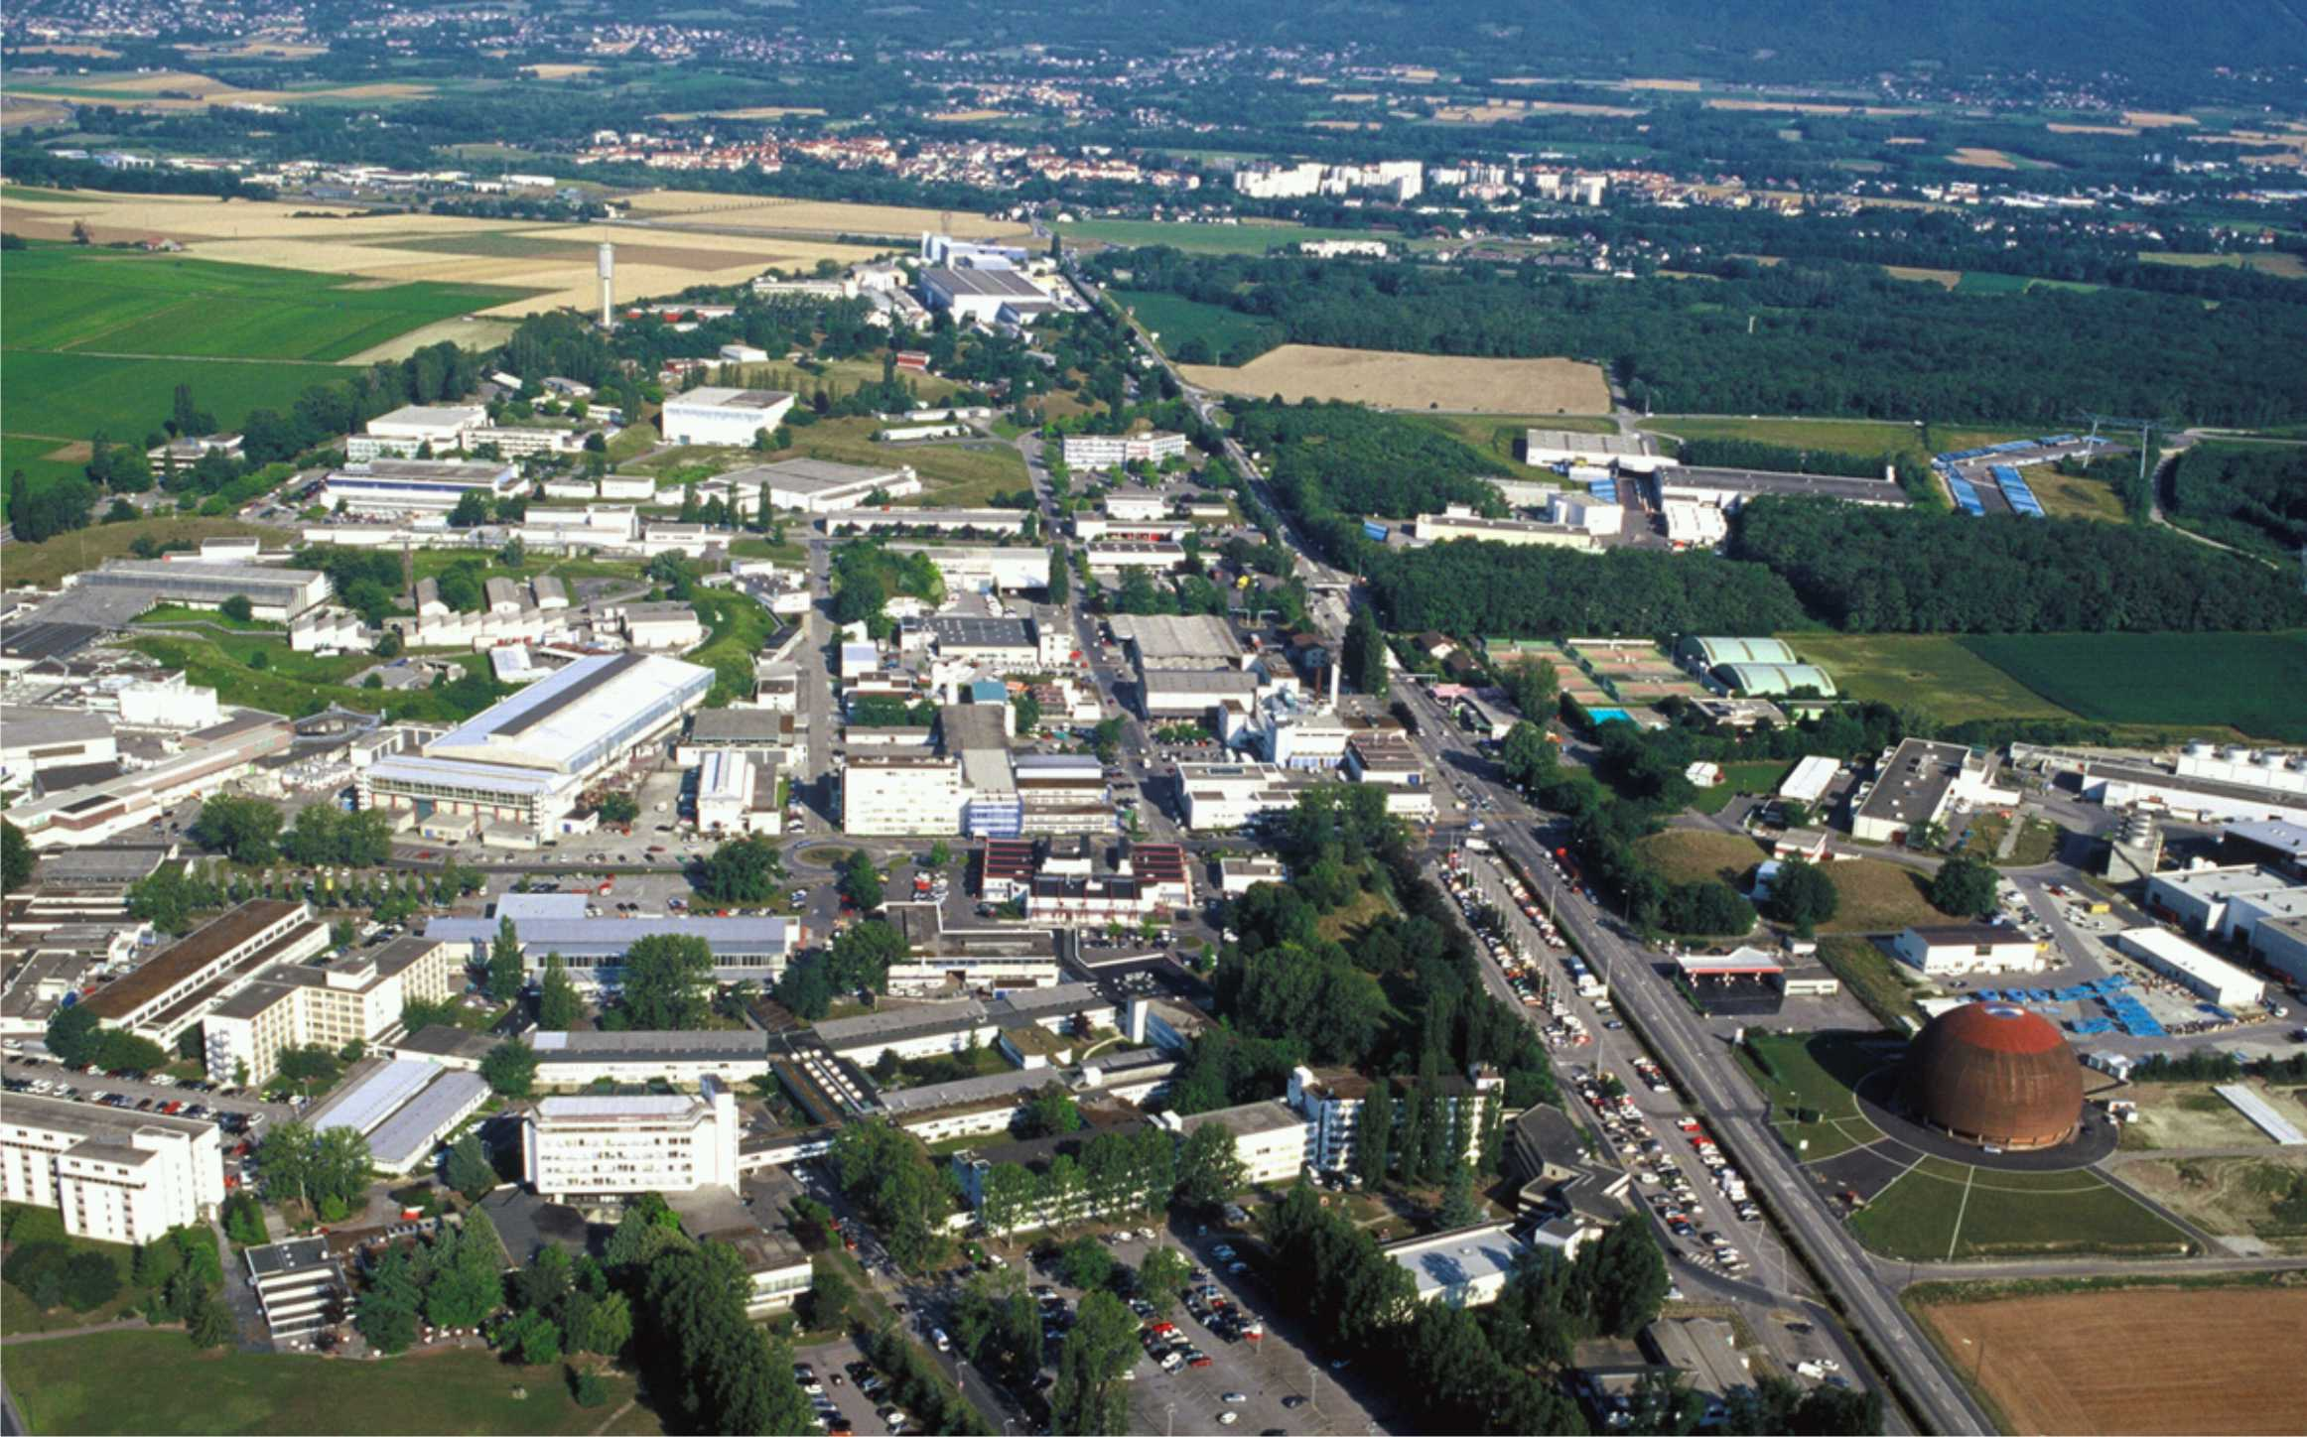
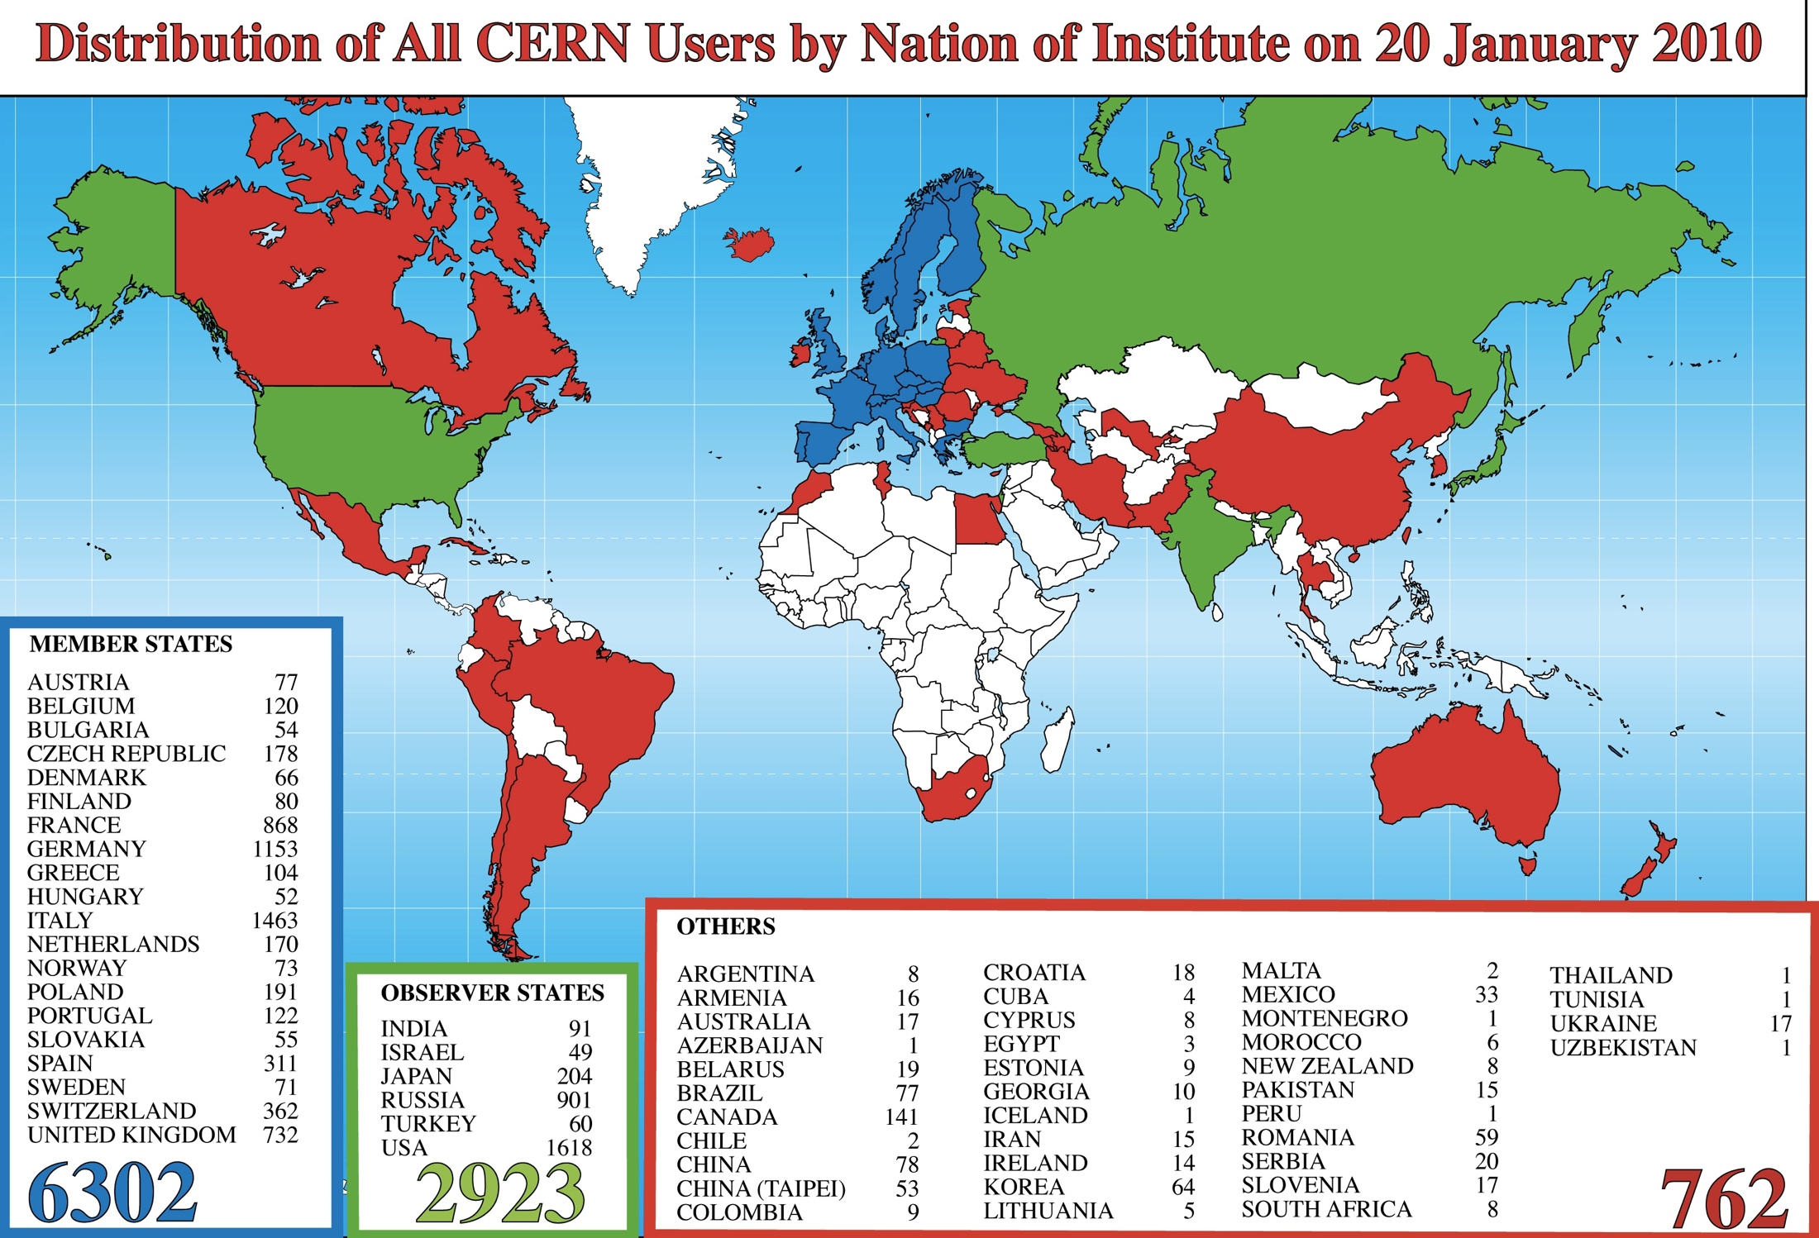
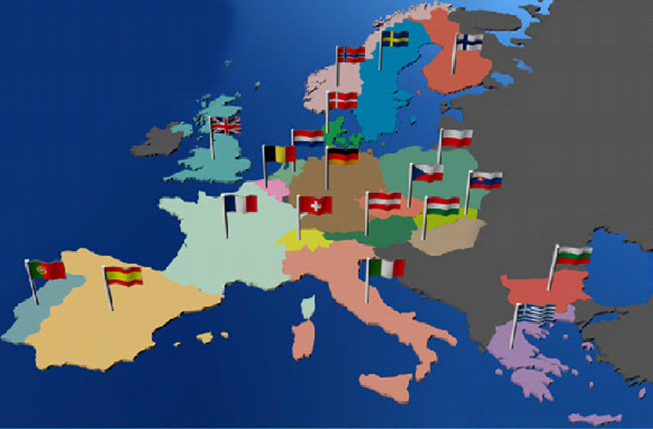
CERN
Founded in 1954 by 12 countries
Today: 20 member states
About 10’000 users from all over the world
Annual budget: approximately 1 Billion US $
2400 permanent staff – 1000 fellows/students
Notes:
To start out let’s see what CERN Is all about
60.000 visit requests per year.
12-14 petabytes per year of data (petabyte = 1 million gigabyte)
140 IT centers in 35 countries
One year of data = a pile of CDs 20kms high
4000 buildings
5400m3/h of water = 10% consumptions of Geneva
180MW

Slide 4
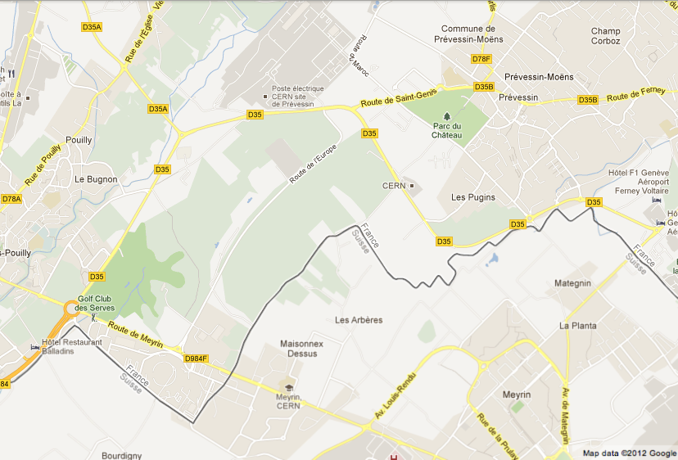
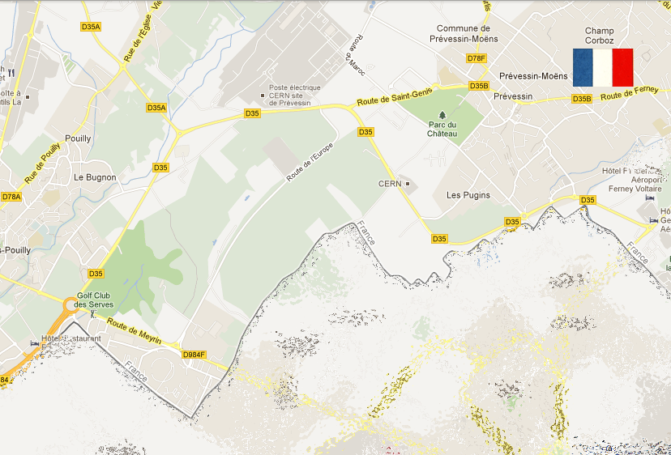
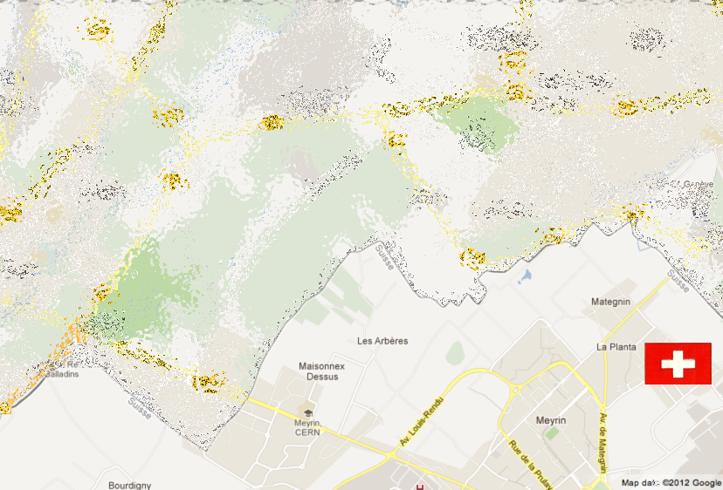
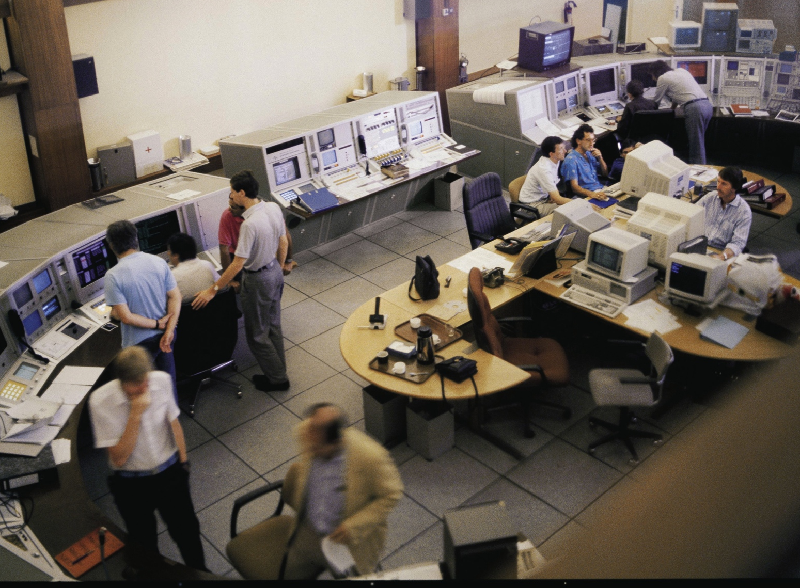
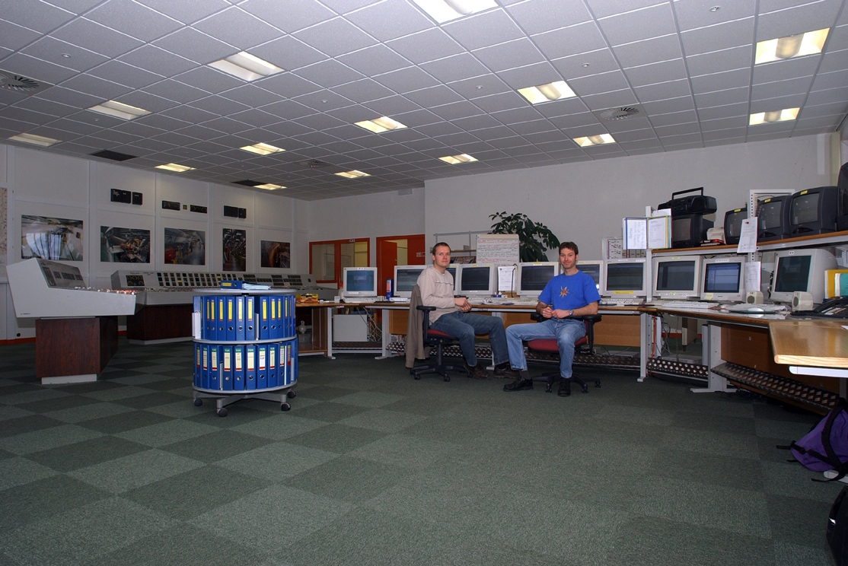
All Control Rooms Seperated
Notes:
As I said I’m working in the central control room, but it wasn’t always central. It used to be spread over the two sites, and even two countries

Slide 5
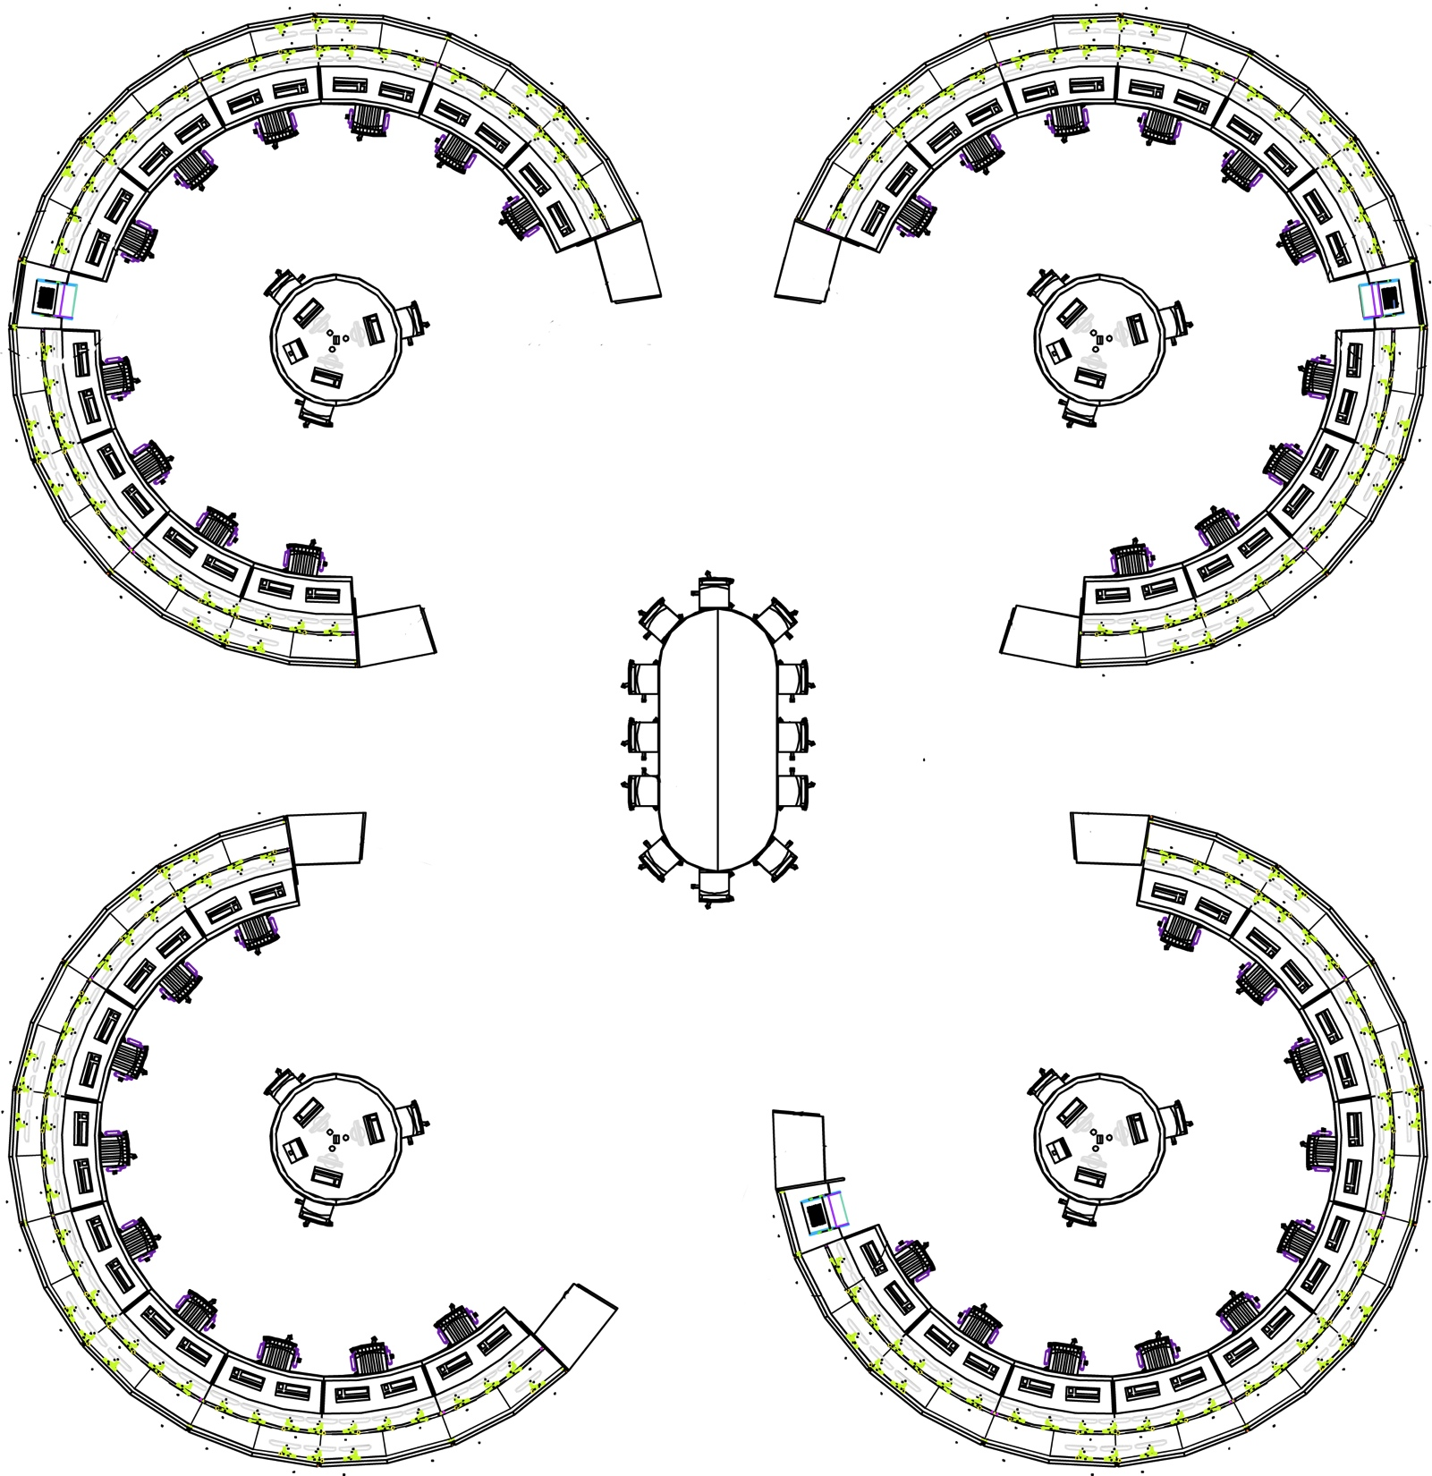
All Control Rooms in one
PS
TI
PSB
CRYO
SPS
LHC
Notes:
Today all central control rooms are grouped together in one room, which improves communication in between operators greatly!
You see that beam operations is now together with CRYO and Techical Infrastructure, TI.
In TI We look out for all technical systems needed to run the accelerators, mainly Ventilation, cooling and electricity, but also auxiliary systems as fire and gaz detection, evacuation, telecoms, IT networks, flooding, emergency stops, etc.

Slide 6
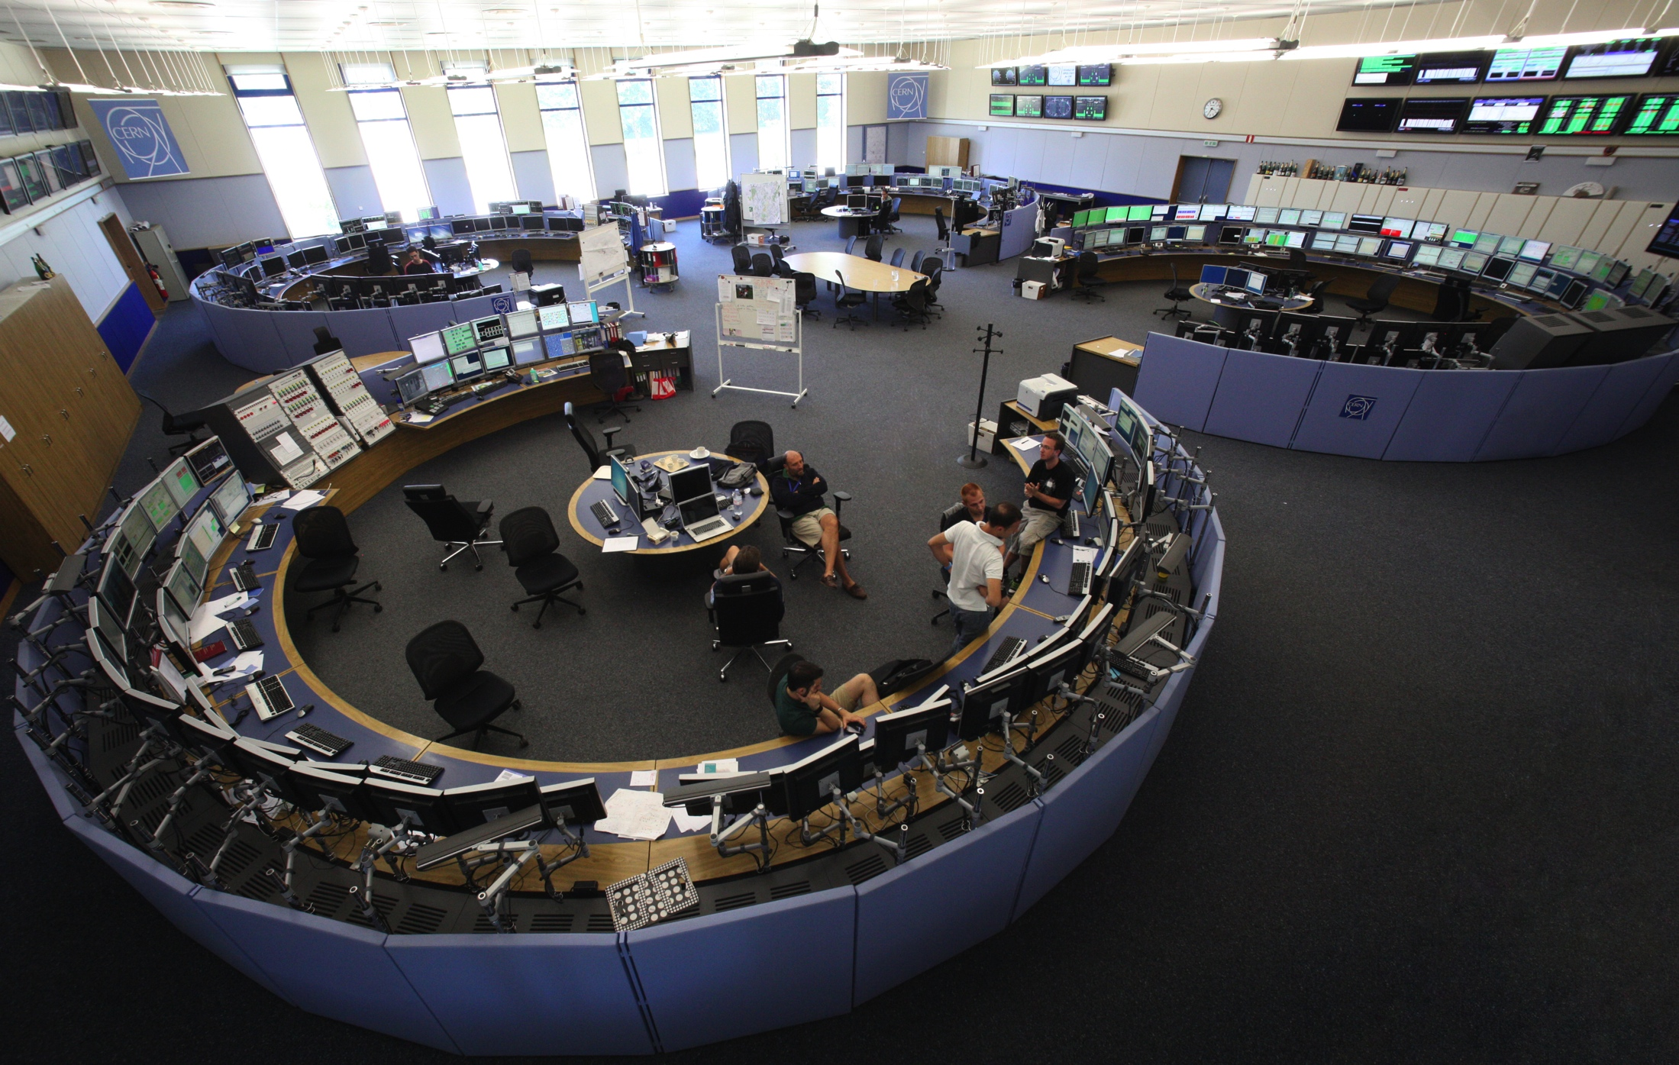

Cern Control Center
Notes:
Here’s a picture of the new central control room

Slide 7
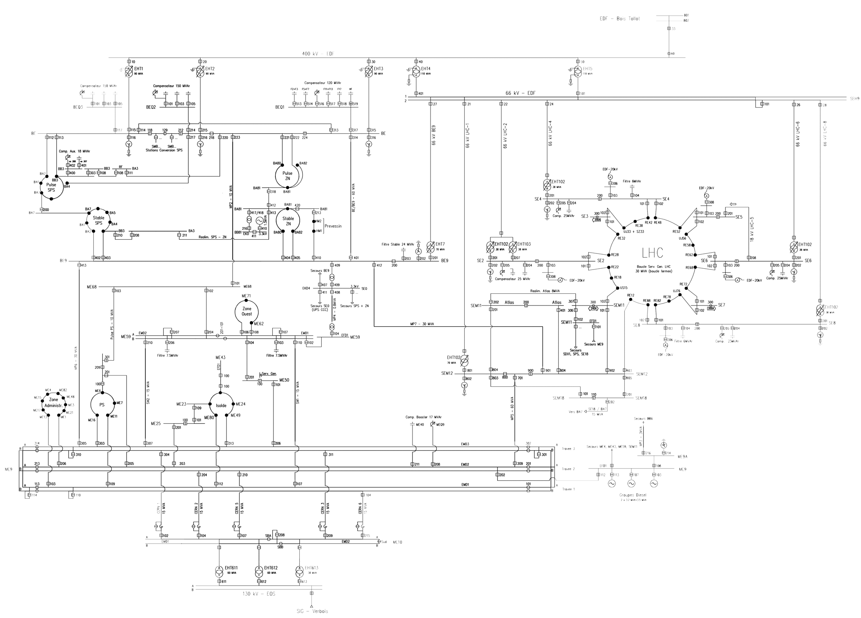
3 different sources of electricity
400.000V French network
Auto Transfer System
Diesels
130.000V Swiss network
Notes:
Before explaining what happened I will tell you briefly about the electrical network at CERN.

Slide 8
The source of the problem!
Notes:
Let’s zoom on this part of the network.

Slide 9
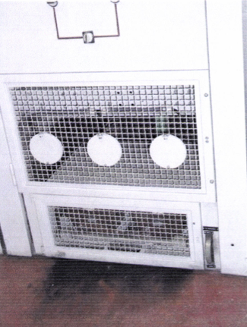
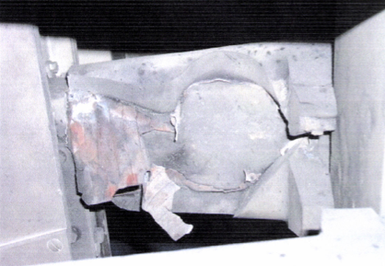
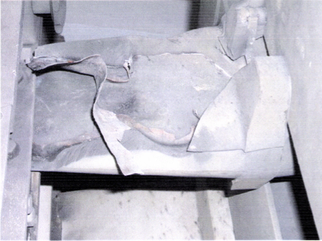
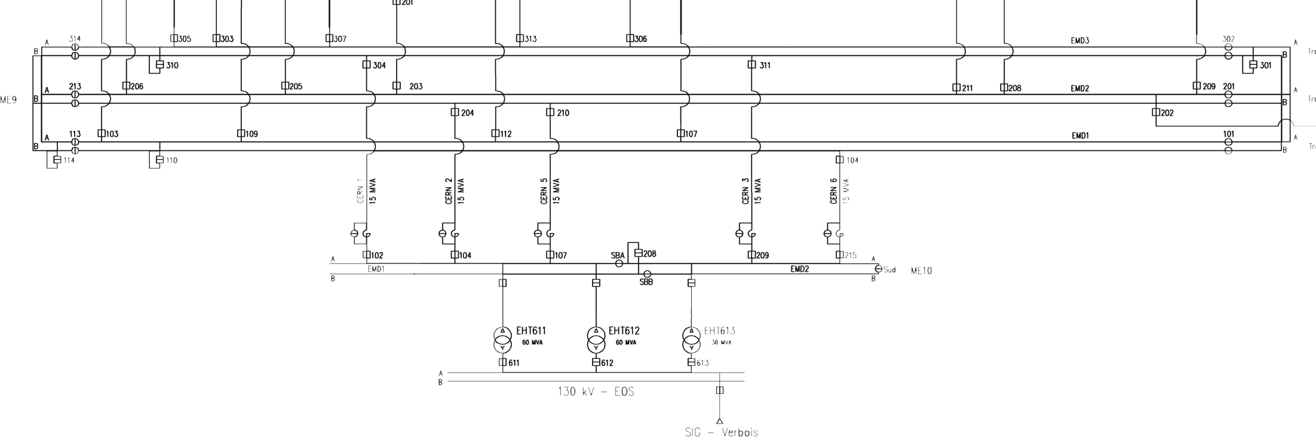
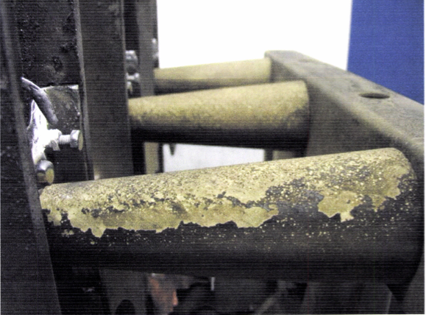
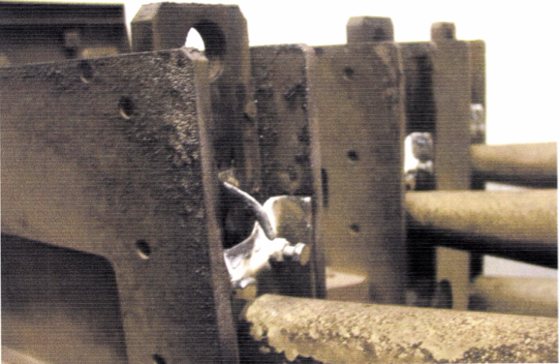
18KV short circuit
Notes:
29th of July 2006 7h45 in the morning: Thousand of alarms all power out!
18kV Circuit breaker exploded
Autotransfer system fails, switches ON with the fault present

Slide 10
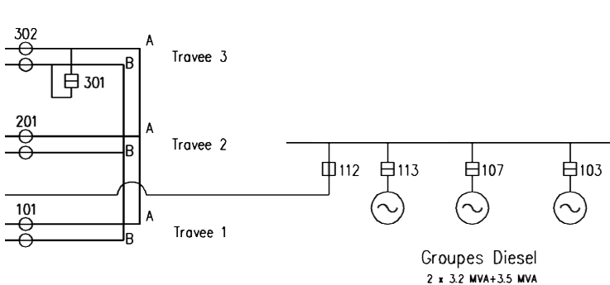
Diesels
Fails!
ON, but overload!
Runs for 44 min
Notes:
Diesels:
1 fails
1 switches on but falls out on overload
1 switches on, but fails after 44 minutes, cooling problem

Slide 11
What happened!
  Imagine a control room without light, phones or PCs!
  Specialists called via private phones collected during the event
  Electricians sent to places most likely to have failed
Notes:
Systems fail one by one after UPS’s run out of battery
CCC no power, lights, alarms, supervision during 13 hours!

Slide 12
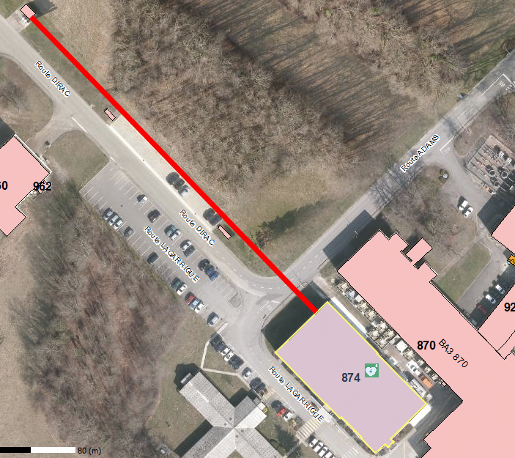
Lessons learned – EL network – Power for CCC
Notes:
One of the lessons we learned was that the Control Room needed more secure power. A complete renovation of the electrical network was therefore planned.
This is how the control room was powered before renovation

Slide 13
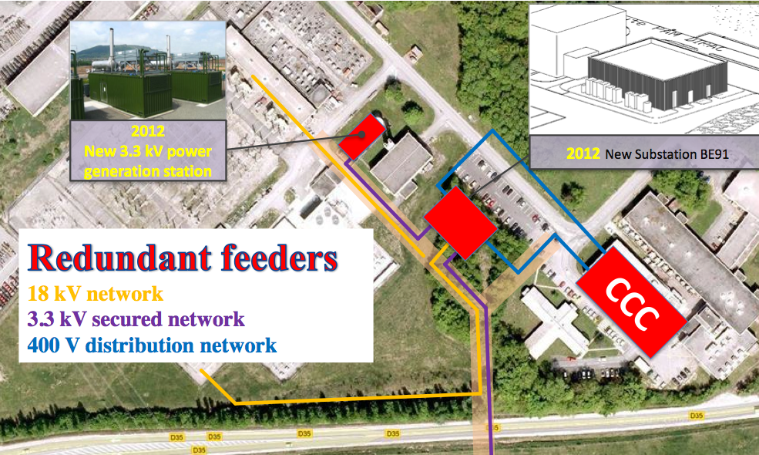
Lessons learned – EL network – Power for CCC
Notes:
This is how the CCC will be powered after the works that are ongoing as we speak.

Slide 14
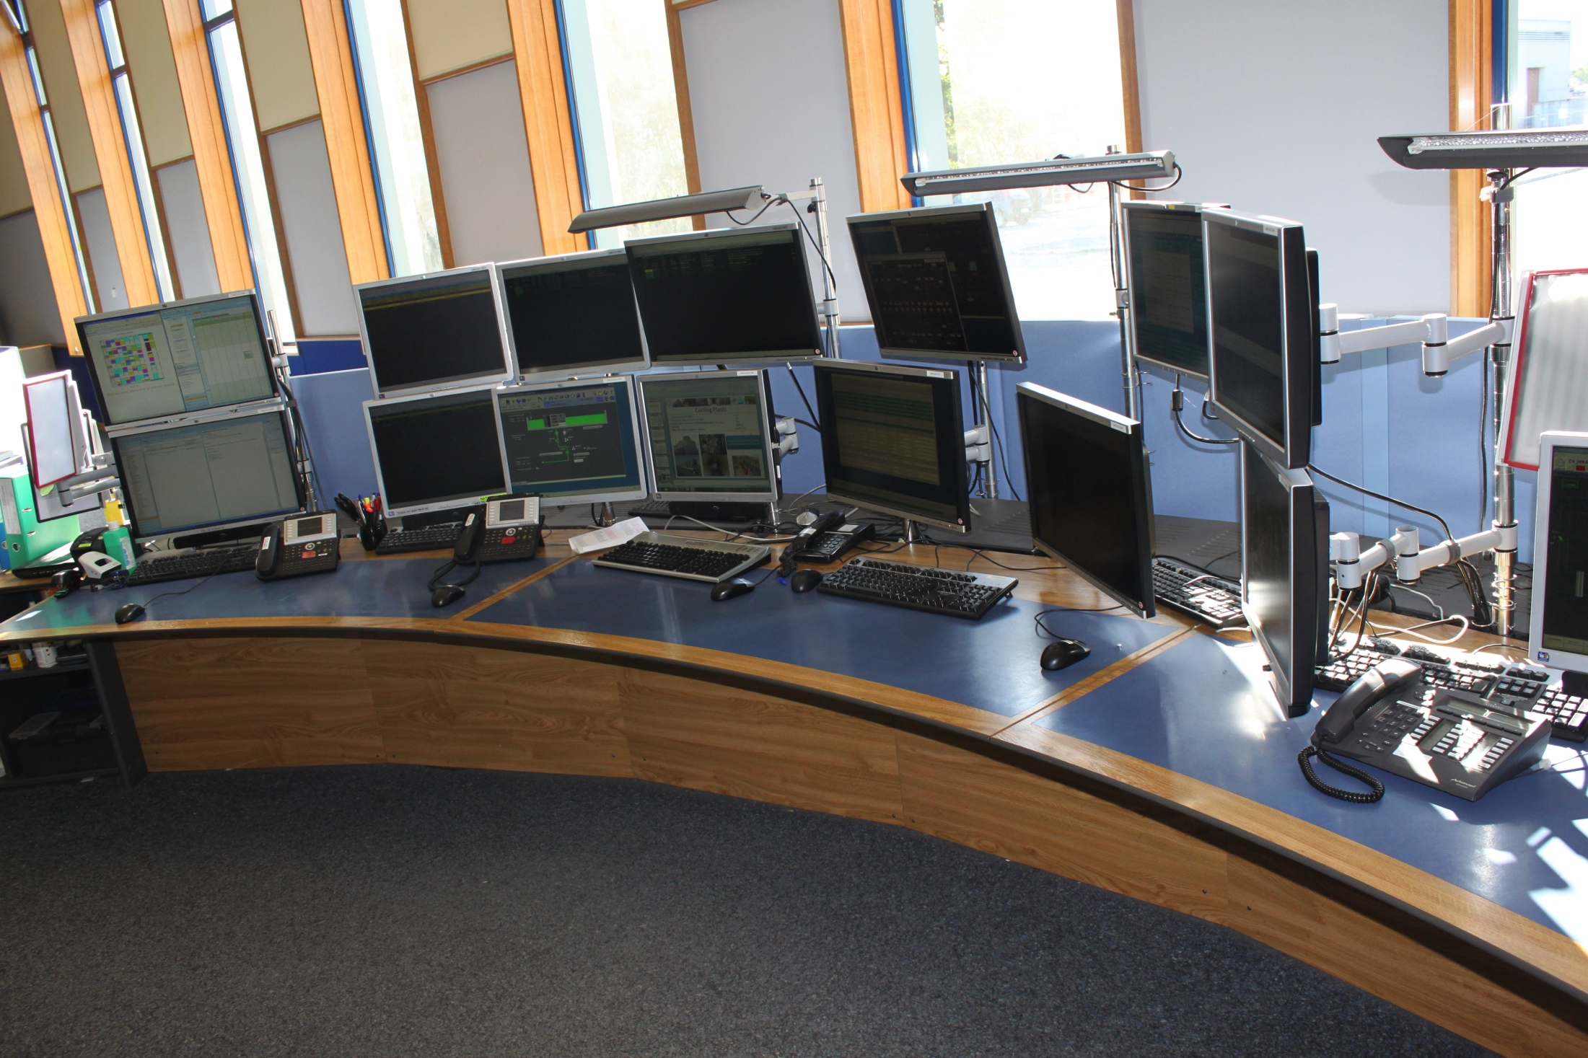
Lessons learned – Phones
Node 1
Node 2
French landline
Notes:
One solution to improve the telephone network is to split the network over the nodes, and again on two completely separate IT networks. But also something very simple and effective: Installing a proper french landline.
These phones are connected to a Callcenter, where we can add a predefined emergency message and log on and off phones according to the number of operators.

Slide 15
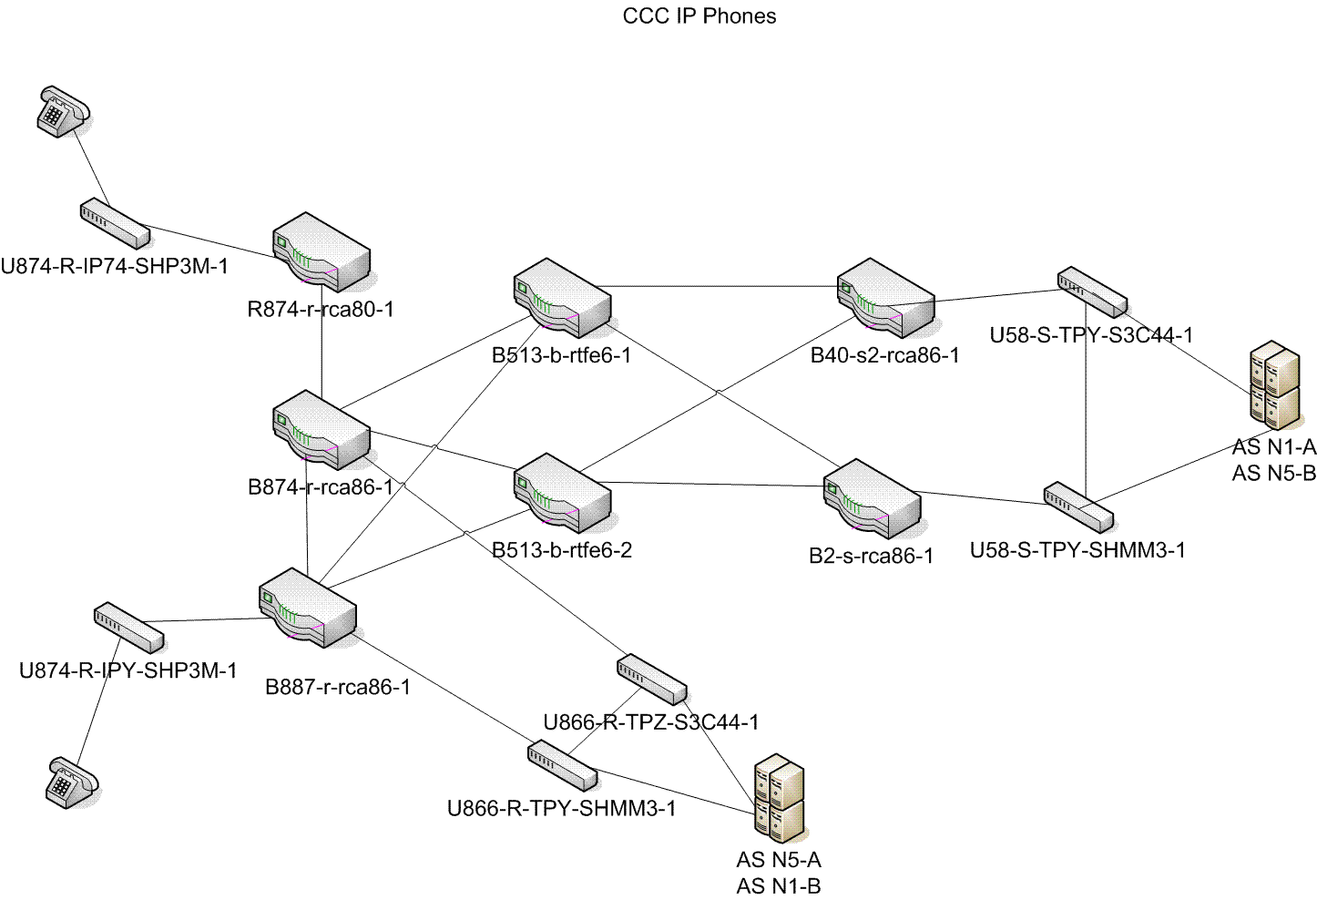
Lessons learned – Phones

Slide 16
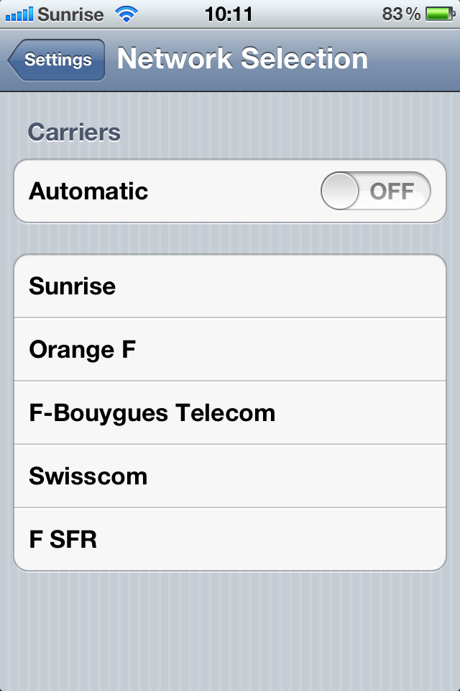
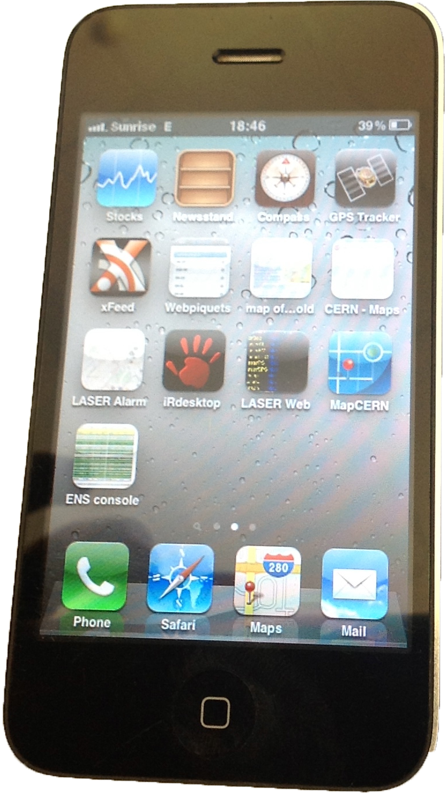


Lessons learned - GSM – Other Providers
Simple is often the solution!
Notes:
Another simple solution that was put in place was to unblock the cell phones used in the control room. We can now chose from 5 different carriers in two countries!

Slide 17
Lessons learned – Checklist
Notes:
We also implemented a checklist compiled of many 1 page procedures to help us find a fault and how to react.
3 parts: First we inform and reduce incoming calls. Then we investigate and make a plan, then follow a list of priorities to restart the systems.
Printed version

Slide 18
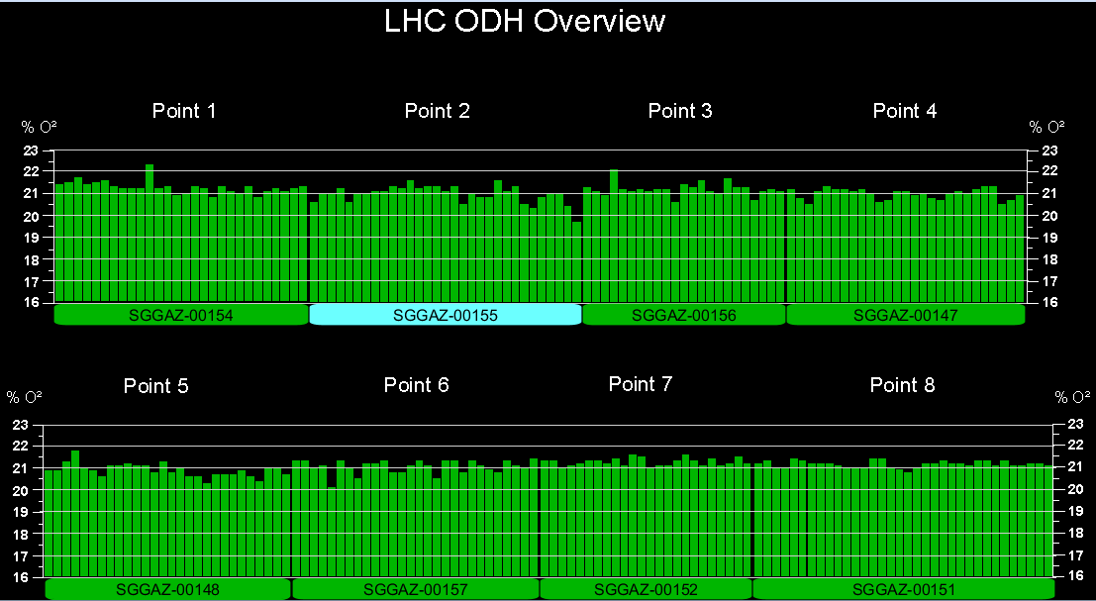
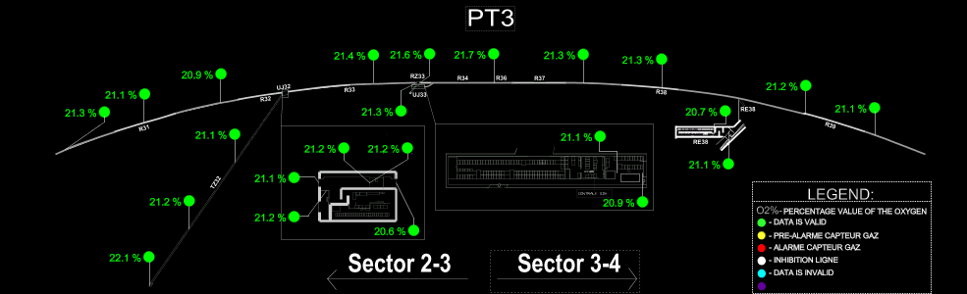
Lessons learned – Oxygen Deficiency Hazard
1 sensor on fault: Alarm in CCC + Firemen
2 sensors on fault: Alarm in CCC + Firemen + Evacuation
Notes:
By measuring the oxygen constantly we can detect a helium leak quickly

Slide 19
Lessons learned – Crisis Team
A team of 10 persons is called in when a crisis occur
  Take decisions
  Make statements to press
  Handle priorities
Crisis rooms in two locations
  France - Cern Control Center
  Switzerland - Firemen

Slide 20
Thanks for your attention!
I've introduced CERN, the CCC and TI operation
Explained how CERN is powered
Showed what happened on July 29 2006
Listed a number of important improvements made
  Communications now reliable
  Electricity supply being renovated and made redundant
  Priority lists and checklists established to be prepared
A crisis management team being set up to handle very big events
We are better prepared should disaster strike again!

