Slide 1
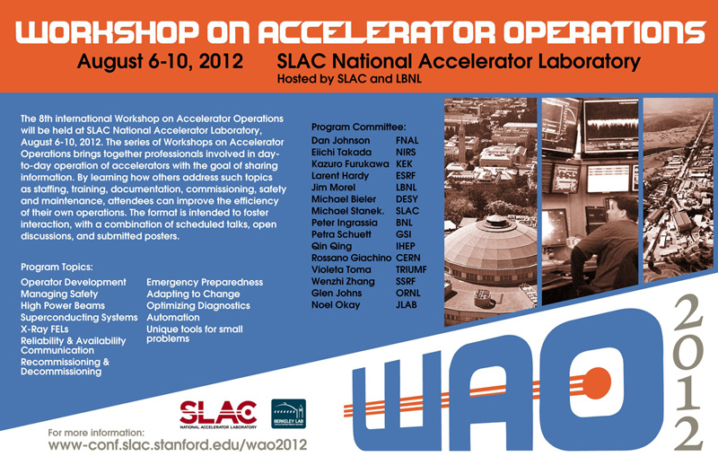

Slide 2
WAO 2012
Workshop on Accelerator Operations
Hosted by SLAC National Accelerator Laboratory & Lawrence Berkeley National Laboratory
August 6-10, 2012 at SLAC

Slide 3
Wecome to SLAC
Thank you all for your contributions to WAO 2012!
Safety First:
Kavli Evacuation Plan
Earthquake response
Site Access
Public areas
Accelerator areas – access escorted by SLAC badged personnel
Construction Areas

Slide 4
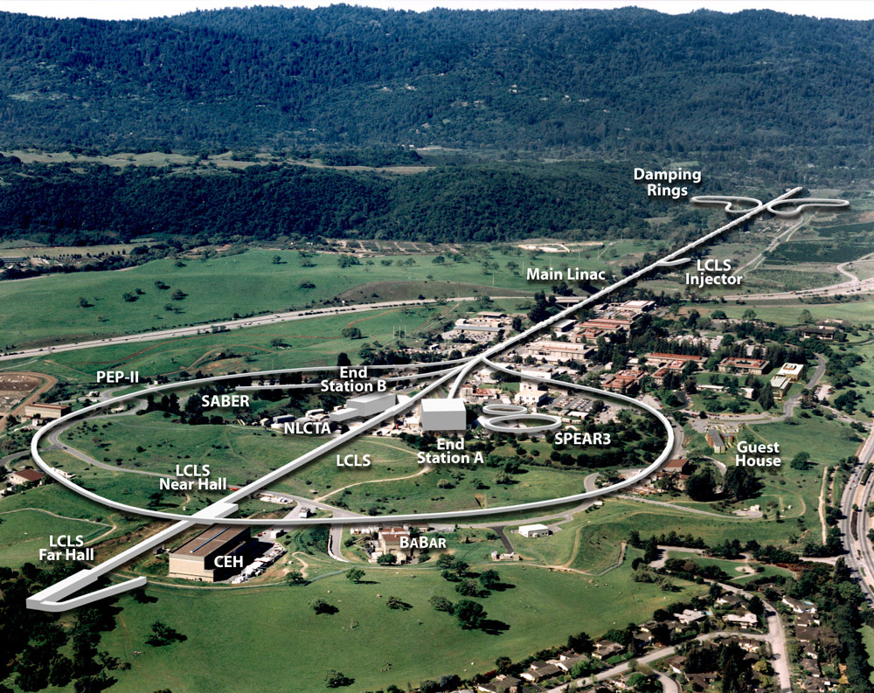
SLAC site overview

Slide 5
SLAC National Accelerator Laboratory
SLAC Programs
- Linac Coherent Light Source (LCLS)
- Stanford Synchrotron Radiation Lightsource (SSRL)
- Photon Science
Photon Ultrafast Laser Science & Engineering
Stanford Institute for Material & Energy Sciences
Center for Sustainable Energy through Catalysis
- Particle Physics & Astrophysics
Experimental Particle Physics
Kavli Institute for Particle Astrophysics & Cosmology
Accelerator Research & Development

Slide 6
Logistics
Lunches – 1 hour
Pre-paid – tickets inside name tag
WAO 2012 Tables outside Research Office Building (behind Kavli)
Not pre-paid – SLAC Cafeteria, Off-site options
Opportunity to meet and interact with other WAO participants
Tuesday Banquet 18:30
Quadrus Conference Center (across Sand Hill Rd)
Guest Speaker – Dr. Richard Muller, LBNL

Slide 7
Logistics
Tours – sign up in Kavli Auditorium foyer
SLAC – Tuesday, Aug 7, 15:00-17:00
- Linac Klystron gallery visitors alcove
- Main Control Center
- LCLS Beam Transport Hall
- Undulator Hall
- X-ray diagnostic area
- X-ray hutches
LBNL – Friday, Aug 10, 13:00-18:00
- Advanced Light Source
- 88 inch cyclotron
- Personal vehicles & SLAC vans (limited)

Slide 8
Logistics
Prepared Talks
- Get Copies to Helen O’Donnell to be posted on WAO website
Files available on WAO 2012 website for ~1 month after WAO.
Open Discussions
Posters – Redwood Room, Monday-Thursday
Session Wednesday 15:15 session
Invited Speaker – Thursday, Aug 9
Dr. Clete Kushida, M.D. Ph.D. –
Director, Stanford Center for Human Sleep Research

Slide 9
WAO Local Support staff
Helen O’Donnell
Barbara Hemstad
Lisa Adair
Wanda Elliot
Bernadette Espiritu
Queenie Huang
Naomi Nagahashi
Sharon Oden
Judy Pena
IT Support – Ken Zhou

Slide 10
WAO 2012 Program Committee
Dan Johnson, FNAL
Eiichi Takada, NIRS
Kazuro Furukawa, KEK
Larent Hardy, ESRF
Jim Morel, LBNL
Michael Bieler, DESY
Michael Stanek, SLAC
Peter Ingrassia, BNL
Petra Schuett, GSI
Qing Qin, IHEP
Rossano Giachino, CERN
Violeta Toma, TRIUMF
Wenzhi Zhang, SSRF
Glen Johns, ORNL
Noel Okay, JLAB

