Slide 1
Outages During the Run
Coping with the Power Company

Slide 2
CAD:
RHIC (Relativistic Heavy Ion Collider) is part of the CAD (Collider Accelerator Department) at Brookhaven National Laboratory, Upton New York, USA.
The facility is comprised of three pre-injectors (Proton LINAC, EBIS and a Tandem van De Graaff, a Booster, a post booster (the AGS) and RHIC itself.
In addition to the primary purpose of providing beam for injection into RHIC, injectors provide beam for various secondary users:
Brookhaven Lab Ion Production (BLIP): Protons from 200 MeV LINAC
NASA Space Radiation Lab (NSRL): Slow extracted Protons and Ions from 2 GeV Booster to user facility

Slide 3
RHIC Background:
Relativistic Heavy Ion Collider- species from protons to Uranium.
Two 3.8km SC rings, warm RF (SC upgrade in progress), 6 Intersection regions.
Ability to run dissimilar species.
Polarized proton collisions at 510GeV CM

Slide 4
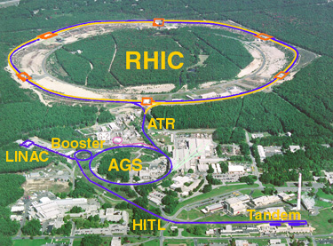

Slide 5
Power outages during Run 11 and 12
Scheduled work on the electrical grid, both inside and outside of the laboratory was originally planned to be completed during the shutdown periods following runs 11 and 12.
This work included upgrades to aging/outdated equipment as well as increasing capacity for the laboratory.
During the work, it was required that the feed for the Booster Main Magnet Power Supply remain off.
For various reasons, the work was not completed until each run had begun.

Slide 6
Dealing with the power company
With the program was running, increased work coordination from Operations was necessary..
Communication and coordination between the Utility company, Facilities and Operations (F&O) and Operations was key to success.
Not only are emergencies unpredictable, but the general and long term Utility Company’s schedule is not readily available (to anyone?).
All of the information from the Utility was relayed to CAD second hand through F&O.
This was frustrating…

Slide 7
Scheduling:
Ideally, work that can interrupt Accelerator Operations must be completed during shutdown.
Conflict between the Lab and Utility schedules.
Vacation at the lab and Utility coincide with shutdown (summer).
Job cancellation: weather, failure, car accidents.
Job Interdependence, waiting for the other guy.
Other?
The result is that the utility company “requested” shutdowns during “the worst possible” times.
In Addition, complications arouse, adding more periodic shutdowns throughout the run.

Slide 8
Work Planning:
Many fold and complicated: F&O, Utility company, Operations, Operations support groups…
Overall plan must include measures for shutdown and recovery of not only the accelerators, but services and support systems.
CAD administration, Operations, Accelerator Physics and Experiments determine the best schedule- studies, commissioning, special runs.
Repairs, maintenance, commissioning and/or installation to coincide with beam outages.
Each shutdown was designed to resemble a mini-shutdown.

Slide 9
Step back: Power at CAD
Dedicated power feeds are critical for accelerator operations:
CAD/RHIC complex requires ~35MW, the laboratory ~55MW total.
Two Feeds: “Primary” and “Alternate”
A “Stiff grid” is essential to both private sector and laboratory:
Power swings of many MW as large magnets pulse.
AGS Booster ~3 MW swing.
Harmonic content critical, risk of equipment damage/shutdown.
Cross talk and power disruption to others.

Slide 10
A little background, continued:
The Booster Main Magnet Power Supply uses 13.8kV AC off the BNL grid (i.e. coupled to the Utility grid).
Therefore, Booster operation must be carefully regulated and monitored.
Crosstalk “Solution” = use both available 69 kV feeds- “Primary” and “Alternate”.
The Alternate Feed is dedicated to run the Booster MMPS only, while the rest of the lab runs off the Primary Feed.
When work must be done on either line, the Booster cannot run.

Slide 11
Booster cycles, harmonics, power

Slide 12
Harmonic analysis- critical for operation

Slide 13
69kV Feed- Normal positions

Slide 14
“Alternate Feed” – No Booster

Slide 15
Outage: Run 11
Work was originally scheduled for completion during the shutdown.
“Surprise” need for outage during early setup for NSRL run 11a and RHIC.
Some affect of the schedule, though no cancelled experiments.
Need for late outage, apparently known to the utilities company, was not relayed to BNL until startup was already underway.
Through scheduling and preparation, the impact of the 2011 outage had minimal (no) affect on the RHIC program.
Luckily it was a one time deal!

Slide 16
2012 shutdowns:
Uncertainty again with last minute scheduling by Utility company.
Surprise discovery during pre-job inspection.
Downtime during critical startup period.
Reduced Machine development critical for polarized proton development.
Delays in commissioning of EBIS beams in the Booster needed for NSRL and RHIC.
Collider schedule and performance impact.
Cancelled, rescheduled ad delayed experiments at NSRL.

Slide 17
December 2011
Dec 19th:
Utility company informs BNL that that they have not completed scheduled work. Additional shutdown necessary to complete planned upgrades.
“Agreement” reached to schedule with Operations to reduce the impact of the outage.
Dec 20th:
Utility performs pre-job inspection and discovers an issue requiring immediate attention.
An emergency outage scheduled.

Slide 18
Alternate feed with Booster- Not used

Slide 19
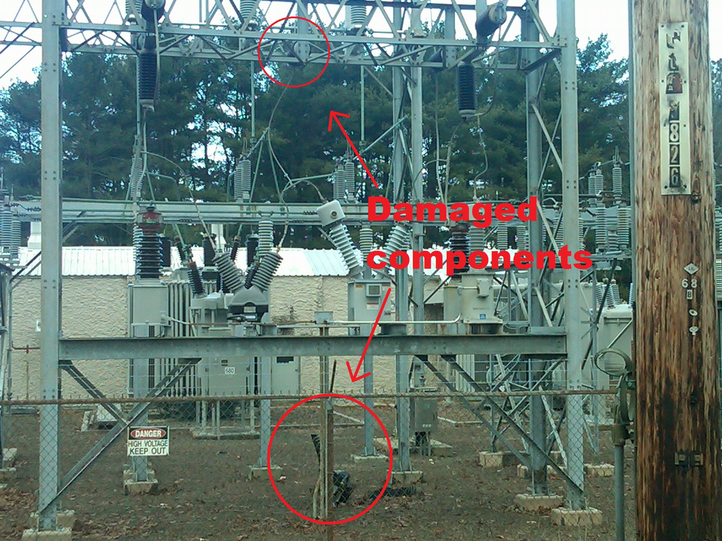

Slide 20
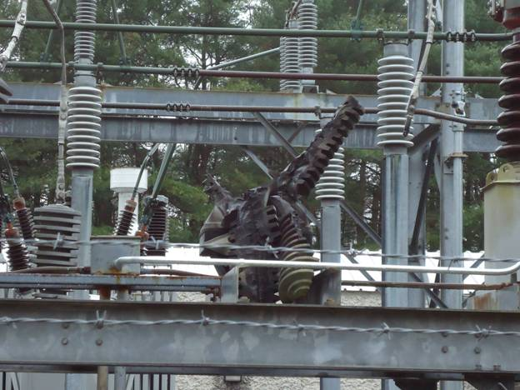

Slide 21
December 21st: Before the RHIC run
Operations prepares for outage 0800-1600hrs.
Equipment secured.
Opportunistic maintenance schedule executed.
Scheduled NSRL experiments delayed and or cancelled.
Utility company begins work (1000hrs!).
Beam activities and NSRL experiments suspended for the day.
1530hrs Utility company work completed.
Booster restored by 1600hrs.
Setup continues, NSRL runs abbreviated schedule.
“Emergency” situation resolved, shutdown scheduled for April 19th (Changeover date).

Slide 22
April 19: Changeover to Uranium
0700hrs: Prep for scheduled outage begins after RHIC filled for extended store.
0800hrs: Power outage/injector maintenance begins, proton store in RHIC for studies continues.
0815hrs: RHIC store lost!
Commission Uranium ramp – no tunnel access.
Experimental access begins
1100hrs: Maintenance in RHIC begins.
1530hrs: Power restored, begin U setup and NSRL experiments.
Next outage scheduled for April 24.

Slide 23
Re-scheduling
April 24th: Utility company cancels outage scheduled for the 25th.
Re- schedule for May 9th (Scheduled Maintenance Day).
NSRL informed- Experiments originally scheduled were not cancelled (they were getting smart).
April 25th: Utility company must shutdown before May 9^{th:}
Re-rescheduling necessary…

Slide 24
And More Changes…
Agreement reached: Saturday April 28th.
NSRL not running scheduled on Saturday.
Planned extended store in RHIC.
No maintenance (overtime) scheduled.
Experimental access scheduled between stores.
Minimal impact:
Good luck never hurts.
Work still not complete…
Re-re-re-schedule?
May 9th outage (re)scheduled.

Slide 25
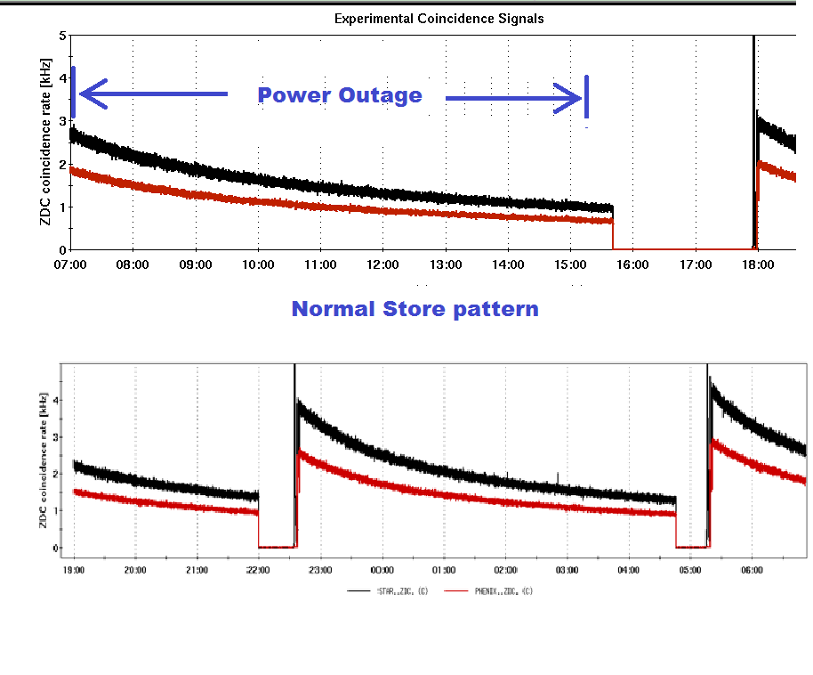

Slide 26
May 9: Scheduled Maintenance day
Abbreviated NSRL schedule cancelled.
Extended store, beam measurements scheduled in RHIC until early afternoon.
Scheduled maintenance in injectors throughout the day.
Installation and testing of new phase shifters to the RHIC power supply completed during and after maintenance while awaiting beam.
Recovery complicated and delayed by problems introduced by weather related power dips that occurred before the shutdown- Bad luck.

Slide 27
Schedule for minimal impact:

Slide 28
Speaking of bad luck…

Slide 29
Overall Results
Efforts to minimize the loss to the RHIC program were successful, though some pain was felt by other users.
With some diplomacy and communication, some flexibility can be worked into the Utility company’s schedule.
Structured preparation and execution of complex shutdown and restart reduces the program loss.

Slide 30
Planned shutdown and recovery:
Equipment unaffected by the outages were readied for operation prior to the restoration of power.
Specific plan and steps for recovery followed by multiple groups, divisions and companies proved effective in recovering the program.
BNL F&O personnel well prepared for power restoration.
System experts, Operations well prepared for accelerator recovery.
Shutdown recovery methods aided in overall complex recovery.

Slide 31
Fallout
For the last two runs, disruptions arouse from last minute or “emergency” outages.
Stress in the relationship between the lab and utility company.
NSRL Experimenters and BNL liaisons:
Reduced confidence.
Burden on Operations increased by complications before, during and after the outage.
Off hours work and ECI’s ($$$).
Decreased efficiency.

Slide 32
How to improve?
Engineering Solution: single point failures:
Initial design.
Add Booster filtering $$$
Coordination:
Create better flow of information between CAD, F&O and the power company- Web? Tweet?
Ensure outages are planned to occur during shutdown!?
Communication
Communication…
Communication!!!

Slide 33
Conclusions
With domain over the power at the lab and for the accelerators, we are subject to the outside utility’s scheduling.
By improving communication with the power company, delays and other problems may be avoided.
When known work on the grid is planned, always have alternate plans ready for outages during the run.
Continued upgrades to the electrical systems at the lab makes it necessary to deal with the power company…

Slide 34
Thank you!

