Slide 1
DESY: From High Energy Physics to Synchrotron Radiation
Accelerator Operation in a changing Environment
Michael Bieler
DESY: From High Energy Physics to Synchrotron Radiation
WAO2012, SLAC, Aug. 7, 2012

Slide 2
Vocabulary
DESY: Deutsche Elektronen-Synchrotron, Hamburg, Germany
DORIS, PETRA, HERA: Storage rings at DESY
TTF, FLASH, XFEL: FELs at DESY

Slide 3
Content
The History of DESY
Operation of a Collider Ring
Operation of a Ring Light Source
Operation of a SASE FEL
Relations to the Users
Changes for the Operators
Conclusion

Slide 4
The History of DESY
1959: Foundation of DESY
1964: 6 GeV Synchrotron, fixed target
1974: Storage ring DORIS, e⁺/e⁻ collider, 2 x 6 GeV
1978: Storage ring PETRA, e⁺/e⁻ collider, 2 x 23.5 GeV
1992: Storage ring HERA, p⁺/e⁻ collider, 920 / 27.5 GeV
1966: First experiments with synchrotron radiation
1981: 15 beamlines at DORIS, ‘parasitic’ use by HASYLAB
1990: DORIS becomes a dedicated light source
1995: One beamline at PETRA, ‘parasitic’ use by HASYLAB
2000: VUV SASE FEL lases at 100 nm
2003: VUV SASE FEL becomes FLASH, a user facility
2007: Shutdown of HERA
2009: PETRA becomes a dedicated light source
2012: XFEL under construction

Slide 5
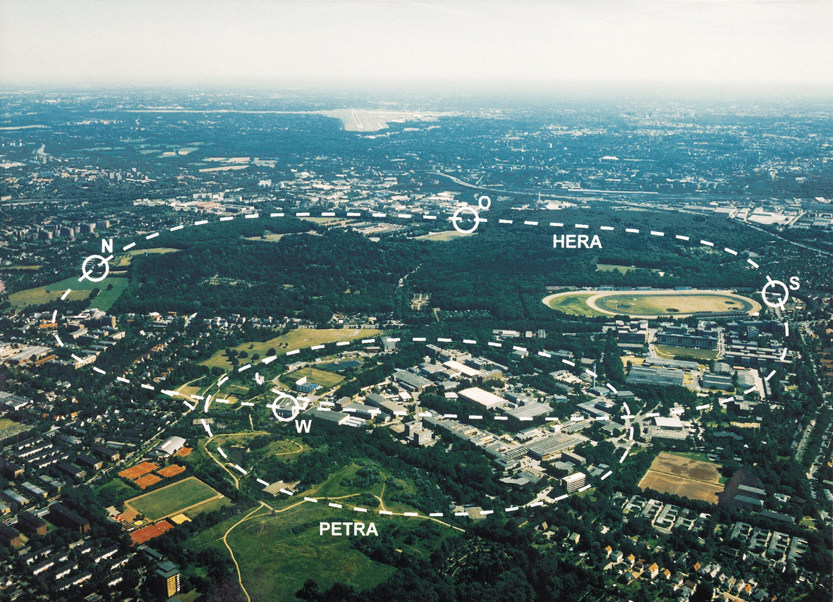
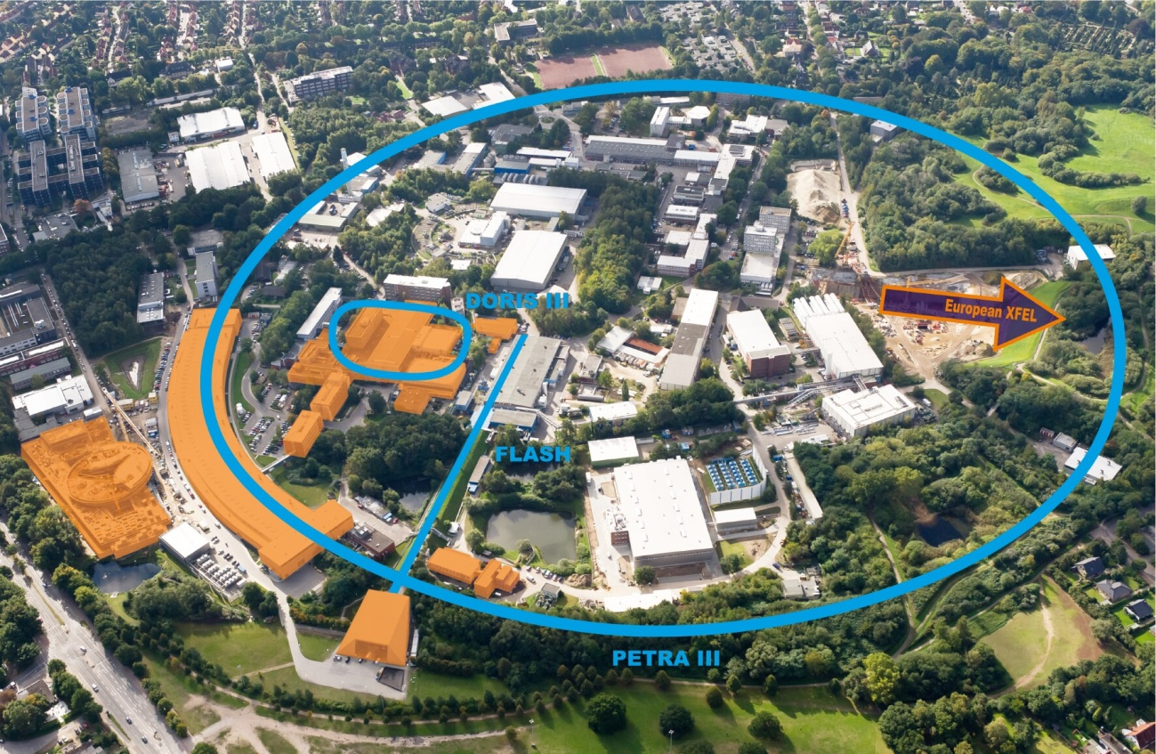
The History of DESY

Slide 6
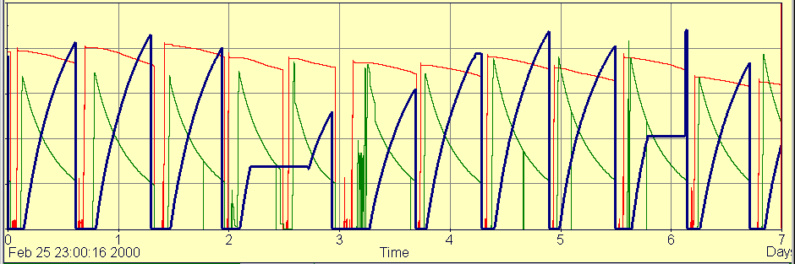
Operation of a Collider Ring
HERA Luminosity Operation:
Run Time 8 – 15 hours
Fill Time 3 – 5 hours
Lumi Efficiency ~ 75 %
Figure of Merit: Integrated Luminosity
Protons
Electrons
Luminosity

Slide 7
Operation of a Collider Ring
Luminosity Operation for Operators:
One or two fills per day
3 – 5 hours of hard work for ~ 3 people
Well known procedures
Constant training on the job
Quick learning curve

Slide 8
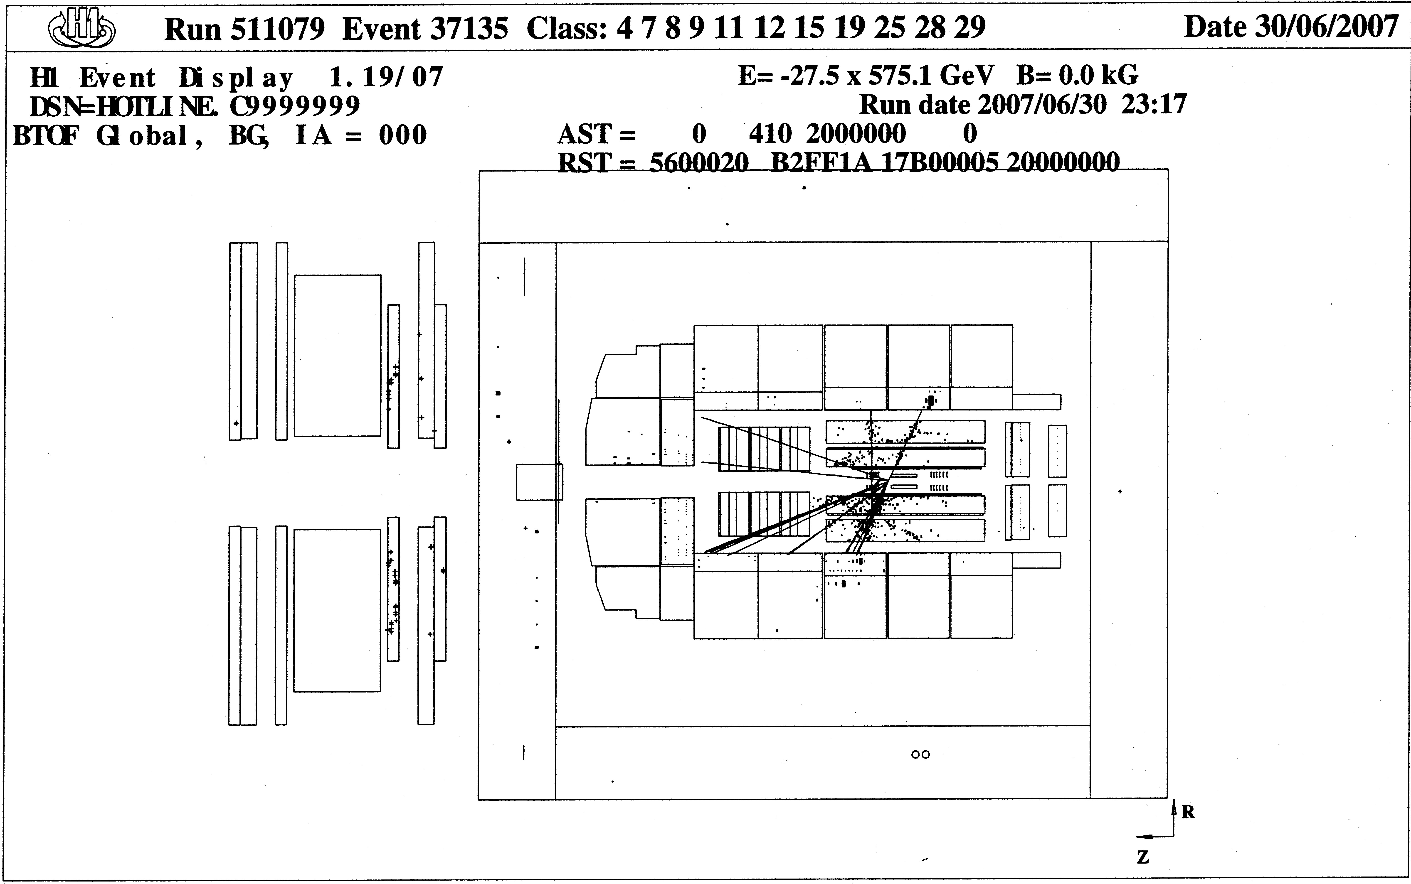
Operation of a Collider Ring
HERA Luminosity Operation:
bad betatron tunes,
coupling, chromaticity
- bad collimator positions
- huge beam emittance
side bunches (particles
in the next rf buckets)
- coasting beam
- bad orbit
- synchrotron radiation
- off energy particles
- many other reasons…
Constant struggle:
Luminosity vs. Background

Slide 9
Operation of a Collider Ring
Luminosity Operation for Operators:
One or two fills per day
Constant attention required
Quick learning curve
Shifts are never boring
bad betatron tunes,
coupling, chromaticity
- bad collimator positions
- huge beam emittance
side bunches (particles
in the next rf buckets)
- coasting beam
- bad orbit
- synchrotron radiation
- off energy particles
- many other reasons…

Slide 10
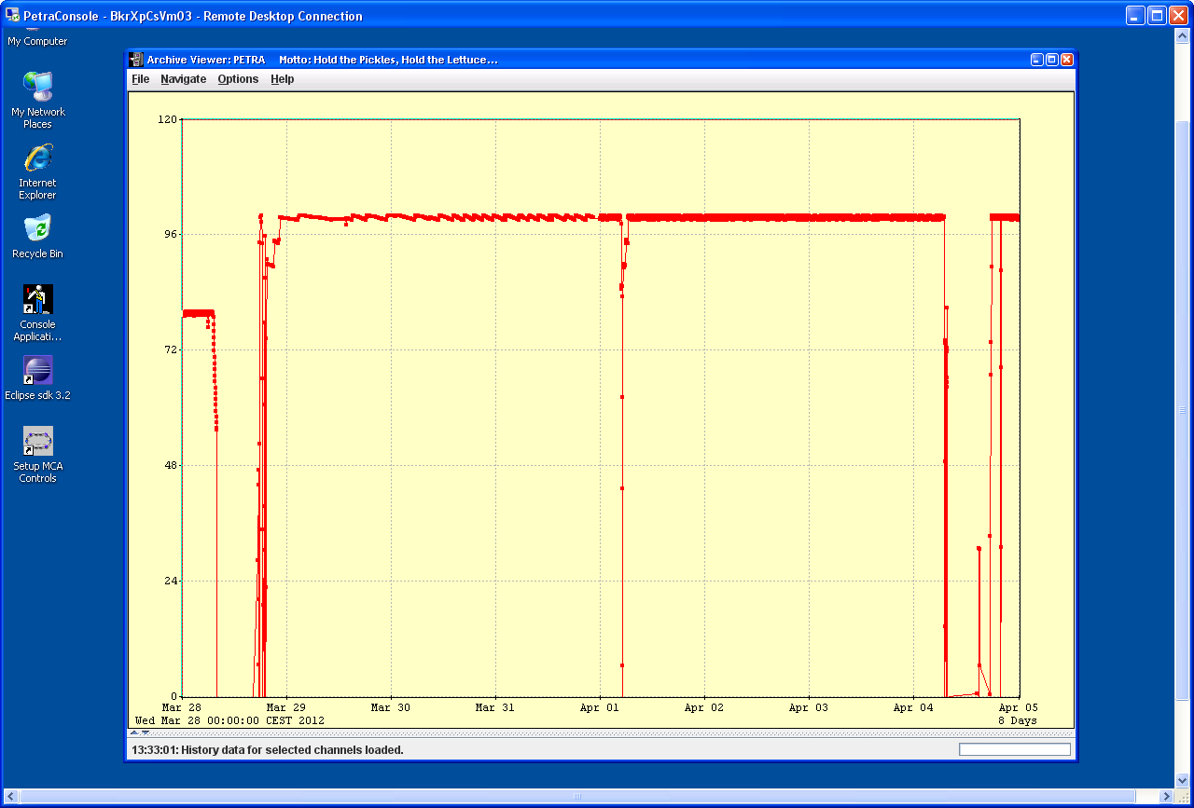
Operation of a Ring Light Source
PETRA Operation for Operators:
1 to 5 fills per week
TopUp operation
Figure of merit: Beam stability
Efficiency ~ 95 %
PETRA Operation
Procedures not well known
Most procedures automated
No optimization during the run
No experience with trouble
Some shifts are boring
Slow learning curve
Beam Current

Slide 11
Operation of a Ring Light Source
PETRA Operation for Operators:
Operators are
overqualified for long, quiet runs without any tuning
potentially under qualified in case of a sudden beam loss
PETRA Operation
Beam Current

Slide 12
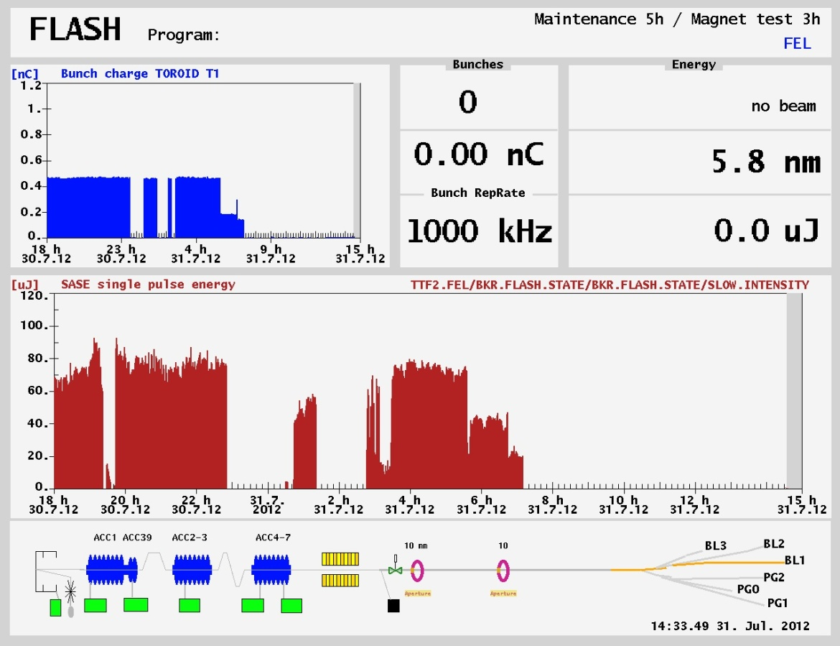
Operation of a SASE FEL
FLASH SASE Operation:
Different output from pulse
to pulse
Many critical parameters
No simple recipes
Not enough automation
Critical procedures
performed by experts

Slide 13
Operation of a SASE FEL
FLASH SASE Operation for Operators:
Procedures not always
successful
Tuning without clear
procedures required
Slow learning curve
Frustration tolerance
required

Slide 14
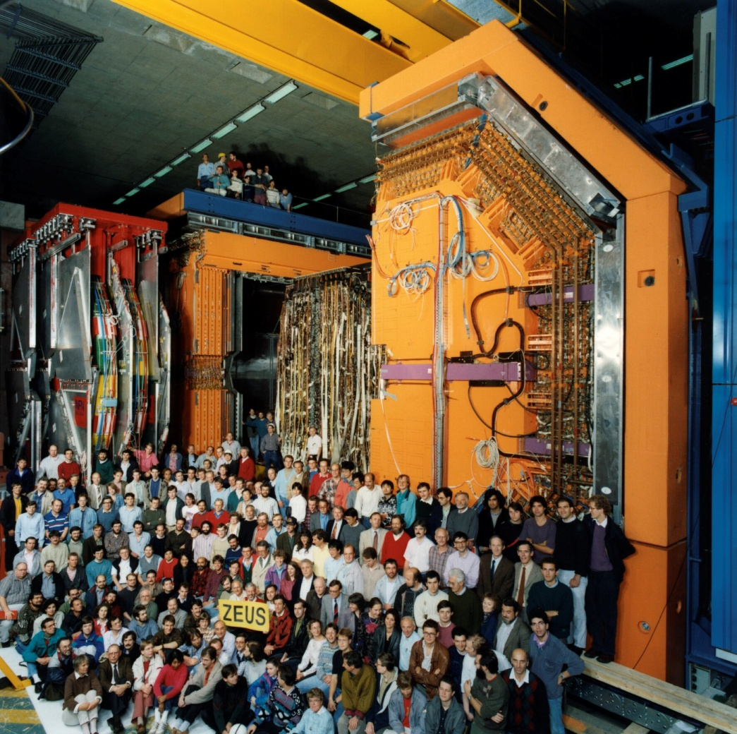
Relations to the Users
HEP Experiments:
Experiments scheduled for
~ 10 years.
Contact persons stay in charge
over years.
~ 4 experiments per machine.
Experimental data (Backgrounds,
lumi,…) visible for operators.
Mutual trust and understanding
can grow.

Slide 15
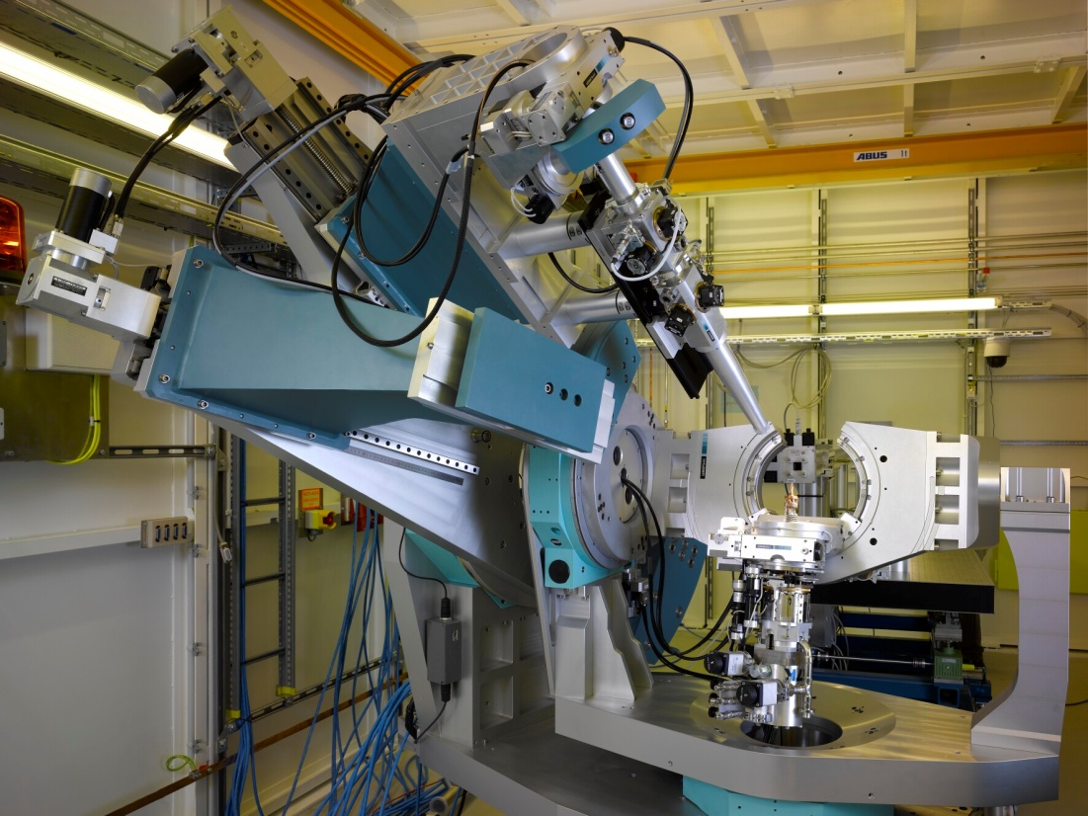
Relations to the Users
Synchrotron Light Experiments:
Experiments scheduled for
~ 10 days. No direct contact
to the users. No user data
visible.
Beamline managers stay in
charge over years.
~ 40 experiments per machine.
Mutual trust and understanding
grows slower.

Slide 16
Operator Satisfaction
Collider Rings:
A shift was good if the experiment has another X nanobarn on tape.
The operator has
tuned the luminosity to a maximum
tuned the background to a minimum
The operator has contributed to these X nanobarn.
Synchrotron Light Sources:
A shift was good if there has been no beam loss.
The operator goes home.

Slide 17
Changes for the Operators
Light sources were introduced over many years at DESY.
The operators learned to handle ring light sources,
but preferred collider rings.
The operators hesitated to operate FLASH, our SASE FEL,
because that was done by experts.
The end of HERA came not unexpected, but it came
nevertheless suddenly. A lot of experience and knowledge
became totally useless from one day to the other.
Now motivation is a problem, as PETRA is not a
challenge and FLASH is too much of a challenge.

Slide 18
Changes for the Operators
What changes were introduced in the control room?
Ring Light Sorces:
More documentation for rare events
During quiet runs side jobs are supported
SASE FEL:
More operator training, more theoretical background
Better procedures and more automation
Integration of operators in machine coordination teams

Slide 19
Conclusion
Operation of a Collider Ring:
Several fills per day
Constant tuning
Much operating experience
Operation of a Ring Light Source:
Long run duration, no tuning
Often boring
Little operating experience
Operation of our SASE FEL:
Constantly changing conditions
Constant tuning
Many critical parameters
Sometimes frustrating
Easy to learn
Ideal for enthusiasts
Satisfying work
Needs good documentation
Needs training of rare events
Needs a side job on quiet shifts
Slow learning curve
Dedicated training shifts
Experts on call
Few volunteers

Slide 20
Conclusion
For DESY in total the transition from HEP
to Photon Science went rather well.
(Photon Science grew slowly over many years,
HEP is still very active at LHC)
Work in the control room has changed:
From routine operation with much tuning to
waiting for a beam loss
tuning without guaranteed success
Some operators are missing the good old days.

