Slide 1
CERN’s Proton Synchrotron complex operation teams and diagnostics applications
Marc Delrieux, CERN, BE/OP/PS
CERN’s Proton Synchrotron (PS) complex
How are we involved?
Review of some diagnostics applications
examples of 3 possible scenarios for operations
Diagnostics 07/08/2012
Workshop on Accelerator Operations
SLAC National Accelerator Laboratory

Slide 2
CERN’s Protron Synchrotron complex (1/4)

Slide 3
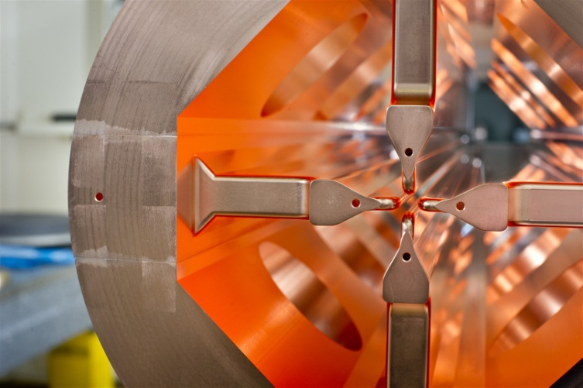
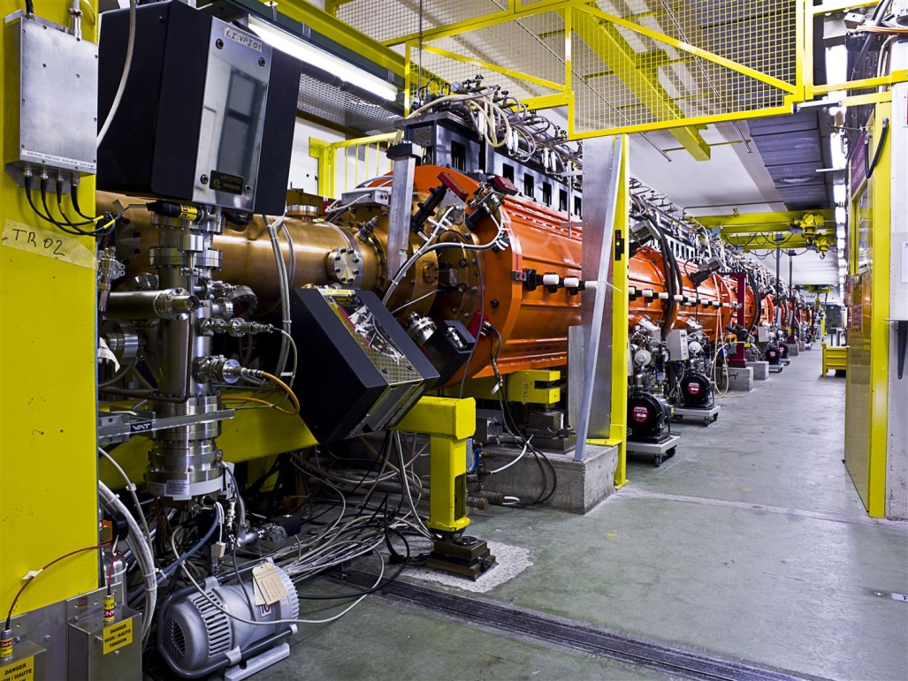
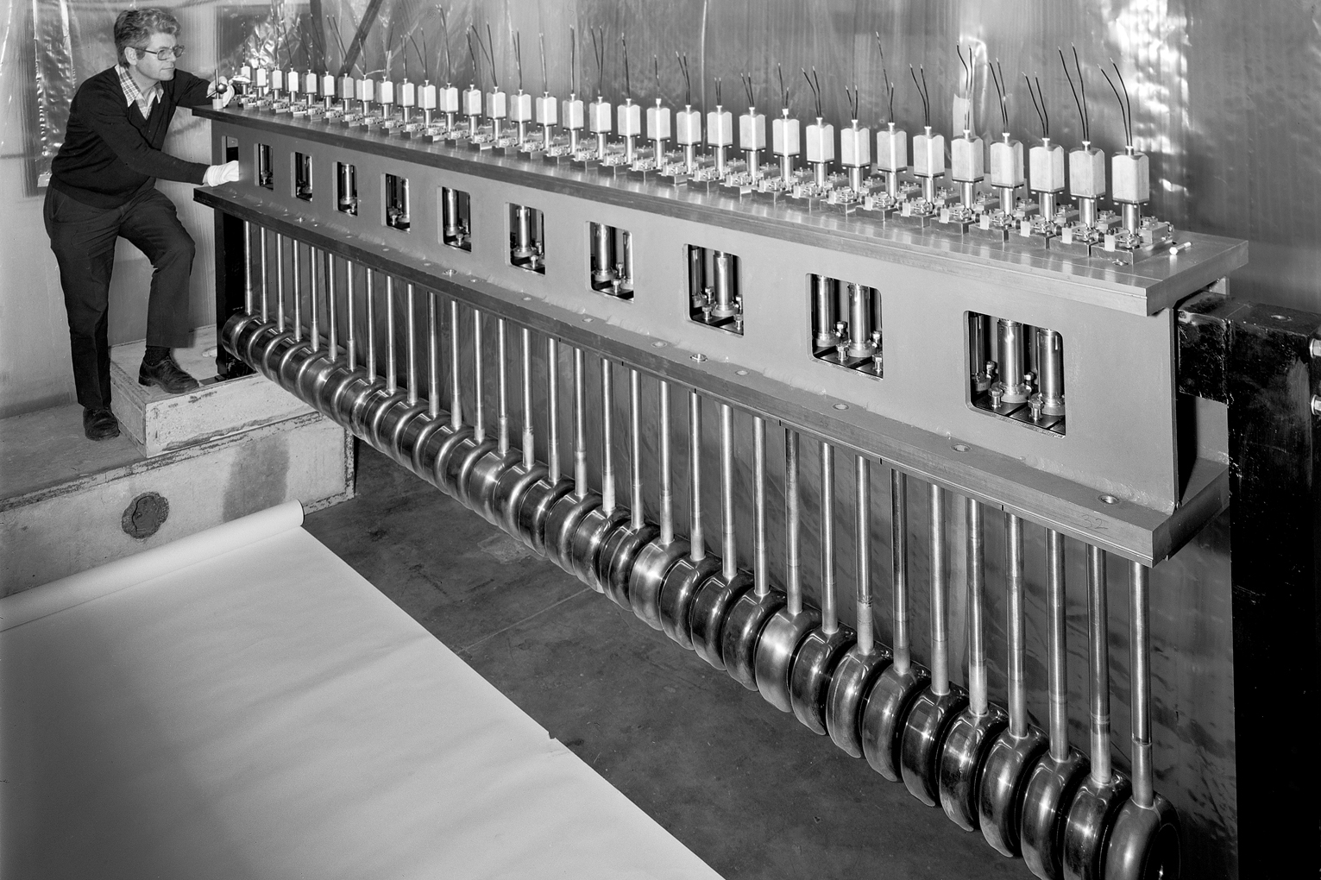
CERN’s PS complex (2/4)
Linac 2, 1978-?
Protons source
Radio-frequency quadrupole
2 buncher cavities (and 1 debuncher)
3 Alvarez drift tubes tanks
Bringing protons to a kinetic energy of 50 MeV, with a beam current up to 180 mA, each 1.2 s

Slide 4
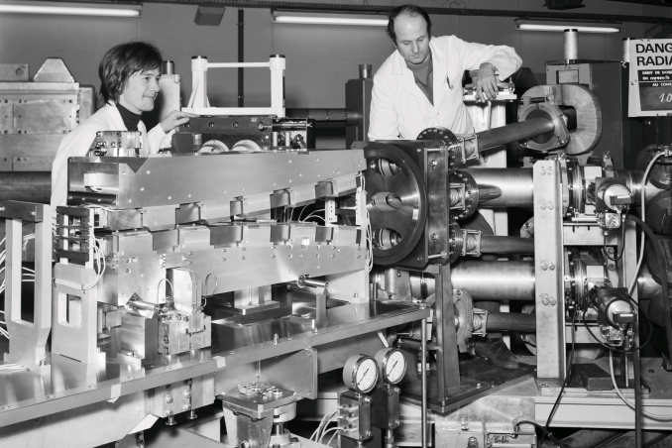
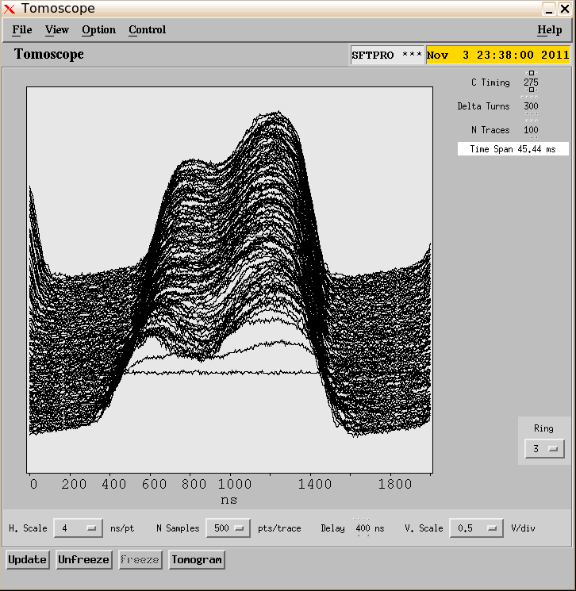
CERN’s PS complex (3/4)
PS booster, 1972-?
4 superimposed synchrotrons of 157 m circumference, injecting a certain quantity of Linac 2’s pulses via a multi-turns injection process
Captures 0, 1 or 2 bunches per ring, hence providing up to 8 bunches to the PS each 1.2 s, with a kinetic energy of 1.4 GeV
Wide intensity spread: 5E09-4E13 protons per cycle
A dedicated experimental area (ISOLDE), which consumes almost 40% of produced cycles (and a huge quantity of protons!)
Space charge effects, tune shift
Critical for intensity and transverse beam
characteristics (hence LHC luminosity)

Slide 5
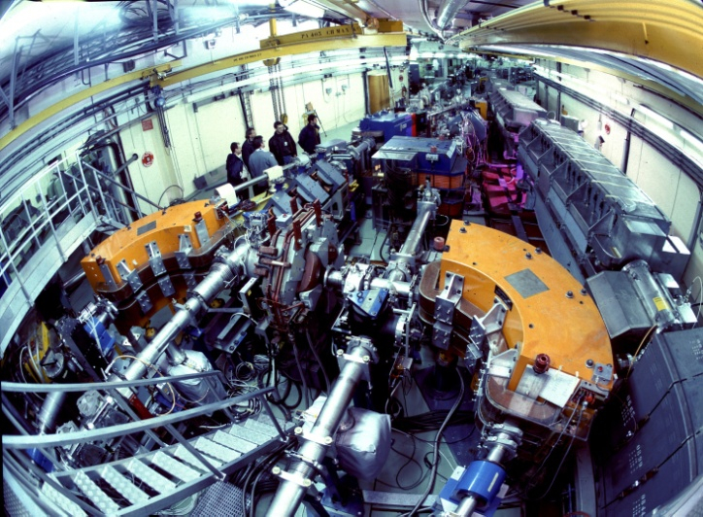
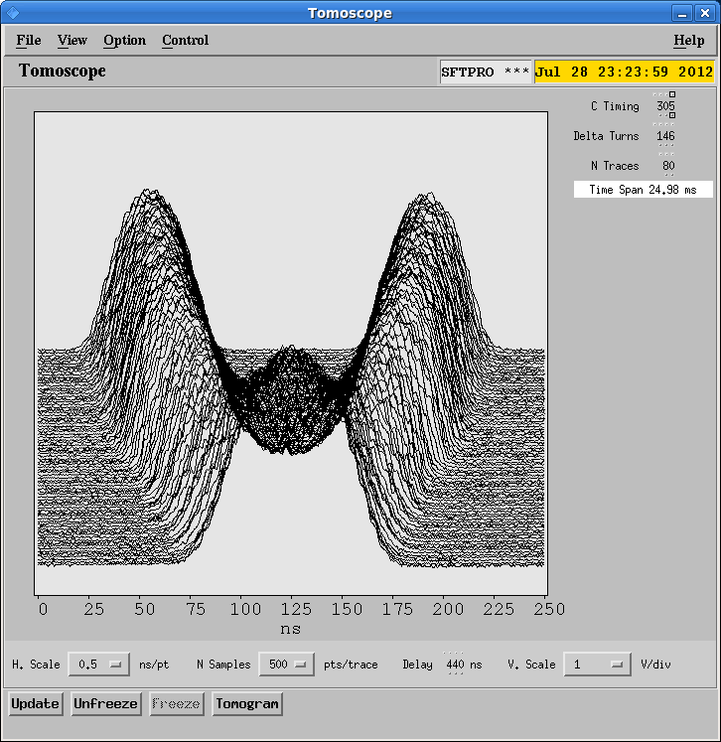
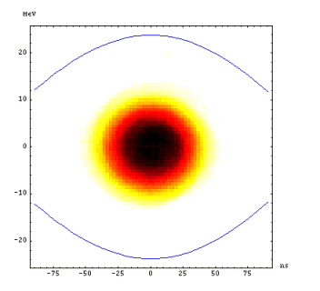
CERN’s PS complex (4/4)
Proton Synchrotron, 1959-?
Has accelerated/decelerated
Protons/antiprotons
Ions
Electrons/positrons
Combined-function magnets
Very versatile Radio-Frequency system
accelerating cavities (3.3-10 MHz)
“gymnastics” cavities (20, 40, 80, 200 MHz).
Wide harmonics range (h7 to h420), numerous manipulations
bunch splitting, bunch merging, batch compression, batch expansion, bunch rotation…
Various extraction energies (up to 26 GeV)
All operational beams cross transition (Transition energy 6.1 GeV).
Fast, slow, and multi-turn extractions (5 turns continuous transfer…)
Critical for longitudinal beams characteristics.
Dedicated experimental areas (East Hall, nTOF), and other client machine (Antiproton Decelerator)
The ions LHC injectors chain also involves Linac3 and LEIR (Low Energy Ion Ring) but these are not operated by PS teams

Slide 6
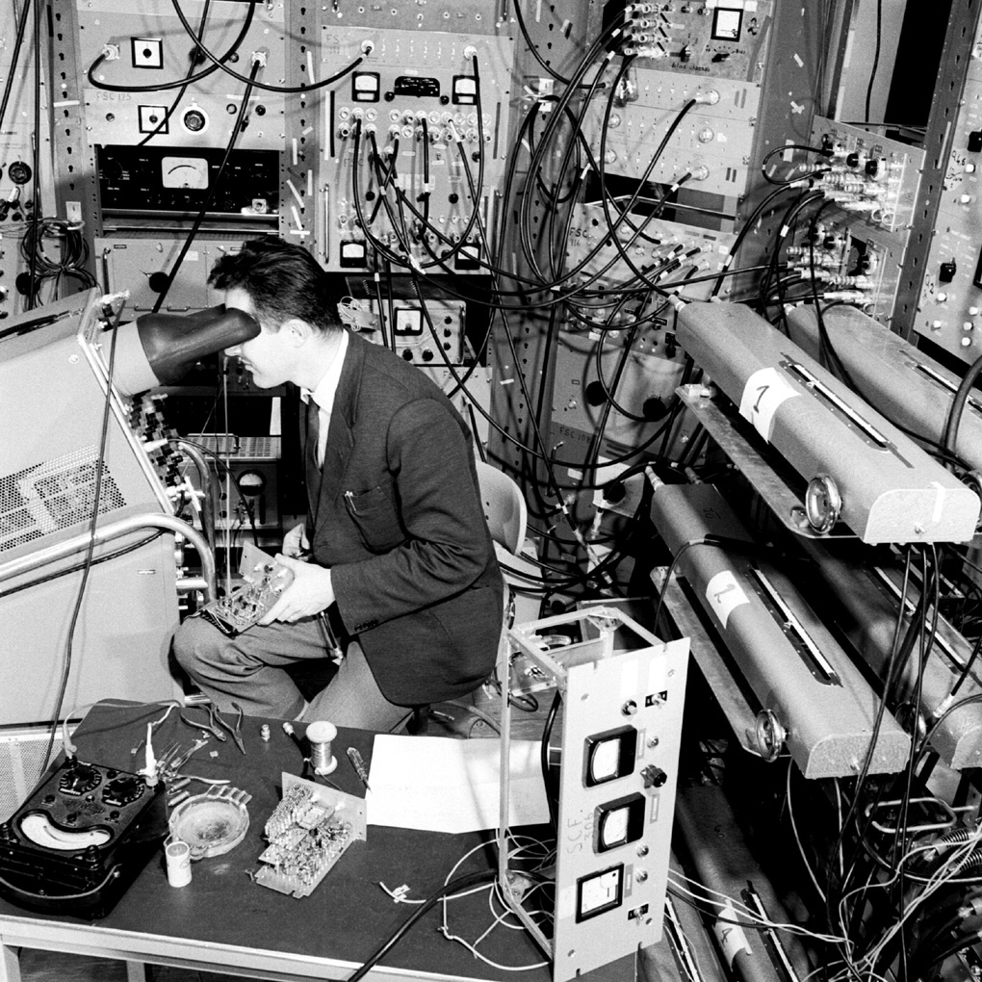
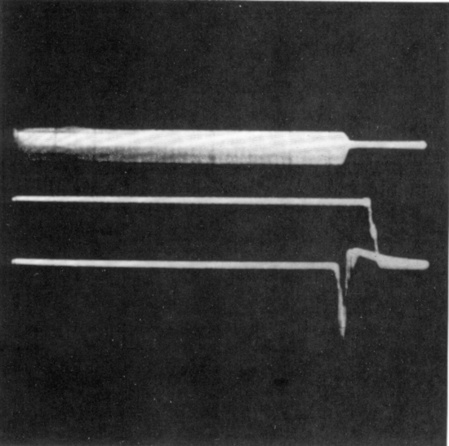
How are we involved in applications?
Since 1959, some of our applications have slightly evolved…
Groups developing applications
Controls
Beam instrumentation
Operation
Each shift leader is linkman for a certain topic
Analogue signals observation
Beam intensity measurements
Longitudinal profile measurements
Beam losses measurements
Orbit measurements and corrections
Transverse profile measurements
Working point
Magnetic cycles
…and also: Controls system, power converters and magnets, beam documentation, Frequency domain measurements, Timing and sequencing, safety…
A linkman’s tasks: write specifications, test applications, report issues, follow-up, train fellow operators, ensure the applications fulfill expectations
A tool for follow-up: from our e-logbook, “report OP issues”

Slide 7
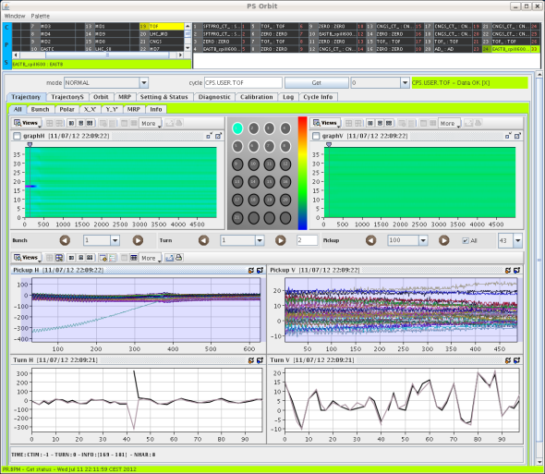
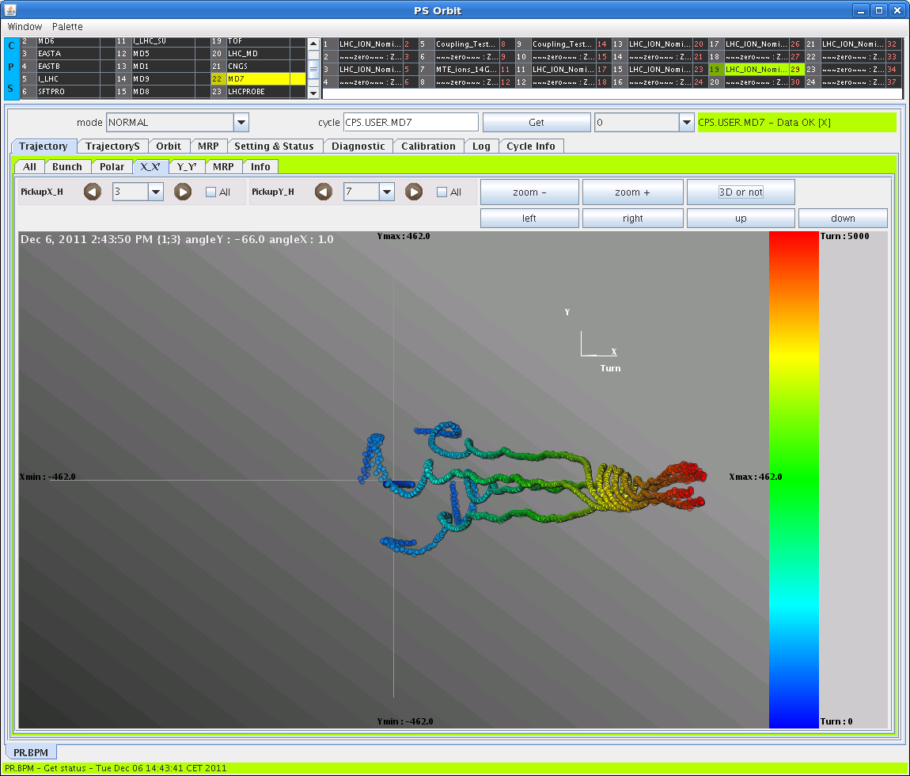
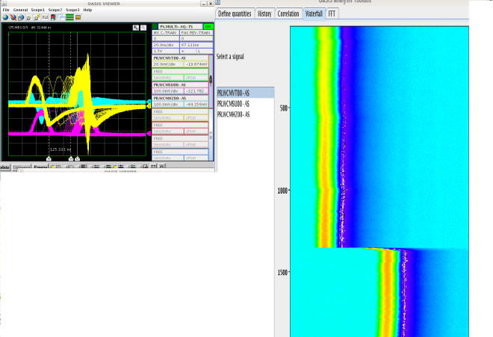
1st (most frequent) scenario: let them do the job
PS orbit (Beam Instrumentation)
40 pick-ups, up to 200 000 measurements
Trajectories (turn-by-turn, bunch-by-bunch),
orbits, mean radial position, phase space reconstruction
OP input permanently necessary
Succession of harmonics for gates
Very good reaction and follow-up
Analog signals
>1800 signals
OP functionalities
Memory, survey…
Multi-triggering and analysis
Piquet service

Slide 8
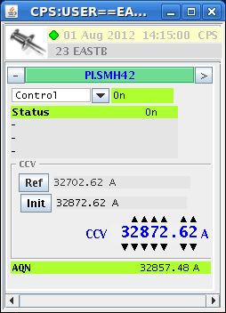
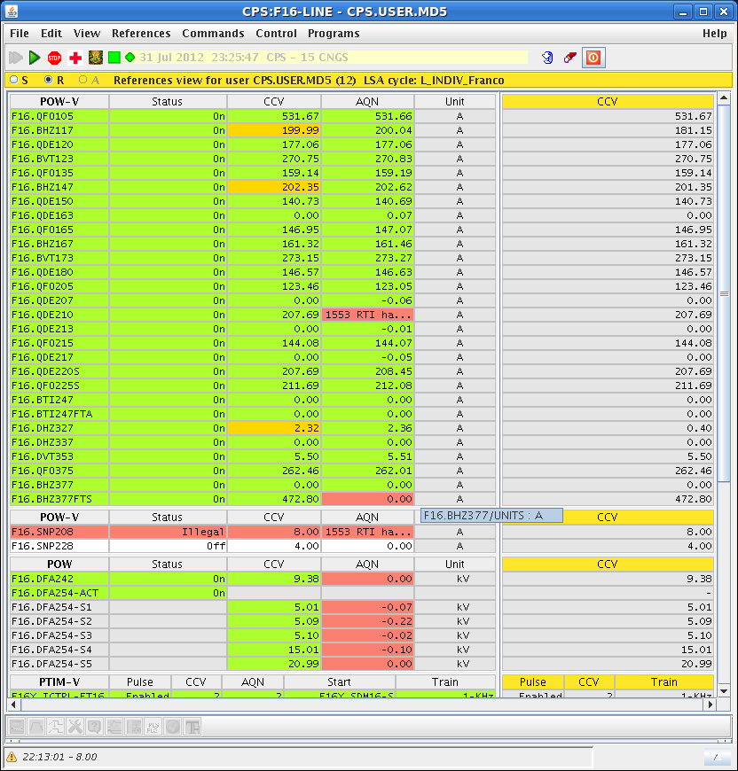
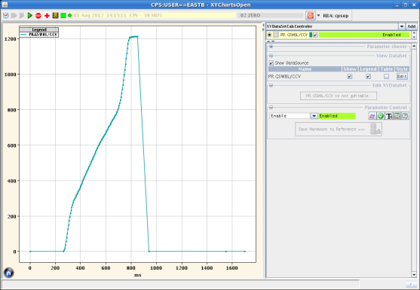
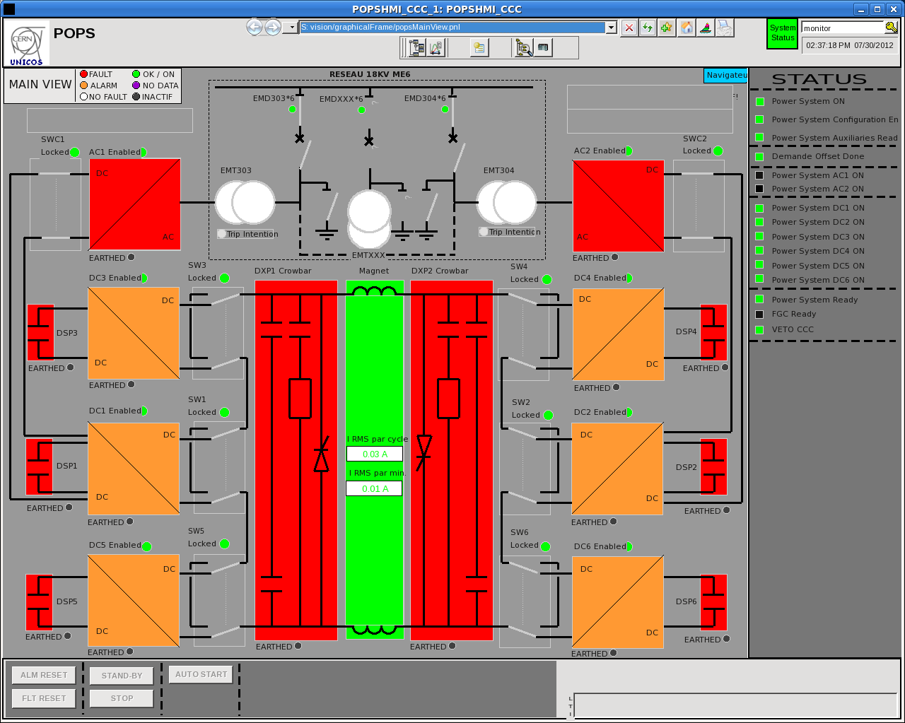
1st (most frequent) scenario: let them do the job
Controls system
Knobs and working sets
Analog functions editor
OP requirements
Piquet service
Equipment groups
PS main power supply
Specialists application and interface
but adapted following OP requirements

Slide 9
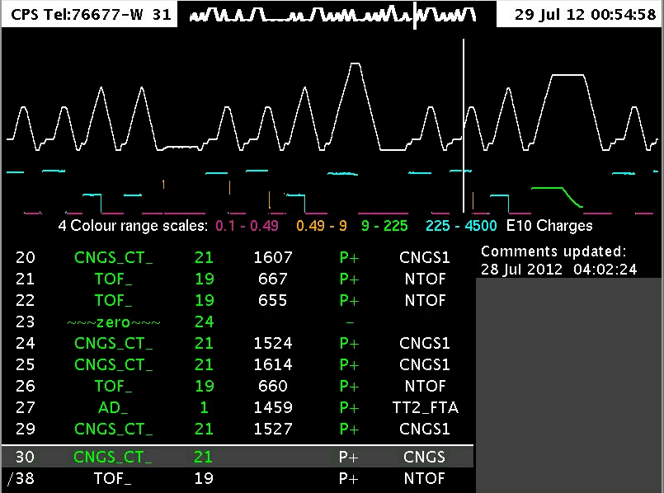
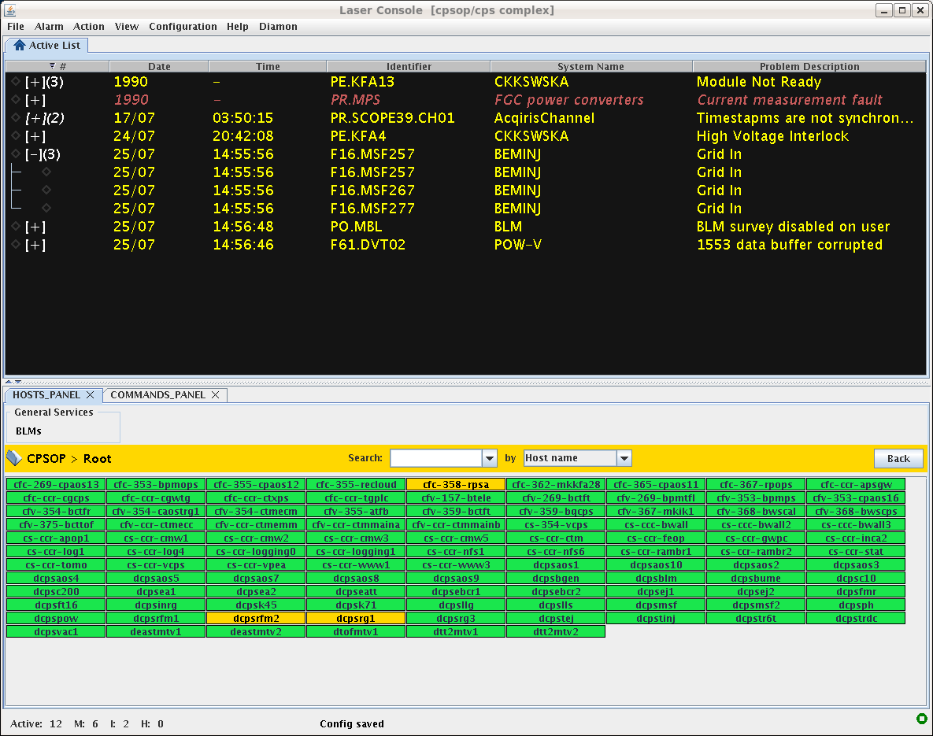
1st (most frequent) scenario: let them do the job
Fixed displays
OP requirements to help fast diagnostics
Intensities, magnetic cycles, destinations, particles types…
Alarms
Adapt an already existing program to PS complex
Integrate commands
Integrate frontends monitoring

Slide 10
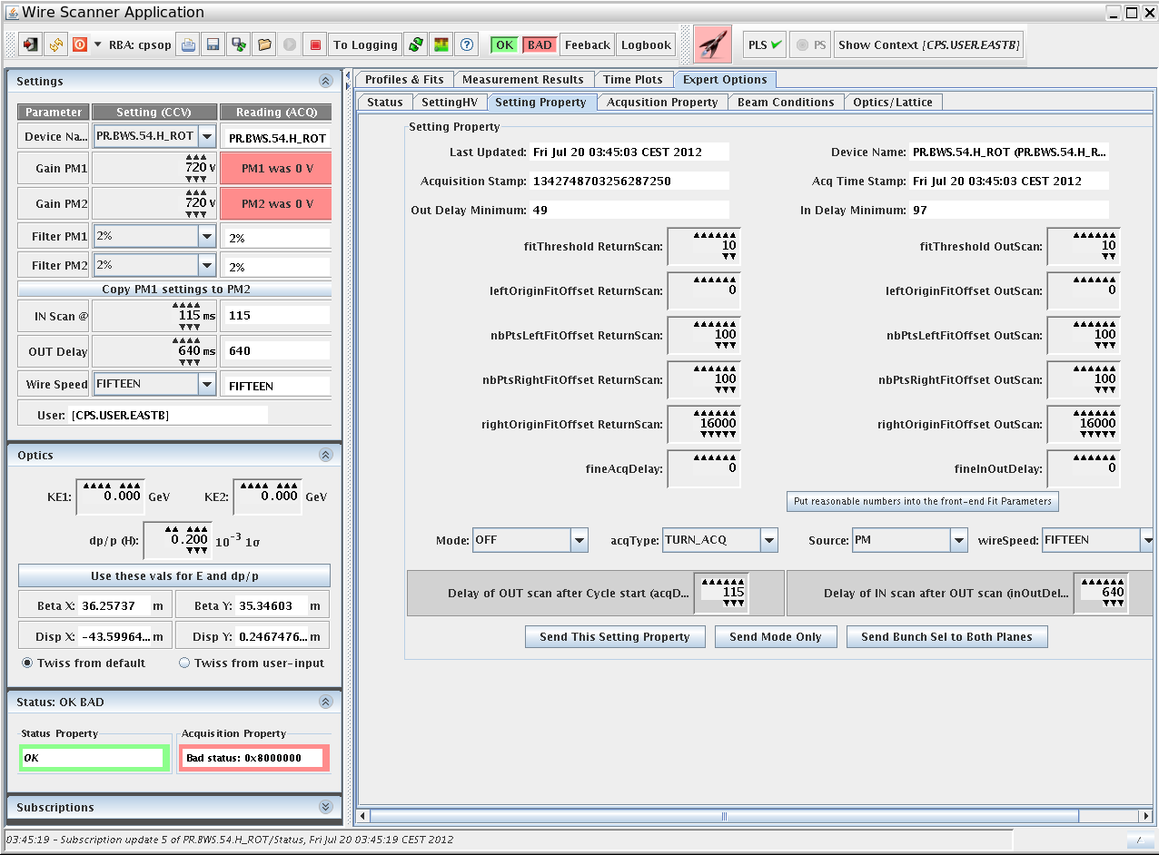
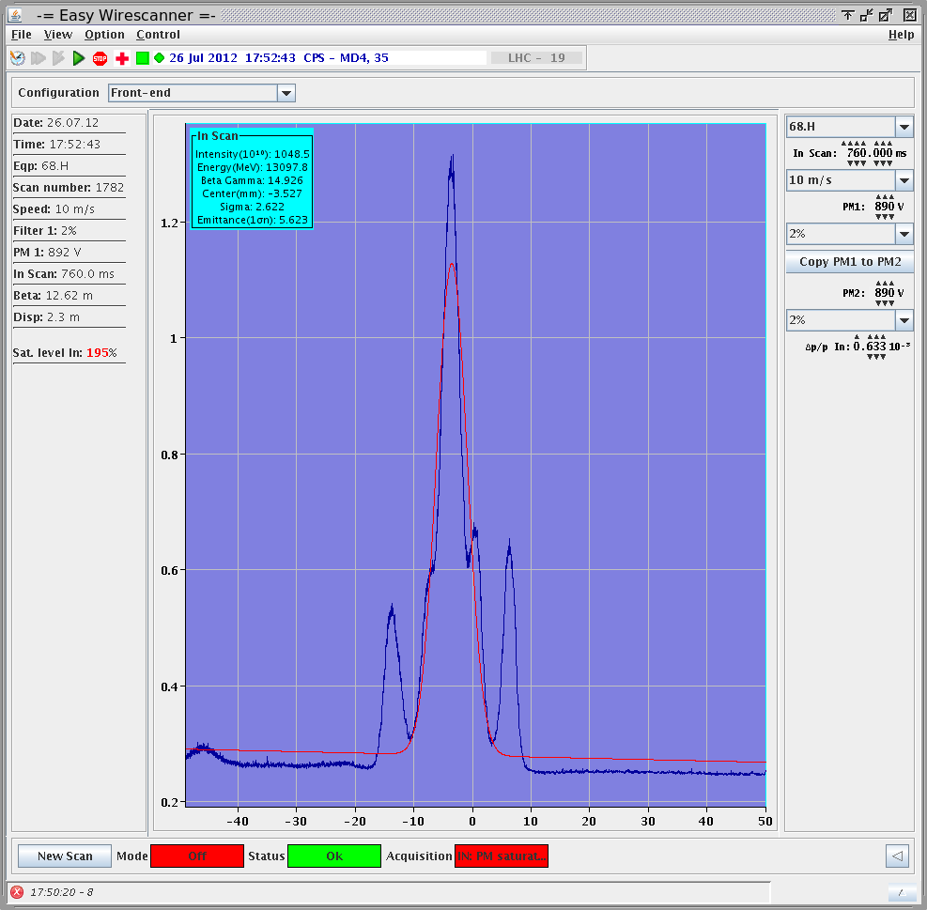
2nd scenario: adapt application
to your needs
In general CERN-(too)-generic applications
LHC is so different from our small pulsed accelerators!
Development for LHC is the priority
So many different beams = so many different settings
Exotic processes and manipulations
Wire scanners, tune and chromaticity measurements…

Slide 11
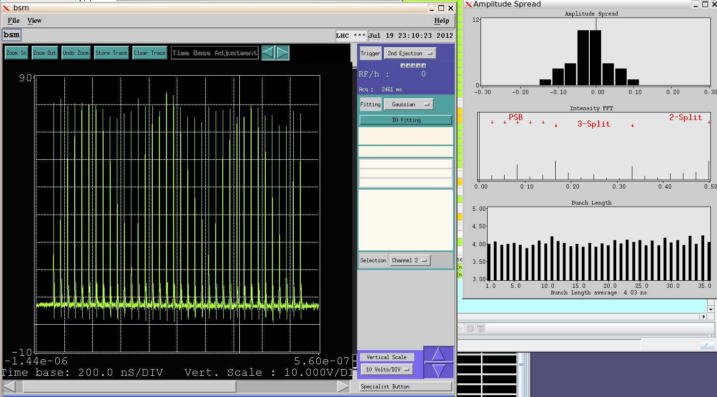
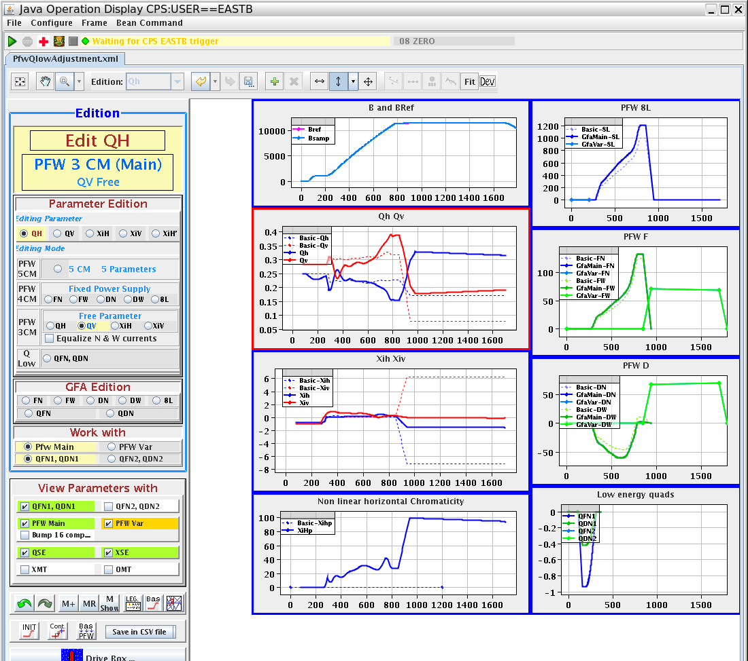
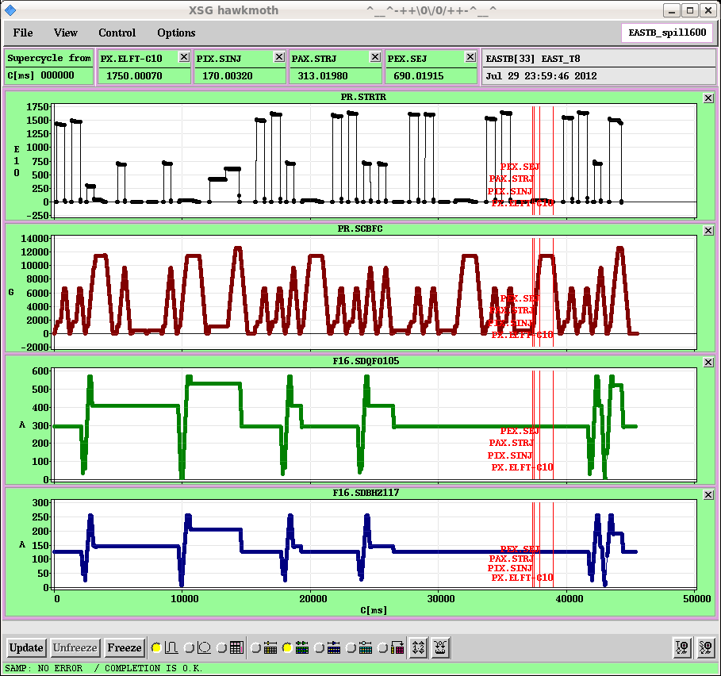
3rd scenario: do it yourself
Specific, dedicated applications
RF gymnastics
Bunch shape measurements
Working point control
Combined-functions magnets
+ additional windings
+ low-energy quadrupoles
Pulsed accelerators
Samplers
Requires heavy maintenance
In any case, you have to use controls tools and follow their standards

Slide 12
Conclusions
If you have a dedicated controls/applications group
Try to get involved as early as possible
Write specifications
Find compromises
Make sure developers do what YOU want
Ask a piquet service for applications YOU consider critical
Make sure you have efficient issues reporting tools
If some operators are able to code (and no one gets offended)
Either adapt existing applications to your needs
Or do 100% of the work…but OP can’t provide the same infrastructure as a dedicated group
Thank you for your attention, and…how do you get what you want?

