Slide 1
Optimizing X-ray FEL performance for LCLS at SLAC
Sean Kalsi on behalf of SLAC MCC operations group, WAO August 8, 2012

Slide 2
Outline
Free Electron Lasers
LCLS Overview
Deliverable X-Ray Parameters
Setting Up the Machine
Tuning Methods
FEL Performance
References
Supplemental Information

Slide 3

Free Electron Lasers

Slide 4
Introduction to Free Electron Lasers
  FEL uses a bunch of unbound electrons
  Amplification of stimulated emission due to a resonance condition
  Resonance condition setup with Electron/Radiation interaction in array of undulator magnets
  Why use FEL?
  High Power (GW)
  Coherent Beam
  Short pulses(fs)
  High spatial and temporal resolution of Atomic and Molecular Processes

Slide 5
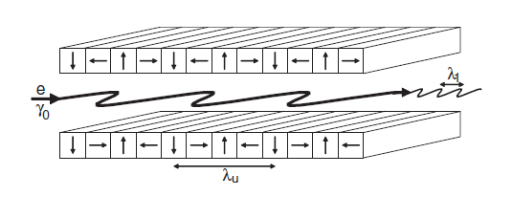
Introduction to Free Electron Lasers
Start with electron bunch entering periodic undulator array
Electron will emit radiation spontaneously as it traverses the undulator

Slide 6
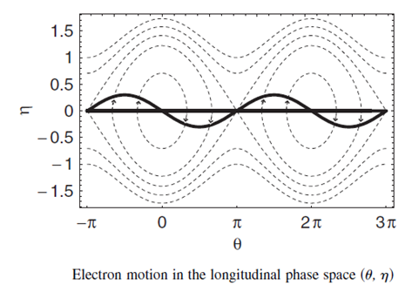
Introduction to Free Electron Lasers
Once enough X-Rays produced the co-propagating photon bunch will micro-bunch the electron beam
Micro-Bunched electron beam will then emit radiation coherently to amplify and produce the FEL
This process of generating an FEL is called Self Amplification by Stimulated Emission(SASE)

Slide 7
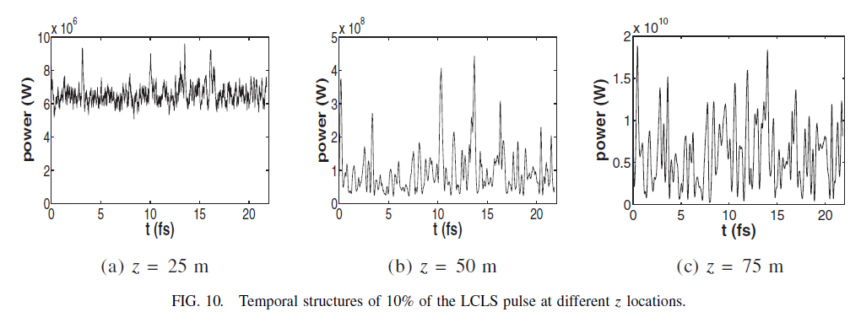
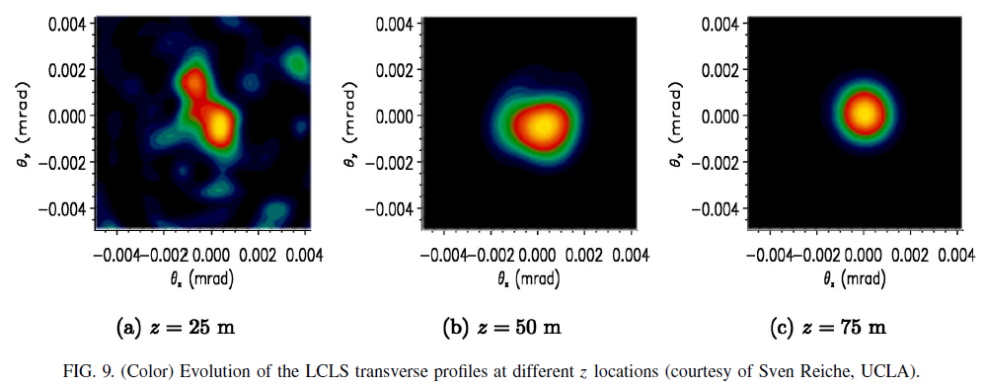
Introduction to Free Electron Lasers
Poor Temporal Coherence(only coherent in each spike):
Hundreds of ~fs spikes make
up FEL pulse due to SASE
Intensity builds up along
length of Undulator
Good Transverse Coherence:
Coherence builds up along
length of the Undulator

Slide 8
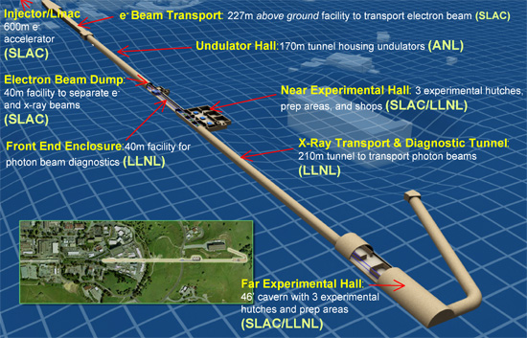
Introduction to LCLS

Slide 9
Introduction to LCLS: Electron Transport
120Hz Pulsed Bunches using 2856MHz RF
RF Gun(6MeV), UV Drive Laser, Photo-Electric Emission
Cu Cathode, 20-350pC, 300-600µm Bunch
Laser Heater(controlling slice energy spread)
1st Bunch Compressor(factor of ~10) BC1
2nd Bunch Compressor BC2
Compress down to 0.5-10+µm(2fs-300fs)
gun
4 wire
scanners
+ 8 coll’s
4 wire
scanners
+ 6 coll’s
L0
TCAV0
L1X
3 wires
2 OTR
3 OTR
vert.
dump
heater
L1S
stopper
3 wires
3 OTR
σ_{z1}
σ_{z2}
μ wall
L2-linac
DL1
135 MeV
BC1
220 MeV
stopper
BC2
5 GeV
TCAV3
L3-linac
BSY
3-15 GeV
DL2
undulator

Slide 10
Introduction to LCLS: Photon Transport
6
AMO
SXR
XPP
XCS
CXI
MEC
Front End Enclosure(FEE):
Gas Detectors, Slits,
Attenuators, K-Mono,
Direct Imager
Near Experimental Hall Hutches:
AMO & SXR (Soft X-Rays)
XPP (Hard X-Rays)
Far Experimental Hall Hutches:
XCS, CXI & MEC (Hard X-Rays)
6 Total Experiment Sites

Slide 11
Deliverable X-Ray Parameters

Slide 12
LCLS User Parameter Space
Photon Energy
480eV to 10.6keV
Photon Pulse Length
2 to 300+ fs
Energy Bandwidth
0.2% (narrow) or 2%(wide)
Normally 2+ Configuration Changes Per 24/hours. For now 1 user at a time, switch every 12 hours

Slide 13
Setting up the Machine

Slide 14
Setting up the Machine
Keys to FEL Performance
Lowest Electron Transverse Emittance
Optimal Electron Bunch Length
Slice Energy Spread Sufficient to Generate SASE
Optimal Undulator Configuration

Slide 15
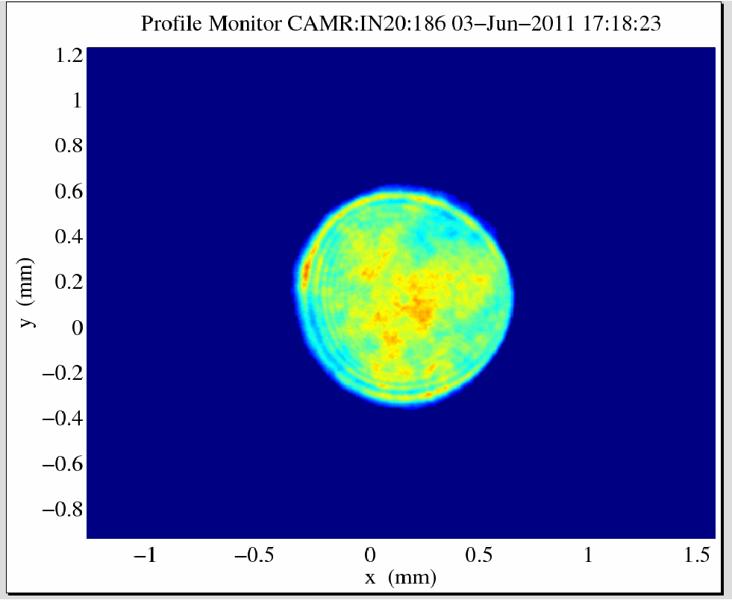
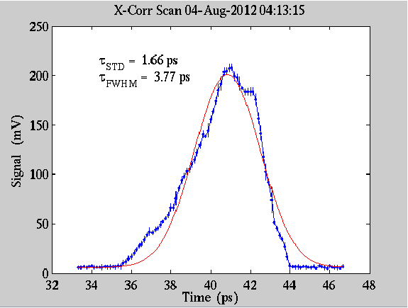
Setting up the Injector
Starting point for good emittance is quality of beam off the cathode
UV Drive Laser Transverse and Temporal Quality
Scan Cathode to find optimal QE and Emittance spot

Slide 16
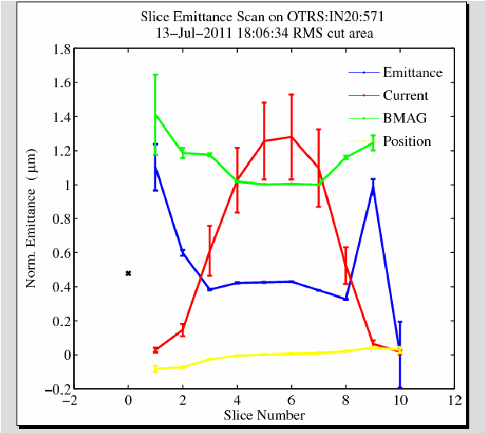
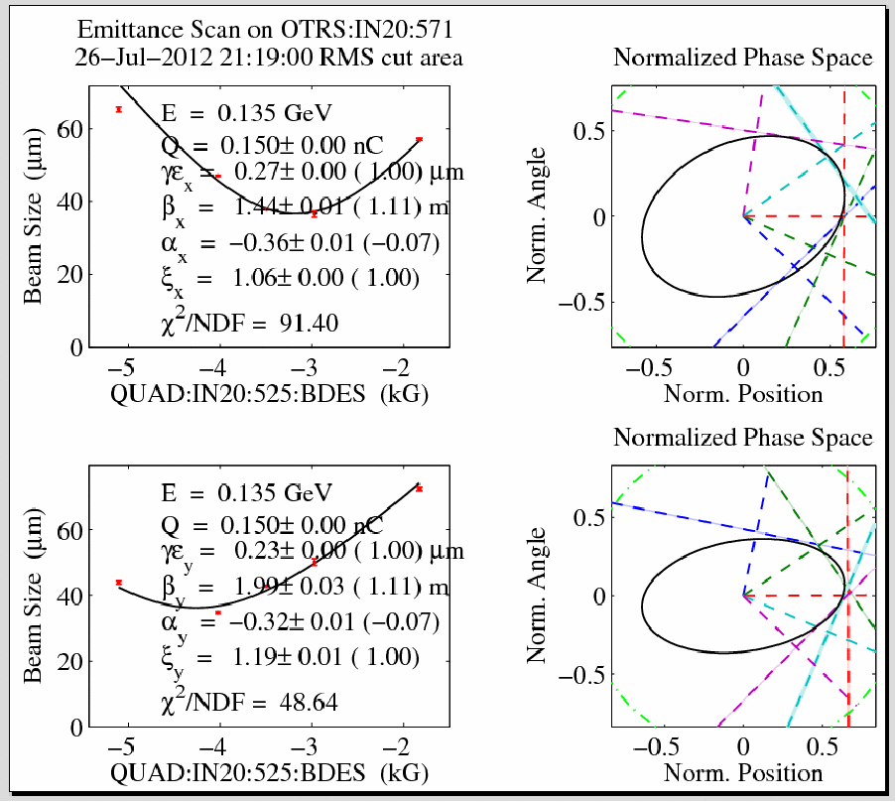
Setting up the Injector
Use injector optics to tune for best transverse emittance
OTR Screens and Wire Scanners for beam size measurements
Can also examine slice emittance in X plane
Clue about temporal quality of laser

Slide 17
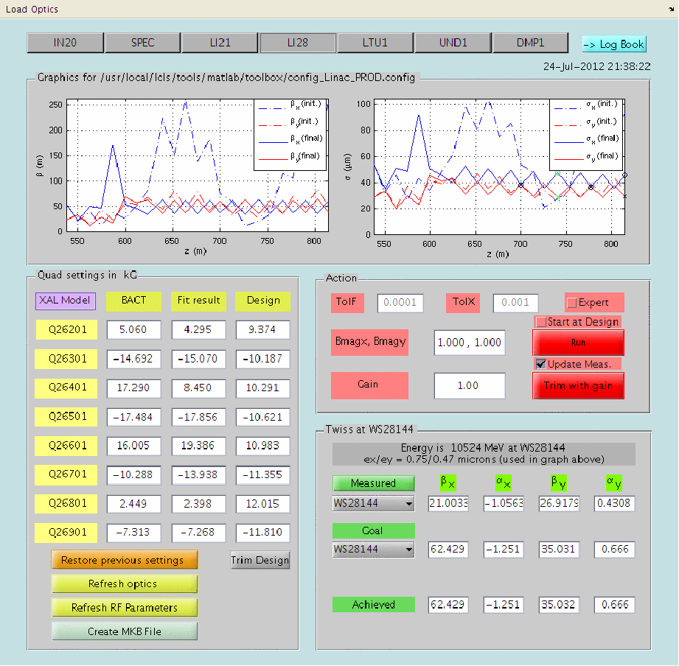
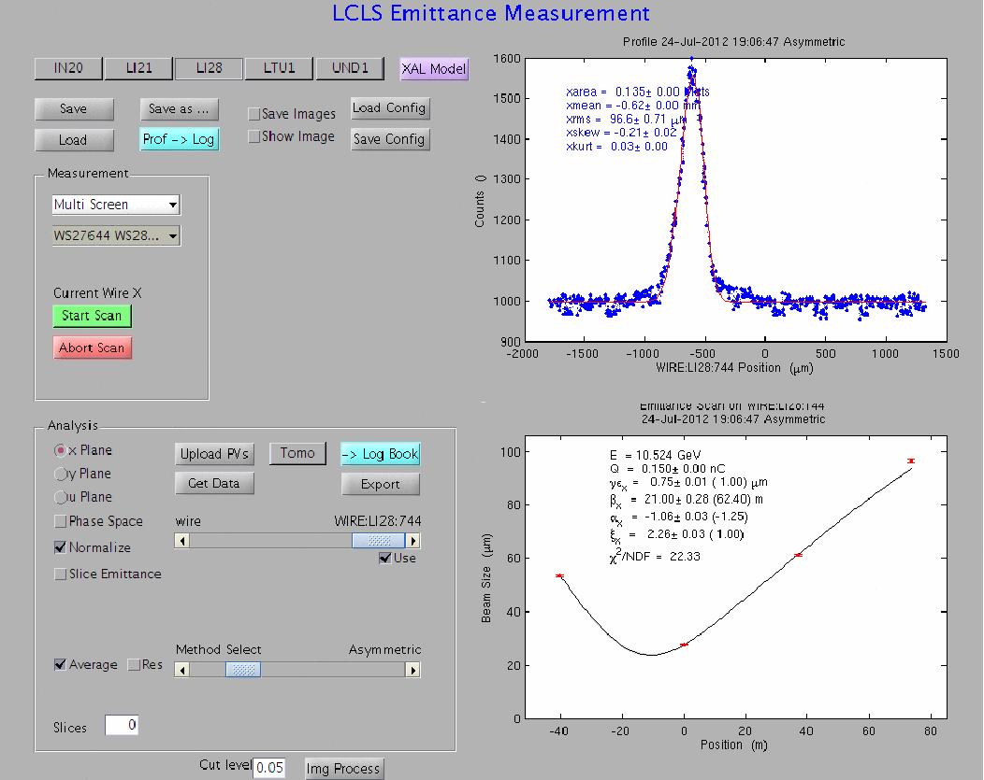
Setting up the Linac
Goal: Preserve Injector Emittance
Emittance Measurement Points(wires): After 1st and 2nd bunch compressor , then upstream of Undulator
Steer to Flat Orbit in Linac and Linac to Undulator Region
Beta and Dispersion Match

Slide 18
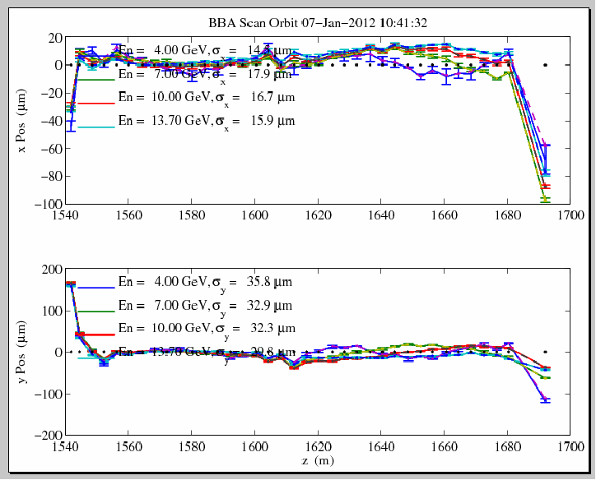
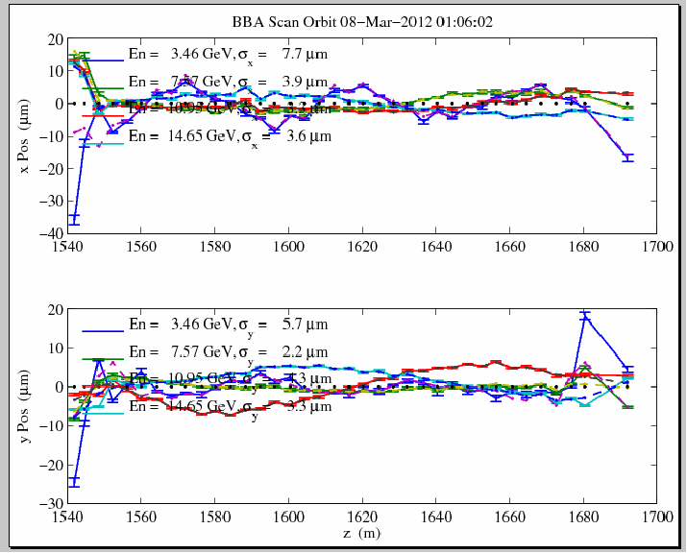
Setting up the Undulator
Goal: Keep the Electrons aligned with the X-Rays
Beam Based Alignment at 4 energies to find flattest trajectory
Uses all 33 Undulator BPM’s and Undulator Quads
Offsets in RF BPM’s drift due to electronics issues

Slide 19
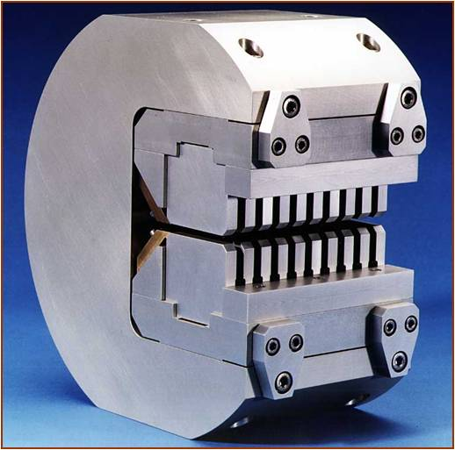
Setting up the Undulator
Undulator Translation Stage: Moves Horizontally to vary magnetic field value in each segment(use for Taper)
Pole Faces are tilted slightly
Field varies(K value)
Horizontally in position along pole face
Beam Entrance

Slide 20
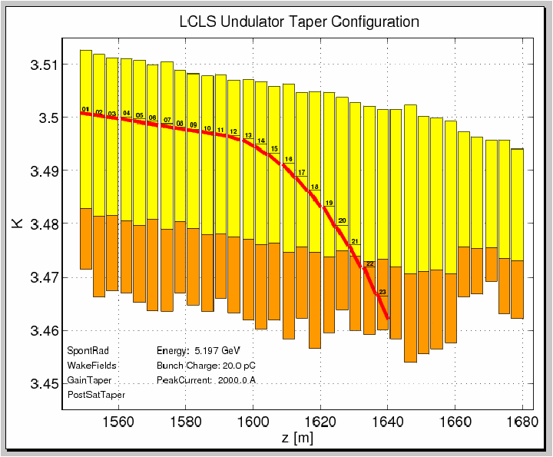
Setting up the Undulator
Undulator Taper: Needed to match Undulator Field to electron bunch that is losing Energy to FEL creation
Quadratic taper in post saturation regime
Helps maintain resonance condition after saturation
Linear Taper in Exponential Gain Section

Slide 21
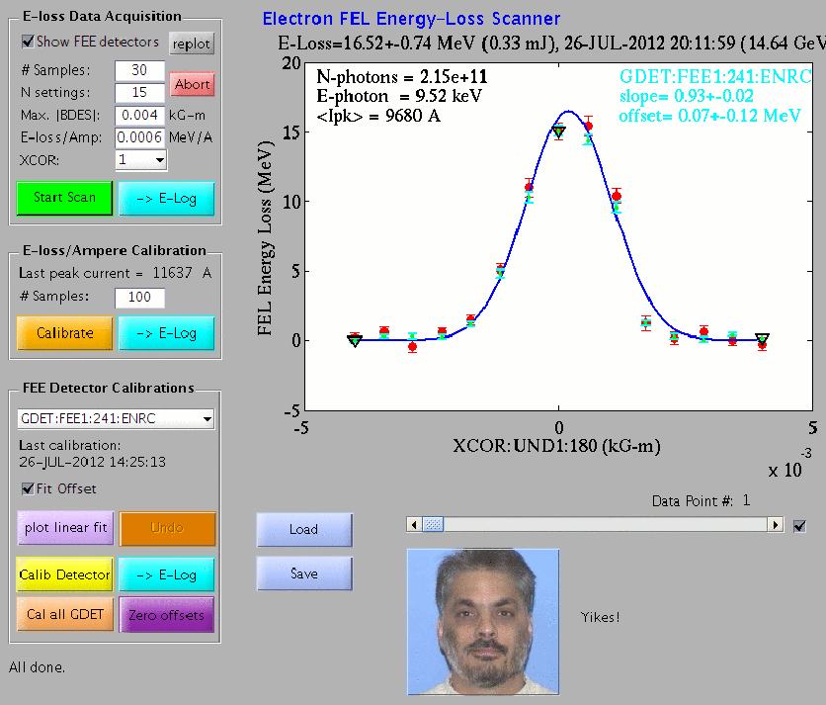
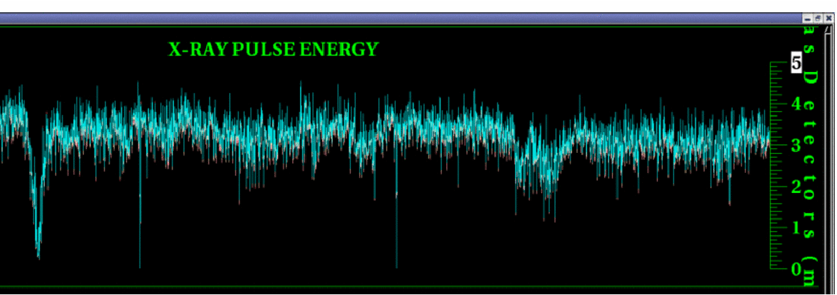
Measuring the FEL Intensity
Start by measuring Energy Loss of Electron Bunch across Undulator
Suppress FEL by kicking with first corrector in the Undulator
Then Calibrate the Gas Detectors measuring the FEL pulse
FEL interacts with GAS emitting photons picked up by PMT’s(minimally invasive)
Use FEE Gas Detector display for real time Pulse Energy Information, and Tuning

Slide 22
Tuning Methods

Slide 23
Tuning Methods
Capability for Minimally Invasive Tuning
Many experiments can handle tuning while beam is delivered
Most gains are made in FEL pulse energy in this mode

Slide 24
Tuning Methods
Often Design Quad settings do not produce Best FEL
Start by setting up to design lattice, but sometimes we can double the FEL by
going off design
Use Beta and Dispersion Matching Quads to tune
Drawback: Reproducibility
Laser Profile Steering
Start with uniform transverse profile, altering the profile will change bunch
profile off of the Cathode
Undulator Taper Tweaks
The better you can match the energy loss profile the more FEL you can produce
Has a dependence on charge, energy, and bunch length

Slide 25
Tuning Methods
Pulse Length in BC1 and BC2
Can optimize directly on FEL Pulse Energy
Difficulties:
More Compression leads to more Energy Spread, which leads to more Jitter
Pulse lengths of ~10 fs require lower charge which means less FEL power
Closed Bumps in Early Linac Orbit
Possible transverse wake field effects in the early part of Linac
Can use feedback setpoints or closed orbit bumps to compensate

Slide 26
FEL Performance

Slide 27
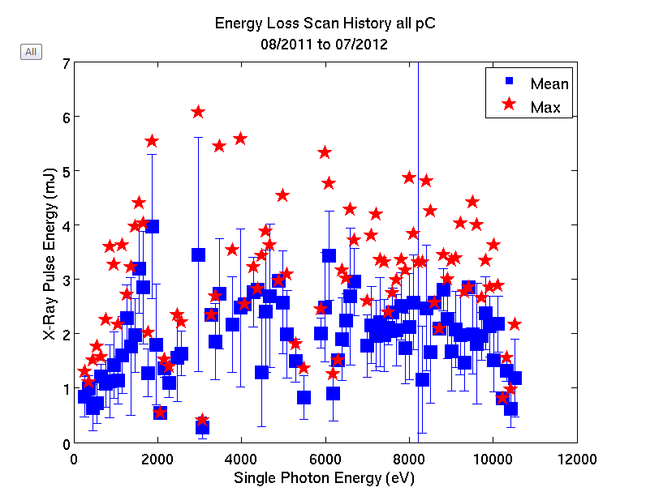
FEL Pulse Energy vs. FEL Photon Energy
Note: Gaps around 3 and 5.5keV are due to lack of statistics

Slide 28
Sources of Information and Figures
LCLS Physics:
A. Brachmann, W. Colocho, F. J. Decker, D. Dowell, P. Emma, J. Frisch, Z. Huang, R. Iverson,
H. Loos, H.D. Nuhn, J. Turner, J. Welch, J. Wu, F. Zhou
LCLS Control System and Diagnostic GUI’s
D. Fairley, J. Frisch, N. Lipkowitz, H. Loos, L. Piccoli, M. Zelazny
MCC Operations Group:
S. Alverson, L. Alsberg, T. Birnbaum, C. Blanchette, A. Egger, M. Gibbs, R. Gold, A. Hammond, C. Hollosi, S. Kalsi, C. Melton, L. Otts, B. Ripman, B. Sampson, D. Sanzone, A. Saunders, P. Schuh, H. Smith, T. Sommer, M. Stanek, E. Tse, J. Warren

Slide 29
References
1.) LCLS Undulator PRD 1.4-001-r4, H. D. Nuhn et al. 5/2008
2.) Tapered Undulators for SASE FEL’s, W. Fawley, Z. Huang et al. 9/2001
3.) Measurements of the LCLS laser heater and its impact on the
x-ray FEL performance, Z. Huang et al. SLAC-PUB-13854, 2009
4.) X-Band RF Harmonic Compensation for Linear Bunch Compression in the LCLS, P. Emma, 11/2001
5.) Link for LCLS Area Physics Requirement Documents:
http://www-ssrl.slac.stanford.edu/lcls/internals/documents/prd/
6.) A Review of X-ray Free-Electron Laser Theory, Z Huang, K. Kim, ANL-AAI-PUB-2007-002,December 2006
7.) FEL SPECTRAL MEASUREMENTS AT LCLS, J. Welch et al. Proceedings of FEL2011, Shanghai, China

Slide 30
END, Thanks!

Slide 31
Supplemental Information

Slide 32
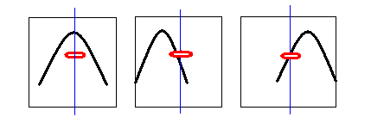
Bunch Compression at SLAC
Setting Chirp(to create compression in a Chicane)
The head of the bunch needs lower energy than the tail. So RF phase is shifted negative. This will cause the head to take a longer path(effectively slow down), and the tail to take a shorter path(effectively speed up) through the chicane, leading to longitudinal compression.
Horizontal is RF Pulse
Vertical is Z position in DLWG
Fig 1: Beam in center of DLWG; RF phase = 0 Deg.
Fig 2: Beam in center of DLWG; RF phase = -20Deg.
Fig 3: Beam in center of DLWG; RF phase = +20 Deg.
Blue line represents arrival of Bunch in center DLWG. Pulse approximates RF distribution in cavity at bunch arrival time.
Note: Beam arrival time in the DLWG does not change(always on blue line when RF is pulsed). The RF phase can shift to align the beam on various parts of the RF pulse.

Slide 33
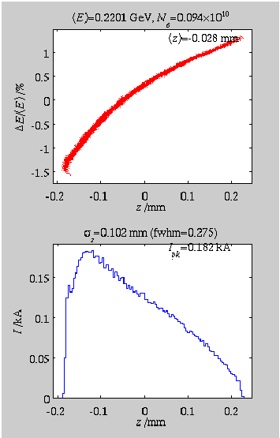
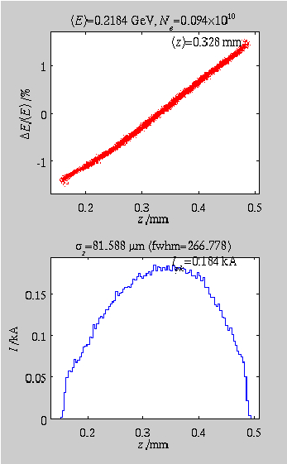
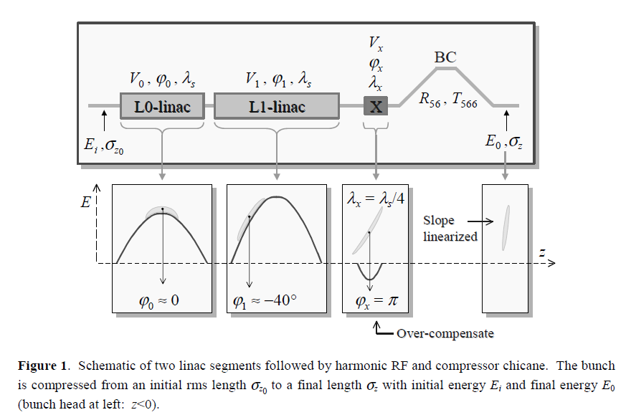
X-Band Chirp at SLAC
S-Band DLWG RF at 2.856GHz
Use X-Band(11.424GHz) for more uniform Chirp
X-Band OFF: After BC1
X-Band ON: After BC1

Slide 34
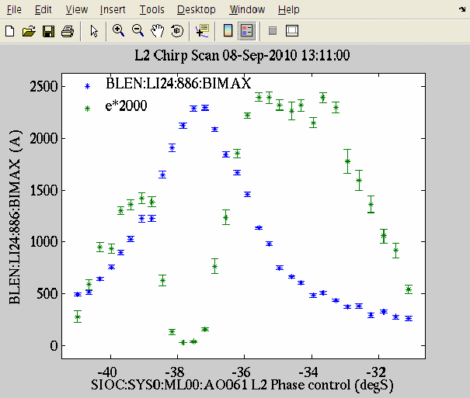
Bunch Length Optimization
Choosing Bunch Length
Optimize on FEL Pulse Energy, Stability or Bandwidth
Blue: Bunch Length( A)
Green: FEL Pulse Energy(arb)
X-Axis: Klystron Chirp
FEL Goes to Zero at Max Compression

Slide 35
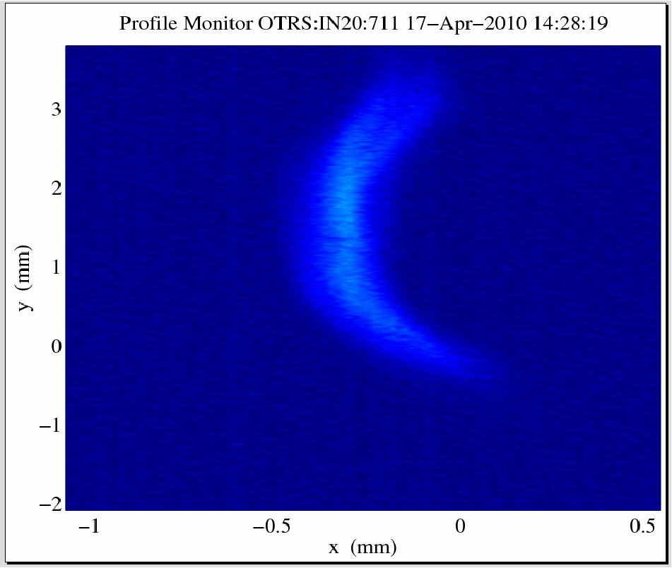
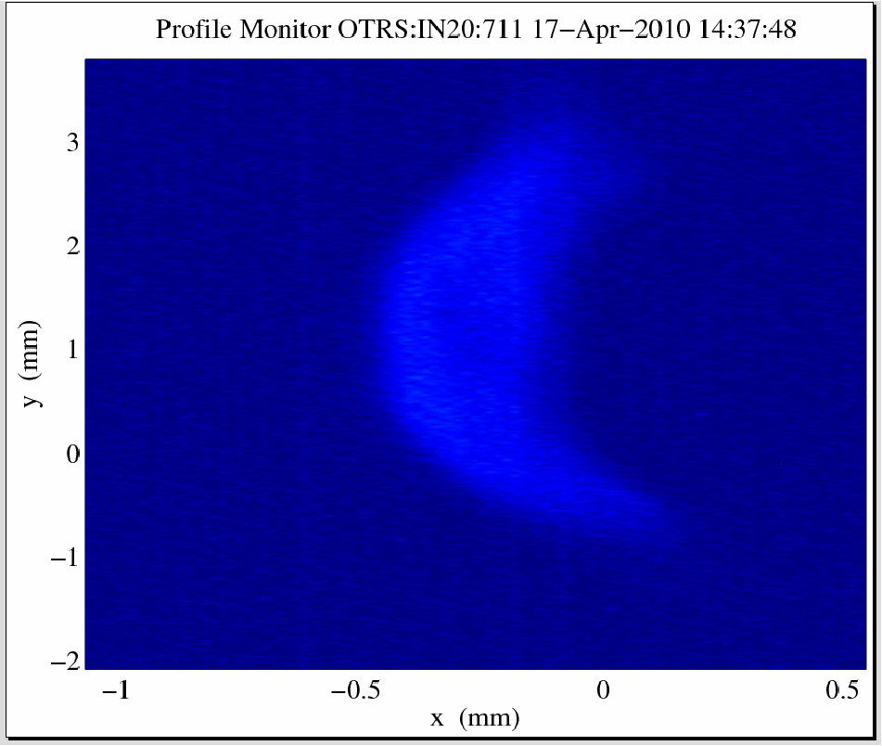
Injector Laser Heater
Use IR Laser “Heater” to blow up and randomize initial slice energy spread
Optimize to eliminate Micro-Bunching induced from Bend Magnets in Compressors which will suppress SASE effect
Setup: Use Transverse Cavity to streak Beam in Y Plane, then send beam in X-Dispersive region to observe uniform slice energy spread increase

Slide 36
Introduction to LCLS: Undulator Transport
Undulator Hall(100M)
33 total Segments, each containing fixed magnets
6.8mm Vertical Gap, Bend in Horizontal Plane
~100 3cm periods per segment
4 wire
scanners
+ 6 coll’s
vert. electron
beam dump
stopper
μ wall
BSY
3-15 GeV
LTU
undulator

Slide 37
Soft X-Ray Operation
Soft X-Rays for LCLS < 2keV
Emittance Requirements less demanding
Optimal FEL at Longer Pulse Lengths
Shorter Gain Length
Laser Heater has stronger effect
Energy Jitter in Linac is a problem at shorter pulse lengths

Slide 38
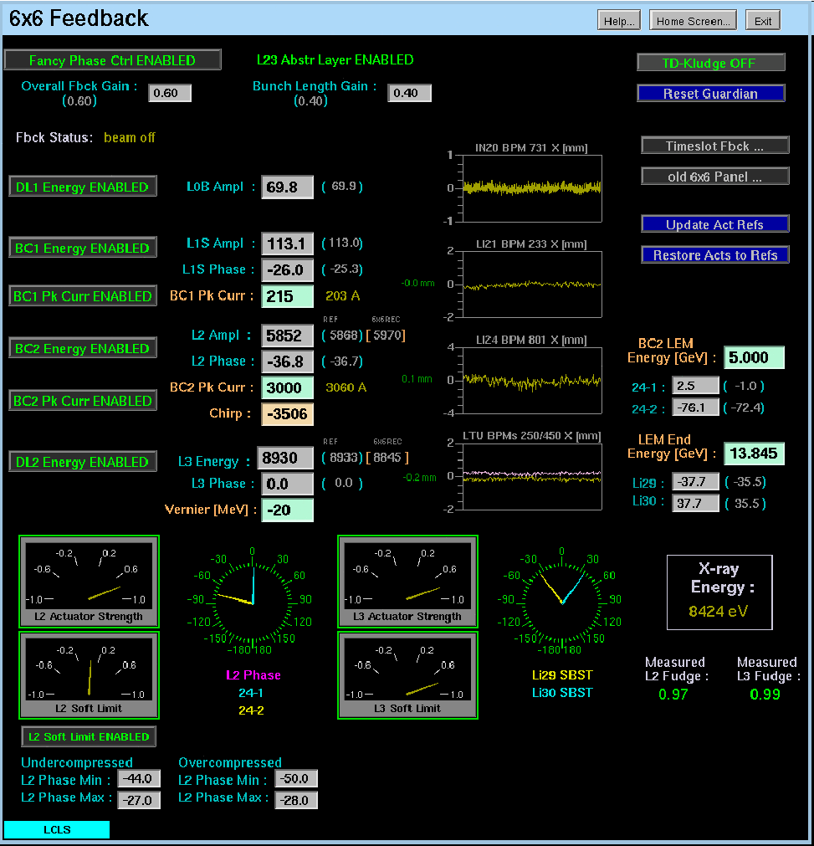
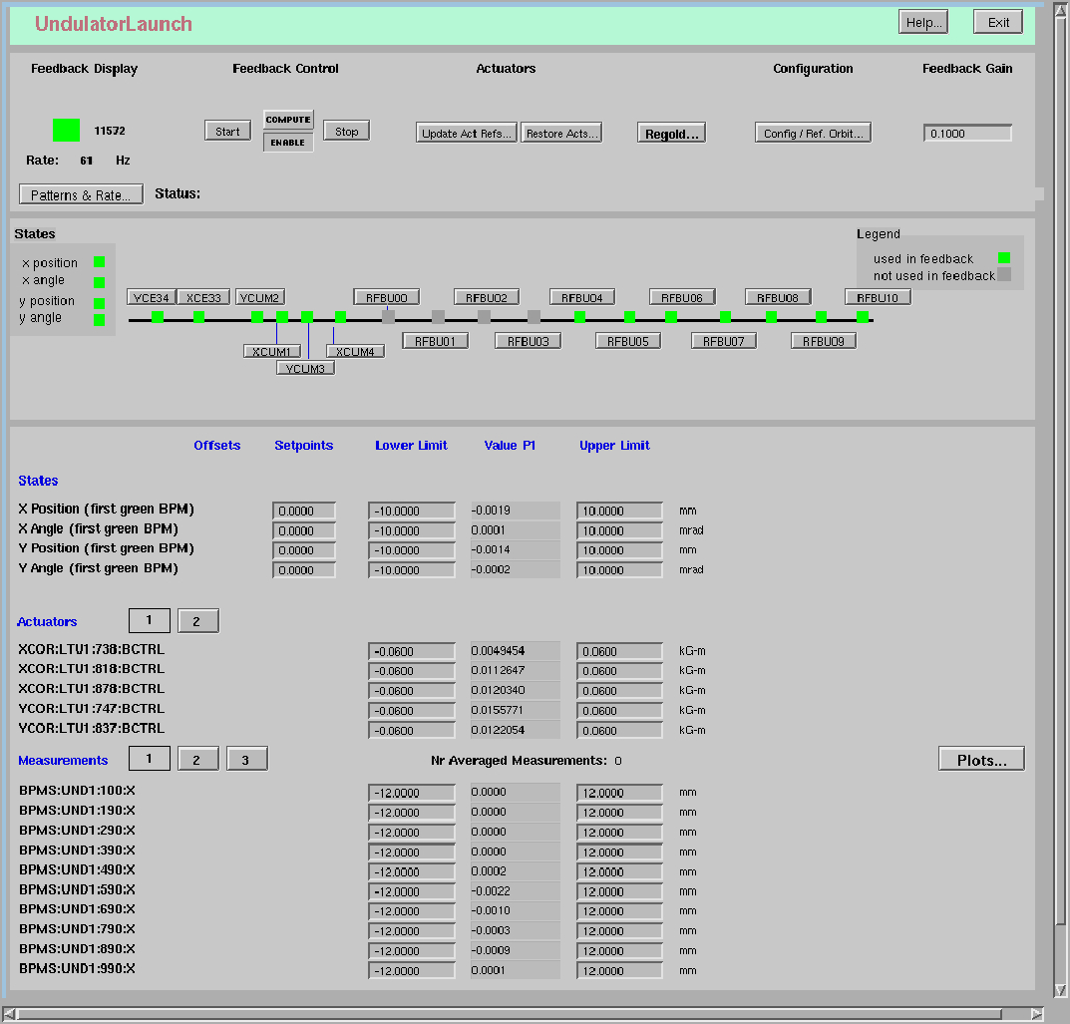
Feedback Displays
Longitudinal Feedbacks
Matlab Based, ~5Hz
Energy Setpoints
Pulse Length Control
Transverse Feedbacks
EPICS Based, up to 120Hz
Ex: Injector Launch,
Launch into Undulator

Slide 39
Feedback Locations
GUN
TFB
L1X
TFB
TFB
LFB
LFB
vert.
dump
L1S
LFB
TFB
TFB
LFB
μ wall
L2-linac
DL1
135 MeV
BC1
220 MeV
TFB
BC2
5 GeV
TFB
L3-linac
BSY
DL2
undulator
TFB
TFB
TFB - Transverse Feedback in region
LFB – Longitudinal Feedback in region

Slide 40

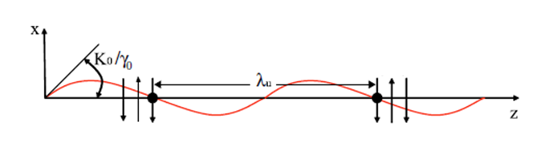
Free Electron Lasers
Setting up resonance condition Undulator
As electron travels 1 period in the undulator, it slips behind a distance equal to one wavelength of the resonant X-Ray emitted
Electron(black dot) co-propagating with seed pulse

Slide 41
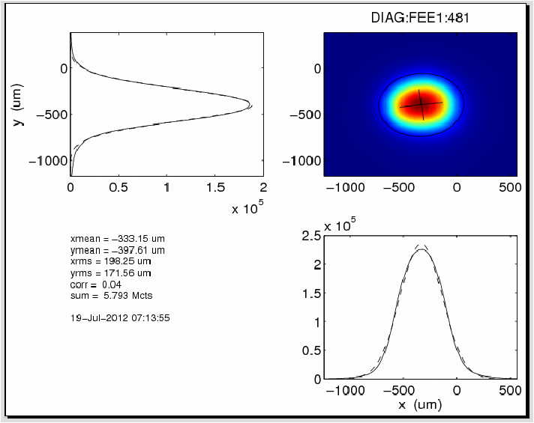
FEL Spot Size in FEE
8.4keV FEL Spot Size

