Slide 1
WAO 2012 Accelerator Control Room Overview
Jim Morel
Lawrence Berkeley National Laboratory
Welcome to the
San Francisco Bay Area

Slide 2
A New Control Room
The Control Room is a very important part of work experience at an accelerator.
A good control room is a place that staff will enjoy being and will be more productive.
A bad control room is a challenging place and staff would rather not be there.
In recent years several facilities have upgraded their control rooms.
In some cases:
the facility is expanding and a bigger control room is needed,
the control room is being upgraded to new technology,
the control room is just old, crowded and ugly.
I thought it would be useful to gather ideas and have an open discussion about what are “Control Room” issues or problems, and what are some solutions and clever ideas that could help others to make sound decisions about changing their control room.

Slide 3
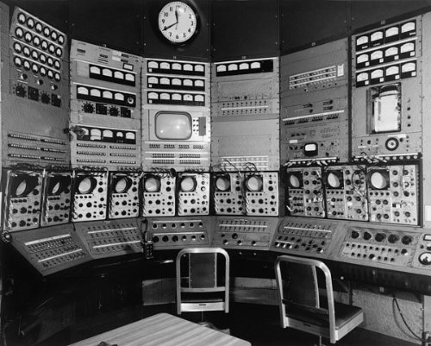
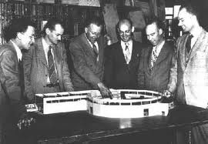
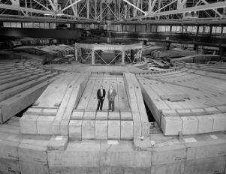
Old School
From the 1950’s- The Bevatron Control Room
Large Rack-Mounted Controls, Meters, O-Scopes

Slide 4
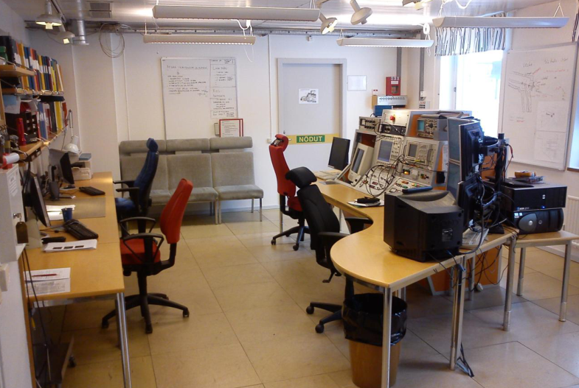
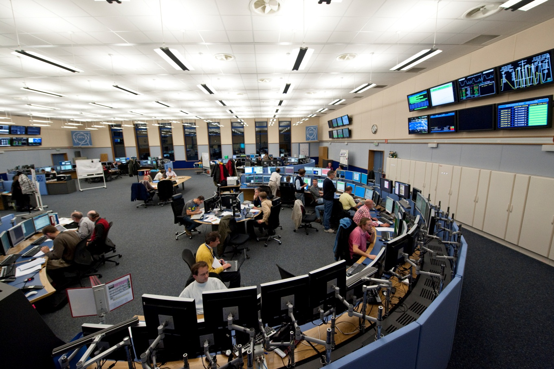
Current Control Rooms come in all sizes.
From The Svedberg Laboratory
Control Room, in Sweden….
…to the
Main Control Room
at CERN

Slide 5
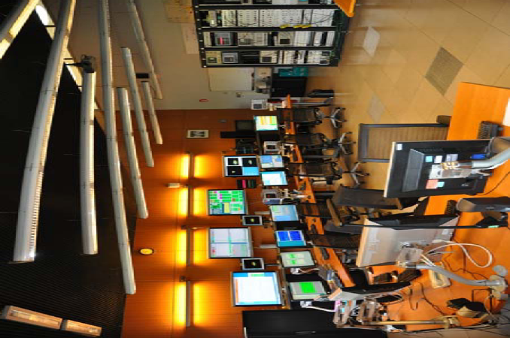
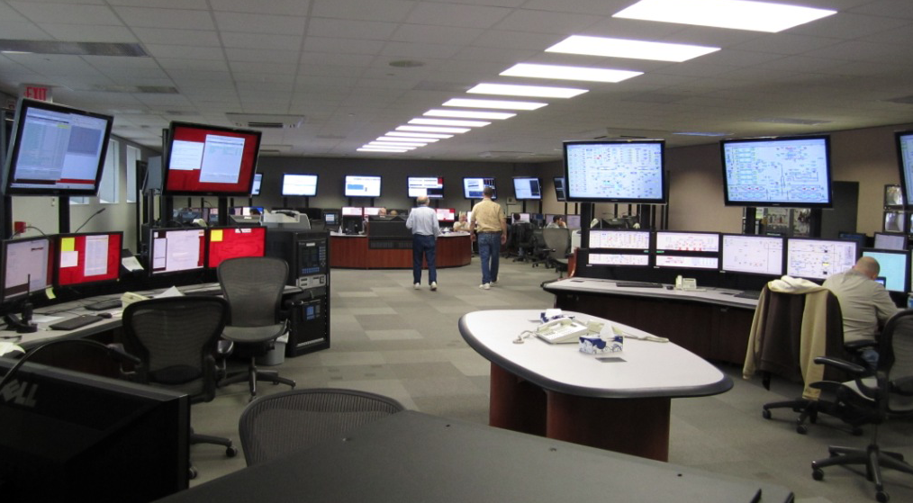
From the
European Synchrotron Radiation Facility (ESRF) control room in Grenoble …
…to the
Brookhaven National Laboratory control room in New York state,

Slide 6
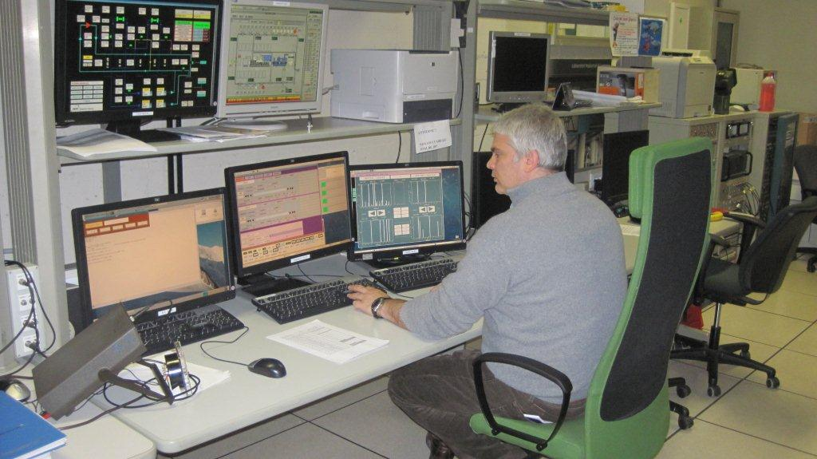
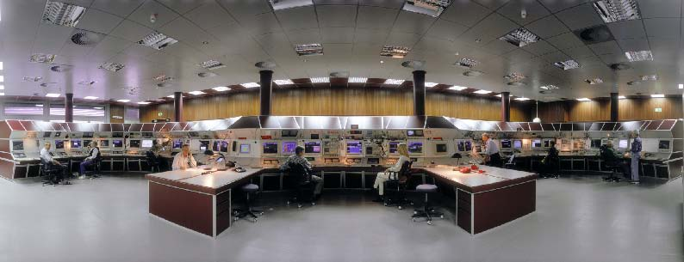
From the Laboratori Nazionali di Legnaro (LNL)
of the National Institute of Nuclear Physics
in Legnaro, Italy to …
…. the GSI main control room
(Helmholtzzentrum für Schwerionenforschung) in Darmstadt, Germany.

Slide 7
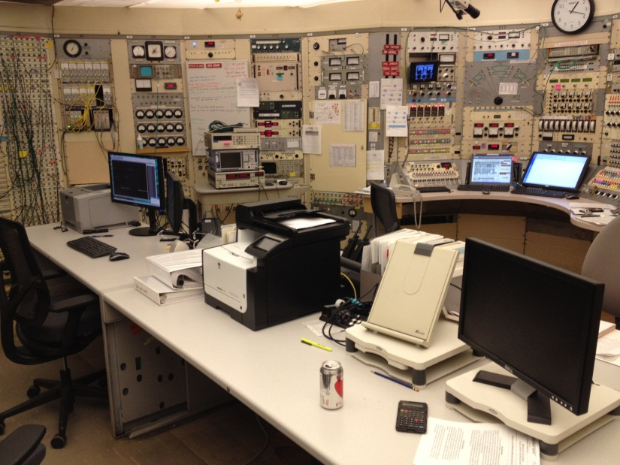
Clearly modern control rooms ….
Paul Scherrer Institute (PSI) Switzerland
…do not look like old control rooms.
88-Inch Cyclotron control room LBNL

Slide 8
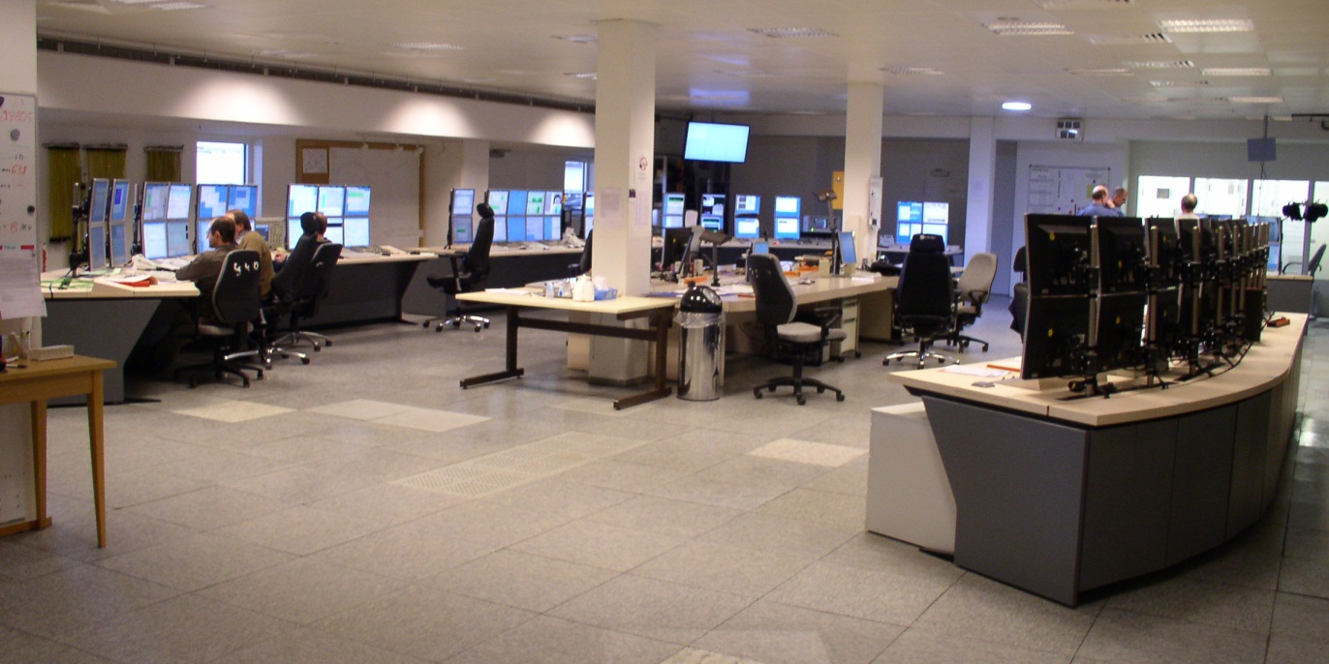
The old rack mounted control room configuration can be upgraded
to accommodate modern controls and displays, but when possible they are being …
Fermi Control Room
DESY Control Room
…replaced with open arrangements of work surfaces and information displays.
The removal of racks allows more light and gives an open spacious feel to the room.

Slide 9
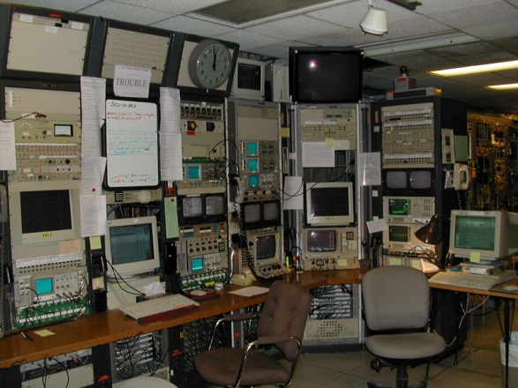
Information Display
The biggest conversion is..
from CRT display….
New- DESY
Old -Cornell
…to flat screen displays.
This is an ongoing process everywhere.

Slide 10
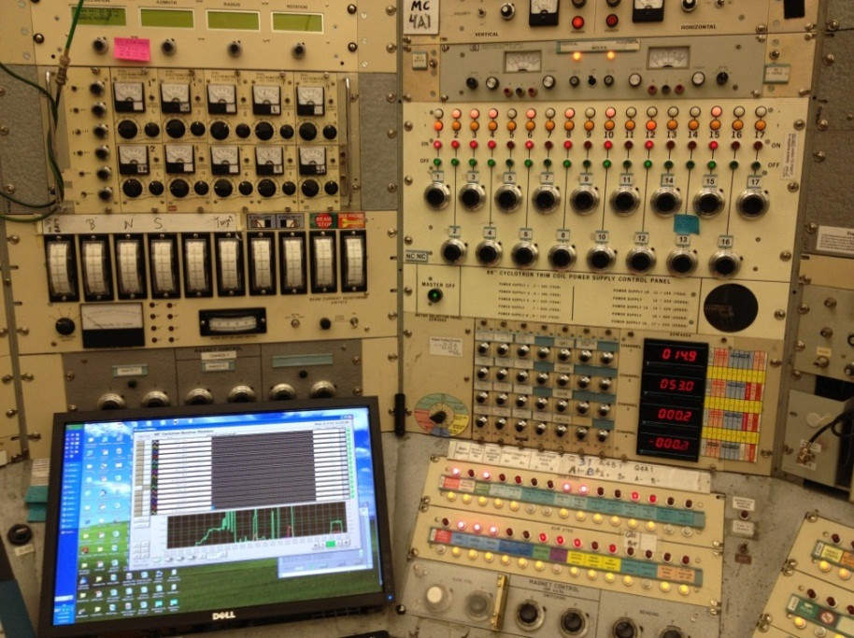
Controls and Diagnostics
The use of...
National Superconducting Cyclotron Laboratory (NSCL) control room at Michigan State University ,
88-Inch Cyclotron
control room LBNL
digital controls and diagnostics…
…as compared to analog controls
has been ongoing in most control rooms.

Slide 11
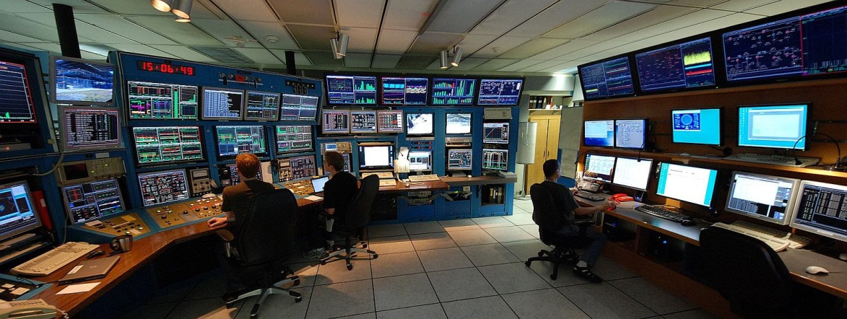
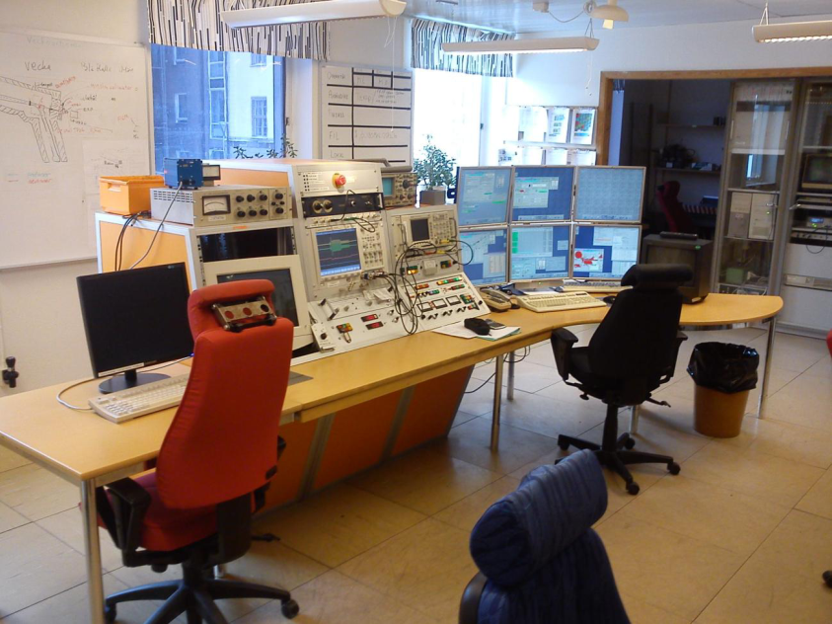
Lighting
The control room lighting has to be controlled by the operations staff,
some operators like the room
to be dark and …
TRIUMF control room
…others like it to be bright and full of sunshine.
The Svedberg Laboratory (TSL)
control room, in Sweden

Slide 12
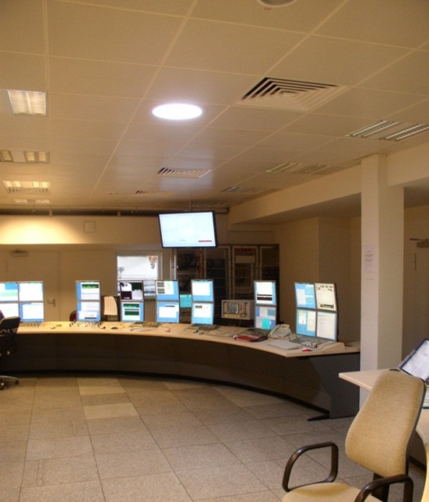
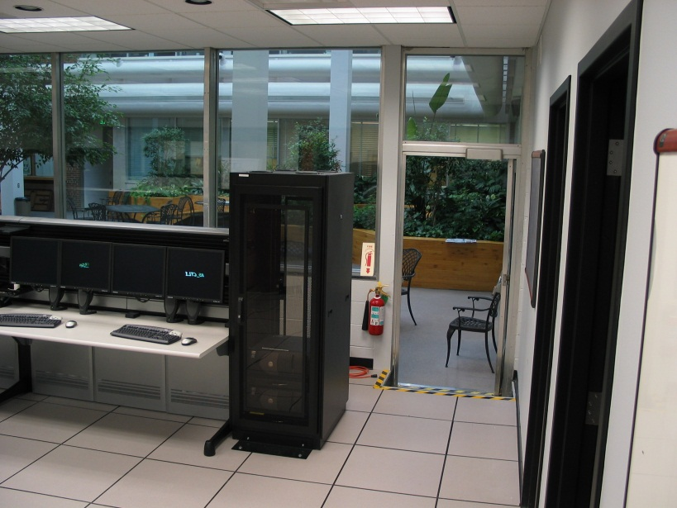
Creative Lighting Alternatives
DESY’s Solution to provide natural light throughout a room with limited windows.
Whenever
possible a source of
exterior light is always effective.
To get light through the ceiling when structural engineering does not allow big holes in the ceiling.
NSCL
A metallized tube reflects daylight into the room.

Slide 13
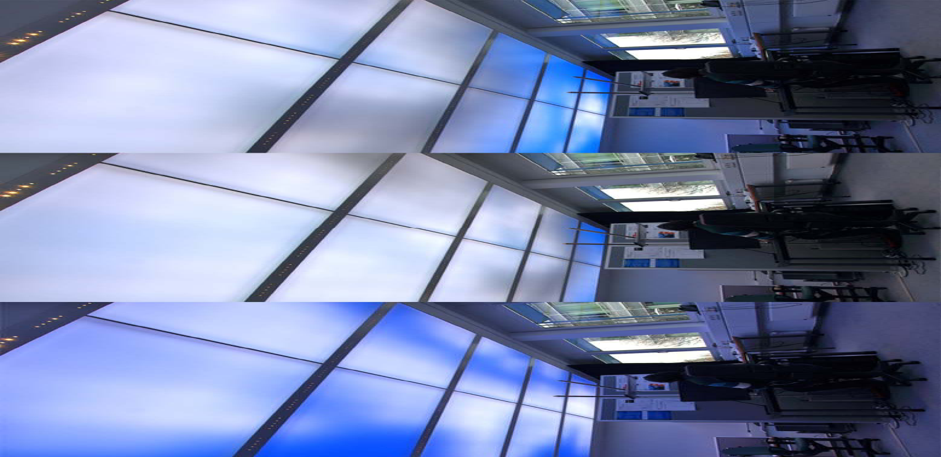
Creative Lighting Alternatives
At GSI they are exploring different lighting ideas for the FAIR control room upgrade.
Consider this option of a lighting scheme where the lights simulate external lighting
sources that change in time like drifting clouds or sunrise in the Aegean.
Dynamic Control Prototype: 34 square meters,
34,560 LED with four different primary colors.

Slide 14
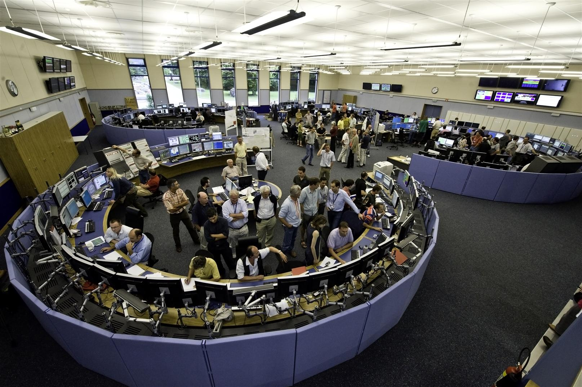
Control Room Layout is a fundamental factor in establishing the general feel of the room.
The limiting factor is the building and the available room.
If, as at CERN, you can design the control room,
then you can
create the room and the feel you want.
CERN main control room

Slide 15
Control Room Layout
Control Room Layouts can be linear or square box like shape or…
…oval shaped, which provide a more efficient use of space and as such are more popular.

Slide 16
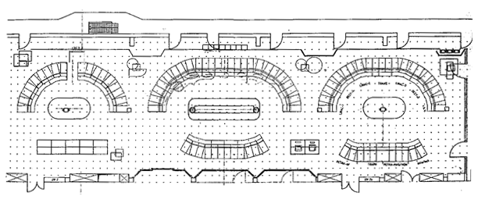
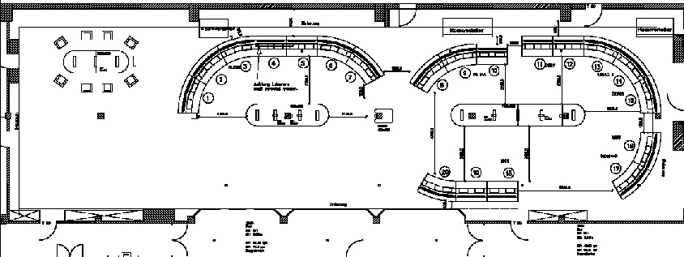
Control Room Layout
When you have to deal with the existing room, during a control room upgrade,
the new control room has to fit in the existing room.
The recent DESY
control room upgrade
had to work out how to
fit the desired changes
in the existing room.
Old
New

Slide 17
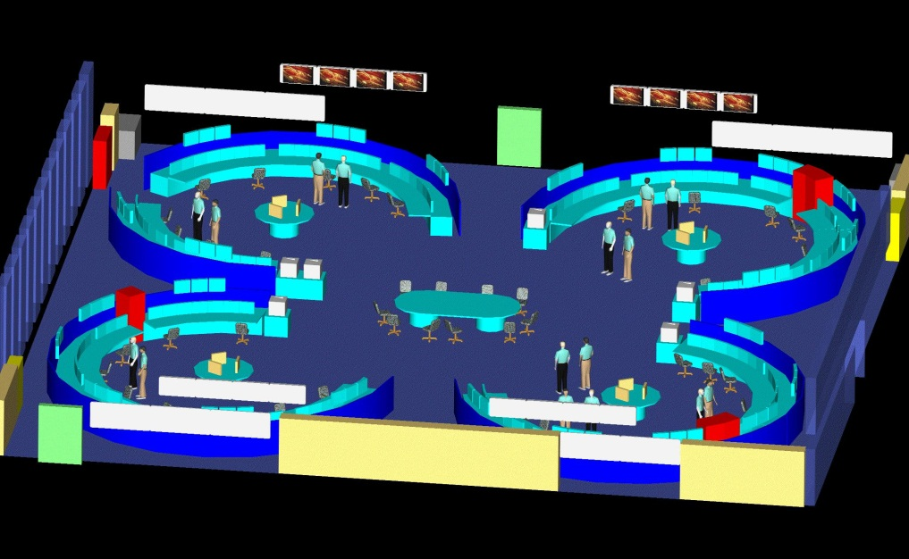
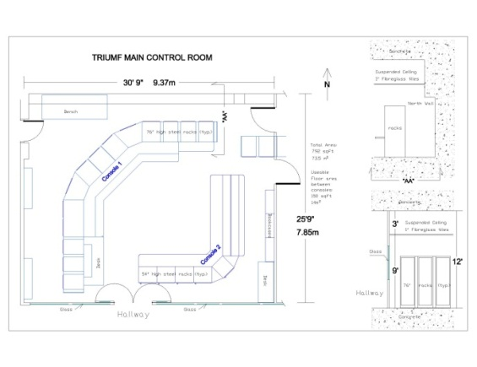
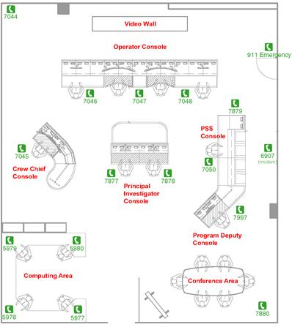
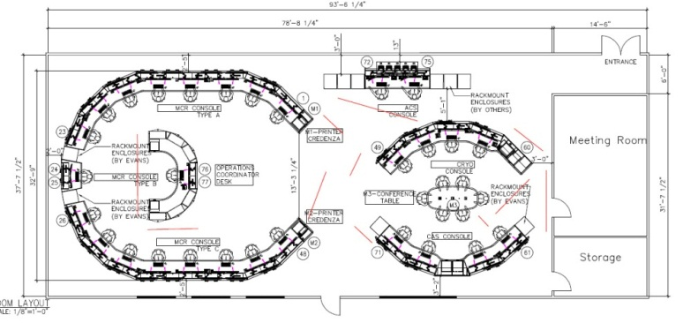
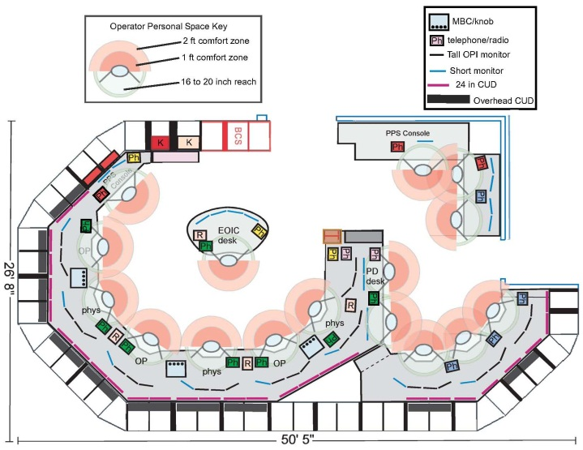
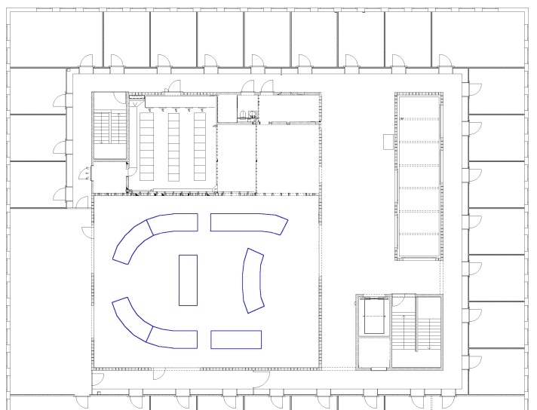
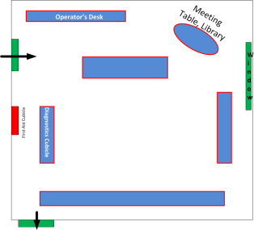
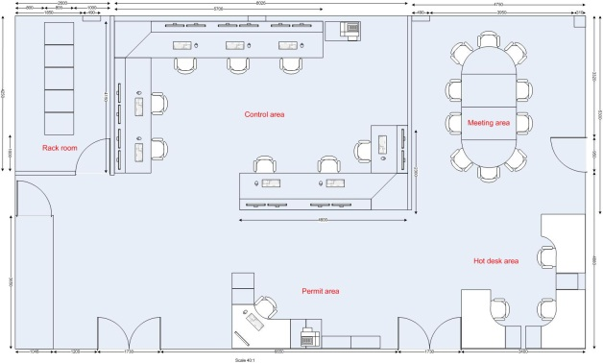
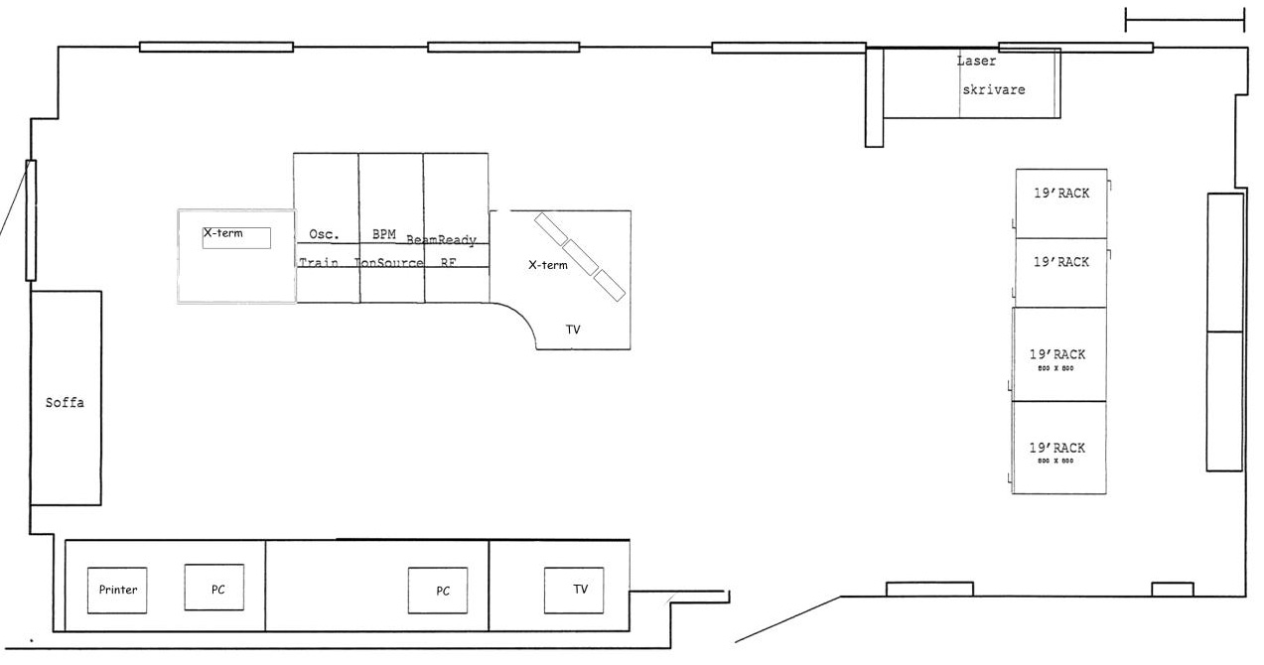
Control Room Layout Examples
TRIUMF
CERN
Brookhaven
JLAB
SLAC
ESRF
PSI
TSL
STFC-EBTF

Slide 18
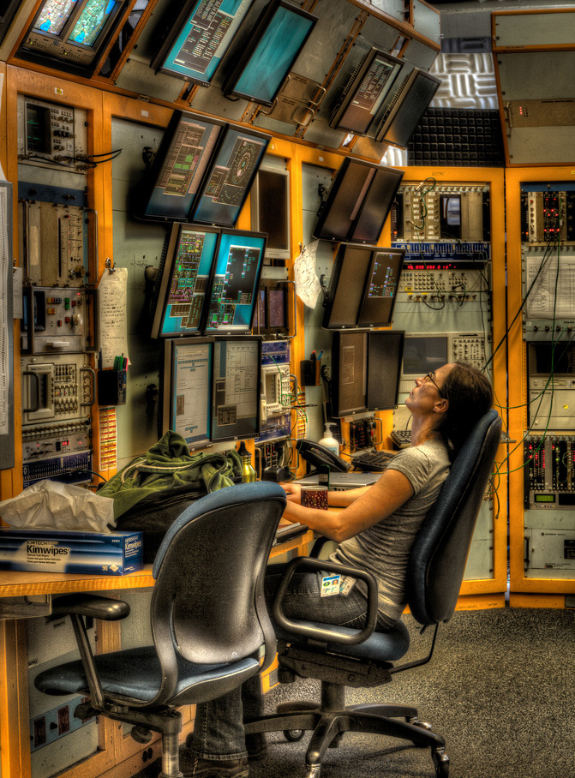
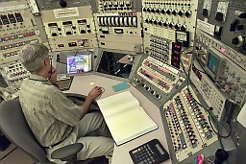
Work Stations
FERMI
Work stations have evolved in time.
Mature facilities have what may be
characterized as crowded and
challenging work stations.
88-Inch Cyclotron
These are usually constrained by the configuration of the control room.
The need for more information displays means having to go up with the extra monitors.

Slide 19
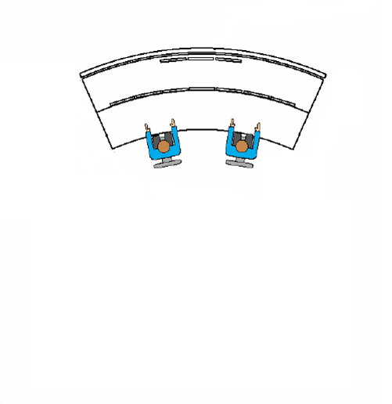
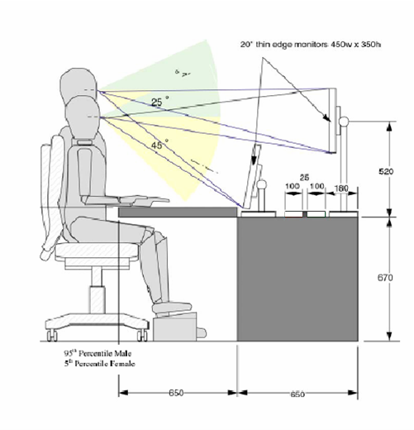
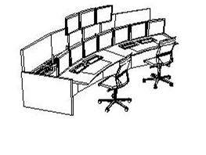
Work Stations
Modern layout-CERN example
Above the line of sight are
3 fixed displays shared between
two operators
3 desk level screens per operator
1 keyboard
1 mouse
The curved oval shape allows each seat to view more displays than the flat linear display configuration.
The newer work station design has a better use of space, is designed using better ergonomics for the personnel working there and does not involve tall “monitor walls”. These drawing are from the CERN control room review of work station design .

Slide 20
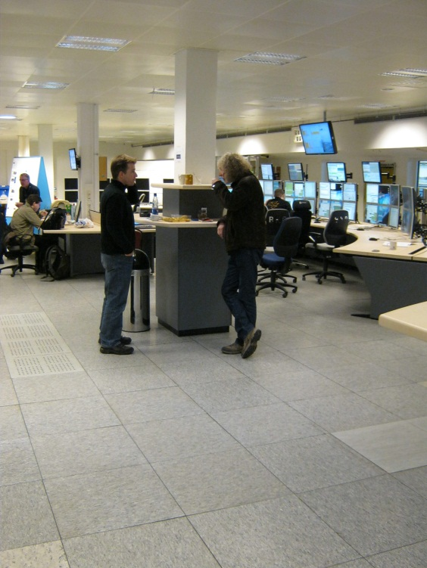
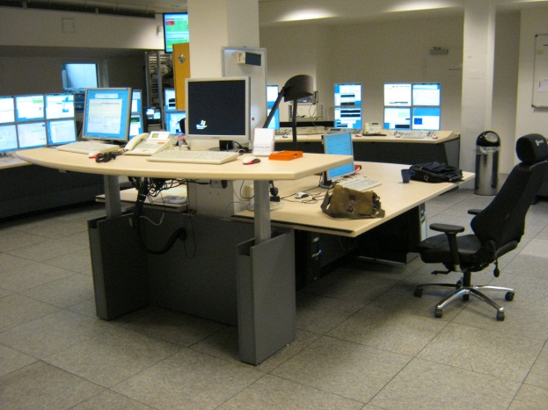
Work Stations
Work stations have become primarily desk-like furniture with monitors.
At the DESY control room the regular desktops are augmented with adjustable height work location which allow a change from always sitting to having a standing work stations and discussion locations.

Slide 21
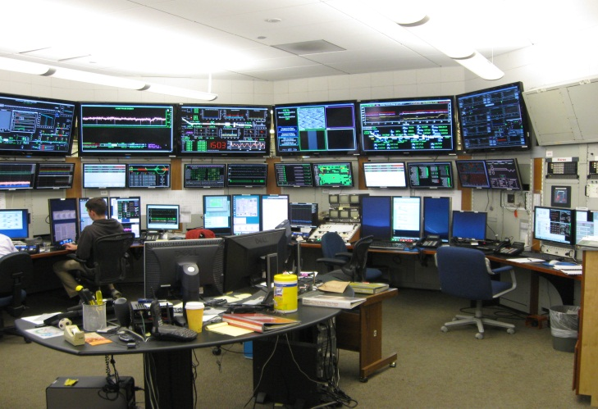
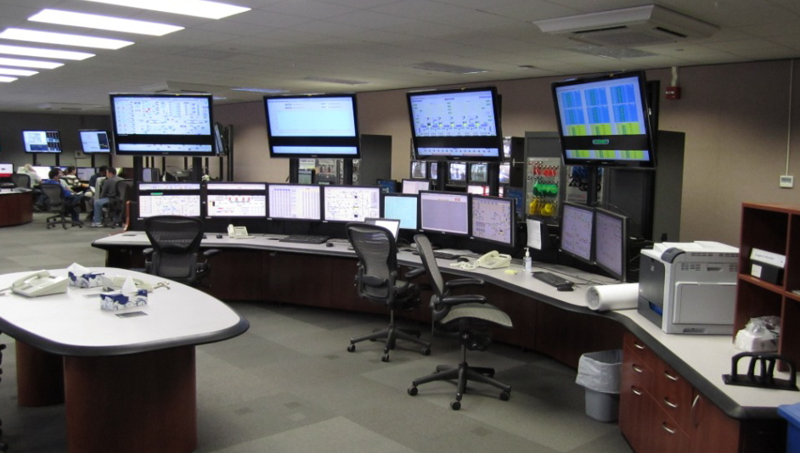
Information Density
Information density should be managed as allowed by space and complexity of the facility allow. Avoid overwhelming the operator.
Examples of High Information Density Configuration
Examples of Moderate Information Density
Configuration

Slide 22
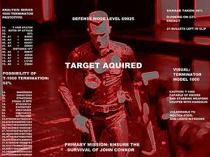
Information Density
Example of Intense Information Density Configuration

Slide 23
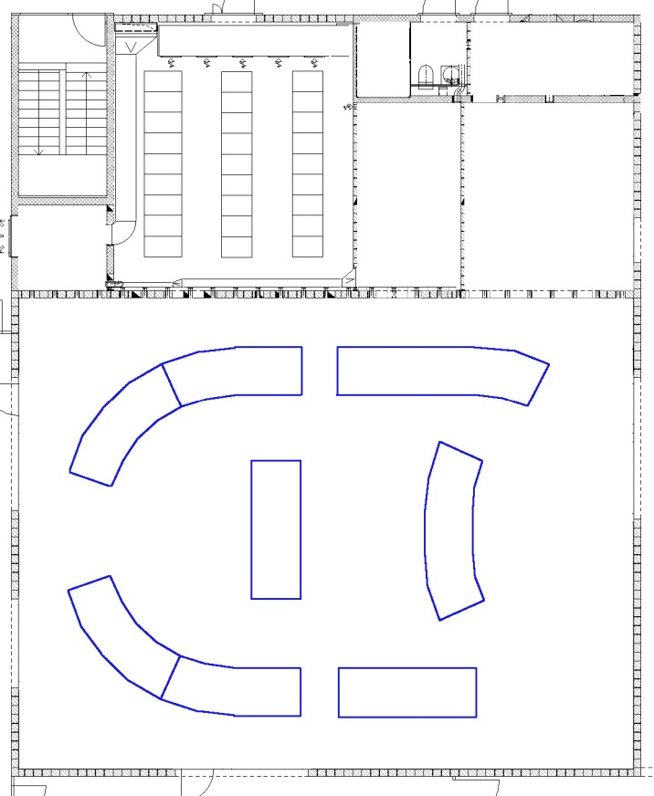
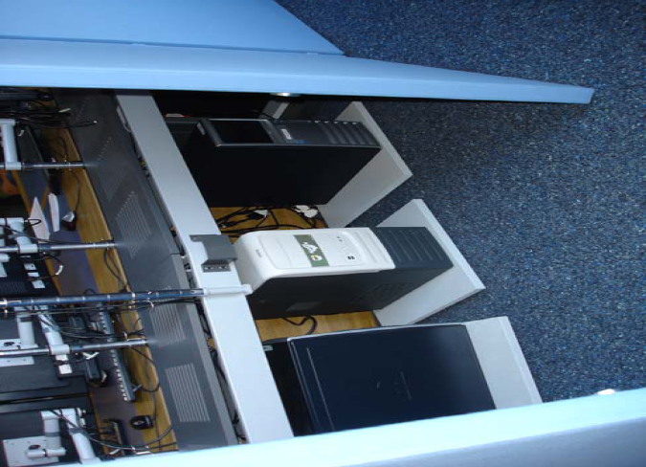
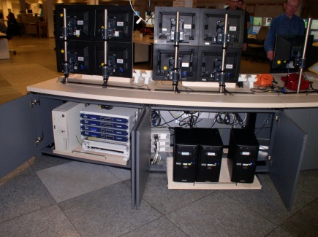
Computer Management
The management of computers has become a matter of planning equipment layout and wiring.
Consider a separate dedicated server room
- Less noise in control room
- Easier accessibility for IT-People
When the computers have to be in the
control room then put them in cabinets
with sound absorbing materials.
Plan the placement to minimize wiring monsters.
If possible use wireless mouse and keyboards

Slide 24
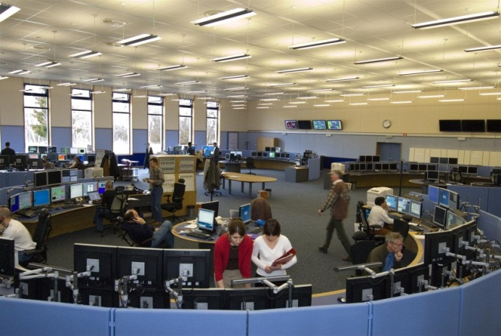
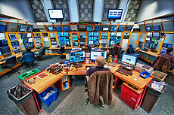
Sound Management
Some Acoustics Design Implementations at CERN
Large rooms can develop reverberations.
All surfaces are made of acoustically damping material,
The ceiling tiles are covered with a rock wool layer ,
The false floor tiles are coated with a highly resistant carpet,
The walls are garnished by acoustic panels of variable thicknesses to break resonant conditions.
CERN
When you have an established control room where the noise is loud then introduce sound absorbing materials where ever you can.
A large component of background noise is the air conditioning. Plan the air conditioning outlets so they do not introduce blowing air noise.
FERMI
The alarm system should be managed so that in the alarm state it is clear what level of alarm has sounded and the impact on the control room is not so overwhelming so that work can continue in the room.

Slide 25
Sound Management = Crowd Management
The management of sound is also a matter of planning the crowds in the control room.
Layout the room so crowds do not form where operators need to do intensely focused work.

Slide 26
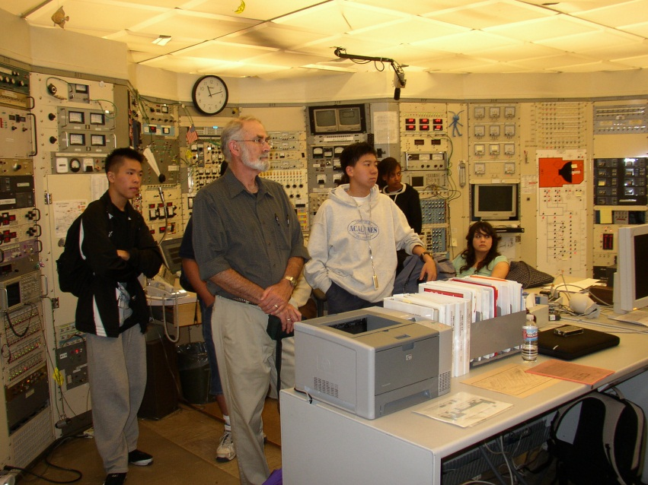
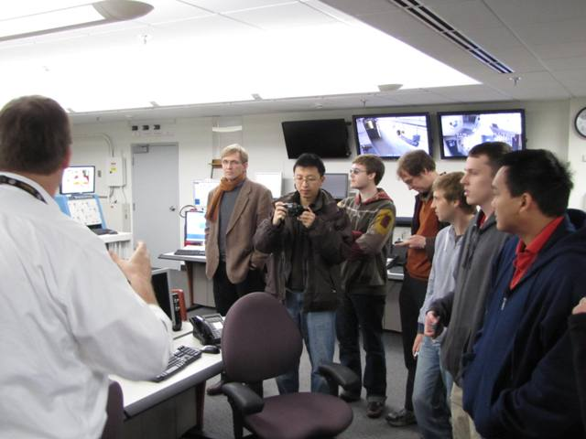
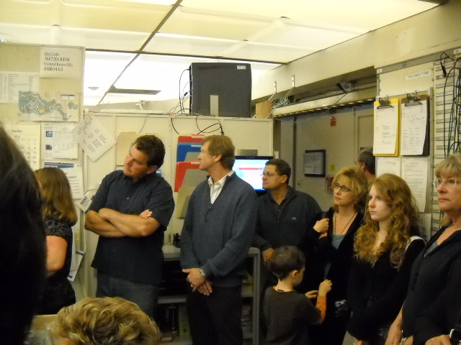
Visitor Management
Make accommodations for visitors.
A good window or visitor gallery is ideal.
Visitors will come.
They will want to see the control room and
they will always be a large part of a facility’s
public relations function.

Slide 27
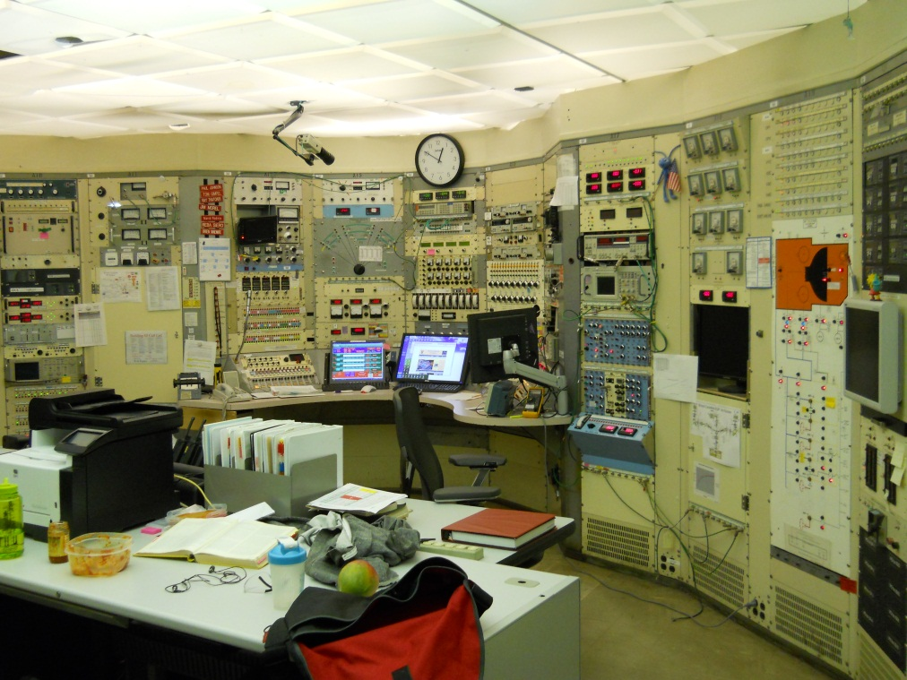
COLOR
is an important aspect of a Control Room.
Inherited color schemes, that are difficult to change, can make for
aesthetically -challenging work environments in mature facilities.
WWII Battleship GREY panels of the 88-Inch Cyclotron.
FERMI’s famous
Yellow –Orange panels.

Slide 28
COLOR
In newer Control Rooms a good color scheme
can greatly improve the work environment.
SLAC
TRIUMF
CERN
Getting operator’s input on the color scheme makes for better results.
Muted tones are the most popular color choices.
PSI

Slide 29
Ideas sent in from the WAO community:
Place computers out of sight and in sound proof enclosure.
Get rid of old panels.
Get rid of noisy fans.
Have the ventilation system low noise and no direct blowing on work stations.
Maintain ventilation system so the room is comfortable during winter and summer.
Manage emotional content in the control room.
Establish rules of Conduct in the control room so the operator has power to manage the crowd and the noise.
Have the lights adjustable.
Provide lighting options which include exterior light.
Have a substantial floor.
Provide food preparation space.
Provide operators a personal space.
Provide meeting spaces that do not interfere with the operators work.
Manage visitors.

Slide 30
Ideas sent in from the WAO community:
If the room is mostly movable work surfaces then consider changing the orientation from time to time.
Allow operators to have input in the control room orientation, furniture, color and lighting decisions.
Have the floor cleanable, old stains have to be removed.
Provide chairs with adjustments for all size people.
Keep crowd scenes away from the operators.
Create an open space.
Acoustically dampen sound resonances.
If you are all digital do not overdo the information density.
Do not go too high with displays.
Spread out the work stations.
Have designated high intensity stations where casual interactions are discouraged.
Have the Logbook entry out of the way so log entries do not interfere with ongoing accelerator tasks. Have logbook entry from multiple stations.
The removal of the racks allows light to come from windows and indirect lighting devices.

Slide 31
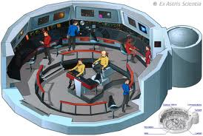
If you could have the
perfect
Control
Room…
What would you want?

