Slide 1
Electron/Positron Injector
Phase-2 Status and Phase-3 Plan
Kazuro Furukawa
for Injector Linac, KEK

Slide 2
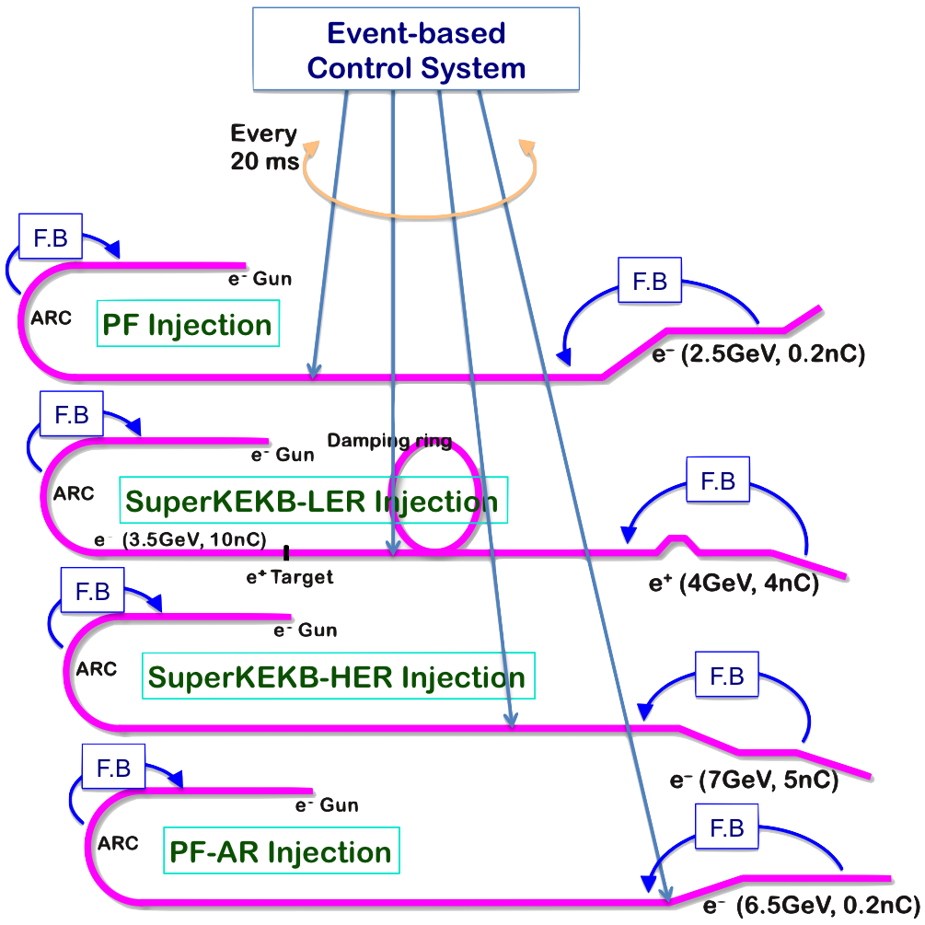
Mission of Electron/positron Injector in SuperKEKB
Injector Linac Mission
  For 40-times higher luminosity in SuperKEKB collider
  Low emittance & low energy spread injection beams with 4 times higher beam current
    New high-current photo-cathode RF gun
    New positron capture section
    Positron damping ring injection/extraction
    Optimized beam optics and correction
    Precise beam orbit control with long-baseline alignment
    Simultaneous top-up injection to DR/HER/LER/PF/PFAR
  Balanced injection for the both photon science and
  elementary particle physics experiments
The single injector would behave as multiple injectors to multiple storage rings by the concept of virtual accelerator
Notes:
Higher Injection Beam Current
To Meet the larger stored beam current and shorter beam lifetime in the ring
4~8-times larger bunch current for electron and positron
Reconstruction of positron generator, etc
Lower-emittance Injection Beam
To meet nano-beam scheme in the ring
Positron with a damping ring
Electron with a photo-cathode RF gun
Emittance preservation by alignment and beam instrumentation
Quasi-simultaneous injections into 4 storage rings
SuperKEKB e–/e⁺ rings, and light sources of PF and PF-AR
Improvements to beam instrumentation, low-level RF, controls, timing, etc

Slide 3
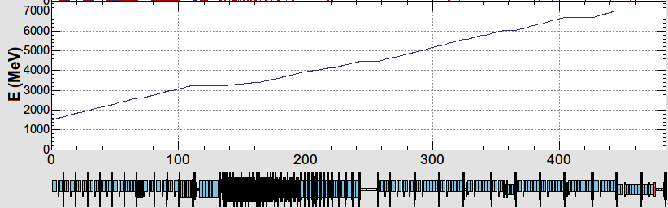
Injector Linac Operation in Phase II - III
10 nC x 2 bunches x 50 Hz (LER)
4 nC x 2 bunches x 50 Hz (HER)
0.3 nC x 1 bunch x 25 Hz (PF-AR)
0.3 nC x 1 bunch x 25 Hz (PF)
B
A
beam bunches from e- gun
beam injection with pulse-to-pulse variable charge and energy
device parameter change at 50 Hz (20 ms)
Pulsed magnet commissioning at 3-5 sectors (2017 autumn), and many more installation (2018-2019)
1.5 GeV e-
1.1 GeV
DR
C
1
2
3
4
5
DC magnets
pulsed magnets
HER: 7 GeV e-
PF-AR: 6.5 GeV e-
4.219 GeV
the same energy
e-
variable energy pulse-to-pulse
LER: 4 GeV e+
1.1 GeV
deceleration
positron target
e+
PF: 2.5 GeV e-
1.5 GeV
C
1
2
3
4
5

Slide 4
Required injector beam parameters
Linac Beam Property Requirements
Stage | KEKB (final) |  | Phase-I |  | Phase-II |  | SuperKEKB (final)
Beam | e+ | e– | e+ | e– | e+ | e– | e+ | e–
Energy | 3.5 GeV | 8.0 GeV | 4.0 GeV | 7.0 GeV | 4.0 GeV | 7.0 GeV | 4.0 GeV | 7.0 GeV
Stored current | 1.6 A | 1.1 A | 1 A | 1 A | – | – | 3.6 A | 2.6 A
Life time (min.) | 150 | 200 | 100 | 100 | – | – | 6 | 6
Bunch charge (nC) | primary e- 10 → 1 | 1 | primary e- 8 → 0.4 | 1 | 0.5 | 1 | primary e- 10 → 4 | 4
Norm. Emittance (γβε) (μrad) | 1400 | 310 | 1000 | 130 | 200/40 (Hor./Ver.) | 150 | 100/15 (Hor./Ver.) | 40/20 (Hor./Ver.)
Energy spread | 0.125% | 0.125% | 0.5% | 0.5% | 0.16% | 0.1% | 0.16% | 0.07%
Bunch / Pulse | 2 | 2 | 2 | 2 | 2 | 2 | 2 | 2
Repetition rate | 50 Hz |  | 25 Hz |  | 25 Hz |  | 50 Hz
Simultaneous top-up injection (PPM) | 3 rings (LER, HER, PF) |  | No top-up |  | Eventually |  | 4+1 rings (LER, HER, DR, PF, PF-AR)

Slide 5
Phase II Operation
Summer Shutdown
Autumn Operation
Phase III
Summary

Slide 6
Phase II Operation
Injector operation: Jan.12 – Jul.17
Proper SuperKEKB injection
Light source injection
  3 injections a day, top-up injection for hybrid mode PF experiments
  5-GeV PF-AR injection test
Stable operation of 64 new pulsed magnets at 50 Hz
4-beam simultaneous operation with thermionic gun
HER injection from RF-gun with slower beam switching
LER positron injection via damping ring
  with adequate timing and bucket selection
Instrumentation improvements
  Beam position monitors, profile monitors, bunch monitors
  Microwave monitors

Slide 7
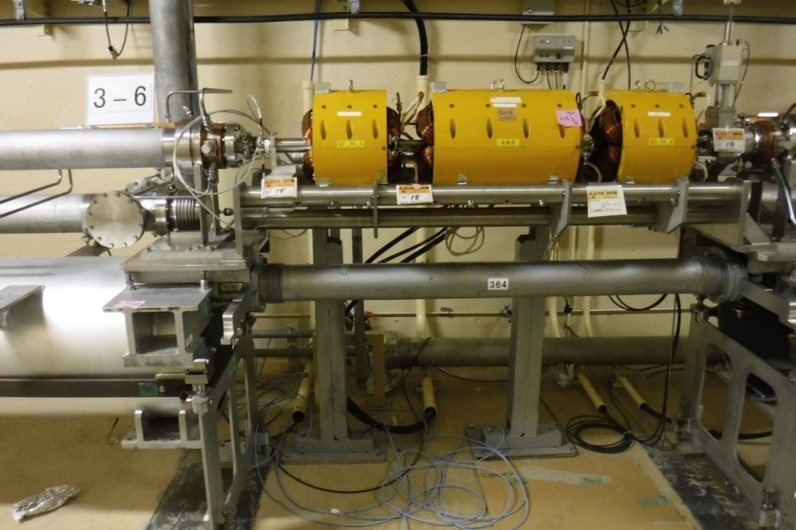
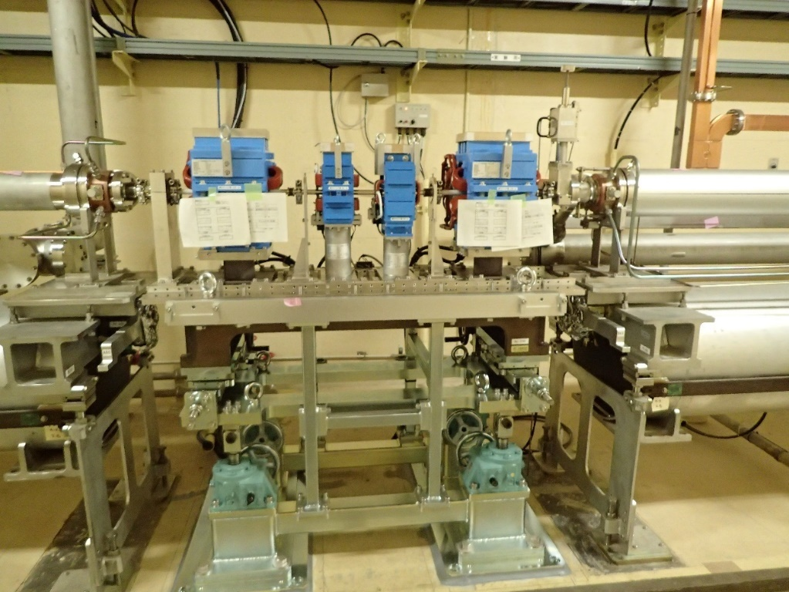
Pulsed Magnets
DC Quads
Pulsed Quads
Pulsed Correctors
Pulsed quad x28 and pulsed corrector x 36 were newly commissioned on new girders (2017 autumn)
Good power supply stability of 0.01% (24 hours)
PXI bus, PXI-EVR, cRIO, 50 Hz controls with Windows and LabVIEW
More pulsed magnet commissioning expected (2018-2019)
Girder mover commissioning (1 micron alignment enabled, 2018-)
  Emittance brow-up investigations and mitigations

Slide 8
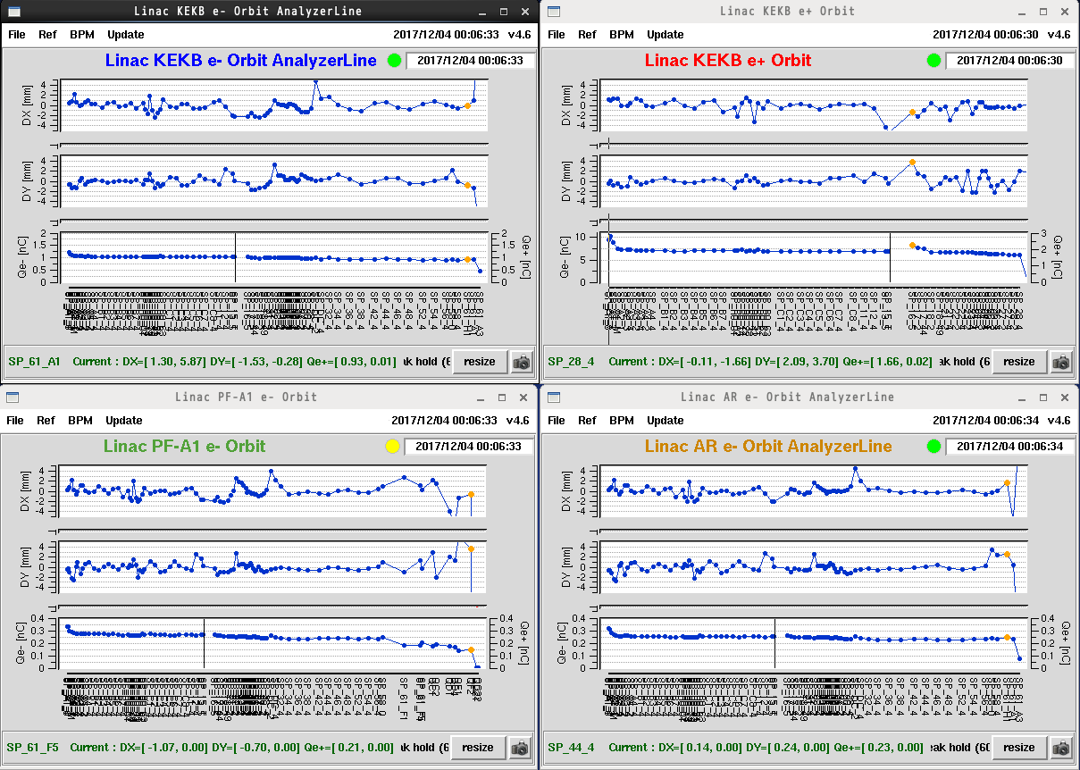
New Pulsed Magnets Enabled Simultaneous Injections
HER
LER
Horizontal
Vertical
Charge/bunch
Stable Operation
PF
PF-AR

Slide 9
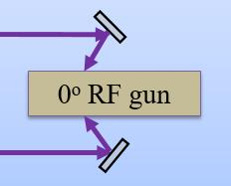
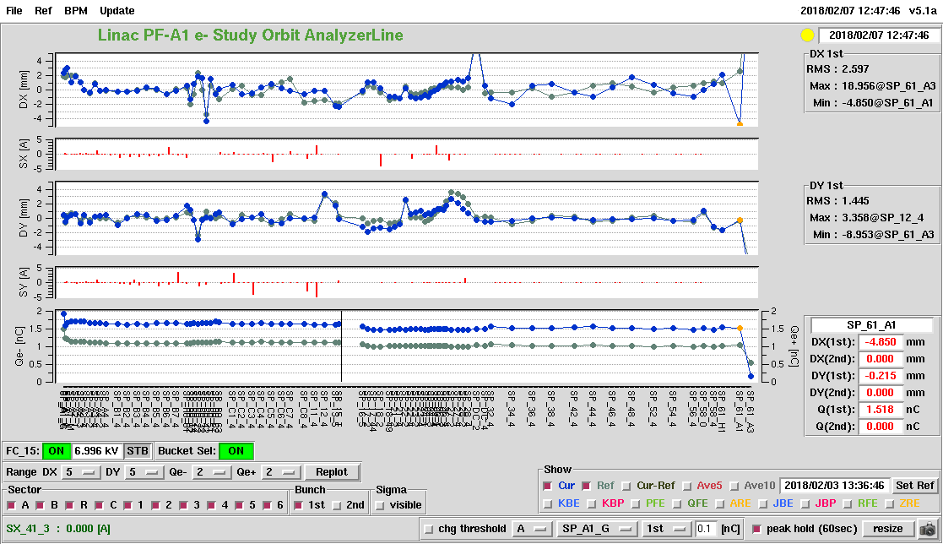
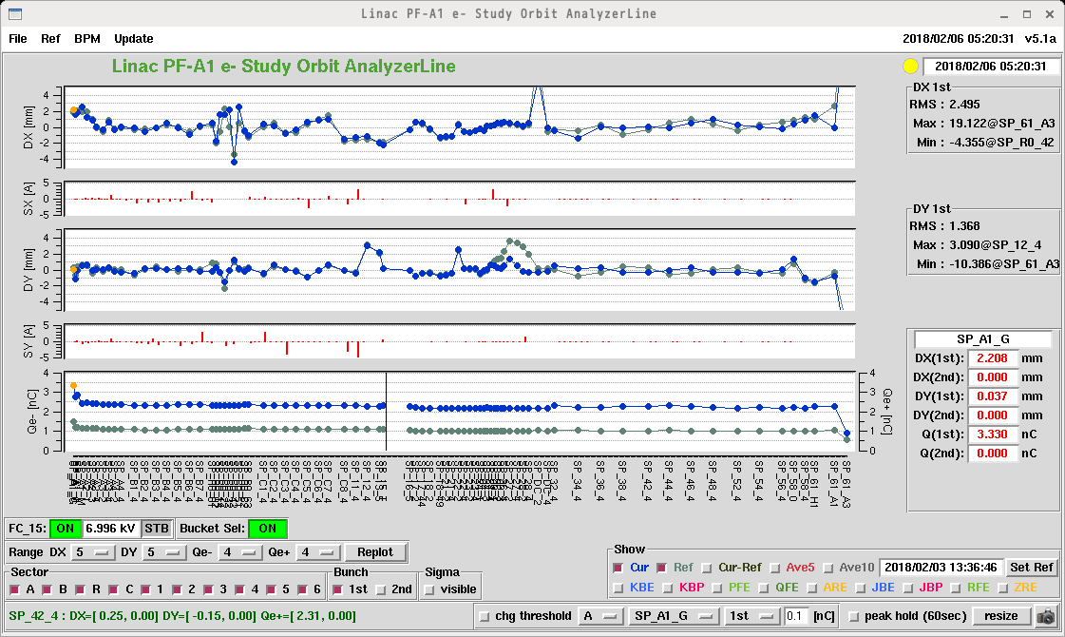
RF gun
2nd laser only
X (mm)
y (mm)
Q (nC)
1.5 nC
Three Yb:YAG fiber oscillators
Redundant Yb:YAG fiber and Nd:YAG disk hybrid laser amplifiers
Dual laser injection on to IrCe cathode
Bunch current up to 3.6 nC
  2.4 nC at the end of linac
  (Phase II requirement: 1 nC)
1st and 2nd laser together
X (mm)
y (mm)
Q (nC)
2.4 nC
3.6 nC

Slide 10
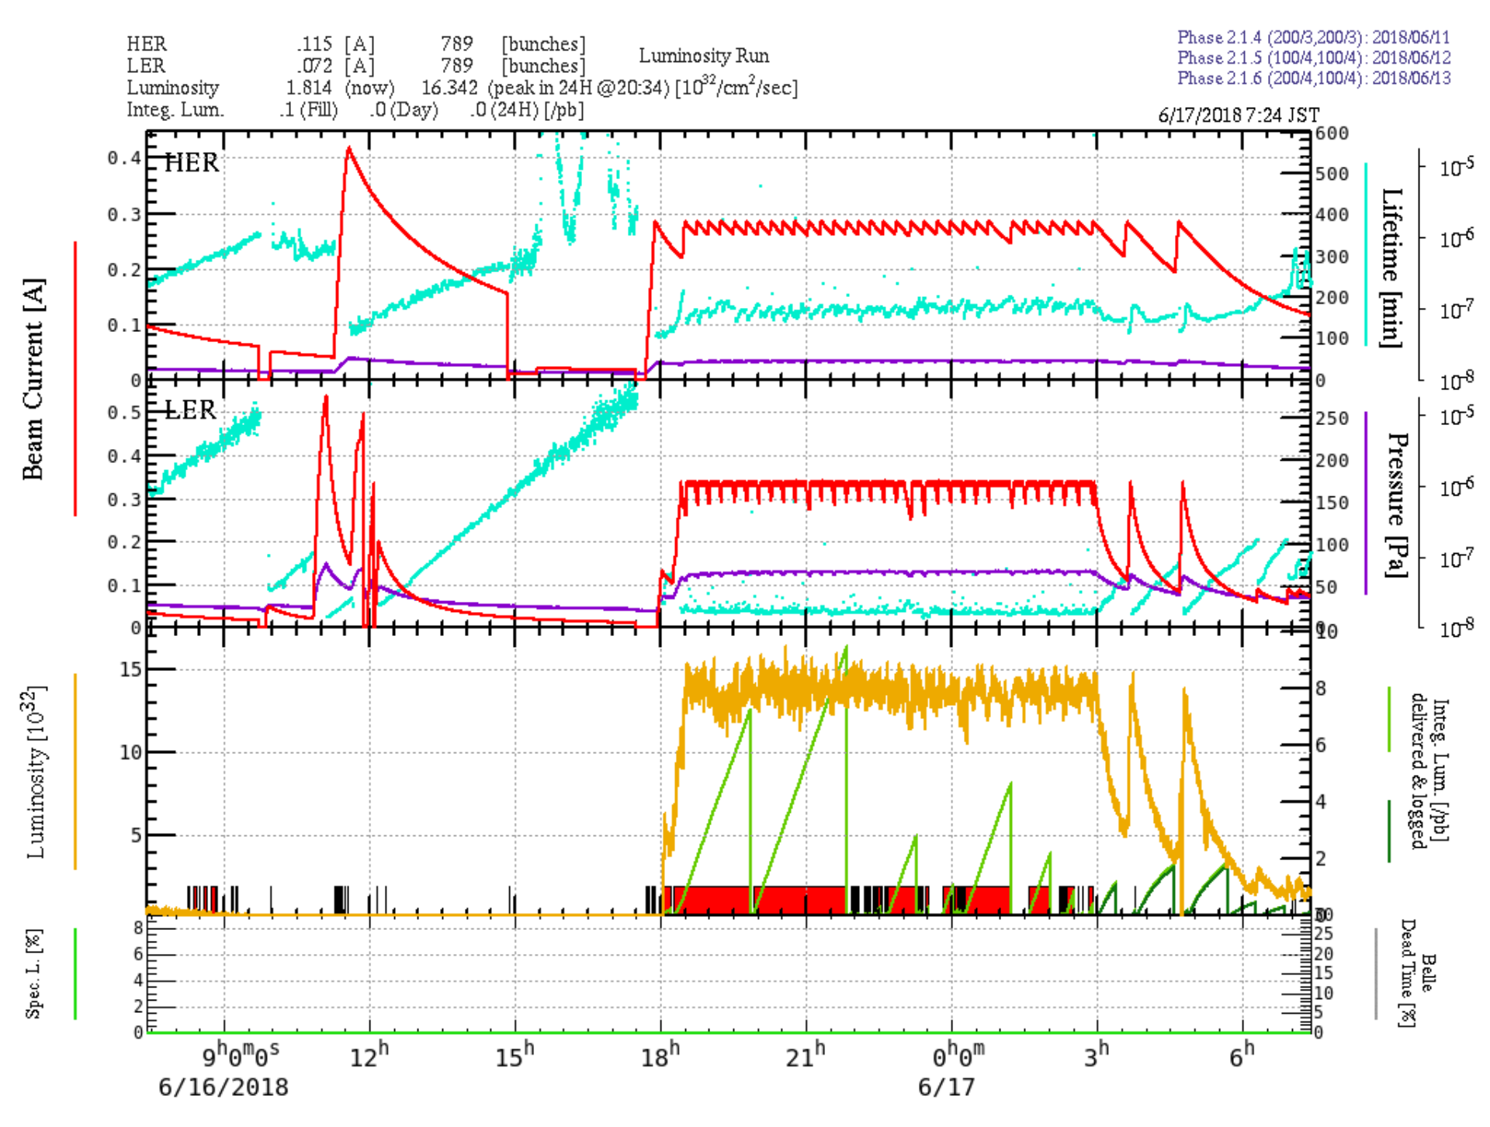
HER Injection with RF Gun
RF-gun
Thermionic gun
・Safety system required 30 seconds to switch between guns before summer.

Slide 11
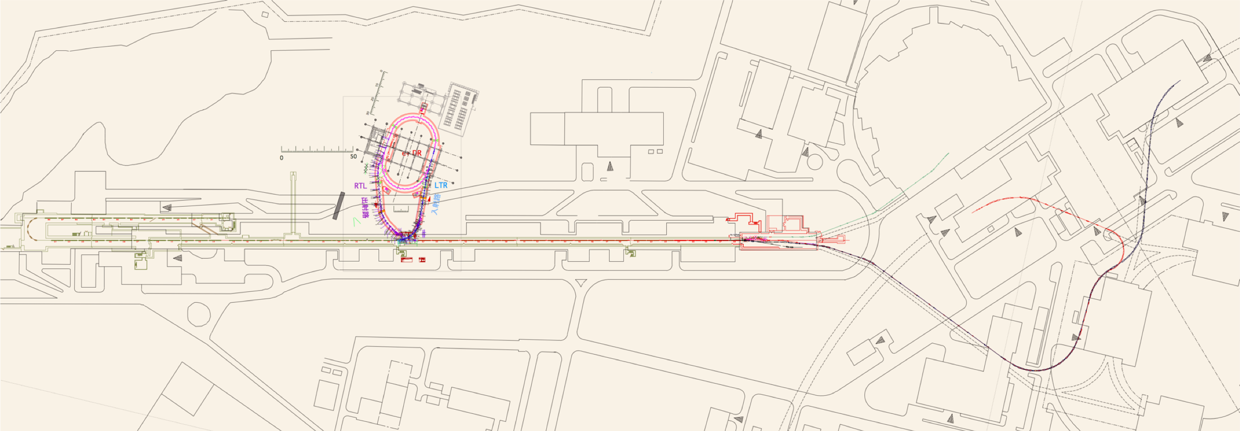



Requirement for SuperKEKB
After the LINAC, beam go through BT.
In Phase5III final, requirement of beam charge is 4 nC for both beam.
Requirement for H/V emittance of e+ beam is 100/15 μm.
Requirement for H/V emittance of e- beam is 40/20 μm.
We have to realize the high quality beam transportation to main ring without emittance growth as far as possible.
Otherwise, injection rate is worse and luminosity can not
reach the target value.
Stage | Phase II (Mar. − Jul. 2018) |  | Phase III (Mar. 2019 −)
Beam | e+ | e– | e+ | e–
Bunch charge (nC) | 1.5 | 1 | 4 | 4
Norm. Emit. μm | 200/40 (Hor./Ver.) | 150 | 100/15 (Hor./Ver.) | 40/20 (Hor./Ver.)
Energy spread | 0.16% | 0.1% | 0.16% | 0.07%
Schematic layout of LINAC and beam transport line (BT)
7 GeV
SuperKEKB5HER
e-
Electron gun
DR (damping ring)
SectorB
SectorA
e+
Jarc
SectorC
Sector1
Sector2
Sector3
Sector4
Sector5
Beam Transport lines (BT)
ARC (Bending section)
Positron generation target
4 GeV
SuperKEKB5LER
BT (Beam Transport line)

Slide 12















Injection Beam at KEKB and SuperKEKB
Comparison between achievement at KEKB and requirement at SuperKEKB Phase III
  Much smaller emittance even with 3-fold higher beam charge
  Still a big challenge that is being resolved
5
4
3
2
1
0
3 times
400
300
200
100
0
1/7
400
300
200
100
0
1/15
0.08
0.06
0.04
0.02
0
1.3 times
Norm. Hor.
Emit. (μm)
Norm. Ver.
Emit. (μm)
Charge (nC)
σδ(%)

Slide 13
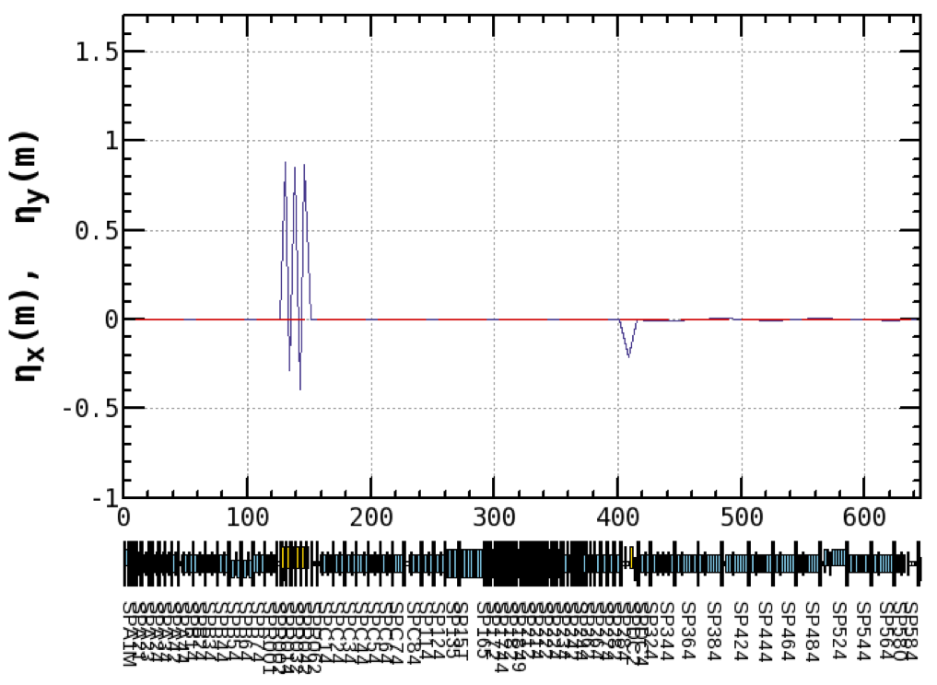
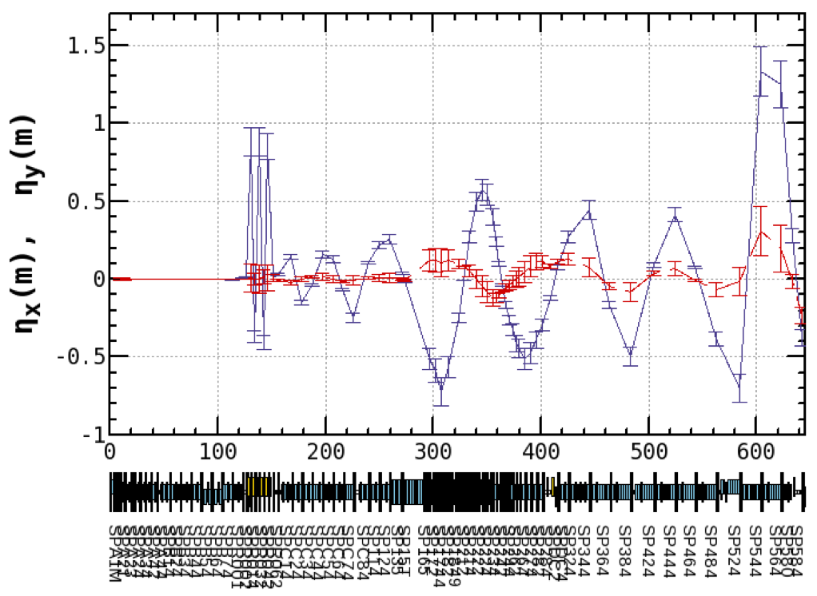
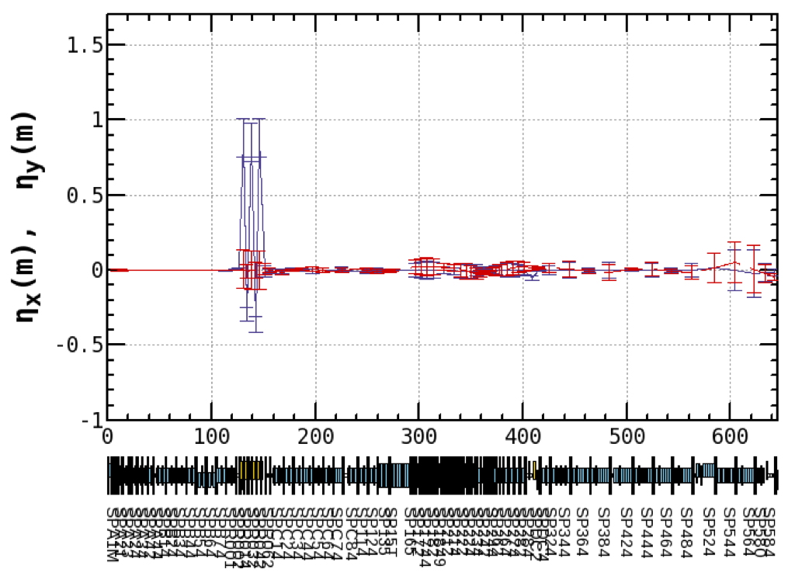

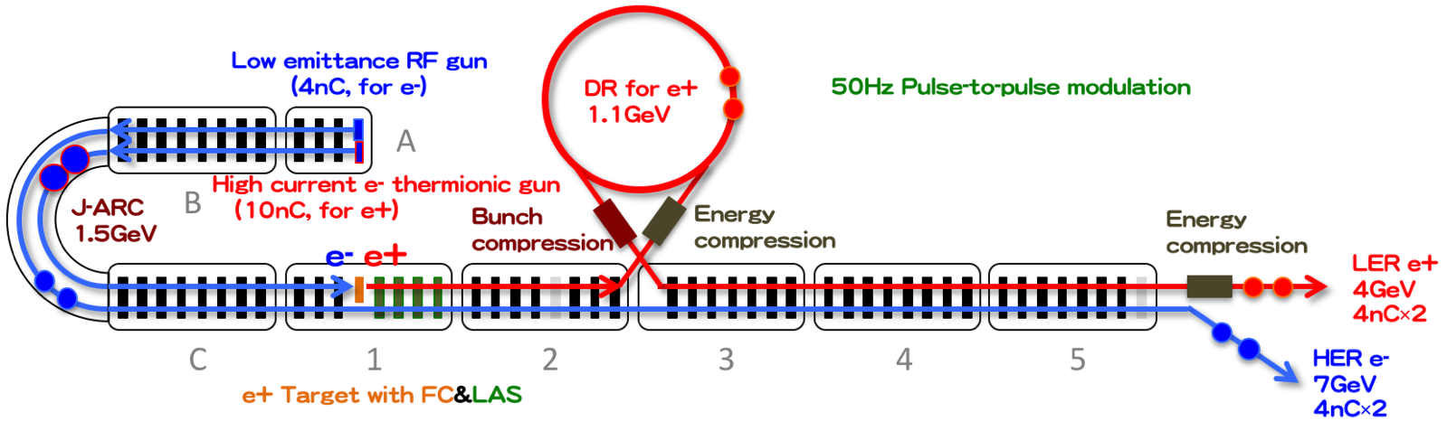
Residual Dispersion Function in Linac
Y. Seimiya et al.
Large residual dispersion was generated from the J–ARC.
With dispersion correction by tuning the magnetic field of quadrupole magnets, residual dispersion became small enough.
Design
Measured
Before
Measured
After
Dispersion correction

Slide 14
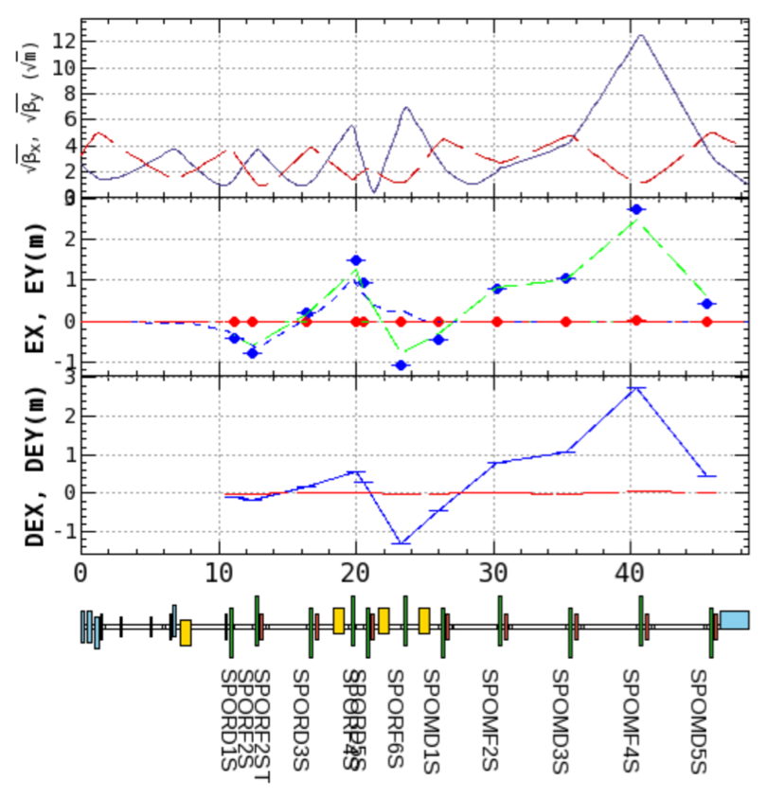
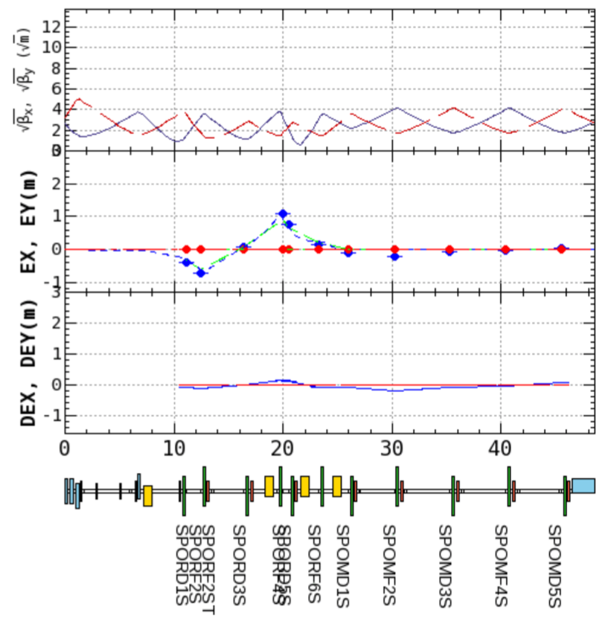
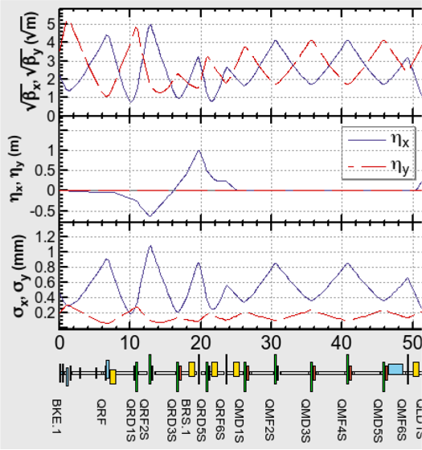
Residual Dispersion Function in DR RTL
This table shows values of residual dispersion before and after correction.
Residual dispersion became smaller in both ARCs.
In 1st ARC, residual dispersion is not still small enough.
Y. Seimiya et al.
e+ | <ηx²>^{1/2} [m] |  | <ηy²>^{1/2} [m] |  | Fudge Factor of Quad.
Correction | Before | After | Before | After | [%]
2nd ARC | 0.079 | 0.019 | 0.0094 | 0.0077 | C 4.5
1st ARC | 1.05 | 0.09 | 0.02 | 0.01 | C 8.2
There are two ARCs in the DR extraction line.
Need more study Before
Example: 1st ARC
After dispersion correction
Optics of the extraction line
The third graph shows residual dispersion. Blue is horizontal and red is vertical.
Extraction Kicker Extraction Septum
DC Bends
Instead of changing the energy of DR, I changed the strength of Bend, Quad all at once. For the kicker and septum, Response measurement was done.

Slide 15
Phase II Operation
Summer Shutdown
Autumn Operation
Phase III
Summary

Slide 16
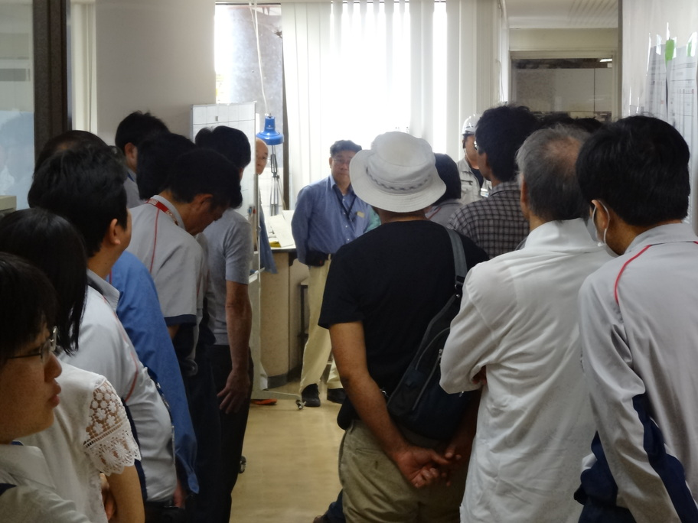
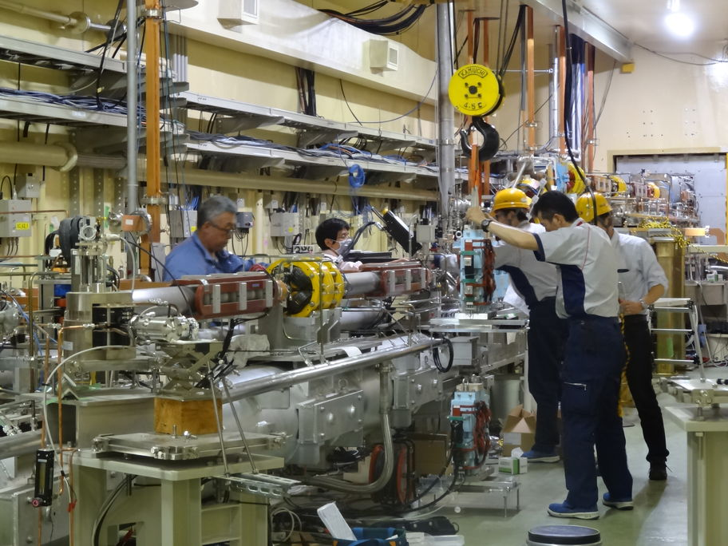
Summer Maintenance and Improvements
105 items were performed
From July 17th to October 22th
There were several near misses (no injuries)
  Taking measures against them
Morning meetings every day

Slide 17
RF System Upgrade
Replacement of SHB1 Solid-State 10kW Amp.
20 years old,
often unstable,
degraded power
RF Monitor Upgrade (Pulse-Shortening Detector)
Solid-State Sub-Booster System
Replaced single 60-kW klystron
with distributed 600W Solid-State Amplifiers
KL_13 Reinstallation

Slide 18
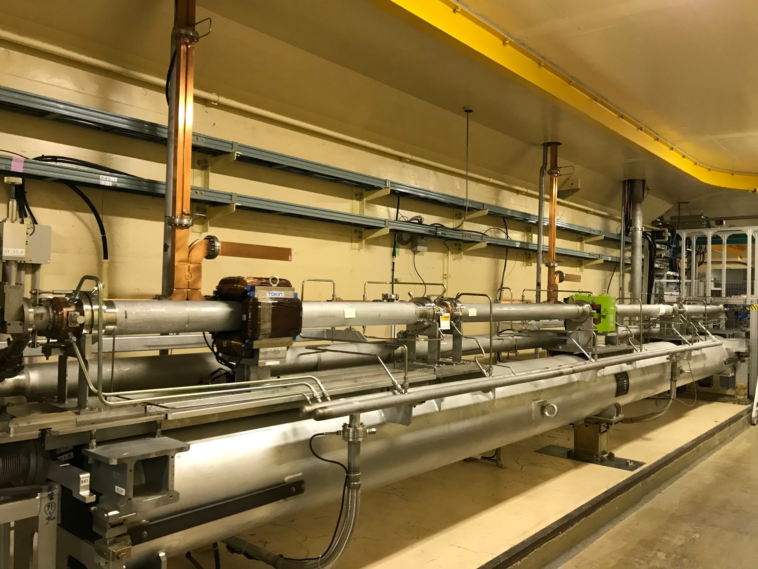
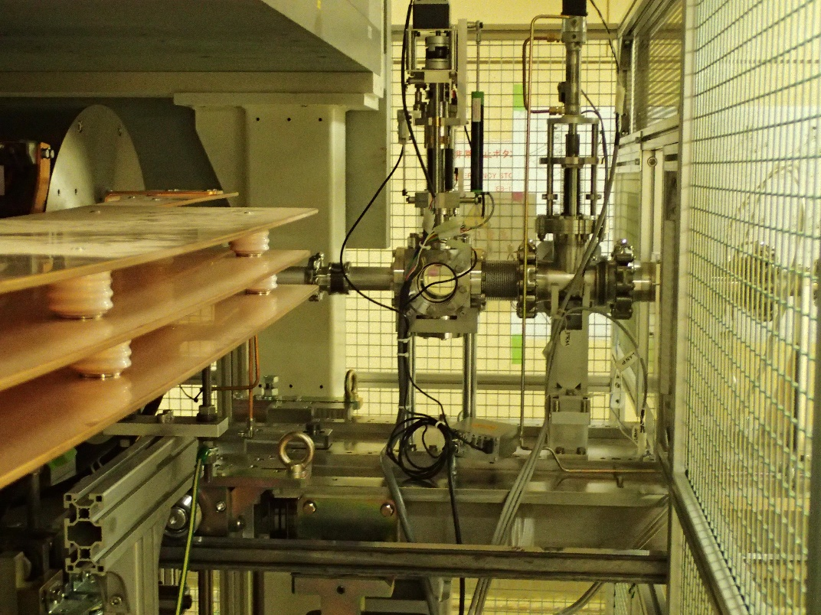
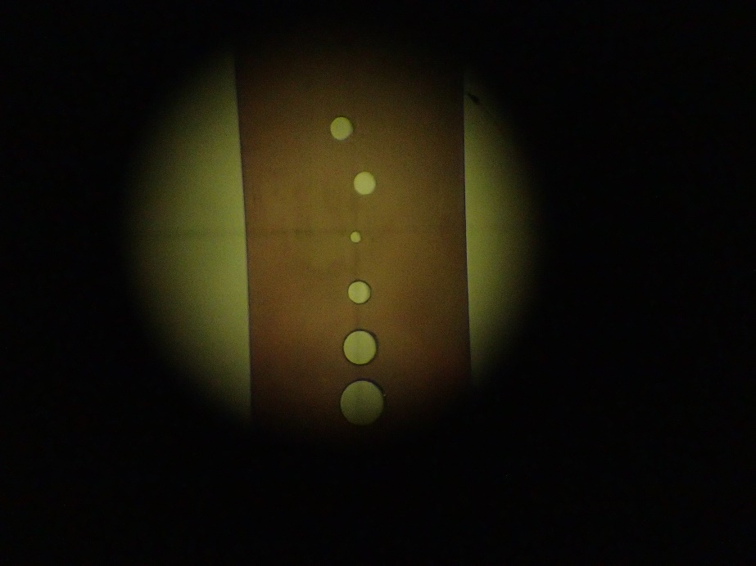
Accelerating Units and Target Hole
Restoration of Unit 1-3
Replacement of markedly deteriorate accelerating structures in Units 1-1 and 5-1 with spares capable of rated power operation
Installation and adjustment of the power supplies for pulse magnets newly installed
Removal of the used FC base-unit and installation of the dummy plunger with holes for beam jitter measurement
Upgrade of control system for bending and solenoidal magnets
Restored Unit 1-3
Dummy plunger with holes (replacing target)

Slide 19
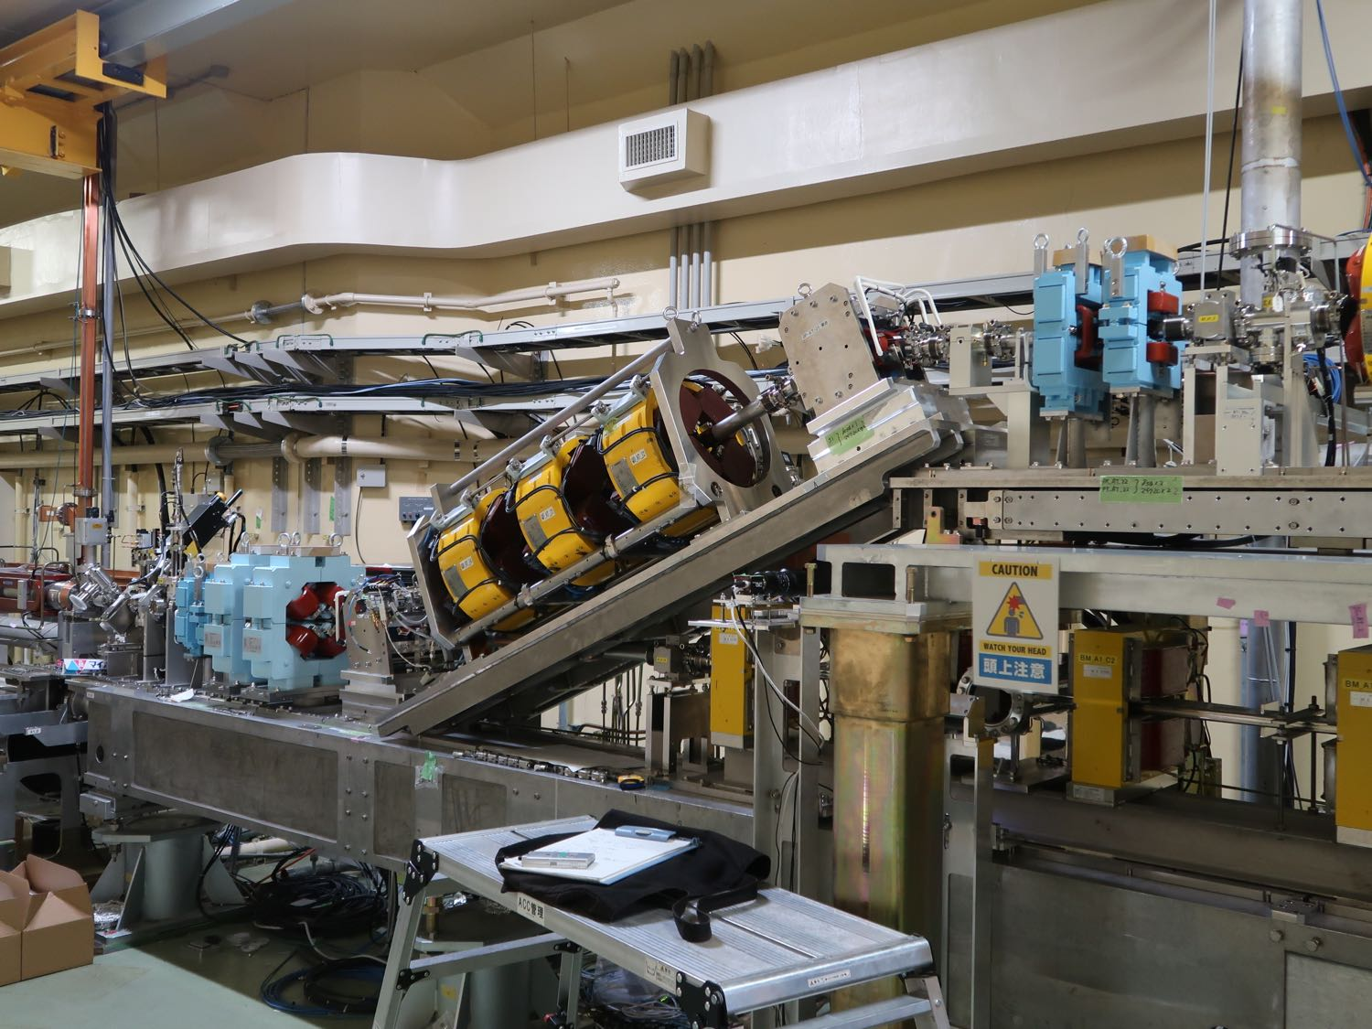
Magnets and Beamline
Pulse magnets installed in beam-merger line of two pre-injectors. (bends x2, quads x4, correctors x4)
Corrector magnets added. (PY_12_2 [pulsed], BX_DS_C2 [DC])
DC corrector magnets removed in Sector-3, 4, 5.
(pulsed correctors installed in summer 2017 summer)
Interlock system configuration improved.
(e+ focusing DC solenoids, beam dump line quads)
Alignment of all beam-line girders and quads measured. Those with large deviation adjusted.
Remote control system installed in e+/e- beam separator.

Slide 20
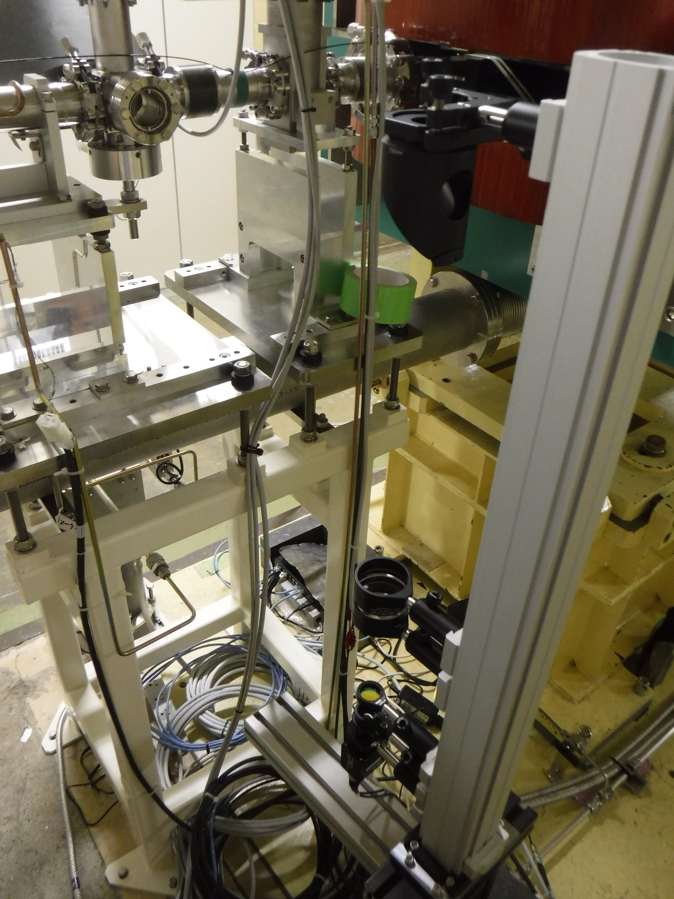
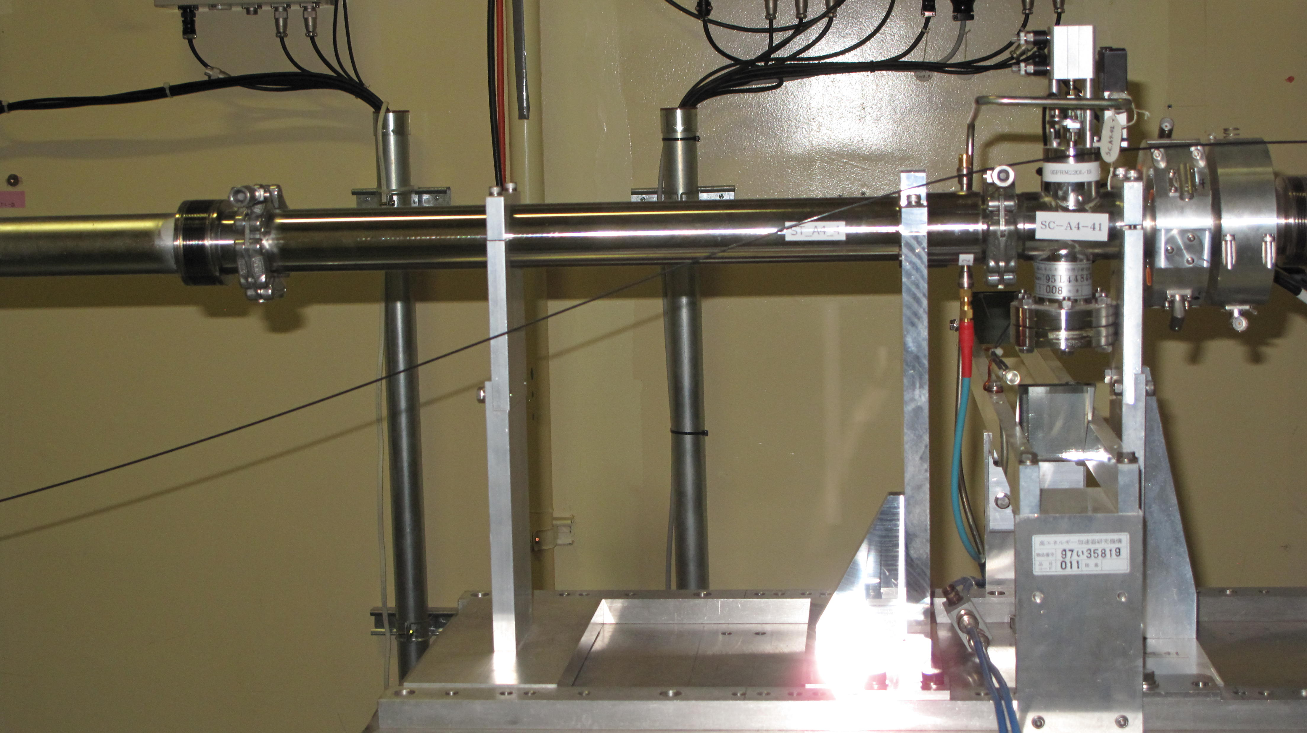
Development of New Beam Monitors
A new beam timing monitor with stripline electrodes was installed at #A44. The resolution is expected to be 2 ps in RMS.
Beam induced RF monitors are improved to held each other.
A new beam profile monitor with OTR target and high-precision optical focus system was installed at SY2 straight line. The resolution is expected to be 8 micron in FWHM.

Slide 21
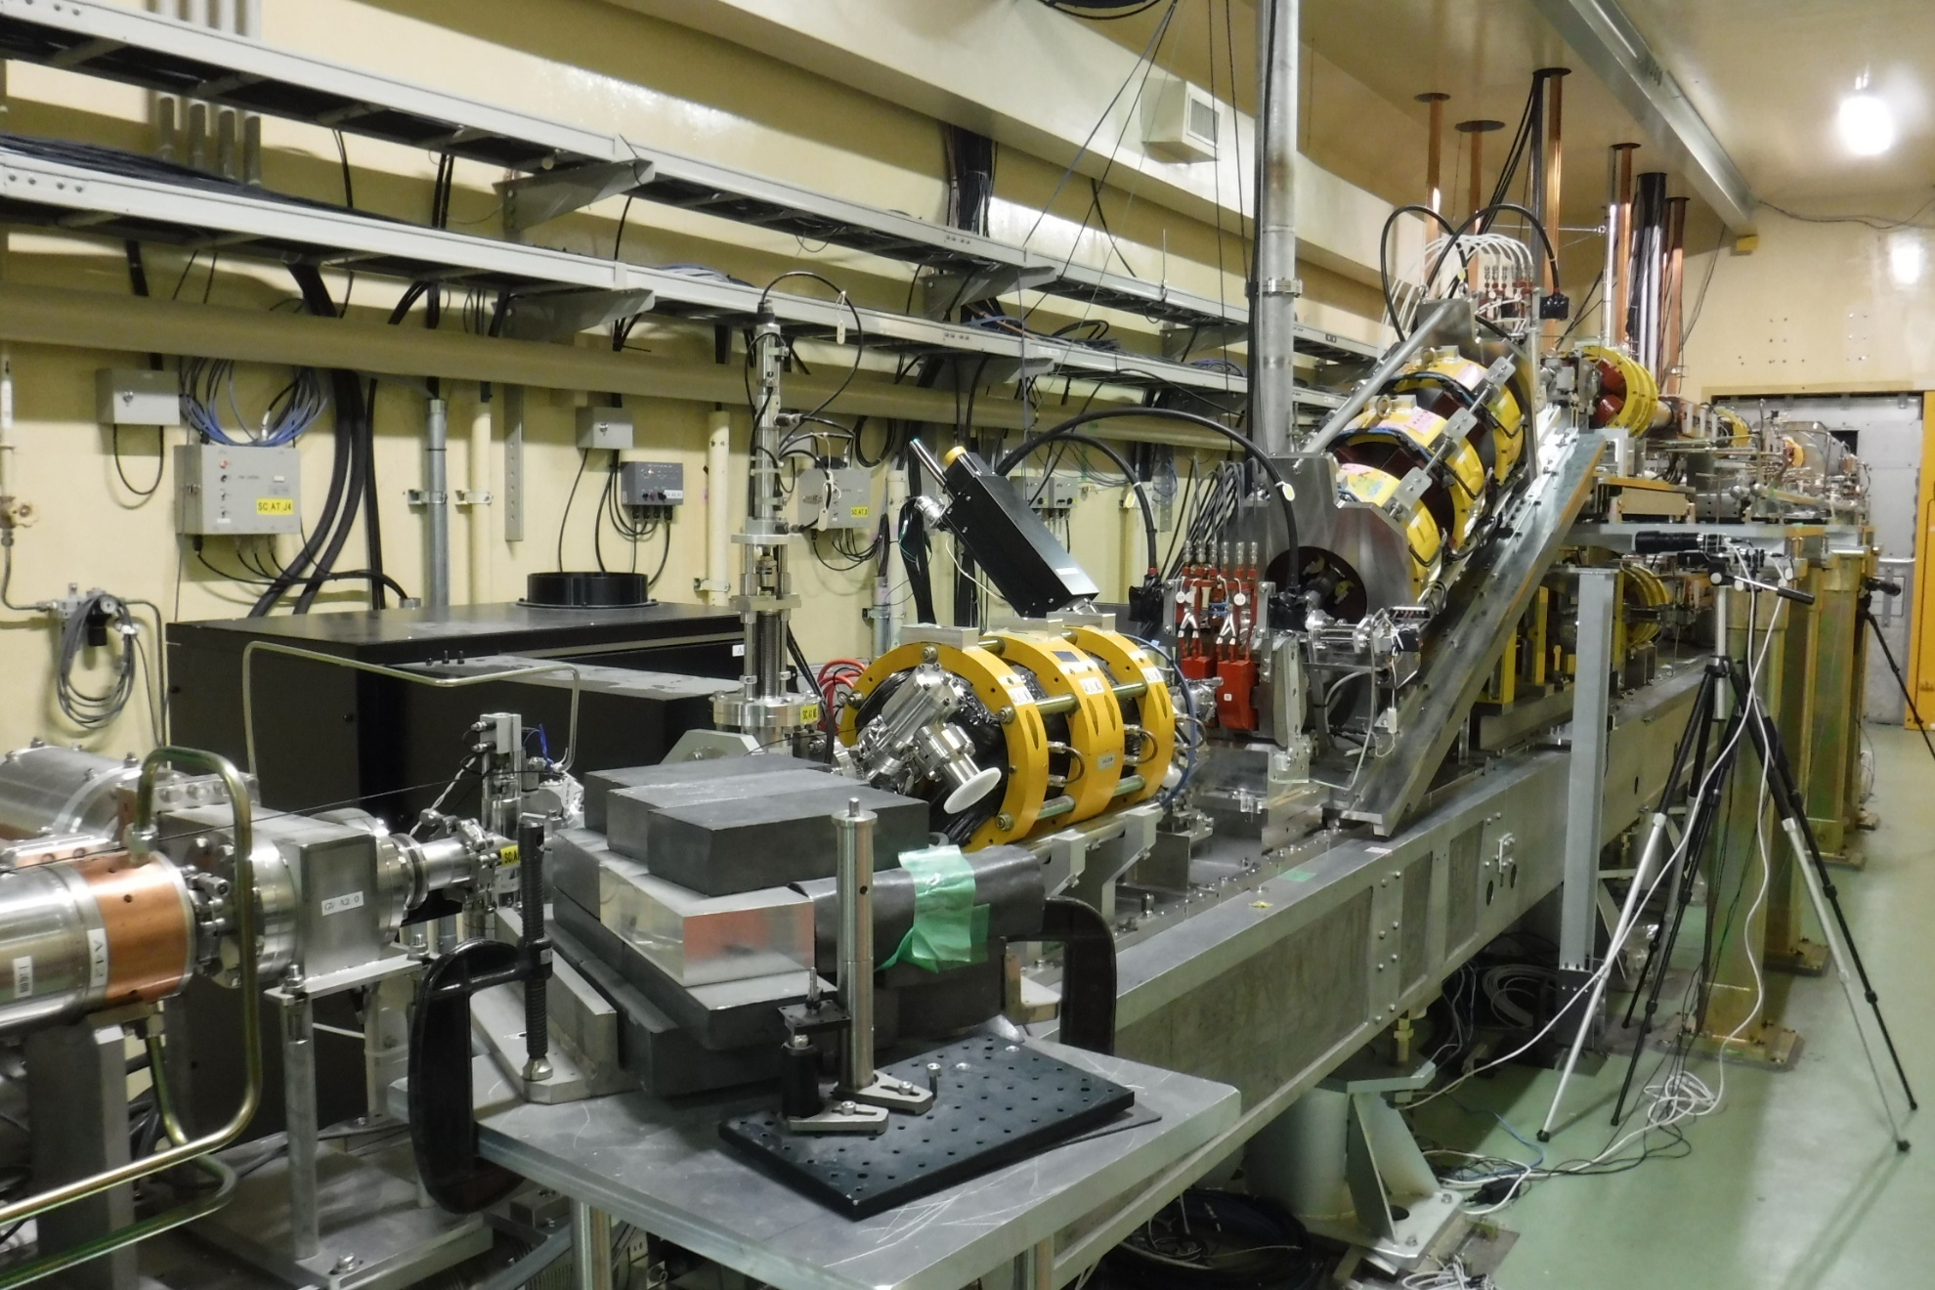
Planning Pulsed Magnets for Merger Line
24-degree Merger
Bend x2
Thermionic Gun
PF-AR
LER (primary e– for e+）
PF
HER
Photo RF Gun

Slide 22
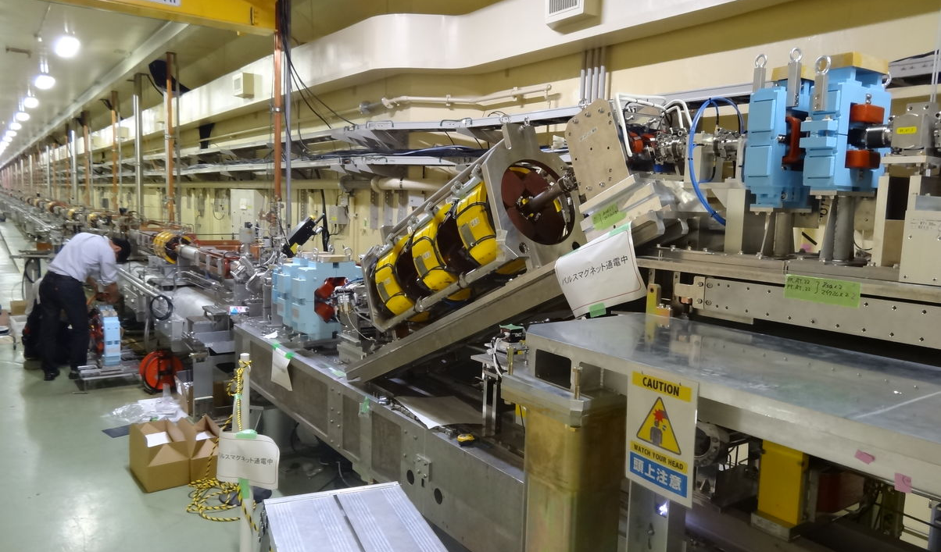
Pulsed Magnets for Merger Line

Slide 23
Phase II Operation
Summer Shutdown
Autumn Operation
Phase III
Summary

Slide 24
Injector Operation in Autumn 2018
Top-up injections to light sources, PF/PF-AR
  With pulsed magnets at beamline merger of guns
No positron damping ring operation
  Opportunity to study beam behavior at target hole
25 Hz mostly, followed by 3-day 50-Hz hardware checks
  First intense 50-Hz operation since 2011 earthquake in 2019
Emittance brow-up studies and knowledge acquisition
  Beam studies are planned, partially with simultaneous injection
Emittance preservation
  Beam orbit, optics controls and mover application
Gradual beam current and gradient improvements
  For later injection improvement

Slide 25


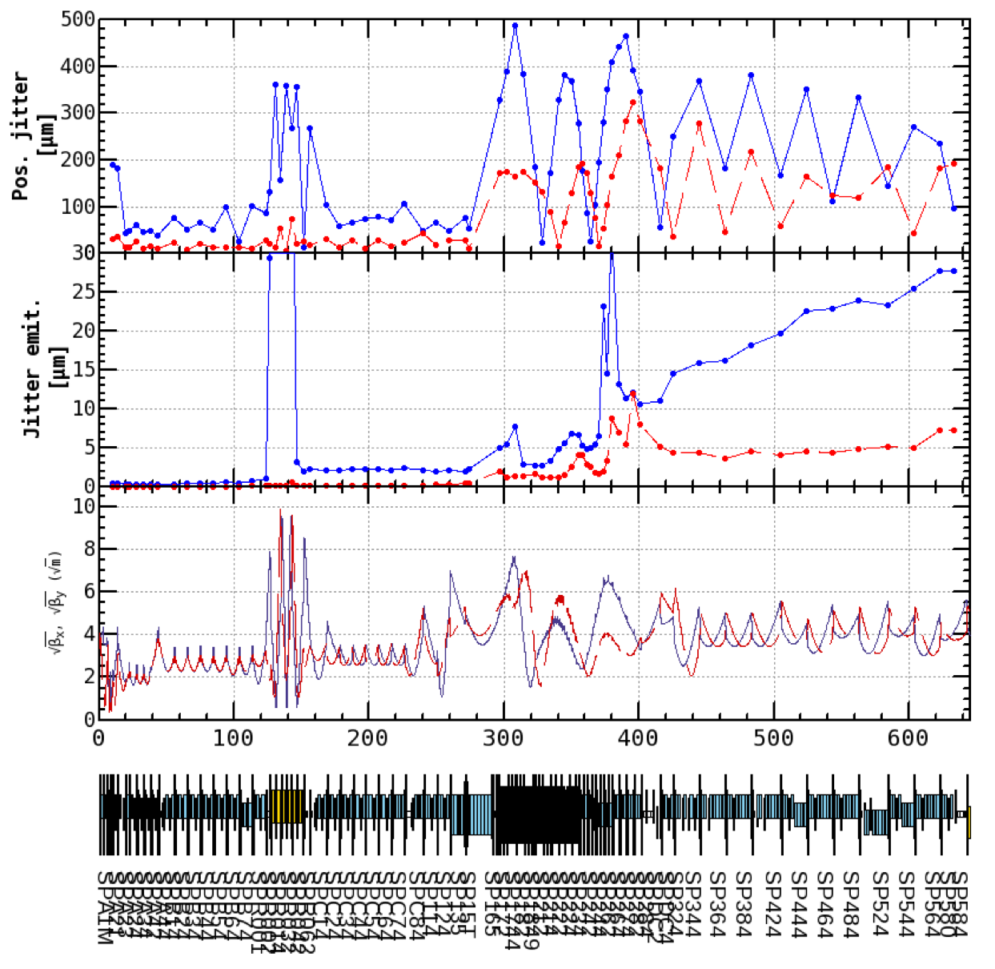
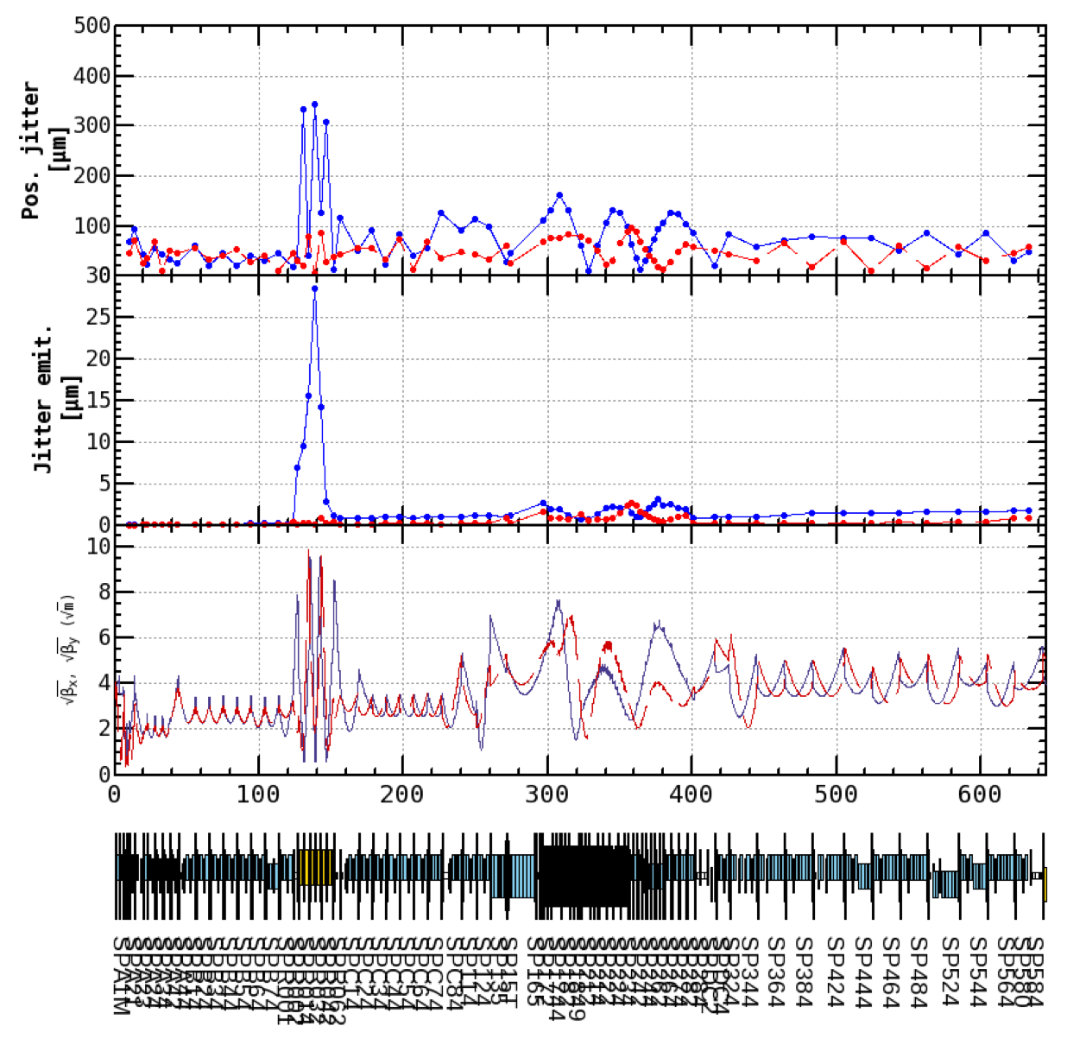


Beam Phase Space Jitter
Before dispersion correction
After dispersion correction
J-ARC e+ target
J-ARC e+ target
1nC
First figure shows the standard deviation of beam position. Second figure shows emittance growth induced by beam jitter.
Linac end:
28 μm
7 μm
Linac end:
1.8 μm
0.9 μm
Beam phase space jitter is reduced by dispersion correction.
Small emittance growth still occurred from after the target after the correction.
We should understand the source of the beam jitter to prepare for the high charged beam
(4 nC) and for accidental jitter source which occur at upstream the target.

Slide 26









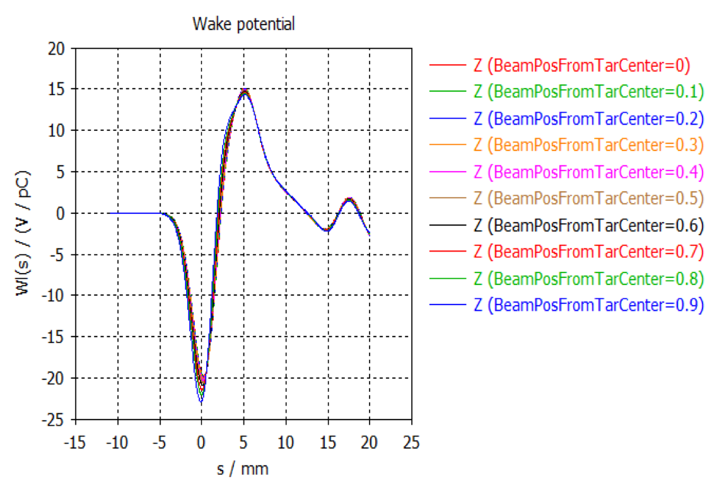
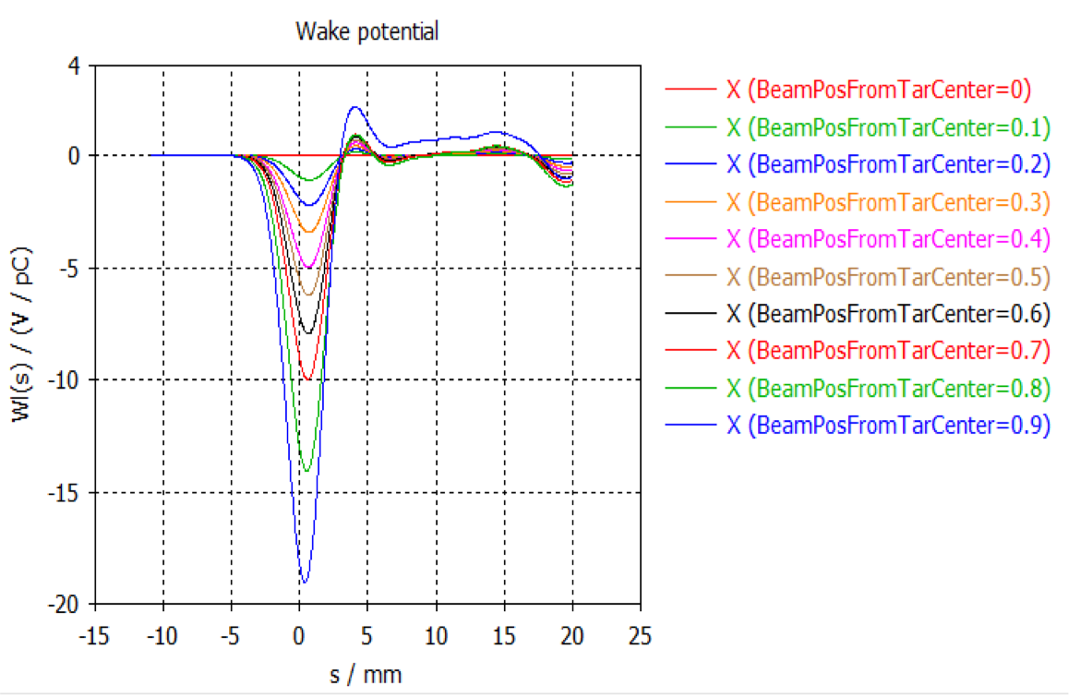

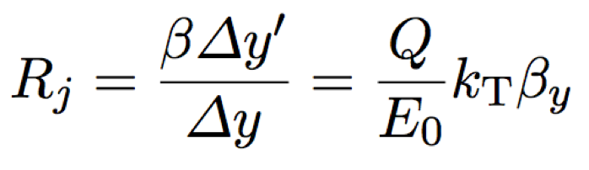
Emittance Growth at Target Hole (?)
Y. Seimiya et al.
e+ e-
e-
φ2 mm
In order to reveal beam jitter problem, simulation analysis of the wakefield in the target hole was performed.
Color variation shows difference of beam position from the center of target hole.
Longitudinal wake
Transverse wake
Wake potential in the target hole.
X = Beam position from the center of target hole.
Enlarged coefficient of beam position jitter:
~ 0.1@1nC << Measured enlarged coefficient

Slide 27

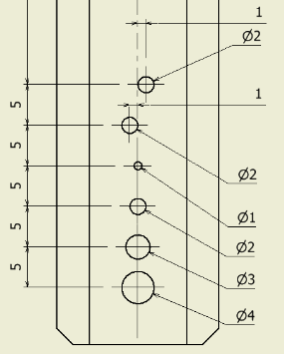
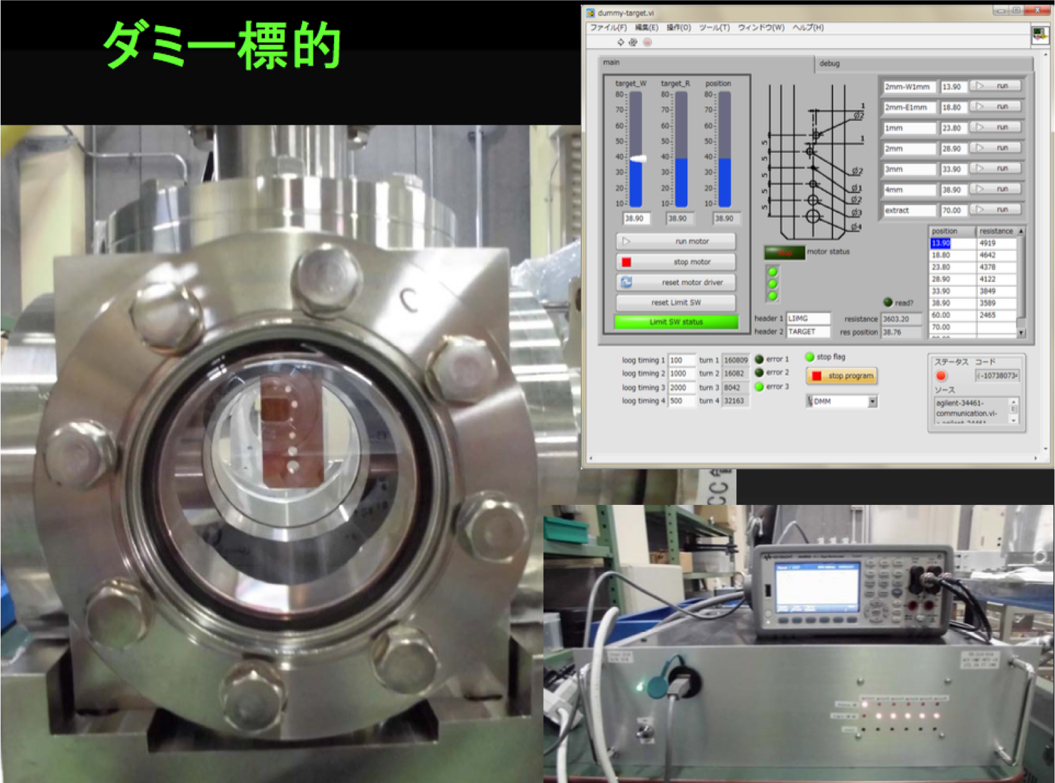
Target Hole Study
Y. Enomoto et al.
To reveal beam jitter source directly, we temporally replace the target to dummy target with several hole, which have different diameter.
In this autumn, we will study the target hole effect on beam jitter.

Slide 28
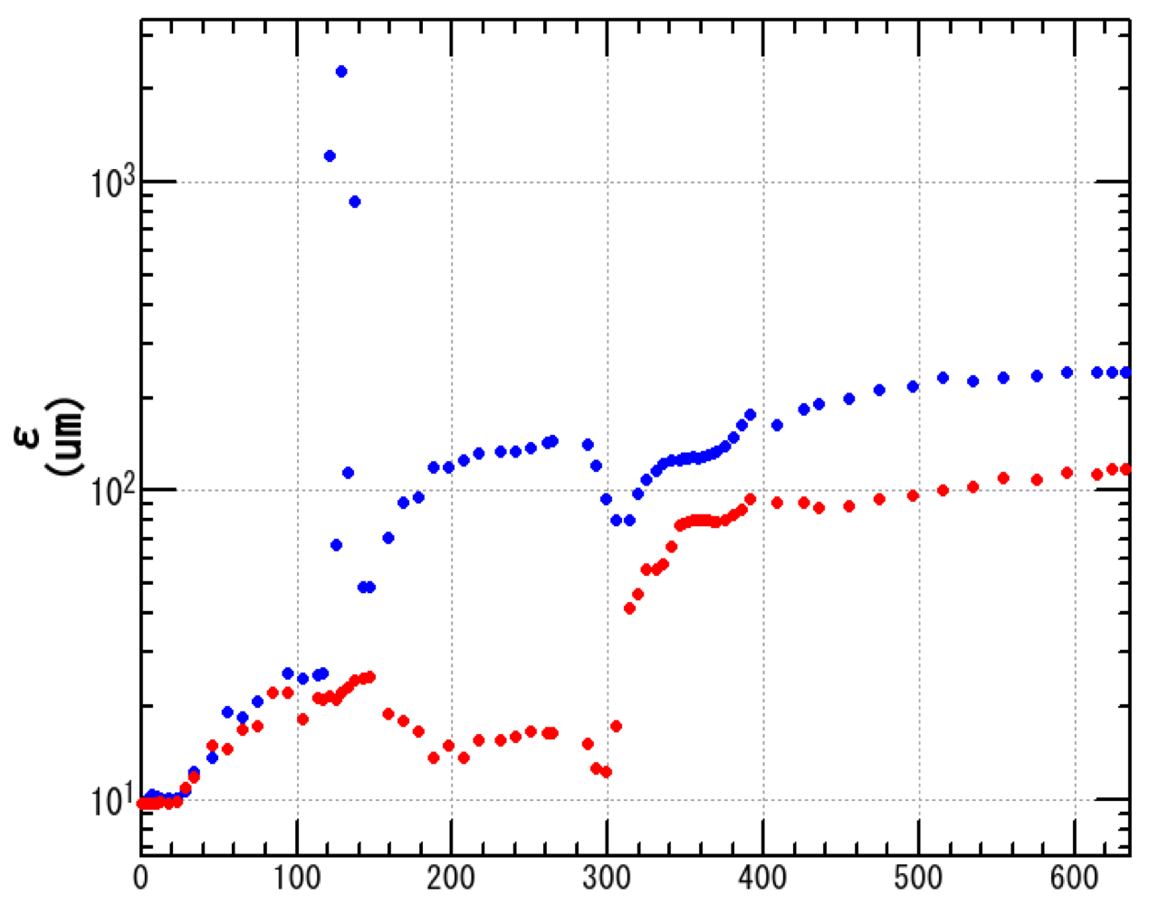
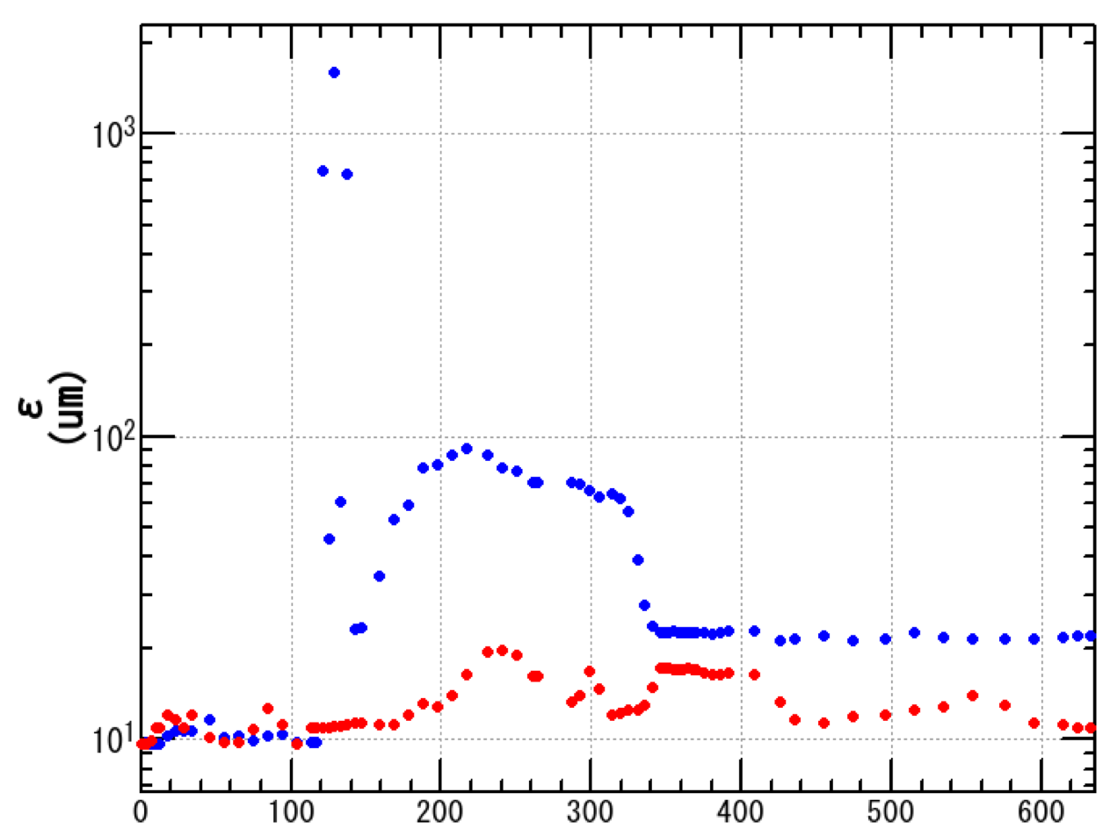
Simulation for Minimizing Emittance Growth Induced by Wakefield in Acceleration Structure
Particle tracking simulation was performed to evaluate this emittance growth.
Simulation conditions:
Phase;III requirement:
• ε_{inj} = 10 μm
• σ_{z} = 1.3 mm
• σ_{δ} = 0.4%
• Q = 5 nC
Horizontal : -
Vertical : -
( <50 μm)
( <20 μm)
Measured misalignments of acc. structure and quadrupole magnet were used.
Iris diameter of acc. structure is about 20 mm.
After emittance is minimized at the end of LINAC
After orbit displacement is minimized
Blue and red dot show horizontal and vertical emittance, respectively.
LINAC end: γβε_{X}:240 μm γβε_{Y}:120 μm
LINAC end: γβε_{X}: 22 μm γβε_{Y}: 11 μm
Blue and red line shows horizontal and vertical requirement of Phase III.
s (m)
End of LINAC
s (m)
By the orbit correction for minimizing emittance growth, requirement of Phase III can be satisfied.

Slide 29
Phase II Operation
Summer Shutdown
Autumn Operation
Phase III
Summary

Slide 30
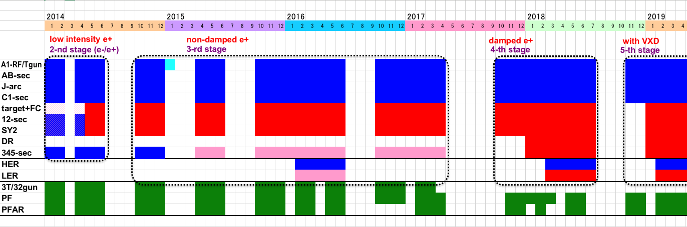
Linac Schedule Overview as of Jun.2018
Schedule
RF-Gun e- beam
commissioning
at A,B-sector
e- commiss.
at A,B,R,C,1
e+ commiss.
at 1,2 sector (FC, DCS, Qe- 50%)
e- commiss.
at 1,2,3,4,5 sector
Phase1: high emittance beam for vacuum scrub
Phase2,3: low emittance beam for collision
Time →
Location
↓
Beam
Licenses
in steps
Low Emittance Beams
Low Emittance Injections
4+1 Ring
Injections
DR
Commiss.
1 nC
Phase1
1 - 2 nC
Phase2
1 - 4 nC
Phase3
Without Top-up
Direct PF-AR BT
: Electron
non damped e+ commiss.
at 1,2, 3,4,5 sectors
e- commiss. at A→5 sectors
damped e+ commiss.
at 1→5 Qe+ = 1~4nC
e- commiss.
at A→5 Qe- = 1~4nC
Improved
RF gun
: Positron
: Low current electron

Slide 31
For Phase 3
Simultaneous injections with some more pulsed magnets, in order to adjust beam optics and orbits
Some more beam instrumentation improvements
Positron target / flux concentrator restoration
50 Hz operation
Further instability hunt
Low emittance beam developments
Reliability, reproducibility, automation, etc.

Slide 32
Summary
The injector performed Phase-2 commissioning without much troubles
The facility is believed to be ready for the first year in Phase-3, while it may face challenges to achieve the final beam qualities

Slide 33
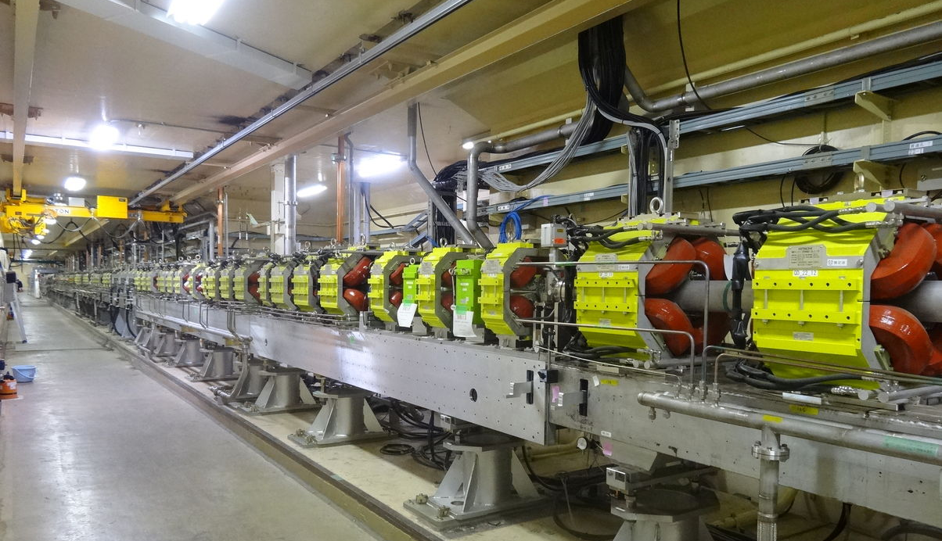
Thank you

Slide 34
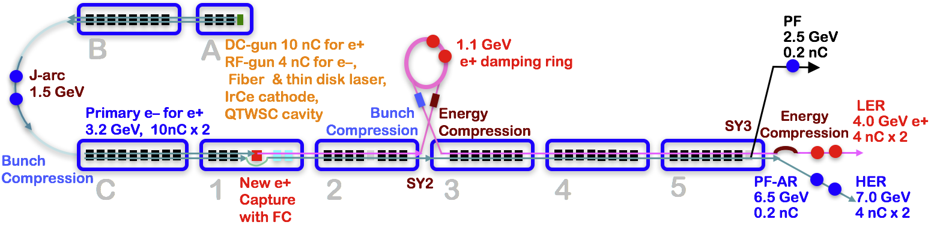
Injector Linac Overview
Injector linac configuration
  Major upgrade items
    Photo-cathode RF-gun for low-emittance e-
    Flux concentrator, LAS structure, solenoids, quads for e+
    Pulsed magnets for adequate beam optics for each beam
    High-precision beam position monitor
    High-precision beamline alignment for low emittance

Slide 35
概要 (2)
陽電子DR運転
  バケットセレクション，入出射タイミング
  低エミッタンス (垂直方向は良い．水平方向は悪い．BTで悪化する)
モニタ
  BPM: VMEデータ収集系
  A1ストリークカメラを3セクタ (34ユニット) に移設した．
  プロファイルモニタ:
    YAG:Ce, OTR (SC_34_2, SC_D4_4)
  RFモニタの活用
1. 入射器Phase II運転

Slide 36
Simultaneous Injection (Thermionic Gun)
HER
LER
Horizontal
Vertical
Charge/bunch
Stable Operation
PF
PF-AR
Horizontal
Vertical
Charge/bunch

Slide 37
A Residual dispersion in the DR extraction line (2)
Y. Seimiya et al.
Emittance improvement by dispersion correction
Emittance was measured by wire scanner.
e+
0.7 [nC]
Horizontal Dispersion at Straight section after the Arcs
DR design emittance
First, we corrected 2nd ARC dispersion. By the correction, emittance was improved from about 300 to 200.
Before Correction
After Correction in 2nd arc
After Correction in 1st arc
Fudge Factor of Quads [%]
<!x²>^{1/2} [m]
0.079
0.019
G 4.5
1.05
0.09
G 8.2
Then, we corrected 1 ARC dispersion. By the correction,
st
Measured Emittance in Sector 3
γβεx [μm]
293+44.5 192+22.4
1.84+0.163 2.01+0.363
126+8.2
64.3
γβεy [μm]
1.5+0.1
emittance was improved to about 130.
Thought the horizontal emittance became less than half, it is still twice as large as that of DR design.
Ms. Iida will talk this issue at the end of this session (TUPAB07).

Slide 38
A) Residual dispersion in BT
Until BT-Wire Scanner (WS) position, dispersion correction was done.
In some ARC, dispersion correction is not finished. → Continue to Phase-III
Y. Seimiya,
N. Iida, M. Kikuchi
e;
<!x²>^{1/2} [m] <!y²>^{1/2} [m]
Fudge Factor of Quadrupole
As a same manner, we corrected dispersion in each ARC of BT.
Correction
Before After Before
0.13 0.11 0.05
0.11 0.02 0.01
0.102 0.038 0.029
0.066 0.029 0.037
0.104 0.091 0.192
- - -
After
[%]
Slope 1
0.01
1.0-5.9
BT-WS placed
Bte 0th ARC
0.02
0-6.7
This table shows residual dispersion before and after
Bte 1st ARC
0.036
2.37
Bte 2nd, 3rd ARC
0.034
2.52
Slope 2
0.116
3.55
Inj. point to MR
correction for e- and Bte 4th ARC
-
-
e+ beam.
Fudge Factor of Quadrupole
e+
<!x²>^{1/2} [m] <!y²>^{1/2} [m]
These ARC names are listed from the upstream of the beam line.
Correction
Before After Before
0.27 0.02 0.01
0.037 0.047 0.126
- - -
- - -
- - -
- - -
After
[%]
BT-WS placed
BTp 0th ARC
0.03
-26-12.9
BTp 1st ARC
0.102
2.5
Slope 1
-
-
BTp 2nd, 3rd ARC
-
-
Slope 2
-
-
Inj. point to MR
BTp 4th ARC
-
-

Slide 39
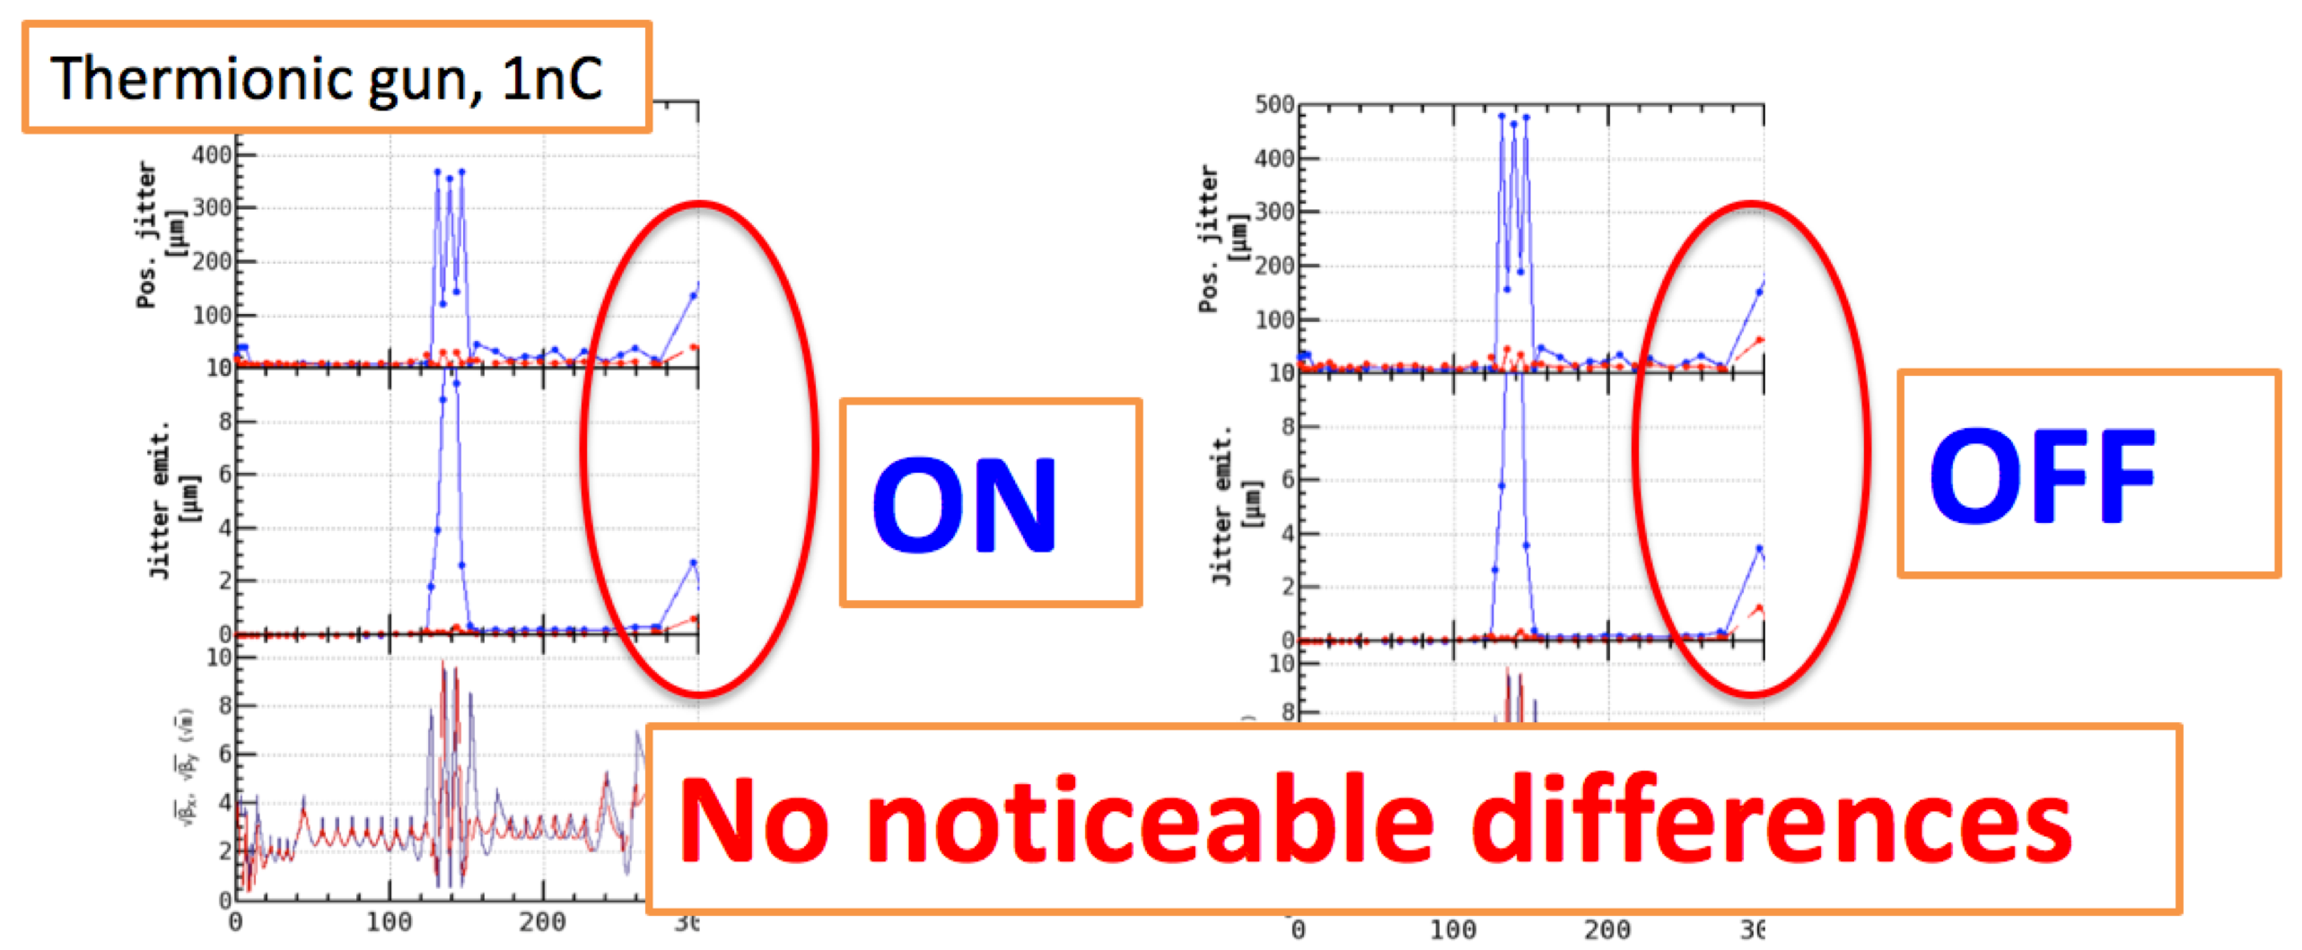
B) Beam Phase Space Jitter (2)
First, we suspected that components around the target made beam jitter.
They are flux concentrator, solenoid, bridge coil, pulsed magnet, chicane, and so on.
We check whether these components are sources of jitter or not by turn off these components.
There is not remarkable differences.
The components are not the beam jitter source.

Slide 40
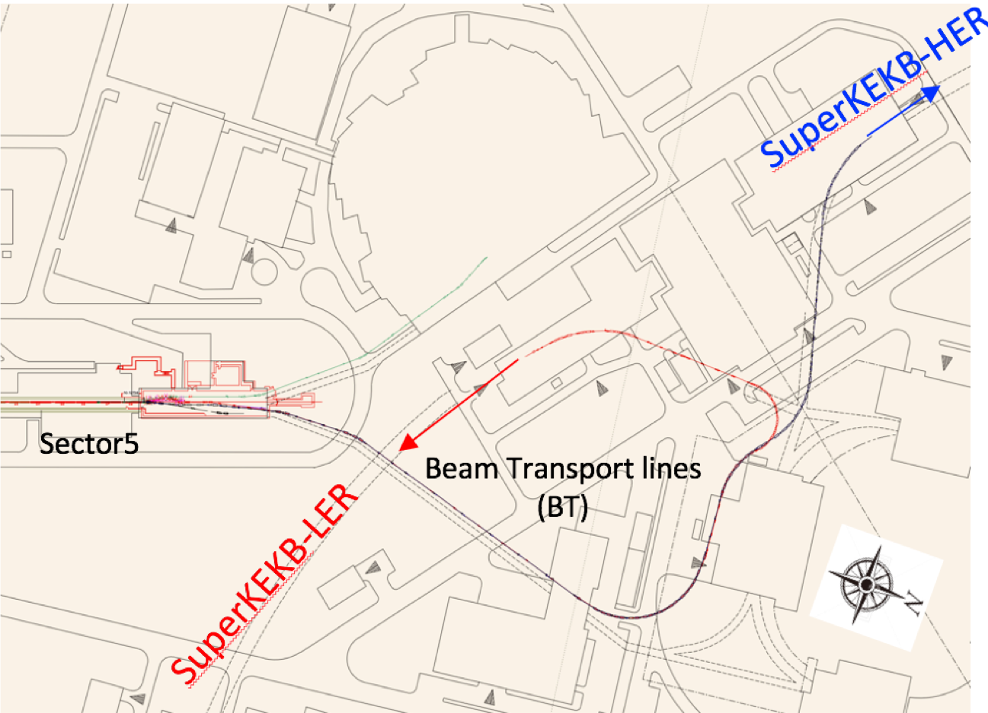
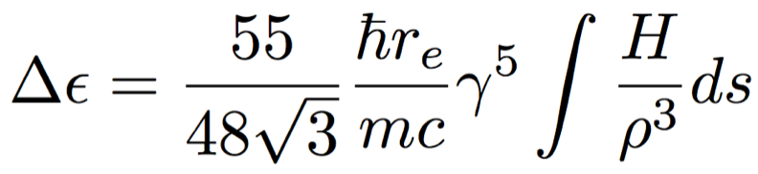
D) Emittance growth induced by radiation excitation in BT
Theoretical emittance growth induced by radiation excitation:
∝ !⁵, 1/∃³
Particle tracking simulation was performed from the end of LINAC to the end of BT.
N. Iida | Initial particles |  | With Radiation | Phase2III3final requirement
 | e8 (7 GeV) !∀ _{x} [∝m] | 20 | 68 | 40
 | e+ (4 GeV) !∀ _{x} [∝m] | 64 | 74 | 100
Initial horizontal emittance of e8 and e+ beam have 20 and 64 ∝m, respectively.
These emittances are increased by radiation excitation and reach 68 and 74 ∝m.
Even if the emittance preservation is perfect in the LINAC, emittance growth by radiation
excitation is larger than Phase8III final requirement for the e8 beam.
We seek a solution of this problem now. One possible way is that other tunnel (AR line) is used as
e8 beam line, which has smaller ρ than that of current beam line.

Slide 41
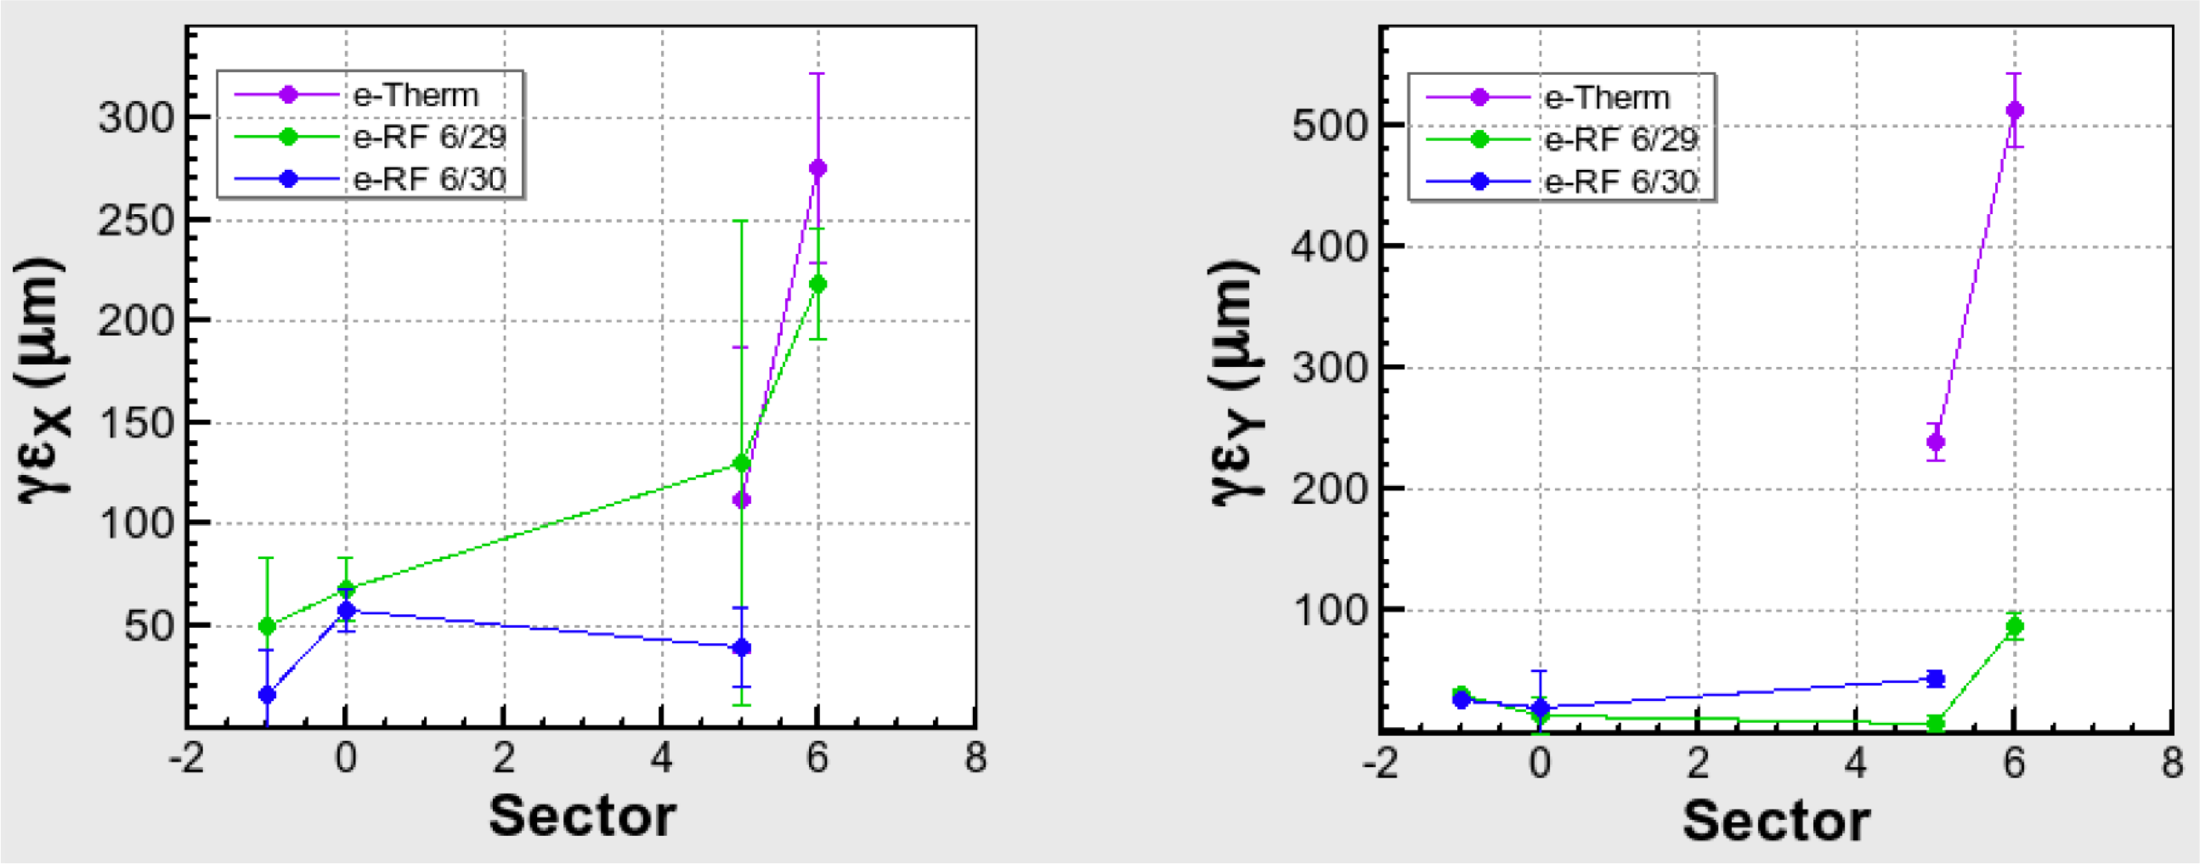




Emittance measurement (e.)
Left and right figure show horizontal and vertical emittance measured at each sector, respectively.
Green and blue plot show emittance of beam generated by RF gun.
Manual orbit correction was done so as to reduce the orbit distortion. By this correction,
emittance was reduced.
In Phase.II, the requirement of e. emittance at the end of LINAC was satisfied.
However, emittance was increased in BT though dispersion correction was done.
This growth is not caused by radiation excitation because BT.WS is placed around the start of BT.
X
1.2nC
Y
N. Iida
Phase.II
reduced by orbit correction
Phase.II
Phase.III
Phase.III
B C
5 BT
B C
5 BT

Slide 42
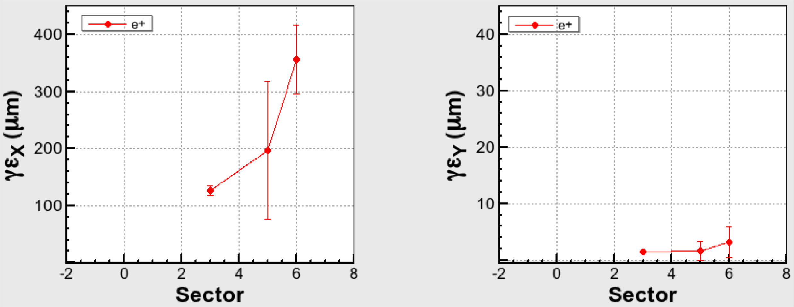
Emittance measurement (e+)
In Phase3II, the requirement of e+ emittance at the end of LINAC was also satisfied.
However, e+ emittance was also increased in BT though dispersion correction was done.
Investigations for this emittance growth source in BT are under going.
X
0.7nC
Y
N. Iida
Phase3II
Phase3II
Phase3III
Phase3III
B C
5 BT
B C
5 BT

Slide 43
エミッタンス (mm∙mrad) バンチ電荷量: ～ 1 nC
B
A
陽電子 εx/εy ～200/2
陽電子 εx/εy ～100/2
1.5 GeV e-
1.1 GeV
DR
C
1
2
3
4
5
Phase II 目標値
電子: εx,y ～150
陽電子: εx / εy ～200 / 40
電子 εx,y ～ 40
電子 εx,y ～20
ΒΤにおけるエミッタンス増大(電子，陽電子)： ～ 200
1. 入射器Phase II運転

Slide 44
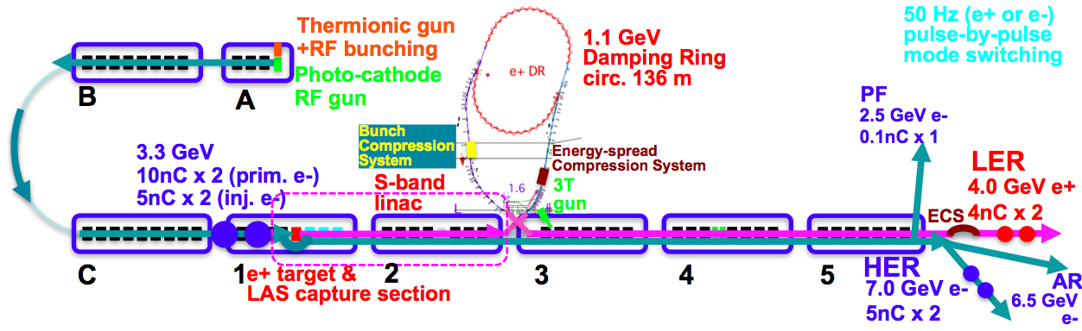
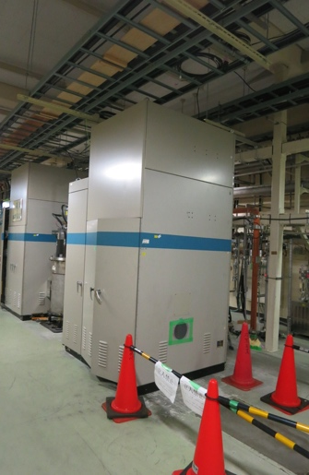
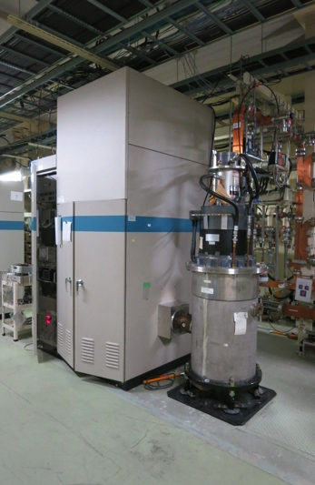
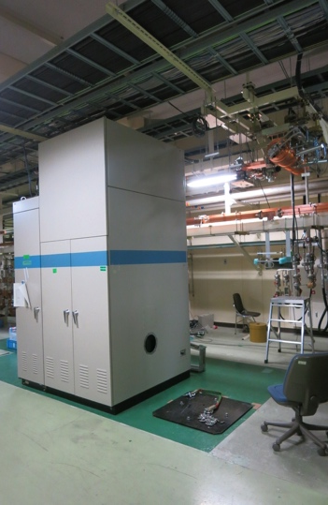
Klystron Modulator Installation and Temporary Gun Removal
Other Improvements
 | ECS | BCS
Voltage required [MV] | 41 | 21.5
# 2m accelerator structure | 2 | 1
Accelerator field [MV/m] | 10.2 | 10.75
Operation power [MW] | 29.0 | 19.0
Pulse width [µs] | 0.8 | 0.8
Rep. rate [Hz] | 50 | 50
KL_DS/BCS
KL_DN/ECS
KL_32

Slide 45
Newly Installed Pulsed Magnets
KEKB
Common optics was enough
SuperKEKB
Independent beam optics with
26 Quads and 26 Correctors
in Sectors 3 – 5
10 Correctors
in Sectors 1 and 2
2 Quads
for Positron Target
Positron common optics
with some steering magnets
Independent beam optics
with pulsed magnets
HER (7 GeV)
PF-AR (6.5 GeV)
Beam energy
LER (4 GeV)
PF (2.5 GeV)
A | B | C | 1 | 2 | 3 | 4 | 5
Sector

Slide 46
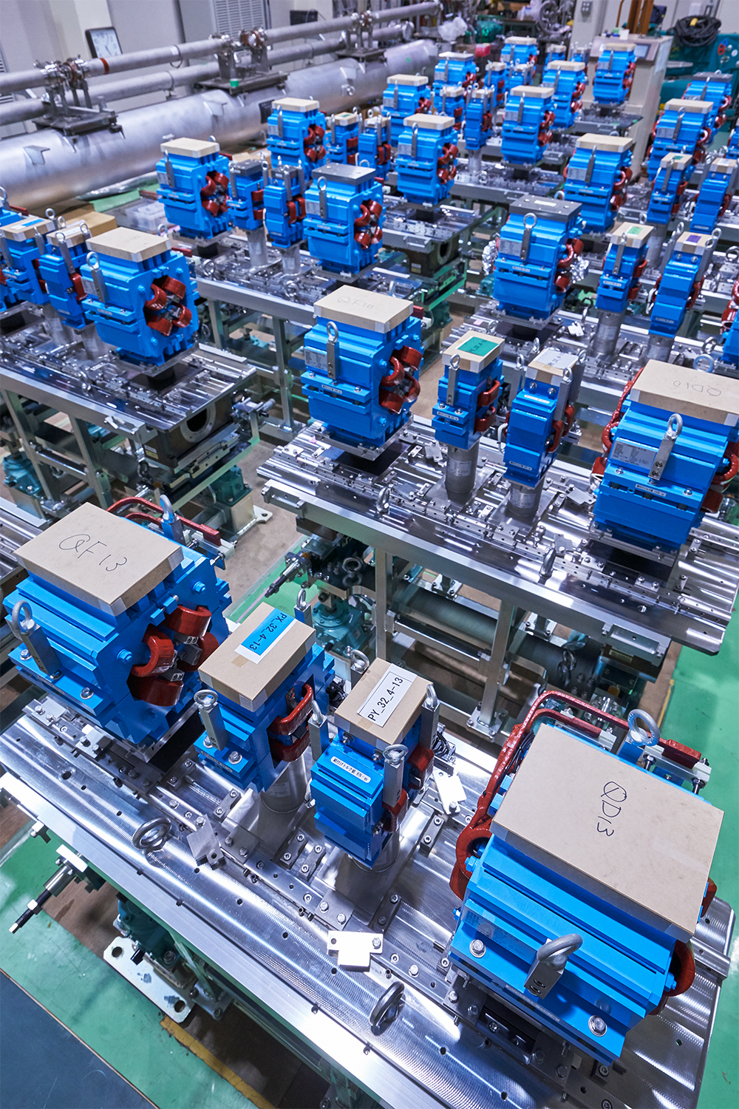
Pulsed Magnet Installation 1
Installation during long shutdown at summer 2017
  Not possible before Phase 1 without DR because of the aperture
  Replacement for 64 magnets
  In 99 days between May and October
  All components including magnets, girders, cabling, cooling water, controls, etc.
  In parallel with other replacements and installations
2017/3/31 by N.Toge

Slide 47
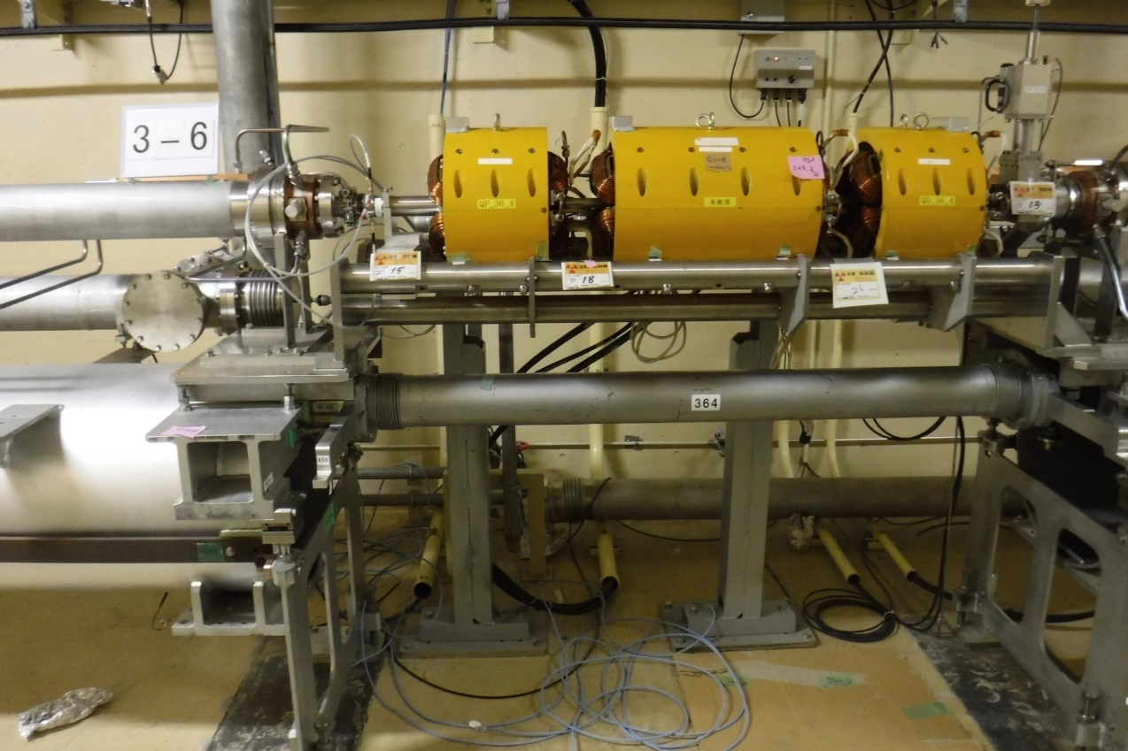

Pulsed Magnet Installation 2
13 New girders
  each for 2 quads and 2 correctors
  ready for 10 μm alignment to realize low emittance preservation in Phase 3

Slide 48

Pulsed Magnet Installation 3
Standard cabinet configuration for pulsed magnets
4 quads and 4 correctors for a half sector
Pulsed power supplies
& Interlock system
for 2 quads and 2 correctors
Pulsed power supplies
& Interlock system
for 2 quads and 2 correctors
Controls
Girder and magnet replacements before July
Power supply installation and cabling before September
Comprehensive system tests in September for a month

Slide 49

Performance of Quad Power Supply
High performance with energy recovery
  Total energy recovery rate of 68.5％ (measured)
  No need for additional wall power (only 39kW for all new magnets)
High precision and high stability by analog feedback with IGBT
  Stability of 0.01％ for 24 hours
Flexible synchronous controls with global event control system
  Independent pulse-by-pulse modulation at 50 Hz
Drives a 1 mH coil
at 330 A, 340 V, 1.5 ms risetime

Slide 50
Power Consumption Measurement
Actual power consumption (measured)
Energy stored in coil inductance
Heat loss at Magnet
Heat loss on cables
Total Energy
Energy recovery ratio = 1 - P_{measured} / P_{total} = 68.5 %

Slide 51

Stability of Quad Power Supply
25 mA / div
0.014578 A / 165.946 A = 0.0107% / 24 hours (for PF_52_4 magnet)

Slide 52
Examples of Other Recent Improvements
Other Improvements
Energy and bunch compressors on the beam transport of DR
Beam lines and power supply rearrangement for DR BT
Thermionic gun and bunchers
Beam position monitors
Wire scanners and streak cameras
LLRF system to co-op with event timing controls
LLRF monitors
Independent RF amplifiers
Alignment
Direct beam transport to PF-AR
Safety system and radiation control licenses
Rejuvenation of old components
Operation software
Operation manuals

