Slide 1
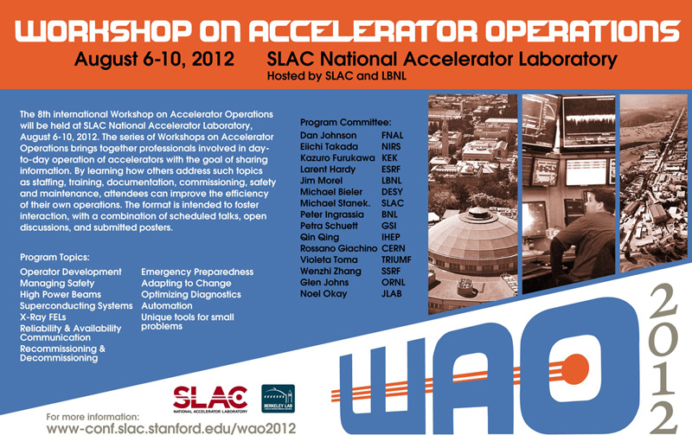

Slide 2
WAO 2012 Summary
Workshop on Accelerator Operations
Hosted by SLAC National Accelerator Laboratory & Lawrence Berkeley National Laboratory
August 10, 2012 at SLAC

Slide 3
Thank you to WAO Local Support staff
Helen O’Donnell
Barbara Hemstad
Lisa Adair
Wanda Elliot
Bernadette Espiritu
Queenie Huang
Naomi Nagahashi
Sharon Oden
Judy Pena
IT Support – Ken Zhou

Slide 4
WAO 2012 Statistics
Nations: 14
Australia
Canada
China
France
Germany
Italy
Japan
Republic of Korea
Spain
Sweden
Switzerland
Taiwan
United Kingdom
United States
Participants 106
Research Facilities 38
Accelerator Engineering Corporation
Alba Synchrotron Facility
ANL
ARRONAX / Subatech
Australian Synchrotron
BESSY
BNL
Canadian Light Source
Canadian Nuclear Safety Commission
CERN
DESY
Diamond Light Source
Fermilab
GSI
HIT
Indiana University Cyclotron Operations
Institute of High Energy Physics
ISIS
Jefferson Lab
KEK
Jefferson Lab
KEK
Korea Atomic Energy Research Institute
LANL
LBNL
LNL-INFN-IT
Mass. Gen. Hospital
National Institute of Radiological Sciences, Japan
National Synchrotron Radiation Research Center
NSCL
Research Center for Electron Photon Science, Tohoku University
Cyclotron and Radioisotope Center, Tohoku University
RIKEN
Shanghai Institute of Applied Physics
Sincrotrone Trieste
SLAC
SNS
SYNCHROTRON SOLEIL
The Svedberg Laboratory
TRIUMF

Slide 5
WAO 2012 Summary
“It’s a Workshop, Not a Conference!”
Share information, participate
- questions, answers, successes, failures
- nearly every participating lab contributed
Broad range of topics
- that is the nature of accelerator operations
Variety of communication methods
- Prepared talks
- Posters
- Open discussions
- Tours
- Keynote Speaker
- Discussions during the breaks, meals

Slide 6
WAO 2012 Summary
Intro to several facilities – How We Do Business
- Accelerator details, Organization, Scheduling staff
Developing Staff
- Training, Retention, Advancement
- Formal conduct of Ops, Structured training, & Skill Management
vs. Informal On-the-Job training
- Additional responsibilities
- Supplementary projects, “2nd jobs”
Safety Systems, Tools, Culture
Disaster recovery, lessons learned
- prepare your Operators with guidance & tools to deal with the unexpected

Slide 7
WAO 2012 Summary
Optimizing group reaction to changing circumstances
Operations has key role in efficient diagnostic development
- Ops/Controls collaboration
- Ops creation of Intuitive GUI or HMI
Automation where possible
- but ensure understanding of what’s underneath
Special Challenges
- unique systems, hazards, configurations
Tools for Reliability, Availability tracking, Communication
- Commercial software (BlockSIM, Stockbook)
- sharing software between labs (eg. logbooks)
- UPS power feed ‘flywheel’ system

Slide 8
WAO 2012 Summary
Sleep Research
- physiological responses
- sleep disorders
- simple measures (light exposure, sleeping environment)
- Slides of the talk will be posted on the WAO website
- Further Questions for Dr. Kushida can be emailed to WAO2012.slac.lbnl@gmail.com

Slide 9
WAO 2012 Summary
Posters - detailed solutions to several problems
- water leaks, instrumentation, web access to controls, standards, etc.
Poster authors: send poster pdf’s to Eiichi. We’ll get them on WAO2012 website.
Discussions
Balance rigid procedures & freedom* to explore (& fail)
*within limits/constraints
Control Room summary & brainstorming
(temp control, longer range KVM devices, Access control)
Ideas for Future WAO sessions
Let the Program Committee know if you’re interested in hosting a future WAO.

Slide 10
WAO 2012 Program Committee thanks you for your participation!
Dan Johnson, FNAL
Eiichi Takada, NIRS
Kazuro Furukawa, KEK
Larent Hardy, ESRF
Jim Morel, LBNL
Michael Bieler, DESY
Michael Stanek, SLAC
Peter Ingrassia, BNL
Petra Schuett, GSI
Qing Qin, IHEP
Rossano Giachino, CERN
Violeta Toma, TRIUMF
Wenzhi Zhang, SSRF
Glen Johns, ORNL
Noel Okay, JLAB

