Slide 1
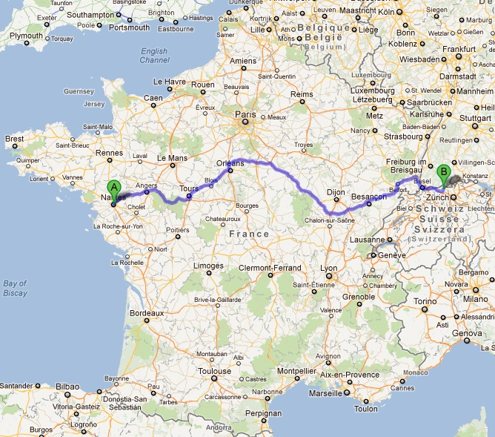
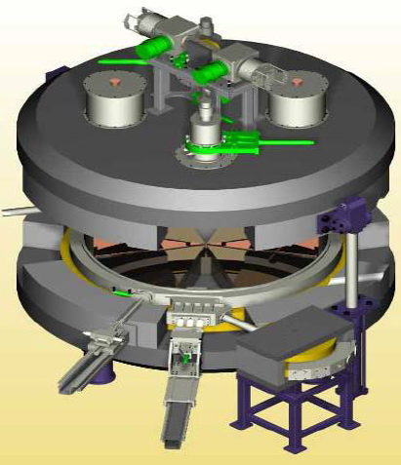
The C70 ARRONAX Hands-on phase and operation
Freddy Poirier (IN2P3/Subatech)
WAO 2012
IPAC 2011: “C70 and beamlines status”, WEPS69
IPAC 2012: “C70 Hands-on phase”, MOPPD024
ARRONAX: Accelerator for Research in Radiochemistry and Oncology at Nantes Atlantique.
Operation and Maintenance team: S.Girault, F.Gomez-Serito,
C.Huet, L.Lamouric, E.Mace, F.Poirier
Cyclotron ARRONAX

Slide 2
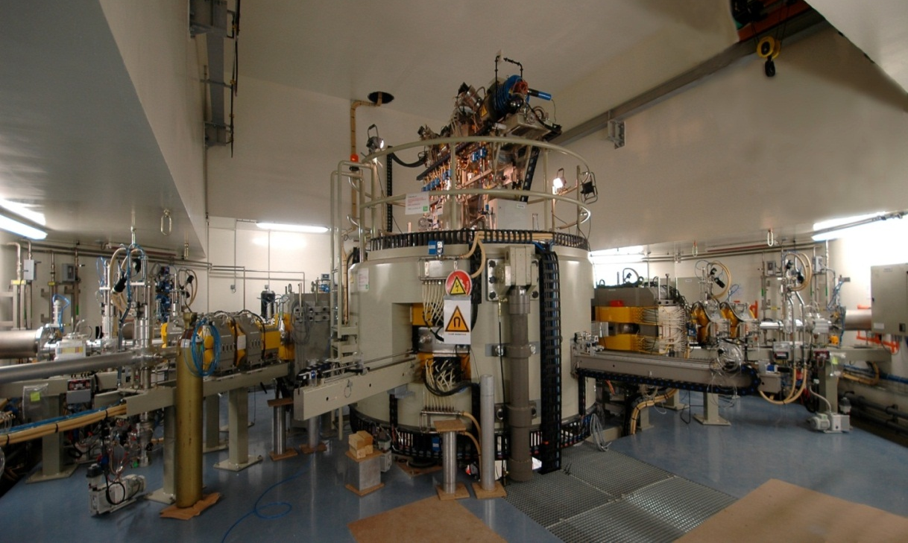
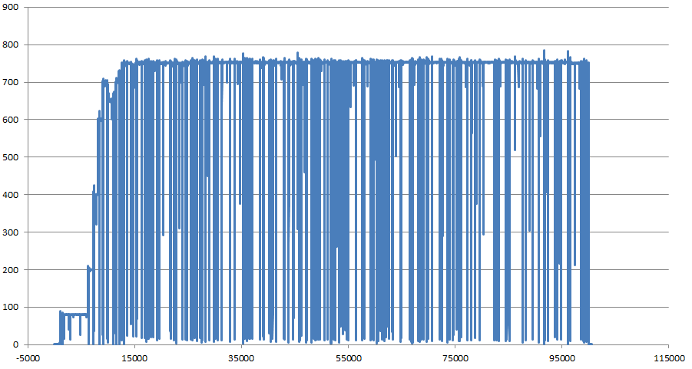
Historical Background
Inauguration in 2008
Machine reception (2010) and hands-on phase phase (2011-12)
October 2008 : Inauguration
March 2010: Low intensity Irradiation
October 2010: 24h at 750 pμA on beam dumps
Dec. 2010: Final machine reception
2011-12: Hands-on phase with an extended program on tuning and exploration of beam parameters for users.
24h tests in 2010
750 μA
24 h

Slide 3
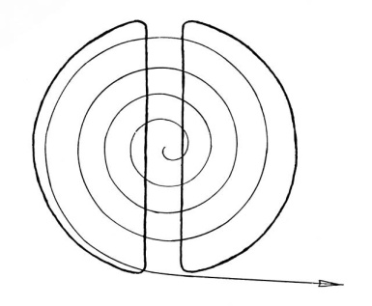
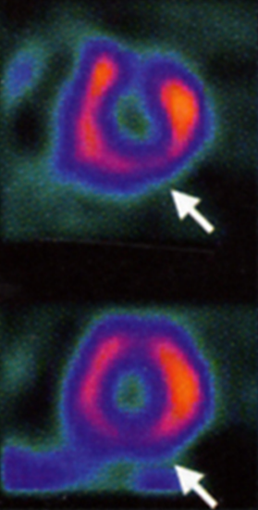
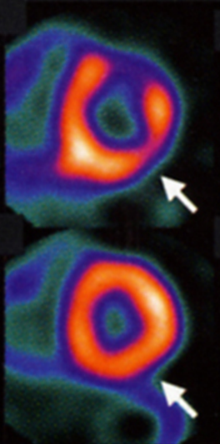
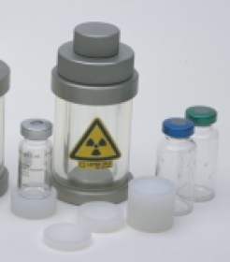
ARRONAX goal
A tool to produce radionucleides for research in nuclear medecine
Imaging: β+ radioelements for PET (ex: ⁸²Sr/⁸²Rb, ^{44m/44}Sc, ⁵²Fe, ⁶⁴Cu ...)
Therapy: α immunotherapy (²¹¹At), β⁻ radioelements : ⁶⁷Cu, ⁴⁷Sc
un outil pour la recherche en radiochimie
notamment radiolyse alpha de l’eau (stockage des déchets nucléaires)‏
un outil pour la recherche en Physique
notamment étude des matériaux sous rayonnement
Développement de système de détection
Mesures de données nucléaires
un outil pour la formation
Université de Nantes
École des mines de Nantes
CHU de Nantes
Formation continue
un site de production industrielle pour les besoins médicaux
Radioelement for therapy
Target irradiation
Production of radioelements
In the target by transmutation
Tomographic imaging of the heart
Particles Beam
Acceleration
Chimical extraction
Separation
Purification
Marking
Radioactive medical element (experimental)‏
⁹⁹Tc-MIBI
SPECT
⁸²Rb-PET
Cyclotron ARRONAX

Slide 4
ARRONAX goal
A tool to produce radionucleides for research in nuclear medecine
Imaging: β+ radioelements for PET (ex: ⁸²Sr/⁸²Rb, ^{44m/44}Sc, ⁵²Fe, ⁶⁴Cu ...)
Therapy: α immunotherapy (²¹¹At), β⁻ radioelements : ⁶⁷Cu, ⁴⁷Sc
A tool for radiochimistry/radiobiology research
notably alpha radiolyse of water (eg nuclear waste storage)‏
un outil pour la recherche en Physique
notamment étude des matériaux sous rayonnement
Développement de système de détection
Mesures de données nucléaires
un outil pour la formation
Université de Nantes
École des mines de Nantes
CHU de Nantes
Formation continue
un site de production industrielle pour les besoins médicaux
Cyclotron ARRONAX

Slide 5
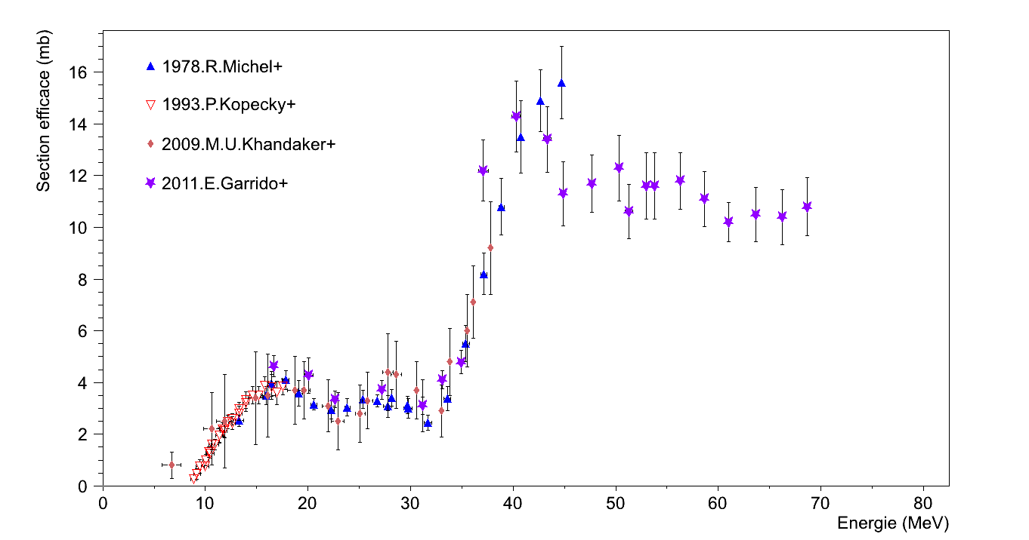
ARRONAX goal
A tool to produce radionucleides for research in nuclear medecine
Imaging: β+ radioelements for PET (ex: ⁸²Sr/⁸²Rb, ^{44m/44}Sc, ⁵²Fe, ⁶⁴Cu ...)
Therapy: α immunotherapy (²¹¹At), β⁻ radioelements : ⁶⁷Cu, ⁴⁷Sc
A tool for radiochimistry/radiobiology research
notably alpha radiolyse of water (eg nuclear waste storage)‏
A tool for physics research
Particularly studies of material under irradiation
Development of detection system
Measurements of nuclear data
un outil pour la formation
Université de Nantes
École des mines de Nantes
CHU de Nantes
Formation continue
un site de production industrielle pour les besoins médicaux
Experience « Stacked Foils »
Cross section measurements: exemple from 17 to 69 MeV- (100 nA)
PIXE - Particle Induced X-ray Emission
- Non destructive Caracterisation Method of multielements material, quantitative
Dvt of mesuring bench
( ~nA)
Ti _{naturel} + p→ ⁴³Sc + X
Cyclotron ARRONAX

Slide 6
ARRONAX goal
A tool to produce radionucleides → research in nuclear medecine
Imaging: β+ radioelements for PET (ex: ⁸²Sr/⁸²Rb, ^{44m/44}Sc, ⁵²Fe, ⁶⁴Cu ...)
Therapy: α immunotherapy (²¹¹At), β⁻ radioelements : ⁶⁷Cu, ⁴⁷Sc
A tool for radiochimistry/radiobiology research
notably alpha radiolyse of water (eg nuclear waste storage)‏
A tool for physics research
Particularly studies of material under irradiation
Development of detection system
Measurements of nuclear data
A tool for training and education
University of Nantes
École des mines of Nantes
CHU (accademic hospital) of Nantes
Permanent and dedicated trainings
An industrial production site for medical needs
Cyclotron ARRONAX

Slide 7
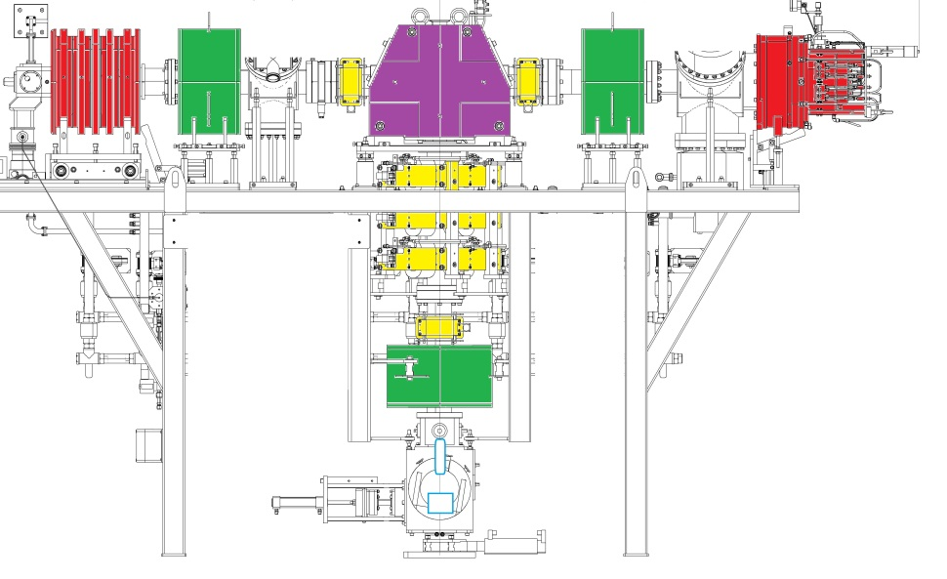
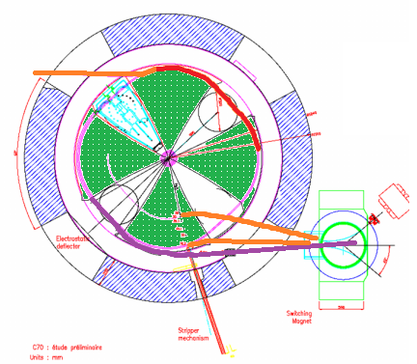
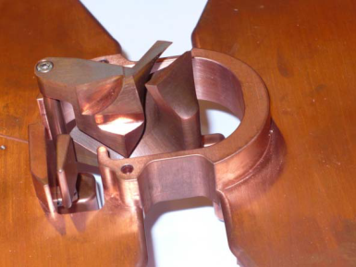
Characteristics
C70 Cyclotron build by IBA:
Isochron cyclotron with 4 sectors
RF: 30.45 MHz
Acceleration Voltage: 65 kV
Max magn. field : 1.6T
~4m of diameter
Max kinetic energy/n: 30-70 MeV
Normalised emittance before extraction: γε_{x}=~4π mm mrad (simulation)
Main additional elements:
2 Multiparticle sources.
Multicusp (H-,D-) with multiple magnets, 5mA max.
Supernanogan ECR ion source (He2+,HH+)
Injection: Series of magnetic elements (glaser, steerer, quad.) on the top of the cyclotron to adapt the beam to the entrance of the cyclotron, and finally the spiral inflector
Extraction: stripper (-) or electrostatic deflector (+)
Extracted Particles | Energy range (MeV) | Highest possible current (µAe) | most common current range (µAe) | Nb of particles / bunch at 1 µAe
H+ | 30 - 70 | 375 x 2 | 0.05 – 80 x 2 | 205 10³
He2+ | 70 | 70 | 0.07 – 0.1 | 102 10³
HH+ | 35 | 50 | 0.1 – 1 | 410 10³
D+ | 15 - 35 | 50 | 0.05 – 1.2 | 205 10³
2 strippers: carbon based foils, eff=~95%
He2+, HH+
H-, D-
H+
He2+
H+
cyclotron
1 deflector: 66kV,eff<<90%
inflector

Slide 8
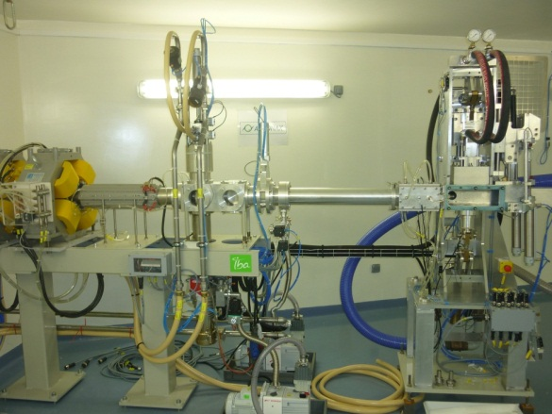
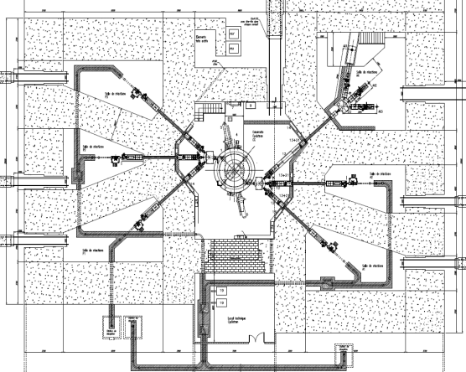
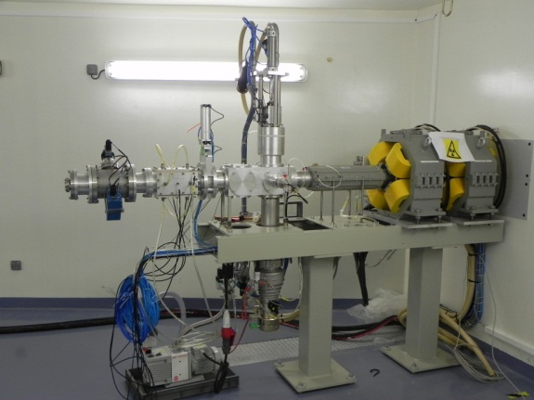
Beamlines Today
6 vaults, around the cyclotron, accomodate the beamlines
Beamline with irradiation station accomodating rabbits with samples
3 beamlines are dedicated to low current (<1.2μA) in the same vault
1 of these is a top-bottom line with a vertical dipole
Beamline for neutronic activator
Beamlines:
8 in total
5 dedicated to average and high current
3 dedicated to low (or very low) current
Cyclotron ARRONAX

Slide 9
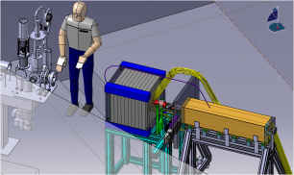
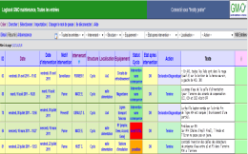
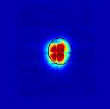
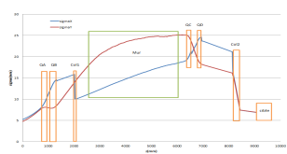
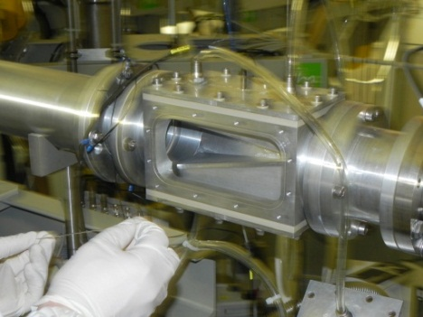
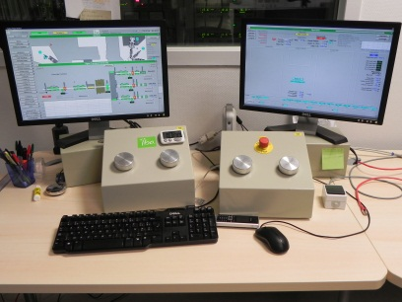
How we do business (1)
GMO: Maintenance and Operation Group Tasks
Operation
Maintenance and beamline adaptation
External Projects
Computing
Developments
Beam follow up, Beam Optimisation, Beam Creation
Curative, preventive
Beam dynamics
GMO: 6 persons
3 have more than 3 years of experience and are “senior operators”
Operators deal with basically every aspects of the accelerator: Operation, maintenance, users, developments (beamline, diagnostics), computers, mechanics, beam dynamics.
To comply with french law on industrial accelerators (yes this cyclotron falls into this class by its use), they have to pass a national certificate: camari
Each operator is 3 times a week in charge of the operation with/without a senior (that is when every one is on site) for none “heavy weeks”.
Cyclotron ARRONAX

Slide 10
Operations
Very diverse weeks in terms of beam parameters and beamlines: particles types, energies, beam size, inter-bunch time,…
“None-heavy” operational weeks:
He2+
H+
D+
Maintenance
67.8 MeV 100 nA, 20 mm
68.4 MeV 300 µA, 30 mm
16.4 MeV 1 µA, 10 mm
Tuning of the machine and beamline is performed before sending the beam to the users and can take up to a few hours
+ heavy weeks: so called production week: Approximately, once a month over a week the group is on 24h operation with 38.5 hours/week/ope
Require a minimum of 4 persons for this
Cyclotron ARRONAX
Agenda of a scheduled week not a cyclotron/beamline use

Slide 11
How we do business (2)
For these production weeks: e.g. 24 hours/days over 5 days
Mornings | 6h30→14h12 | x5/week | op1
Evenings | 14h00→21h42 | x5/week | op2
Nights* | 21h15→6h45 | x4/week | op3
Days | 9h00→17h42 | x5/week | op4 (5-6)
With this scheme (tested 3 times so far) each operator keeps the same time slot:
Results:
Worked well but
Tiredness
Operation Information is being lost (to some degree), counterbalanced by the use of elog
15 to 30 min of overlay between shifts
+ op during days to help deal with operation + maintenance
*Backed up by the presence of a lab personnel
Cyclotron ARRONAX

Slide 12
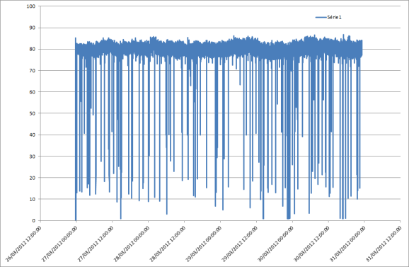
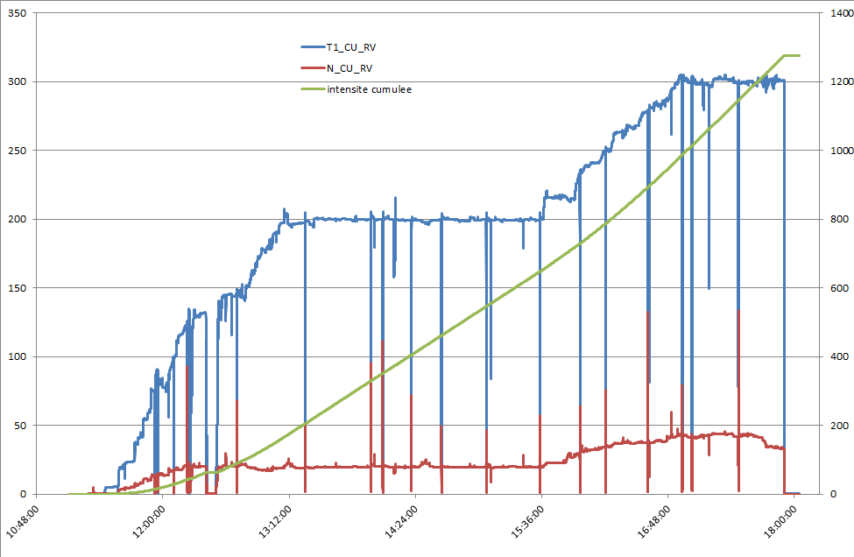
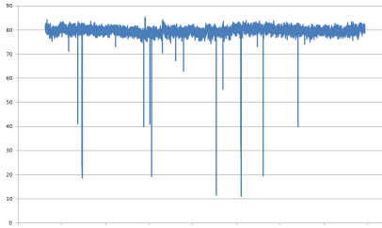
Operations
Single 80 µA runs on target at irradiation station
On neutronic activator 300 µA
200 µA
9h
4 days
Single run:
80.23 µA, σ_{<i>}=1.35 µA
1.6% intensity losses (of overall time)
Dual run:
- σ_{<i>}=2.2 µA (average over both beams)
8 hours
Test of strategy for current ramp-ups up to 200 µA and to 300 µA
(Constrain from the user are in addition)
Stability studies: in view of safety of machine, beamlines, and targets before intensity ramp-ups
Operators are constantly tuning the machine even on steady runs
Cyclotron ARRONAX

Slide 13
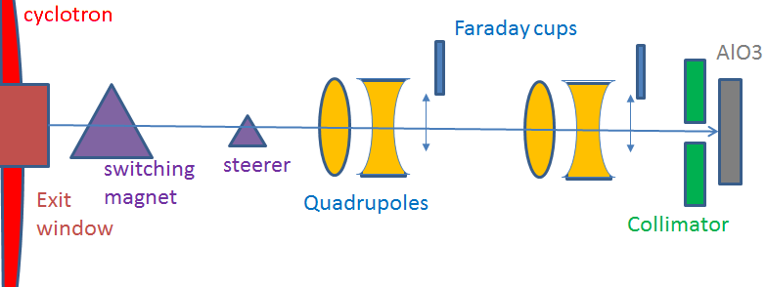
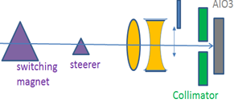
Beam Transport and lines
- Switching magnets
- Steerers
- Quadrupoles 10T/m max
- wobbler
- Faraday cups
- Collimators
- Diagnostics
Simple beam-line such as A2, P1
Ax
~10-15 m
Need for Beam Transport Strategy
- It is primarily dependent on what is behind the collimators i.e. if the experimental target is far downstream and which intensity is used.
1) current optimisation, using inserted faraday cups, and/or beam dumps at end of line if there is one
2) Beam transverse size optimisation
At high current and on an irradiation station with a rabbit, the beam is centred on the collimators upstream the station. The electrical deposit is the measurements
At low current, and for specific needs, optimisation is slightly more complex and relies on dipoles and quadrupoles modifications to get the right beam.
→ diagnostics
Cyclotron ARRONAX

Slide 14
Diagnostics I
Mean current
I_{bunch}
I_{mean}
The main diagnostics are:
- Current measurements (Imean):
- On the 4 individual fingers of the collimators → aperture from 10 to 30 mm limiting the transverse size right at exit of collimators,
- Faraday cups:
Water cooled layers of titanium /aluminium
15kW max (i.e ~210μA at 70MeV)
- Beam dumps combined or not with a current integrator (at very low current)
- Profilers: measures the beam density
- Alumina foils: or thin film foils for location and size measurements at end of line
t
Collimator readings
Faraday cup
Cyclotron ARRONAX

Slide 15
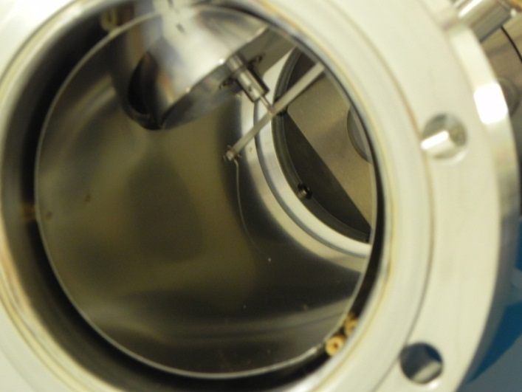
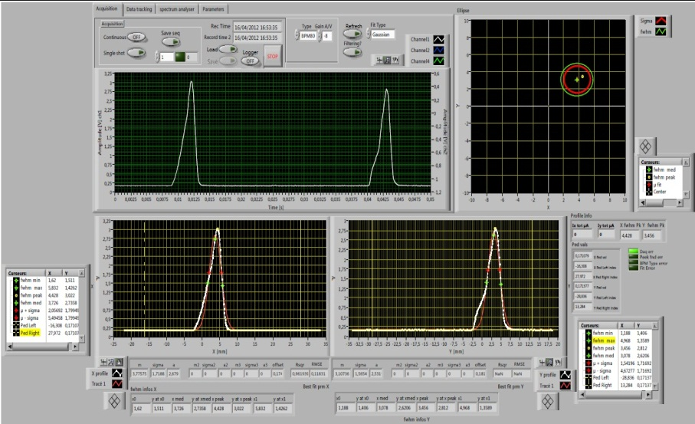
Diagnostics II
Profiler NEC 80 (83):
Installed downstream a collimator
A single wire, frequency 18 Hz (19Hz)
Helicoidal Radius = 2.7 cm (5.31)
Limit (theo.)=150 μA for a 10 mm beam
On-line analysis of beam x-y density
Alumina foil (AlO3) - thickness 1 mm:
Installed outside the line, downstream the exit thin kapton (75 μm) window
Check of the center and beam size
~1nA <I_{moy}<~150 nA for protons and alpha
Vidikon Camera (radiation hard)
→ Off-line analysis code is developed in GMO, based a Matlab tool from LAL.
Cyclotron ARRONAX

Slide 16
Maintenance
The maintenance knowledge is mainly based on existing Cyclotron at lower energies (30 MeV) for Preventive
Curative: The strategy used here is get-to-know the machine
4 weeks/year: Main maintenance (done with GMO/IBA)
Weekly (Mondays) beamline-cyclotron round watch:
List of check-ups done by ARRONAX maintenance group.
Building up a “memory” of the machine problems via an electronic logbook (see later)
Keeping the information flow between cyclotron designer and ARRONAX (both ways):
Tasks/Information exchange charts in use at each IBA/Arronax technical meeting since beg. 2011. (very helpful to recall problems and keep tracks, and make sure there is a resolution in view)
Training of the GMO team with radio protection group
Cyclotron ARRONAX

Slide 17
Electronic log book (elog)
Multi-parameters table filled in by the GMO (Operation & Maintenance Group) → from PSI
Maintenance (12 global parameters):
ID number
Message Date
Intervention date
Intervention reason (failure, surveillance, preparation)
Person in charge
Structure (cyclo, environment)
Location (beamlines, cyclo, technical rooms,…)
Equipment (beam dump, irradiation stations, strippers, sources, water cooling, cryo pump,…)
Status of the cyclotron
Action (finished, ongoing,…)
Comments + attached files
Beam on (25 parameters):
Pilots, particles, beamlines, targets, energy, current, comments, attached files,…
This is not a tracking tool but it will help to define later the data base required
Cyclotron ARRONAX

Slide 18
Present and Future
The C70 ARRONAX cyclotron prototype is in the hands-on phase:
Operations et Maintenances have lead to a high beam uptime (>85%)
Injection solenoid has been changed
The maintenance and operation group in charge of the cyclotron and its beamlines are gathering the know-how, important for the future of the machine:
Time constrain from future users will tighten
Towards 3x8 hours and more “industrial standards”
For the long term use:
Some key points to consolidate:
Beam strategy optimisation and tuning
Studies on beam repeatability
Beam characterisation: off-line & on-line codes to check beams
Some necessary work: Extension of diagnostics
Energy measurements after degradation
Studies for Beam Loss monitor , Beam position monitor, ….
Development of Data acquisition system for beamlines, cyclotron
Continuous development of lines and cyclotron:
Installation of energy degrader
Neutronic activator (several beam tests done → ok)
Increase of current sent to the sample carriers (rabbits).
Cyclotron ARRONAX

Slide 19
Further
The group will grow up in numbers
Plan is mostly to keep them with operation/maintenance tasks + a specialisation
Still relying a lot on flexibility of the operators as we are far from smooth operation
Nearly no automation in beam tuning:
New possible scheme is being studied based on new diagnostics to be put in: with a Parallel machine/human interface (manpower…gasp!) connected to existing PLC
Operators agenda will probably change in view of the latest runs
One of the hot topics that we can foresee is communication and tracking information:
We’ll look at tools (software) that offer this possibilities: CMMS + APS?
Cyclotron ARRONAX

Slide 20
Thank you!

Slide 21
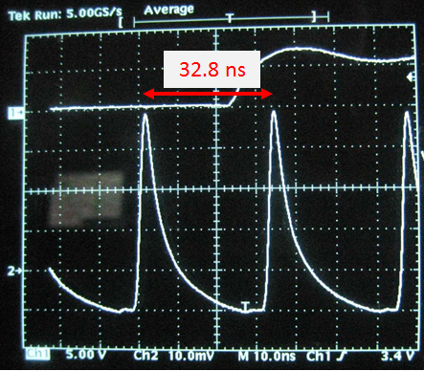
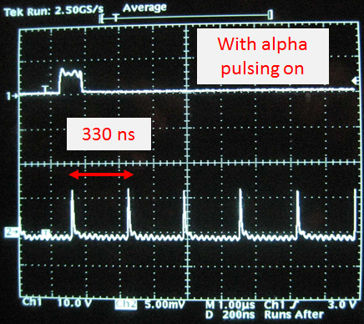
Cyclotron Adaptations
Alpha pulsing: Deflectors for inter-bunch time modification (He2+/2011-12):
Periodic Deflector on the beamline 50 kV @ f_{cyclo}/20
Aperiodic Deflector in the injection timed to the period. def.
Aperiod. Def.: increases the inter-bunch time by n x t_{dp}.
+
t_{dp}
Inter-bunch time from 330 ns to ~5 s
More work on transverse optimisation has to be done
Combination of an aperiodic deflector in injection and a RF 50 kV, 1.5MHz
deflector on the beamline.
To get towards more user friendly setup
GMO + J.L Delvaux (IBA)
Cyclotron ARRONAX

Slide 22
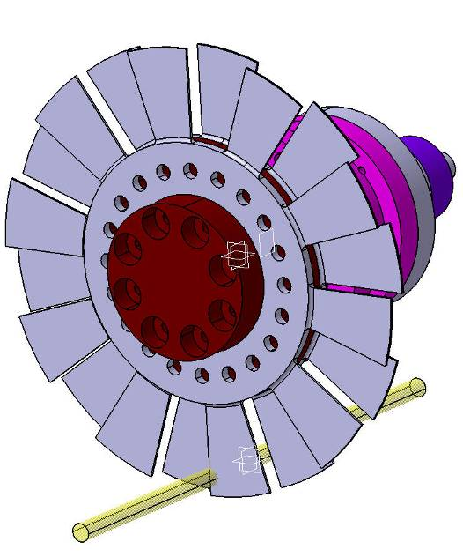
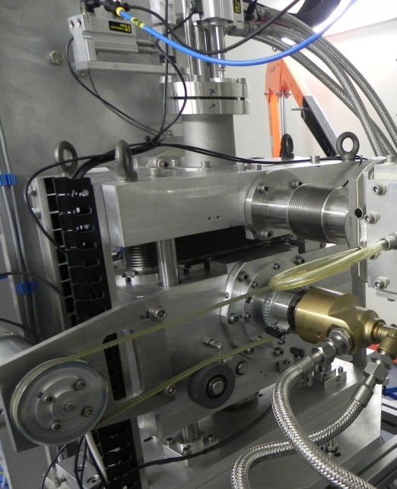
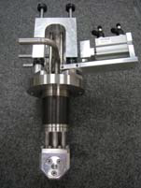
Beamline Adaptations
Energy degrader for proton and alpha (Subatech/ARRONAX)
In order to get a larger range of available energies (10 to 30 MeV)
Protons: Alumium window of diameter= 10 mm, water thickness = 0.7 mm
Alpha: Rotating wheel with 20 aluminium plates (1.25 mm thick)
Degrader Installation has been done and the water cooling system has been tested
Alpha degrader:
Proton degrader:
Cyclotron ARRONAX

Slide 23
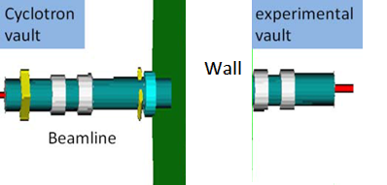
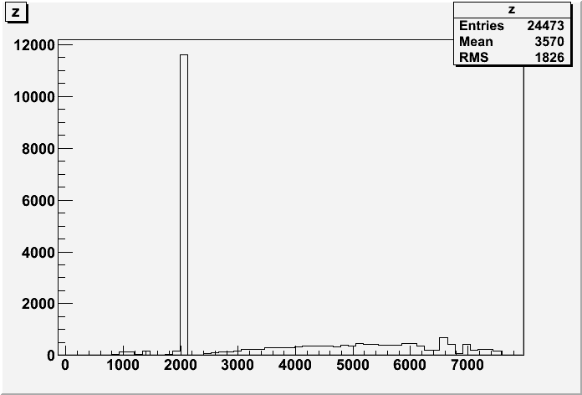
Simulation
Development of simulation with G4beamline, Astra &Transport:
General simulation studies
Support and confirm Beam transport strategies
Benchmark/Confirmation of beam characteristics (beam size, particles losses, emittance,…) + users are in demand of this
Extrapolation to high current?
An exemple with G4beamline:
G4beamline beamline layout
particles losses along the beamline
2
1
3
4
Beam transverse size along the line
Preliminary work from <2 student , W.Tan - EMN
Cyclotron ARRONAX

