Slide 1
HWDB: Operations at the Spallation Neutron Source
Workshop on Accelerator Operations
August 6-10, 2012
Glen D. Johns
Accelerator Operations Manager

Slide 2
Outline
Facility overview
Organization
Shift schedule
Operating schedule
Availability

Slide 3
Where is SNS? Eastern Tennessee as part of Oak Ridge National Lab

Slide 4
What is SNS?
World’s highest power pulsed spallation neutron source
Consists of a 1 GeV superconducting linear accelerator, accumulator ring, and a flowing liquid mercury target
Operates as a National User Facility for conducting neutron scattering research
13 instruments in User Program
6 in commissioning or under construction
Funded by the Department of Energy’s Office of Basic Energy Sciences (~$181M/year)

Slide 5
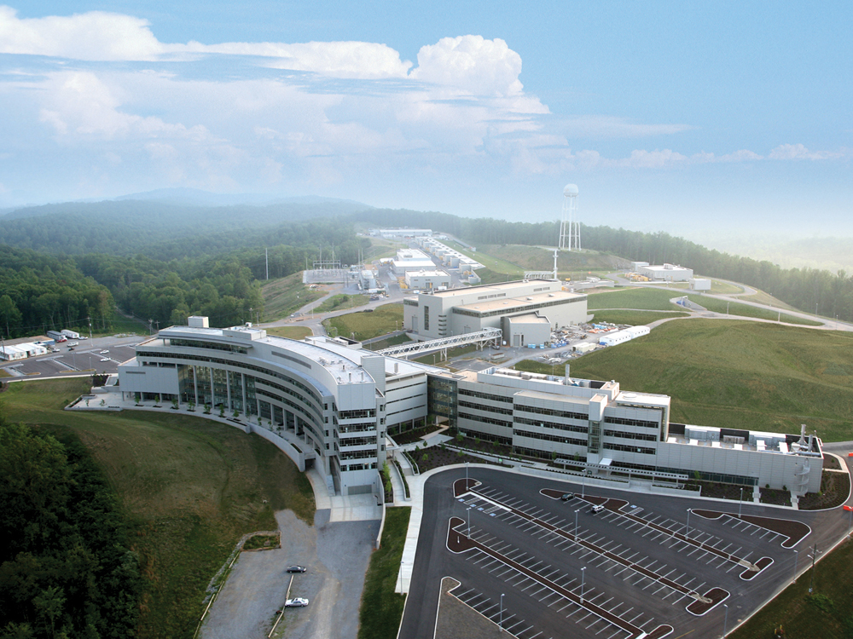
Support buildings
-CHL
-RFTF
-CUB
Klystron gallery
Linac tunnel
Ring
Main office building
-CCR
Instrument hall /
Target building

Slide 6
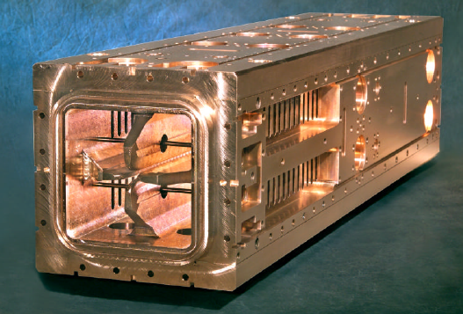
SNS Accelerator Complex
Front-End: Produce a 1-msec long, chopped, H- beam
LINAC: Accelerates the beam to 1 GeV
Accumulator Ring: Compress 1 msec long pulse to 700 nsec
H- stripped to protons
Deliver beam to Target
2.5 MeV
87 MeV
186 MeV
387 MeV
1000 MeV
Ion Source
RFQ
DTL
CCL
SRF, β=0.61
SRF, β=0.81
402.5 MHz
805 MHz
Recent 1 MW operating parameters
925 MeV beam energy
1.14E14 protons per pulse
60 Hz pulse rep rate
1.1 mA average current to target

Slide 7
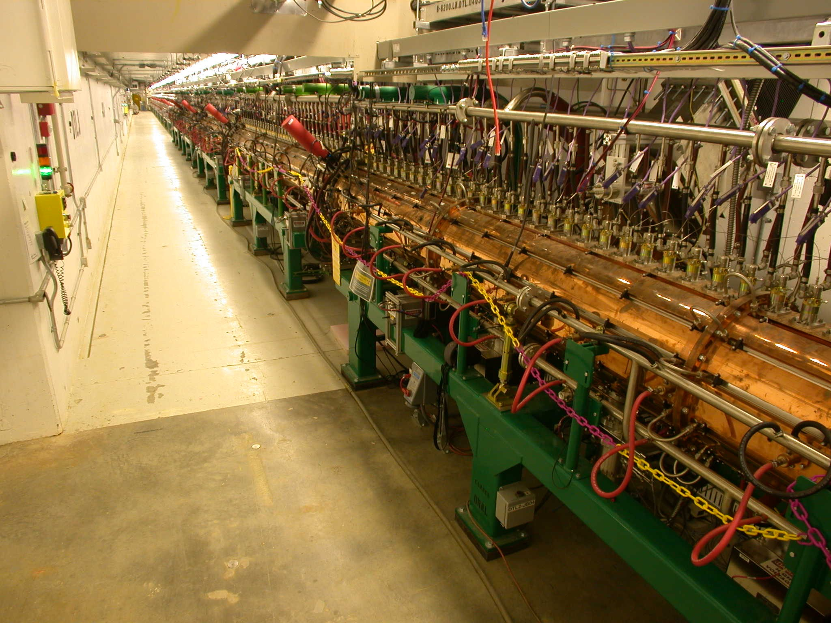
SNS Accelerator Complex
Front-End: Produce a 1-msec long, chopped, H- beam
LINAC: Accelerates the beam to 1 GeV
Accumulator Ring: Compress 1 msec long pulse to 700 nsec
H- stripped to protons
Deliver beam to Target
2.5 MeV
87 MeV
186 MeV
387 MeV
1000 MeV
Ion Source
RFQ
DTL
CCL
SRF, β=0.61
SRF, β=0.81
402.5 MHz
805 MHz
Recent 1 MW operating parameters
925 MeV beam energy
1.14E14 protons per pulse
60 Hz pulse rep rate
1.1 mA average current to target

Slide 8
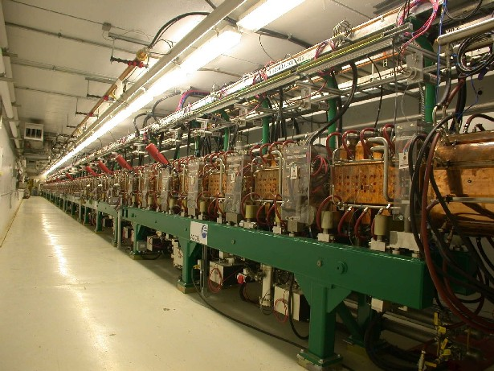
SNS Accelerator Complex
Front-End: Produce a 1-msec long, chopped, H- beam
LINAC: Accelerates the beam to 1 GeV
Accumulator Ring: Compress 1 msec long pulse to 700 nsec
H- stripped to protons
Deliver beam to Target
2.5 MeV
87 MeV
186 MeV
387 MeV
1000 MeV
Ion Source
RFQ
DTL
CCL
SRF, β=0.61
SRF, β=0.81
402.5 MHz
805 MHz
Recent 1 MW operating parameters
925 MeV beam energy
1.14E14 protons per pulse
60 Hz pulse rep rate
1.1 mA average current to target

Slide 9
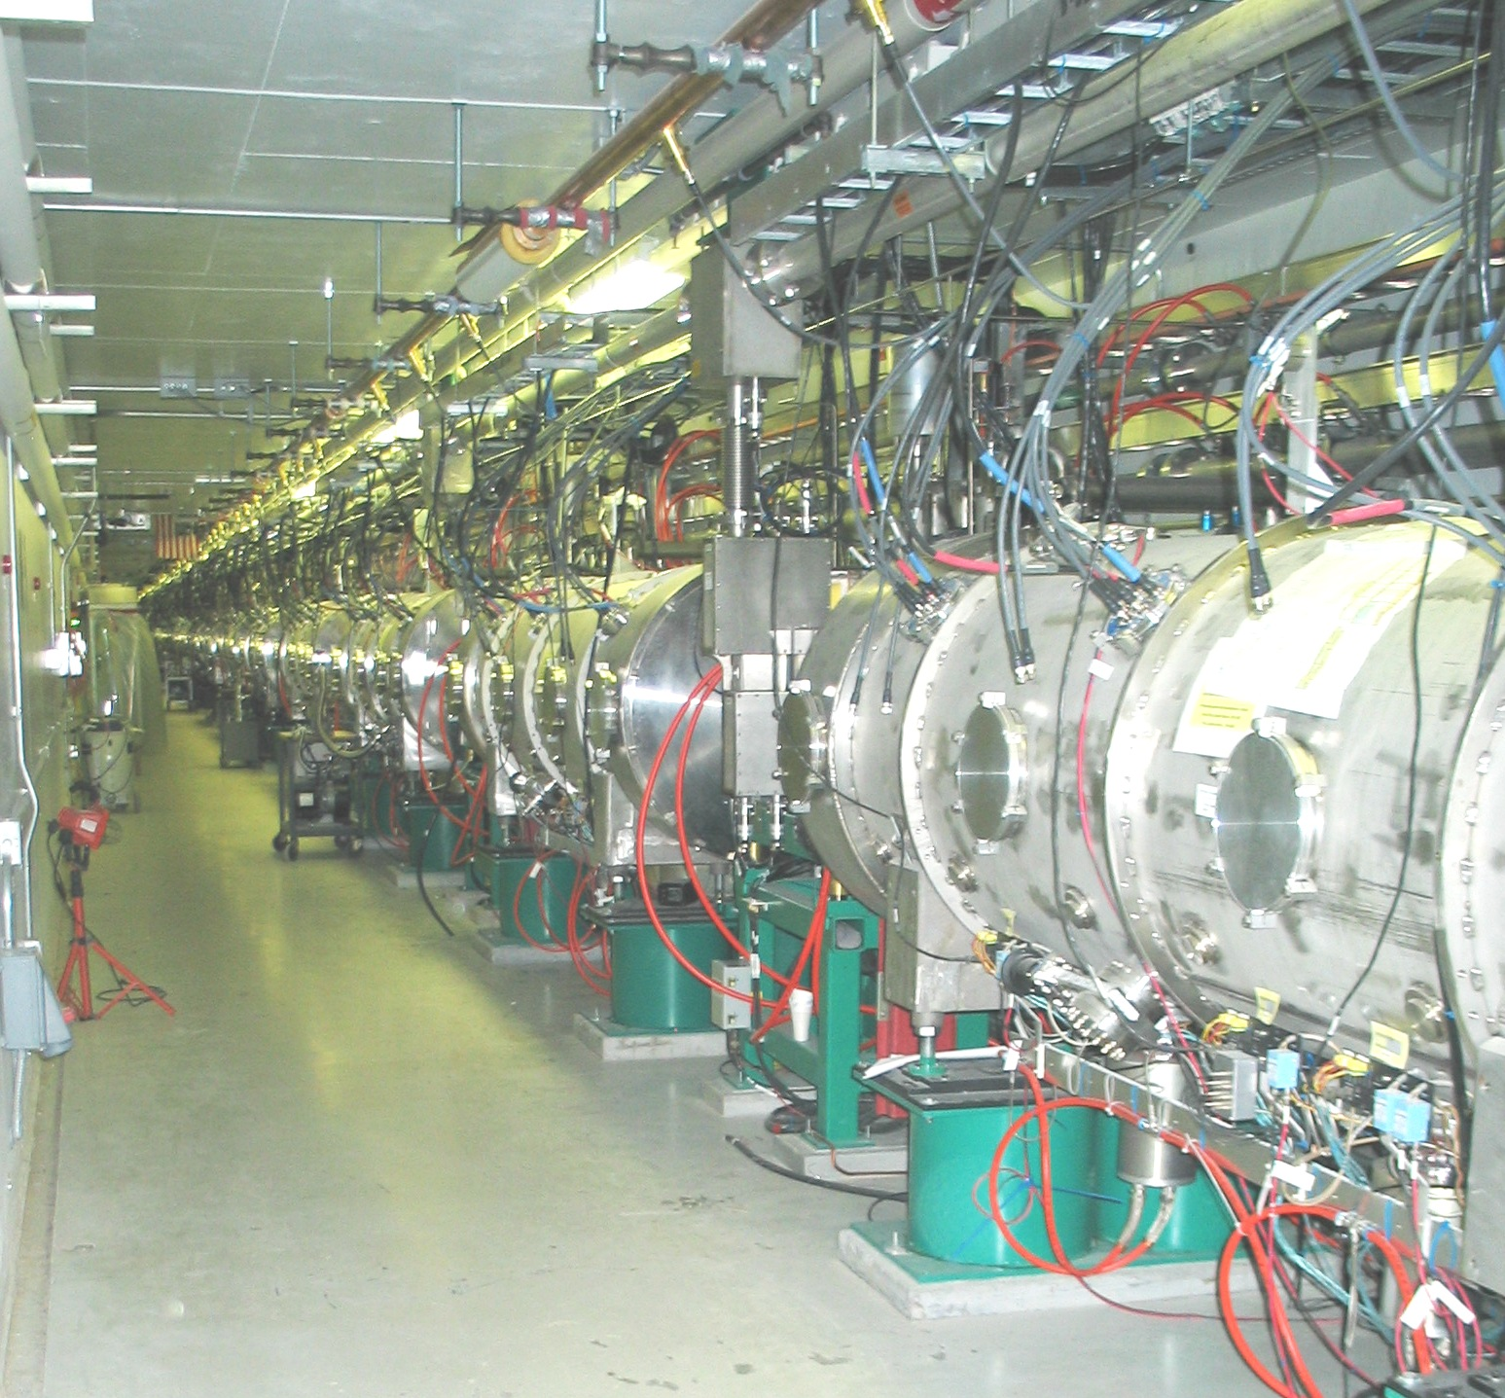
SNS Accelerator Complex
Front-End: Produce a 1-msec long, chopped, H- beam
LINAC: Accelerates the beam to 1 GeV
Accumulator Ring: Compress 1 msec long pulse to 700 nsec
H- stripped to protons
Deliver beam to Target
2.5 MeV
87 MeV
186 MeV
387 MeV
1000 MeV
Ion Source
RFQ
DTL
CCL
SRF, β=0.61
SRF, β=0.81
402.5 MHz
805 MHz
Recent 1 MW operating parameters
925 MeV beam energy
1.14E14 protons per pulse
60 Hz pulse rep rate
1.1 mA average current to target

Slide 10
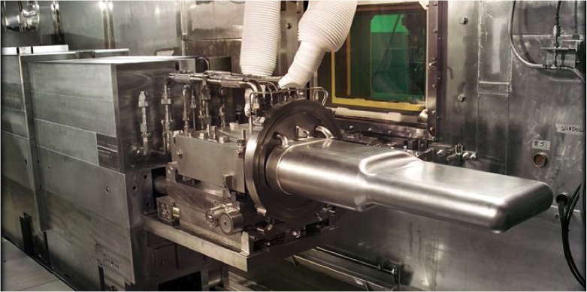
SNS Accelerator Complex
Front-End: Produce a 1-msec long, chopped, H- beam
LINAC: Accelerates the beam to 1 GeV
Accumulator Ring: Compress 1 msec long pulse to 700 nsec
H- stripped to protons
Deliver beam to Target
2.5 MeV
87 MeV
186 MeV
387 MeV
1000 MeV
Ion Source
RFQ
DTL
CCL
SRF, β=0.61
SRF, β=0.81
402.5 MHz
805 MHz
Recent 1 MW operating parameters
925 MeV beam energy
1.14E14 protons per pulse
60 Hz pulse rep rate
1.1 mA average current to target

Slide 11
Research Accelerator Division (~370)
Facility Operations
(70)
Facility Maintenance
Site Services
Data Operations
(72)
Control Systems
Instrument Data Acquisition and Controls
Instrument Operations
(46)
Accelerator and Target Operations
(157)
Electrical and RF
Superconducting Linac Systems
Accelerator Physics, Beam Instrumentation, Ion Source
Mechanical Systems and Operations
Accelerator Operations
Instrument Support
Scientific Support
Sample Environment
Radiological Control
Information Technology

Slide 12
Accelerator Operations Group (18)
Operations Manager
Machine Specialist
Operations Coordinator
Control Room Shift Supervisor (10)
Maintenance & Operability Coordinator
Control Room Accelerator Specialist (4)

Slide 13
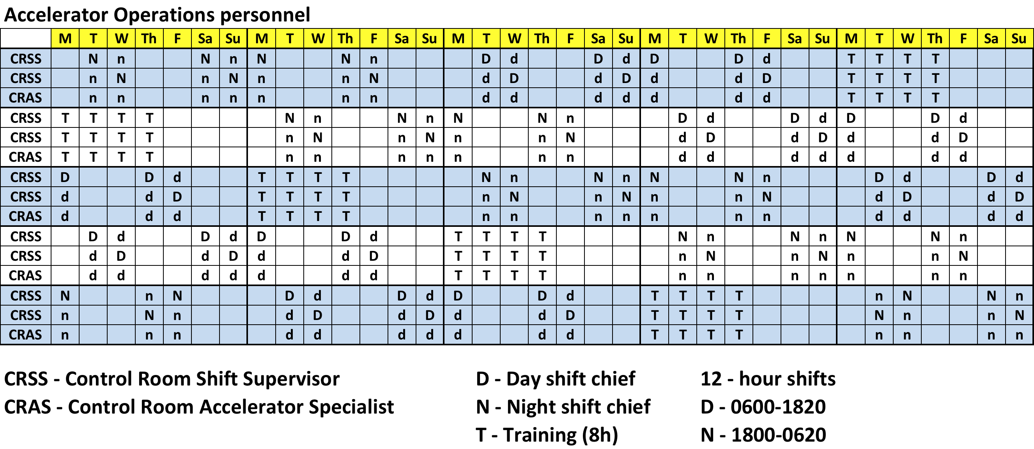
Shift Schedules

Slide 14
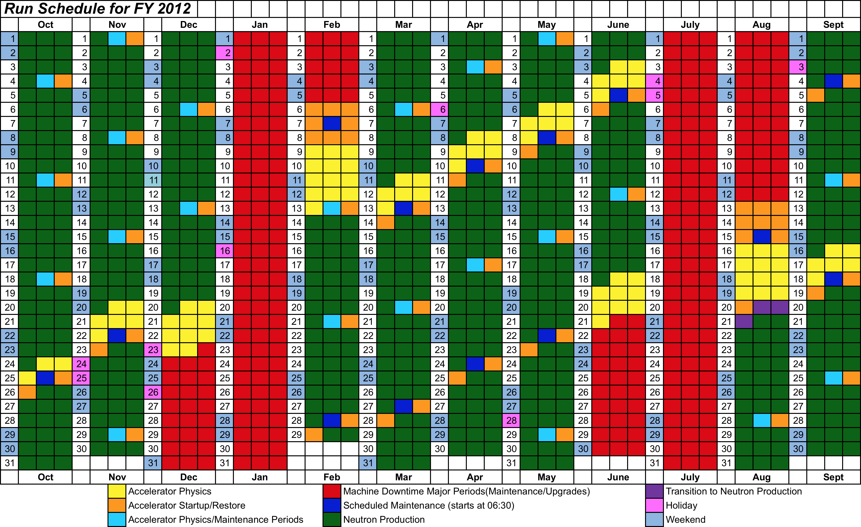
FY12 Operating Schedule

Slide 15
How are we doing?
92.1%
93.6%
80.7%

