Slide 1
Electronic Radiation Safety Work Control Forms at SLAC
Zoe Van Hoover, SLAC AD Safety Officer
2012 Workshop on Accelerator Operations

Slide 2
Radiation Safety Work Control Form (RSWCF) Purpose
Configuration Control of Credited Radiation Safety Systems is internally required by SLAC, in order to comply with DOE Order 420.2C
SLAC Guidelines For Operations
Radiation Safety Systems Technical Basis Document
Credited Radiation Safety Items:
Personnel Protection System (PPS)
Beam Containment System (BCS)
Shielding
Accelerator Housing Integrity

Slide 3
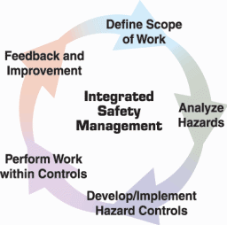
Radiation Safety Work Control Form Purpose
Radiation Safety Work Control Form (RSWCF) is an administrative tool used to document and guide a process:
Define Scope of Work
Determine appropriate controls
Requirements before starting work
(control radiological hazards during work)
Checkout requirements after work
Execute work within controls
Delineate end of work, bringing Radiation Safety Credited Controls back into active service after work and checkout/certification is complete

Slide 4
RSWCF Process Participants
Many people from multiple work groups participate in the planning, approval, and execution of work on credited radiological controls:
Work Requestor
Person Responsible (for executing work)
Area Manager
Radiation Physicist (representing Radiation Safety Officer)
AD Safety Officer (ADSO)
Engineering Operator in Charge (EOIC)
Safety Systems Engineers & Technicians
RSWCF process must be understood and followed by all participants
Ensure work is only performed under the correct controls
Ensure Radiation Safety Credited Controls are returned to active service only when they are in a safe and certified configuration

Slide 5
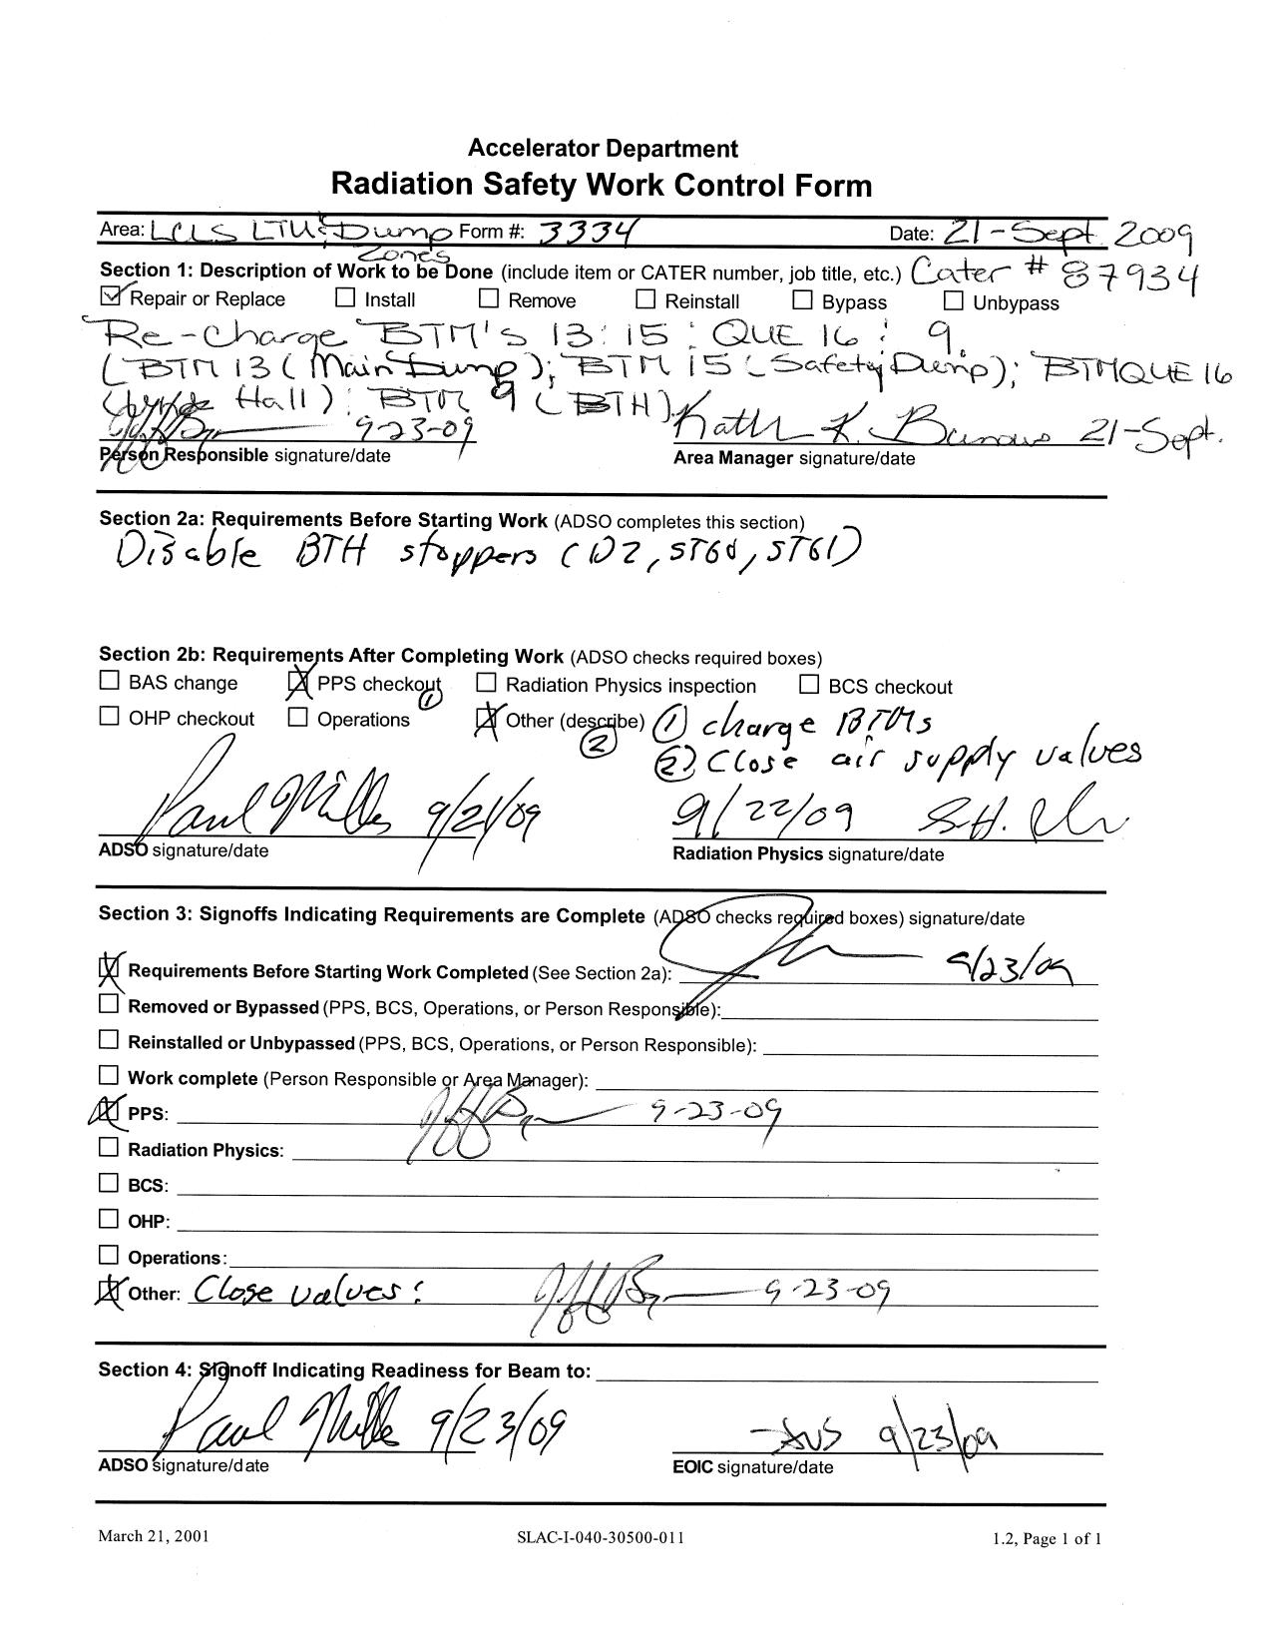
RSWCFs: The Old Way
Paper forms were kept in a binder in the Main Control Room.
Advantages:
Track record of use
(20+ years, 3500+ RSWCFs)
Robust against computer outages
Flexible
Disadvantages:
Only available for reference/editing in the control room
No searchable record or history logging
No enforcement of correct workflow
Not linked to other work planning tools
Readability
Wastes paper

Slide 6
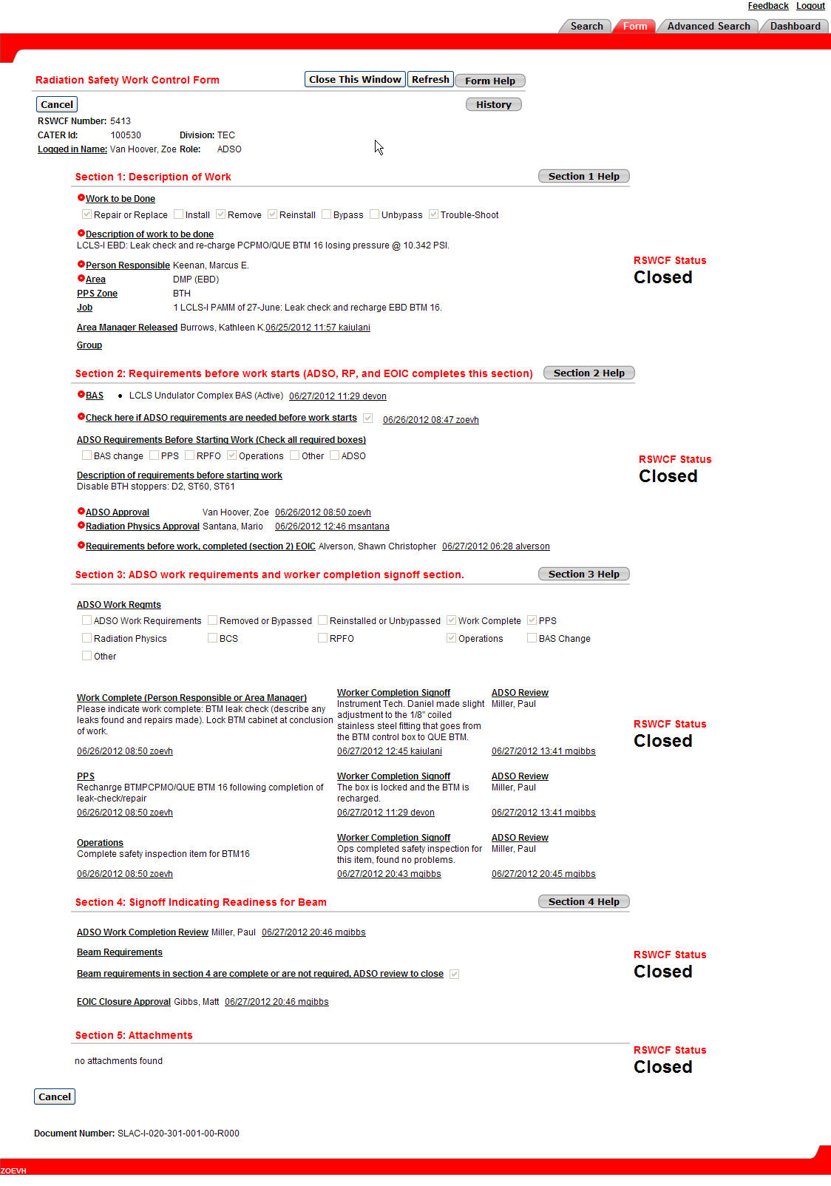
RSWCFs: The New Way
Electronic forms are managed within a web browser.
Advantages:
Available from any web browser
remote viewing
electronic signature
Searchable record of all forms
History logging of each form
Enforces correct workflow
Linked to existing electronic trouble reporting and tracking system
Linked to electronic log
Readable
Flexible
Disadvantages:
New system: learning curve for users
Vulnerable to computer outages

Slide 7
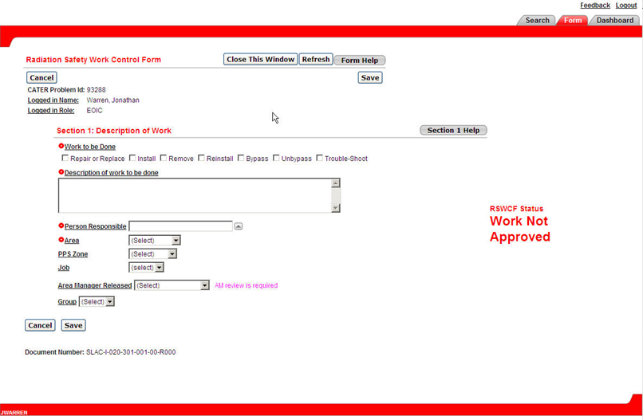
RSWCF Workflow: New Form

Slide 8
RSWCF Workflow: Work Not Approved

Slide 9
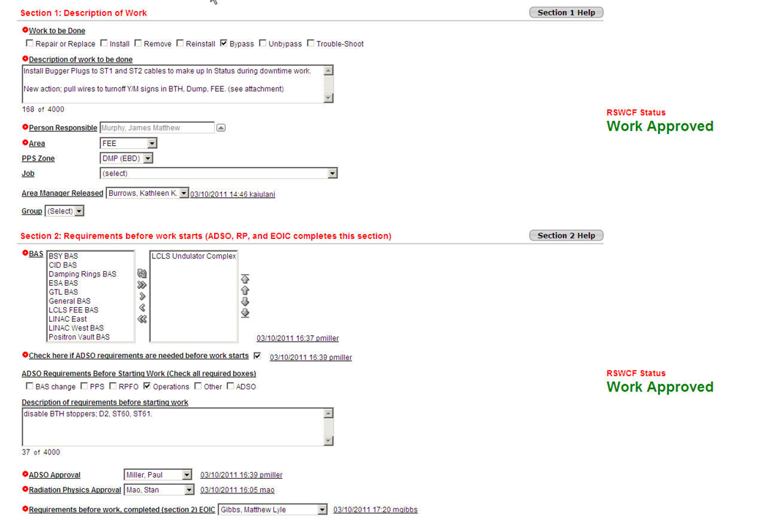
RSWCF Workflow: Sections 1 and 2

Slide 10
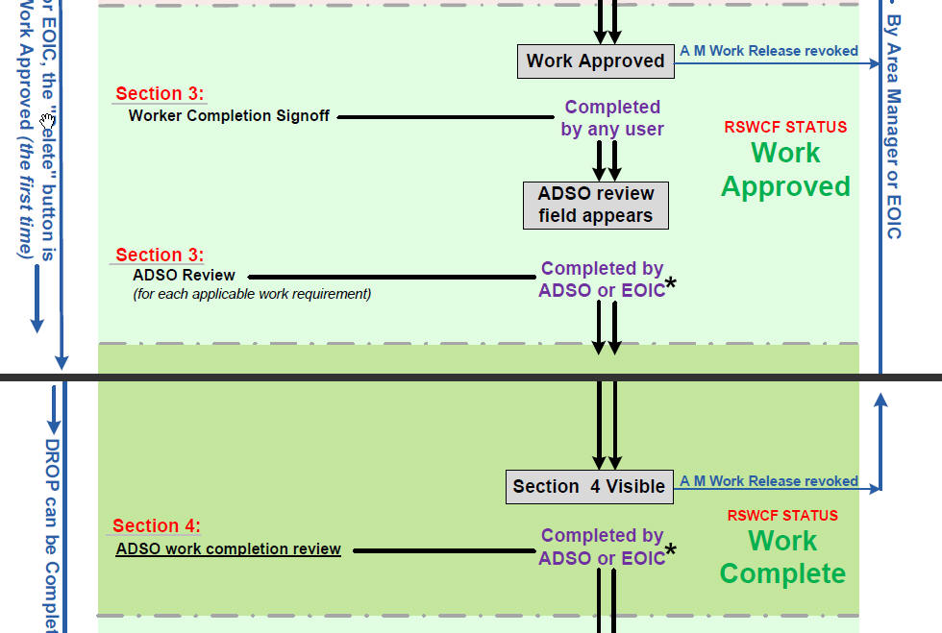
RSWCF: Work Approved & Work Complete

Slide 11
RSWCF Workflow: Sections 3 and 4

Slide 12
RSWCF: Review to Close & Closed

Slide 13
Electronic RSWCF Requirements
Accessible yet secure
History – Audit trail
Documentation Configuration Control
Work Flow
Electronic Signature
Error Handling
Read-Only Version
Timeout
Integration with CATER (Comprehensive Accelerator Tool for Enhancing Reliability)
Extensive checkout before releasing into production

Slide 14
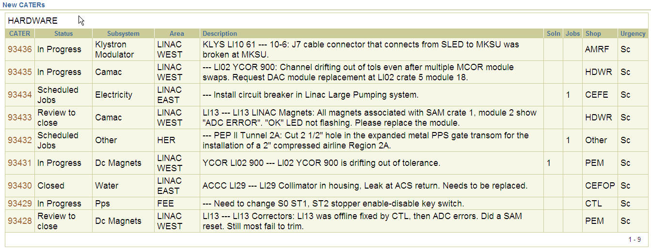
CATER
Web-based tool for reporting and tracking problems and scheduling maintenance
Oracle database
Developed using Oracle Application Express (APEX)

Slide 15
CATER

Slide 16
Electronic RSWCF Introduction Timeline
2010: In-house development and testing
First round of development
Preliminary testing and feedback from operations group
Second round of development
Sept-Oct: ADSO and Maintenance Office testing
Nov: Created formal checkout procedure
Dec: Executed final checkout
January 2011: Released for 2-Mile LINAC Facility
May 2012: Released for SPEAR Facility
Over 450 Electronic RSWCFs processed since introduction

Slide 17
Future Projects
Expand for use in additional Facilities:
NLCTA (Next Linear Collider Test Accelerator)
SSRL and LCLS Experimental Facilities
E-mail integration
Additional CATER integration with electronic logbook

