Slide 1
Five years of operation at HIT Daily Performance Check & Beam Time Statistics
M. Galonska, S. Scheloske, R. Cee, E. Feldmeier, K. Höppner, J. Mosthaf, C. Schömers, T. Winkelmann,
A. Peters, T. Haberer
and the
HIT team

Slide 2
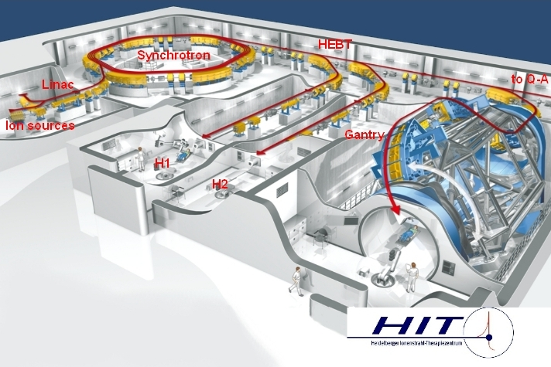
Pencil Beam Library
Pencil Beam Library
ion species | C, p, O, He,... | Steps
energy | 50 – 430 MeV / u | 255
focus | 4 – 13 mm | 4 (6)
intensity | 10⁷ – 10¹⁰ / spill | 10
gantry angle | 0° − 360° | 36
Accelerator Model
settings for each combination source-treatment room / ion type provided by Control System, i.e. E, F, I, G
any E, F, I can be requested cycle-by-cycle (treatment plan)
Device settings stored in the device controller units, backuped in a DB
Therapy, verified flash data: non-volatile memory of controllers
machine adjustment/experiment: volatile part of controller
2
Notes:
2

Slide 3
Daily Quality Assurance
Availability of 10 000 combinations / ion type and treatment room requires
Daily quality assurance by Medical Physics team (~ 2 h)
„Room Certification“
Daily Accelerator Performance Check (~ 30..45 min.)
approx. 2 % of all possible combination, but covering the whole energy-focus-intensity-ion type space
→ Automated standard procedures for beam request, data acquisition, and analysis
3
Notes:
3

Slide 4
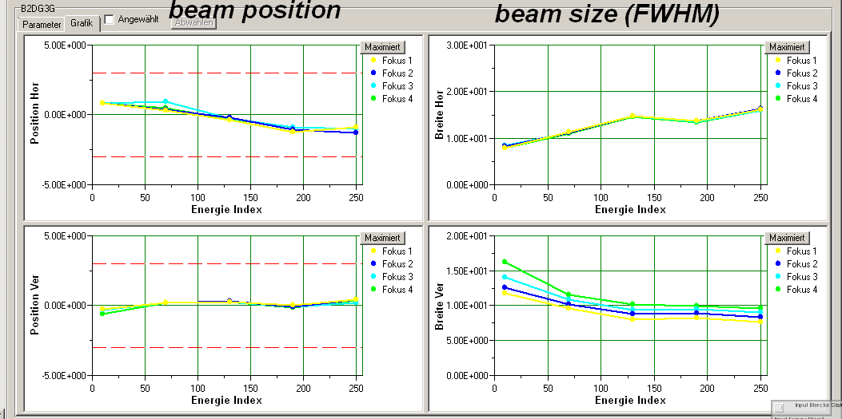
Daily Accelerator Performance Check
Beam size and position in the two treatment rooms (~7 m upstream the patient position)
Beam position at Synchrotron exit
Particle rates (intensity)
Beam currents in LEBT-Linac-Section
Output Energy of Linac
Beam position in the synchrotron during injection to extraction
Spillshape
4
Notes:
Ströme E-Septa
4

Slide 5
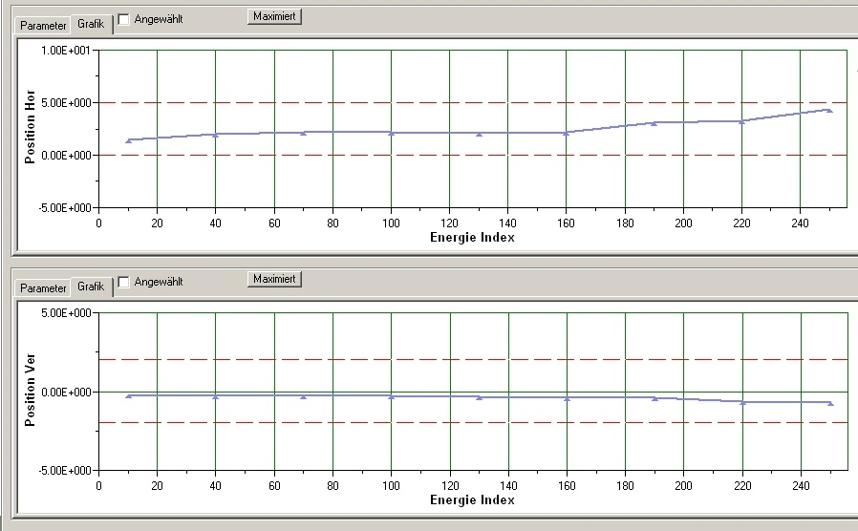
Daily Accelerator Performance Check
Beam size and position in the two treatment rooms (~7 m upstream the patient position)
Beam position at Synchrotron exit
Particle rates (intensity)
Beam currents in LEBT-Linac-Section
Output Energy of Linac
Beam position in the synchrotron during injection to extraction
Spillshape
5
Notes:
Ströme E-Septa
5

Slide 6
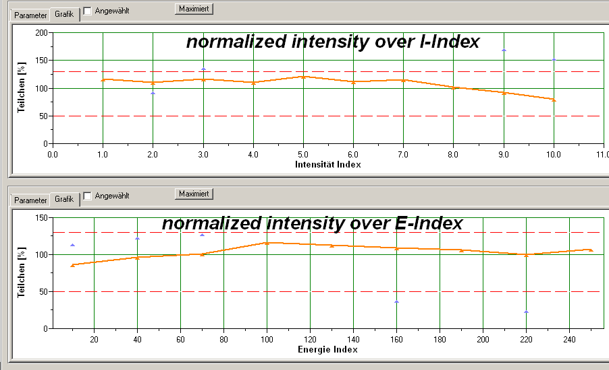
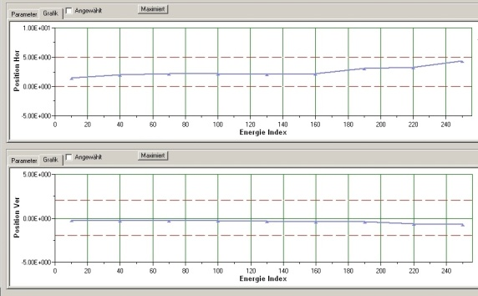
Daily Accelerator Performance Check
Beam size and position in the two treatment rooms (~7 m upstream the patient position)
Beam position at Synchrotron exit
Particle rates (intensity)
Beam currents in LEBT-Linac-Section
Output Energy of Linac
Beam position in the synchrotron during injection to extraction
Spillshape
6
Notes:
Ströme E-Septa
6

Slide 7
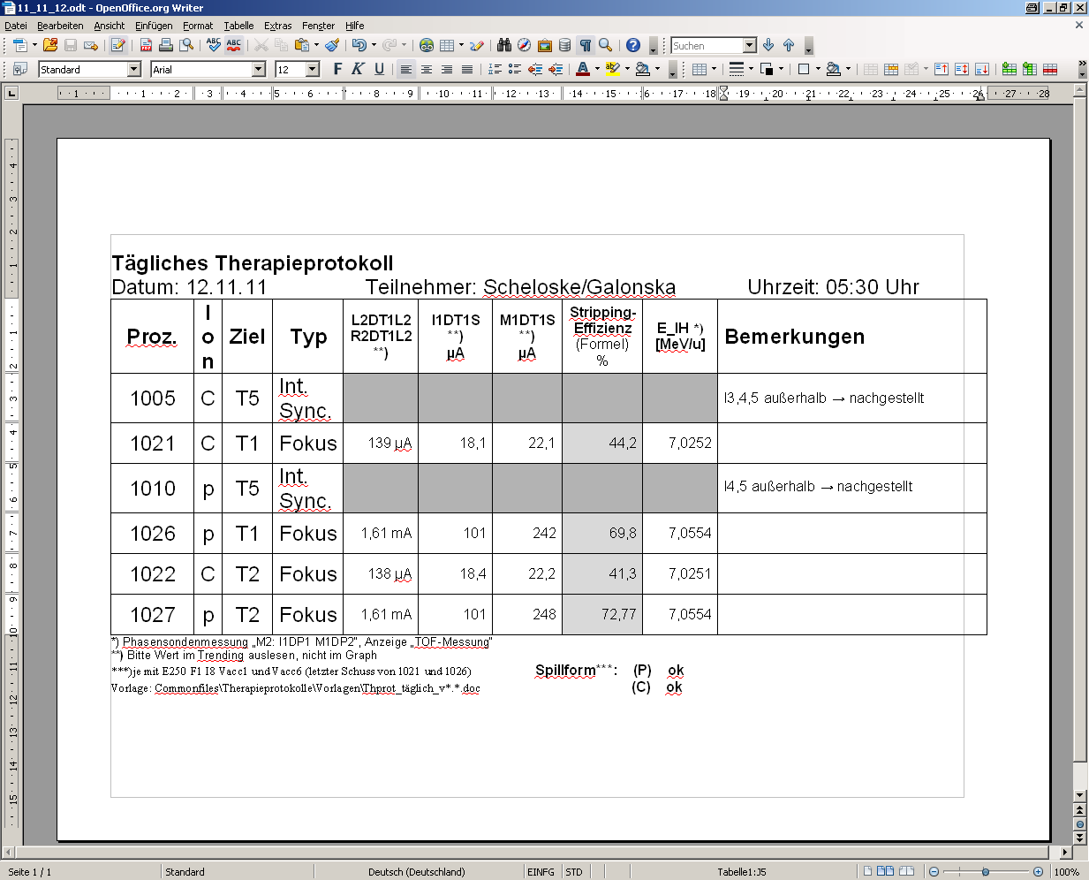
Daily Accelerator Performance Check
Beam size and position in the two treatment rooms (~7 m upstream the patient position)
Beam position at Synchrotron exit
Particle rates (intensity)
Beam currents in LEBT-Linac-Section
Output Energy of Linac
Beam position in the synchrotron during injection to extraction
Spillshape
7
Notes:
Ströme E-Septa
7

Slide 8
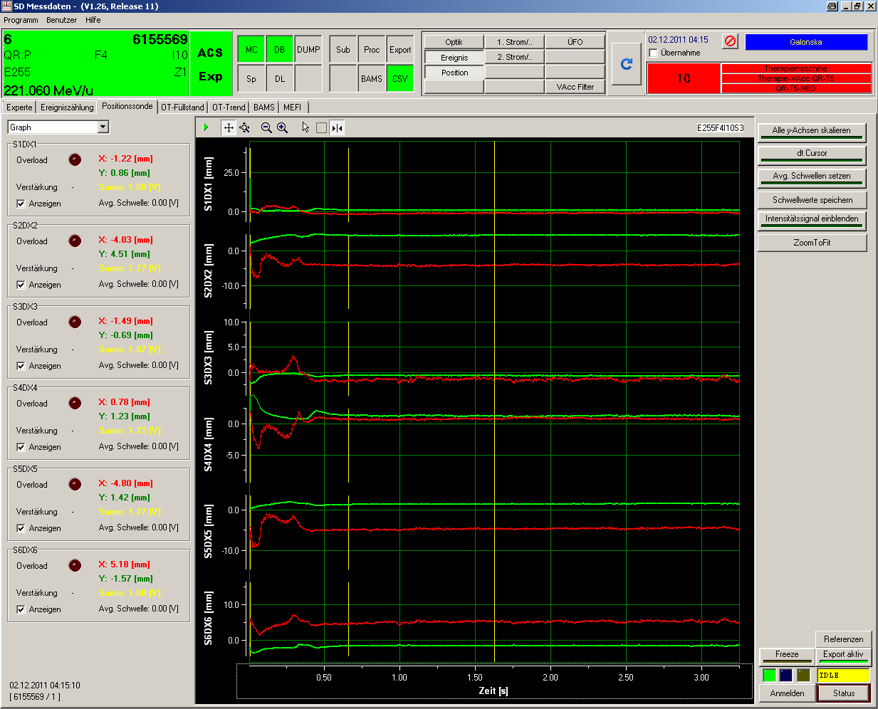
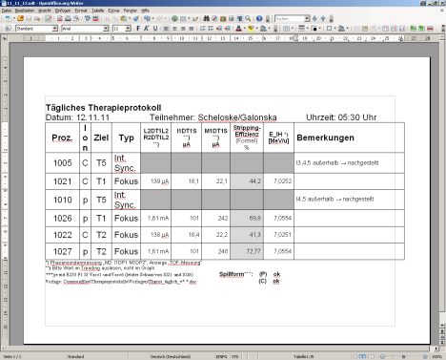
Daily Accelerator Performance Check
Beam size and position in the two treatment rooms (~7 m upstream the patient position)
Beam position at Synchrotron exit
Particle rates (intensity)
Beam currents in LEBT-Linac-Section
Output Energy of Linac
Beam position in the synchrotron during injection to extraction
Spillshape
8
Notes:
Ströme E-Septa
8

Slide 9
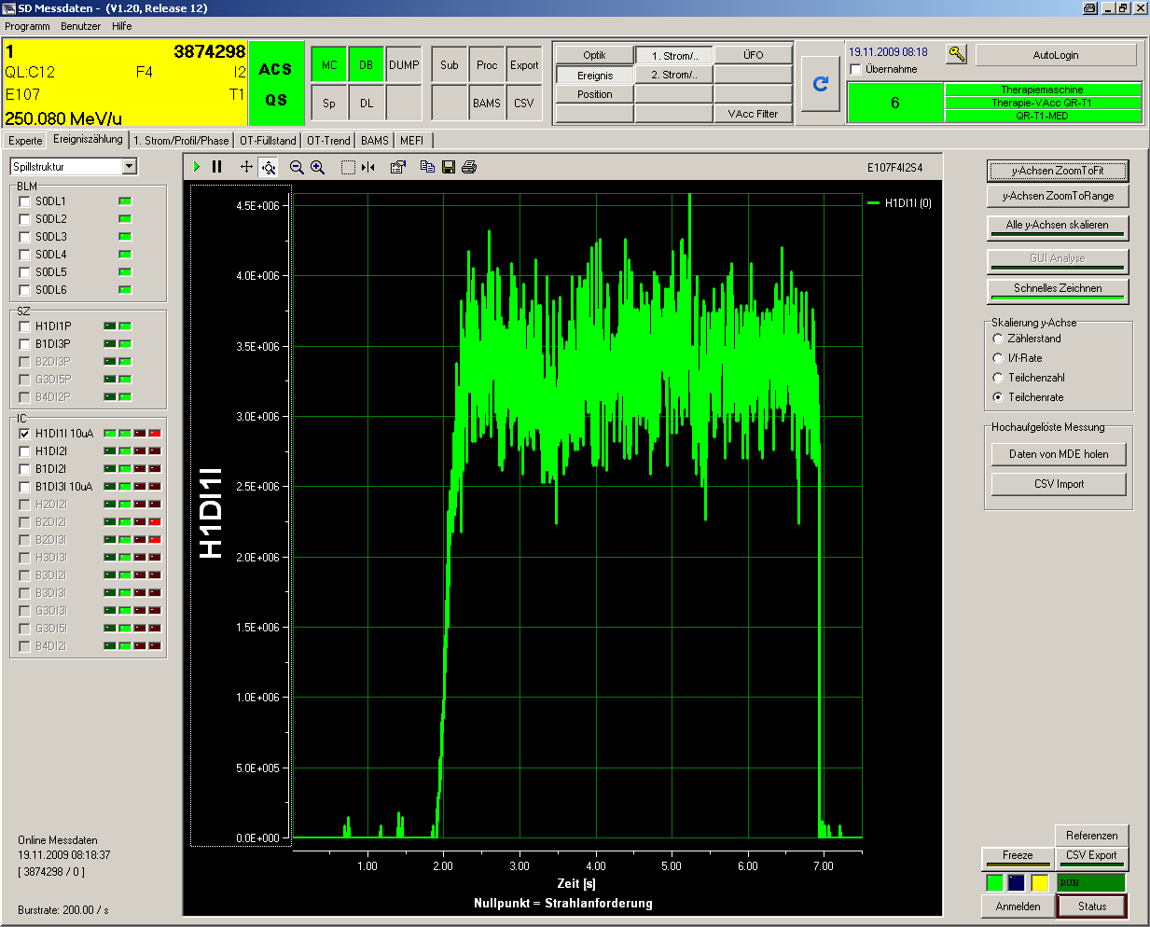
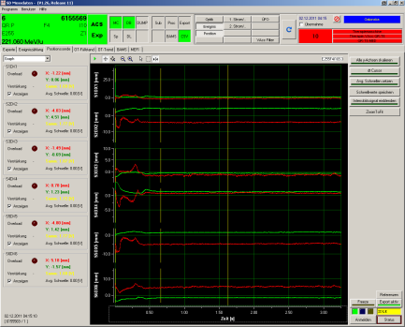
Daily Accelerator Performance Check
Beam size and position in the two treatment rooms (~7 m upstream the patient position)
Beam position at Synchrotron exit
Particle rates (intensity)
Beam currents in LEBT-Linac-Section
Output Energy of Linac
Beam position in the synchrotron during injection to extraction
Spillshape
9
Notes:
Ströme E-Septa
9

Slide 10
Conclusion
Stable and reliable beam quality for patient treatment
Re-adjustment of beam size (position) in a four-months period (typ.)
Synchrotron ~ 1..2 / year (typ.)
Linac ~ 1..2 / year (typ.)
Re-adjustment particle rates in intervals of some days (small margin!)
Spillshape for a year although feed-forward
....but
10
Notes:
10

Slide 11
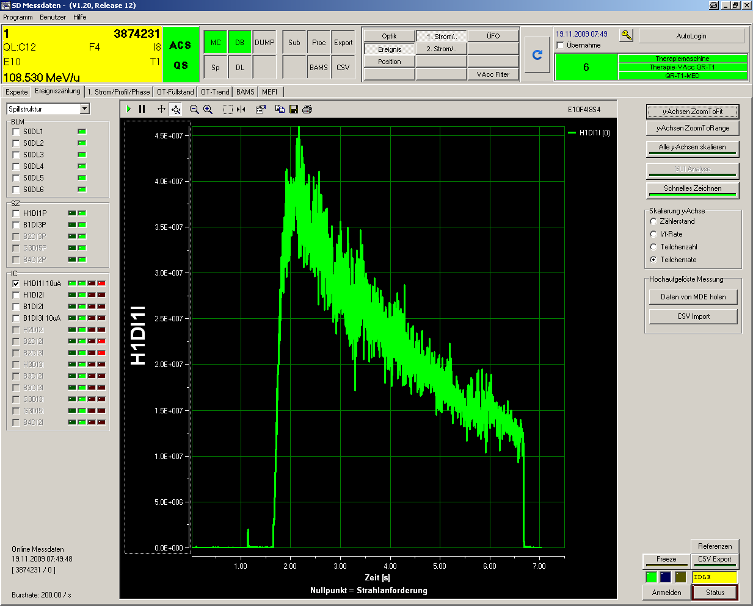
Conclusion
Stable and reliable beam quality for patient treatment
Re-adjustment of beam size (position) in a four-months period
Synchrotron ~ 1..2 / year
Linac ~ 1..2 / year
Re-adjustment particle rates in intervals of some days (small margin!)
Spillshape for a year although feed-forward
....but
malfunction of KO-Exciter
Synthesizer
→ Hardware
...back in 2009
11
Notes:
11

Slide 12
...and
Stable and reliable beam quality for patient treatment
Re-adjustment of beam size (position) in a four-months period
Synchrotron ~ 1..2 / year
Linac ~ 1..2 / year
Re-adjustment particle rates in intervals of some days (small margin!)
Spillshape for a year although feed-forward
calibration of quadrupole
power supply controller
→ Hardware
...back in 2008
12
Notes:
12

Slide 13
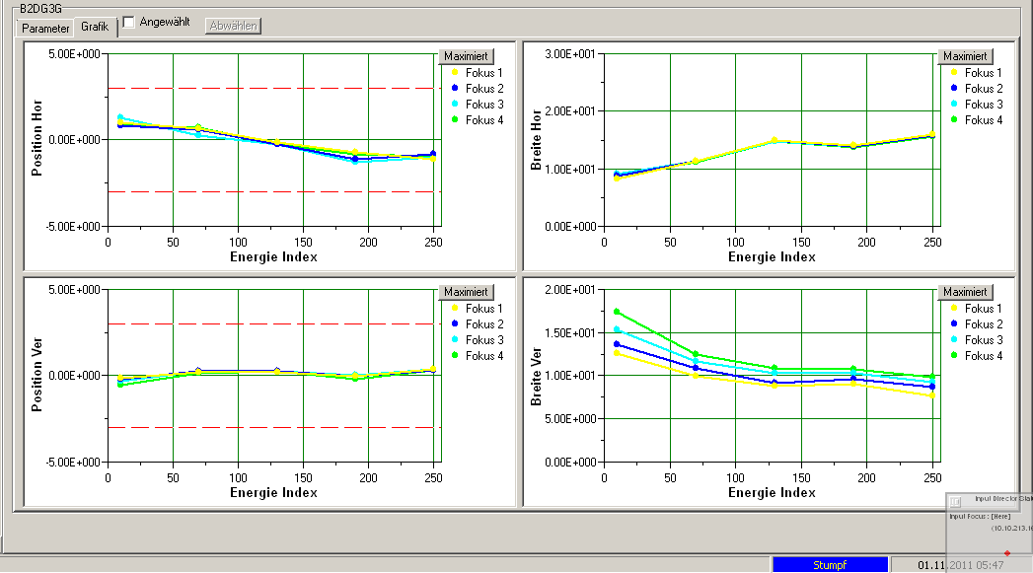
Beam position and size
13
Notes:
Ströme E-Septa
13

Slide 14
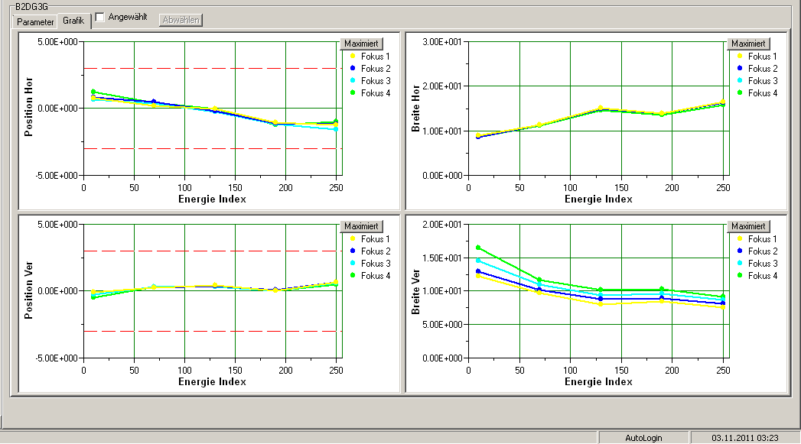
Beam position and size
14
Notes:
Ströme E-Septa
14

Slide 15
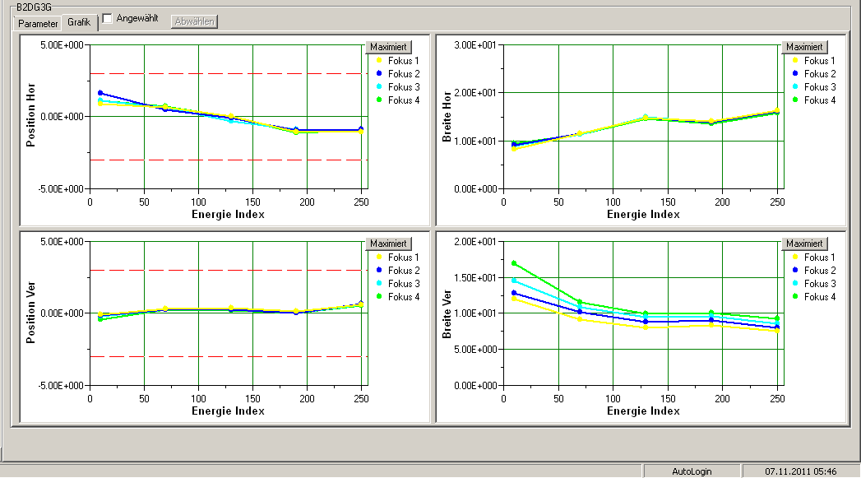
Beam position and size
15
Notes:
Ströme E-Septa
15

Slide 16
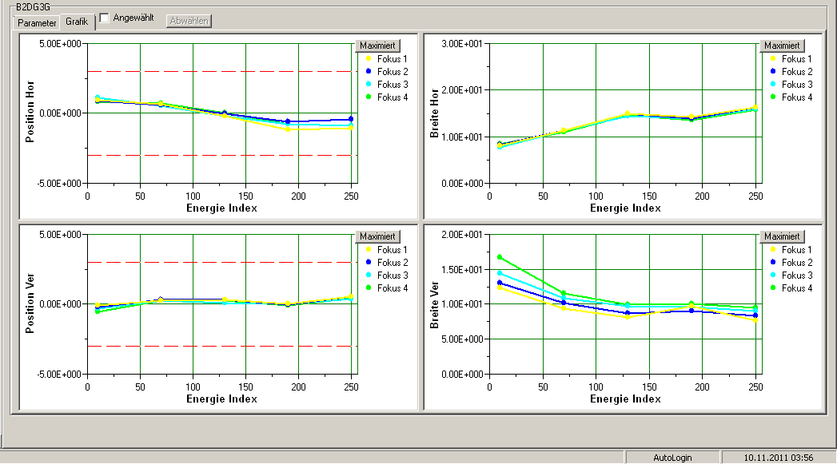
Beam position and size
16
Notes:
Ströme E-Septa
16

Slide 17
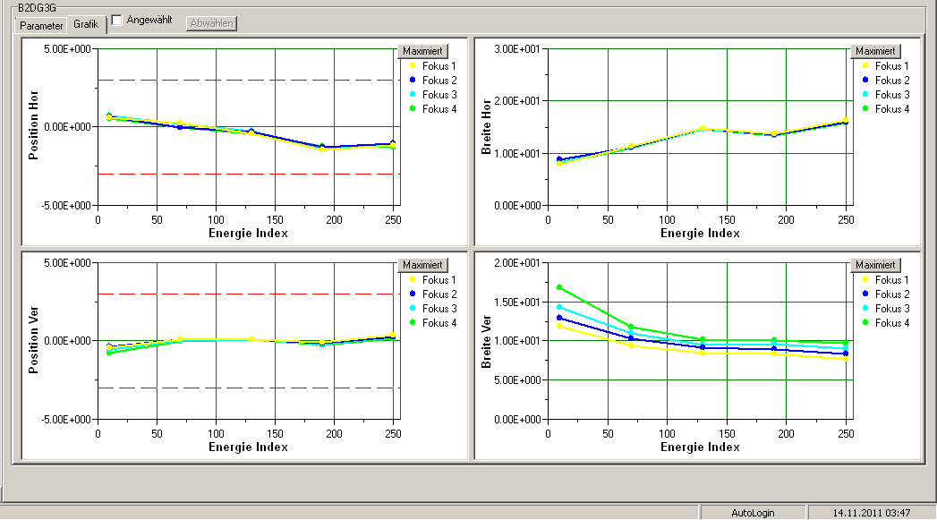
Beam position and size
17
Notes:
Ströme E-Septa
17

Slide 18
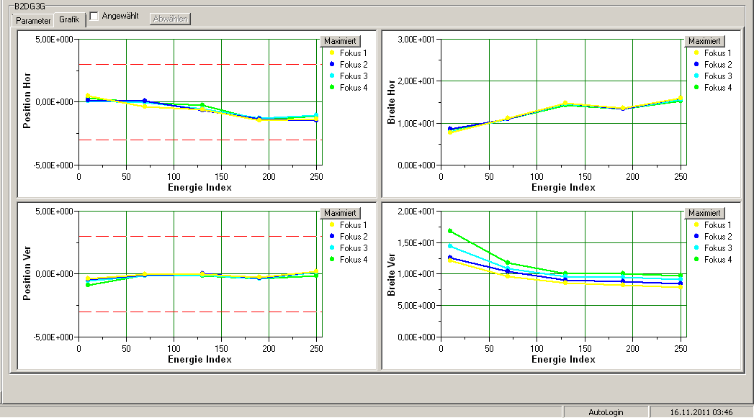
Beam position and size
18
Notes:
Ströme E-Septa
18

Slide 19
Beam position and size
19
Notes:
Ströme E-Septa
19

Slide 20
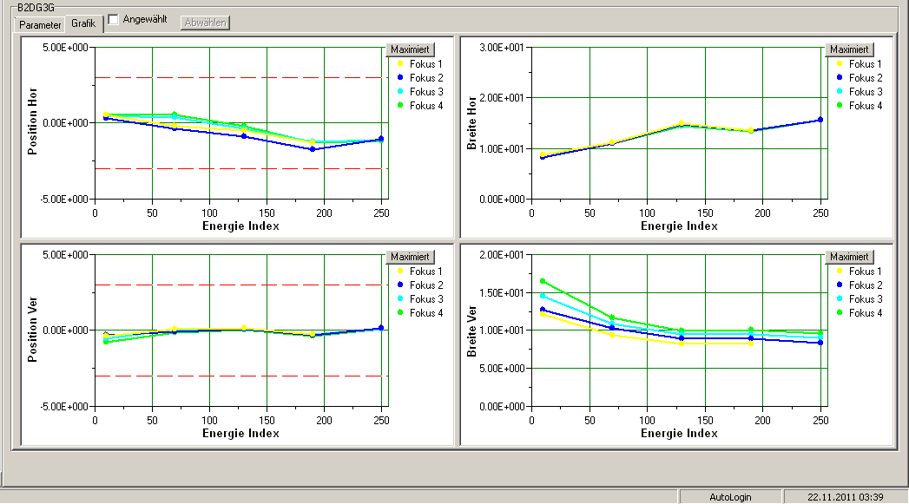
Beam position and size
20
Notes:
Ströme E-Septa
20

Slide 21
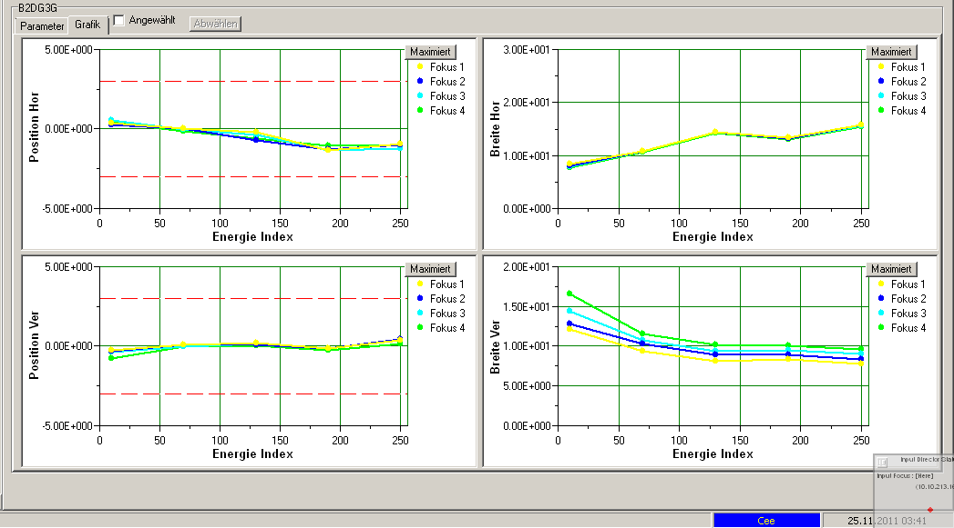
Beam position and size
21
Notes:
Ströme E-Septa
21

Slide 22
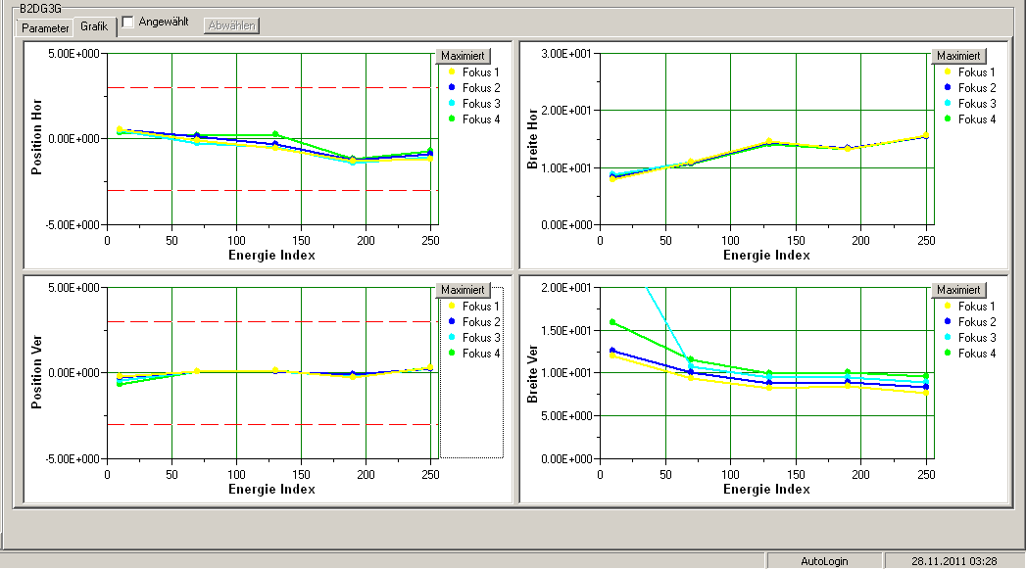
Beam position and size
22
Notes:
Ströme E-Septa
22

Slide 23
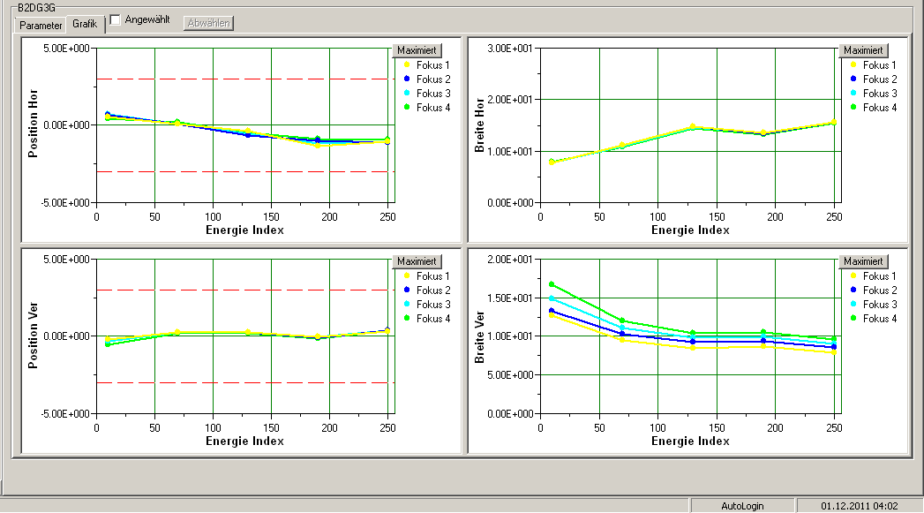
Beam position and size
23
Notes:
Ströme E-Septa
23

Slide 24
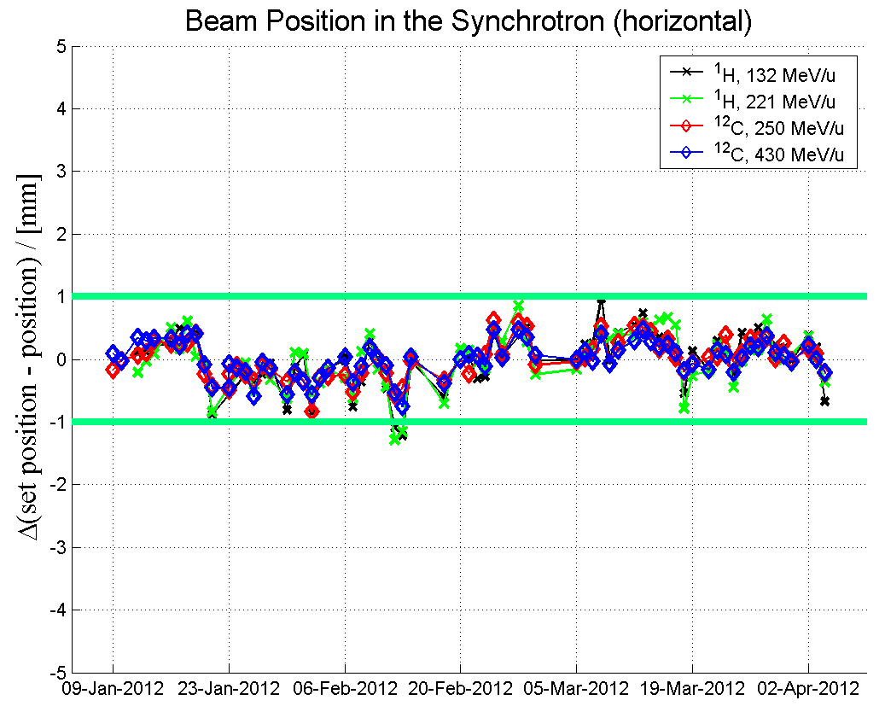
Beam position synchrotron
Long term stability with magnetic
field control in the synchrotron
E. Feldmeier, IPAC10, IPAC12
24
Notes:
Ströme E-Septa
24

Slide 25
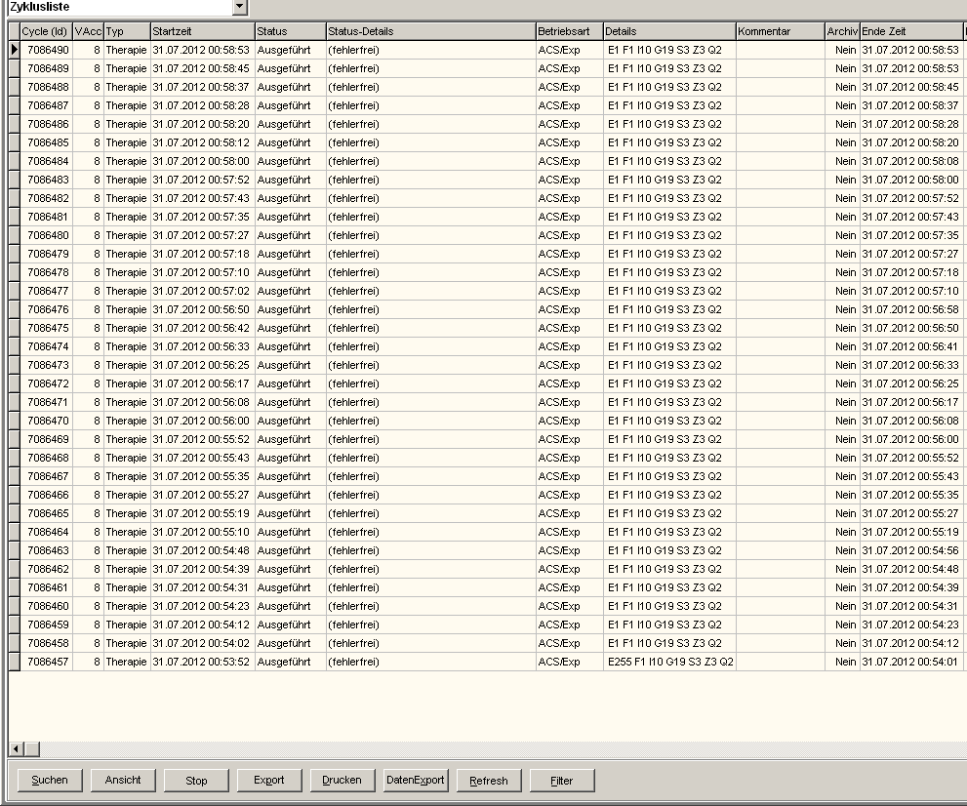
Beam Time Statistics
proprietary control system supplied by automation company
oracle database for storing:
cycle data
measured values (power supplies, beam instrumentation, vacuum pressure, ...)
device parameters
alarm & error logs
devices of virtual accelerators
users & access rights
computers & applications
25
Notes:
25

Slide 26
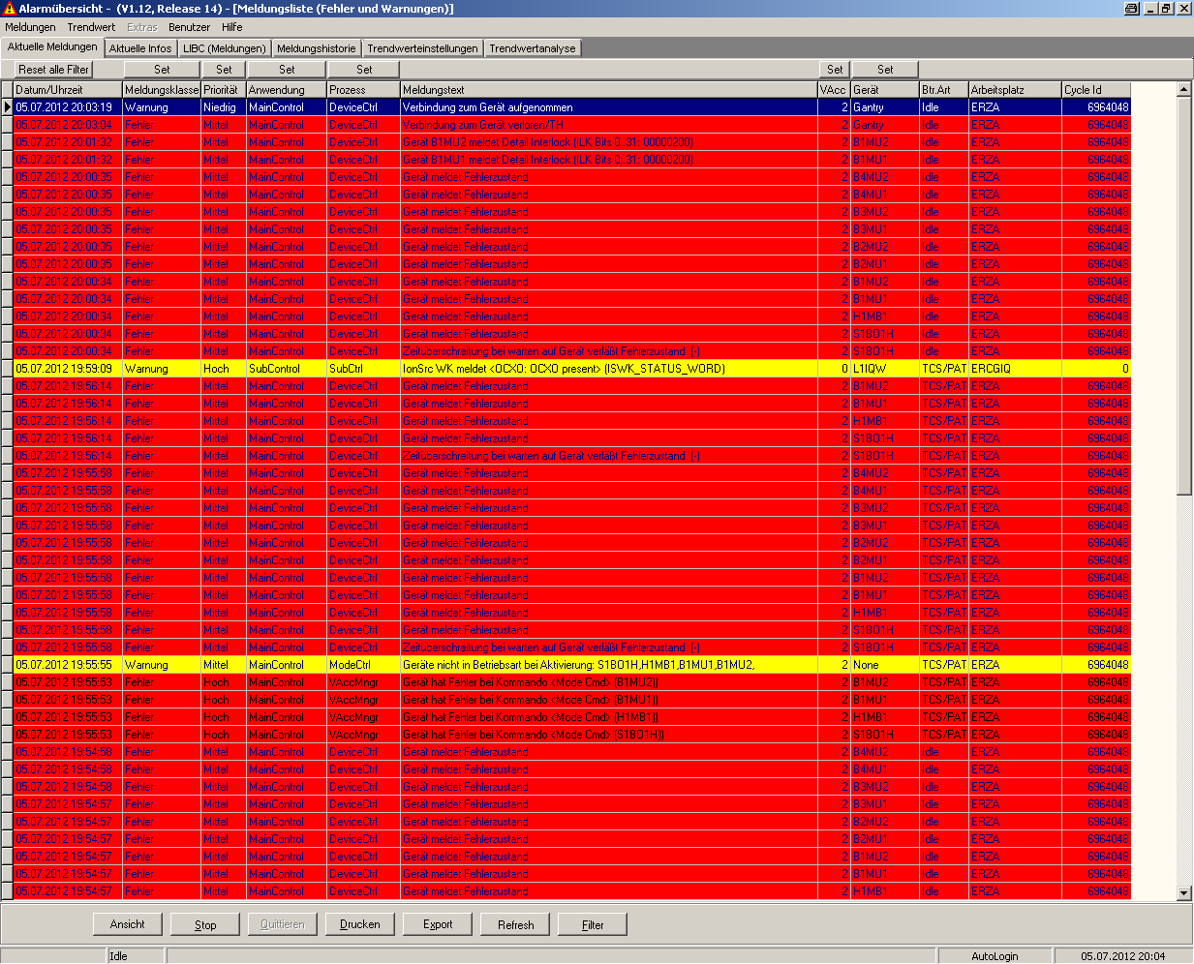
Beam Time Statistics
proprietary control system supplied by automation company
oracle database for storing:
cycle data
measured values (power supplies, beam instrumentation, vacuum pressure, ...)
device parameters
alarm & error logs
devices of virtual accelerators
users & access rights
computers & applications
26
Notes:
26

Slide 27
Beam Time Statistics
proprietary control system supplied by automation company
oracle database for storing:
cycle data, beam history
measured values (power supplies, beam instrumentation, vacuum pressure, ...)
configuration, device parameters
alarm & error logs
devices of virtual accelerators
users & access rights
computers & applications
...but
analysis and statistics tools required
daily/weekly reports beam statistics
parameters
machine status
errors & interlocks
...
27
Notes:
27

Slide 28
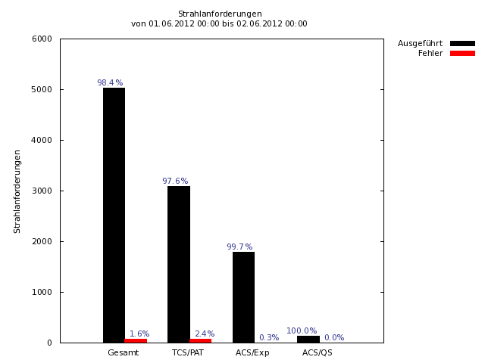
Example Cycle Data
Automatic report
DB reading
daily, weekly
part of e-log
K. Höppner et al., PCaPAC
28
Notes:
28

Slide 29
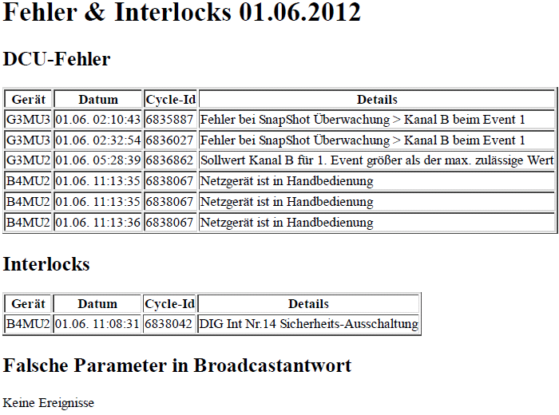
Example Errors & Interlocks
K. Höppner et al., PCaPAC
29
Notes:
29

Slide 30
Example
Errors & Interlocks
Errors
K. Höppner et al., PCaPAC
30
Notes:
30

Slide 31
Beam Time Statistics
Beam statistics:
performance,
number of particles,
beam request modes (therapy, accelerator physics, experiment),
used sources, destinations, ion types,
distribution of E, F, I parameters.
Error analysis:
number of beam request failures, dependent on system mode
identify usual error sources, problems of devices.
K. Höppner et al., PCaPAC
31
Notes:
31

Slide 32
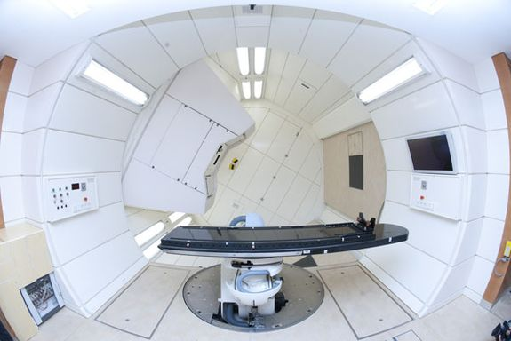
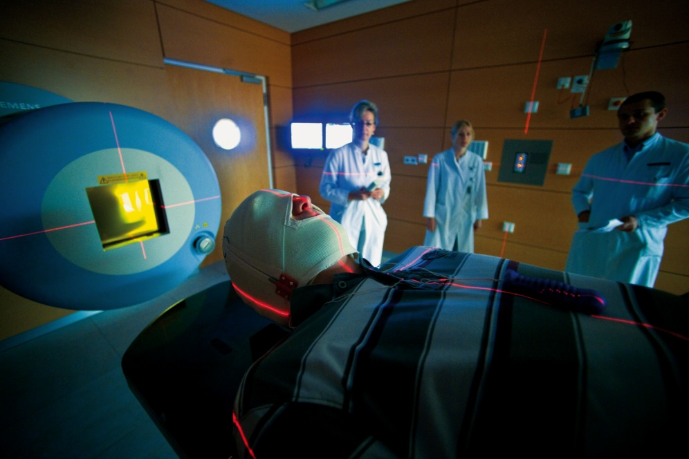
Thanks!
http://www.klinikum.uni-heidelberg.de
32
Notes:
32

