Slide 1
TRIUMF Electronic Logbook System
Broadcasting Activities Beyond the Control Room
Eric Lee | ISAC Operator | TRIUMF

Slide 2
Overview
History of the logbook evolution from paper to web-based electronic logbook in the ISAC facility at TRIUMF.
Motivations for the electronic logbook.
Features for more detailed and accurate documentations.

Slide 3
Background
TRIUMF started with paper logbooks for documenting shift activities.
Useful for incoming shifts to know exactly what happened before.
Eventually became useful for support groups as well.

Slide 4
Paper Logbook Limitations
Stylized handwriting.
Can become easier to read through experience.
Single copy.
Everyone has to come to the Control Room to read the logbook.
Introduced additional traffic in the Control Room.
Led to potential distractions to operators.

Slide 5
ISAC Electronic Logbook
ISAC started with a goal for an electronic logbook (elog) system.
Initially, paper logbook was used along the elog.
Eventually phased in documenting completely in the web-based electronic logbook.

Slide 6
ISAC Logbook - I
Notes:
ISAC paper logbook MkI – Hand-written.

Slide 7
ISAC Logbook - II
Notes:
ISAC paper logbook MkII – Hand-written, with print-outs from control systems for details and status snapshots.

Slide 8
ISAC Logbook –III
Notes:
ISAC paper logbook MkIII – elog

Slide 9
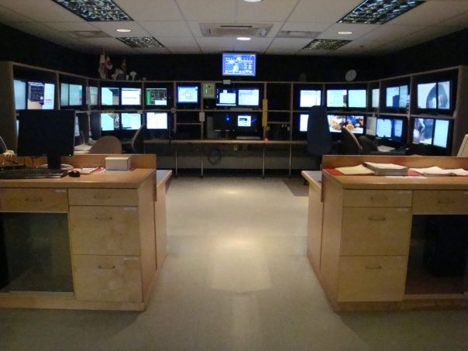
Motivations
Accessibility
Searchability
Storage

Slide 10
Accessibility
Web-based.
Eliminated the single copy physical limitation.
Accessible through a browser.
No need to visit the Control Room to read the logbook.

Slide 11
Accessibility - II
Off-site access.
TRIUMF personnel may log in to the external elog.
Further reach for reporting shift activities and machine status.

Slide 12
External Elog

Slide 13
External Elog - II
Notes:
3-shift or 8-shift length display.

Slide 14
Accessibility Benefits
Easily accessible to a large audience on or off site.
Global access.

Slide 15
Searchability
Difficult to search in paper logbook.
Accompanying database for the elog.
Search parameters may include:
Date
Author
Keywords
Speed up finding details for reference or investigation.

Slide 16
Search Fields

Slide 17
Searchability Benefits
Searching for past events and details requires less time and became more effective.

Slide 18
Storage
Physical logbooks require large storage space over time.
Long term preservation considerations:
Fireproof
Water-proof
Flood-proof
Insect-proof
Additional costs for storage solutions.

Slide 19
Storage Benefits
Electronic logbook information stored digitally.
Takes up less physical space.
Backed up regularly.
Multiple back-ups are possible.
Low cost for digital storage expansion.

Slide 20
Unintended Side Effects
Instructions may be overlooked among the entries.
Misinterpreted criticism.

Slide 21
Overview
History of the logbook evolution from paper to web-based electronic logbook in the ISAC facility at TRIUMF.
Motivations for the electronic logbook.
Features for more detailed and accurate documentations.

