Slide 1
UPS Improvements to Beam Availability at the Australian Synchrotron Light Source
Don McGilvery

Slide 2
The Australian Synchrotron Light Source
3rd Generation Synchrotron Light Source with a full energy injection system.
Have good beam availability – Why do more?
Biggest cause of downtime – interruptions to incoming power feed.

Slide 3
Causes of Brownouts
We have redundant high quality underground feeds from 2 local substations on the national grid.
Most interruptions are from distant, not local causes.
Electrical Storms
High winds
Electrical distribution Network maintenance
Vehicles and poles
Furry creatures
Bushfires (floods?)
Earthquake(?)

Slide 4
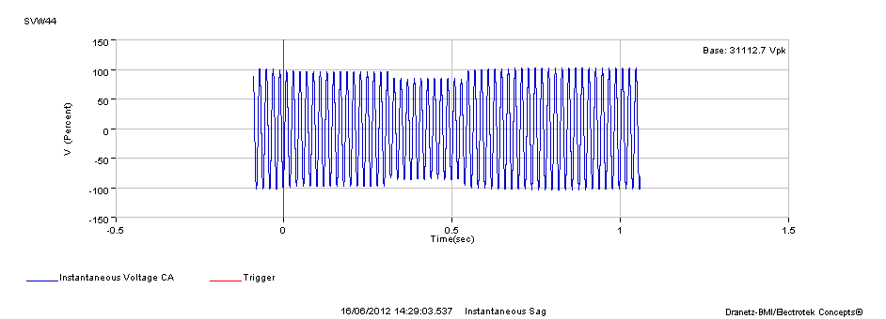

Slide 6
Systems Protected
Three independent flywheel based energy storage
Storage Ring RF system (1MW UPS)
Storage Ring magnets/vacuum and control/diagnostic systems (1.2MW)
Technical Plant, Refrigerated Cooling water systems and compressed air.. (1.8MW) (the largest single unit installed worldwide by the supplier)
Emergency systems, Beam lines, Control Room and Control systems already protected by battery based UPS systems backed by a 400kW diesel generator.

Slide 7
Systems not Protected
Injection system - Linac and booster
Building Hvac, general light and power

Slide 8
Performance
50% Reduction in beam loss events
In the first 6 months no stored beam interruption during 18 brownout events which would have resulted in an estimated 30hrs downtime
Did not protect against total loss of site power for 2 hrs (short on 22kV feed to another building on site)
The Switchboard Trip times have been fixed to improve resilience.
Did not protect against moderate earthquake (measured 5.3 with the epicentre 100kms away) Largest in Victoria for 100 years. No large voltage variation on power grid but large phase shifts inhibited UPS from resynchronising after brownout. A bank data centre had a similar fault.
Phase synchronisation limits have been relaxed

Slide 10
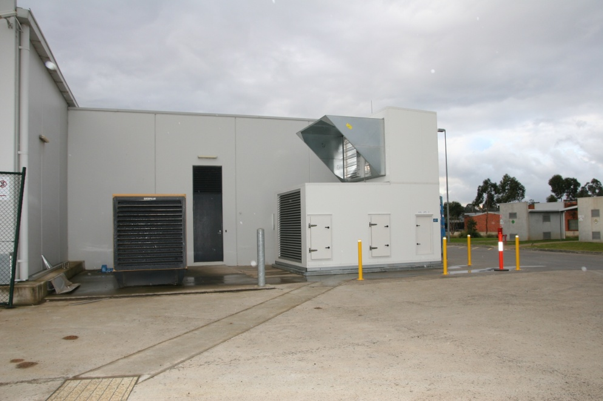
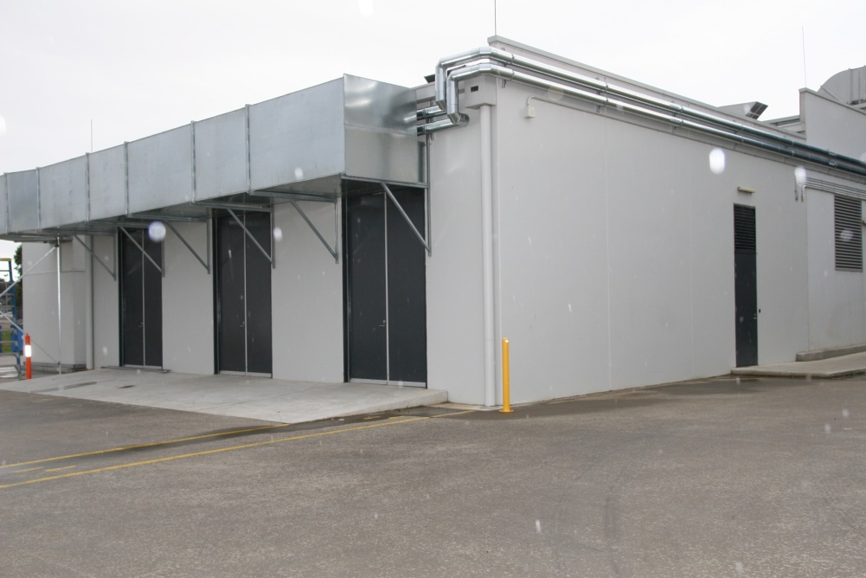
Other Issues
Cooling issues
Volume of air and filters
Ambient temperatures above 35C
Noise and vibration – no problems so far

Slide 11
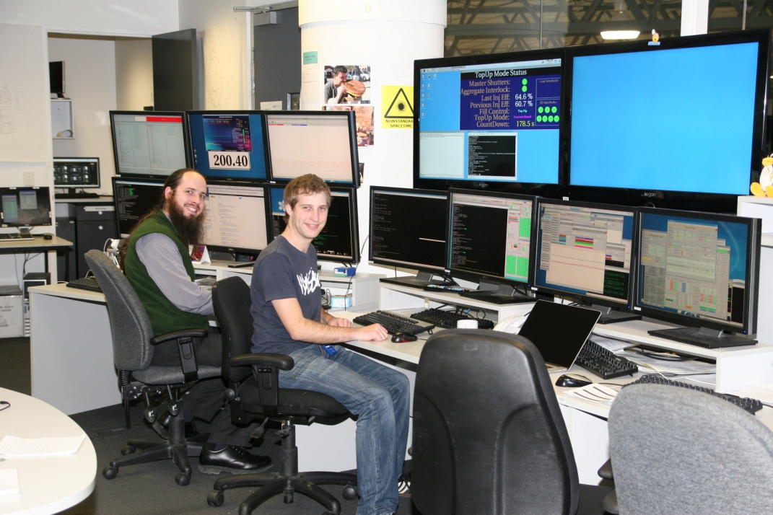
Upsides
Improved outcomes for Users
Improved machine reliability
Greater machine stability
Greater RF stability
Possible improved power converter reliability
Reduced Stress in the Control Room

Slide 12
Downsides
Cost of System A$4M
Extra power consumption (possible offset with reduced headroom on RF)
Lower Stress in the Control Room (reduced vigilance)
Loss of training opportunities (recovery from big events takes longer)
Extra point of failure (earthquake shut down UPS system resulting in 4hr downtime rather than 30 minute downtime)
More difficult to justify further improvements (RF LLE system)
Possible reduction in urgency from technical support staff if less critical systems fail after event.

Slide 13
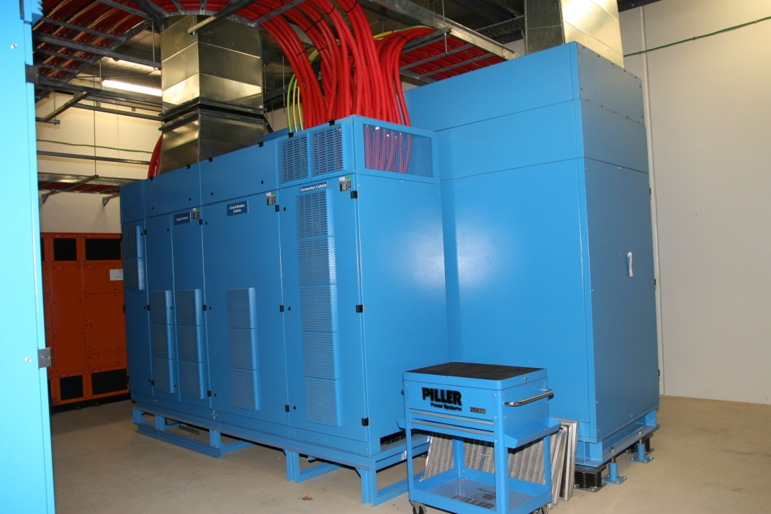
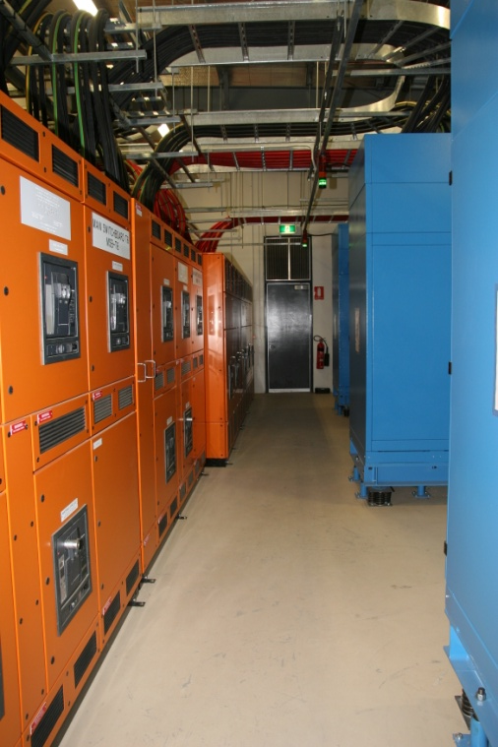
Is it worth the cost?
Light source – yes
Research Physics facility – probably not
Can we justify it via cost savings – No!
Does it improve User Outcomes? – Yes but difficult to quantify
Does it improve Operator working conditions or health? - Yes

Slide 14
Summary
After 4 months of operation
A 50% reduction in downtime
The longest uninterrupted user run > 500 hrs without an unscheduled beam loss event.
Operations Manager commented “The best $4M he ever spent”.

Slide 16
PIE CHARTS

Slide 17
COLOUR PALETTE
The Corporate Style Colour Palette consists of the following colours
The primary colour should always be the Grey
Other colours should be used sparingly as highlights, feature colours, or in tables and graphs
In graphs the colours should be used consecutively as they appear below
R 116 B 116 G 118
R 60 B 151 G 209
R 27 B 155 G 148
R 148 B 182 G 51
R 204 B 210 G 33
R 255 B 237 G 33
R 235 B 188 G 53
R 222 B 152 G 41
R 197 B 56 G 48
R 195 B 28 G 103

