Slide 1
ISAC Target Reliability from Design to Implementation to Long Term Service
Violeta Toma
WAO 2012

Slide 2
Overview
Introduction to ISAC
Past: Phase I – on-line testing
one target module
more target modules
Present: Phase II – off line testing
ISAC target life cycle
Future: Phase III – remote connect & disconnect

Slide 3
ISAC
ISAC = Isotope Separation and Acceleration
Notes:
Isotope Separator and Accelerator (ISAC) facility uses the isotope separation online (ISOL) technique to produce rare-isotope beams (RIB). The ISOL system consists of a primary production beam (proton beam), a target/ion source, a mass separator, and beam transport system. The rare isotopes produced during the interaction of the proton beam with the target material nucleus are stopped in the bulk of the target material. They diffuse inside the target material matrix to the surface of the grain and then effuse to the ion source where they are ionized to form an ion beam that can be separated by mass and then guided to the experimental facilities.

Slide 4
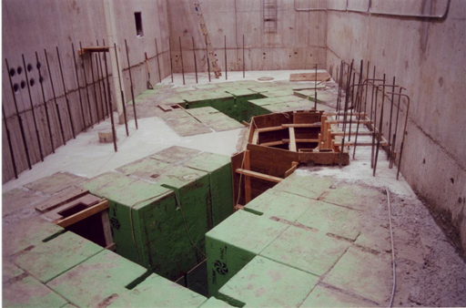
Phase one
Two target stations
One target module
Notes:
…this is an easier to see layout of the five modules and the location of the target module.
Having only one target-module: no beam delivery during cool-down after end-of-beam

Slide 5
ISAC Target Life Cycle
Machine shop
6 -12 months
Notes:
The life cycle of the target starts in the machine shop with the parts manufacturing stage. The long time is due to Machine shop work load. Some parts are out-sourced, some are made by the Targets group. To overcome the impact such a long time has on target availability, an inventory of parts was built. Currently we have spare parts to build 5 target (good for 6 months). New parts are ordered when spares are used up.

Slide 6
ISAC Target Life Cycle
Machine shop
6 -12 months
Target (material)
1 – 8 weeks
Notes:
Our targets are in-house made. The target is prepared on site by the chemist who is part of the Targets/IS group. To prepare a target starting from raw material it can take anywhere from 1 week (Ta foils) to 2 months (U carbide target as it needs sintering).
We use 12 different target materials, and produce ~10 targets a year.
It is important that the chemist receives early warning for what targets are needed when.

Slide 7
ISAC Target
Target and target tube
Notes:
This is the ISAC target.

Slide 8
ISAC Target Life Cycle
Machine shop
6 – 12 months
Target material
1-8 weeks
Target assembly and baking
5 days
Notes:
Assembly : 1 day spent checking that the parts conform to specifications and 4 days to clean, assemble and bake the target
Jigs used to confirm parts are to specs
Clean parts of grease, flux, etc
Target baking (without the heat shield to get rid of grease, flux, etc)

Slide 9
ISAC Target
In house made target
1 -8 weeks
Target assembly &baking
5 days

Slide 10
ISAC Target Life Cycle
Machine shop
6 -12 months
Target material
1 – 8 weeks
Target assembly and baking
5 days
Test stand
1 week
Notes:
Test stand - heat shield is installed and:
Tests: electrical, vacuum,
the target is heated to nominal values 580 A on target heater and 230 A on ionizer, stable beam extracted = this tests the target assembly

Slide 11
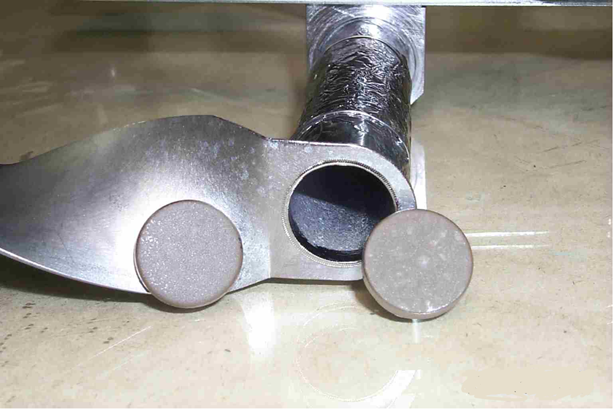
ISAC Target
Notes:
Target and target heat shield

Slide 12
ISAC Target Life Cycle
Notes:
This is the ISAC target assembly…with the heat shields on and cooling lines.

Slide 13
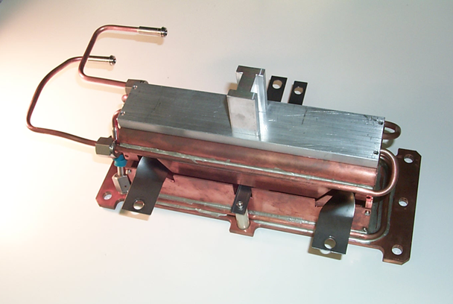
Test stand
Target assembly goes to the
Test stand.
Notes:
After baking the heat shield is installed and the target goes to the test stand where it is subjected to the same temp as in production and beam is extracted. If all goes well…

Slide 14
ISAC Target Life Cycle
Machine shop
6 -12 months
Target material
1 – 8 weeks
Target assembly and baking
5 days
Test stand
1 week
Target installed in Target Module
2 days

Slide 15
ISAC Target
Hot Cell (HC) – Target remote installation into the Target Module (TM)
Notes:
Target is brought to the Hot Cell for installation in the Target Module (TM) -> electric, vacuum tests

Slide 16
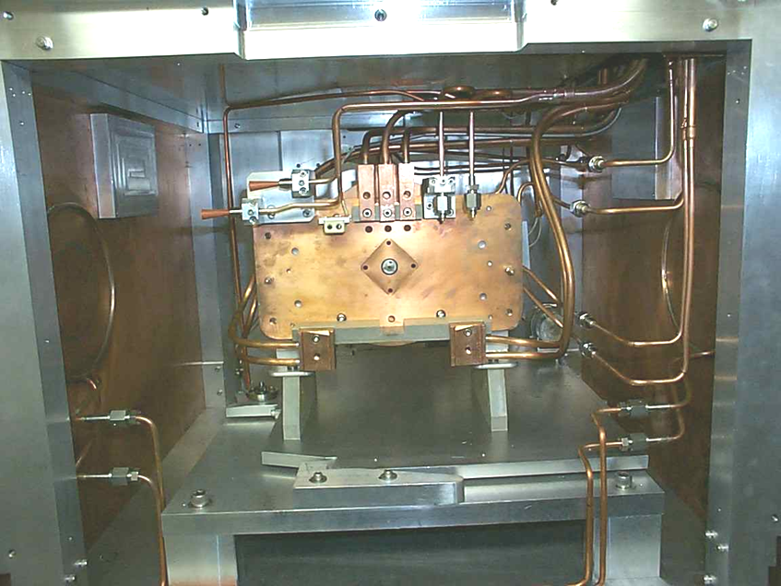
ISAC Target Module
Notes:
Target module (left) with the containment box visible and inside view of the containment box (right)

Slide 17
ISAC Target Life Cycle
Machine shop
6 -12 months
Target material
1 – 8 weeks
Target assembly and baking
5 days
Test stand
1 week
Target installed in Target Module
2 days
Conditioning Station
2 days
Notes:
Target module is then craned to the Conditioning station where it is pumped down, HV conditioned and heaters conditioned. Conditioning station simulates the actual operating conditions except for the proton beam. This time the target and Target Module are tested - electrical, vacuum. The cooling water circuits are also tested in static pressure tests – Pumped down & leak checked
All these off-line tests allow for early possible failures identification and remedy – saves a lot of production time.

Slide 18
Conditioning station

Slide 19
ISAC Target Life Cycle
Target material
1 – 8 weeks
Test stand
1 week
Machine shop
6 -12 months
Conditioning Station
2 days
Target installed in Target Module
2 days
Target preparations for production
2 days
Target assembly and baking
5 days
Beam Delivery
2-4 weeks
Post mortem analysis and storage
Notes:
If all test results are OK the Target Module is moved to the target pit for connections, on-line conditioning and production.
Target preparations for production = crane to MAA, connect services, pump down, condition High Voltage and target heaters
After that => beam delivery
Leaving out the parts and target fabrication: it takes roughly 3 weeks to have a new target ready.
Due to the off line testing the beam availability is very little affected compared to the times when the testing was done on line.

Slide 20
Beam on Target
Target tube
Ionizer tube
Proton beam
Notes:
Clearer image of the target assembly with components and p+

Slide 21
Phase I & II
Machine shop
6 -12 months
Target material
1 – 8 weeks
Target assembly and baking
5 days
Test stand
1 week
Target installed in Target Module
2 days
Conditioning Station
2 days
Target preparations for production
2 days
Beam Delivery
2-4 weeks
Post mortem analysis and storage
Notes:
While moving from phase I to phase II the target life cycle did not change significantly, but the beam availability increased by ~ 9 days (more if problems occurred)

Slide 22
Documenting & Improving
Target travel document
Learn from failures
Learn from success
Standardized parts
Dedicated target reliability engineer
Notes:
Target travel document = follows the target during its entire life. It contains all info about target
Learn from failures = post mortem analysis
Learn from success = inspect targets that ran well
Standardized parts = less drawings to maintain
Dedicated target reliability engineer = new position (~2 years). Works with target chemist & remote handling

Slide 23
Phase III
Present: manual connect/disconnect
Cool- down for one week after beam off
Beam off during manual dis/re-connect
Personnel dose
Future: remote connect/disconnect
No cool-down necessary
Dis/Re-connect can be done while delivering beam from the other station
No dose to personnel
Notes:
To further improve beam availability we have plans to implement remote Target Module disconnect/connect.
We are also looking at altering other limiting factors:
Cooling flow limitations require access to opposite (possibly hot) target station to turn off dump beam stop cooling
• East & West connections are not identical - High Powered conductors have to be replaced when switching operation of a module between east and west stations
• No documentation or written procedures for connections
• No specifications for torque when connecting high powered connectors
Tooling: An assortment of tooling of different sizes and types are required. Different bolt styles and sizes are used to attach the various components.

Slide 24
Manual Target Disconnect/Connect

Slide 25
Beam Availability
Machine shop
6 -12 months
Target material
1 – 8 weeks
Target assembly and baking
5 days
Test stand
1 week
TRG installed in Target Module
2 days
Conditioning Station
2 days
Target preparations for production
2 days
Beam Delivery
2-3 weeks
Post mortem analysis and storage
Notes:
Remote disconnect/connect will save time and dose.
~11 more days of beam available more if problems occurred..

Slide 26
ISAC Target
Problems:
Manufacturing problems
During baking:
Target legs warping
Target tube warping
During conditioning
Electrical short
Vacuum leaks
Water leaks
Notes:
Manufacturing problems: wrong flux used (opened during target heating), improper cleaning (caused long pump down, sparking)
Wrong material used => target legs warp
Design flaw = not enough support for target tube => it warps = banana effect

Slide 27
Summary
Phase I => II
Gain: ~ 9 days beam availability and improved reliability
Phase II => III
Gain: ~11 days beam availability and further improved reliability

Slide 28
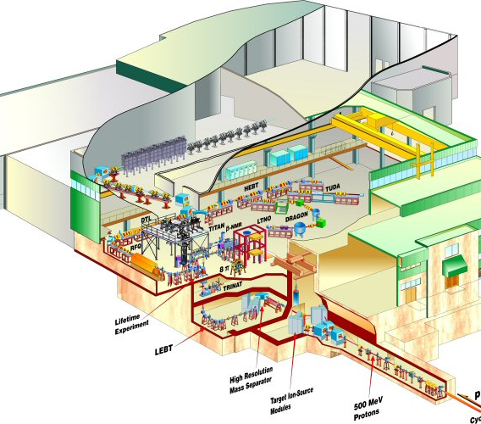

Slide 29
Notes:
And this is where the TM lives.

