Slide 2
Outline
Introduction
LHC beam is a dangerous beam
LHC Beam Operation /Machine protection
Conclusions

Slide 3
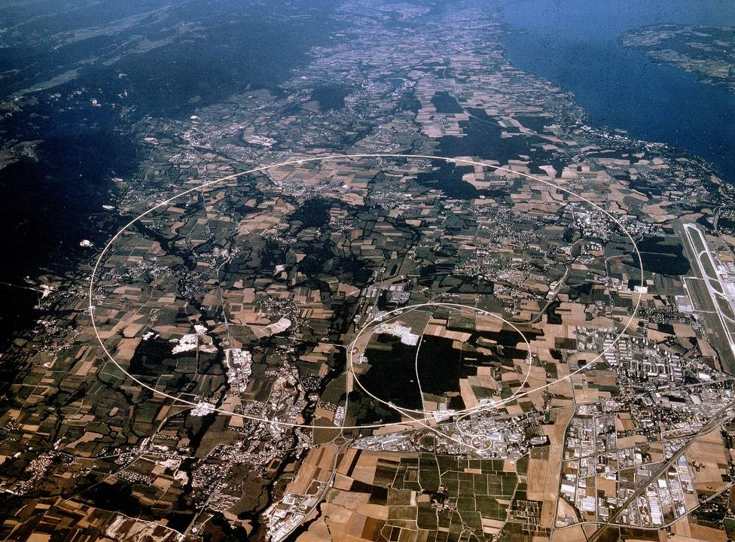
CERN
CERN Accelerator Complex
Large Hadron Collider
(LHC)
Super Proton Synchrotron
(SPS)
Proton Synchrotron
(PS)

Slide 4
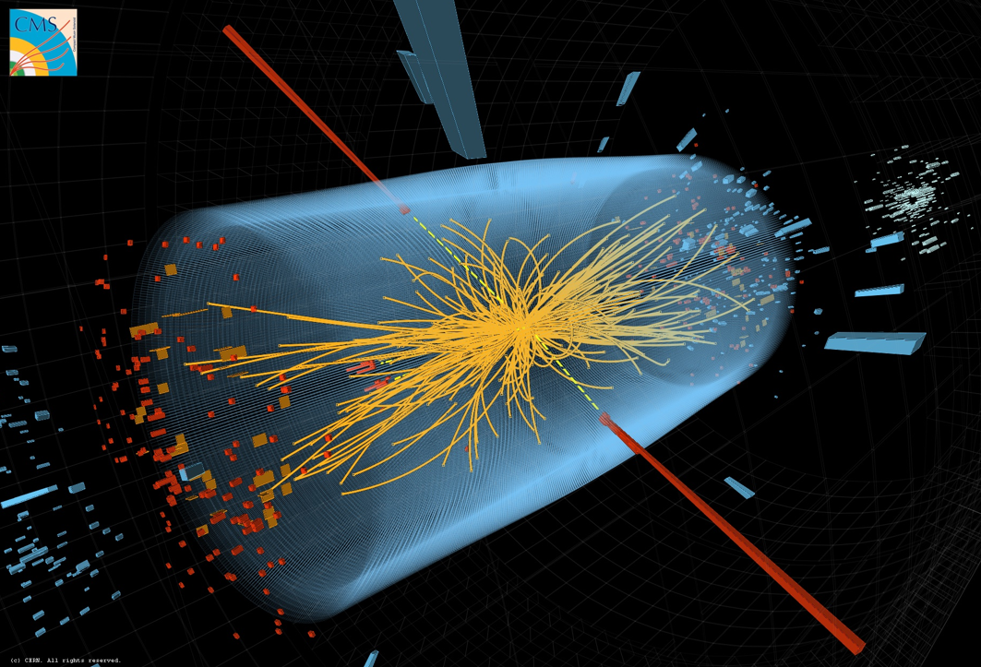
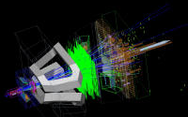
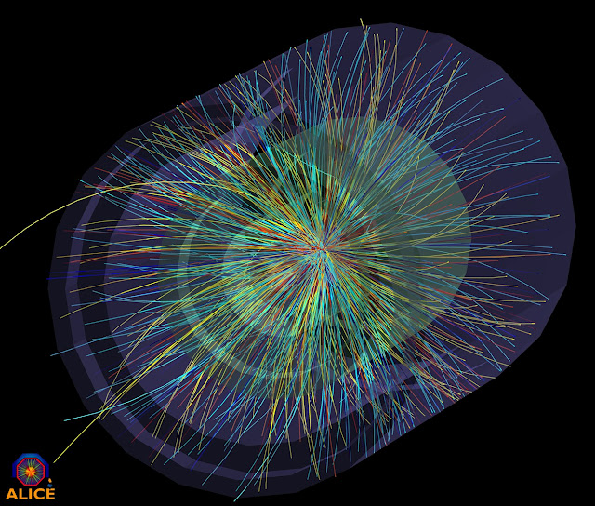
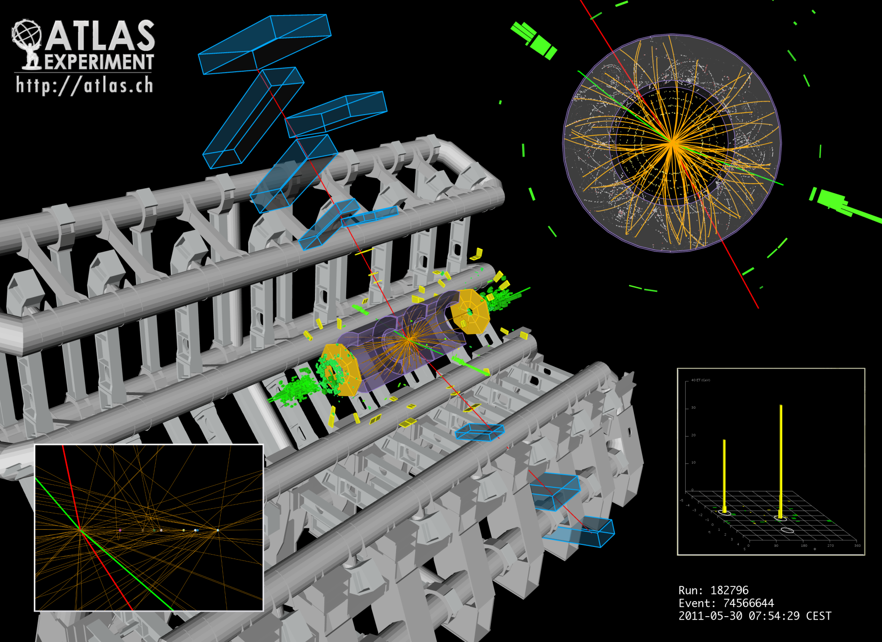
CERN
CERN Accelerator Complex
CMS
LHC-b
ALICE
ATLAS

Slide 5

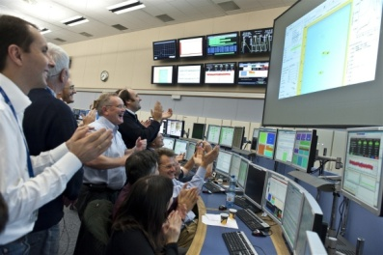
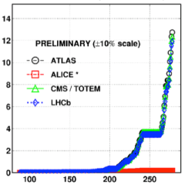
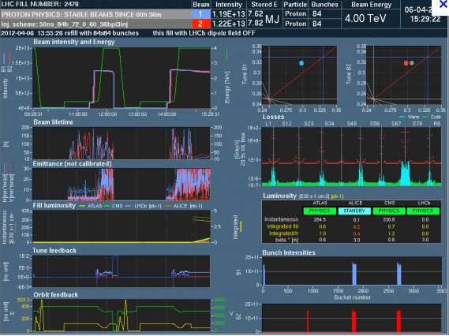
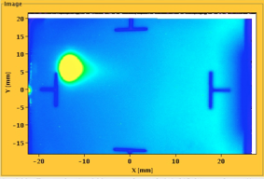

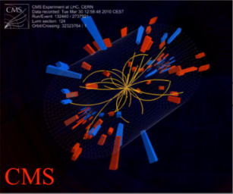
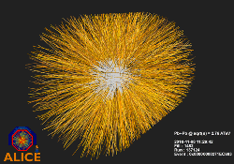
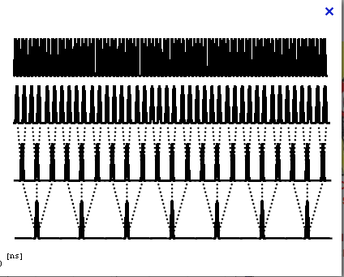
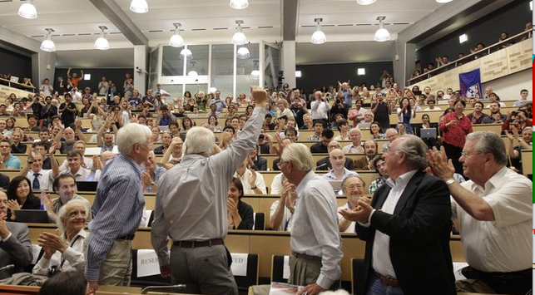
LHC timeline
LHC milestones
4 TeV
August 2008
First Injection
September, 10 2008
Both beams circulating
November 29, 2009
Beams back
October 14, 2010
248 bunches
November, 2011
Higgs candidates
February, 2012 highest energy
2008
2009
2010
2011
2012
September, 19 2008
Incident
March 30, 2010
First collisions at 3.5 TeV
November 2010
Ion run
June, 28 2011
1380 bunches
July, 2012
5 fb⁻¹
1380
5 fb⁻¹

Slide 6
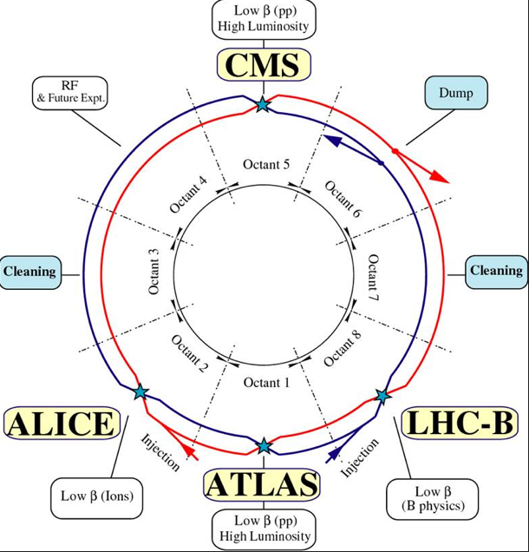
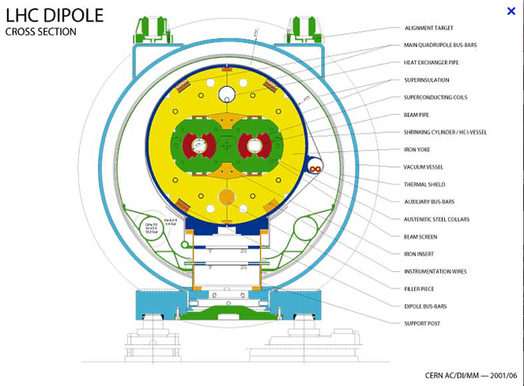
LHC layout
A schematic view of the 26.7 km-long LHC ring composed of 8 arcs and 8 long straight sections (LSSs)
A two-in-one magnet design, the counter-rotating proton beams circulate in separated vacuum chambers and cross each other only in the experimental interaction regions.

Slide 7
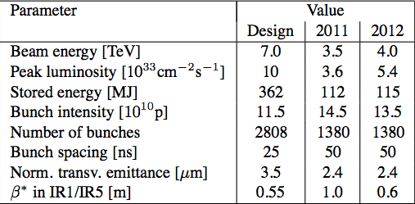
LHC Parameters
LHC parameters for proton operation 2012
6.6
15

Slide 8
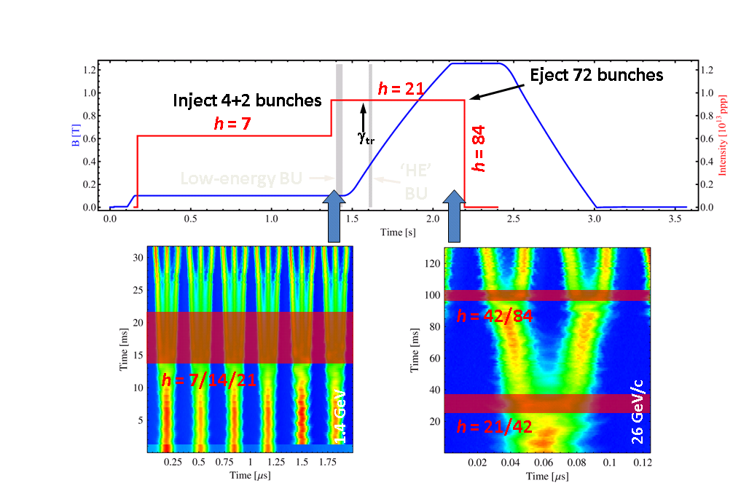
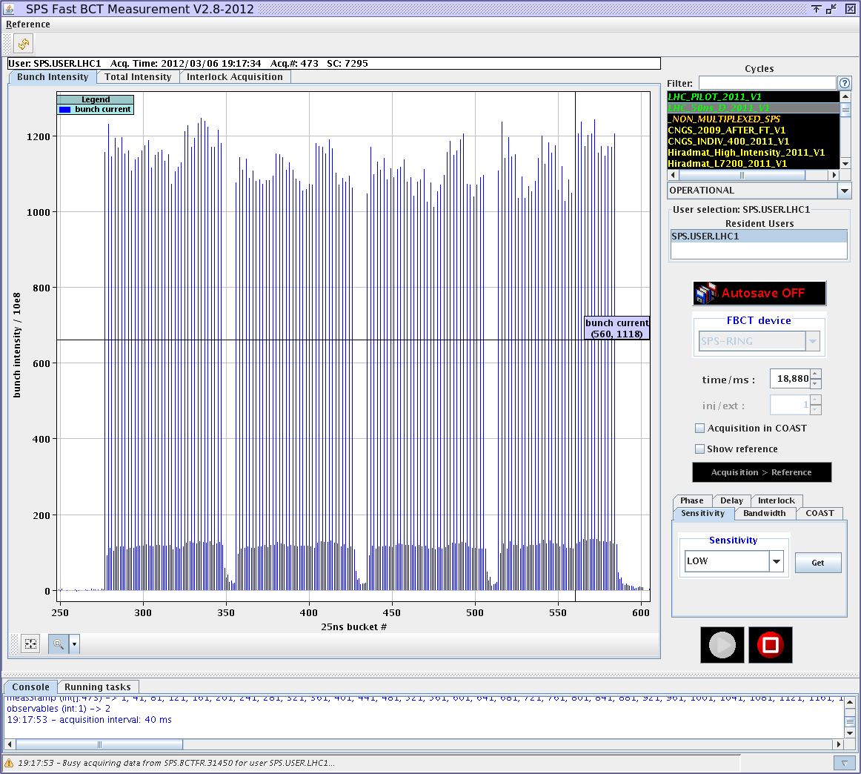
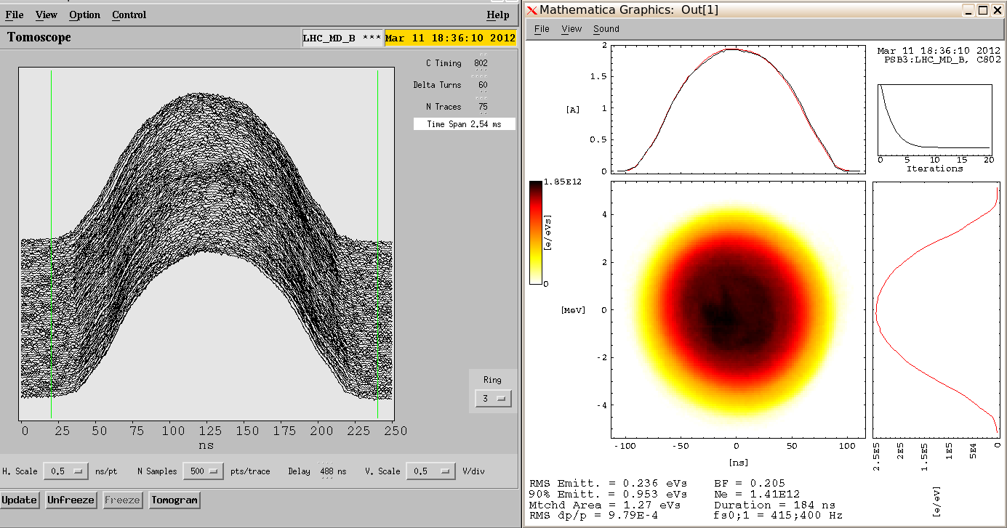
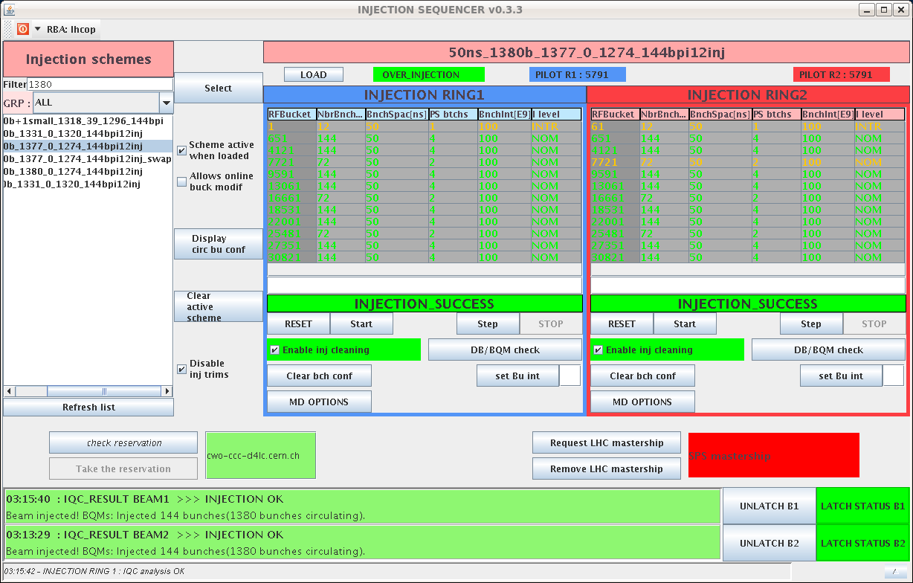
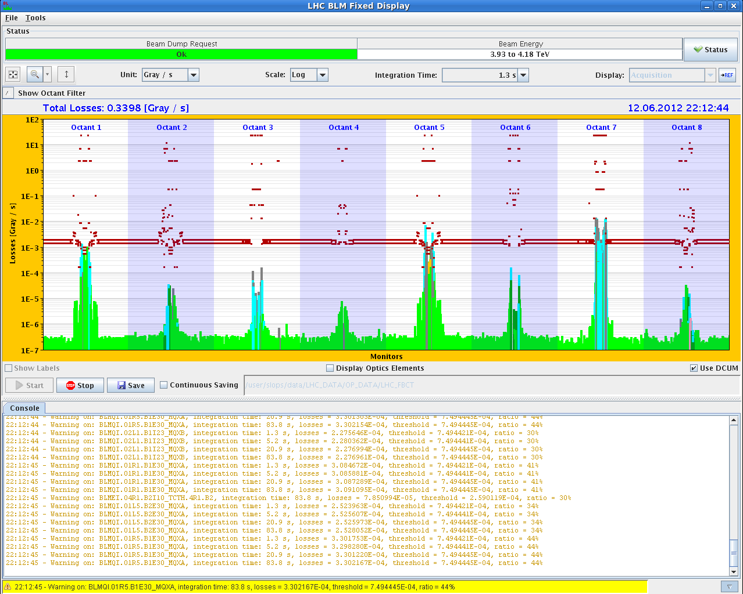
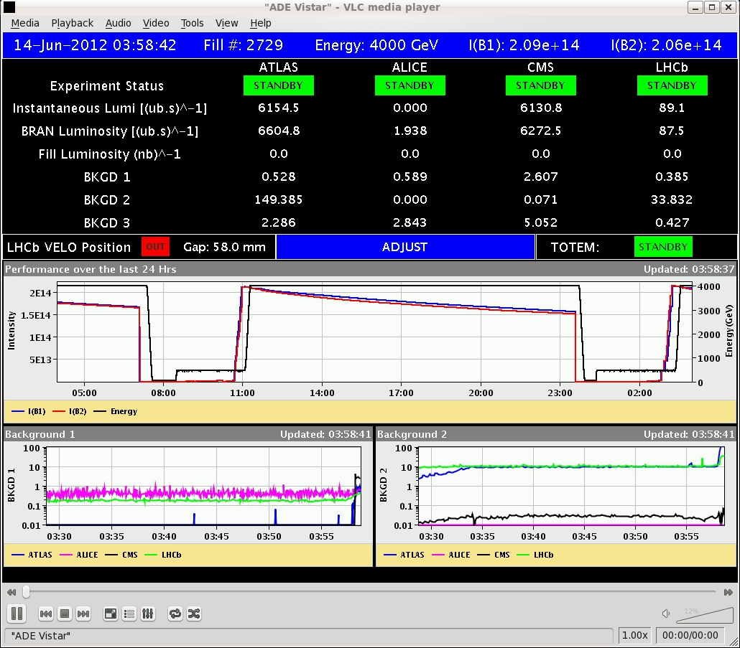
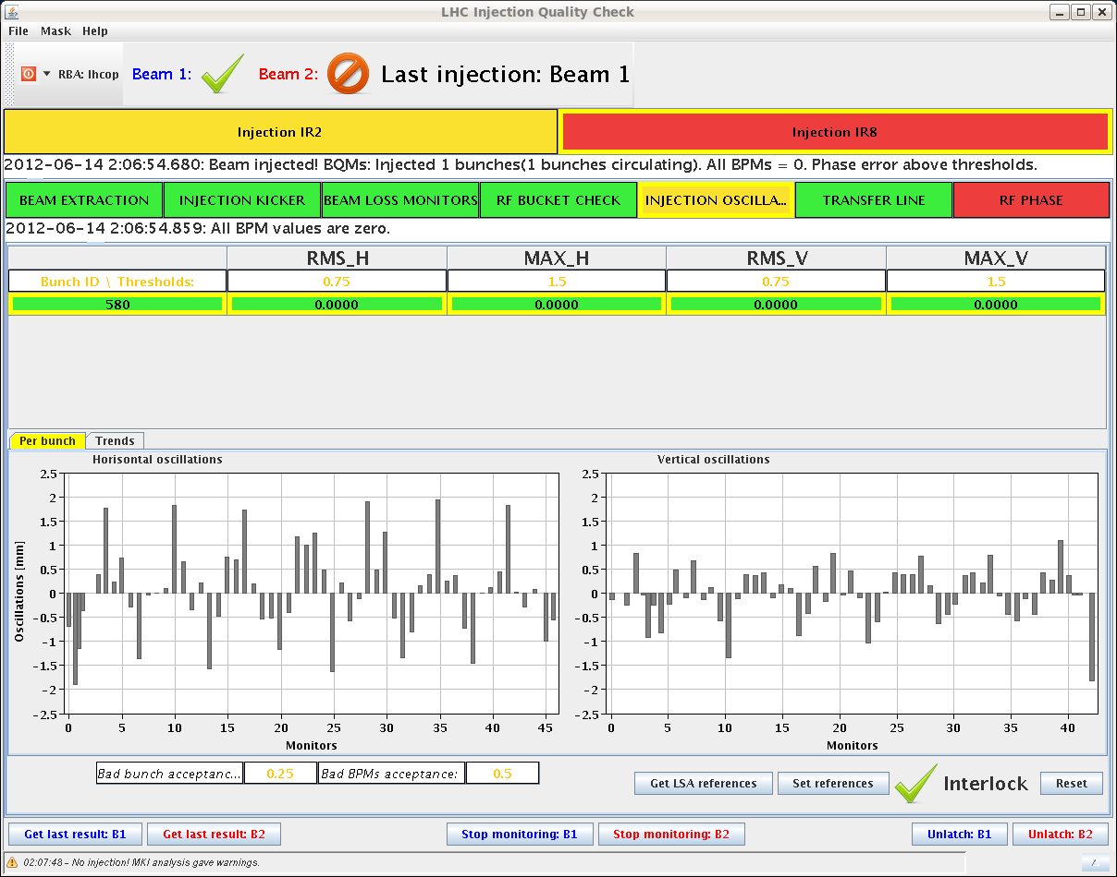
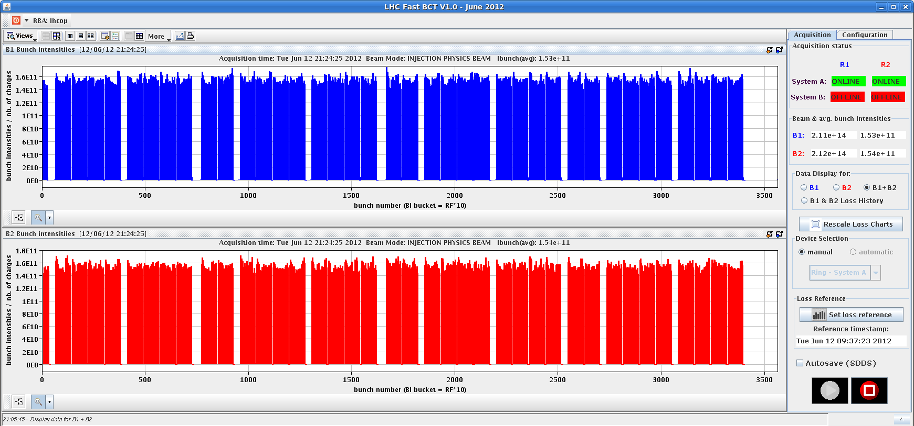
LHC beam journey
Emmittance measurement at 1.4 GeV
Bunch splitting at 1.4 GeV
Single bunch intensity at 26 GeV
Booster & CPS
SPS injection
SPS extraction
LHC Injection
LHC Ramp
1.4GeV/26 GeV
26 GeV
450 GeV
450 GeV
4 / 7 TeV
Total intensity 2.10 ¹⁴ /beam
Beam losses end of ramp warning
Luminosity adjustments

Slide 9
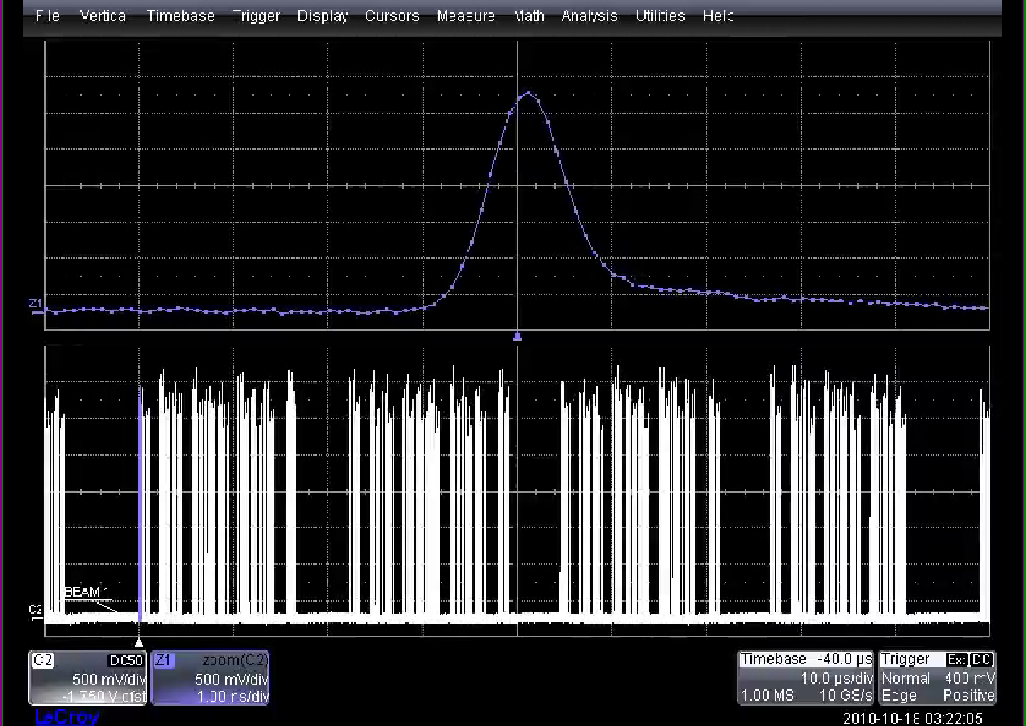
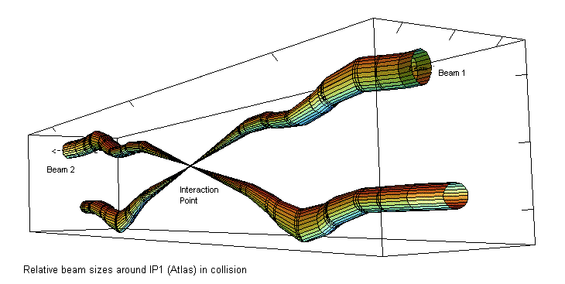
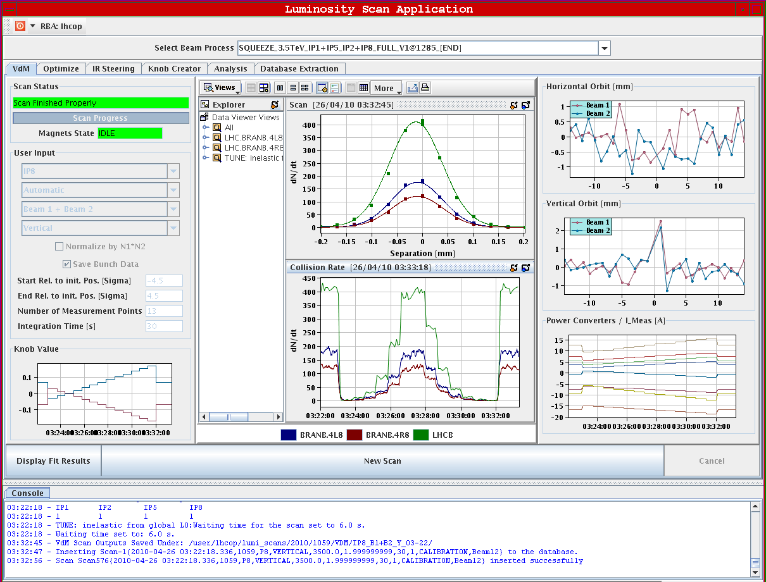
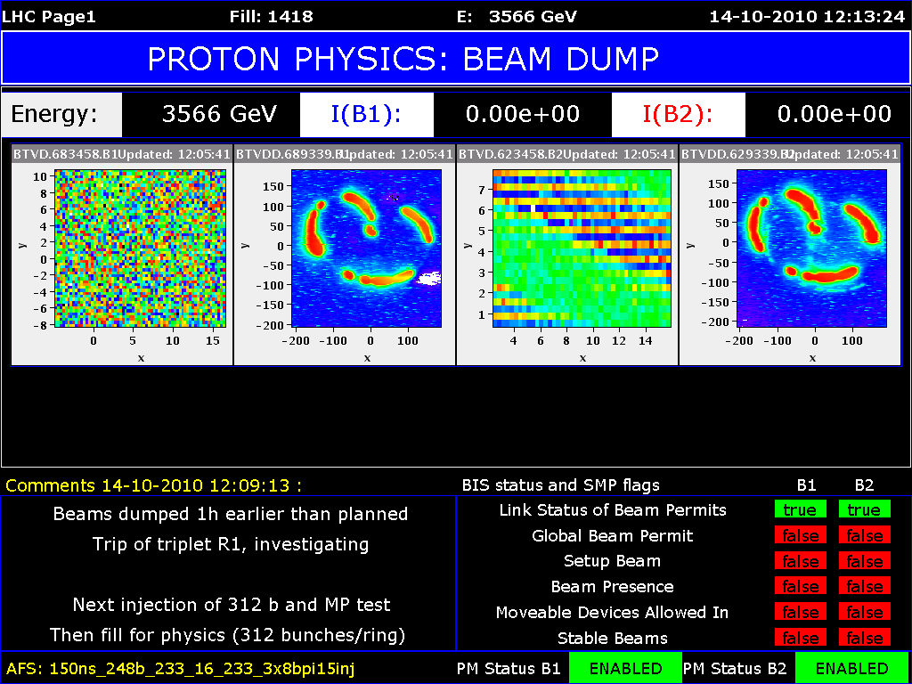

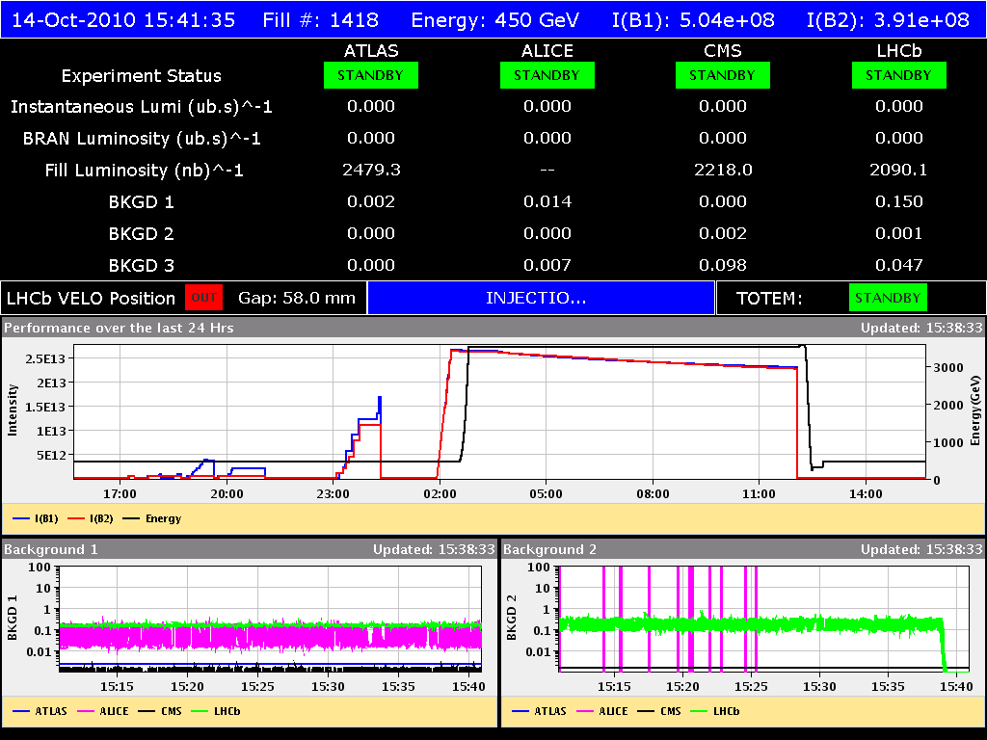
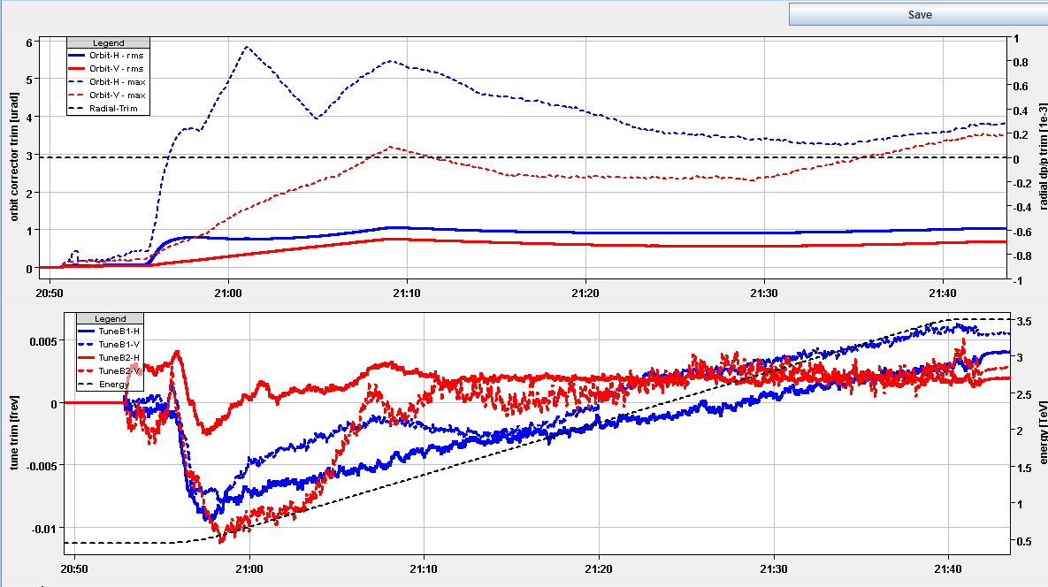
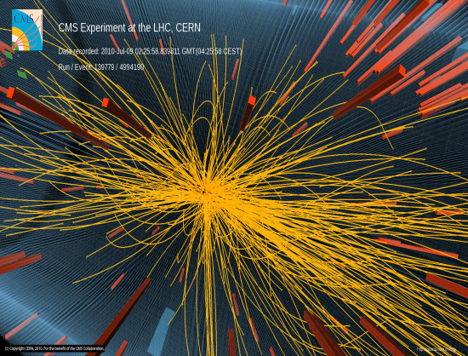
Operating machine
Filling
Squeezing
Collisions
Beams in collision
Beams dumped
Ramp
down
STABLE BEAMS
Ramp up
Pre-injection
flat bottom
Injection

Slide 10
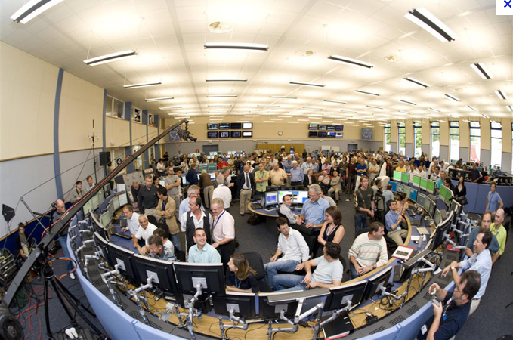
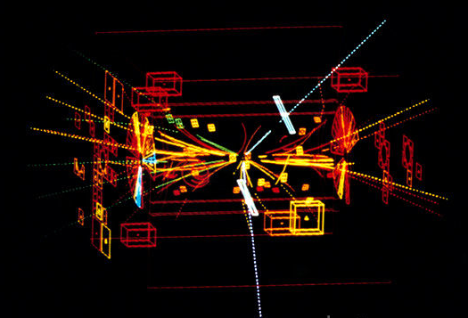
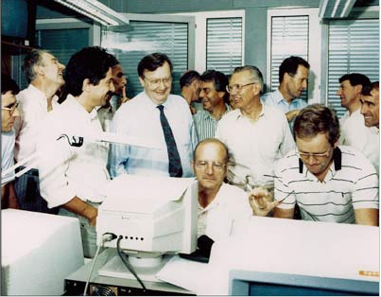
Cern OP experience
LHC machine operation
  2006 one OP group working in the Cern Control Centre
  Direct line to the Injectors chain (Booster, CPS, SPS)
  Share PPbar and Electron Positron collider experience
‘80 Ppbar beam operation challenge
  Collisions 270 GeV, Intensity P 10¹³ Pbar 10¹²
  Old fashion control but already Sequence driven
’90 Electron positron collider dimension challenge
  Injection energy 3.5 GeV, Collisions 45/90 GeV,
  Control software redesigned by Op
2000 LHC PP collider energy & power challenge
  Injection energy 450GeV, Collisions 4/7 TeV
  Intensity 2.10 ¹⁴
Z particle event in UA1 detector
LEP control room first beam

Slide 11
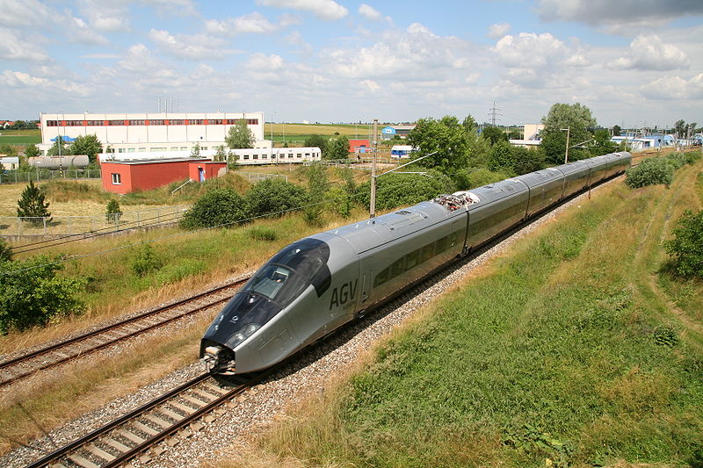

Technological Challenges
Kinetic Energy of 200m Train at 155 km/h
Kinetic Energy of Aircraft Carrier at 50 km/h
Stored energy per beam is 360 MJ
Stored energy in the magnet circuits is 9 GJ

Slide 12
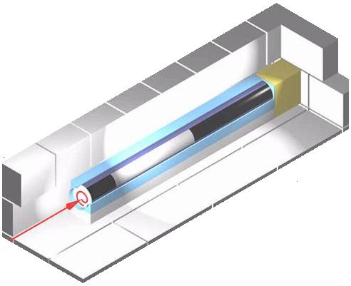
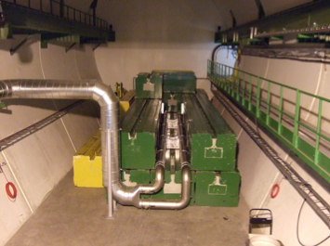
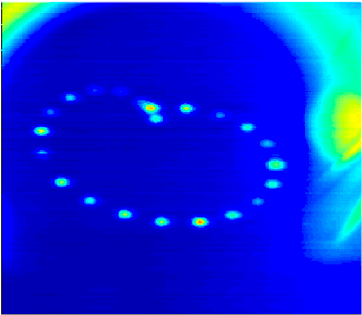

Protection Functions
Beam Protection:
Beam Energy
Beam Dump
100x energy of TEVATRON
0.000005% of beam lost into a magnet = quench
0.005% beam lost into magnet = damage
Failure in protection – complete loss of LHC is possible
Beam is ‘painted’ diameter 35cm
Concrete Shielding
8m long absorber Graphite = 800°C

Slide 13
Killer beam & downtime
LHC operation is several orders of magnitude more dangerous.
Magnet quench (or a few magnets): a few hours
Collimator replacement: a few days to 2 weeks (including bake out if needed)
Superconducting magnet replacement : 2 months (warming up, cooling down)
Damage to an LHC experiment: many months
Beam accidents could lead to damage of superconducting magnets, and to a release of the energy stored in the magnets (coupled systems)
Experience with the accident in sector 34 in 2008 : one year downtime!!
LHC 50 ns | Intensity x bunch | Nr bunches | Energy [GeV] | Intensity | Energy [MJ]
flat bottom PSB | 9.50E+11 | 1 | 0.5 | 9.50E+11 | 0.0001 | x4
flat top PSB | 9.50E+11 | 1 | 1.4 | 9.50E+11 | 0.0002 | x4
flat bottom CPS | 9.50E+11 | 6 | 1.4 | 5.70E+12 | 0.0013
flat top CPS | 1.58E+11 | 36 | 26.0 | 5.70E+12 | 0.0237
flat bottom SPS | 1.58E+11 | 144 | 26.0 | 2.28E+13 | 0.0948
flat top SPS | 1.55E+11 | 144 | 450.0 | 2.23E+13 | 1.6090
flat bottom LHC | 1.52E+11 | 1380 | 450.0 | 2.10E+14 | 15.1389 | x2
flat top LHC | 1.50E+11 | 1380 | 4000.0 | 2.07E+14 | 132.6456 | x2

Slide 14
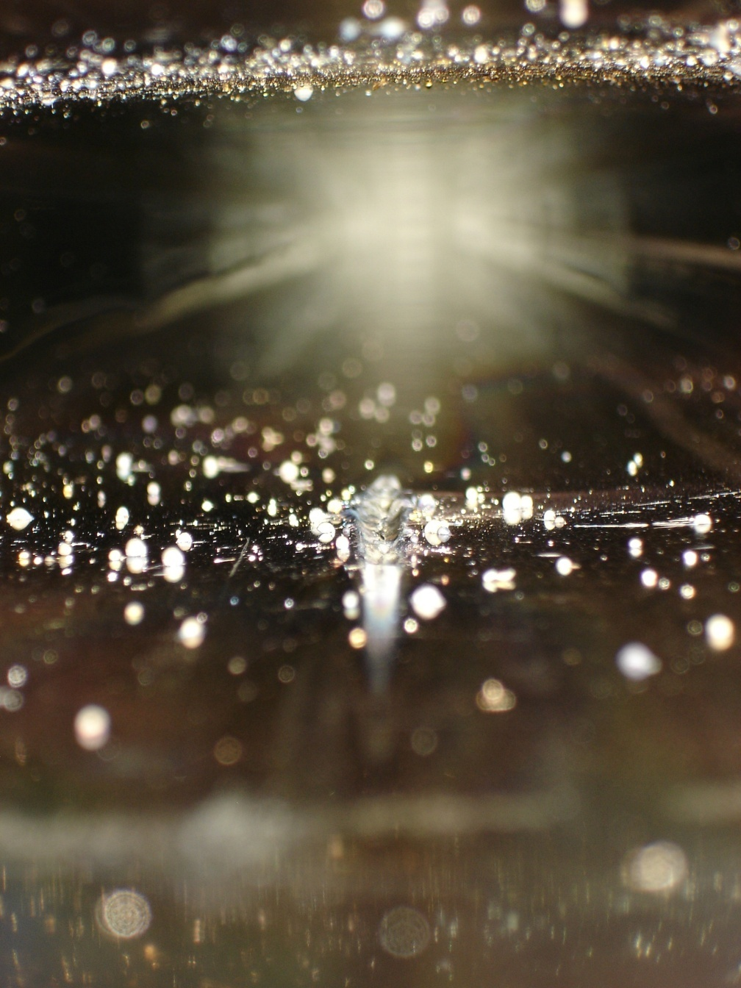
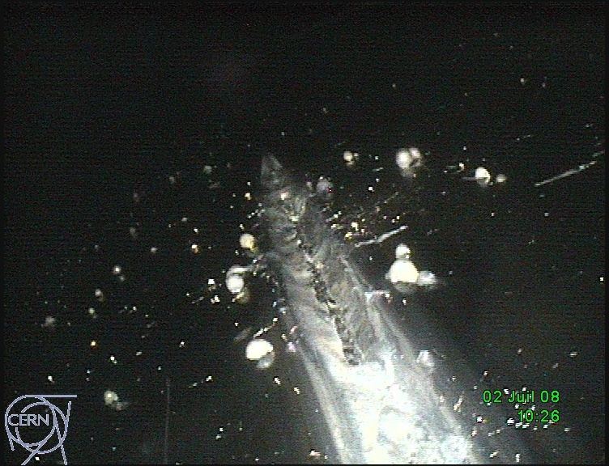
When the MPS is not fast enough…
At the SPS the MPS was been ‘assembled’ in stages over the years, but not following a proper failure analysis.
As a consequence the MPS cannot cope with every situation! It is now also covered by the Machine Protection WG but would require new resources…
Here an example from …. 2008 ! The effect of an impact on the vacuum chamber of a 400 GeV beam of 3x10¹³ p (2 MJ).
Vacuum to atmospheric pressure, Downtime ~ 3 days.

Slide 15
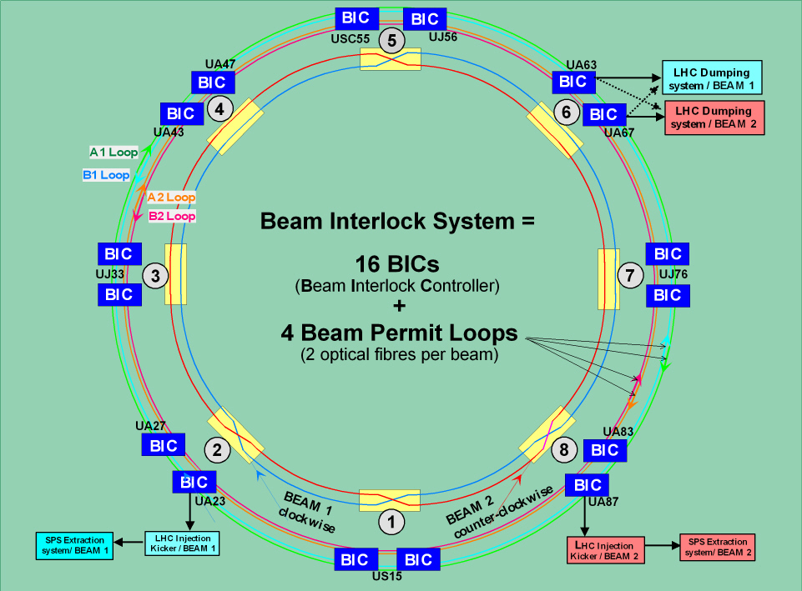
LHC machine protection Interlock
LHC Beam interlock system
  Interact with all LHC systems involved in the protection of the machine.
  Safe Machine Parameters, Safe Beam Flag, Beam Presence Flag, Mask and Unmasking mechanism
  Interface with the Beam dumping system and the SPS extraction system.
SPS Extraction / LHC Injection Beam interlock system
  Protects the transfer lines from SPS to the LHC.
  Protects the LHC against bad injection.
Software Interlock system
  Detailed surveillance of many machine
  parameters
Machine Protection Diagnostics
  Detailed post mortem analysis
Remote Base Access Control system
  Token assigned to change parameters

Slide 16
Safe Machine Parameters
afe achine arameters
S
M
P
receives accelerator information
generates flags & values
directly transmitted
and / or
broadcast
Injection procedure
protection configuration
Beam Interlocks
Collimation
Beam Loss Monitors …
Extraction Interlocks
*fast *safe *reliable *available

Slide 17
Extraction Interlocks
Transfer Lines
Beam-1 = TT60 + TI2
Beam-2 = TT40 + TI8
Super
Proton
Synchrotron
Large
Hadron
Collider
Extraction Master Beam Interlock Controllers

Slide 18
Extraction Interlocks
Super
Proton
Synchrotron
Large
Hadron
Collider

Slide 19
Extraction Interlocks
Beam presence flag = False Only Safe bean can be injected (1*10⁹)
Beam presence flag = True Any beam can be injected into LHC
three beam transfer conditions:
probe
set-up
Super
Proton
Synchrotron
nominal
Large
Hadron
Collider
Directly Transmitted
Interlock Signals
SPS
Machine
Parameters
LHC
Machine
Parameters

Slide 20
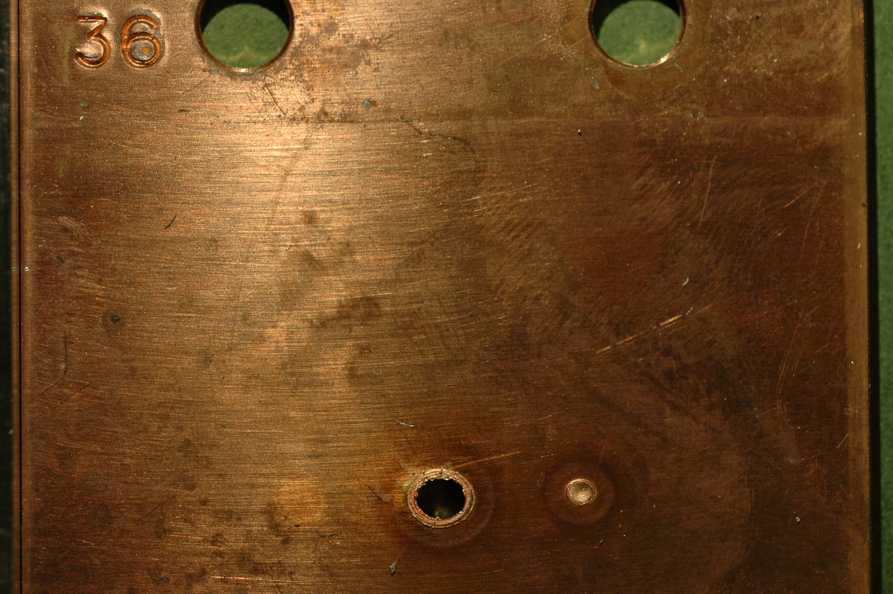
Safe beam flag evolution
  The Safe Beam Flag depends:
    on the beam energy and intensity
Shot | Intensity / p+
A | 1.2×10¹²
B | 2.4×10¹²
C | 4.8×10¹²
D | 7.2×10¹²
Estimated damage level for fast losses
  at 450GeV ⇒ ~ 2 · 10¹² protons
  at 7 TeV ⇒ ~ 1 · 10¹⁰ protons
A B D C
I _{beam}
SPS damage by V. Kain Chamonix 2005
1 · 10¹⁵
1 · 10¹⁴
SBF = "False"
2 · 10¹²
1 · 10¹³
1 · 10¹²
In this intensity range,
a safe beam becomes unsafe
during acceleration
1 · 10¹¹
1 · 10¹⁰
SBF = "True"
1 · 10⁹
1 · 10⁸
Energy
0.45
2
3
4
5
6
7 TeV

Slide 21
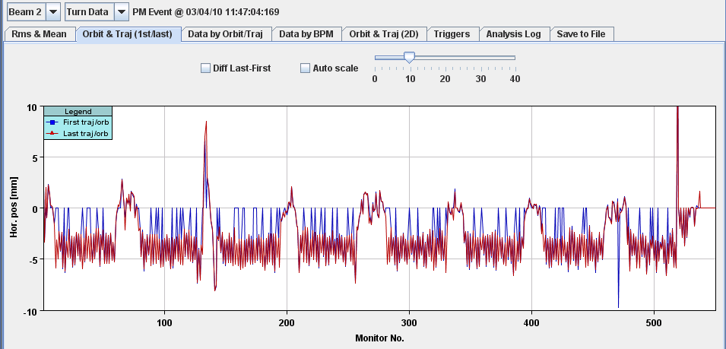
Software interlock
On large accelerators it is not always possible to cover all failure mechanisms with a hardware system:
  It needs something more flexible like adding a new interlock if not too time critical
Survey the control system components relevant for machine protection
  as additional protection layer, with possibility to abort beam if necessary
Provide additional protection for complex but less critical conditions
  (> 12 BPMs over 6 mm for beam 2 horizontal plane (too large RF frequency change)
Trigger orbit excursion >>
Threshhold

Slide 22
Post Mortem user interface
LHC Post Mortem system is an automated post-operational analysis of transient data recordings from LHC equipment systems
Meant to support machine protection by helping the operations crews and experts in understanding the machine performance and beam dump events and answer fundamental questions:
  What happened? (ie the initiating event / event sequence leading to dump/incident)
  Did the protection systems perform as expected (automated Post operational checks)?
  Assist in trend analysis, statistics of machine performance, …
Each beam dump generates ~ 1GB of PM data which is automatically analysed in typically < 1 min

Slide 23
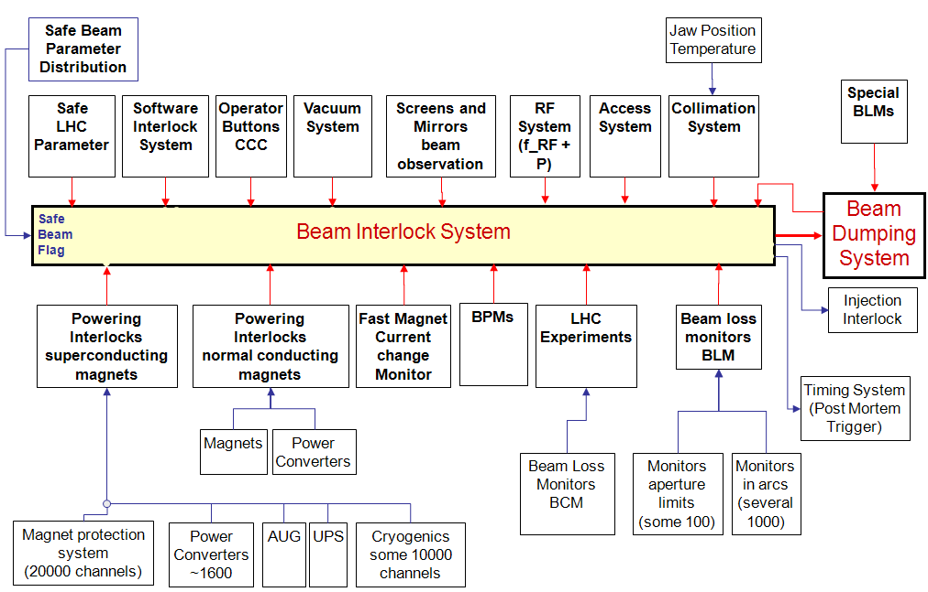
Transient data recording after a beam dump (PM)

Slide 24
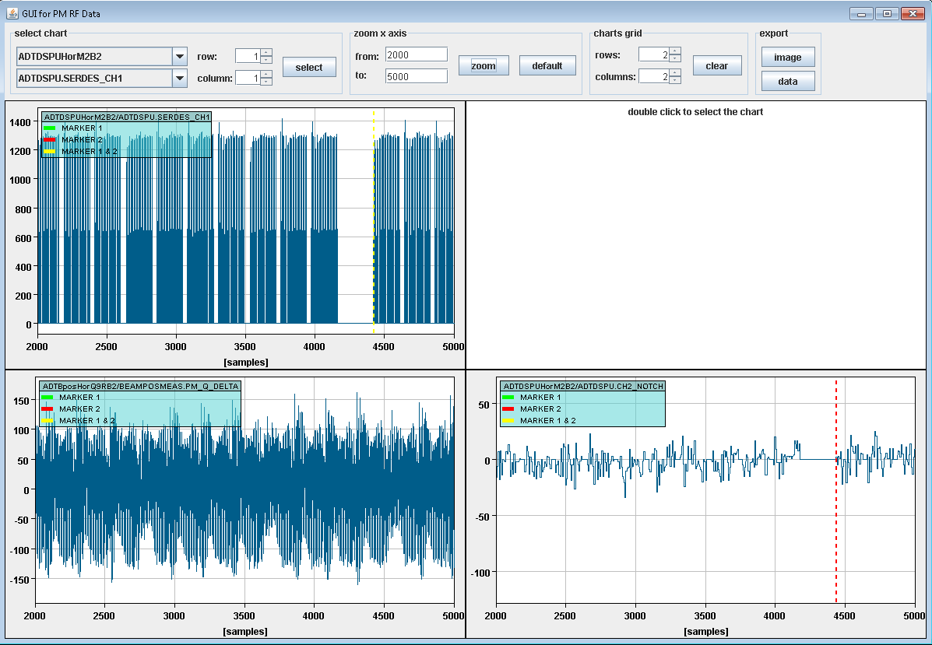
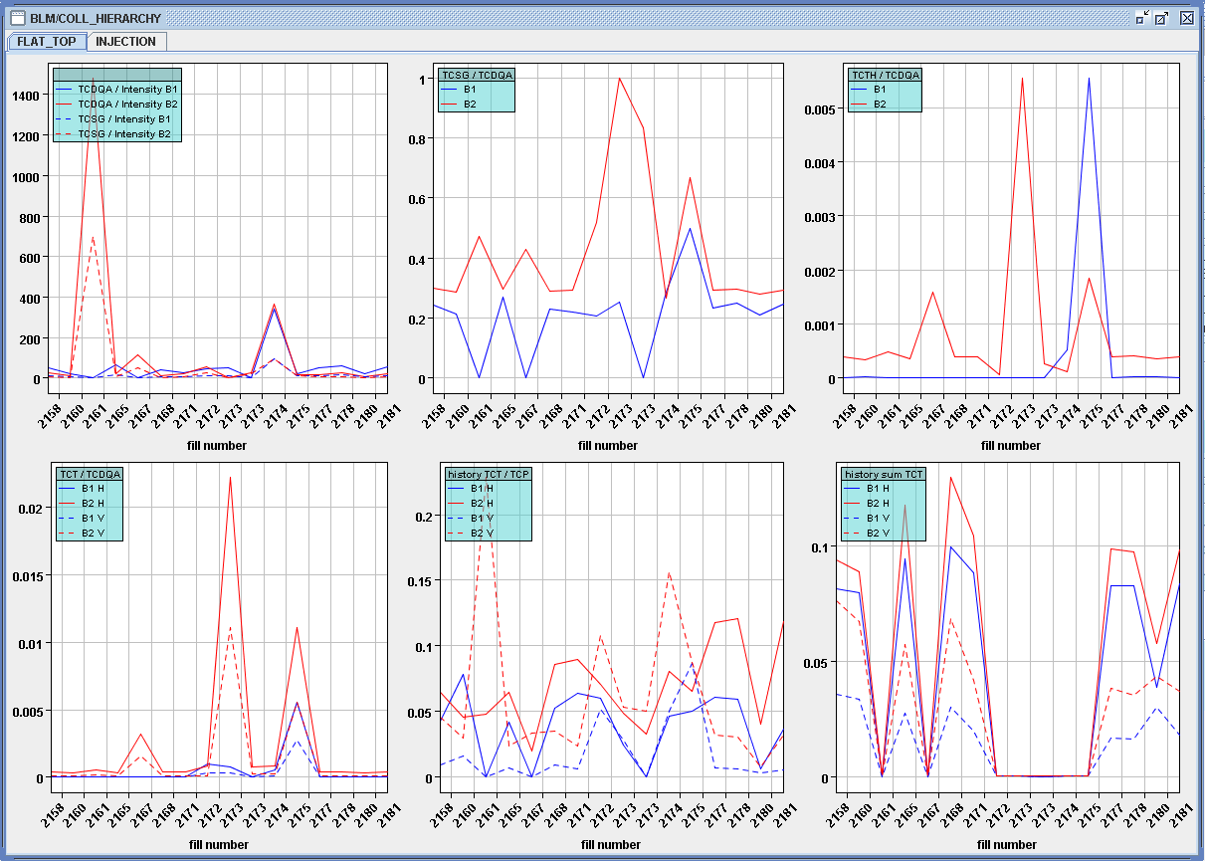
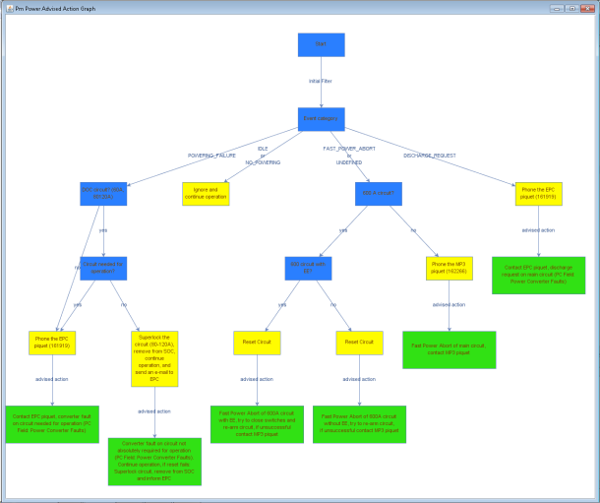
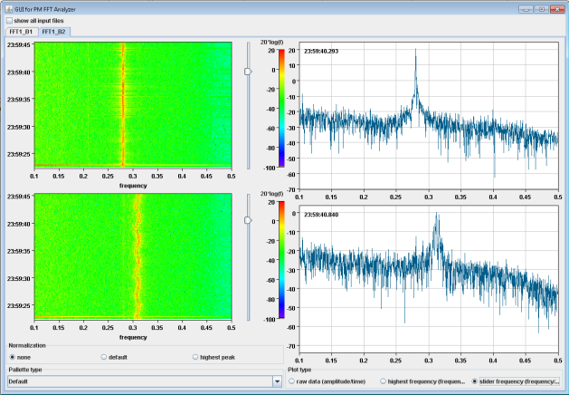
Analysis modules for beam PM
COLL hierarchy
RF/ADT data
MP3 expert system
BBQ/Tune signal

Slide 25


Who’s operating the LHC
LMC LHC machine committee (50)
  Responsible for strategic decision short & long-term
  Highest organ for accelerator technical decisions
LHC Coordinators (6)
  Senior accelerator physicists responsible for the weekly LHC performances
LHC Machine protection committees (6-12)
  Responsible for approval of energy or intensity increase
LHC Engineers In Charge (7)
  Responsible day to day operation when in charge or during his/her special activity.
  All of them
The entire operation team in the control centre is sharing the stressful moments as well as the records achievement

Slide 26
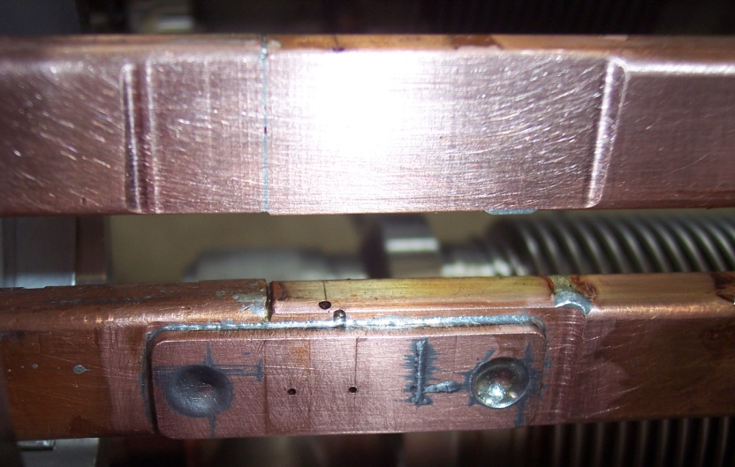
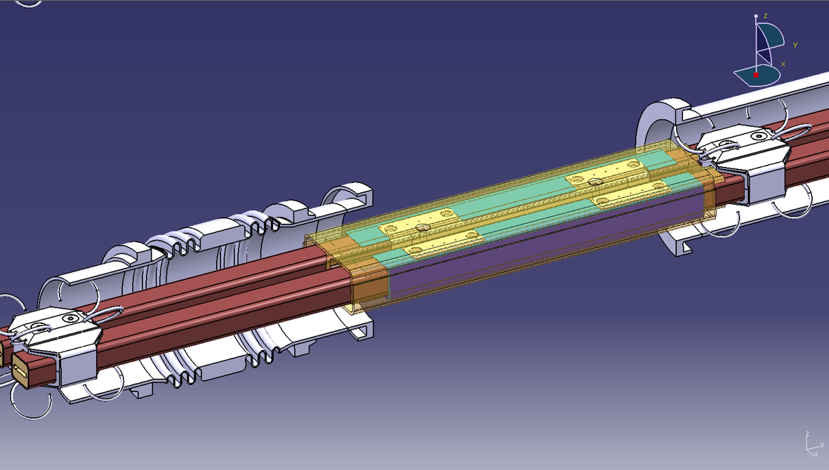

The next's years at LHC
Since the accident of September 2008 the LHC has been operated at ½ its nominal energy.
In March 2013 the LHC will be stopped for approximately 1 ½ years to perform a complete repair of the defect soldering.
Towards the end of 2014 the LHC will come back online at its full energy for the next adventure of particle physics.

Slide 27
Summary
LHC Machine Protection Systems have been working well during 2011 run thanks to a lot of loving care and rigor of operation crews and MPS experts.
No quenches with circulating beam.
No evidence of major loopholes or uncovered risks, additional active protection will provide further redundancy.
LHC is a stressfully operation, we are confident on our Machine Protection System which capture most failure before effect on the beam are seen.
We have to remain vigilant to maintain current level of safety of MPS systems while increasing efforts on increasing MPS availability.

Slide 28



Summary
CERN experiments observe particle consistent with long-sought Higgs boson
“We observe in our data clear signs of a new particle, at the level of 5 sigma, in the mass region around 126 GeV. The outstanding performance of the LHC and ATLAS and the huge efforts of many people have brought us to this exciting stage,” said ATLAS experiment spokesperson Fabiola Gianotti, “but a little more time is needed to prepare these results for publication.”
"The results are preliminary but the 5 sigma signal at around 125 GeV we’re seeing is dramatic. This is indeed a new particle. We know it must be a boson and it’s the heaviest boson ever found,” said CMS experiment spokesperson Joe Incandela. “The implications are very significant and it is precisely for this reason that we must be extremely diligent in all of our studies and cross-checks.”
See you in 2 years with an LHC at 6.5 TeV
Thank you for your attention
Acknowledgement:
Cern op group, Machine protection WG, B.Todd, M.Lamont, J.Wenninger, R.Schmidt, B.Puccio, M.Zerlauth, V.Kain, S.Redaelli, G.Arduini,

