Slide 1
Experience with Cryogenic Operations During the Fermilab Collider Program
The Fermi National Accelerator Laboratory is a U.S. Department of Energy (DOE) research laboratory, operated under DOE contract by Fermi Research Alliance (LLC), a joint partnership of the University of Chicago and the Universities Research Association (URA).

Slide 2
Topics to Cover
History of the Tevatron and the Fermilab Collider Program
Overview of the Cryogenics Systems at Fermilab
Responsibilities for Cryogenic System Operations
How the Cryogenics affected Operations
Lessons learned during the last decade of collider operations
Questions

Slide 3
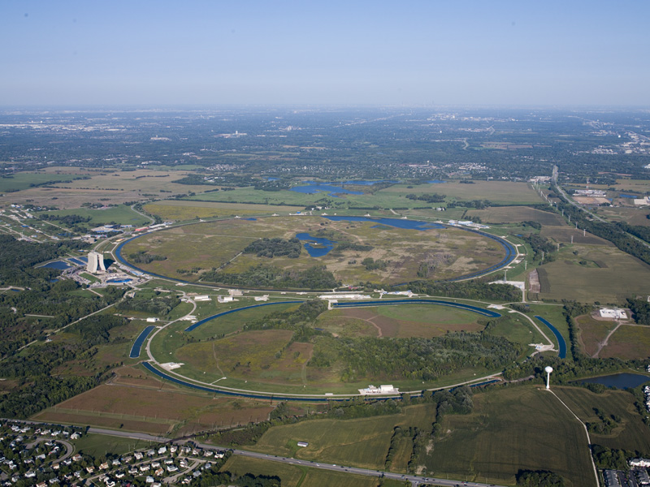
History of the Tevatron and the Fermilab Collider Program

Slide 4
The Tevatron History
First large scale superconducting accelerator
Construction started in the early 1980s
First beam in 1983
Anti-Proton Source construction also happened at the same time
First Proton / Anti-Proton Collisions in 1985
First Collider engineering run in 1988 (1 year)
Split time between fix-target and collider running, with the last decade being exclusively collider.
Turned off October 2011

Slide 5
The Tevatron Numbers
4 miles in circumference (6.4 km )
~775 magnets (This number changed over time as the machine was modified)
Split into 6 sectors
RF, Injection, Extraction, and Detectors were installed between the sectors
Each sector was further sub-divided into 4 houses. This also matched the cryogenic system. 24 houses total

Slide 6
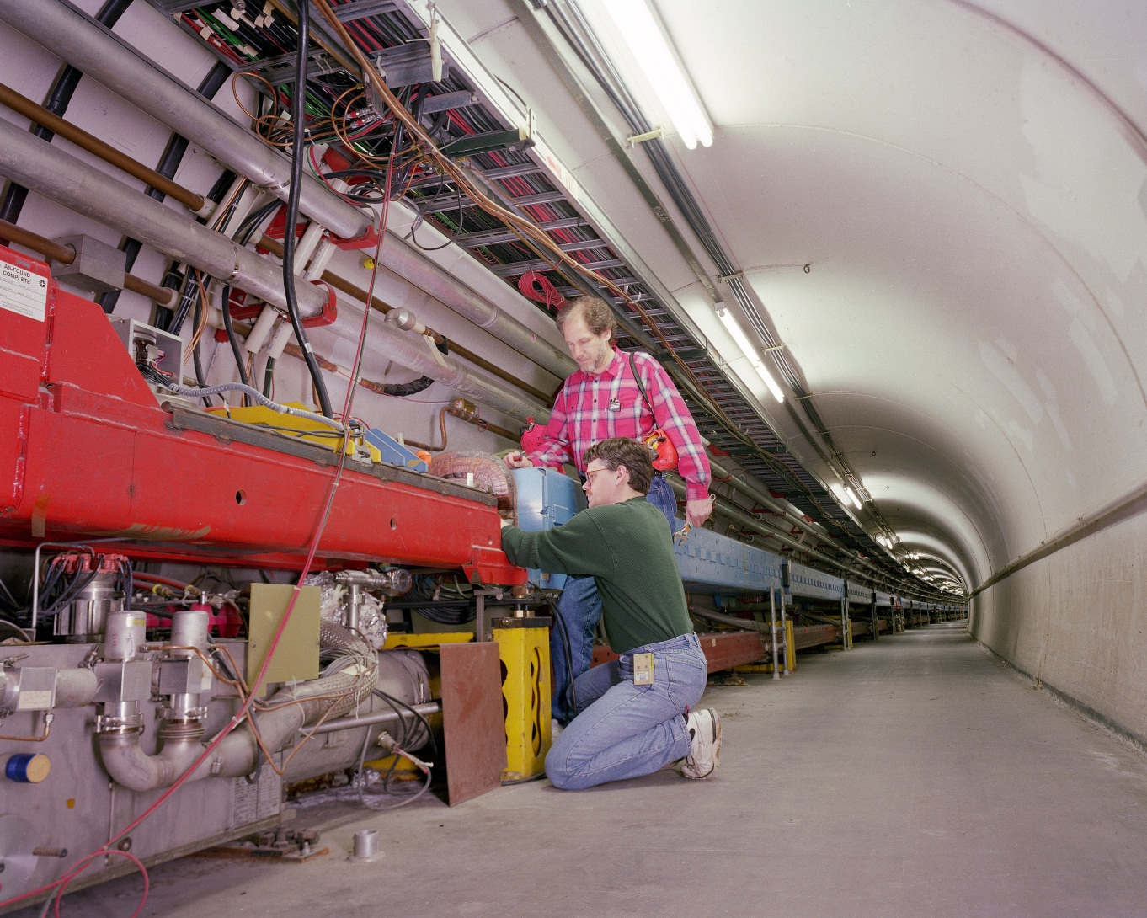
View of the Tevatron Tunnel

Slide 7
Overview of the Cryogenic Systems at Fermilab
Largest in the world when built
Named a International Historic Mechanical Landmark in 1993
Accelerator cryogenics has it’s own support department. Separate experimental cryogenics support.
Cryogenics support included engineering, technical, and operational support.

Slide 8
Cryogenic Numbers
Cryogenic system uses liquid helium with a liquid nitrogen shield to cool the magnets
4.4K to 4.6K at the magnet coils
One large central helium liquefier
24 satellite refrigerators around the machine
6 locations with either 4 or 8 helium compressors
Other cryogenic equipment in the accelerators also supported

Slide 9
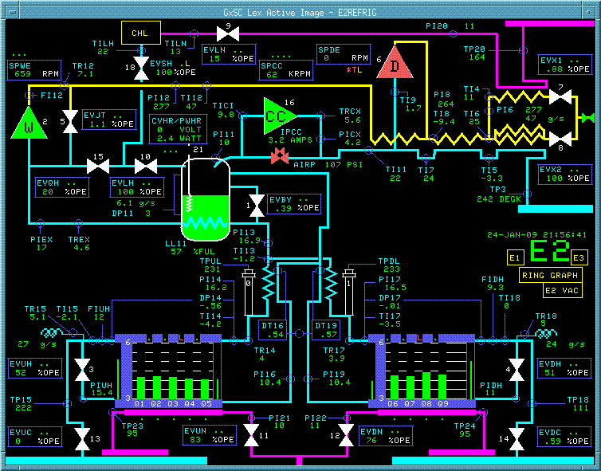
Cryogenic Theory in 1 minute

Slide 10
Responsibilities for Cryogenic System Operations
The Cryogenics Support Group is responsible for:
  Operating the Central Helium Liquefier, which is manned around the clock
  Engineering support for any modifications
  Cryogenics inventory
  Technical support and maintenance of the satellite refrigerators and helium compressors
  On Call operational support to the Main Control Room

Slide 11
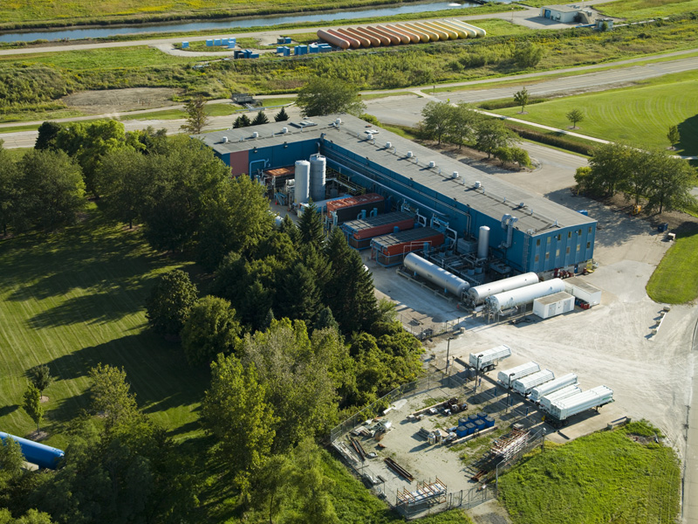
Central Helium Liquefier

Slide 12
Operations Group support for cryogenics
Operate and monitor the Tevatron Cryogenics systems. Done with support from the Cryogenics group
  Monitor system to insure parameters are in operational tolerance
  Recover the machine from a magnet quench (superconductor going normal)
  Insure cryogenic operations before machine turn on
  Assist as needed with cryogenic repairs
  Assist as needed with cryogenic emergencies. The accelerator tunnel and some building are ODH (an Oxygen Deficiency Hazard)

Slide 13
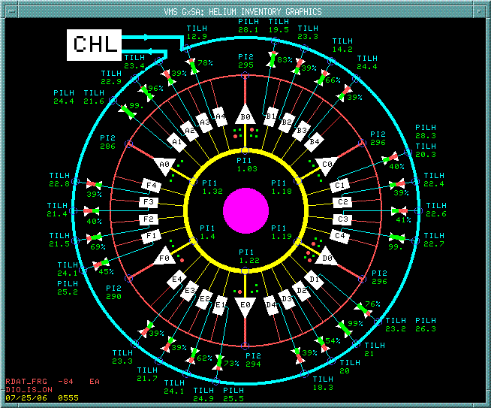
Global Schematic of Tevatron Cryogenic System

Slide 14
Shared effort between Groups
Manpower on the evening and overnight shift.
Cryogenics engineers would provide training classes as needed.
Cryogenics group would provide documentation and procedures for the system.
Cryogenics and operations worked together with the Controls group to insure the proper operational software was available.
Good communication between the groups

Slide 15
Interactions between the Operations Group and the Cryogenics Group
During machine operation, both groups had a control room manned around the clock. The Main Control Room (MCR) for operations, and the Central Helium Liquefier (CHL) control room for Cryogenics.
Only the Main Control Room was manned during long maintenance periods.
Both groups maintained a electronic log book that was readable by the other control room.
Cryogenics provided an on-call engineer as a single point of contact for problems .

Slide 16
Question: How can interactions between the groups affect operations
Communication between the groups is critical since failures can be very time consuming.
Two Control Rooms means areas of responsibilities must be clearly defined, but it also allows for cross training and manpower swaps when needed.
Single point of contact for the Main Control Room to the On-Call Cryogenic Engineer was critical during failures.

Slide 17
Cryogenics, Machine operation, and Success
The accelerator has to be running reliably for there to be a successful physics program
In a superconducting machine the cryogenics must be reliable for the machine to operate.
Failure can happen in the cryogenic system itself or in some system that affects the cryogenic system.
In a superconducting accelerator almost everything affects the cryogenics

Slide 18
Definitions
Quench – When the superconductor in the magnet goes normal and it is no longer safe to power the magnet system.
Quench Protection System (QPM) – System designed to detect a quench, de-power the accelerator, and spread out the heating in the magnet string. The system would also signal the cryogenic system to start recovery.
Refrigerator recovery – The process of cooling the magnet string down to an operational temperature.
Failure – For the purpose of this talk, it is any thing that causes the Quench Protection System to de-power the machine

Slide 19
How was cryogenic operations different from other sub-systems?
Duration of failures. Most failures had a long recovery time. Once the failure was fixed, the system needed to be recovered.
Quench Protection system always assumed worst case
Quenches always had the potential to break something
Injection field quench recovery 15 to 30 minutes
High Field quench recovery 2 to 3 hours
Low beta magnet insertion at high field 4 + hours
Complete helium expansion engine overhaul 8 to 12 hours

Slide 20
Causes of Quenches
Beam induced quench. Beam is steered into a magnet inducing heating.
Magnet / Component Failure. Long recovery time.
Failures in other interacting system that induce a quench or is interpreted as a quench
Failures in the cryogenic system itself.

Slide 21
Beam Induced Quenches
Beam or beam loss induces a quench in the system
  Beam is steered into cryogenic magnet
  Beam losses during acceleration
  Beam loss due to tight aperture

Slide 22
Reduction of Beam Quenches
Automatic beam orbit correction between beam stores
Magnet alignment during maintenance periods
Collimation at loss points
Better simulations to help with orbit tuning

Slide 23
Failures in other systems that affect cryogenics
Power supply failure can induce a quench
  Loss of regulation in the power system usually resulted in a quench
  Power system shutting down usually would not induce a quench but could if conditions were right.
  Correction element power supply failure or other power supply failure usually resulted in a beam induced quench.
Failure in the quench protection system
  The quench protection system tried to protect against itself. It monitors for hardware failure and could induce a quench depending on the failure

Slide 24
Magnet /Component Failure
Components usually fail during a quench
Quenches and component failures were both documented and analyzed.
  Long term solutions that are critical for stability
  At least once lead to a redesign and modification of the Tevatron magnets
  At times has lead to changes in the way we operated the Tevatron

Slide 25
Cryogenic system failures
The cryogenic system has a large number of moving mechanical components: helium compressors, expansion engines, and cold compressors.
Moving components regularly fail and required maintenance.
Regular inspection helped catch failing components and could reduce repair times.
Regular cryogenic maintenance improved the collider uptime. This was not historically how we scheduled maintenance on other systems.
Failures are time critical

Slide 26
Lessons Learned
Need a stable accelerator to be successful
Cryogenic failures are time consuming
Communication is critical
Maintenance of the cryogenic system should be planned
Protect the cryogenic component by knowing the beam orbit and controlling it
Analyze failures and make long term fixes

Slide 27
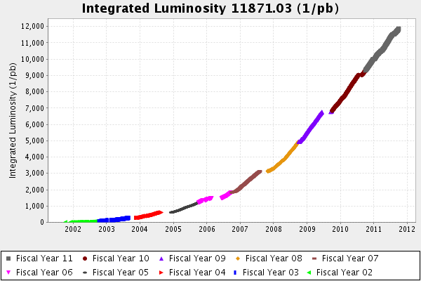
Measure of Success

Slide 28
Questions

Slide 29
Extra Pictures

Slide 30
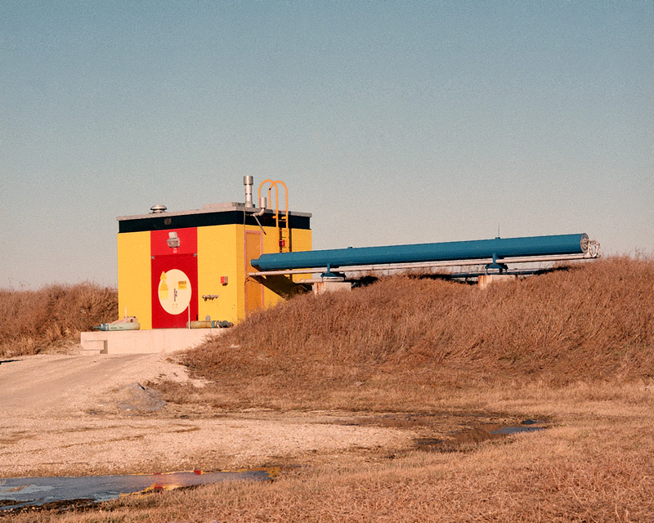
Satellite Refrigerator Building

Slide 31
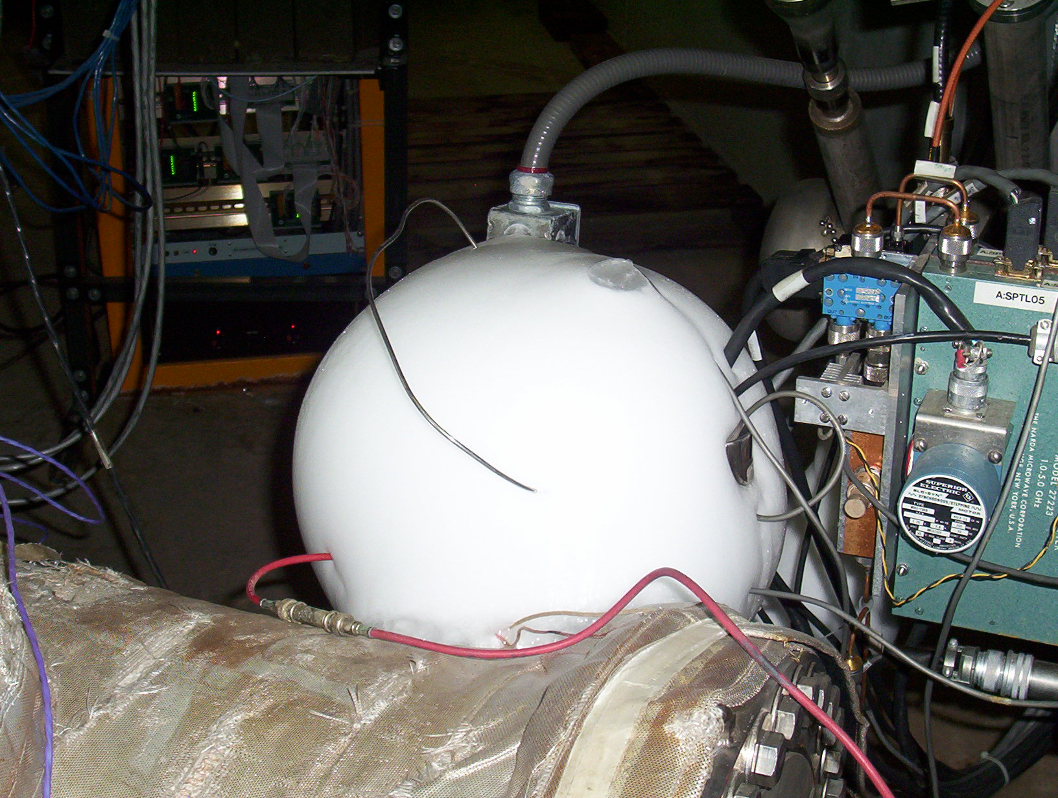
Ice Ball

Slide 32
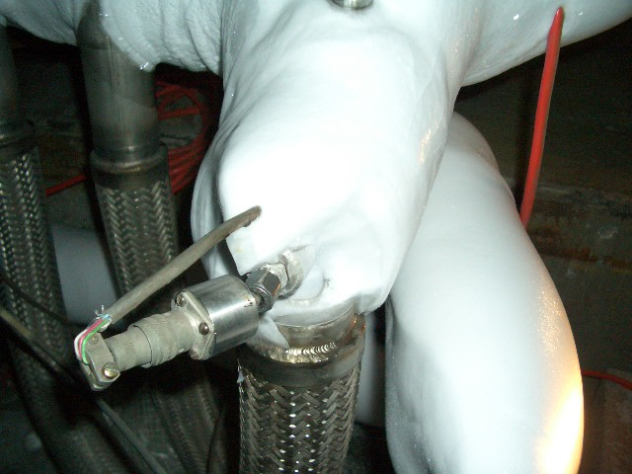
Damage from an Ice Ball

Slide 33
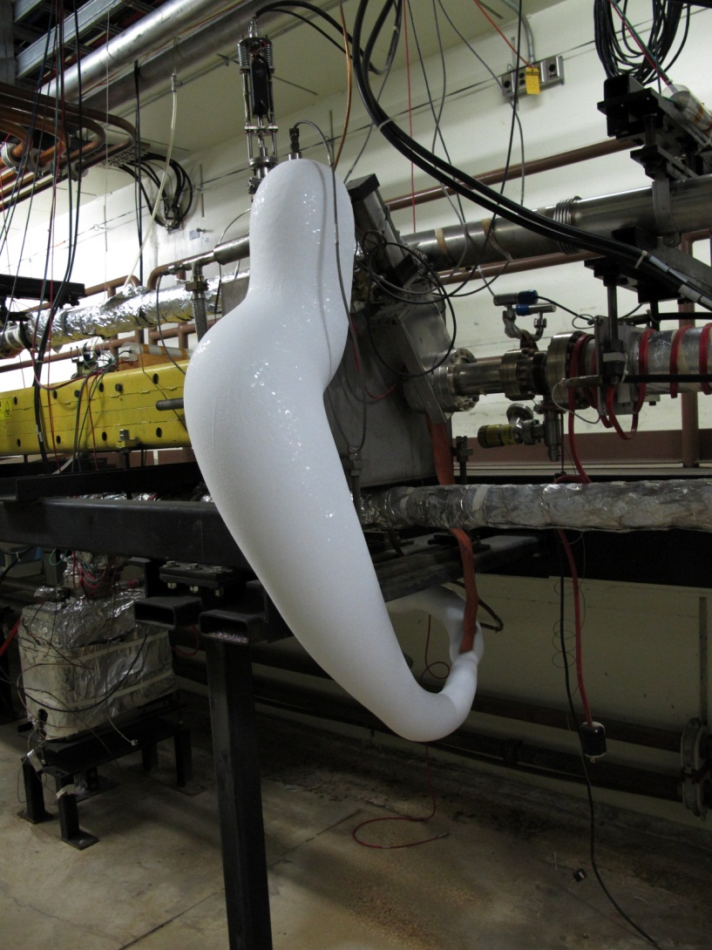
Ice Ball at Turnaround Box

Slide 34
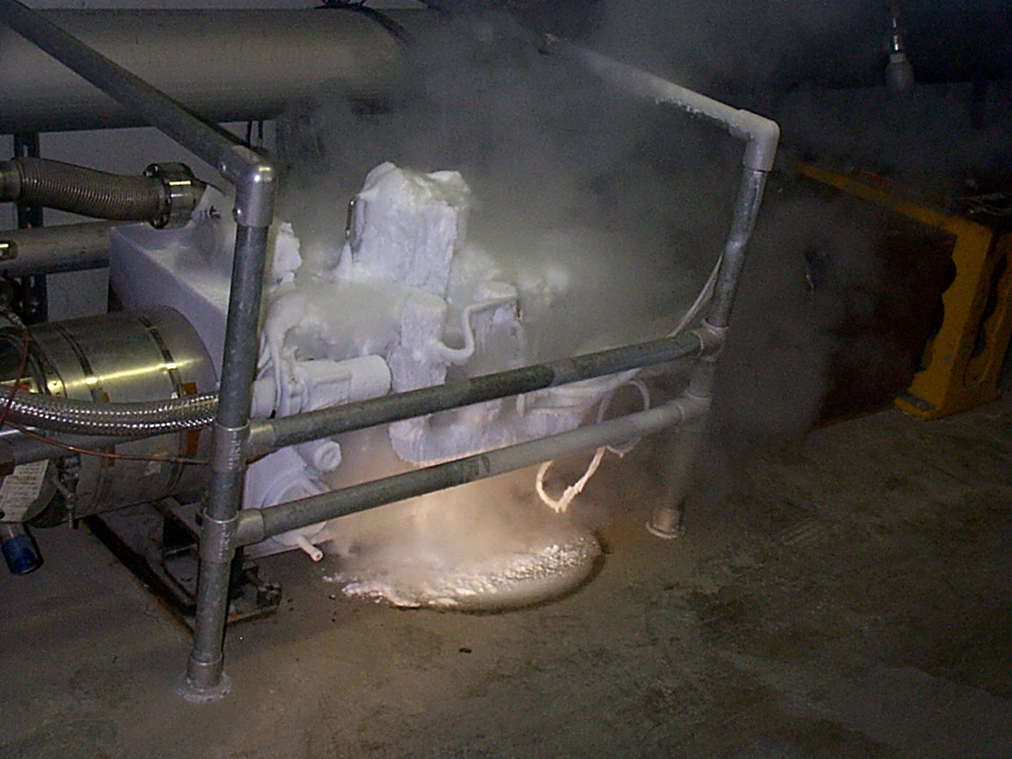
Cryo Leak

Slide 35
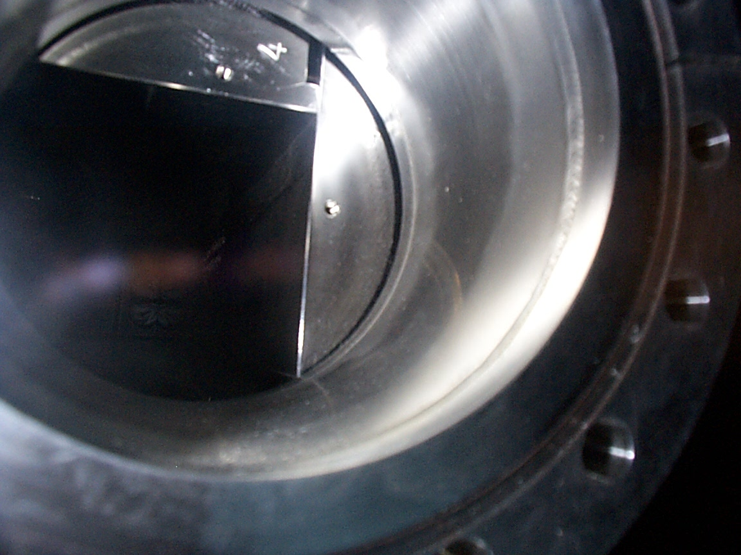
Beam Damage

Slide 36
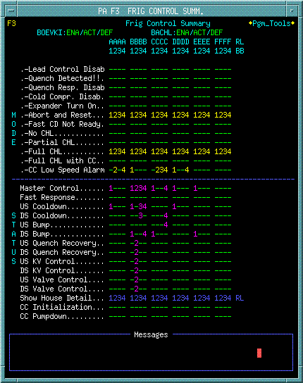
Frig Control Summary

Slide 37
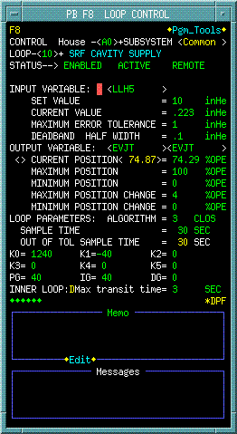
Control Loop

