Slide 1
Tuning an Accelerator for 1 MW
C. Peters
WAO 12
August 8th, 2012

Slide 2
The Spallation Neutron Source
What
  A really big microscope (nanoscope?)
    Produces neutrons by spallation
    Neutrons are used to study molecular structure and properties of materials
  Really powerful and power hungry
    Most intense pulsed neutron source in the world
    20 MW in and 1 MW out

Slide 3


The Spallation Neutron Source
Where
  Oak Ridge National Laboratory (ORNL) in Oak Ridge, TN
  People LOVE their football (not futbol)
  Oil = Awl
  It’s hot and humid
  Lots of mountains
  Lots of really smart people

Slide 4
The Spallation Neutron Source
How
  Accelerator
    H- ion source and Linac (96 accelerating cavities)
      1 millisecond long pulse chopped into 700 nanosecond long slices
      Pulsed at 60 Hz
    HEBT – High Energy Beam Transport
    Ring
      Stacks 700 nanosecond slices into 1 intense pulse
    RTBT – Ring to Target Beam Transport
  Target
    Mercury…….lots of neutrons

Slide 5
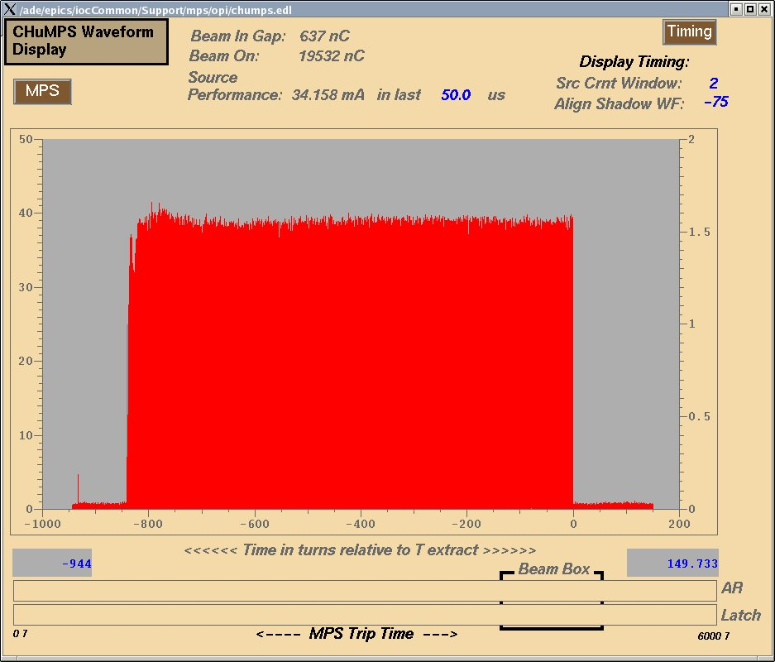
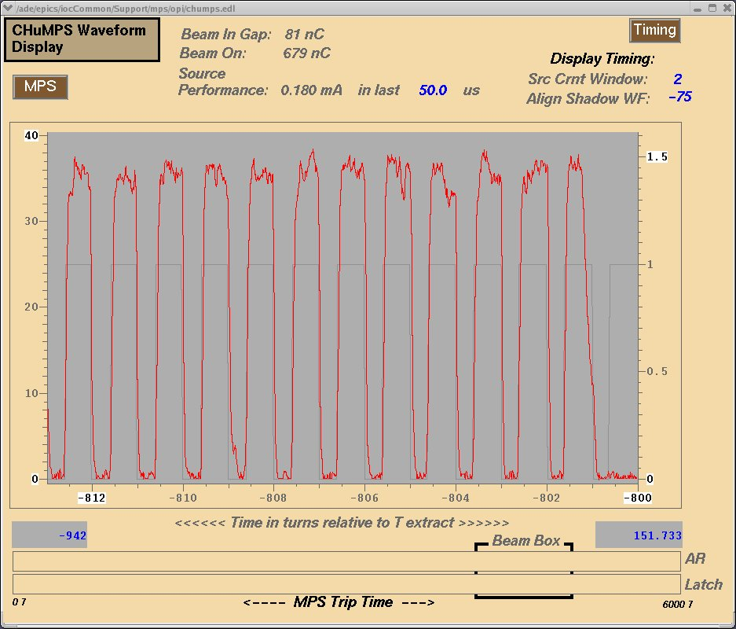
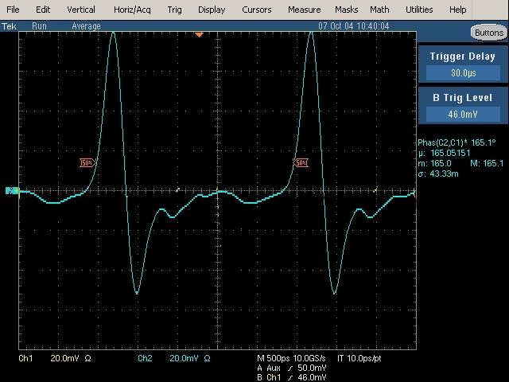
2.5 nanoseconds
1 millisecond
1 microsecond

Slide 6
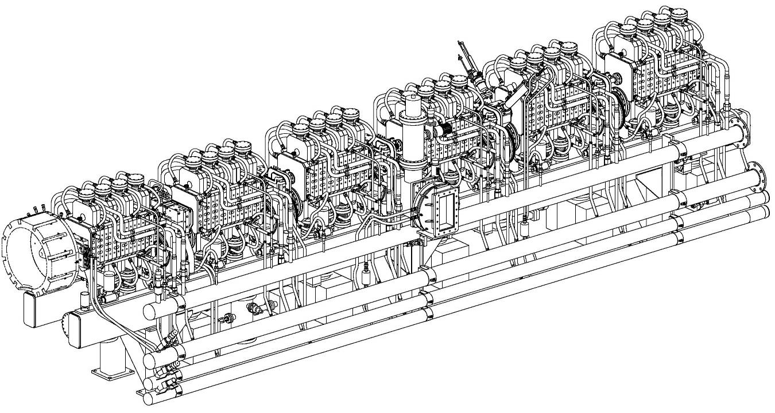
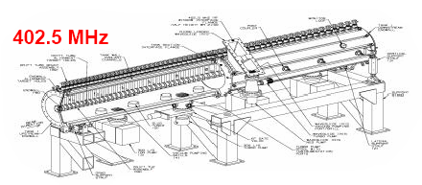
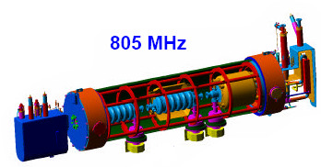
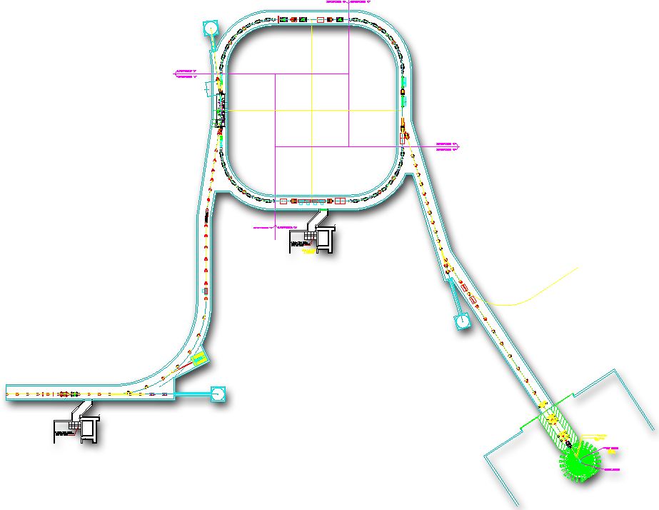
RFQ
Diamond Stripper Foil
805 MHz
H⁻ Beam
Proton Beam
1060 mini-pulses
e⁻
e⁻
Neutrons!
Liquid Hg
Proton Beam
p⁺
p⁺
1 mini-pulse
e⁻
e⁻
Current
2 mini-pulses
3 mini-pulses
Collimators
Injection
Extraction
RF
1ms
2.5 MeV
87 MeV
186 MeV
387 MeV
1 GeV
RTBT
Ion Source
HEBT
RFQ
DTL
Liquid Hg Target
CCL
SRF, β=0.61
SRF, β=0.81
Courtesy D. Bartkowski

Slide 7
The Spallation Neutron Source
Typical numbers lately
  Ion source pulse is about 36 to 38 mA for about 850 microseconds
    1e14 ppp or about 17 kW per pulse
  About 4500 hours of neutron production
  About 630 hours of accelerator physics
  Machine availability > 92%
  Average about 15 short trips per day
How did we get there?

Slide 8
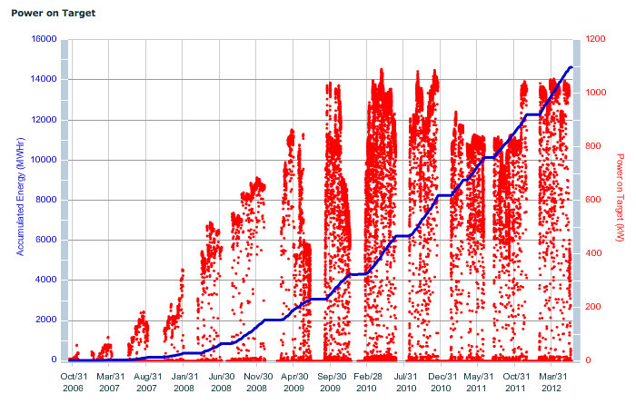
Energy and power on target from October 2006

Slide 9
AP development then
Early on (2006 – 2007)
  Low power production beam (< 200 kW)
  Accelerator physicists did it all
    Timed in linac RF cavities
    Ring set up
    Corrected orbits
    Set beam parameters on target at the beginning of each run and at each ion source change
  Accelerator physicists tuned the beam in an emergency
  Operators in general did not tune……don’t touch!
Slowly operators began helping with AP studies
  Short pulse, low rep rate, beam orbit tuning
AP studies time decreased as neutron production time increased so operators started tuning more

Slide 10
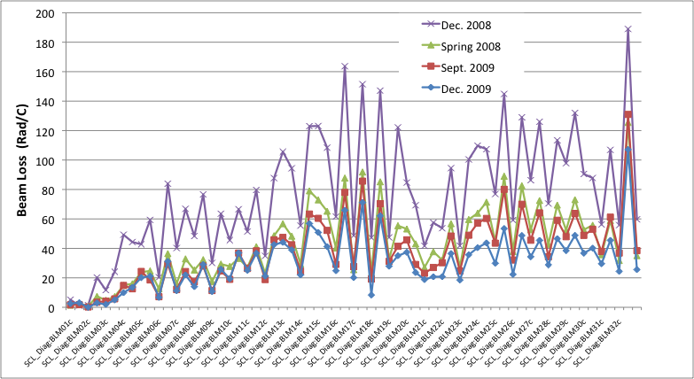
AP development to operations
As power has increased
  Neutron production time dominates
    Operators find trends (got to do something for 12 hours)
    RF and quadrupole fine tuning at 60 Hz beam rep rate – BE CAREFUL

Slide 11
How to make sure operators can’t break it
Machine Protection System (MPS)
Errant beam controls
Operation Shift Checklist
Errant beam alarms & production documentation

Slide 12
Machine Protection System
MPS does exactly what it states
  Turns off the beam really fast (fault to beam off in ~ 20 microseconds)
  Turn off RFQ and ion source pulses, and tell chopper to chop away all of the beam
  FPAR (Fast Protect Auto Reset)
    Turns off beam, miss the next pulse, allows beam
    Holds beam off until operator reset if a fault happens too many times (chatter fault limit)
  FPL (Fast Protect Latch)
    Turns off beam
Operators need to know the MPS will turn off the beam
  Make a mistake tuning and the MPS turns off the beam fast
Gotcha
  MPS signals can be bypassed
  Rules in place
    Control Room Shift Supervisor needs expert and manager approval in order to bypass almost all MPS signals in almost all cases
    Control Room Shift Supervisor can bypass BLMs at 1 Hz beam repetition rate

Slide 13
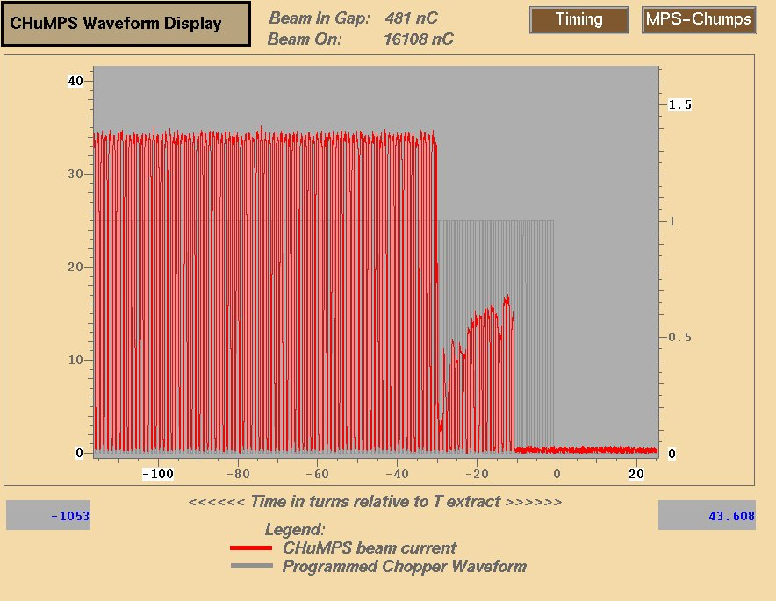
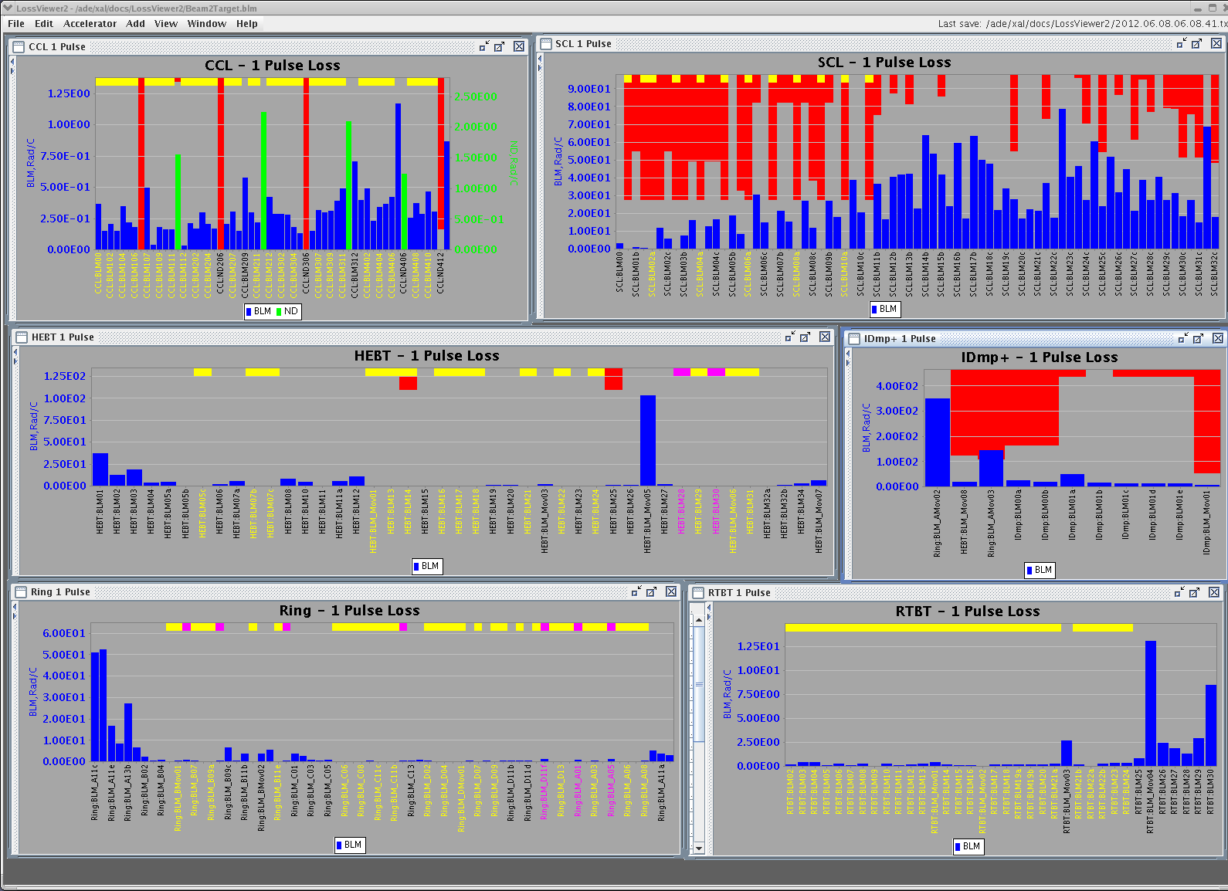
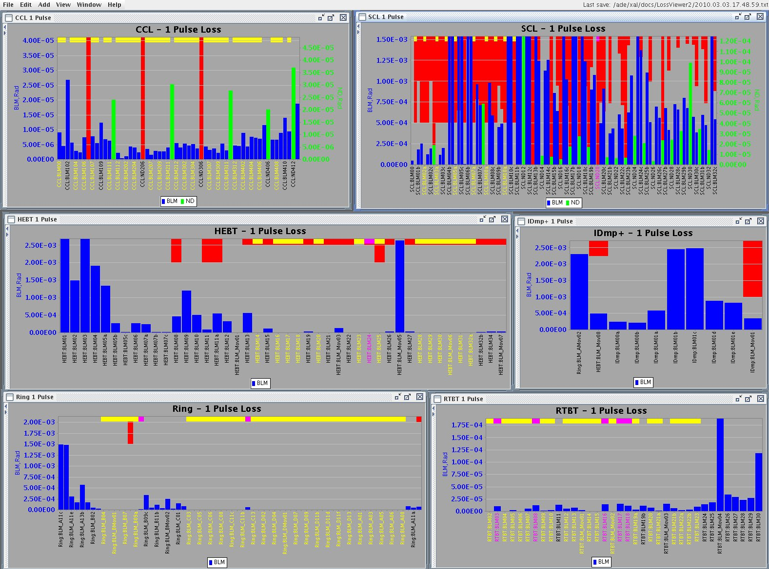
Machine Protection System
All signals in MPS are important, BUT
  Beam Loss Monitors (BLMs) are the last line of defense
    About 340 ion chambers
      Beginning and end of each cavity, at quads, and moveables
    Hardware trip for single pulse loss
    Software trip for monitoring activation
Ion source or RF faults may not be detected by internal protection hardware
  Ion source power supply malfunction not detected until BLMs in the SCL

Slide 14
Machine Protection System
Problems in 2009
  SCL cavity damage possibly due to linac errant beam
    Ion source HV, DTL, CCL RF malfunctions
  MPS delay measurements performed
    When a fault occurred in some instances 300 microseconds or more of beam was accelerated before MPS turned beam off
    Long delays found throughout MPS
A few more things
    BLMs had chatter fault setting for 2 bad pulses in 60 cycles
    BLM trip limits were set too high above operating levels
All fixed and looking good!
  But linac errant beam continues……..

Slide 15
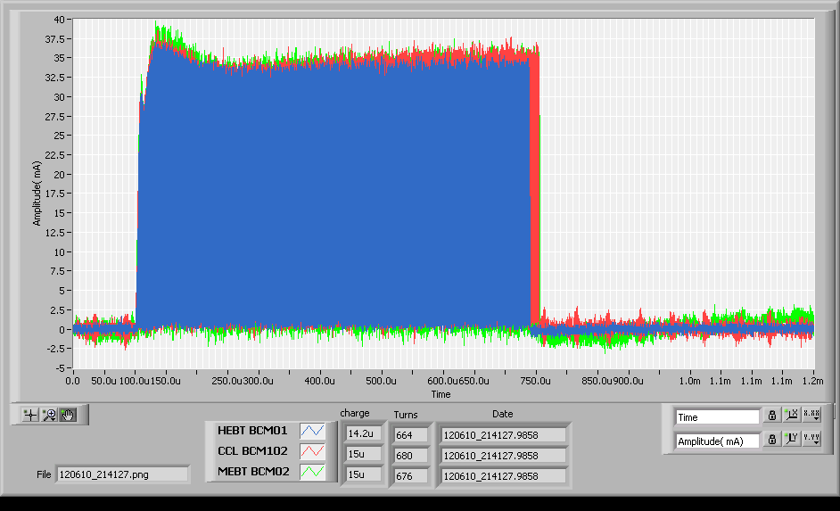
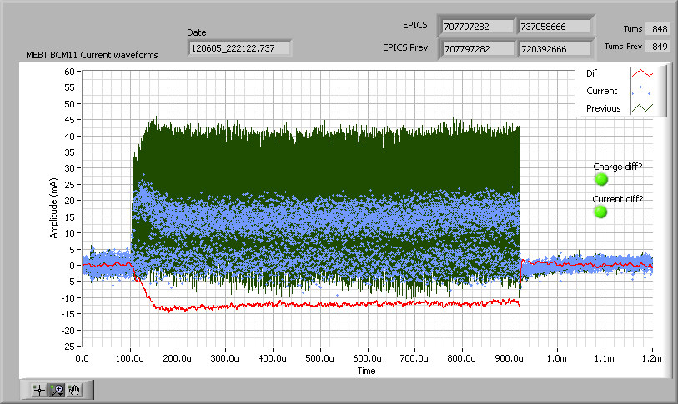
Linac errant beam is going to happen
Differential BCM diagnostic
  BCMs in CCL and HEBT showed beam is lost in the SCL (15 to 30 turns)
  Most instances caused by DTL and CCL RF
    Undetected by RF protection module
Plan for future
  Differential BCM system connected to MPS for faster turn off to protect SCL
    Beam turn off time of 5 microseconds
  Ion source beam pulse history
    Turn off beam if source pulse differs from previous

Slide 16
How to make sure operators can’t break it
Machine Protection System (MPS)
RTBT errant beam controls
Operation Shift Checklist
RTBT errant beam alarms & production documentation

Slide 17
RTBT errant beam controls
Protect the target
  RTBT BLM limits set tighter in case of kicker misfire
  Ring and RTBT magnets have current windows
    If a power supply readback goes outside of a set window then the MPS turns off the beam
      All RTBT power supplies (quads, correctors, extraction septum, DH13)
        Power supply windows set based on Operations Envelope
      Injection kicker power supplies waveform and extraction kicker power supplies waveform mask monitoring
        Scopes running Windows XP operating system
  All set prior to beam power on target exceeds 100 kW

Slide 18
How to make sure operators can’t break it
Machine Protection System (MPS)
RTBT errant beam controls
Operation Shift Checklist
RTBT errant beam alarms & production documentation

Slide 19
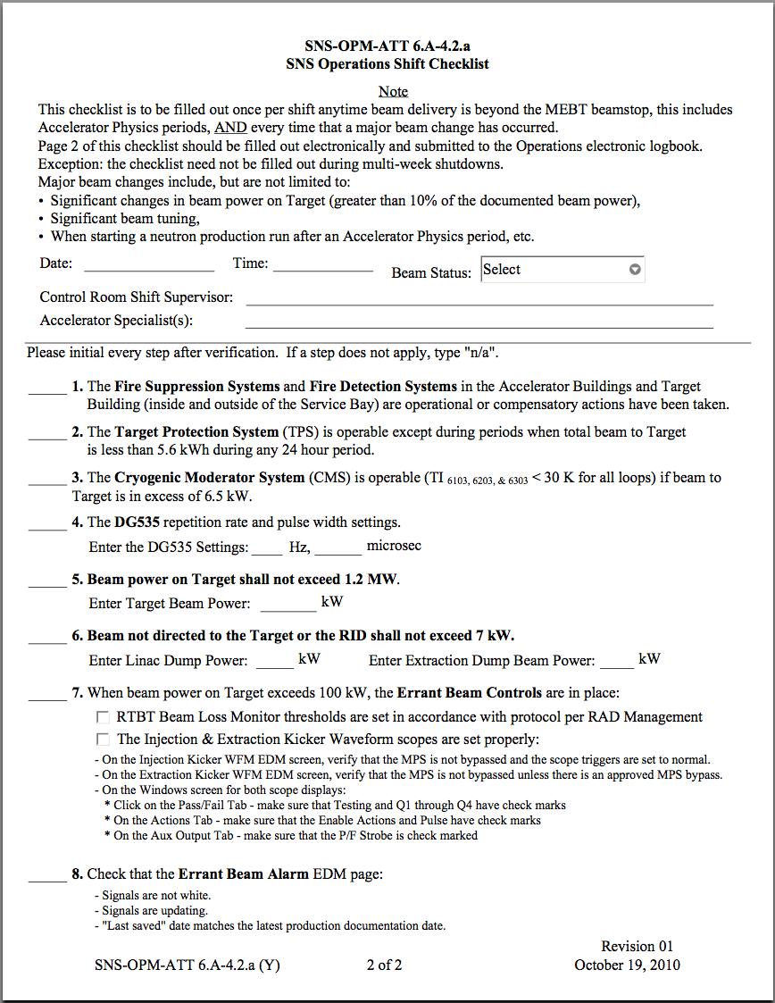
Operations Shift Checklist
Once per shift check operating parameters
  Verify important systems are working
  Verify errant beam controls are engaged and working properly
  If something is not correct then fix it
  Elog completed checklist
Operators have created an OS checklist script
  Verify parameters are within spec, run script, and the script elogs the checklist

Slide 20
How to make sure operators can’t break it
Machine Protection System (MPS)
RTBT errant beam controls
Operation Shift Checklist
RTBT errant beam alarms & production documentation

Slide 21
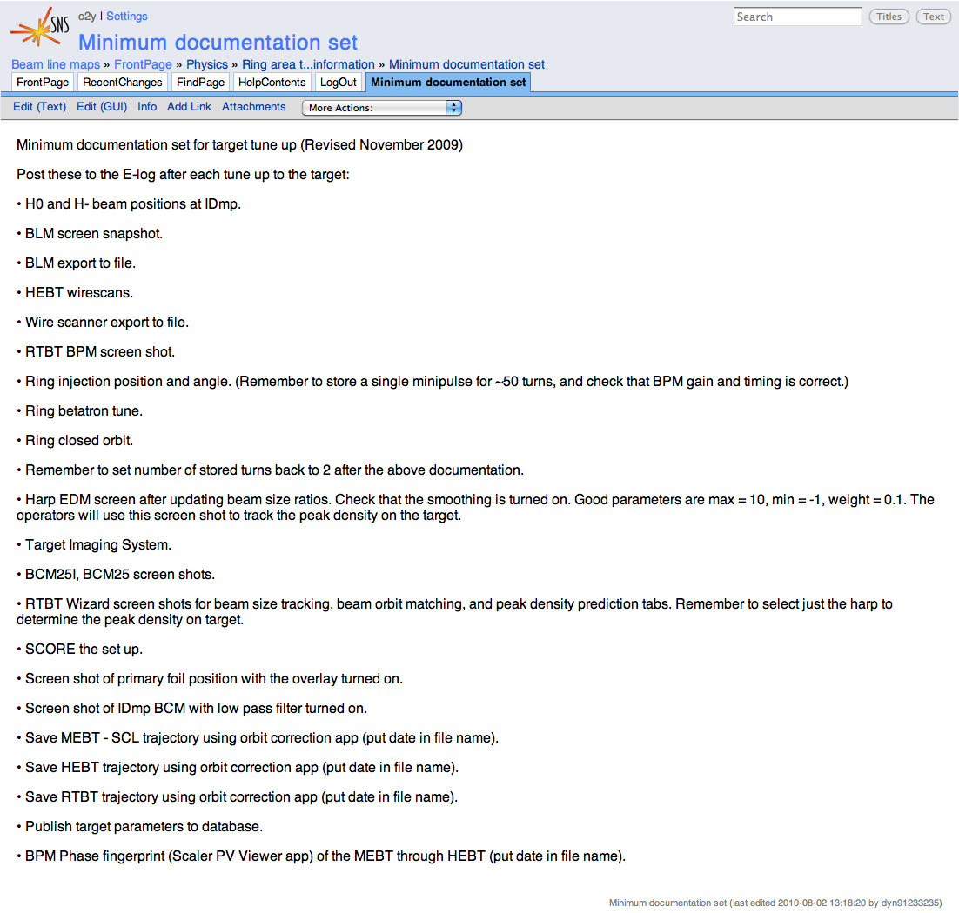
Production documentation
At beginning of run and at each ion source change
  Document beam parameters
    Beam positions in the injection dump
    Beam size on target
    Beam peak density on target
    Beam position on target
  Wiki-ized list of parameters to save

Slide 22
Errant beam alarms
Alarms set based on the production documentation and errant beam controls
  Monitoring errant beam controls always
  Monitoring beam parameters always
    +/- 10% in harp beam size
    +/- 6 mm by +/- 4 mm target position
    +/- 10% in beam peak density on target (measured at the harp)
    +5% in beam power on target
    +20% in beam power on injection dump
  Values are set using Control System Studio (CSS)
    CSS records information in the elog

Slide 23
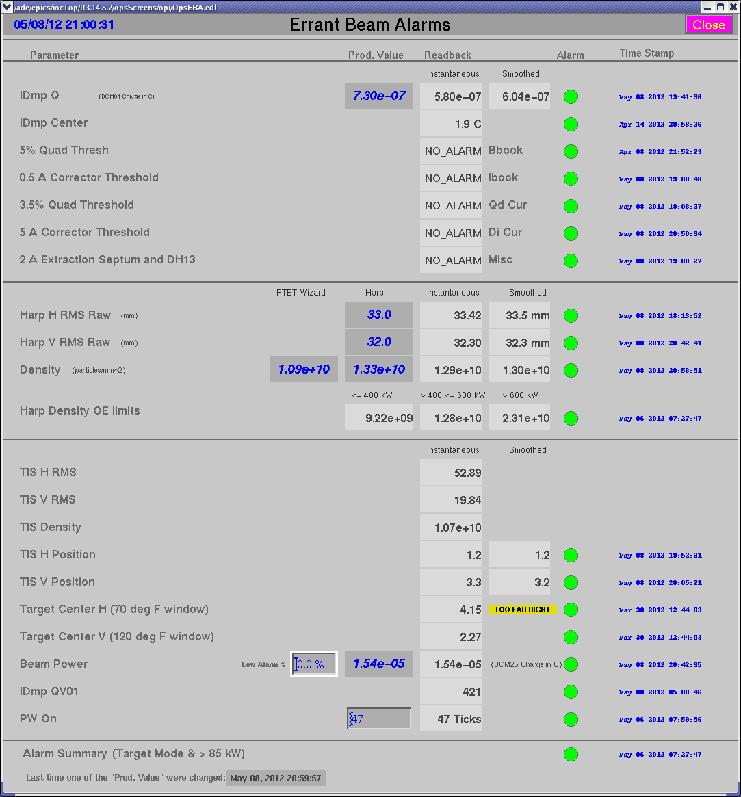
Errant beam alarms
Alarms are very important for tuning
  Systems are tied together
    Change position at the foil to reduce beam loss and beam size on target changes
  EDM page displays documented parameters from tune up
    Don’t have to search through elog or notebook to find what the parameters should be

Slide 24
AP development to operations now
How things have run recently
  Accelerator physicists and operators together set up Linac RF and Ring for 5 month run
    Time in linac RF cavities (1-2 shifts)
    Ring set up (1-2 shifts)
    AP studies begin (the interesting stuff)
  When physicists are done playing
    Machine specialist and operators
      Correct orbits
      Set beam parameters on target
      Production documentation at the beginning of the run and at each ion source change for the remaining run
  Operators own production

Slide 25
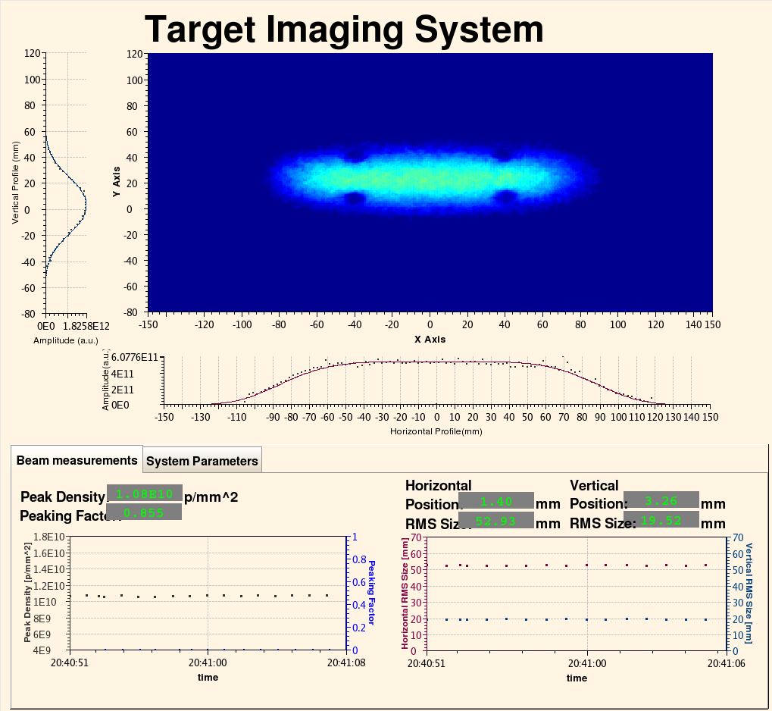
AP development and operations future
Eliminate time consuming tasks
  Target Imaging System
    Use this system to determine target parameters instead of prediction based on RTBT beam sizes
  RID Imaging System
    Add imaging system to the Ring injection dump
Move machine setup to operators (Guns, germs, and steel)
  Automate and speed up repetitive tasks
    Now have an automated SCL RF cavity phasing and scaling (warm linac a different story)
    Production documentation
  Create thorough beam tuning recipes
Creates more time for AP studies and new ideas!!!

