Slide 1
Machine Operation and Progresses in SSRF
Wenzhi ZHANG
Manzhou Zhang
Shanghai Synchrotron Radiation Facility
WAO12
SLAC. USA
2012-08-10
www.sinap.ac.cn

Slide 2
Contents
Introduction
Operation statistics of SSRF
Progresses in recent two years
Maintenance

Slide 3
Location
Shanghai Synchrotron Radiation Facility
SSRF

Slide 4
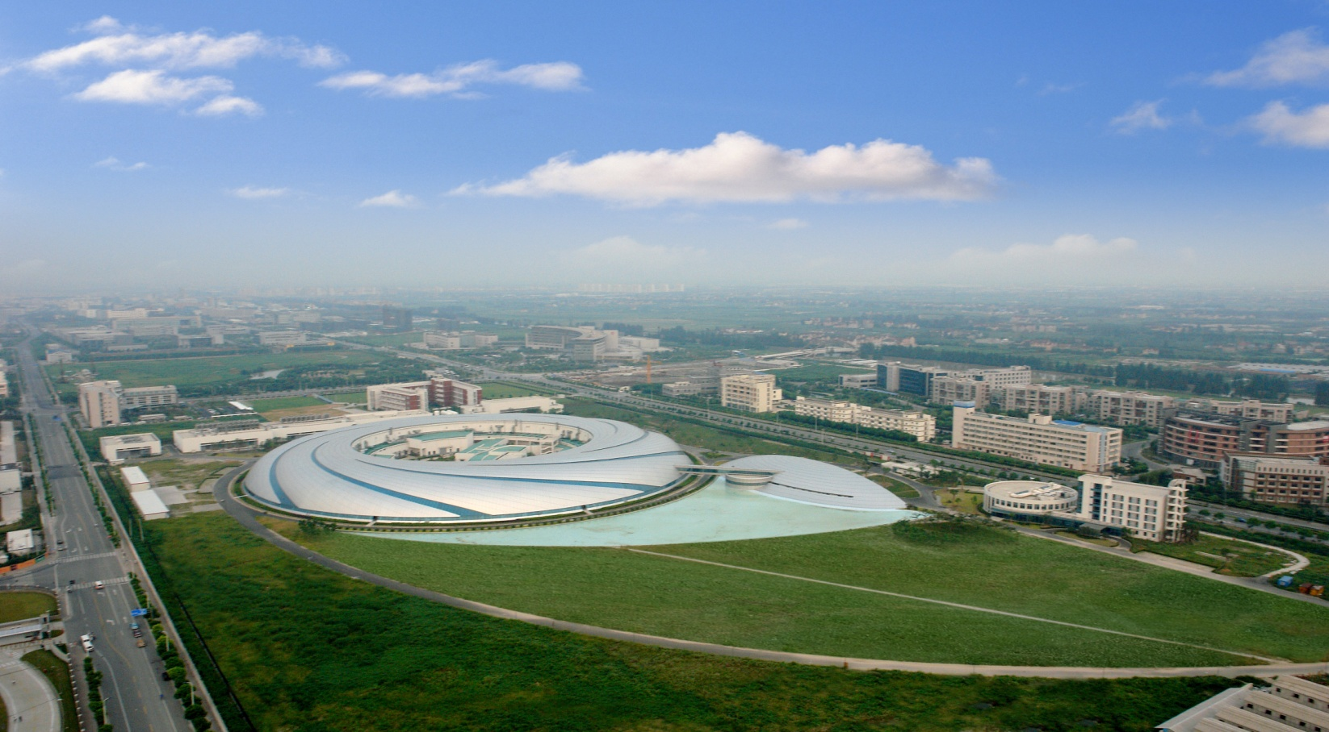
Bird’s eye view of SSRF

Slide 5
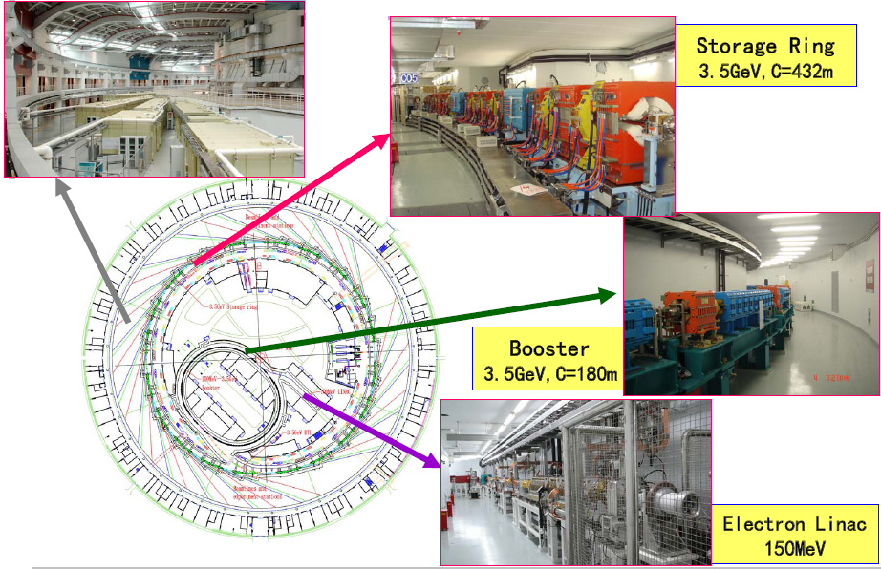
Overview of SSRF

Slide 6
Introduction -- History
Dec. 25, 2004 -- Groundbreaking;
Oct. 2007 --- Commissioning
May, 2009 ---- Open to users
7 Beamlines -- in the first phase
2 bending magnets; 2 wiggler ; 3 in-vacuum undulators
5 Beamlines are under construction
24 Beamlines are planed to build in next 3 years

Slide 7
Beam Parameters (Operation mode)
Parameter / unit | Design value | Measured value
Beam energy / GeV | 3.50 | 3.50±0.02
Beam current / mA | 200~300 | 210 (operation current) 300 (achievable)
Tune (H, V) | 22.22, 11.29 | 22.220, 11.290 (±0.002)
Natural emittance / nm.rad | 3.89 | 3.8±0.2
Coupling | 1% | 0.3%
Natural chromaticity (H, V) | -55.7, -17.9 | -55.8, -17.9 (LOCO model) -50, -15 (direct measurement)
Corrected chromaticity (H, V) | --------- | 1.5, 0.5
RMS energy spread | 9.845×10⁻⁴ | 0.001
Energy loss per turn / MeV | 1.435 | ~1.45 (without ID, from RF power)
Momentum compaction factor | 4.27×10⁻⁴ | (4.2±0.2)×10⁻⁴
RF voltage / MV | 4.0 | 1.51, 1.55, 1.54 (Three cavities)
RF frequency / MHz | 499.654 | 499.654 (depend on machine conditions)
Synchrotron frequency | 0.0072 (V_{RF}=4.0MV) | 0.0075±0.0002
Natural bunch length / ps | 13 | 14±2
Injection efficiency | --------- | >95% (from BS DCCT to SR DCCT)
Beam lifetime / hrs | >10 | ~17 (0.3% coupling, 210 mA)

Slide 8
Machine Operation Status

Slide 9
Operation Schedule
Year | User time (hours)
2009(May-Dec.) | 2094
2010 | 3829
2011 | 4370
2012 | 4600

Slide 10
Availability & MTBF during scheduled user time

Slide 11
Hardware faults

Slide 12
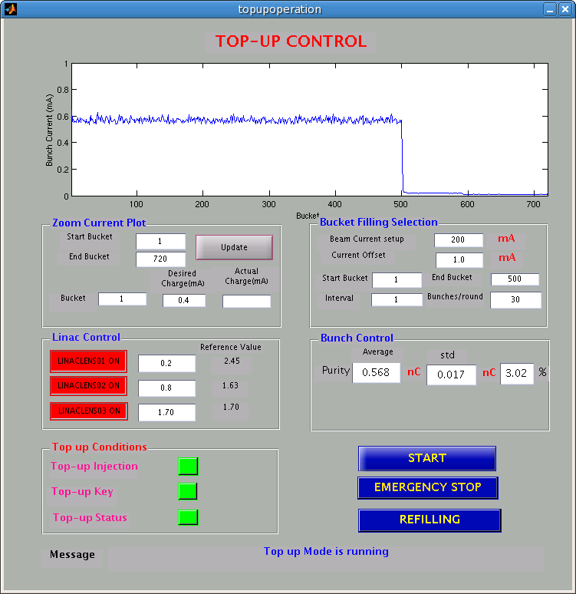
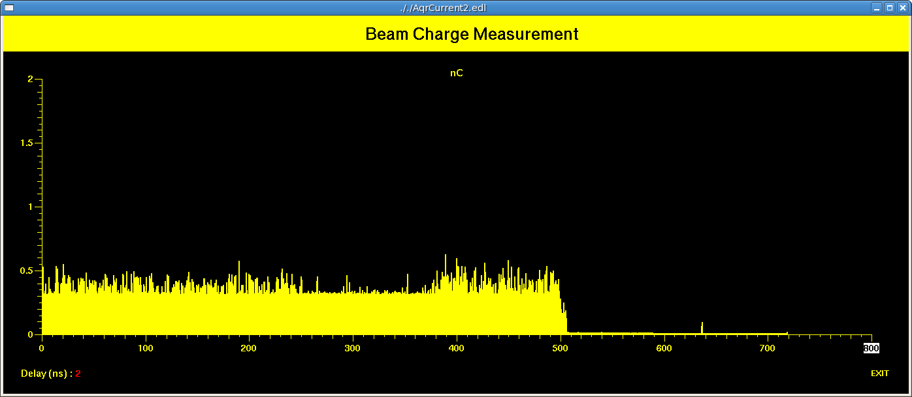
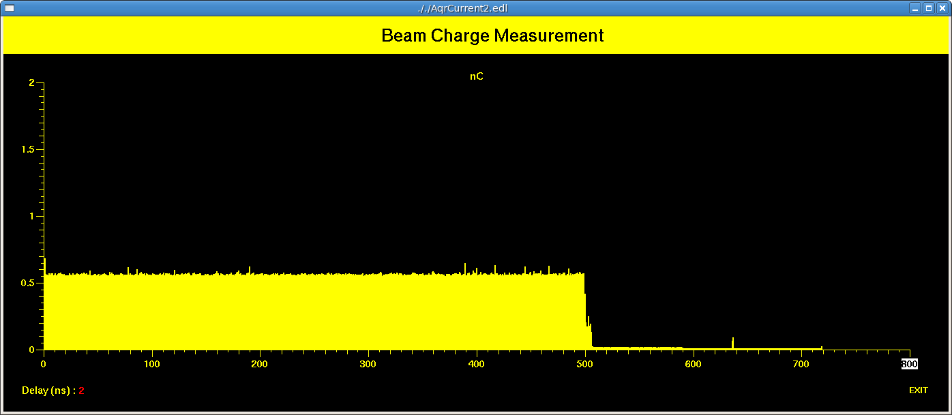
Top up preparation
Progresses
Control software panel
Filling pattern control (up: initial, below: 3hours top-up operation

Slide 13
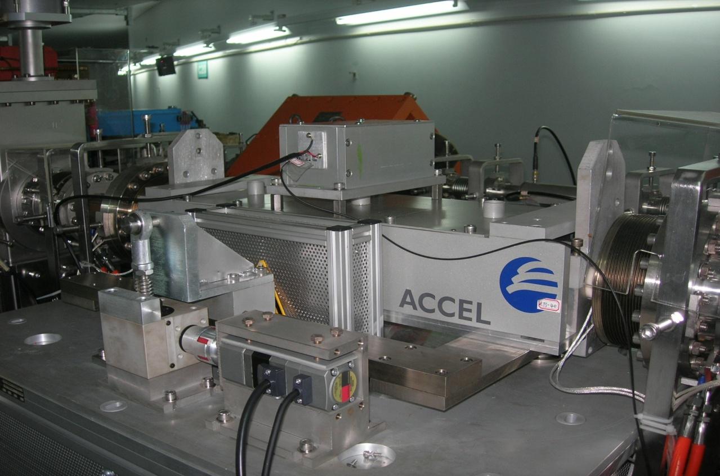
Topup injection
range：-5∼5 mrad（±2mm）；
step： < 10μrad；
speed：= 18μrad/sec；
resolution：10μrad；

Slide 14
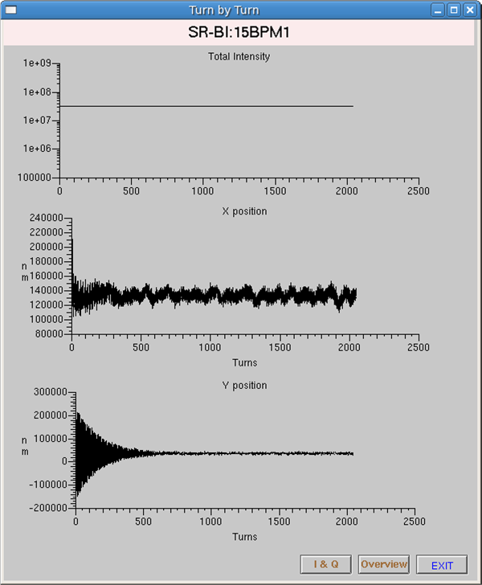
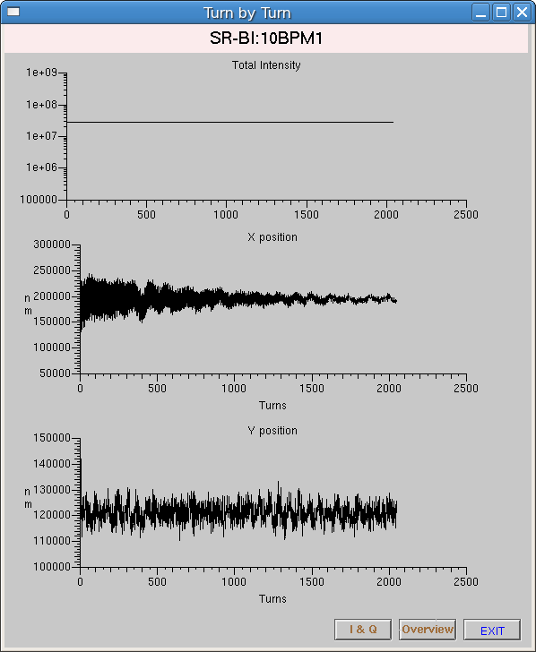
Top up commissioning
BPM 15-1 turn-by-turn data after injection
Before optimize after optimize
During machine shutdown, 4 stepper motors are added to the 4 injection kickers to adjust tilt. After online optimizing, the injection perturbation in vertical plane reduced from 150micron to 10 micron , and +/- 50 micron in horizontal

Slide 15
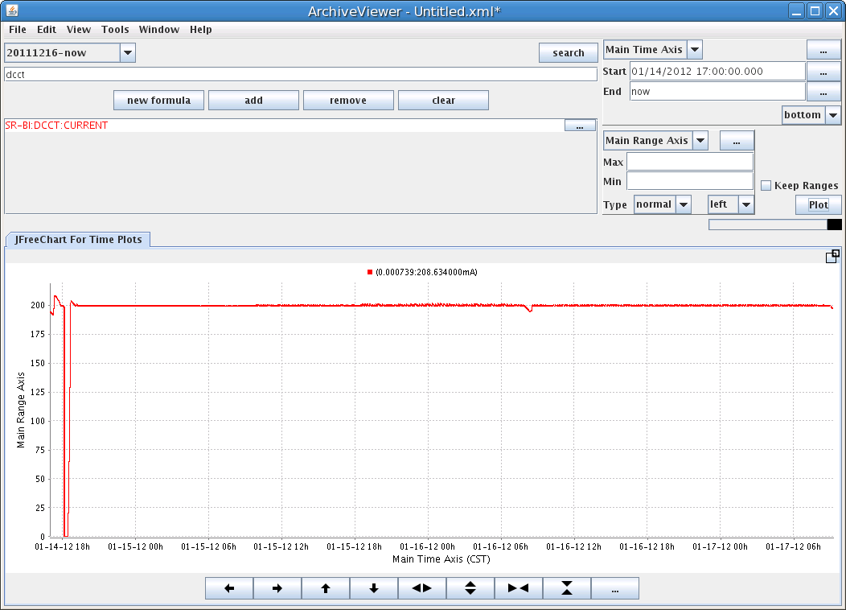
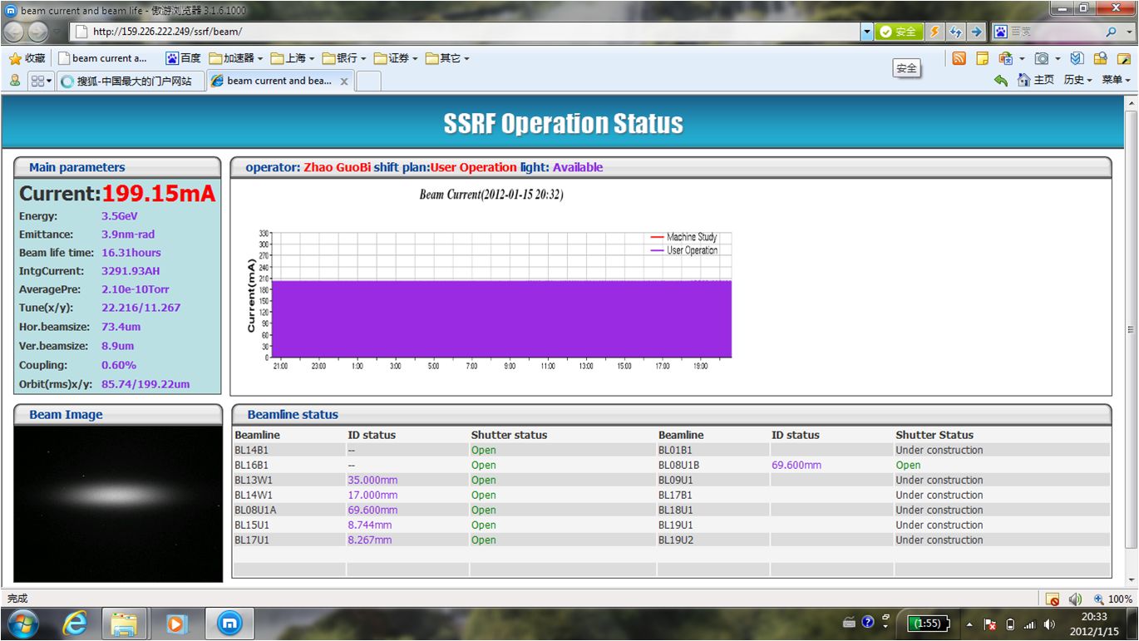
4 days top up operation for users
Jan. 14, 2012

Slide 16
Lower Emittance Lattice mode

Slide 17
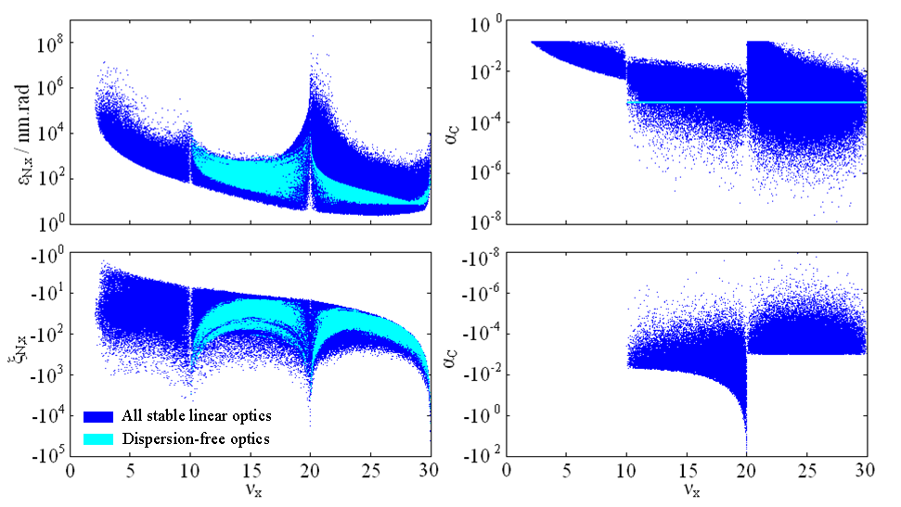
MOGA (Multi-Objective Genetic Algorithm )：Is used to find Low ε lattice

Slide 18
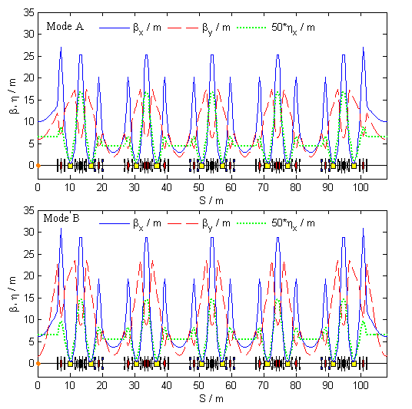
Lower emittance optimization
Parameter / unit | Ope. Mode | Mode A | Mode B
Tune (H, V) | 22.22, 11.29 | 23.31, 11.23 | 23.31, 11.23
Natural emittance / nm.rad | 3.89 | 3.51 | 2.88
Eff. Emitt. in LSS / nm.rad | 4.86 | 4.25 | 4.00
Eff. Emitt. in SSS / nm.rad | 5.17 | 4.58 | 4.15
Natural chromaticity (H, V) | -55.7, -17.9 | -69.9, -20.5 | -74.5, -26.7
Momentum compaction factor | 4.27×10⁻⁴ | 4.03×10⁻⁴ | 4.13×10⁻⁴
β_{x}, β_{y}, η_{x} at the center of LSS /m | 10.00, 6.00, 0.15 | 10.00, 6.00, 0.13 | 6.15, 1.71, 0.13
β_{x}, β_{y}, η_{x} at the center of SSS /m | 3.60, 2.50, 0.11 | 3.00, 2.00, 0.087 | 3.71, 1.90, 0.11

Slide 19
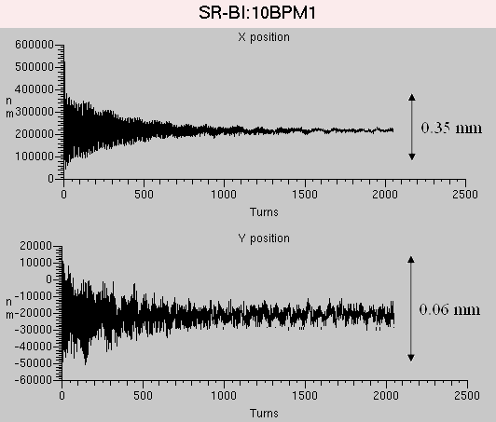
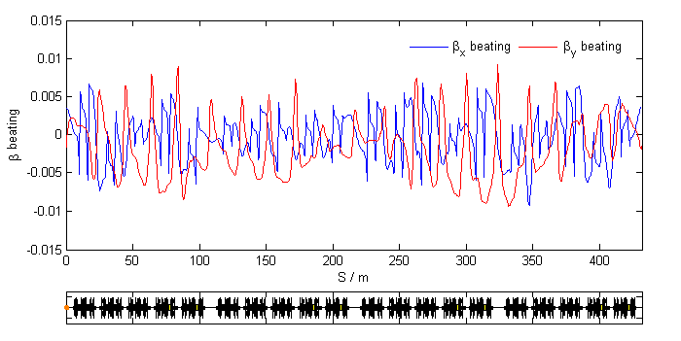
Lower-emittance mode commissioning and calibration
LOCO calibration，beta beating~0.40%/0.45%
Injection efficiency ~60%
Coupling~0.3%，Beam life time 17 hours@210mA

Slide 20
Main parameters measurement for low emittance
 | design | First measure | Second measure
Tune | 23.31, 11.23 | 23.309, 11.238 | 23.316, 11.235
Beam Emittance | 2.88 | 2.9±0.2 | 3.0±0.2
Natural Chromaticity | -74.5, -26.7 | -67, -23 | ------
Corrected Chromaticity | ------ | 2.0, 3.0 | ------
Injection Efficiency | ------ | ~50% | 60%~70%
Beam Current | ------ | 210 | 210
Coupling | ------ | 0.5% | 0.3%
Beam Lifetime | ------ | 15 | 17
Alpha 1 | 4.13e-4 | (4.2±0.2)e-4 | ------
Synchrotron tune | 0.0075 | 0.0074±0.0002 | ------
RMS Beta Beating | ------ | 0.70%, 0.80% | 0.40%, 0.45%

Slide 21
Beablines commissioning results
Beam lines | Brightness | Other merit
BL08U | +20%
BL13W | - | Beam size decreased
BL14W | +50% | Ionization chamber I0 decreased
BL14B | +8% | Much stable
BL16B | +7% | Scattering background -10%
BL15U | +30% | Energy resolution
BL17U | -

Slide 22
Maintenance
Routine maintenance every two weeks
check hardware according to plan
RF commissioning 5~6 hours
Summer shutdown

Slide 23
VARIAN vacuum gauge
Other problem we meet
In 2006, some problems had been found with cathode shortcutting

Slide 24
Filament burned
2007--2010，there are 48 filaments which have burned (total 170) at storage ring
2010-- 2012，same case for LINAC and Booster
The average life time is about 3 years.
We can not get enough support from VARIAN.

Slide 25
Thank you for your attention

