Slide 1
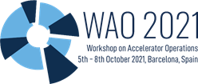
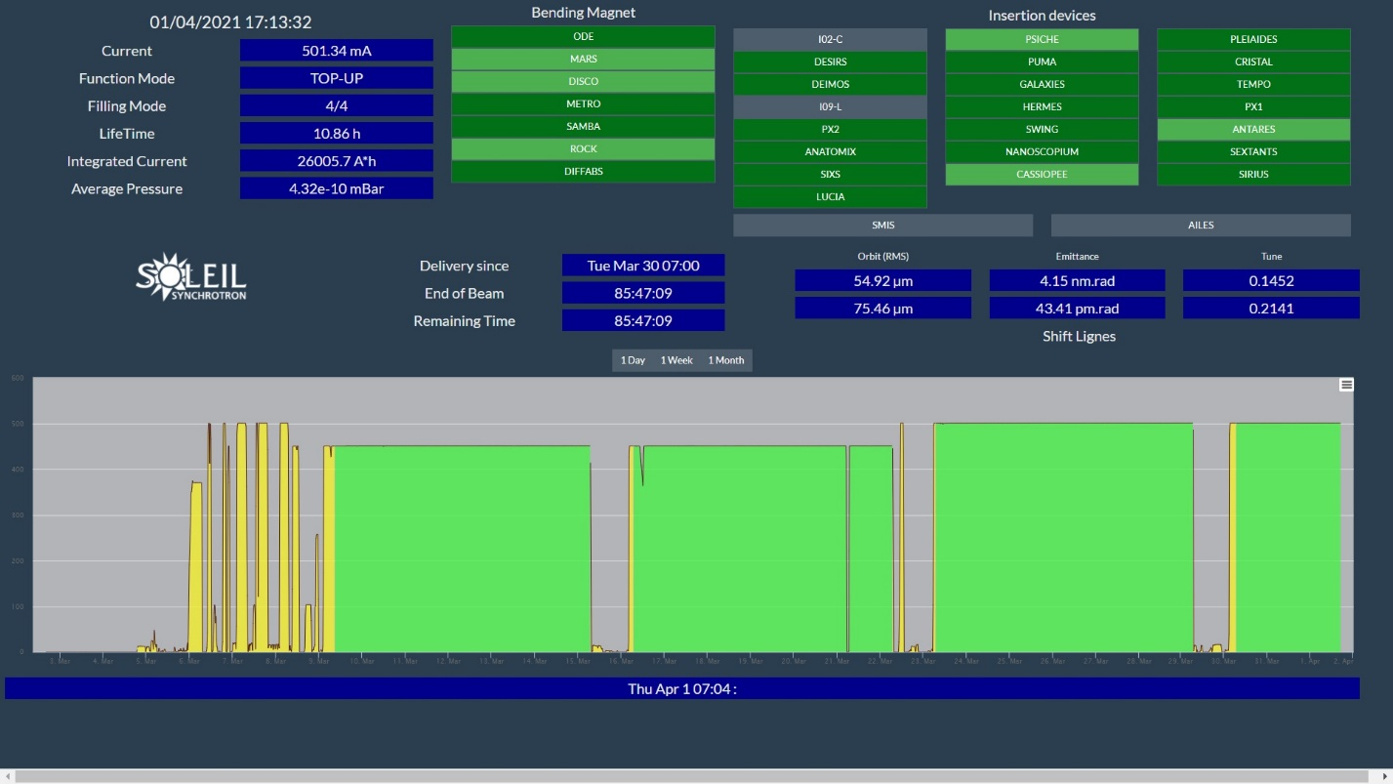
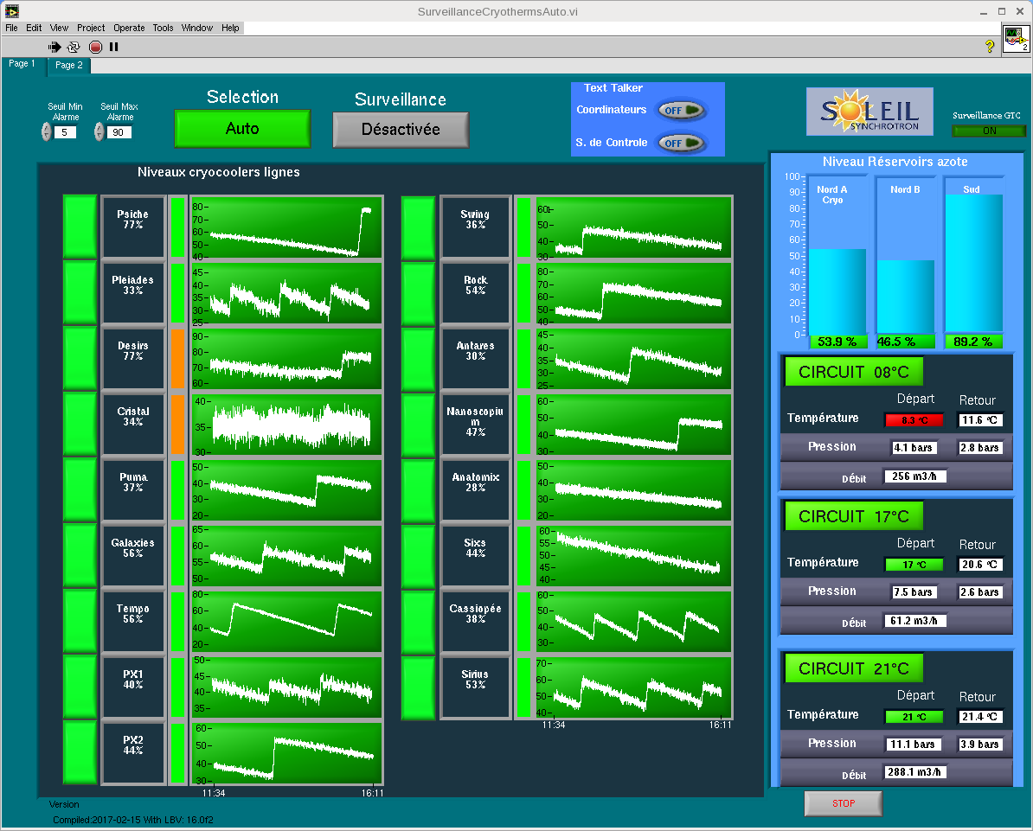
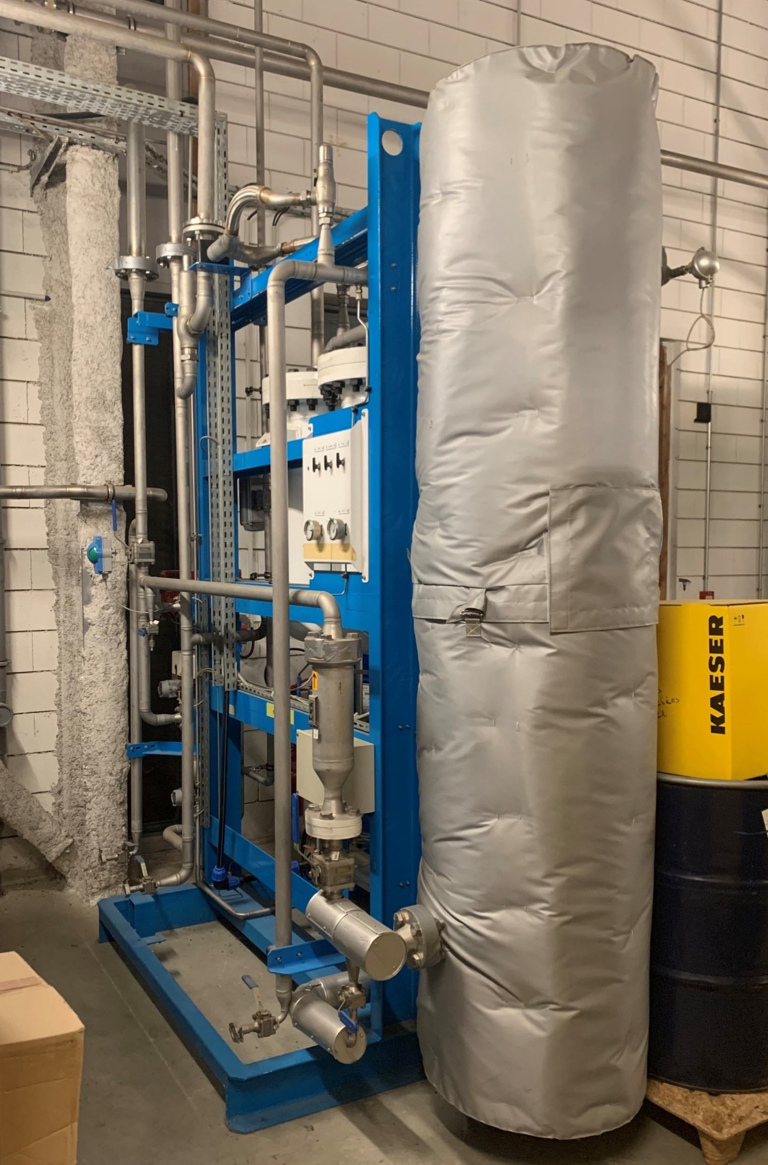
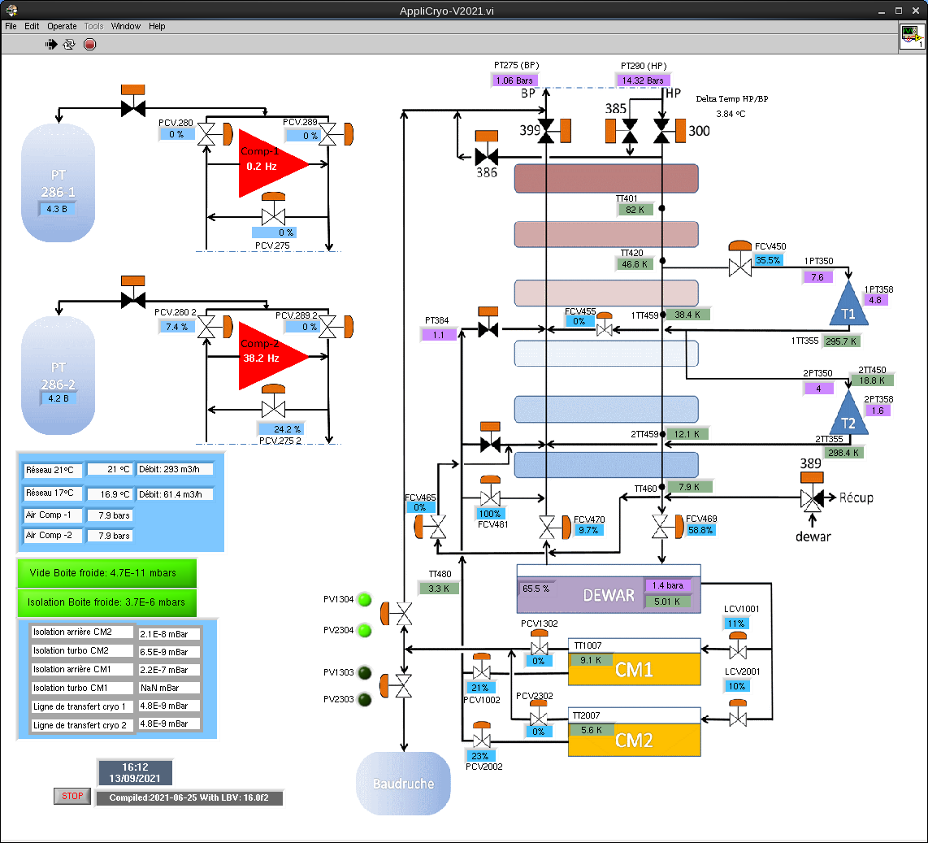
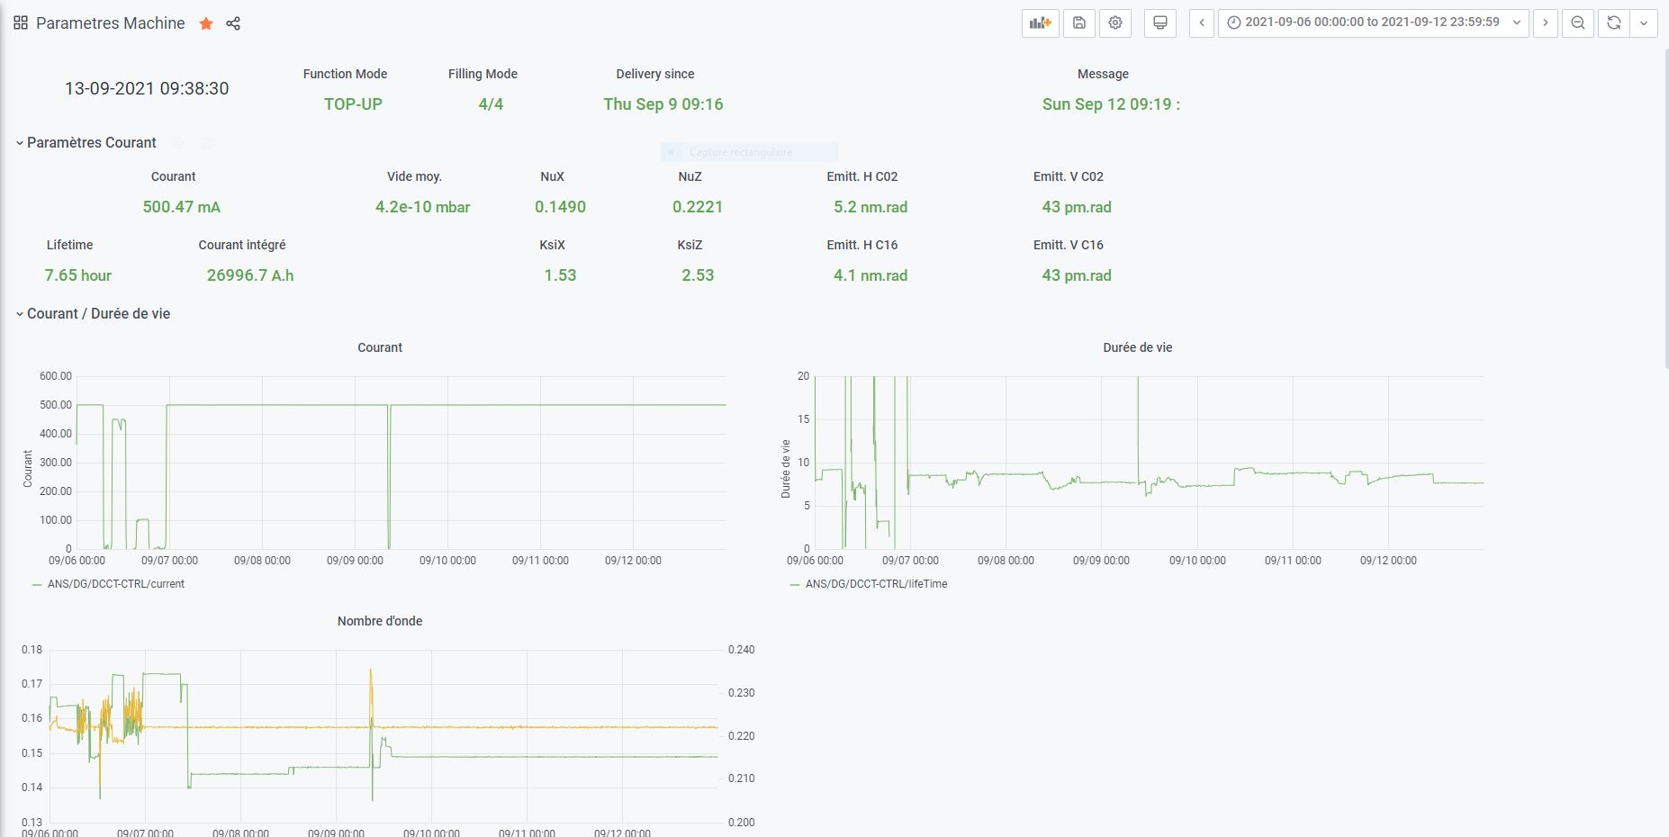
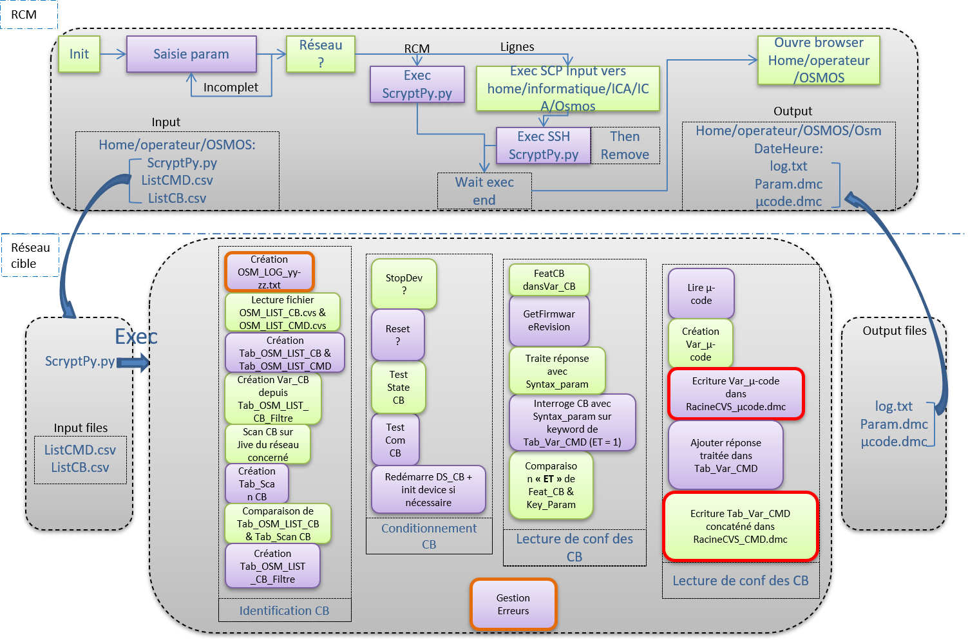
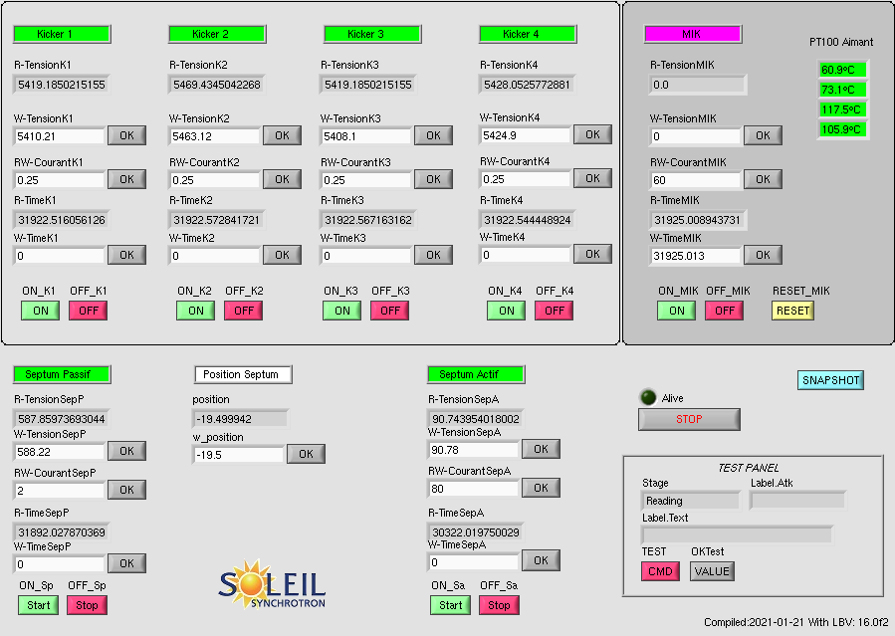
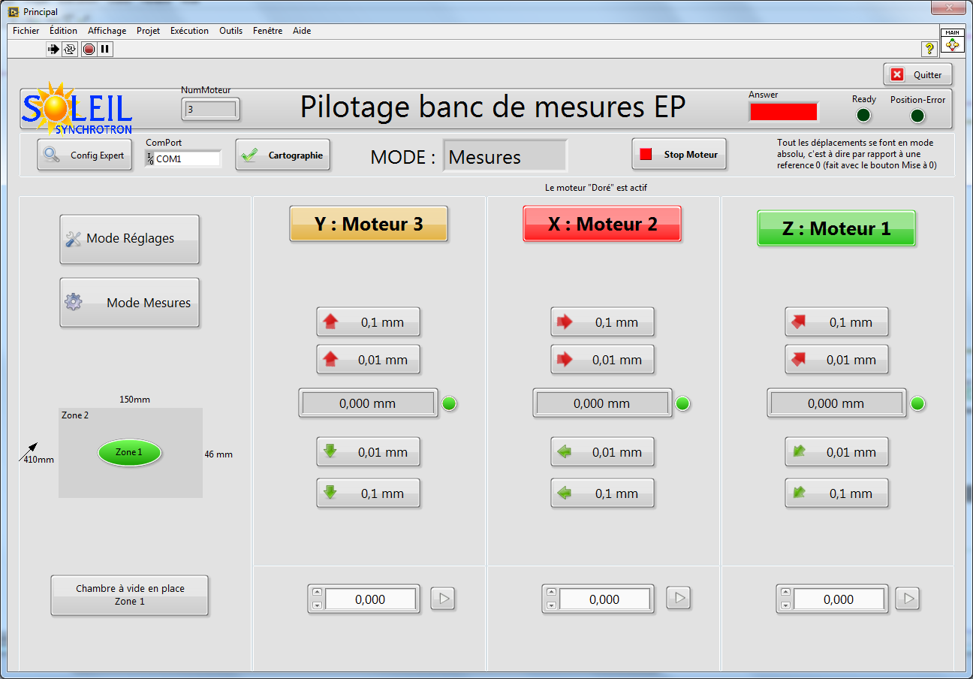
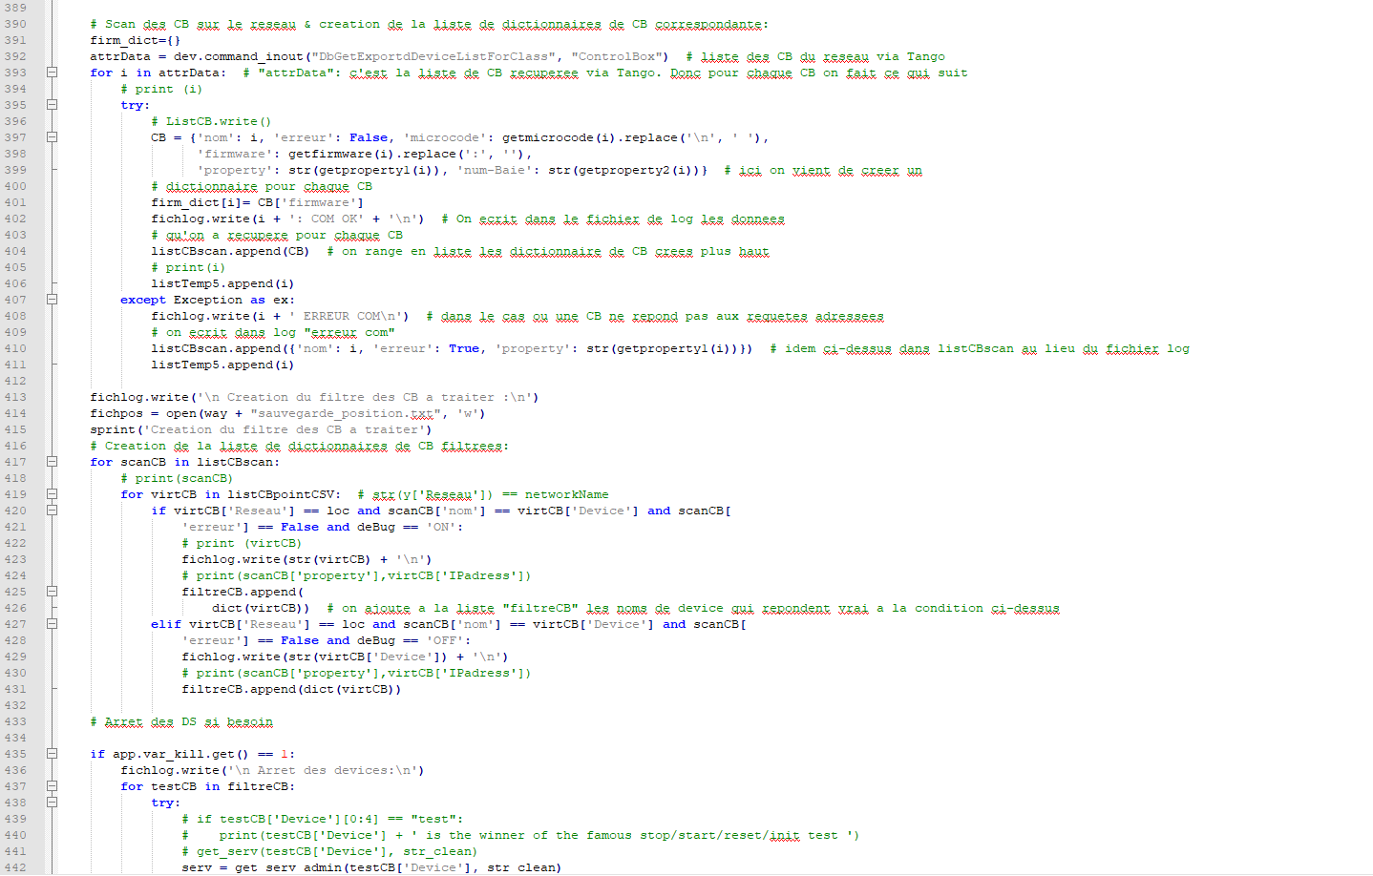
Secondary activities of the SOLEIL operators
Christophe Bourg, Yann Denis, Xavier Delétoille, Samuel Garnier, Jean-Francois Lamarre*, Thomas Marion, Laurent S. Nadolski, Emmanuel Patry, Guillaume Roux, Clément Tournier, Didier Trévarin, Synchrotron SOLEIL, Gif-sur-Yvette, France
* jean-françois.lamarre@synchrotron–soleil.fr
SOLEIL is the French third generation synchrotron light source in operation since 2007 and providing photon beams to 29 beamlines with a maximum intensity of 500 mA, 5 000 hours per year.
For about ten years, the eight operators of the operation group have developed their own programs, first in GlobalSCREEN and then in LabVIEW and python, to ensure their main functions, namely to drive the accelerators with a 98-99% beam availability with top performance and stability. Today, they maintain these software programs and continue to develop new ones adapted to changing needs. In addition to their primary operation roles, some members of the group also have support duties for other groups in the organization
Control Group
One operator devoted to 20%
Cryogenic Cell:
Two operators devoted to 20%
The SOLEIL control group has proposed web-based activities to a member of the operation group:
Helping evaluating and choosing the web technology for the future operation and controls
Selection of a javascript plugin for Grafana allowing to collect data from database. It is then possible to create and customize dashboards to facilitate the on-call duty personnel and group managers.
Design of a new machine status version for the synchrotron SOLEIL web site: more dynamic and interactive than the current one which is based just on a snapshot.
In January 2019, a cryogenics cell was created to support the engineers in charge of the cryosystem of the storage ring RF cavities (LHe, GHe, LN2) and the cryogenics systems for the beamlines (LN2). This cell is composed of 2 permanent people and 5 technicians with various backgrounds, including 2 operators who devote a part of their time to the group.
Involvement to the on-call duty rolling (5 weeks/years)
Participation during operation and maintenance work
LabVIEW applications were created to provide a remote monitor of the cryogenic system status and another one to provide the assistance necessary to the experiment coordinators to remotely monitor the cryocoolers used by the beamlines.
Acquire new skills useful for operation
Study and implementation of a heating system for regeneration of activated carbon used in helium cleaning
Study and implementation of a control board to protect the He-liquefier in case of drop or shutdown on cooling circuit with automatic switching on the tap water circuit.
Electronics Group
Other External Requests
The Electronics group has asked support to the operation group to develop a tool able to automate a backup of all the motor systems (controlbox) configuration. At the origin, the backup was slow (10 days), semi-manual, cumbersome and made possible only during summer shutdown.
The Osmos application written in Python allows to perform the task in only one day with high quality without any error due to manual entry and the continuous evolution of the park of the motor systems widely deployed bring a strong added value for operation and maintenance work.
The operation group is also solicited by various Accelerators groups to provide its expertise.
Development of new applications in LabVIEW for Pulsed Magnet group to control a magnet measurement test bench for the MAX-IV then SOLEIL Multipole Injection Kicker (MIK) and one used during its commissioning
Technical support and involvement in the implementation of water leak detector systems for other groups: Linac, power supply, radiofrequency technical rooms
Regular requesting of different work groups to install new temperature sensors (PT100 probes) in racks, on beamlines…

