Slide 1
Corona - How did life change in the main control room?
Sonja Schumann and Miriam Klich

Slide 2
Content
Introduction
Situation before Corona
Beam time 2020
Beam time 2021
Review
Summary

Slide 3
Introduction - GSI
Research areas
Nuclear and Particle Physics
Atomic Physics
Plasma Physics
Biophysics and Medical Science
Materials Research
SIS18: max. rigidity 18 Tm
Protons 4,5 GeV
Uranium 1 GeV/u
Picture: GSI Helmholtzzentrum für Schwerionenforschung

Slide 4
Introduction - FAIR
Picture: GSI / FAIR / D. Fehrenz

Slide 5
Introduction - Accelerator operation
Beam time at GSI 6 months - Shutdown 6 months
~ 20 operators, 3 operators per shift
Experimenters from different countries
Accelerate many different elements
1 to about 6 experiments in parallel
Durations -> a few hours to several weeks
Main control room (MCR) ~ 300sqm with ventilation system

Slide 6
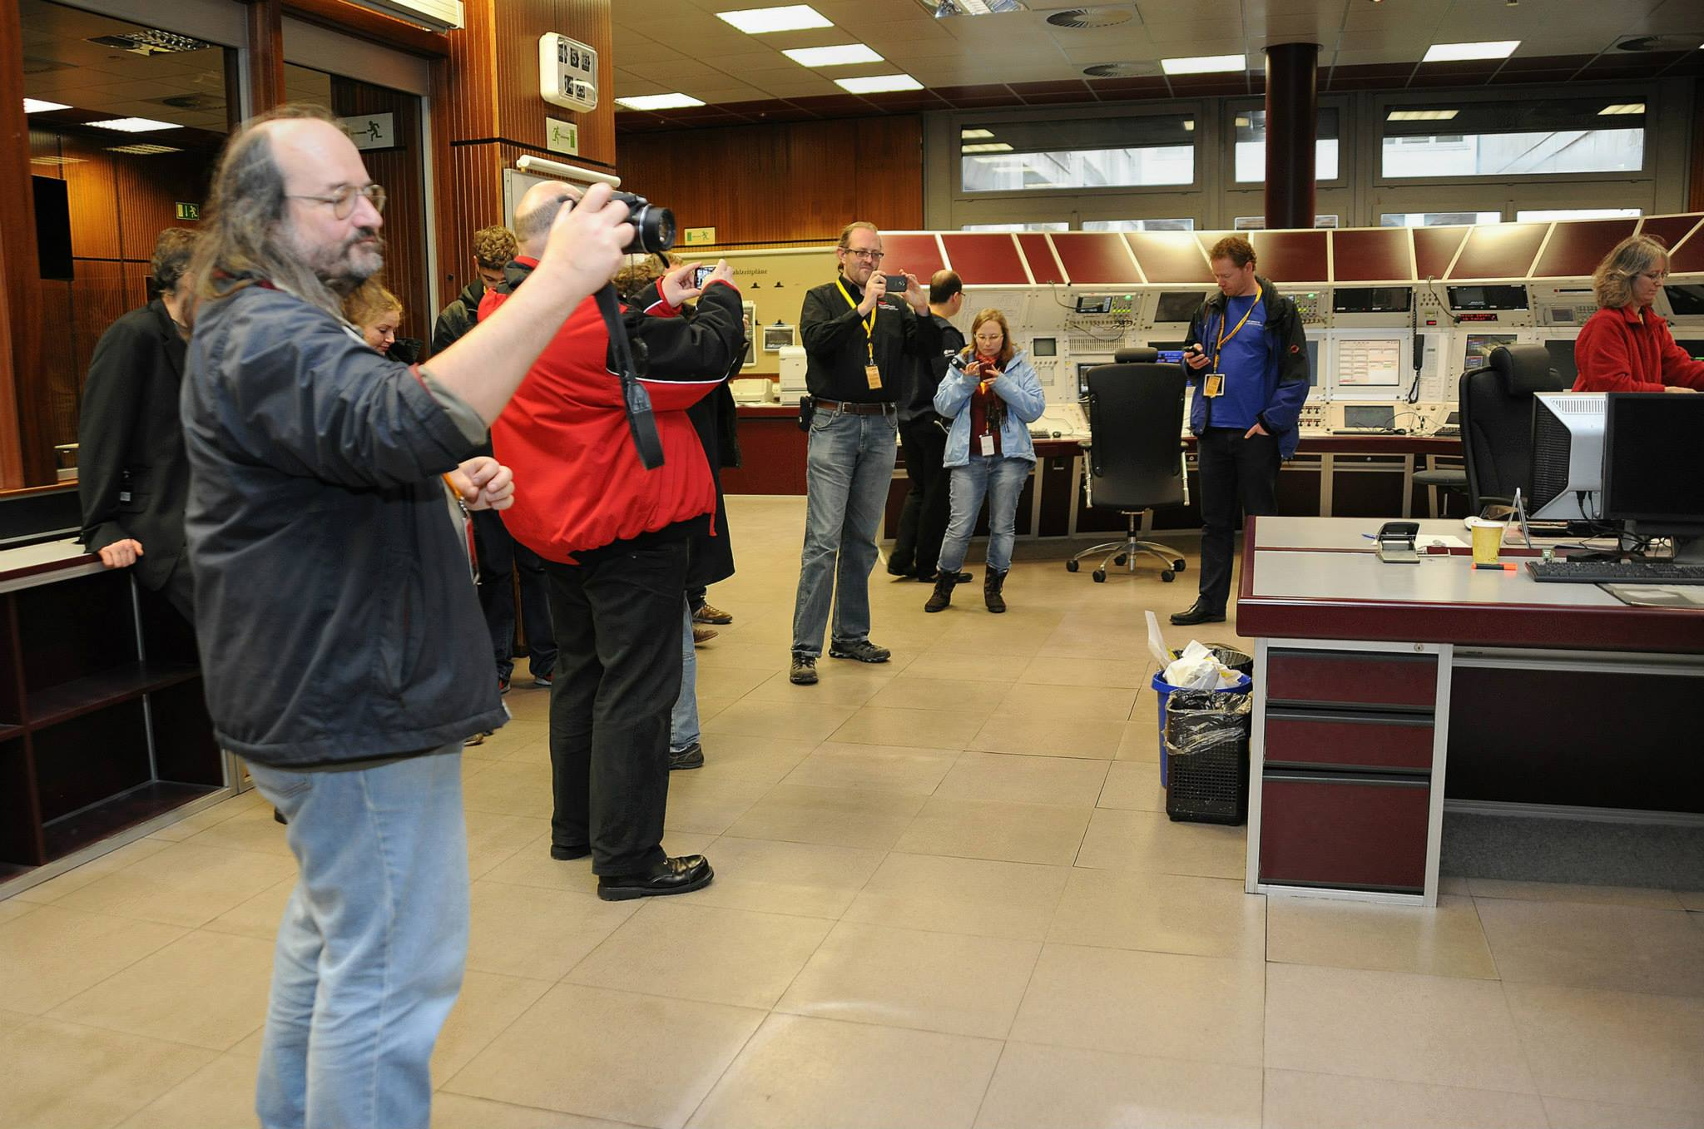
Situation before Corona
A lot of people in MCR
People come to MCR to get to know what’s going on
Visitor groups
MCR as meeting-room
Picture: GSI / G. Otto

Slide 7
Main Control Room
UNILAC
SIS18
ESR
CRYRING
Picture: GSI / R. J. Steinhagen

Slide 8
Beam time 2020 - Changes
Germany started lockdown
Will GSI also be closed?
Borders were closed
Experimenters couldn‘t come or had to leave earlier
Beam time schedule changed everyday
Beam settings had to be changed more often

Slide 9
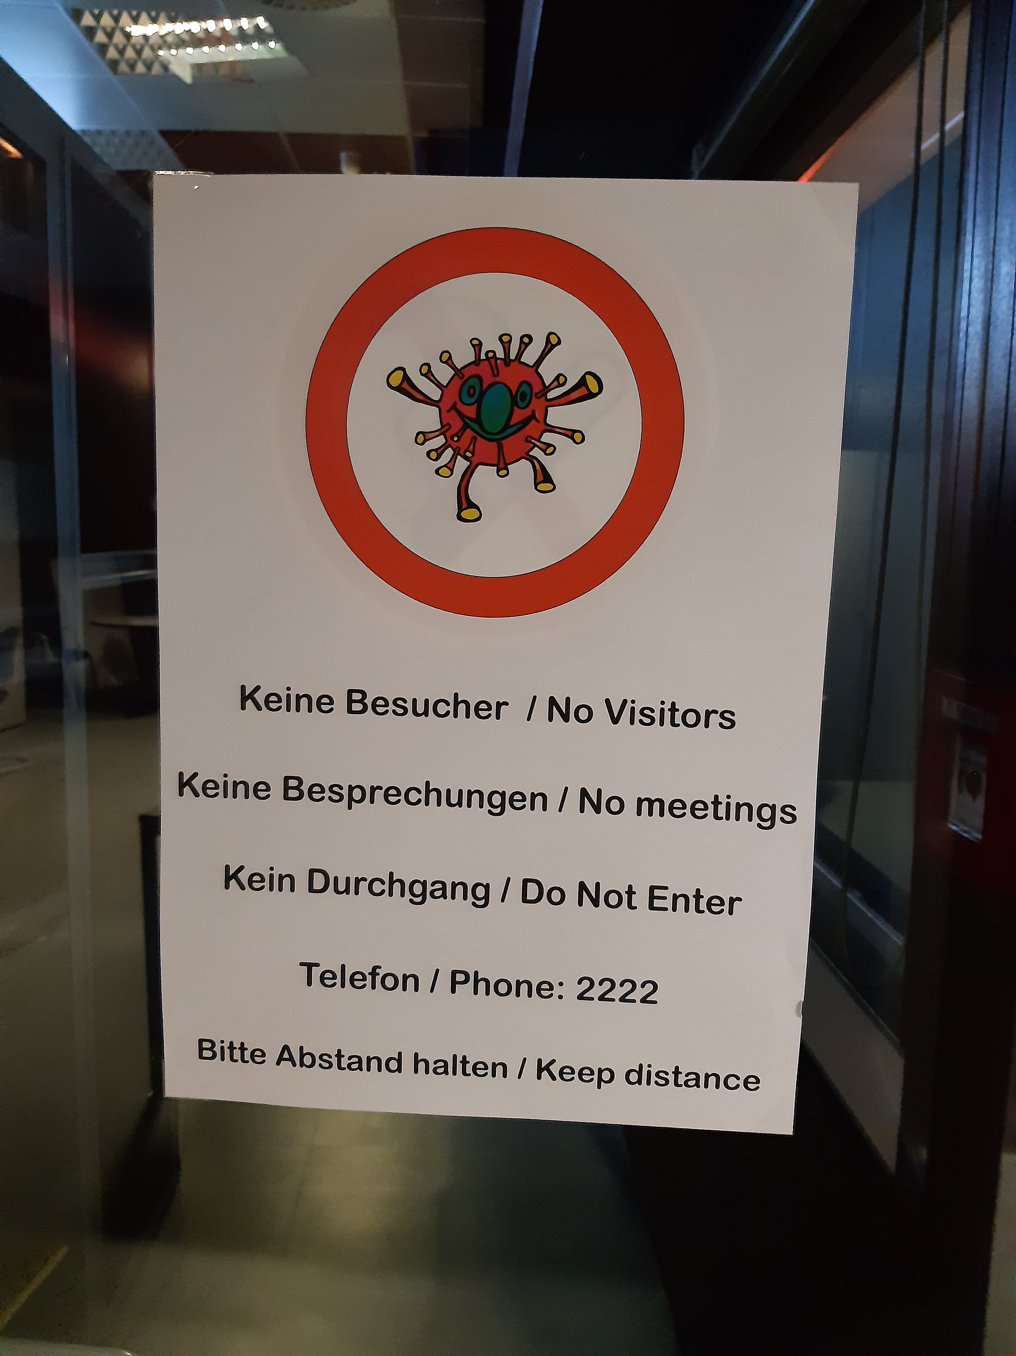
Beam time 2020 - Measures
No visitor groups or meetings
<10 people in MCR
1.5 meter distance
> 2 Persons per console = wear a mask
Stay at home when you have a light cold
Disinfectant dispenser was installed
Requests from experimenters via phone or zoom

Slide 10
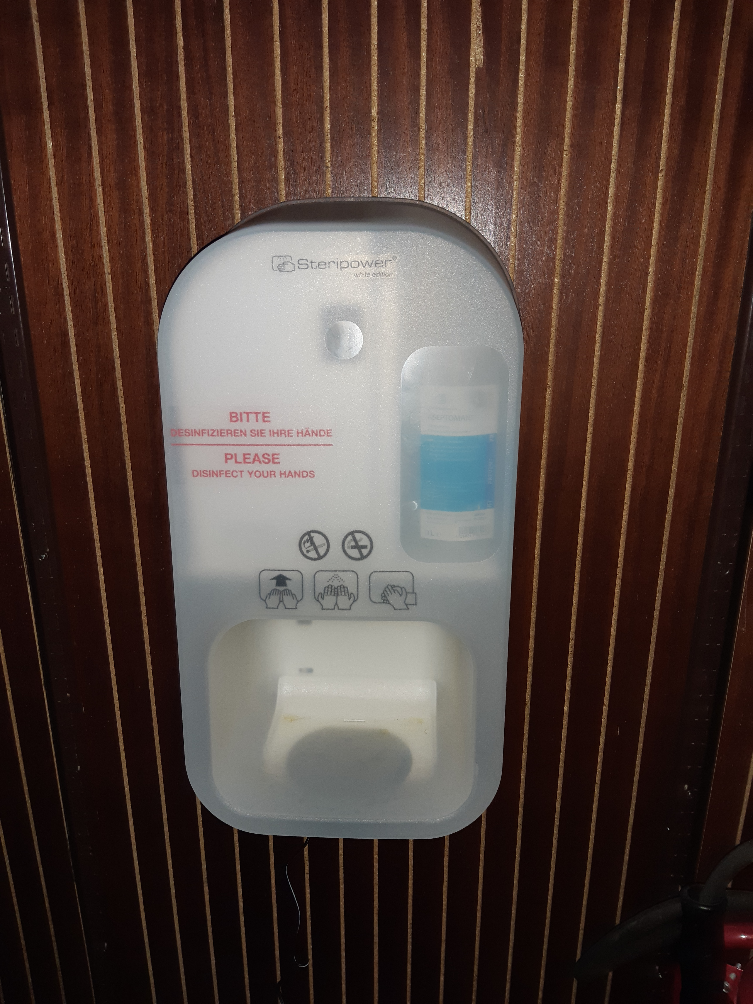
Beam time 2020 - Measures

Slide 11
Beam time 2021 - Measures
Beam time schedule planned with Corona in mind
Mask requirement at GSI and MCR
Corona tests
Vaccination campaign in June 2021

Slide 12
Review
Positive changes
More attention to hygiene
Improved technical infrastructure
Less people
Neutral changes
Masks
Zoom
Negative changes
Different opinions within the team
Working together more difficult

Slide 13
Summary
Beam time 2020 was very stressful and uncertain
Beam time 2021 was nearly normal
Just small permanent changes

Slide 14
Thank you for your Attention!

