Slide 1
Running a Beam Particle Accelerator during the COVID-19 pandemic
Introduction: return to work context
Layout of workspaces
Organisation of the operation group
Organisation of weekly short interventions and machine shutdowns
IT ressources used
Balance sheet 2020 – statistics
Conclusion
Samuel.GARNIER Synchrotron SOLEIL 1/19

Slide 2



Introduction : return to work context
On March 17 2020: national lockdown
Openning remote connections (from 30 to 150)
Setting up Work From Home for all those who could do it,
The Operation Group : resumption of technical work
Setting up of a crisis unit (regular progress report)
Establishment of an organization and arrangements to be made before resuming operation
Need of an annex control room
2/19

Slide 3
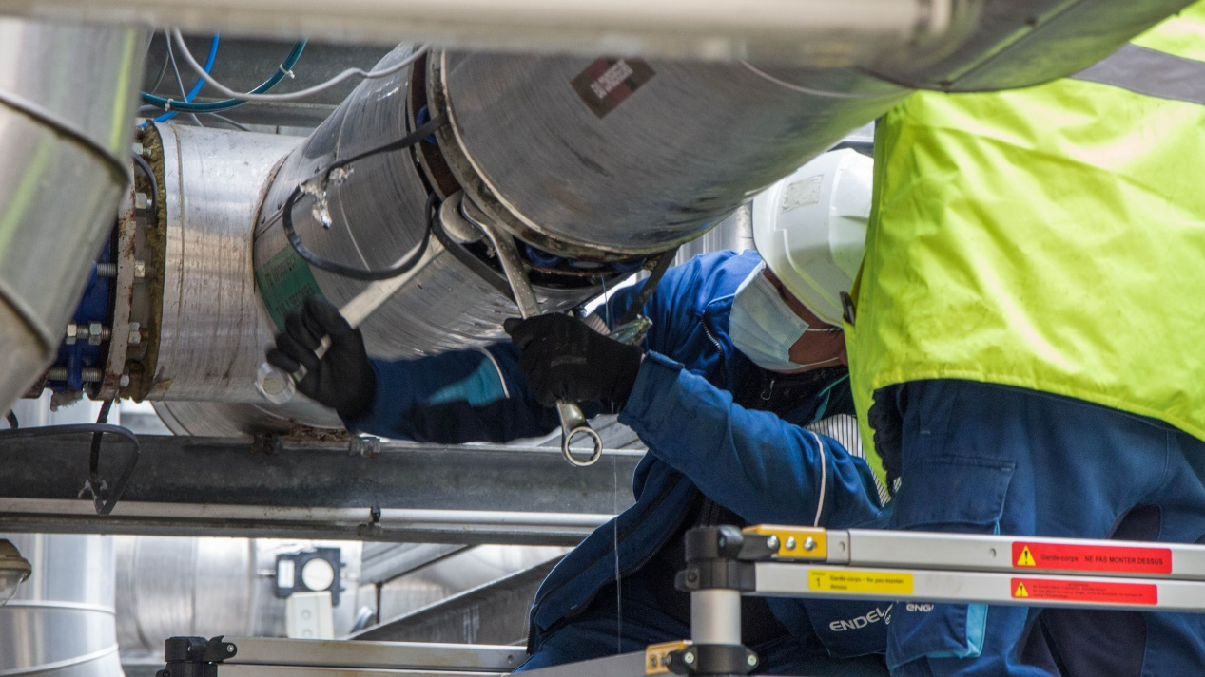

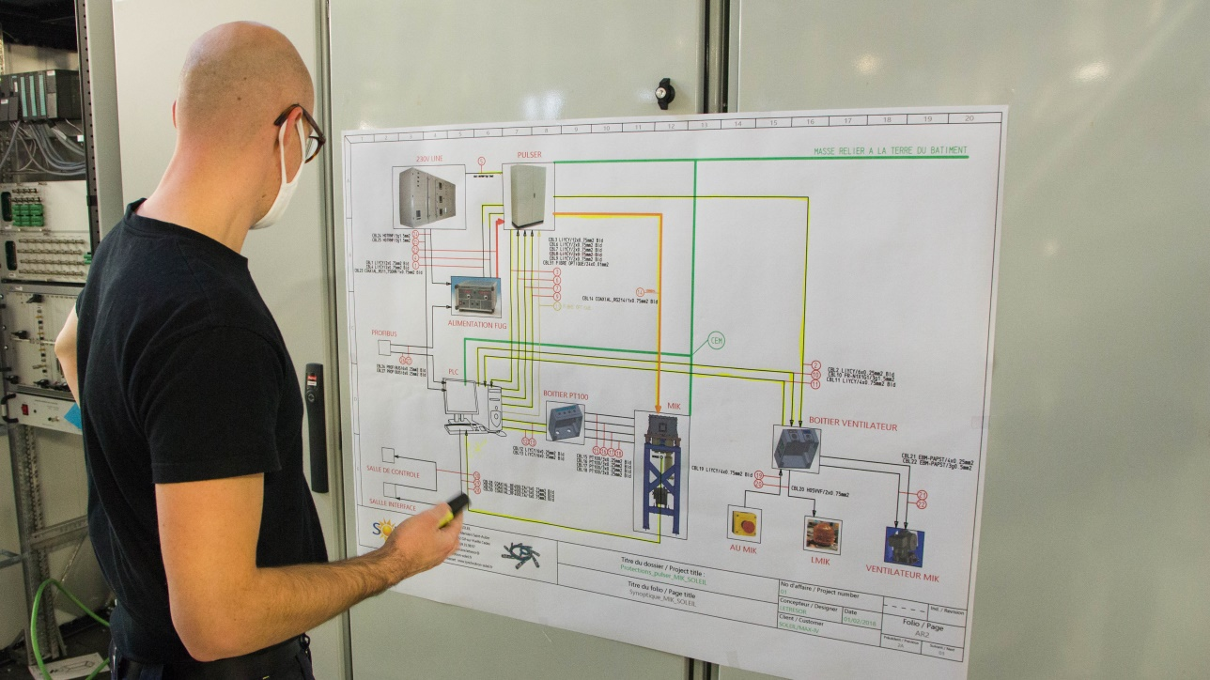

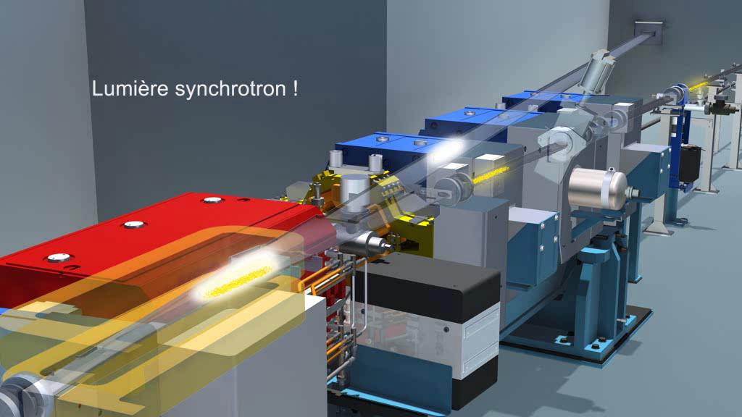
Introduction : return to work context
On may 11, 2020 resumption of activity : shortened two-week machine shutdown
On May 21, 2020 the beam restarted
3/19

Slide 4
Introduction : return to work context
2020 Operation schedule – Initial
4/19

Slide 5
Introduction : return to work context
2020 Operation schedule – Final
Reported
No installation of MIK and Superbend ROCK
5/19

Slide 6
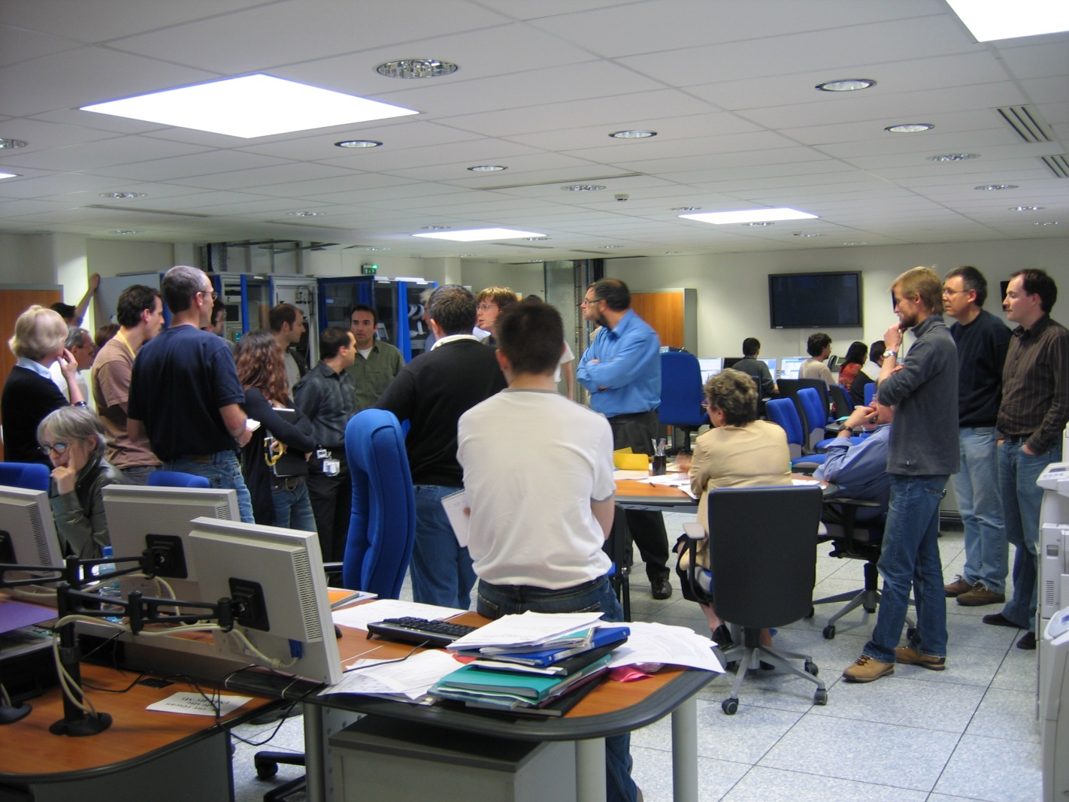


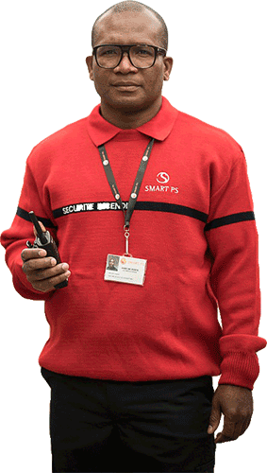




Layout of workspaces
Layout of the control room
Use of the control room before the pandemic
Access to the control room limited to 7 persons:
Operator and up to 3 persons during a shift
Up to 2 persons for
brief interactions
1 fire safety and first aid guard
Request to perform as many actions as possible remotely
PTO (Partial Time Operator) replaced by guards to limit the number of people in contact with the operator. Moreover some operators were not allowed to perform first aid actions anymore
6/19

Slide 7
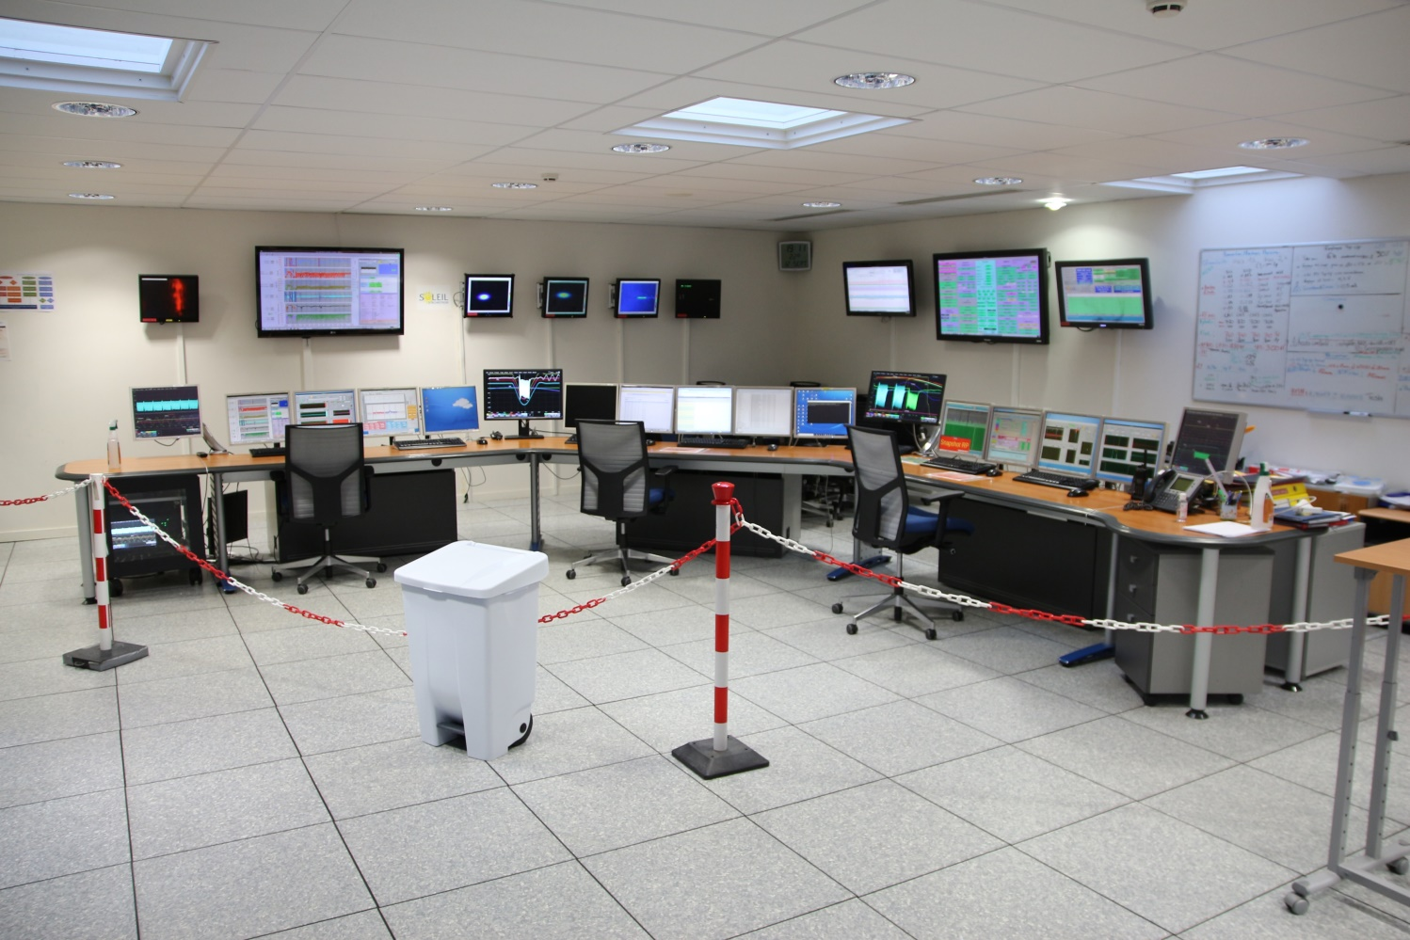
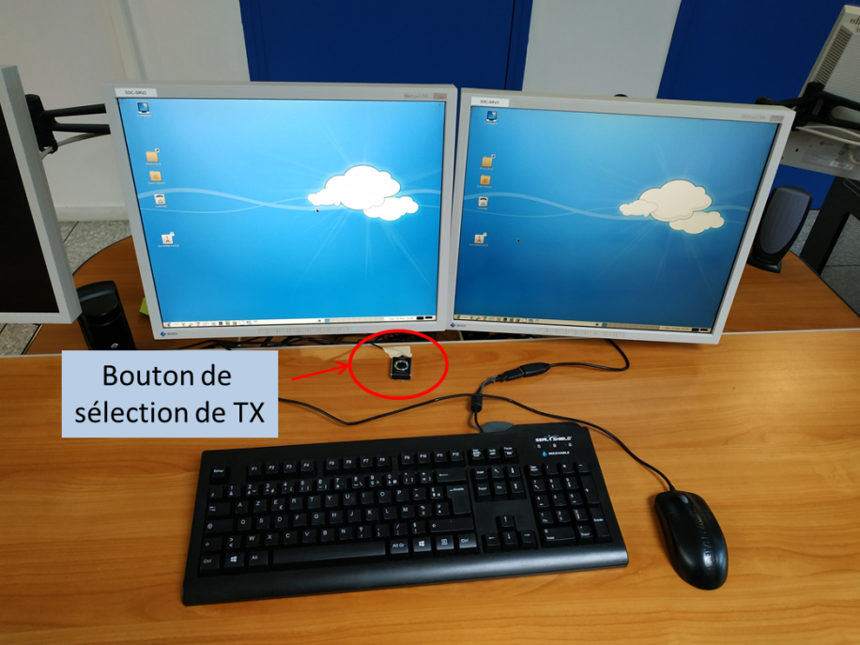
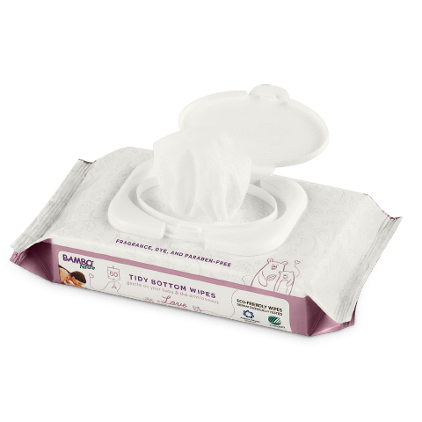
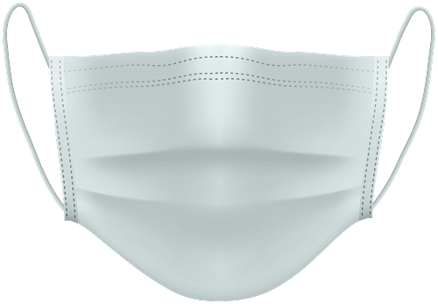
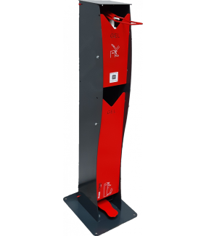
Layout of workspaces
Layout of the control room
Main desk
Limited seating (number divided by 3)
Sanitary equipments:
  Hydroalcoholic gel terminal
  Disinfectant wipes
  Surgical masks
  Special COVID-19 trash
Security barriers to restrict access only
to the operator
Tx switch
Mouse number divided by 2
More frequent cleaning 2 X /day
Broadcasting health instructions on the video network
7/19

Slide 8
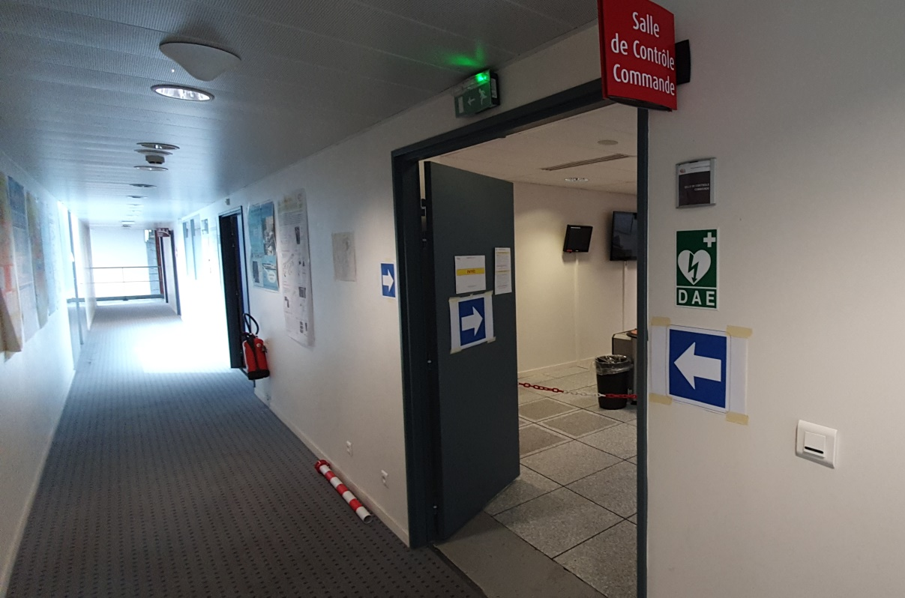
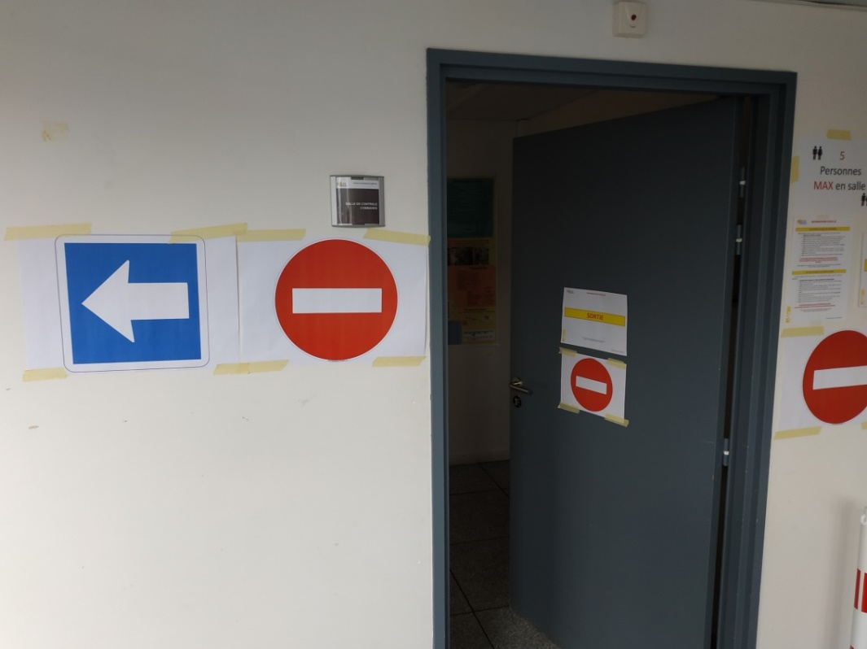
Layout of workspaces
Layout of the control room
Testing for a short time one traffic direction
Add traffic signs, safety signs
8/19

Slide 9
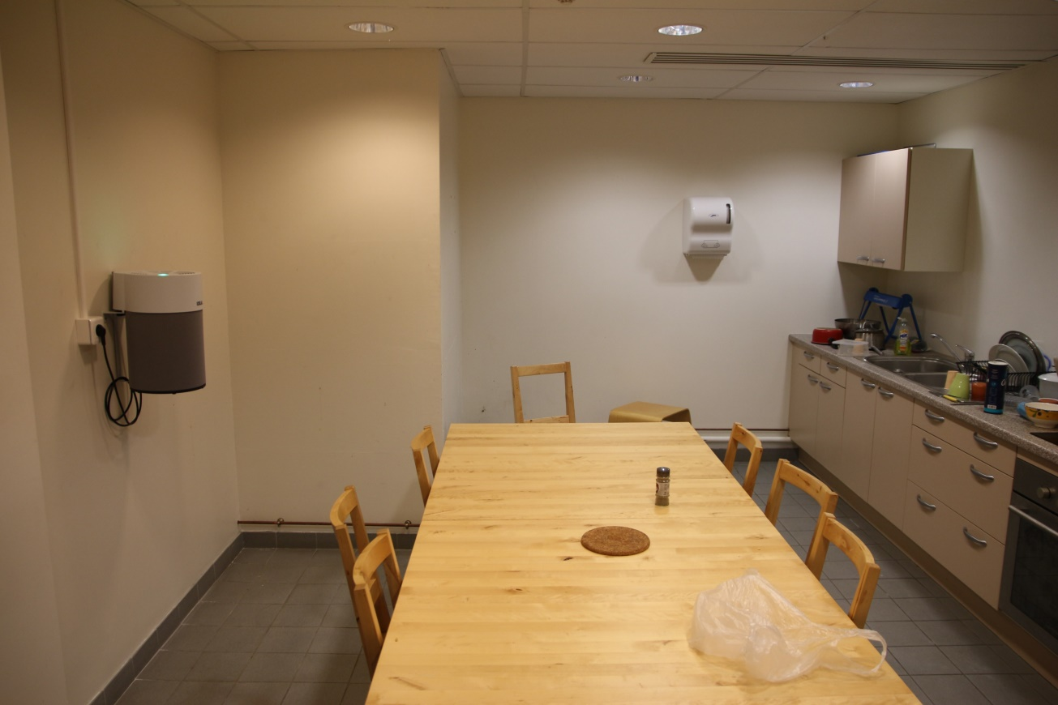
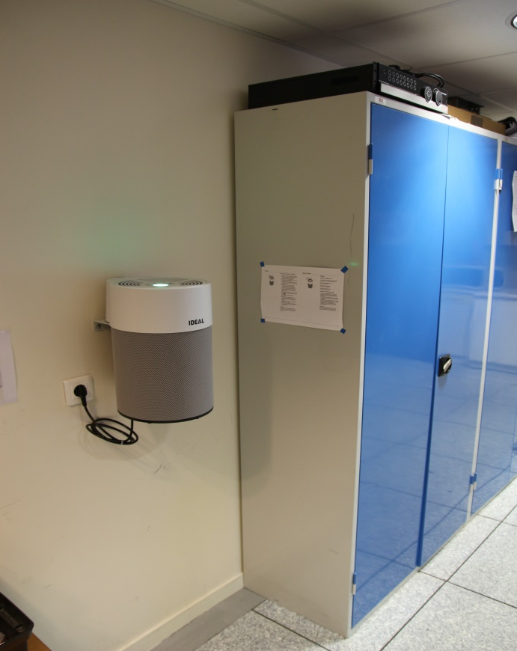
Layout of workspaces
Layout of the control room
Adding 2 air purifiers in 2 rooms used by operators and guards
8/19
Notes:
.

Slide 10
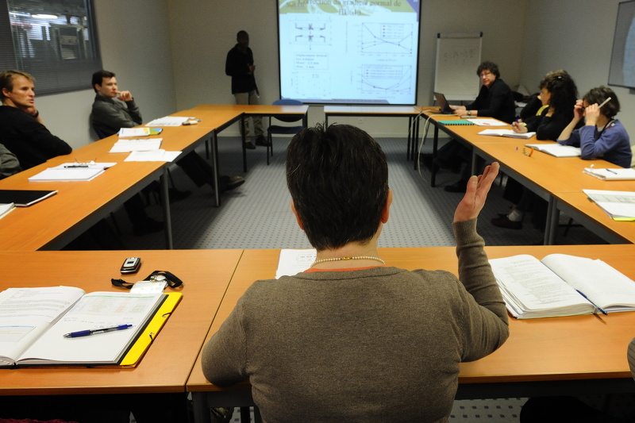
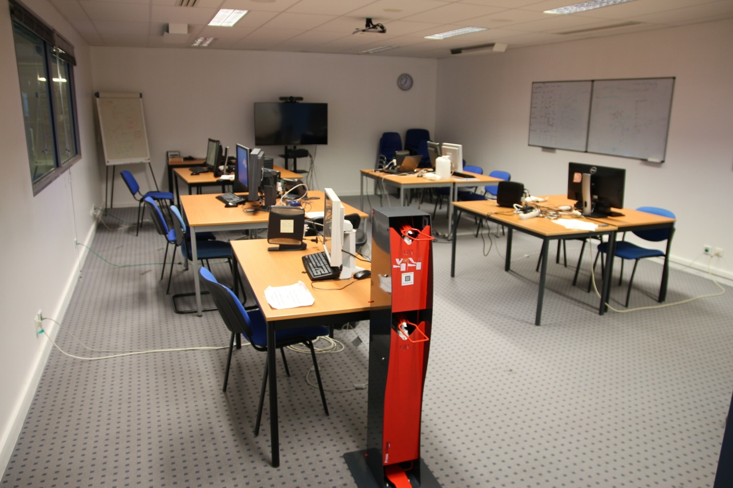
Layout of workspaces
Layout of the HELIOS meeting room
Access to the control room limited to 5 people
Promote remote connections and new communication tools
Before:
After:
9/19

Slide 11
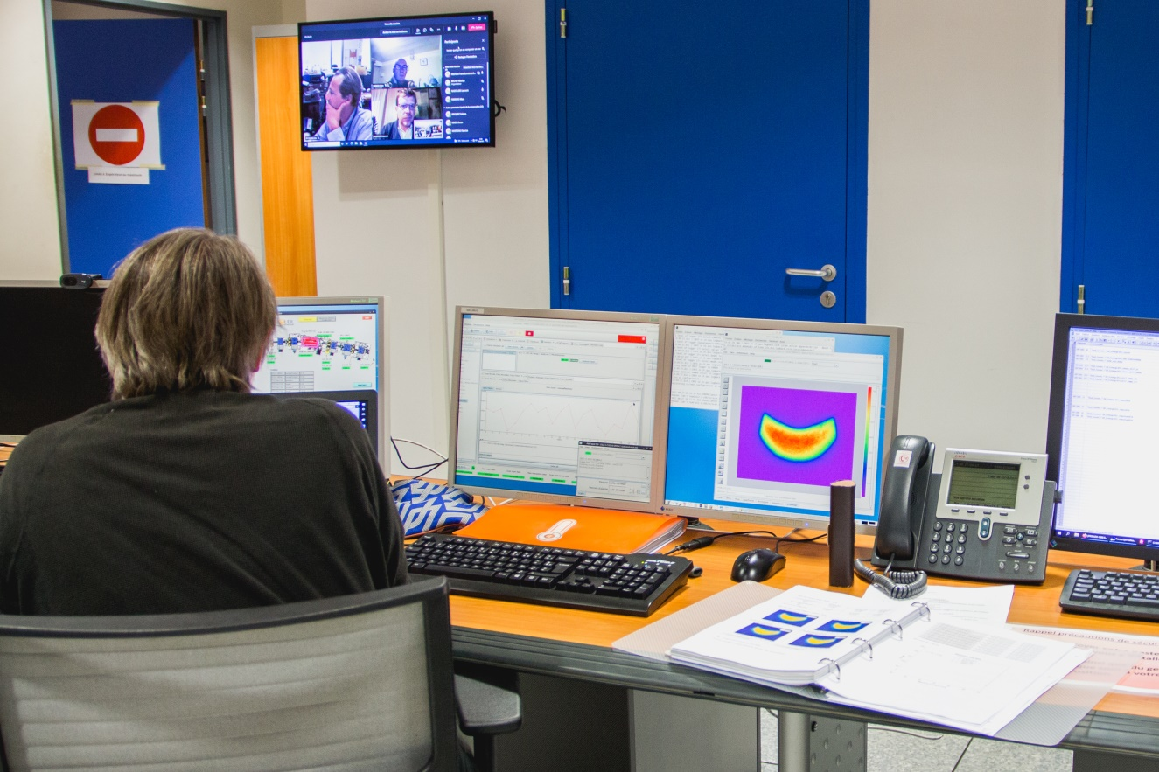
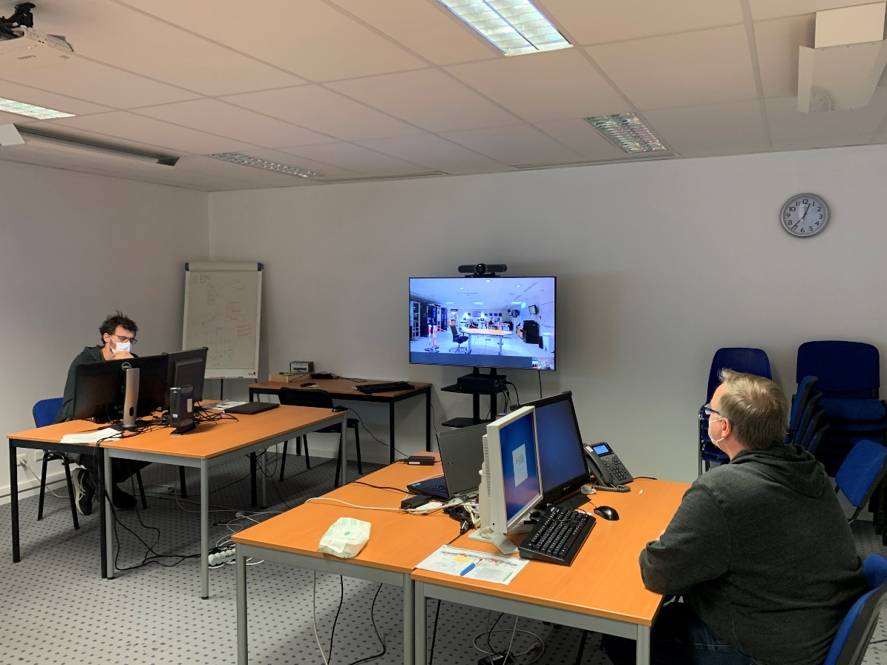
Layout of workspaces
Layout of the HELIOS meeting room
Videoconference between the 2 rooms as well as people at home and in the office
10/19

Slide 12

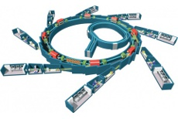


Organisation of the operation group
The group is made up of 8 operators and 2 engineers
(equiped with laptop PC or stationary PC from SOLEIL at home)
the manager and his assistant make sure to be on site at least one at the time
RUN PERIOD
SHUTDOWN PERIOD (operators in normal working hours)
1 operator in staggered working hours
1 main operator
(so-called room person -duty)
Each Monday, 1 operator in normal working hours
help the operator on site
1 operator in support
The Other operators (in normal working hours) work from home
The Other operators work from home
11/19

Slide 13
Organisation of the operation group
Operators Schedule
Operators
in staggered hours
Operators
in rest period
Operators working from home
lun 11/05/20 |  |  |  |  |  |  |  |  |  |  |  |  |  |  |  |  |  |  |  |  |  |  |  |  |  |  |  |  | CB |  | CT |  | GR |  | SG |  | TM |  | EP |  | DT |  | AB |  | YD
mar 12/05/20 |  |  |  |  |  |  |  |  |  |  |  |  |  |  |  |  |  |  |  |  |  |  |  |  |  |  |  |  | CB |  | CT |  | GR |  | SG |  | TM |  | EP |  | DT |  | AB |  | YD
mer 13/05/20 |  |  | EP |  |  |  |  |  |  |  |  |  |  |  |  |  |  |  |  |  |  |  |  |  |  |  |  |  | CB |  | CT |  | GR |  | SG |  | TM |  |  |  | DT |  | AB |  | YD
jeu 14/05/20 |  |  | EP |  |  |  |  |  |  |  |  |  |  |  |  |  |  |  |  |  |  |  |  |  |  |  |  |  | CB |  | CT |  | GR |  | SG |  | TM |  |  |  | DT |  | AB |  | YD
ven 15/05/20 |  |  |  |  |  |  |  |  |  |  |  |  |  |  |  |  |  |  |  |  |  |  |  |  |  |  |  |  | CB |  | CT |  | GR |  | SG |  | TM |  | EP |  | DT |  | AB |  | YD
sam 16/05/20 |  |  |  |  |  |  |  |  |  |  |  |  | CT |  | GR |  | SG |  | TM |  | EP |  | DT |  | AB |  | YD
dim 17/05/20 |  |  |  |  |  |  |  |  |  |  |  |  | CT |  | GR |  | SG |  | TM |  | EP |  | DT |  | AB |  | YD |  | 40 |  | 40 |  | 40 |  | 40 |  | 40 |  | 41 |  | 40 |  | 40 |  | 40
lun 18/05/20 |  |  |  |  |  |  |  |  |  |  |  |  |  |  |  |  |  |  |  |  |  |  |  |  |  |  |  |  | CB |  | CT |  | GR |  | SG |  | TM |  | EP |  | DT |  | AB |  | YD
mar 19/05/20 |  |  |  |  |  |  |  |  |  |  |  |  |  |  |  |  |  |  |  |  |  |  |  |  |  |  |  |  | CB |  | CT |  | GR |  | SG |  | TM |  | EP |  | DT |  | AB |  | YD
mer 20/05/20 |  |  |  |  |  |  |  |  |  |  |  |  |  |  |  |  |  |  |  |  |  |  |  |  | AB |  |  |  | CB |  | CT |  | GR |  | SG |  | TM |  | EP |  | DT |  |  |  | YD
jeu 21/05/20 |  |  | EP |  | SG |  |  |  |  |  | CT |  |  |  | GR |  |  |  | TM |  |  |  | DT |  |  |  | YD |  |  |  |  |  |  |  |  |  |  |  |  |  |  |  | AB
ven 22/05/20 | TM |  | AB |  | EP |  |  |  |  |  |  |  |  |  |  |  |  |  |  |  |  |  |  |  |  |  |  |  |  |  | CT |  | GR |  | SG |  |  |  |  |  | DT |  |  |  | YD
sam 23/05/20 | DT |  | YD |  | AB |  |  |  |  |  |  |  | CT |  | GR |  | SG |  | TM |  | EP
dim 24/05/20 | CB |  | YD |  | AB |  |  |  |  |  |  |  | CT |  | GR |  | SG |  | TM |  | EP |  | DT |  |  |  |  |  | 40,5 |  | 41 |  | 32 |  | 41 |  | 32 |  | 41,5 |  | 40 |  | 44 |  | 49
lun 25/05/20 | TM |  | SG |  | DT |  |  |  |  |  |  |  |  |  |  |  |  |  |  |  |  |  |  |  | AB |  |  |  |  |  | CT |  | GR |  |  |  |  |  | EP |  |  |  |  |  | YD
mar 26/05/20 | TM |  | EP |  | DT |  |  |  |  |  |  |  |  |  |  |  |  |  |  |  |  |  |  |  | AB |  |  |  |  |  | CT |  | GR |  | SG |  |  |  |  |  |  |  |  |  | YD
mer 27/05/20 | YD |  | TM |  | EP |  |  |  |  |  |  |  |  |  |  |  |  |  |  |  |  |  | DT |  |  |  |  |  | CB |  | CT |  | GR |  | SG |  |  |  |  |  |  |  | AB
jeu 28/05/20 | YD |  | AB |  | EP |  |  |  |  |  |  |  | CT |  |  |  |  |  |  |  |  |  | DT |  |  |  |  |  | CB |  |  |  | GR |  | SG |  | TM
ven 29/05/20 | GR |  | YD |  | SG |  |  |  |  |  |  |  | CT |  |  |  |  |  | TM |  | EP |  |  |  |  |  |  |  | CB |  |  |  |  |  |  |  |  |  |  |  | DT |  | AB
sam 30/05/20 | CT |  |  | TM |  |  |  |  |  |  |  |  |  |  | GR |  | SG |  |  |  | EP |  | DT |  | AB |  | YD
dim 31/05/20 | CT |  |  | TM |  |  |  |  |  |  |  |  |  |  | GR |  | SG |  |  |  | EP |  | DT |  | AB |  | YD |  | 25 |  | 47,5 |  | 40 |  | 38,5 |  | 49,75 |  | 34,5 |  | 26 |  | 31 |  | 41,25
lun 01/06/20 | AB |  | SG |  | GR |  |  |  |  |  |  |  | CT |  |  |  |  |  | TM |  | EP |  | DT |  |  |  | YD
mar 02/06/20 | AB |  | CT |  | GR |  |  |  |  |  |  |  |  |  |  |  |  |  | TM |  |  |  |  |  |  |  |  |  |  |  |  |  |  |  | SG |  |  |  | EP |  | DT |  |  |  | YD
mer 03/06/20 | SG |  | EP |  | CT |  |  |  |  |  |  |  |  |  | GR |  |  |  |  |  |  |  |  |  | AB |  |  |  |  |  |  |  |  |  |  |  | TM |  |  |  | DT |  |  |  | YD
jeu 04/06/20 | SG |  | EP |  | CT |  |  |  |  |  |  |  |  |  | GR |  |  |  |  |  |  |  |  |  |  |  |  |  | CB |  |  |  |  |  |  |  | TM |  |  |  | DT |  | AB |  | YD
ven 05/06/20 | TM |  | SG |  | EP |  |  |  |  |  |  |  | CT |  |  |  |  |  |  |  |  |  |  |  |  |  |  |  | CB |  |  |  | GR |  |  |  |  |  |  |  | DT |  | AB |  | YD
sam 06/06/20 | GR |  |  | AB |  |  |  |  |  |  |  |  | CT |  |  |  | SG |  | TM |  | EP |  | DT |  |  |  | YD
dim 07/06/20 | GR |  |  | AB |  |  |  |  |  |  |  |  | CT |  |  |  | SG |  | TM |  | EP |  | DT |  |  |  | YD |  | 42,25 |  | 26,5 |  | 49,5 |  | 41,75 |  | 30,25 |  | 35 |  | 32 |  | 49,25 |  | 32
lun 08/06/20 | DT |  | CT |  | TM |  |  |  |  |  |  |  |  |  | GR |  |  |  |  |  |  |  |  |  | AB |  |  |  |  |  |  |  |  |  | SG |  |  |  | EP |  |  |  |  |  | YD
mar 09/06/20 | DT |  | GR |  | TM |  |  |  |  |  |  |  |  |  |  |  |  |  |  |  |  |  |  |  | AB |  |  |  |  |  | CT |  |  |  | SG |  |  |  | EP |  |  |  |  |  | YD
mer 10/06/20 | CT |  | DT |  | GR |  |  |  |  |  |  |  |  |  |  |  |  |  | TM |  |  |  |  |  |  |  |  |  | CB |  |  |  |  |  | SG |  |  |  | EP |  |  |  | AB |  | YD
jeu 11/06/20 | EP |  | DT |  | GR |  |  |  |  |  |  |  |  |  |  |  |  |  | TM |  |  |  |  |  |  |  |  | YD |  |  | CT |  |  |  | SG |  |  |  |  |  |  |  | AB |  | YD
ven 12/06/20 | EP |  | SG |  | DT |  |  |  |  |  |  |  |  |  | GR |  |  |  | TM |  |  |  |  |  |  |  | YD |  |  |  | CT |  |  |  |  |  |  | TM |  |  |  |  | AB
sam 13/06/20 | TM |  |  | YD |  |  |  |  |  |  |  |  | CT |  | GR |  | SG |  |  |  | EP |  | DT |  | AB
dim 14/06/20 | TM |  |  | YD |  |  |  |  |  |  |  |  | CT |  | GR |  | SG |  |  |  | EP |  | DT |  | AB |  |  |  | 30,25 |  | 40,5 |  | 26,5 |  | 41,25 |  | 45,5 |  | 40 |  | 43 |  | 26,25 |  | 45,25
lun 15/06/20 | CT |  | DT |  | AB |  |  |  |  |  |  |  |  |  |  |  |  |  | TM |  |  |  |  |  |  |  | YD |  |  |  |  |  | GR |  | SG |  |  |  | EP
mar 16/06/20 | CT |  | DT |  | AB |  |  |  |  |  |  |  |  |  |  |  |  |  |  |  |  |  |  |  |  |  | YD |  |  |  |  |  | GR |  | SG |  | TM |  | EP
mer 17/06/20 | TM |  | CT |  | DT |  |  |  |  |  |  |  |  |  |  |  |  |  |  |  |  |  |  |  | AB |  |  |  |  |  |  |  | GR |  | SG |  |  |  | EP |  |  |  |  |  | YD
jeu 18/06/20 | TM |  | CT |  | DT |  |  |  |  |  |  |  |  |  |  |  |  | SG |  |  |  |  |  |  | AB |  |  |  |  |  |  |  | GR |  | SG |  |  |  | EP |  |  |  |  |  | YD
ven 19/06/20 | YD |  | GR |  | CT |  |  |  |  |  |  |  |  |  |  |  | SG |  |  |  |  |  | DT |  | AB |  |  |  | CB |  |  |  |  |  |  |  | TM |  | EP |  |  |  |  | AB
sam 20/06/20 | AB |  |  | SG |  |  |  |  |  |  |  |  | CT |  | GR |  |  |  | TM |  | EP |  | DT |  |  |  | YD
dim 21/06/20 | AB |  |  | SG |  |  |  |  |  |  |  |  | CT |  | GR |  |  |  | TM |  | EP |  | DT |  |  |  | YD |  | 45,5 |  | 43 |  | 41,25 |  | 45,25 |  | 32 |  | 40 |  | 35 |  | 45,5 |  | 30,25
lun 22/06/20 | GR |  | CT |  | YD |  |  |  |  |  |  |  |  |  |  |  | SG |  |  |  |  |  | DT |  | AB |  |  |  |  |  |  |  |  |  |  |  | TM |  | EP
mar 23/06/20 | GR |  | AB |  | YD |  |  |  |  |  |  |  |  |  |  |  | SG |  |  |  |  |  |  |  |  |  |  |  |  |  | CT |  |  |  |  |  | TM |  | EP |  | DT
mer 24/06/20 | CT |  | GR |  | AB |  |  |  |  |  |  |  |  |  |  |  |  |  |  |  |  |  |  |  |  |  | YD |  |  |  |  |  |  |  | SG |  | TM |  | EP |  | DT
jeu 25/06/20 | CT |  | DT |  | AB |  |  |  |  |  |  |  |  |  |  |  |  |  |  |  |  | EP |  |  |  |  | YD |  |  |  |  |  | GR |  | SG |  | TM |  | EP
ven 26/06/20 | SG |  | DT |  | CT |  |  |  |  |  |  |  |  |  |  |  |  |  |  |  | EP |  |  |  | AB |  | YD |  |  |  |  |  | GR |  |  |  | TM |  |  |  |  |  |  |  |  | YD
sam 27/06/20 | YD |  |  | EP |  |  |  |  |  |  |  |  | CT |  | GR |  | SG |  | TM |  |  |  | DT |  | AB
dim 28/06/20 | YD |  |  | EP |  |  |  |  |  |  |  |  | CT |  | GR |  | SG |  | TM |  |  |  | DT |  | AB |  |  |  | 26,5 |  | 42,5 |  | 40,5 |  | 30,25 |  | 40 |  | 45,25 |  | 33,75 |  | 26,5 |  | 45,5
lun 29/06/20 | TM |  | GR |  | SG |  |  |  |  |  |  |  |  |  |  |  |  |  |  |  | EP |  |  |  |  |  | YD |  |  |  | CT |  |  |  |  |  |  |  |  |  | DT |  | AB
mar 30/06/20 | YD |  | TM |  | SG |  |  |  |  |  |  |  |  |  |  |  |  |  |  |  | EP |  |  |  |  |  |  |  | CB |  | CT |  | GR |  |  |  |  |  |  |  | DT |  | AB
mer 01/07/20 | GR |  | TM |  | YD |  |  |  |  |  |  |  |  |  |  |  | SG |  |  |  |  |  |  |  |  |  |  |  | CB |  | CT |  |  |  |  |  |  |  | EP |  | DT |  | AB
jeu 02/07/20 | GR |  | AB |  | YD |  |  |  |  |  |  |  |  |  |  |  | SG |  |  |  |  |  |  | DT |  |  |  |  | CB |  | CT |  |  |  |  |  | TM |  | EP |  | DT
ven 03/07/20 | EP |  | GR |  | TM |  |  |  |  |  |  |  |  |  |  |  | SG |  |  |  |  |  | DT |  |  |  | YD |  | CB |  | CT |  |  |  |  | SG |  |  |  |  |  |  | AB
For the first 6 weeks of takeover only one operator was at SOLEIL. The Work From Home rate was about 65%
12/19

Slide 14
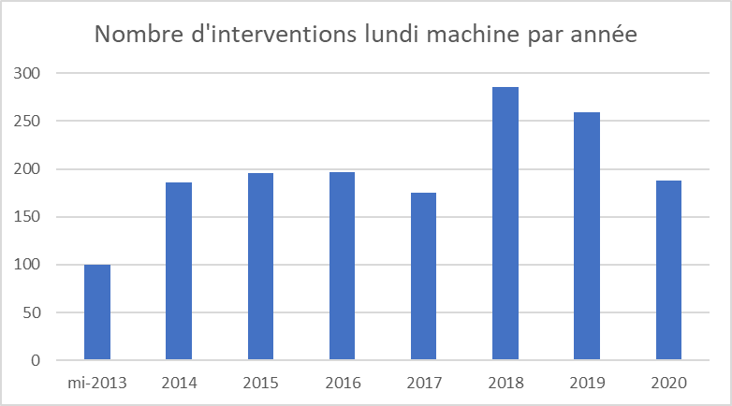

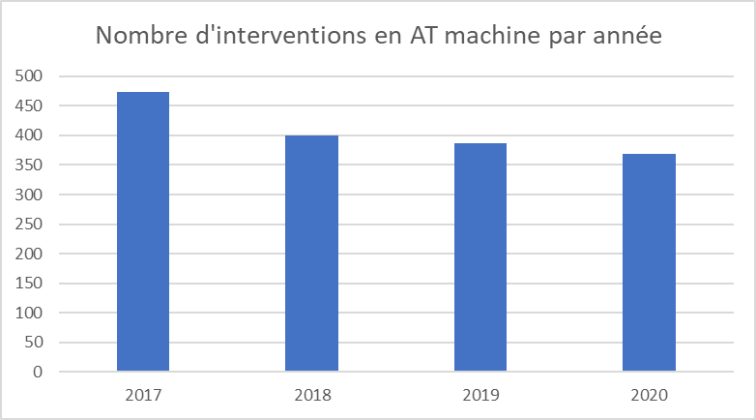
Organisation of short weekly interventions and machine shutdowns
Adapt the machine schedule to limit the interaction in the control room and into the tunnels :
Before: all interventions started at the same time
Number of short weekly interventions per year
Now: extension of intervention schedules and time slot defined for each intervention
14:45
14:15
13:45
13:30
13:00
Number of interventions for the machine shutdowns per year
Reducing the work interaction and concurrent works
New work scheduling and precise task sequencing
Increase of the allocated time whenever possible in staggered hours
13/19

Slide 15




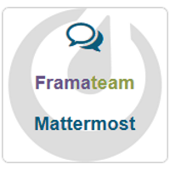

IT ressources used
Hardware and software
Installation of cameras to communicate between the 2 rooms as well as people at home and in the office
Use of Microsoft TEAMS :
to communicate with call and videoconference
to share projects, files
to assign tasks
to discuss with oncall people and phycisists during a shift
Use Pulse Secure to VPN access
Use No Machine or MobaXterm to access machine network
Possibility to control all the equipments of the machine
Temporary use of:
14/19

Slide 16
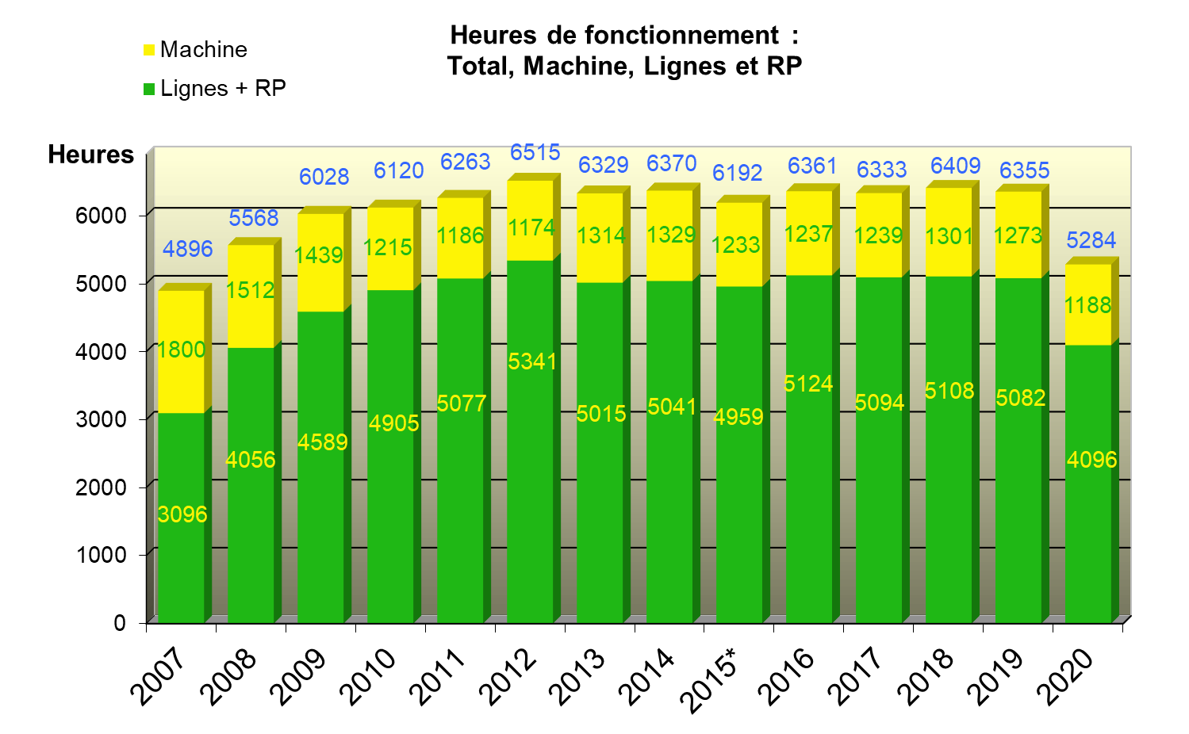
Balance sheet 2020 – statistics
Operating time:
Total, machine, beamline + RP
Machine
beamline + RP
hours
15/19

Slide 17
Balance sheet 2020 – statistics
4th best year of beamline availability
16/19

Slide 18
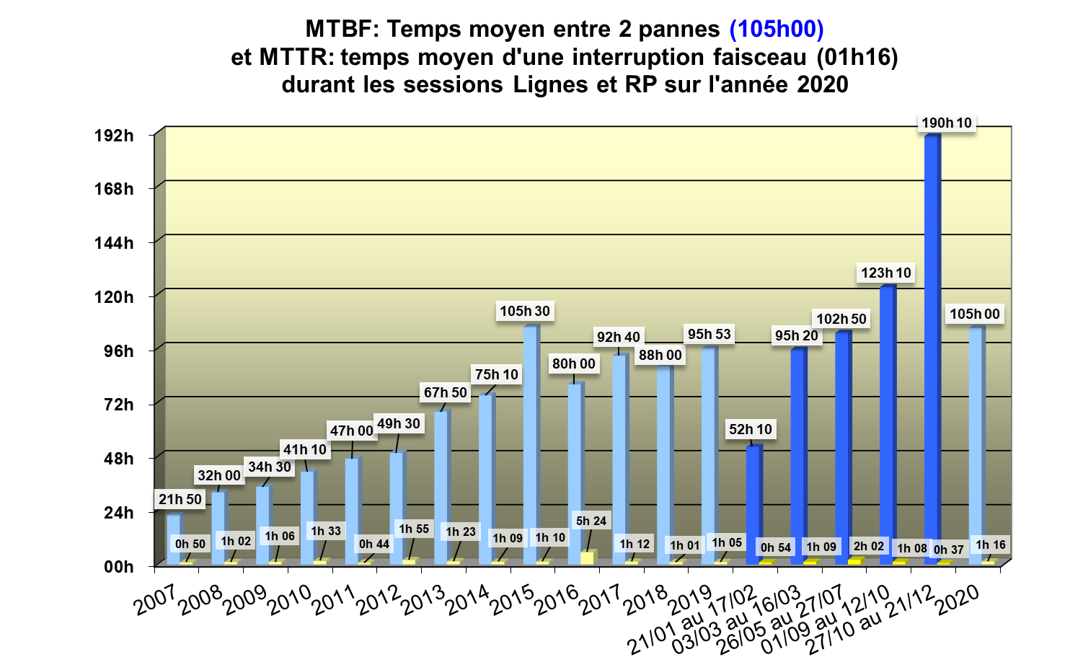
Balance sheet 2020 – statistics
MTBF: Mean Time Between Failure (105h00)
And MTTR: Mean Time To Repair (01h16)
during beamlines and RP sessions in 2020
16/19

Slide 19
Conclusion
  Evolution of Work From Home : decreasing
  Until 2021 september 7, maximum of Work From Home
À partir du 7 septembre
From september 7 | From october 20 | From november 8
2 days on site at least per week (3 days of WFH maximum) | 3 days on site at least per week (2 days of WFH maximum) | 4 days on site at least per week (1 days of WFH maximum)
  Setting up a hybrid meeting (face to face and visio)
Maintaining Social Distancing (Avoid Close Contact., etc.)
Maintain Good Hygiene Practices (hand washing, touchless greetings etc.)
Clean and disinfect frequently touched objects and surfaces in personal workspace and shared equipment
Face covering policy
  Number of people in rooms is still limited
17/19

Slide 20
Conclusion
  opening access to the machine network outside the control room did not introduce any major additional incidents
  Since the reopenning, despite the Work From Home and health constraints on SOLEIL, performances and beam availability were not impacted
  Using the Microsoft teams software with on-call duty (live video of the equipment failure) saves time for troubleshooting
  additional ideas for control room upgrade
18/19

Slide 21


Thanks
  for your attention
Thanks to the contributors:
Jean-François LAMARRE
Xavier DELETOILLE
Laurent NADOLSKI
19/19

