Slide 1
Controls in the Time of Covid
Ian Blackler
October 8th 2021

Slide 2
A.K.A. One Hundred Years of Quarantine
Ian Blackler
October 8th 2021

Slide 3
Quick Summary
What made our situation unique—or at least unusual?
What that meant we could do.
What we still couldn’t do.
What changes we made (mostly Controls/Software-based) to respond to Covid.
What we’re going to keep, what we’re going to drop, and what we wish we already had.
<number>

Slide 4
BNL C-AD: A Quick Overview
Three pre-injectors, three rings (including RHIC) and a fixed-target line. Hundreds of full-time staff.
Then everybody went home. But, we have something very few other labs have: Anybody can touch anything if they can log in.
Obviously this lends itself very well to mass remote operations, but as they say “With great power comes great responsibility.”
<number>

Slide 5
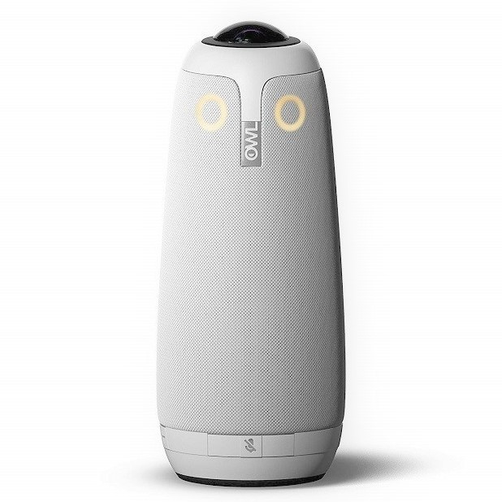
Physical Upgrades
Our standard NX servers were not sufficient for the new Covid load.
We introduced a new “Load Balanced” toplogy.
6 new machines: 384Gb RAM, 16 core/32 thread CPUs.
5 old machines: 92Gb RAM, 24 thread CPUs.
Once set up, no extra man power.
But would people switch? About 50% so far.
Also:
Call forwarding. Ergonomic chairs for all. Mic’d headsets for the MCR. And an OWL.
<number>

Slide 6
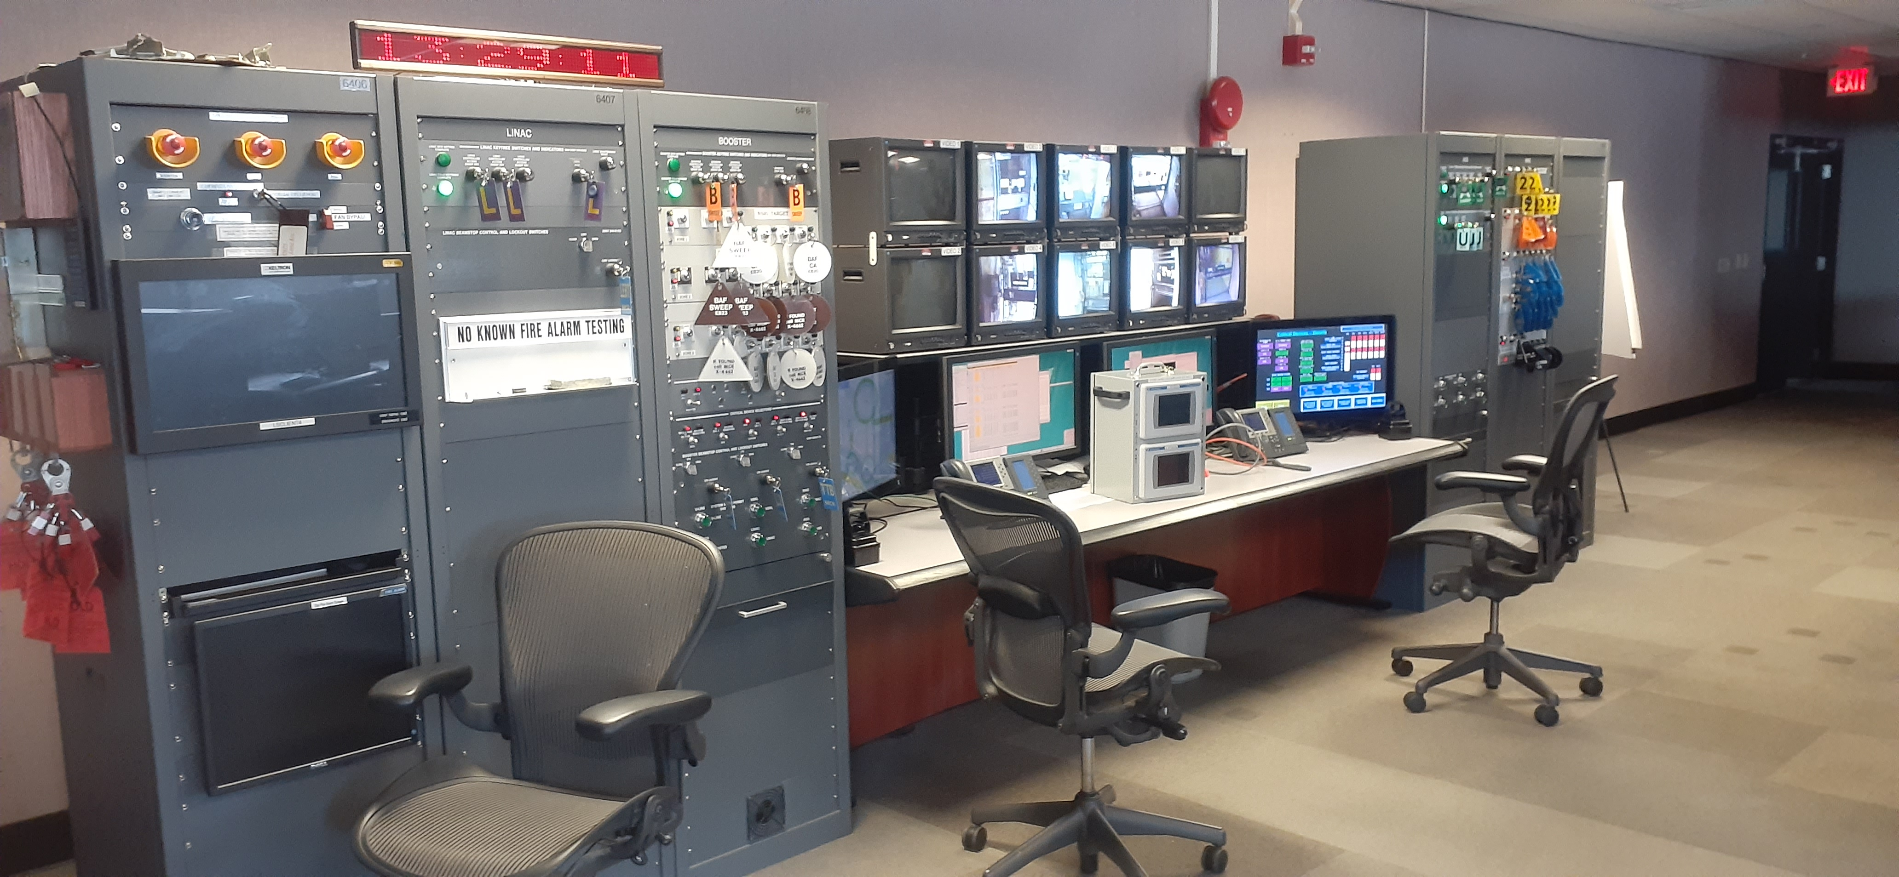
A Backup Control Room?
With radios, call-forwarding, and an open controls system, a backup Control Room looked like a possibility.
Ideal if the MCR became contaminated.
Just one small hitch:
Access Controls and Fire
Alarms cannot be rerouted
both physically and by
regulation.
(But we did put up a sign.)
<number>

Slide 7
Unlimited Power
Since anyone can do nearly anything when logged in, we need specific controls and procedures to account for that.
Luckily we have this:
And this:
That may seem woefully inadequate, but it’s been sufficient for us.
Now that everyone is remote—and actively banned from the Main Control Room—we need a little more.
<number>

Slide 8
When the Rogues go Rogue
Aborting a store by inserting a YAG or a diamond detector.
Running a bayesian optimisation script.
Less severe things like:
Tweaking collimators and other beamline components.
Tuning sources.
Updating settings.
Far, far more than we anticipated.
“Those that respect the law and love sausage should watch neither being made.” ~ Mark Twain
<number>

Slide 9
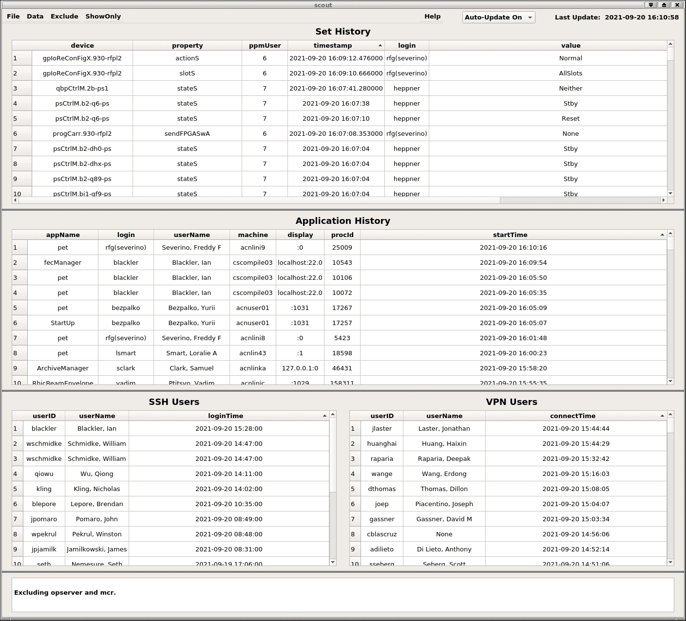
Mitigation—Leveraging the tools we have, and building on them
Every setting made in the Controls system is saved and timestamped. We also keep the login, process ID, hostname, etc.
Great for post-mortem diagnosis, but cannot stop anything proactively.
Developed an app for monitoring:
Logins, settings, and applications
Not enough:
Process kill and user kill commands.
Still not enough...
<number>

Slide 10
The Rogues’ Gallery
Not these guys.
<number>

Slide 11
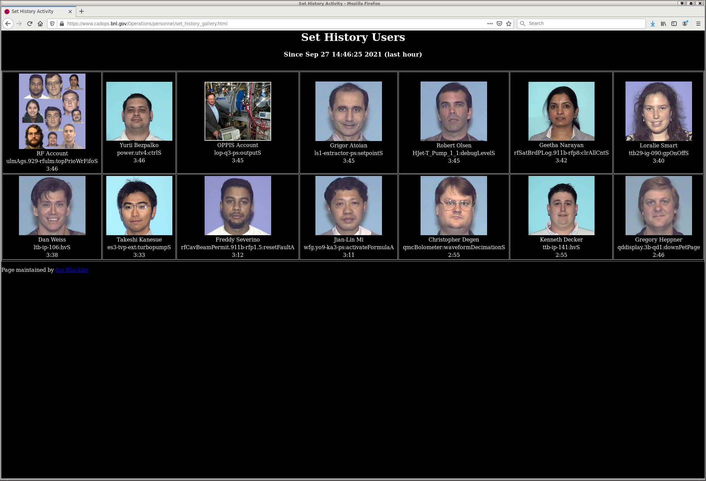
The Rogues’ Gallery
These guys.
A manager scans the database for users’ last settings.
Formatted and displayed with mugshots.
A new version has uid and pid.
<number>

Slide 12
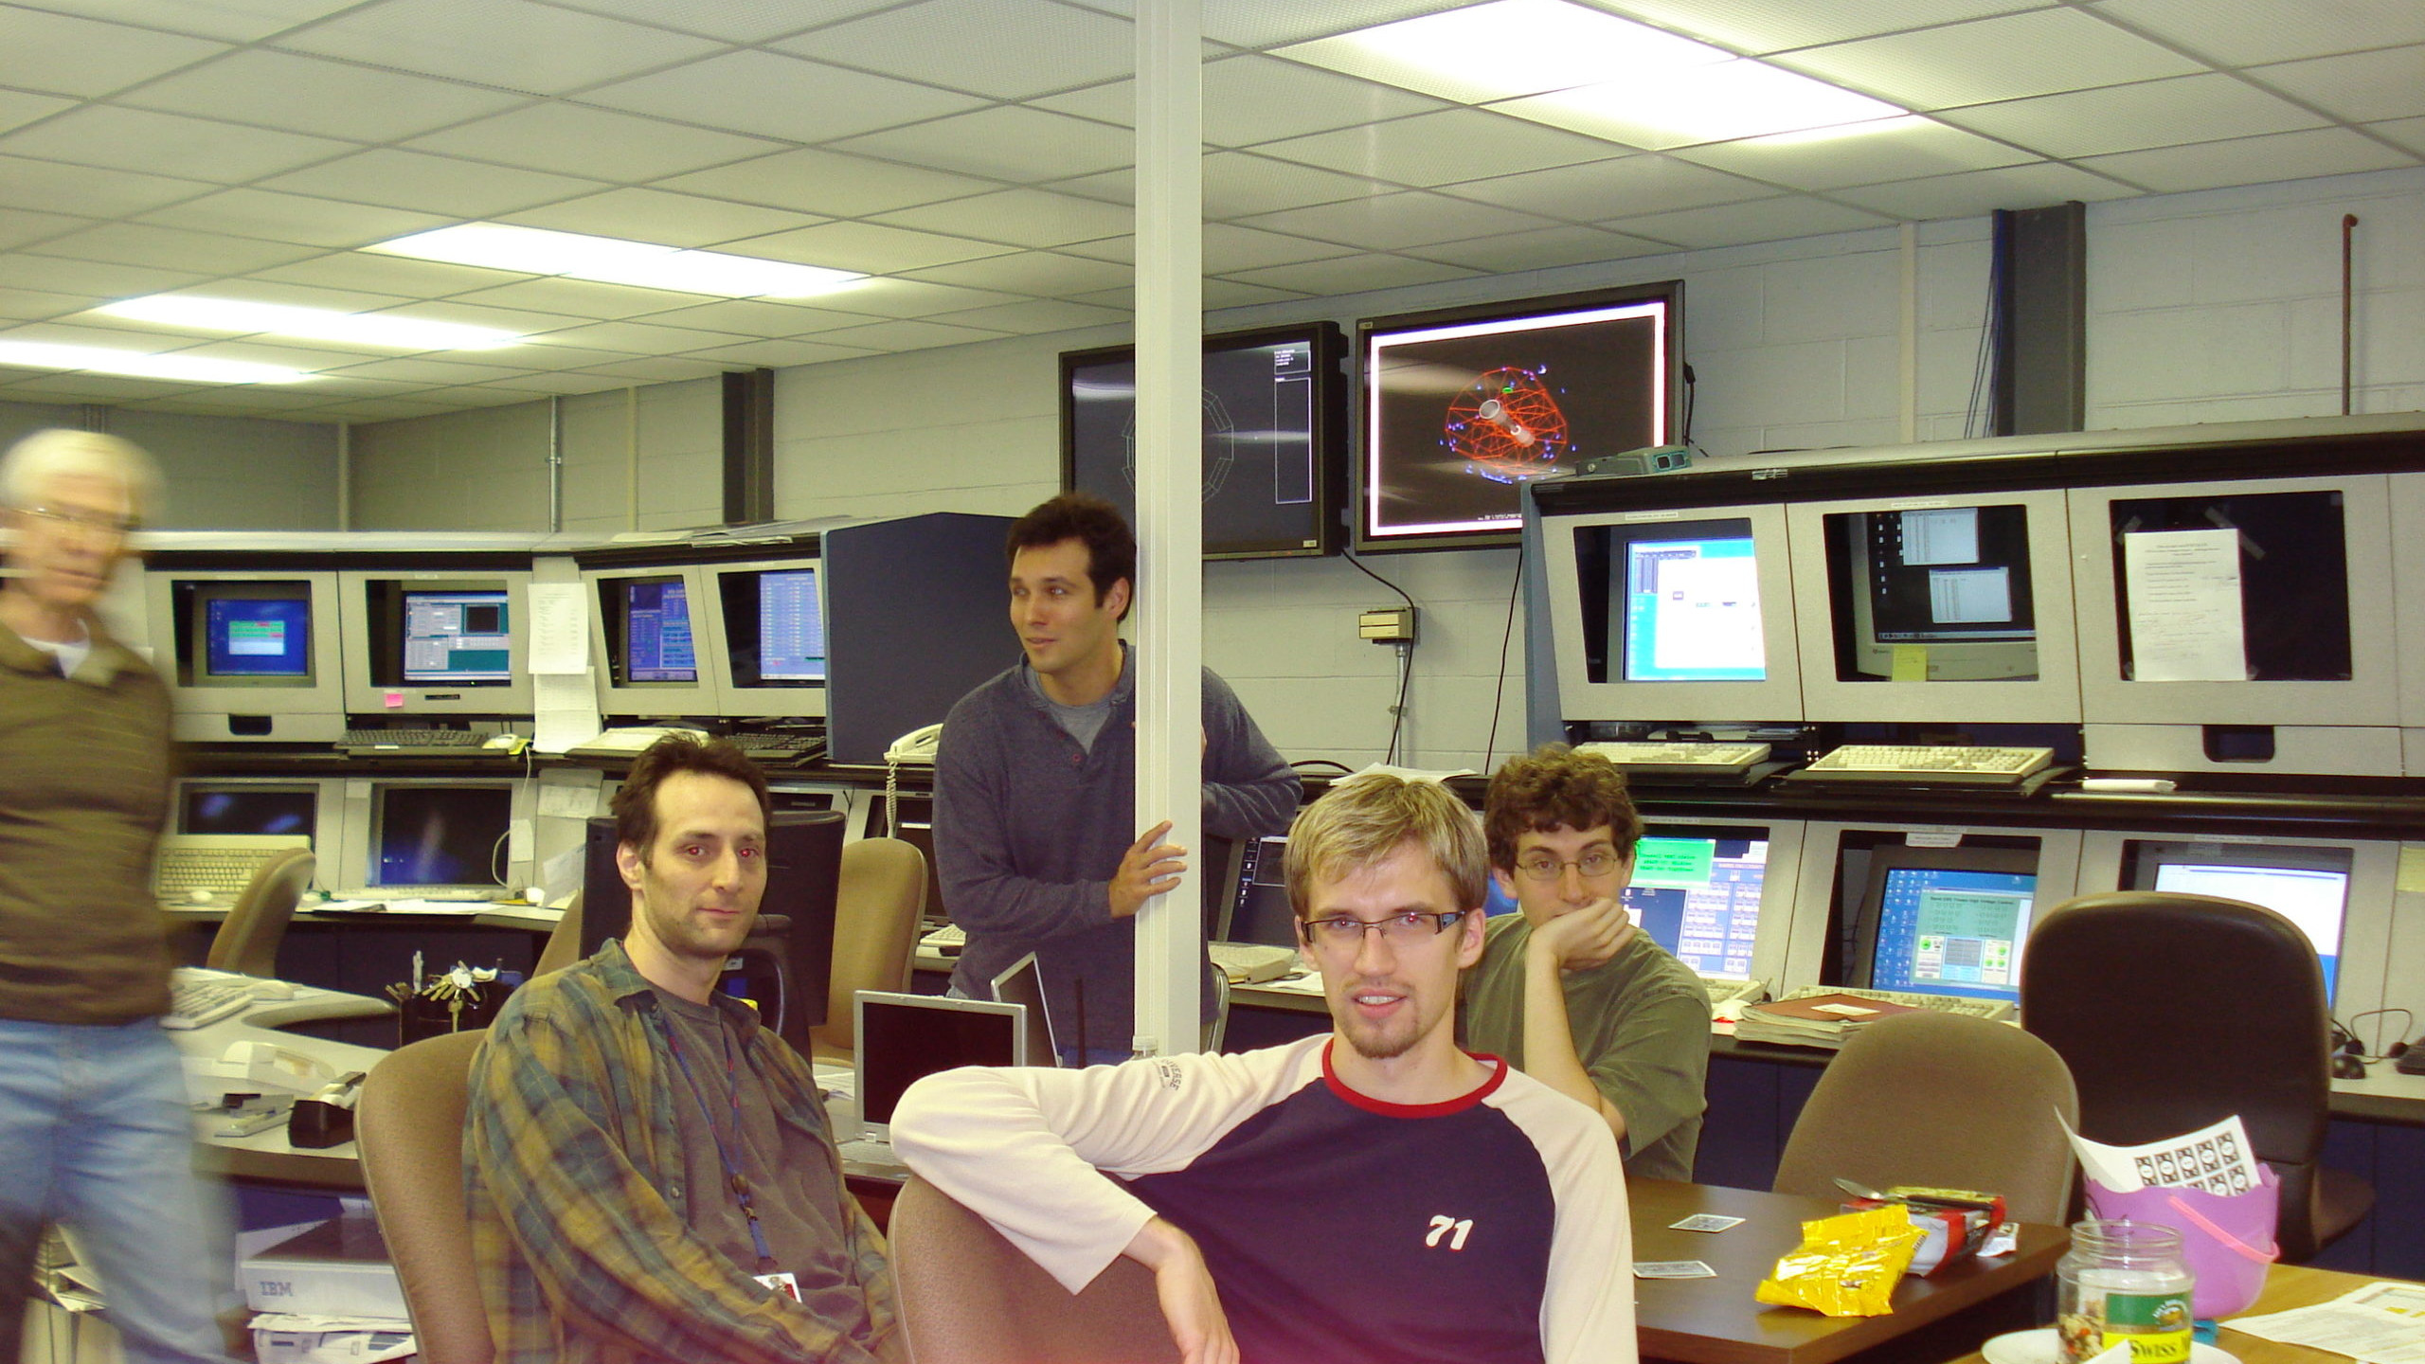
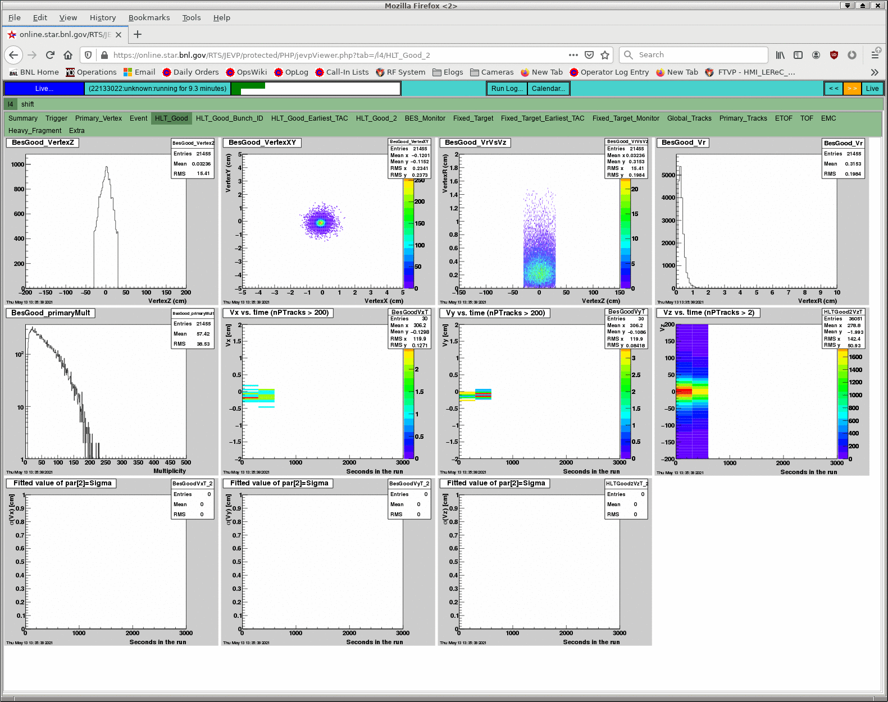
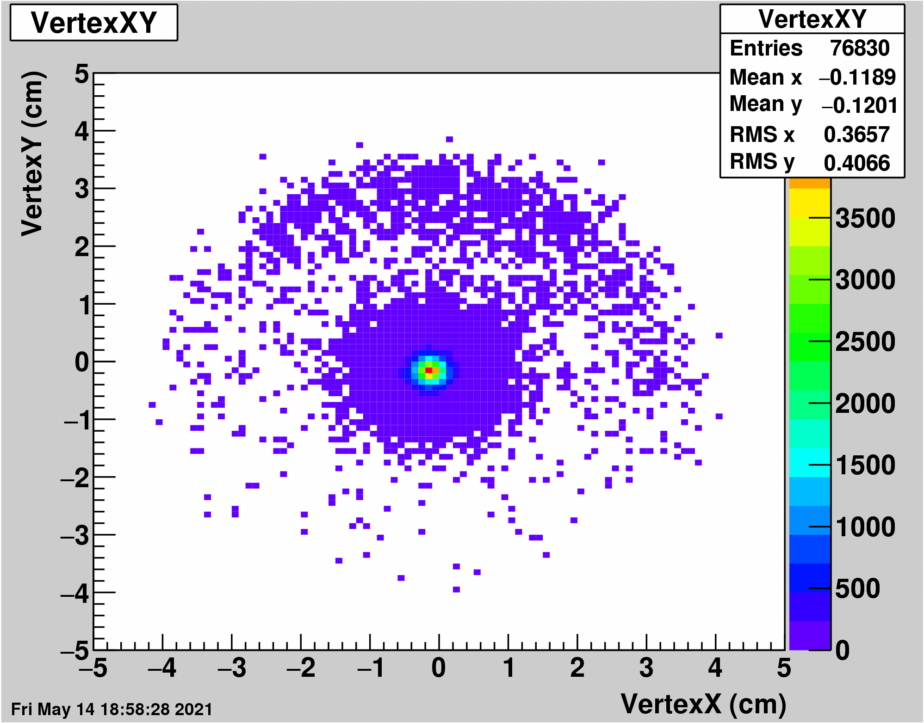
The Other End of the Beampipe
Face-to-face meetings were often the best for more subtle problems. Now completely off the table.
Zoom was formally designated for new communications, but Teams chat with senior physicists was often the go-to.
Extra information from online data proved very helpful:
<number>

Slide 13
Intra-Group Communications
Face-to-Face in the MCR/office/meeting room has always been one of the gold standards. Now it’s off the table.
Initial choices were between Bluejeans (already in use), Zoom (new and untested), MS Teams (also new), and Skype (who?)
Bluejeans was not remotely up to the task, Zoom seemed okay but struggled in our Linux environment. MS Teams took the crown, with Zoom becoming popular for meetings. Nobody seems to know what happened to Skype.
With all the typing in Teams chats, elogs became neglected. People not in particular channels missed information, searching for information was much harder, etc, etc.
<number>

Slide 14
Shift work
Week | Day | Day Shift | Owl Shift |  | Week | Day | Day Shift | Owl Shift |  | Week | Day | Day Shift | Owl Shift
1 | Mon |  |  |  | 3 | Mon |  |  |  | 5 | Mon
 | Tue |  |  |  |  | Tue |  |  |  |  | Tue
 | Wed |  |  |  |  | Wed |  |  |  |  | Wed
 | Thu |  |  |  |  | Thu |  |  |  |  | Thu
 | Fri |  |  |  |  | Fri |  |  |  |  | Fri
 | Sat |  |  |  |  | Sat |  |  |  |  | Sat
 | Sun |  |  |  |  | Sun |  |  |  |  | Sun
2 | Mon |  |  |  | 4 | Mon |  |  |  | 6 | Mon
 | Tue |  |  |  |  | Tue |  |  |  |  | Tue
 | Wed |  |  |  |  | Wed |  |  |  |  | Wed
 | Thu |  |  |  |  | Thu |  |  |  |  | Thu
 | Fri |  |  |  |  | Fri |  |  |  |  | Fri
 | Sat |  |  |  |  | Sat |  |  |  |  | Sat
 | Sun |  |  |  |  | Sun |  |  |  |  | Sun
To minimise crew overlaps and the risk of quarantining multiple crews at once, we moved to a synchronised 12-hour shift rotation.
3 on, 7 off, 4 on, 7 off.
6 teams cover all of the shifts over 6 weeks.
<number>

Slide 15
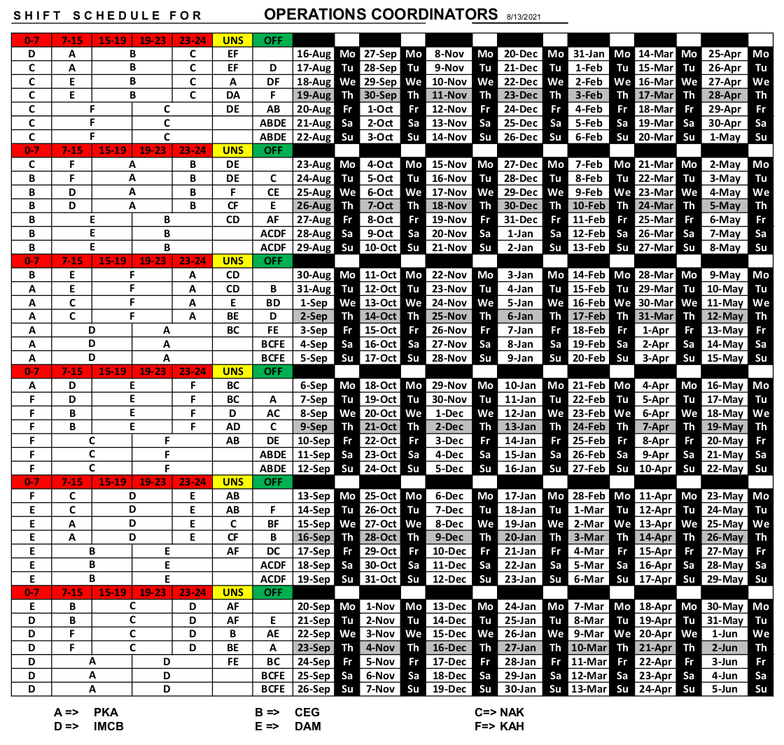
Shift work revert
The new rotation has become too arduous for some, so we are reverting.
The old schedule is a blend of 8 and 12-hour shifts.
It’s less complicated than it looks, but not by much.
<number>

Slide 16
Concluding
Almost everything you saw, we’re keeping, but we also want a few more changes…
Docusign or equivalents. We are all surprised we took so long on this one.
A more coherent directory of call-in information.
12-hour shifts are going away. They caused far too much burnout.
Teams meetings and chat will be reduced. Too much information was lost.
We’re all still a little scared of the owl, so the jury is out on that one.
Assuming we return to “normal” “soon.”
<number>

