Slide 1
Status of the ESS
Plans for operation and impact of COVID
PRESENTED BY Marc Munoz, on behalf of the ESS Team

Slide 2
Agenda
1 ESS status
2 Impact of COVID
3 Creating the Operations organization
4 Conditioning and Commissioning

Slide 3
1
ESS Status

Slide 4
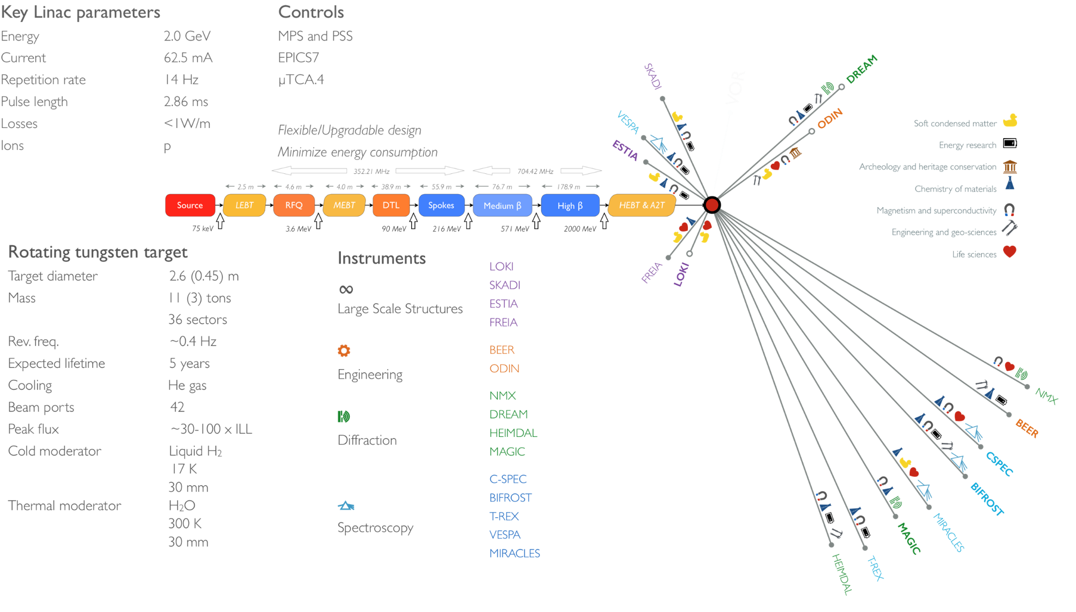
ESS at a Glance

Slide 5
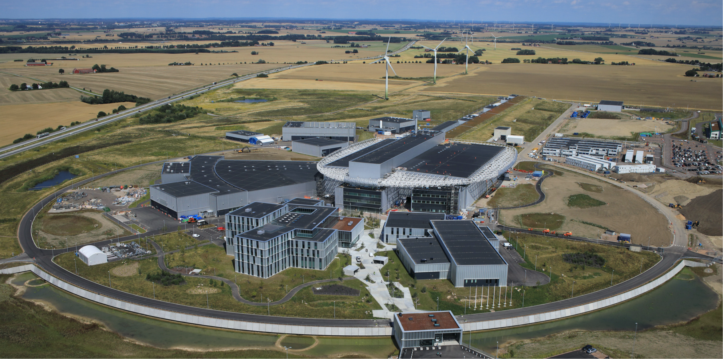
ESS Site

Slide 6
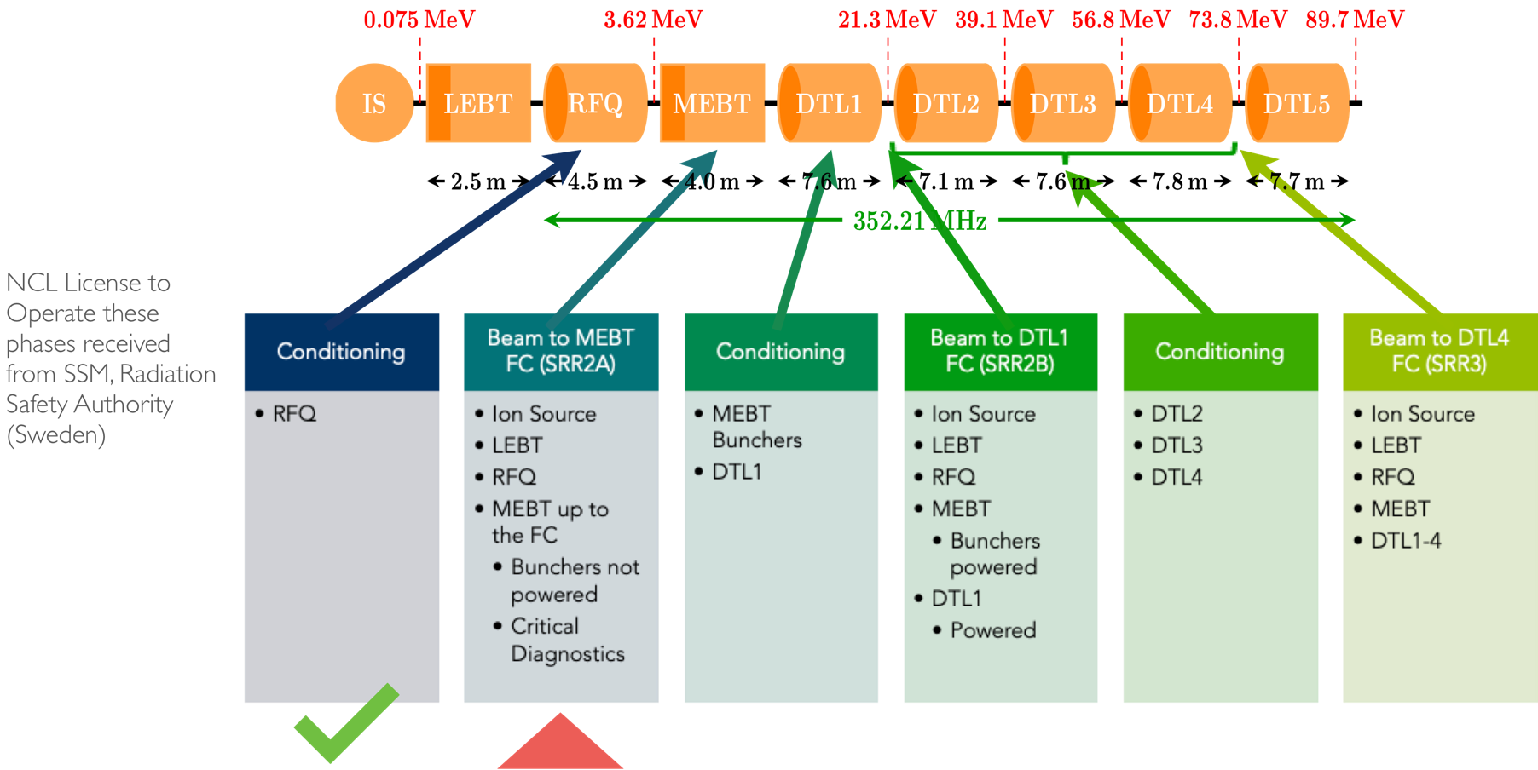
Next steps: Installation and Commissioning

Slide 7
2
Impact of COVID

Slide 8
COVID development in Sweden
Source Johns Hopkins University

Slide 9
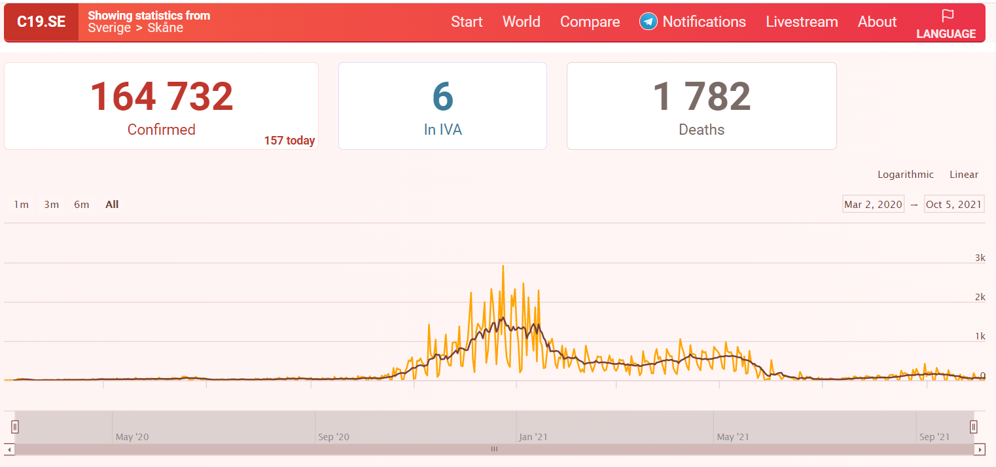
ESS during COVID
Start of the pandemic
Even if the external image of Sweden was that there were not many restrictive measures during COVID, that is not the reality
ESS adopted measures beyond the Swedish government recommendations
Our region (Skane) had a relatively low incidence the last two waves

Slide 10
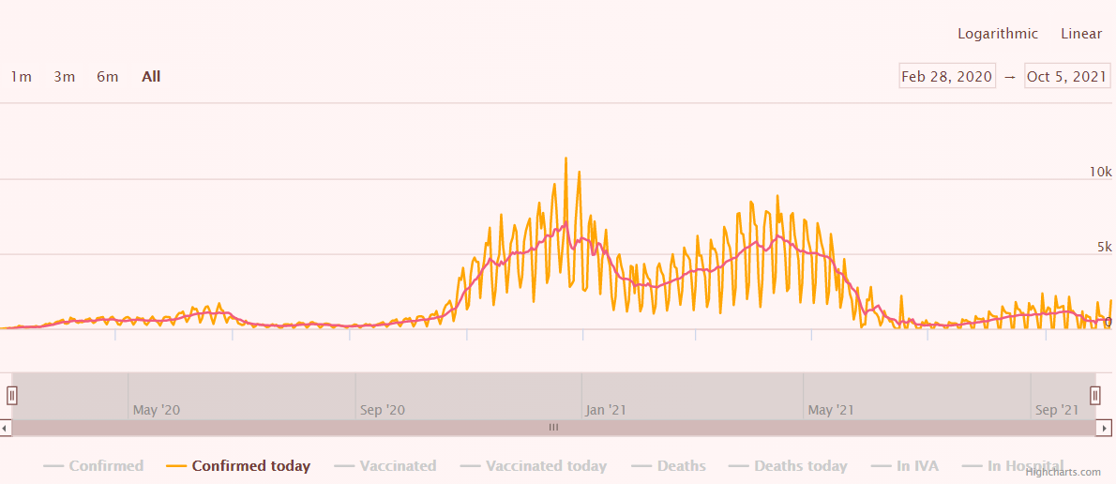
Work from Home was implemented the 15/3/2020:
Only installation work at the ESS site
TS2 Operation on site
Cryo operation on site
Mask on site
Travels to and from ESS were severely restricted
Limited occupancy of the Local Control Room
Skanska kept working on the site the whole pandemic
ESS staff moved to the finished ESS office building and labs
Increased in the rate of installation work
Finished installation of the RFQ with help from CEA
RFQ conditioning
Creation of a second Local Control Room to conduct conditioning and commissioning
How all this affect the schedule?
After summer 2020 very limited work at the offices and labs was allowed for some groups
Mask on site and office
Occasional COVID test after vacation
Increased in the rate of installation work
Still, not travel from/to ESS
TS2 and Cryo Operation on site
Increased occupancy, but still limited
Mask usage reduced
Start to ease the visit requirements
Weekly COVID test
29 Sept 2021 Swedish government lift restrictions (still recommendations)
15 October 50% occupancy

Slide 11
COVID cases at ESS - 2021
The total number includes ESS employees and consultants (working on ESS premises or from home), and everybody working on ESS premises: In-Kind partners, Skanska, contractors

Slide 12
NCL plan pre-COVID (Rev. Dec 2019)
Start of RFQ Conditioning
SRR2A
Start of Beam Commissioning
SRR2B
Jan
Feb
Mar
Apr
May
Jun
Jul
Aug
Sep
Oct
Nov
Dec
2020
RFQ Conditioning
4 wks
SRR2A Follow-Up
2 wks
Beam Commissioning to the MEBT FC
9 wks
PSS1 Re-Validation
3 wks
DTL1 and MEBT Bunchers Conditioning
4 wks
SRR2B Follow-Up
2 wks
Beam Commissioning to the DTL1 FC
6 wks

Slide 13
NCL plan today
SRR2B
SRR3
SRR2A
Mar 18 '22
Jan 12 '23
2021
Today
2022
2023
2021
Aug
Oct
Dec
Feb
Apr
Jun
Aug
Oct
Dec
Feb
Apr
2023
ISrc/LEBT SAR
ISrc/LEBT
ISrc/LEBT SAR Follow-Up
ISrc/LEBT Local/Integrated Testing
RFQ
RFQ SAR
RFQ SAR Follow-Up
MEBT SAR
MEBT
MEBT SAR Follow-Up
MEBT Local Hardware Tests
MEBT Integrated Hardware Tests
DTL1 Installation
DTL1 Local/Integrated Testing
DTL
DTL2 Installation
DTL2 Local/Integrated Testing
DTL3 Installation
DTL3 Local/Integrated Testing
DTL4 Installation
DTL4 Local/Integrated Testing
Oct 13 '21 - Dec 17 '21
Beam Commissioning (ISrc to MEBT FC)
MEBT Bunchers Conditioning
Jan 27 '22 - Feb 9 '22
DTL1 Conditioning
Feb 25 '22 - Mar 24 '22
Commissioning
Beam Commissioning (ISrc to DTL1 FC)
Apr 8 '22 - May 23 '22
DTL2 Conditioning
Nov 2 '22 - Dec 20 '22
DTL3 Conditioning
Nov 2 '22 - Dec 20 '22
DTL4 Conditioning
Oct 27 '22 - Dec 14 '22
Beam Commissioning (ISrc to DTL4)
Jan 26 '23 - May 2 '23

Slide 14
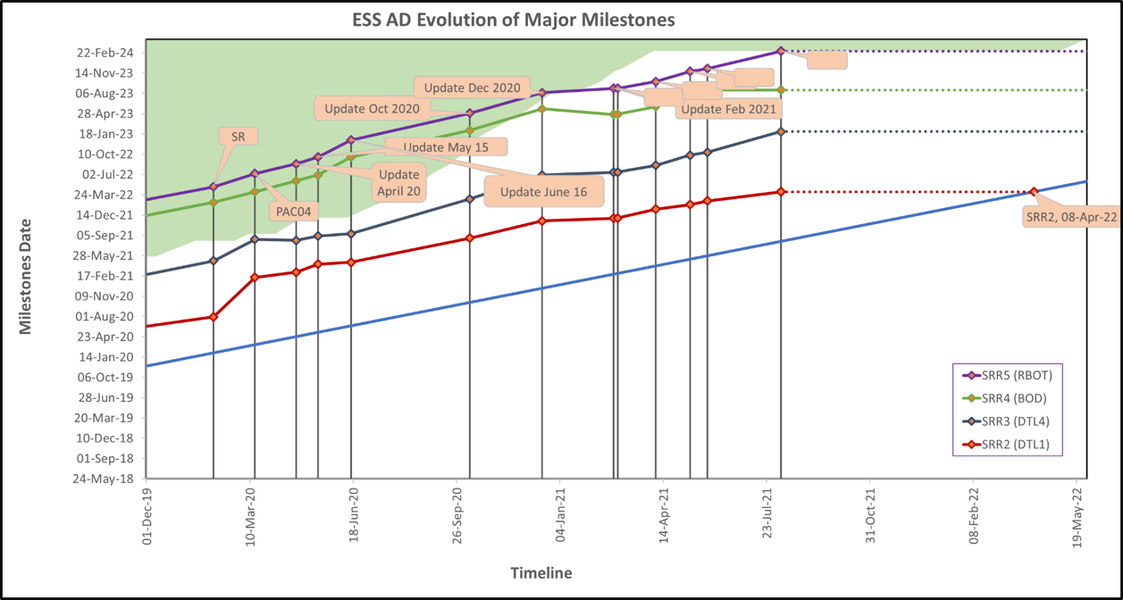
Beam on Target Situation
RBOT before COVID March 2022
RBOT after COVID March 2024 (guess as today, we are finishing a rebaselining this month)

Slide 15
What are the reasons for the delay?
How ESS adapted to work in COVID times
Effect on InKind partners
Delay in the installation
I.N.F.N. Staff were not permited to travel to ESS for installation and tuning of the DTL until 8 month after the scheduled date (and tuning and installation by Facetime proved a bit difficult, but we did manage installation of 6 out of 24 post-couplers during this period)
CEA Saclay staff also have to wait a long time before being able to come to ESS to validate RFQ installation and start the RF conditioning
Effect on the partner labs themselves
Reduced or completely stop of work
Deliveries

Slide 16
3
Creating the Operations organization

Slide 17
Operations team
3 Shift Leaders (Arek, Benjamin, Joe) and 2 Operators (Julien) hired
2 more Shift Leaders being recruited now
Extra Temporary Operators ‘’loaned’’ by Software and Beam Physics
Training provided for operations personal, plus new learning platform (sabacloud)
During non-operation time, we have SL on site (not necessarily at the LCO) during normal working hours
Next commissioning run:
2 shifts per day
7 days a week
1 SL (from Operations), 1 Operator (Ops or temporary) plus up to 6 person from predefined teams
Limit for the moment of 8+1 persons at the LCO

Slide 18
LCO

Slide 19
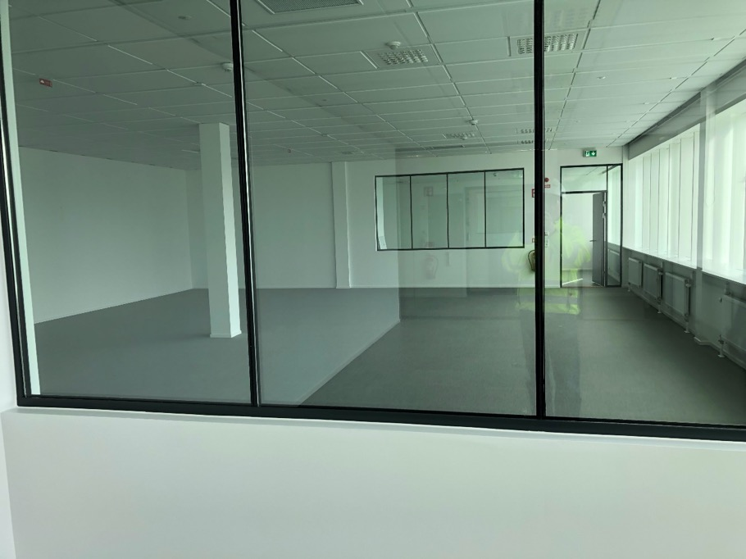
MCR

Slide 20
Moving ESS from Project to Operational
Always one SL on shift during working hours
Parts of the tunnel are now under PSS control, limiting the number of people in it
Daily coordination meeting run by the SL over Zoom to coordinate access to the controlled area
Requires Work Order system working and in use
New systems ready to move to operations:
Training system, including certification
Identity management, linked to the training system, PSS and access
EAM tool much improved (ESS Enterprise Asset Management System)
Better definition on the procedures and process
Better definition of the steps before starting test on the control room (Technical and Safety reviews)
Access to the PSS controlled area

Slide 21
4
Conditioning and Commissioning

Slide 22
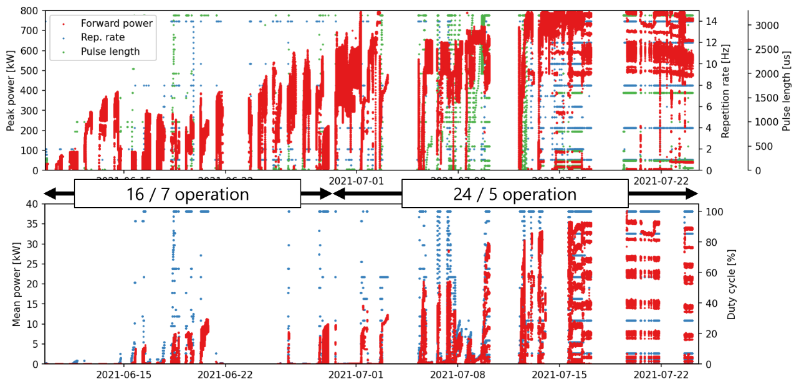
Summary of RF conditioning
2 Shifts per day
1 SL + RFQ experts + CEA partners (at the start)
Driven by the RFQ experts
SL to help and to operate the PSS1
Started 7 days/week, moved later to 5 days/week
RFQ conditioning to nominal (or close to nominal) field in ~650 hours of operation

Slide 23
Commissioning restarts in one week
2 Shifts per day
Responsibilities, handover of systems
Updates in the tools:
New logbook -> Olog
New CS-Studio -> Phoebus version
Better prepared than the last times:
Clearly defined stages
Larger operation group

Slide 24
Shift Scheduler
Web based tool
All shifts for the next commissioning run planned

Slide 25
Backup Slides

Slide 26
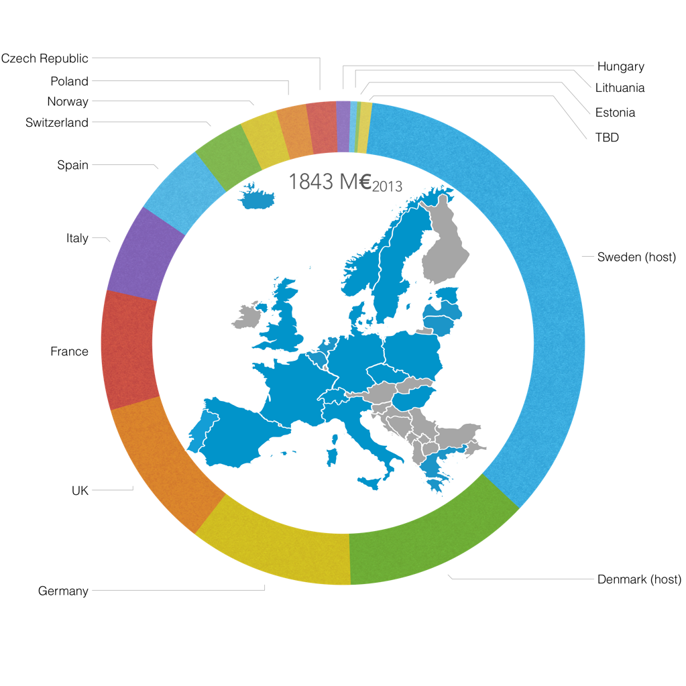
Financing: Cash and InKind

Slide 27
RFQ Conditioning
The ESS RFQ in numbers
2 coaxial power couplers
4 vanes ;-)
4.6 m long
5 segments
22 field pickups
60 static tuners
66 cooling circuits
80-120 kV intervane voltage
352.21 MHz
Later History:
January – April 2018: Couplers conditioned at CEA
August – December 2019: Installation and tuning at ESS
June – July 2021: Conditioning

Slide 28
Issues… (expected and unexpected)
Lack of waveform archiving: we have almost no waveform data from normal pulses
Lack of discipline with acquisition windows
Set for a 50 µs pulse, conditioned with 25 µs…
Lot of changes for measurement, calibration, …
Archiver was not entirely stable: multiple downtimes
LLRF stability problems
Firmware hangs after interlocks: issue specific to RFQ system (40 acquisition channels)
Cooling water in the gallery: any valve opened/closed on the CWM circuit will affect all others
Downtime due to klystron water flow interlocks

Slide 29
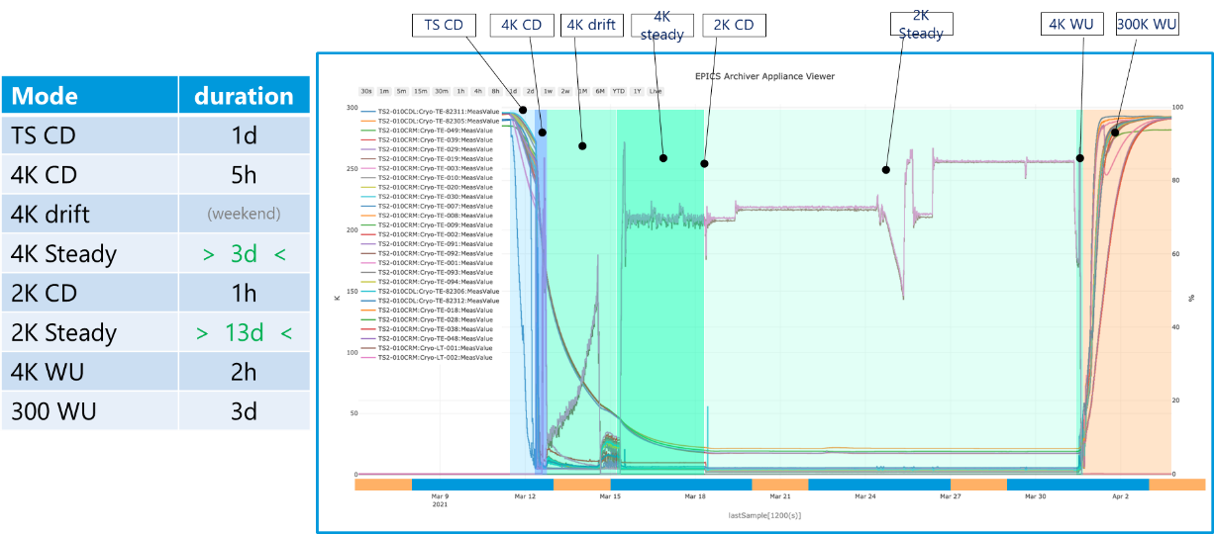
TestStands Activity
TS2 keep working all along the pandemia
Fully qualify the first two cryostats (including the RF part) of the Medium Beta section
Success both on the cryo part and in the RF part

