Slide 1
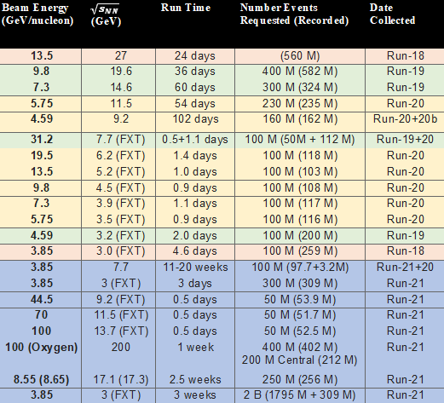
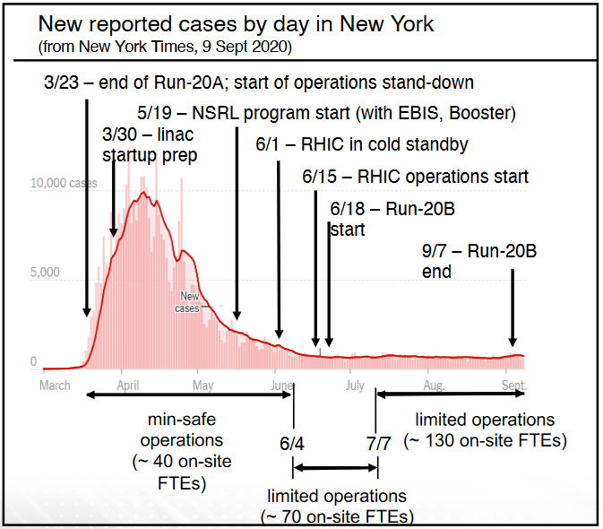
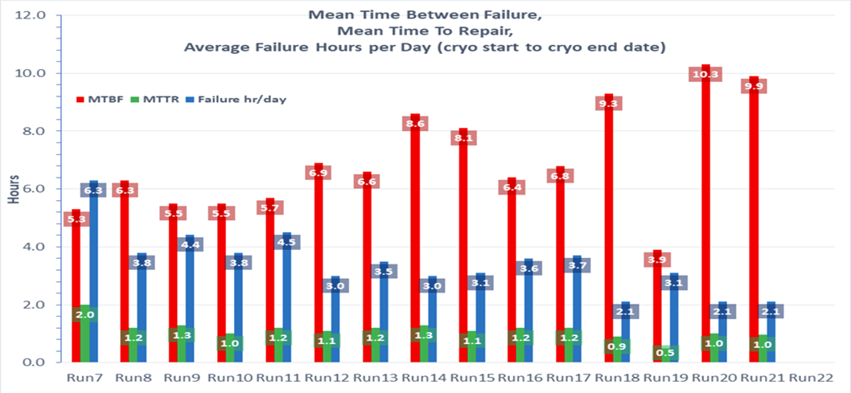
Running the BNL Collider Accelerator Complex during the COVID19 Pandemic
R. Terheide
Abstract
After the initial response to the COVID pandemic, there was a concentrated response from the lab at multiple levels to restructure, where possible, in the interest in safety. Because of this response, many new practices were established to ensure smooth operation and safety. The establishment of a task force, reduced staff on site, reduced interaction between those on site, masks, gloves, and available hand sanitizer are some examples of immediate restructuring that lasted the year of running under COVID19. There were some challenges with continuing to run including a two-month initial downtime, running during the summer, and maintenance periods adjusted to allow for more remote access. Despite this, the percentage of time spent in failure was relatively low, relevant luminosity projections were met, and all goals for the run lasting between Dec. 2019 and Sept. 2020 were reached.
Established Practices
Results from FY20 and FY21
Lab Wide Practices
Establishment of a task force to keep lab personnel informed on relevant information including infection and self-quarantining numbers, direction to telework resources, information on distancing and mask requirements, and eventually vaccination rates.
Mask requirements that evolved with the pandemic
Social distancing requests
Transition to telework when feasible
Resources for vaccination information and locations
Designation of essential and non-essential personnel with non-essential personnel kept off-site
Group and Department Practices
Communication via Microsoft Teams with staff offsite for both setup work and addressing failures. Teams chats were established for each project/group.
Staffing limitations inside MCR and MCR kitchen, mask, distancing and cleaning rules established that continued through FY21 including rules around using group transportation.
A new schedule for operations set up in only 12 hour shifts with no overlap in order to reduce staff interacting with each other.
All goals were reached for the STAR experiment for the RHIC program
NSRL and BLIP ran with little interruption
Challenges During the Run
Issues around bringing in offsite personnel for failures while working around the essential personnel designation.
Multiple failures due to running during the summer for Run20 after the minsafe shutdown. Running during the summer causes many heat related problems for magnets across the complex. Summer running also brought increased risk of storms and power dips across the site.
The remote access system largely depends on keys taken from MCR, with these restricted due to limited staff allowed in MCR most accesses for maintenance required sweeps to be lost for work to be done. This meant many sweeps were required on maintenance days which can slow recovery time.
Communication via teams with staff offsite presented some difficulty especially with involved setup work. It also resulted in less documentation in easily accessible areas such as e-logs.
At times, access to cleaning supplies such as hand sanitizer were difficult to find on site.
References
Burkhart A. (2021, September). View from Operations [Presentation.] RHIC Virtual Retreat 2021. Brookhaven NY, United States https://indico.bnl.gov/event/11680/timetable/?view=standard_inline_minutes
Lee J. H. (2021, September). Run21 Summary and Requests for Run22 [Presentation]. RHIC Virtual Retreat 2021. Brookhaven NY, United States https://indico.bnl.gov/event/11680/contributions/52684/attachments/37172/61210/STAR_Run21_Retreat.pdf
Liu C. (2020, October). RHIC Beam Energy Scan II Operation in 2020 [Presentation]. RHIC Virtual Retreat 2020, Brookhaven, NY, United States. https://indico.bnl.gov/event/9276/contributions/40964/attachments/30837/48460/RHIC_retreat_2020.pdf
Terheide R. (2020, October). View from Operations[Presentation]. RHIC Virtual Retreat 2020, Brookhaven, NY, United States. https://indico.bnl.gov/event/9276/

