Slide 1
Make the main control room the safest place and move on
Stephan Reimann

Slide 2
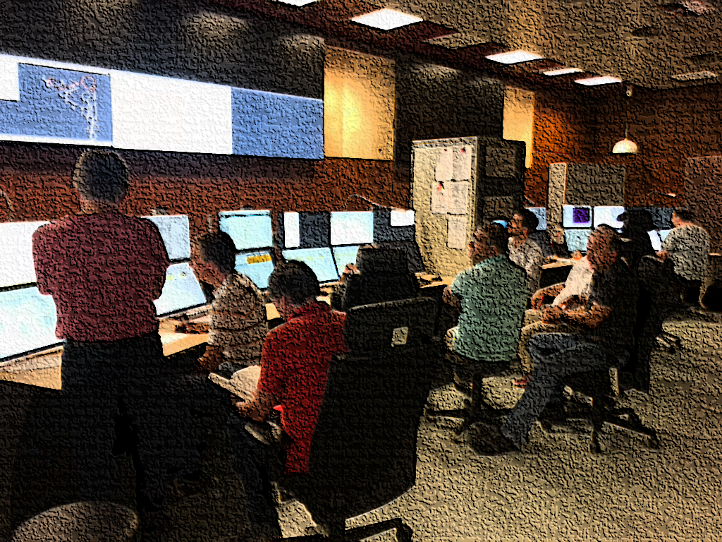
Q1 / 2020
Jan
Feb
Mar
beam time
beam time
beam time
11.03. first Covid-dead in Germany
(incidence: 2.2 / 100k)
disturbing news from Italy → first measures:
no guests on campus
control room only for operators, distance
Home Office recommended
wearing mask was only recommended (masks were anyhow not available)

Slide 3
Q2 / 2020
Apr.
Mai
June
beam time
beam time
incidence: 10.7 / 100k
user beam time stopped – no user anymore
management decision:
continue beam time, extend engineering run
end of beam time
end of pandemic
(incidence: 3 / 100k
task-force health established in GSI → common rules
03.04. peak of 1st wave in Germany (incidence: 44.6 / 100k)
travel ban in Europe
users were affected → frequent re-arrangement of beam time schedule

Slide 4
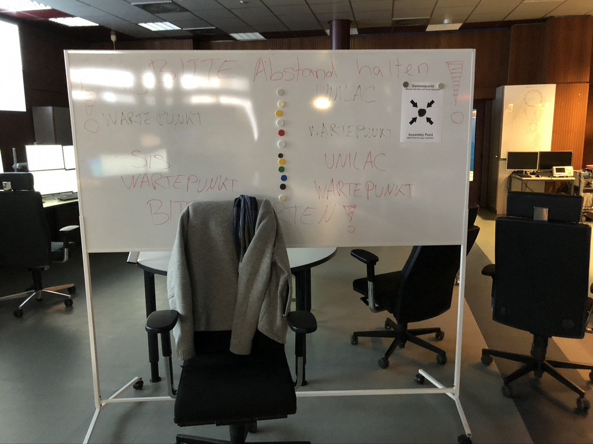
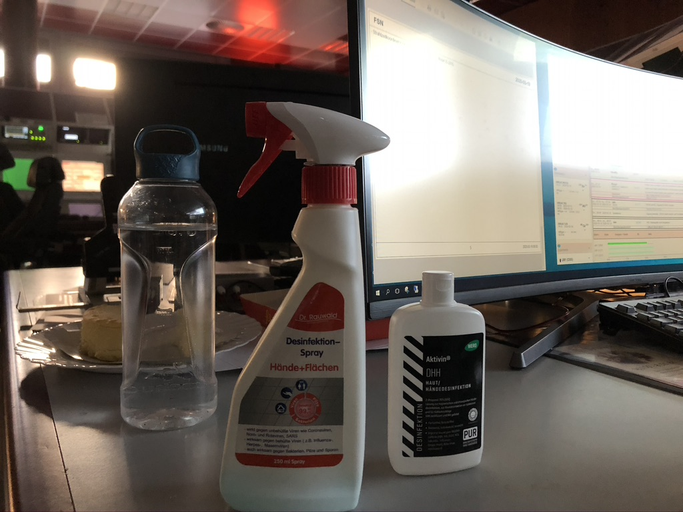
Review: first Covid beam time
surreal situation - beam time was possible but partly meaningless without users
some measures were more recommendation than obligation → so, some persons took it more seriously than others
nobody got hurt

Slide 5
2021 beam time preparation
2020 Shutdown should last until end of the year
November 2020:
incidence went up to 150 / 100K
21.11.: first Operator caught Covid19
not enough operators to maintain operation in case of quarantine cascades
Management decision → 2021 – we run 6 months from January to June
situation has changed → we had to do something
how to run an accelerator facility during a pandemic ... effectively and safely?

Slide 6
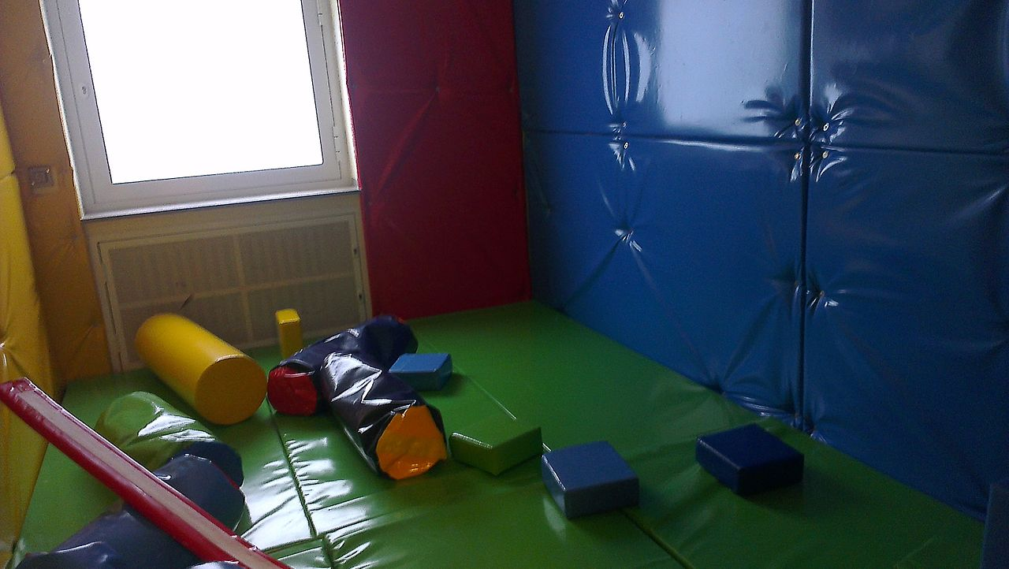
Goal:
Make the main control room the safest place to be
picture: Wikipedia.org

Slide 7
our measures
contact minimization on campus (especially with operators)
HKR Safety measures: masks, disinfectant, distance – no visitors, “only” operators
most staff in home office - longer interruptions for support were accepted
on call support and experts were also in home office, availability by phone when needed (Controls team operated completely from home office)
all meetings via zoom
usual ways of communication and coordination – disturbed → additional morning briefing
plan B – exit strategy.

Slide 8
regular testing
once per week done by our medical doctors

Slide 9
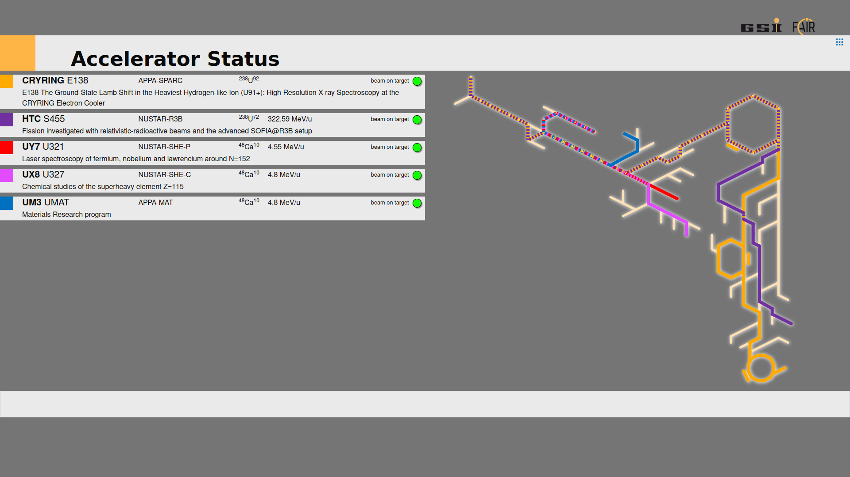
very ambitious and packed beam time schedule (up to 6 accelerator chains parallel)
basically, no rest for shift crew
single operators have been 6 month in heavy rotation
ion sources
target stations
picture by: Achim bloch-Späth

Slide 10
beam time 2021 - how did it go?
we started right into our 3rd wave
but we were lucky – no cases in OP team anymore, no quarantine cascades
no covid related interruptions
2021 beam time was very successful and extraordinary efficient
most important! all colleagues are still well
are they?

Slide 11
spectrum of horror
team spirit
no masks!
this is dictatorship!!!
COVID IS A HOAX
a beam time?
during a pandemic???
YOU KILL US ALL

Slide 12
outlook
In June, a vaccination campaign started at GSI.
Operators got top prioritization for vaccination

Slide 13
Ende

