Slide 1
What Happens to Accelerator Reliability and Maintenance in a Global Pandemic?
Reid Smith NSLS-II
WAO 2021

Slide 2
Contents:
About NSLS-II
COVID-19 Timeline
Impacts on Operations Reliability
Impacts on Maintenance
Going Forward

Slide 3
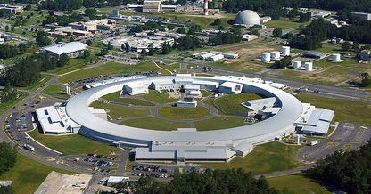
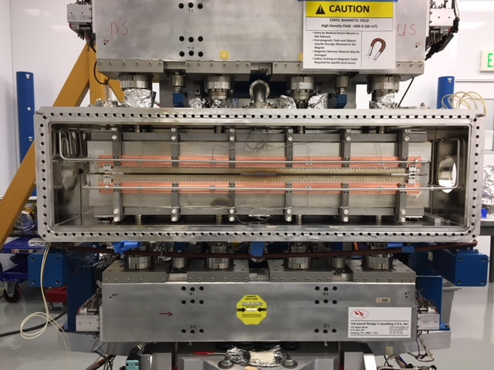
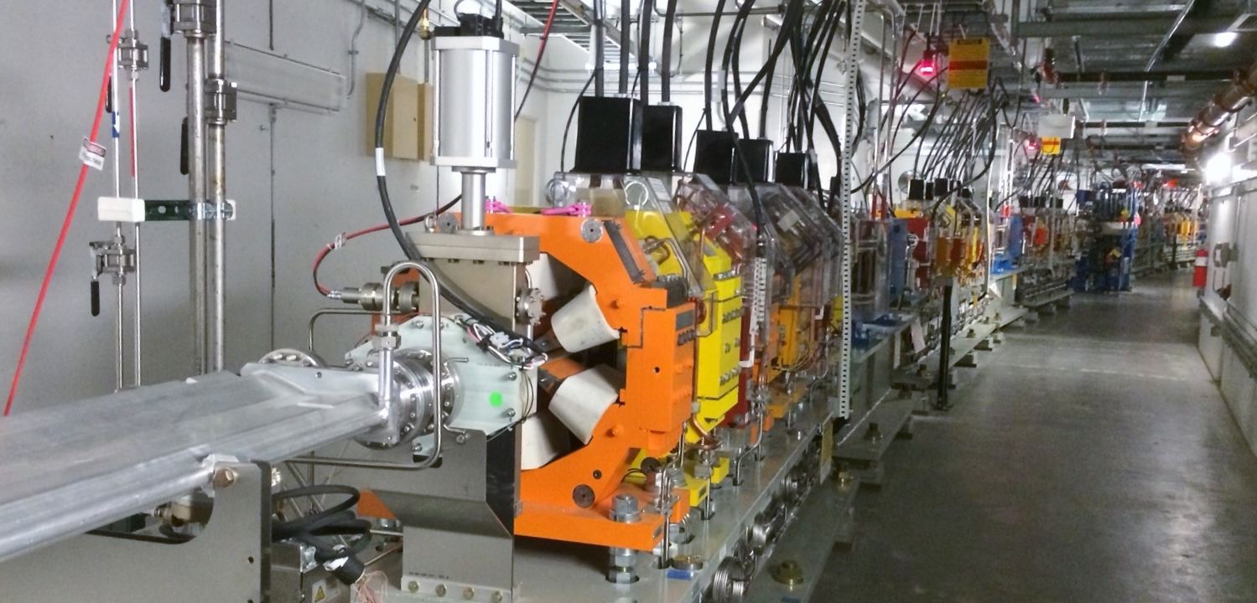
About NSLS-II
3 GeV Synchrotron Xray lightsource
790 m circumference
Double-bend achromat, 30 cells
.55 nm-rad horizontal emittance
Operating since Feb 2015

Slide 4
2020 Timeline of BNL COVID shutdown
Mar 16 COVID lockdown starts; MinSafe Operations
Apr13-May19 Shutdown Cancelled
Jun 04 Phase 1 Reopening
Jun16-Jul04 Short Shutdown
Jul 06, 2020 Phase 2 Reopening
Aug 06 Estimated start of Phase 3, moving to ‘Normal Operations
…
Oct 7, 2021 Currently in Phase 2 ‘Limited Operations’ through foreseeable future
Notes:
*MinSafe = minimum number of people possible to maintain safe operation of 2 COVID research beamlines
*Shutdown Cancelled to continue beamline COVID research
*PHASE 1: 30-40 people at NSLS-II
*PHASE 2: 10% up to 80% on-site for NSLS-II
*PHASE 3: Normal Operations with maximum telework, moving to Normal

Slide 5
2020 Timeline of BNL COVID shutdown
During the months after Lockdown, both total Downtime and Mean Downtime Length (MTTR) increased
before COVID
MTTR: 1.0 hr
Avg DT: 7 hr/month
Minsafe, Phase-I MTTR: 4.2 hr
Avg DT: 21 h/mo

Slide 6
Operations Reliability
Work From Home & reduced response to machine issues
Operating Beamlines with limited access
Major schedule-changes to accommodate COVID research beamlines

Slide 7
OPERATIONS RELIABILITY:
1. WFH& Reduced response to machine issues
Essential personnel included Operators, Floor Coordinators, custodians, and a small cross-section of others.
Techs & System experts not on-site outside of call-ins
Priority was placed on worker safety & keeping personnel distanced.
Machine faults during off-hours were resolved less urgently, “increasing downtime” as a choice (while not impacting programs).
Examples of Major Downtimes made longer by min-safe operations.
Date | Downtime Hrs | Description
4/25/20 20:05 | 14.0 | PPS P5 A-Chain communication. Long fault - left at 2am and resumed work in the morning, intentionally bc no users are active.
6/13/2020 8:05 | 5.9 | Power Supplies - C08 QM2B output dropped to 117A, setpoint unchanged at 138A. R. Lyon came in and replaced SGA.
7/9/2020 17:30 | 4.8 | PPS - Blown Fuse in line cord that feeds the F.E."A" chain. Ewart came in to replace fuse.
Notes:
Explain here: It’s extremely difficult to draw a single line between every cause and every effect, so I’m not going to try. This is due to the large number of variables all changing at once, and the NEWNESS of the whole situation.

Slide 8
OPERATIONS RELIABILITY:
2. Limited beamline operation, exclusively for COVID investigation.
Beamlines each limited to 1 person onsite per-day.
Experimenters adjusting to less access/tools
Remote control established for beamline operation to improve work efficiency.
Smaller teams meant beamlines were not active 24 hrs/day.
When machine-failures occurred, experts were often not called-in during nights or weekends when experiments were known to not be using beam.
Less monitoring of beamline equipment (rack cooling, etc.)
Notes:
Explain here: It’s extremely difficult to draw a single line between every cause and every effect, so I’m not going to try. This is due to the large number of variables all changing at once, and the NEWNESS of the whole situation.

Slide 9
OPERATIONS RELIABILITY:
3. Major schedule changes to accommodate COVID research
FY20 Operations Schedule became fluid, changing plans every several weeks.
Made conditions less predictable for Ops crew and Subsystem group members.
Delayed 3rdRF cavity installation
delayed HEX beamline construction
FY20 Schedule changed from delivering 5000 hrs of to 5130 hrs…
Actually delivered 5416 hrs of Operations (not including downtime) in FY20.
Notes:
Explain here: It’s extremely difficult to draw a single line between every cause and every effect, so I’m not going to try. This is due to the large number of variables all changing at once, and the NEWNESS of the whole situation.

Slide 10
OPERATIONS RELIABILITY:
Impact on Scheduled (and delivered) Operating Hours from FY20 COVID operations.
5416
5416 hrs delivered in FY20, not including downtimes

Slide 11
Maintenance
(Fewer and Shorter) Accelerator Maintenances and Shutdowns
Distancing & Safety limited work that could be done.
Challenges in Planning and Coordination between groups.

Slide 12
MAINTENANCE
Accelerator Maintenance and Shutdown became less frequent, shorter, and expendable.
NSLS-II intended to move Spring Shutdown.
Longer Operations periods with shorter maintenances
Running since Jan 13 Planned: 3 month run + 5 week shutdown Actual: 5 months run + 3 week shutdown
Studies became potential Maintenance
Non-critical Maintenance/Studies were cancelled to continue beamline research.

Slide 13
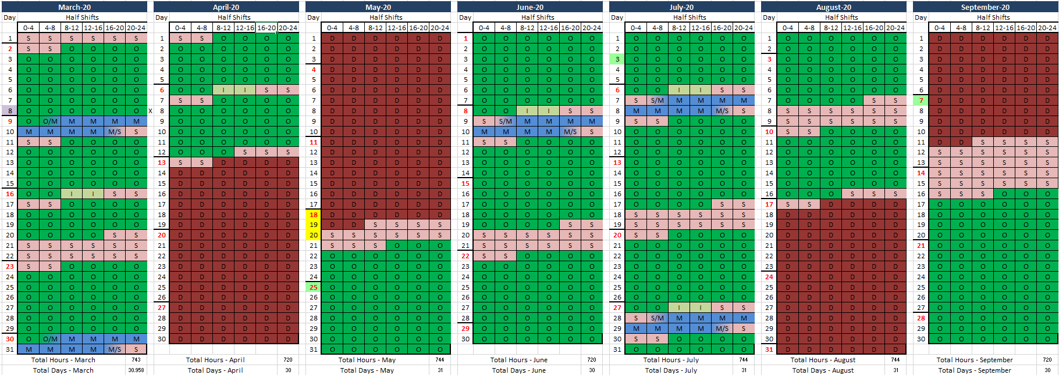
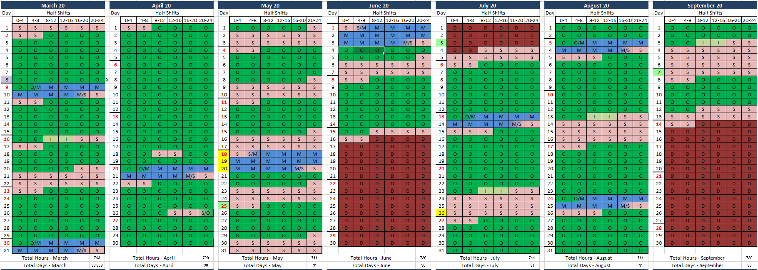
Original FY20 March-Sept schedule
COVID-altered FY20 March-Sept,
re-schedule
Fall Shutdown: Sep14 – Oct 18

Slide 14
MAINTENANCE
2. Distancing & Safety limited work that could be done.
Social Distancing meant planning around crowding.
Had to plan taking-turns in crowded locations (near RF cavity, Cryo system, racks, IDs)
Staying >6’ apart slowed work and communication.
Missing Personnel
Techs & system experts absent from quarantine / illness.
This is still a factor
Only Critical Repairs were Allowed
Non-crucial repairs were put on hold; sometimes until devices failed.
No preventative maintenance = more emergencies.

Slide 15
MAINTENANCE
3. Remotely Planning and Coordination between groups.
No in-person meetings.
Zoom, PDFs, “can everyone please mute unless you’re talking?”.
Coincidental meetings, conversations, impromptu planning were lost.
Good Timing: introduced Online Work Request database ~1 yr ago
A distributed, online db made it easier to work separately.
Work can be Approved, Closed with minimal friction.
Maint. Planning meetings (for years) gave groups a template for talking through jobs that require cooperation / accommodation.

Slide 16
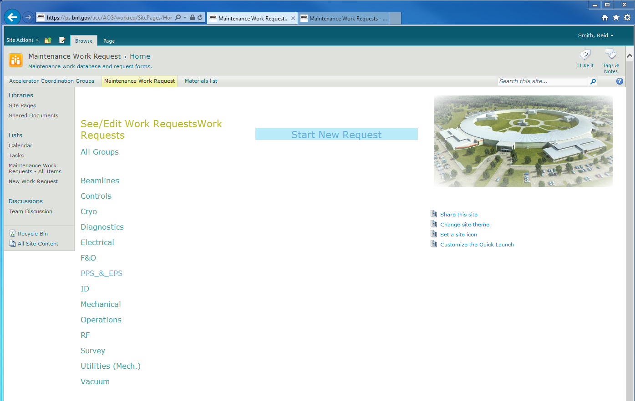
MAINTENANCE
NSLS-II Online Maintenance database
Built in SharePoint for easy onboarding
Simple, Non-relational list / database
Custom entry-form, workflows
Users create/submit work requests for Maintenance work
Auto-Emails to WCCs involved in work
Approval process for WCCs and Maintenance Manager
Exports lists to Excel for easy formatting, PDFs
Easy to Edit Templates (People, Permissions, Dates)
Able to be split by year and archived to keep list manageable

Slide 17
GOING FORWARD
As of the start of FY2022:
Ongoing Impact on Schedule
FY2021 Ops shortened from 5000 to 4500 hrs (delayed FY20 shutdown)
FY2022 Ops shortened to 4800 hrs
(HEX installation/commissioning)
Operational upgrades delayed
Paused 500 mA studies
Delayed plans for 500 mA operation.
Cancelled plans for low-emittance operation mode

Slide 18
GOING FORWARD
As of the start of FY2022:
NSLS-II still in Phase-2. (WFH encouraged, limited people on-site, masks required)
Remote studies (est. in Phase-1) are now standard
Employees/groups occasionally absent for week(s) due to illness / quarantine
Vaccination mandate going into effect
High turnover from retirements, resignations. Increased hiring efforts

Slide 19
SPECIAL THANKS
Emil Zitvogel, Raymond Fliller III, and all NSLS-II operators and Floor Coordinators
Timur Shaftan
Guimei Wang, Yoshi Hidaka & Jinhyuk Choi
Accelerator Group leaders, technicians, and WCCs
The (cooperative and understanding) NSLS-II beamline scientists
All kids/pets/partners wandering through the background of Zoom calls
Abby Armada (for sharing the house with me through an especially-stressful year of WFH)

