Slide 1


Re-commissioning the CERN Accelerator Complex in times of COVID
Workshop on Accelerator Operations 5th – 8th October 2021
Rende Steerenberg - CERN
6 October 2021

Slide 2
Topics
The Context: Long Shutdown & Commissioning
The Impact of Covid, Measures and Tools put in place
Post-Covid
Concluding Remarks

Slide 3
Topics
The Context: Long Shutdown & Commissioning
The Impact of Covid, Measures and Tools put in place
Post-Covid
Concluding Remarks

Slide 4
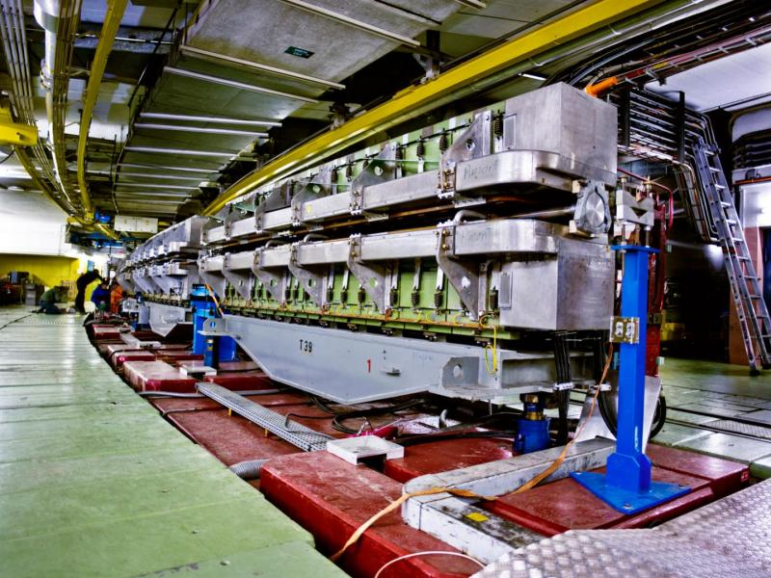
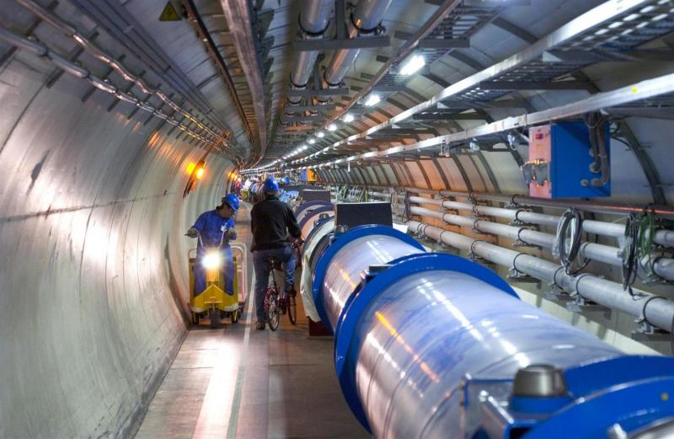
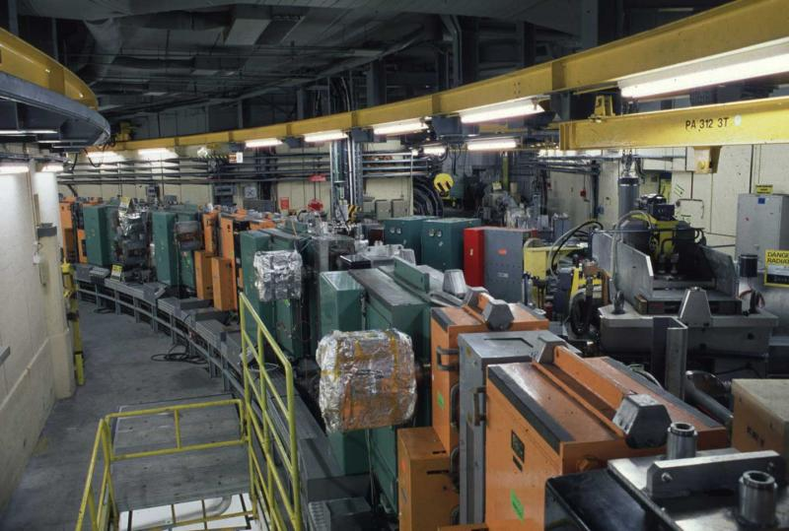
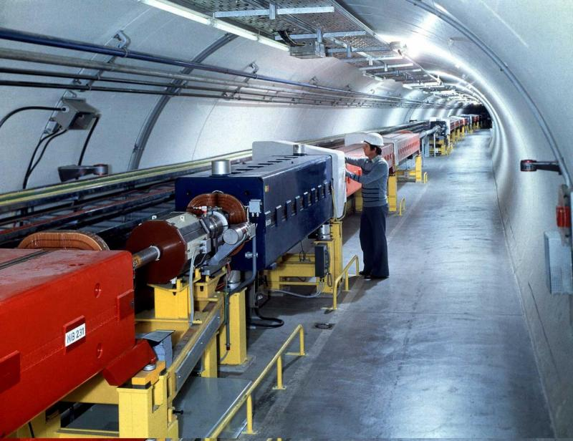
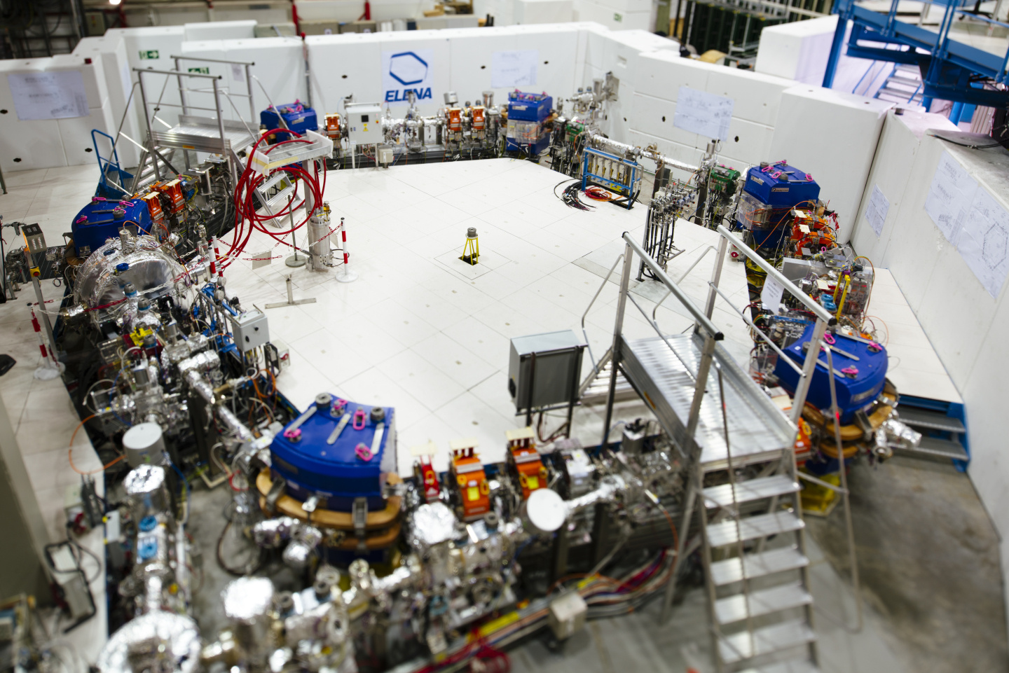
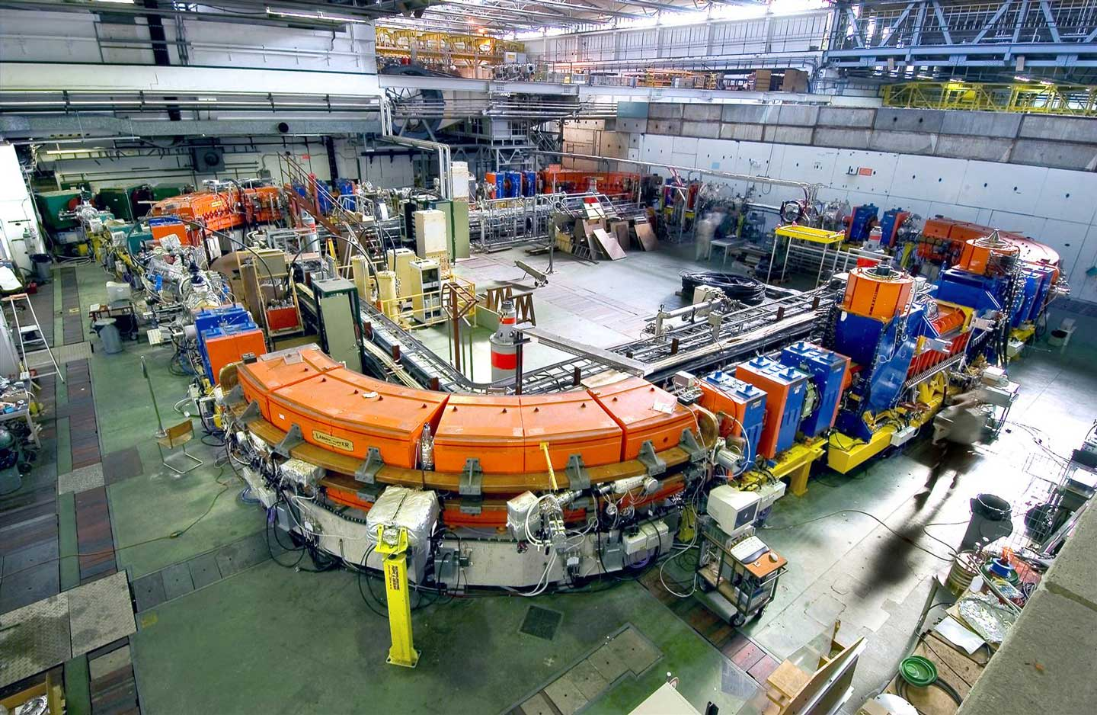
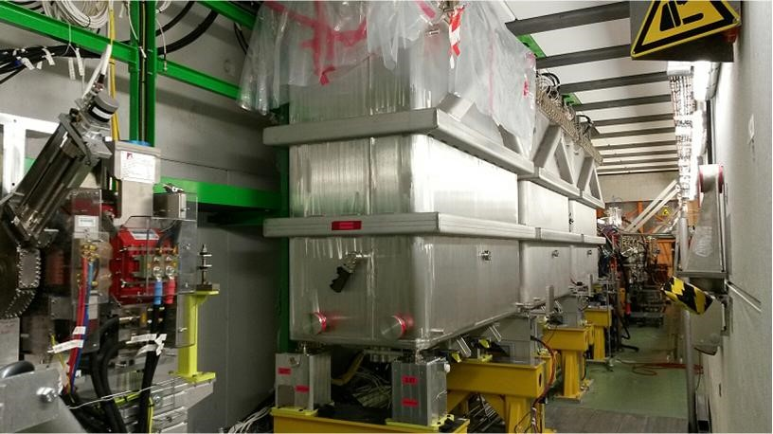
The CERN Accelerator Complex
Notes:
Quick run through the complex
LIU upgrade – machine concerned – extend of the upgrade
New Linac 4 with reliability runs
LHC diode consolidation

Slide 5
The Long-Term Schedule for the Accelerator Complex
Covid struck us during
Long shutdown 2
Long Shutdown 2 (LS2):
2.5 year stop for LHC to consolidate magnet diodes and many other things
  Also the 4 large experiments perform major upgrades
2 year stop for injectors complex to deploy major upgrade program

Slide 6
Long Shutdown updated for the Covid pandemic
A ~3 month schedule shift was introduced - no stretching of commissioning time
A gradual beam commissioning of the injectors complex took place
from mid-July 2020 until mid-May 2021
Beam commissioning of the LHC is now foreseen to start March 2022
about 1 year later than schedule pre-Covid

Slide 7
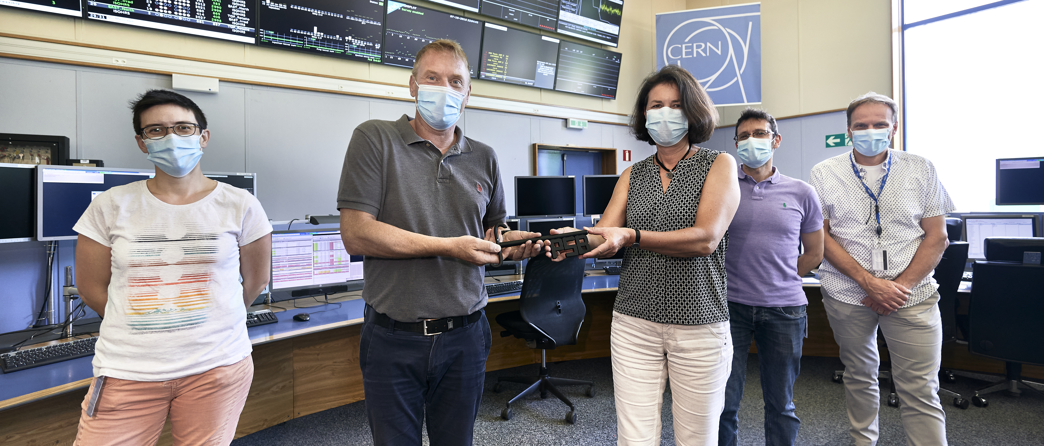
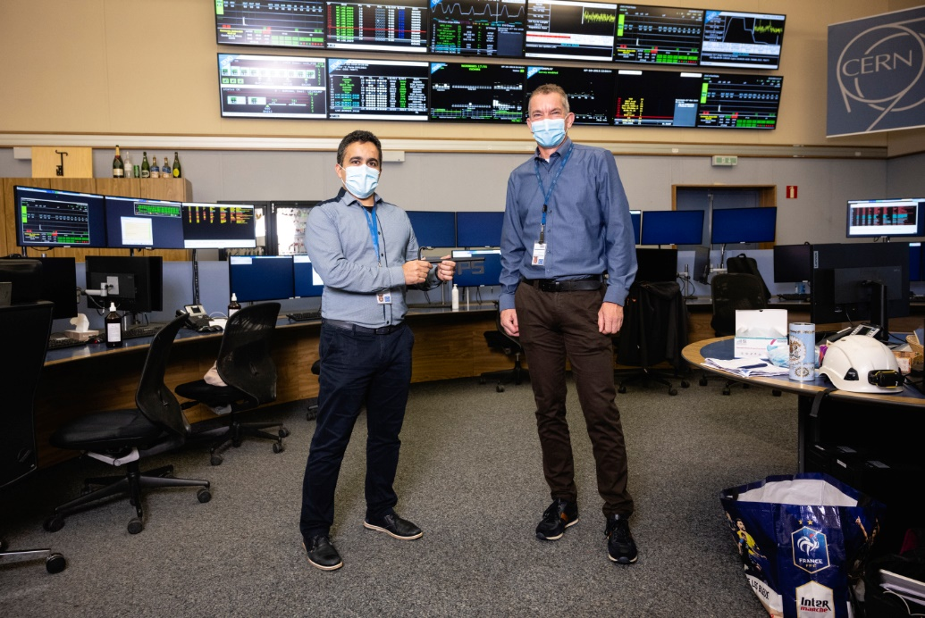
The Shutdown – Run cycle & Responsibilities
Technical Coordination Group
Operations Group
Long
Shutdown 2
Hardware
Commissioning
Cold
Check-out
Beam
Comm.
BEAM
Operation/Physics
Indiv. Sys.Tests
Impacted by Covid measures
The Technical Coordination Group is responsible for the accelerator complex during shutdown periods
The Operations Group is responsible for the hardware & beam commissioning and the subsequent operation of the accelerator complex
The hardware and beam commissioning is driven by the Operations group, but done in close collaboration with equipment owners and accelerator physicists.
  Usually by gathering rather large teams in the control rooms
  Daily briefing meetings and weekly coordination meetings, also in or near the control rooms

Slide 8
Linac 4 + PSB
Hardware
Commissioning
PS
SPS
LHC
Beam Commissioning
Linac 4
PSB
PS
SPS
Physics Running
CERN Safe Mode
Progressive Restart of shutdown activities
Number of confirmed Covid
cases in Switzerland (a.u.)
Persons entering the CERN sites

Slide 9
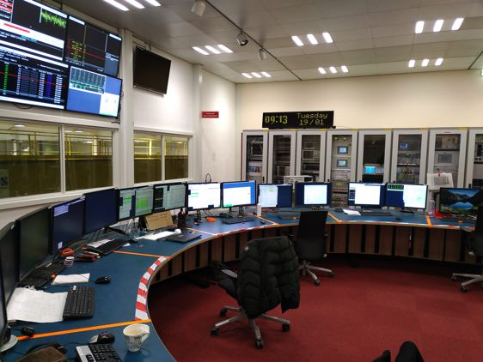
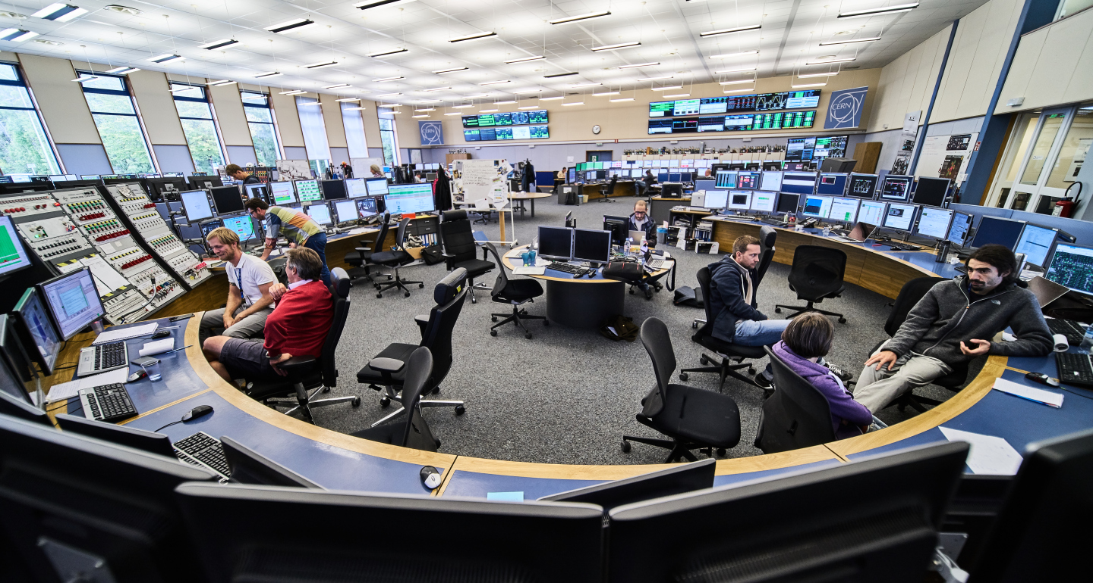
The Operations Control Rooms
Although we have 3 controls rooms, I will concentrate on the CERN Control Centre.
The same measures applied to the other control rooms
ISOLDE Control Room (ICR)
AD-ELENA Control Room (ACR)
CERN Control Centre (CCC)
Picture taken pre-Covid

Slide 10
Topics
The Context: Long Shutdown & Commissioning
The Impact of Covid, Measures and Tools put in place
Post-Covid
Concluding Remarks

Slide 11


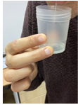
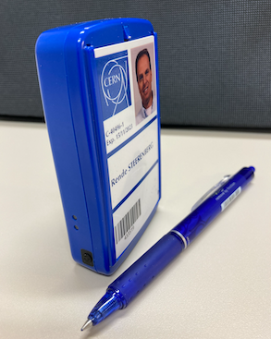
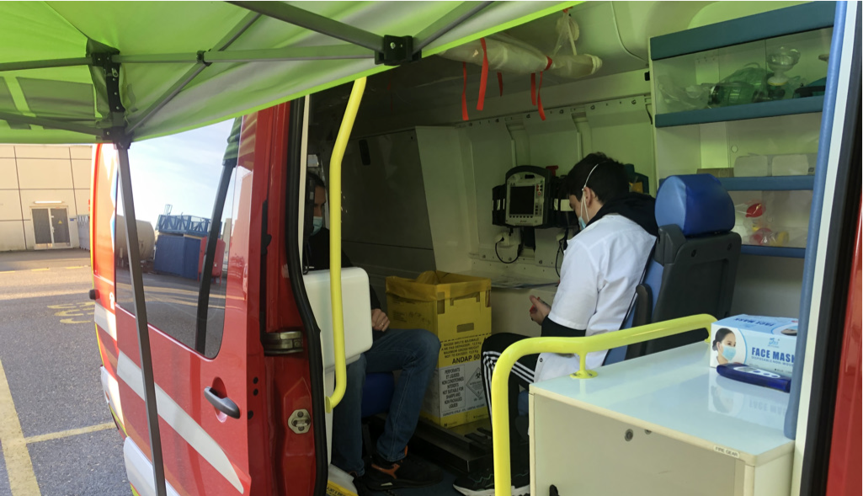
CERN Covid Measures
Very similar to elsewhere….…
Was initially 2m
Wearing a Proximeter
is obligatory to ease and partially automate
contact tracing
Stratified (saliva) testing by the
CERN medical service once per week
Mobile unit next to the Control Room

Slide 12

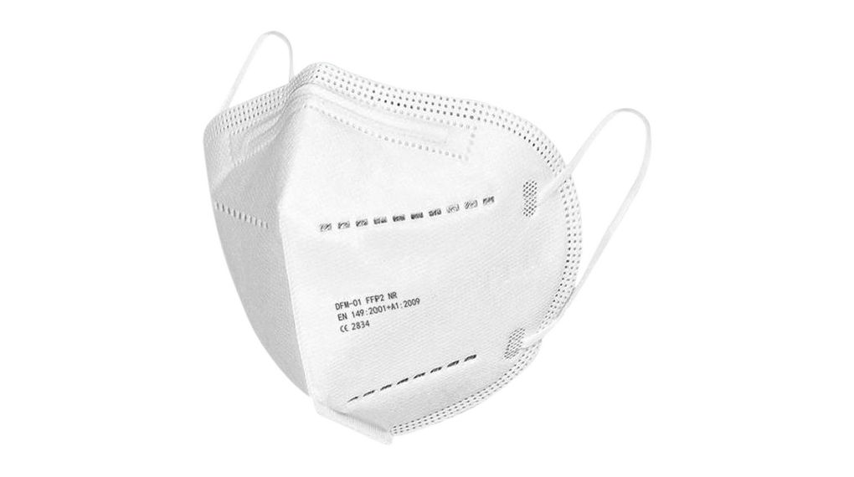
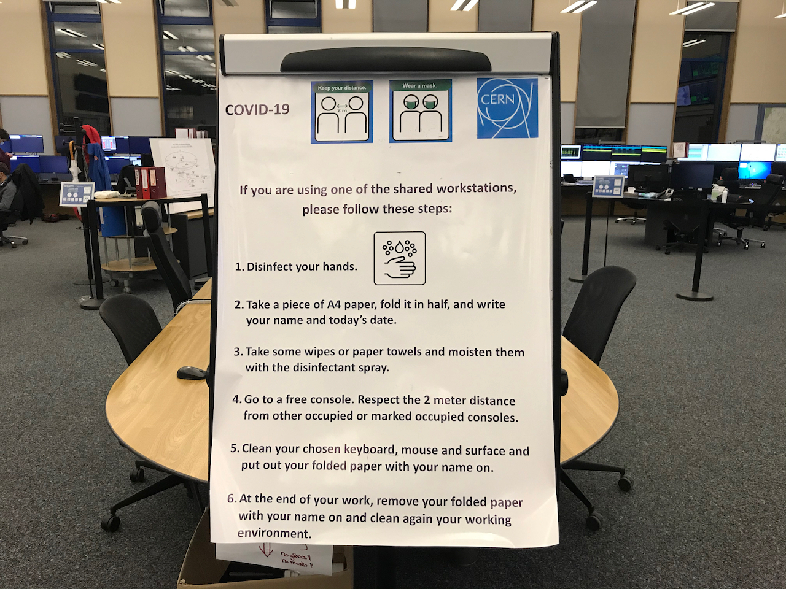
Some additional Controls Room Covid Measures
Wearing FFP2 masks in control rooms as distancing cannot always be guaranteed in such a dynamic environment
Surgical masks protect others
FFP2 masks protect yourself and others
Sharing of work spaces, keyboards, mice etc.
cannot be avoided in the control rooms
A reservation and cleaning protocol was put in place
No changes made to the shift organisation in the control rooms
Due to gradual commissioning initially reduced number of people per shift and not all shift manned – now back to full shifts

Slide 13
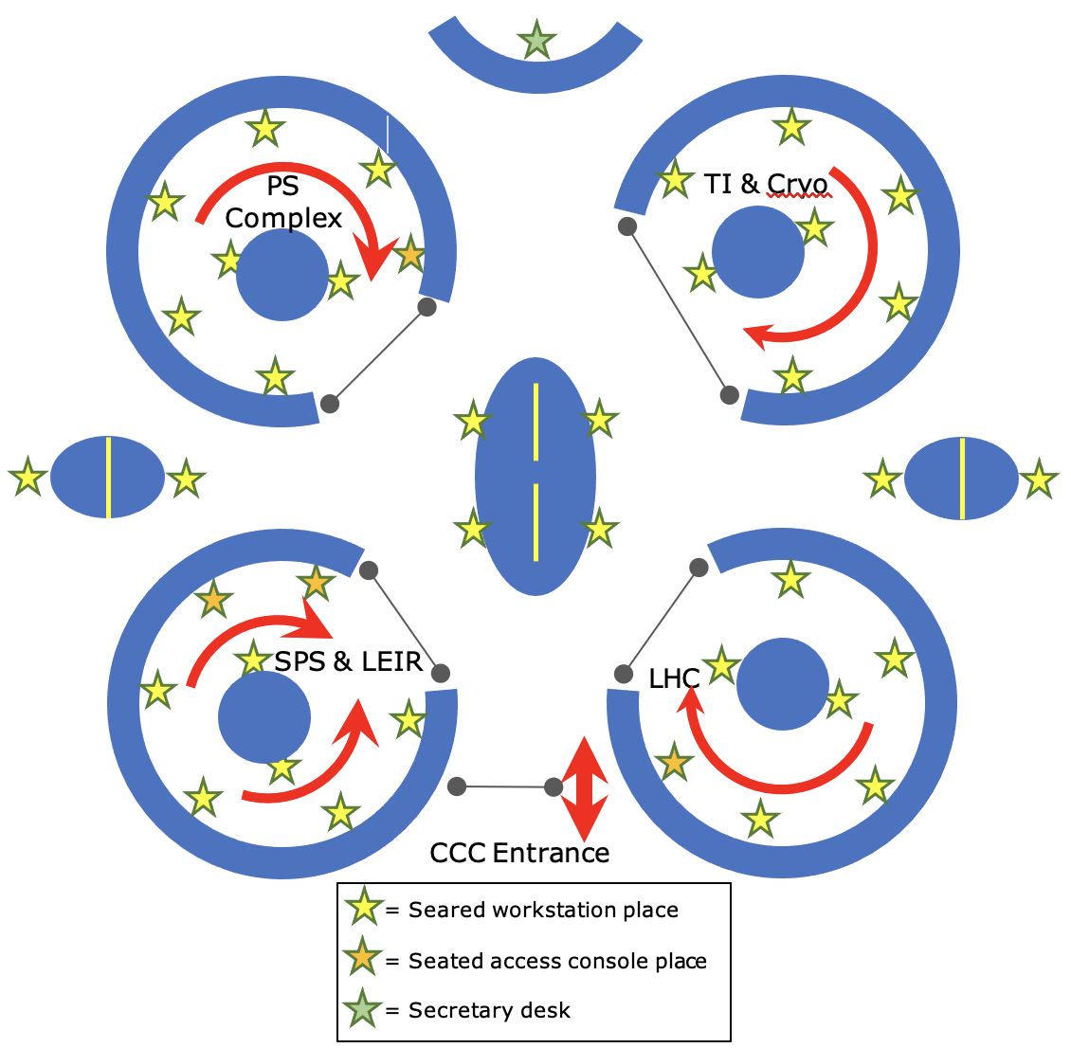
CERN Control Centre Capacity Reduction
All four islands normally ~ 49 work desks, now reduced to ~30.

Slide 14
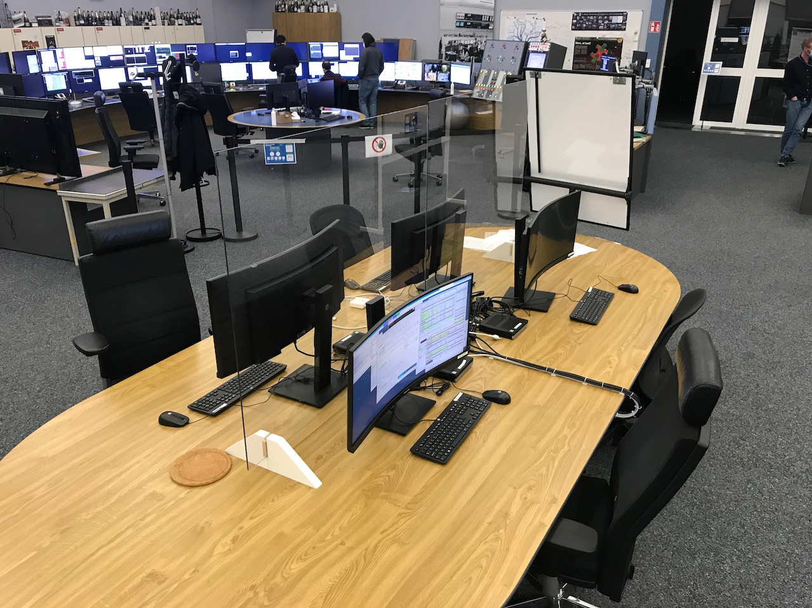
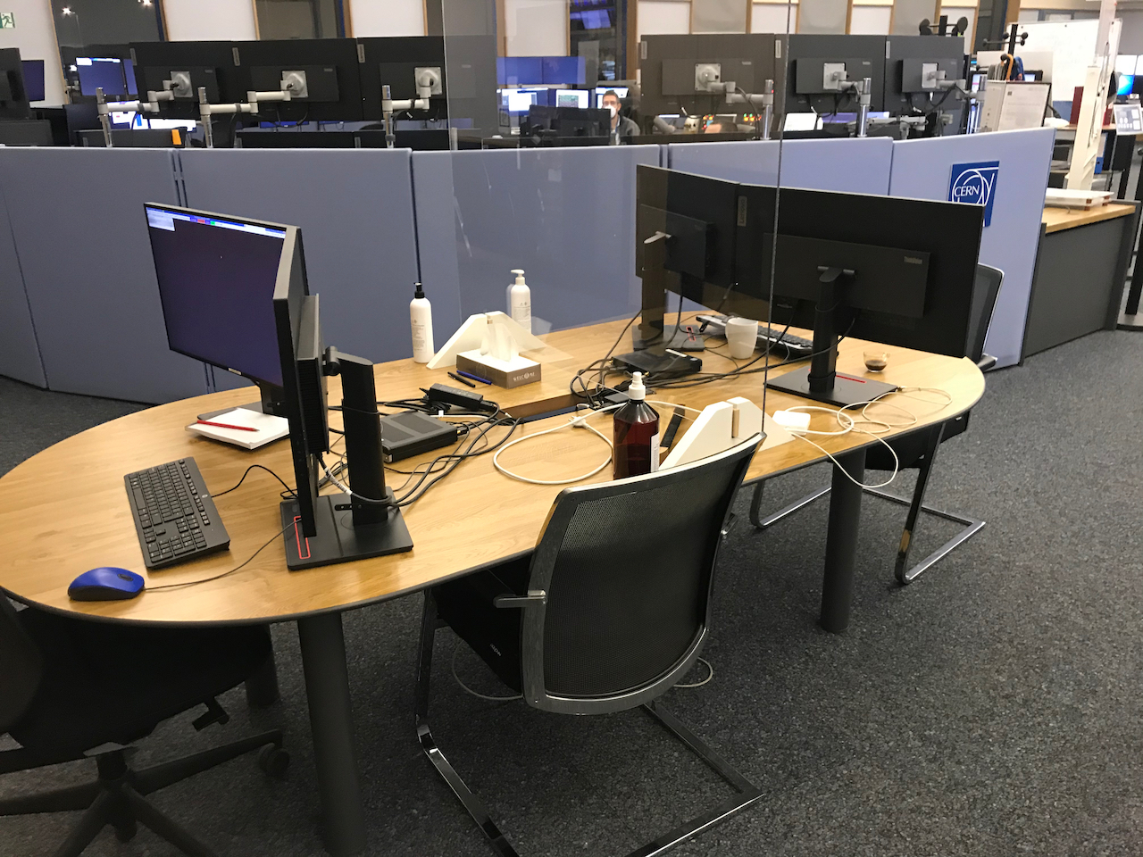
CERN Control Centre Capacity Reduction
All four islands normally ~ 49 work desks, now reduced to ~30.
Partially compensated by 8 temporary additional workstations on side tables and the central table

Slide 15
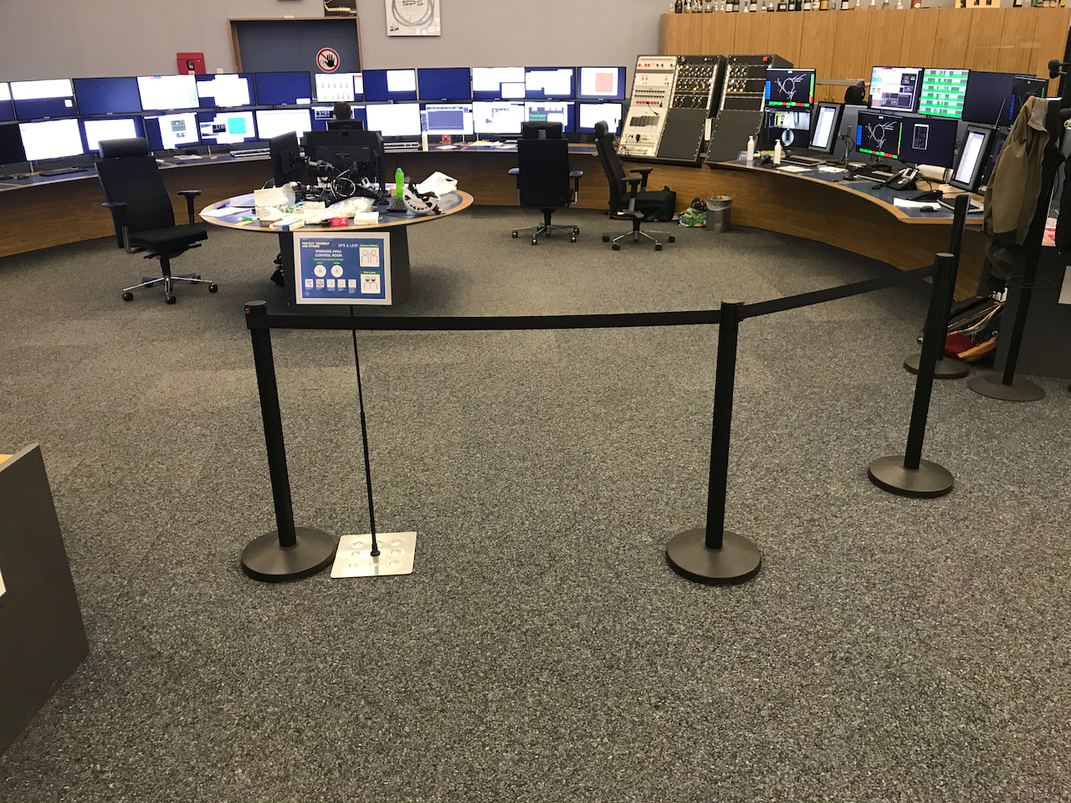
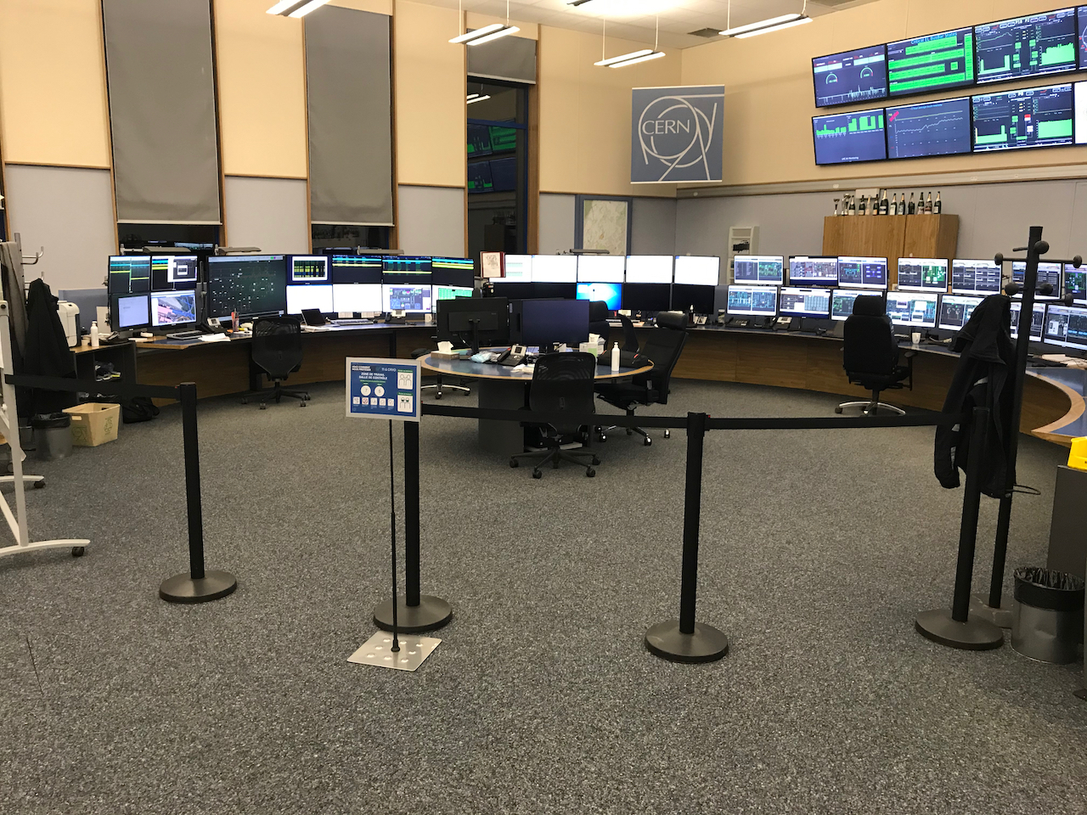
CERN Control Centre Capacity Reduction
All four islands normally ~ 49 work desks, now reduced to ~30.
Partially compensated by 8 temporary additional workstations on side tables and the central table
Island entries are partially closed off with flexible crowd barriers to dissuade people to enter.

Slide 16
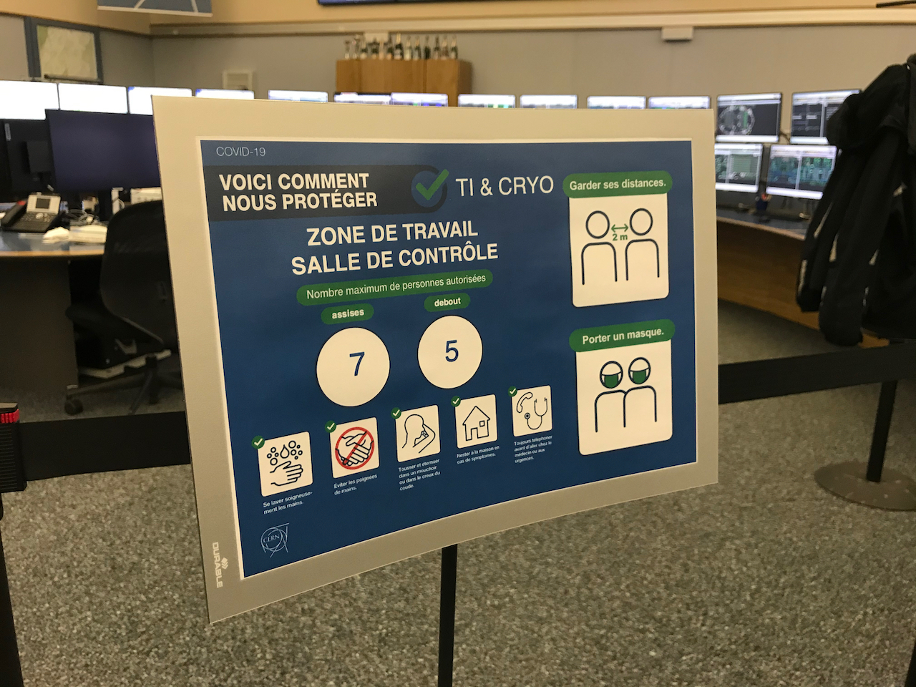
CERN Control Centre Capacity Reduction
All four islands normally ~ 49 work desks, now reduced to ~30.
Partially compensated by 8 temporary additional workstations on side tables and the central table
Island entries are partially closed off with flexible crowd barriers to dissuade people to enter.
Signs with absolute maximum capacity clearly visible at the entry of each island

Slide 17
Coping with restriction island capacity
An overflow control room was considered
  Not preferred – felt as a lack of ‘control’ by operations teams
Remote control was always possible - not much more used in Covid times
  Role Based Access Control is in place as protection against ‘unwanted’ machine parameter changes
  New web-based Remote Operations Gateway developed with secure login
  Web-based desktop sharing tool was developed
Reduced size of commissioning teams to minimum necessary
Meetings and some commissioning activities through webcam
  Each ‘accelerator desk’ is equipped with a video conferencing set

Slide 18
Impact of Quarantine on Operations
Fortunately no larger scale quarantining in the control rooms
  In general very few quarantine cases among operations staff - some close contact cases
  Good compliance of effective measures… …and a bit of luck
Back-up solution(s)
  Possibility to go to ‘back-up’ control rooms – not possible for all activities (e.g. access control)
  Technical infrastructure operation considered possible from home – in extremis
Ensure flexibility and reactivity in the (commissioning) planning
  More difficult for physics operation – possibly accept longer down times
  Ensure availability of people for shift replacements in case of quarantine - within limits
In the worst case, accept temporary stop of part of the complex

Slide 19
Impact of measures on Commissioning and Operation
Zoom meetings and commissioning activities through Zoom
  Multiple Zoom meetings in the same control room not always easy to manage
  Less informal contact – less socialising
  No need to travel back and forth
Reduced control room capacity
  More difficult to train newcomers – Students and fellows miss out on some activities
  Requires greater flexibility from machine coordinators etc. (no non-operations work in the control room)
  Less socialising
Teleworking
  During the early period of the commissioning, prolonged intervention times by some experts
  Less distraction for those not teleworking
Quote:
“We always manage to do what we need to do and most of the time even within schedule, but the way we do it is not as nice as before Covid”

Slide 20
Impact of Covid on Availability
(since the start of SPS North Area physics)
Facility | Destination | Expected 2021 Total [%] | Achieved 2021 Total [%]*
LINAC4 | - | 95 | 97.3
PSB | PS | 90 | 94.4
 | ISOLDE
PS | SPS | 87 | 88.3
 | nTOF
 | AD
 | East Area
SPS | LHC | 84 | 69.3
 | North Area
 | AWAKE
 | HiRadMat
Note:
Expected availability was established from data prior to the Covid pandemic
Time after commissioning for Linac 4 is substantially longer than for SPS, hence more teething problems have been solved.
Reduced availability of the SPS is not so much related to Covid measures, but technical problems that take time to solve.
* Wed. 14.07 noon – Mon. 04.10 noon
Source: Accelerator Fault Tracking

Slide 21
Topics
The Context: Long Shutdown & Commissioning
The Impact of Covid, Measures and Tools put in place
Post-Covid
Concluding Remarks

Slide 22
What will/may stay after Covid ?
Web-based Remote Operations Gateway
  Very user-friendly, excellent tool for machine coordinators on-call.
  Role Base Access Control to be reinforced for some machines
Some webcam based meetings
  Especially short daily briefings
  Sometimes also used for local interventions for direct and visual feedback or instructions
A certain level of teleworking for some of the outside shift activities
Some of the hygiene measures
Most of us look forward to go back to normal, perhaps even with the daily ‘French’ handshaking…

Slide 23
Topics
The Context: Long Shutdown & Commissioning
The Impact of Covid, Measures and Tools put in place
Post-Covid
Concluding Remarks

Slide 24
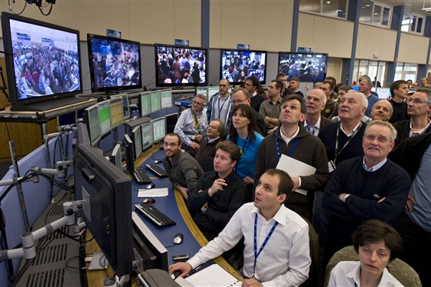
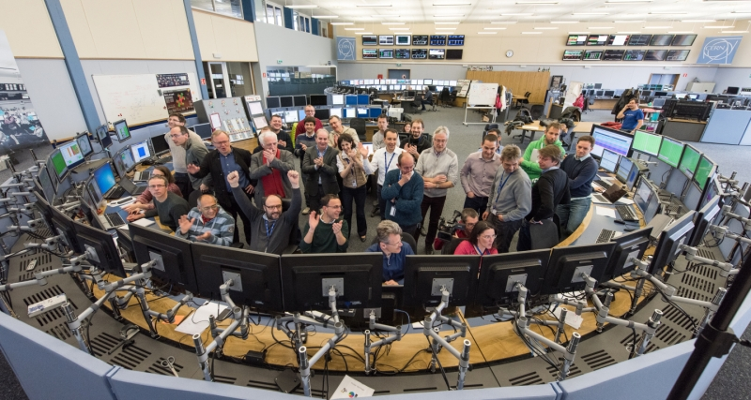
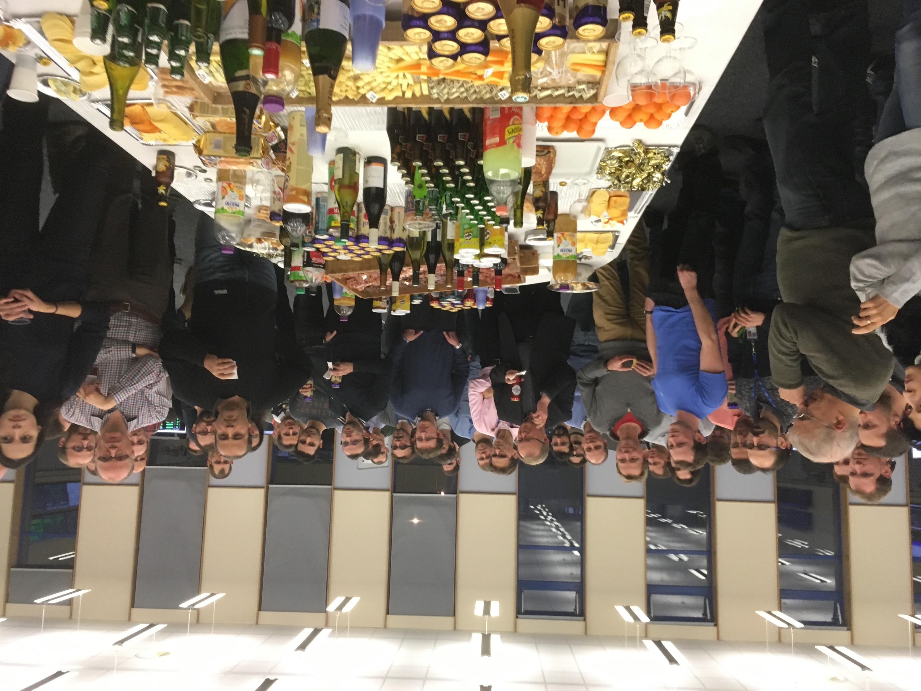
Concluding Remarks
When the pandemic started the CERN accelerator complex was in shutdown mode
  Initially many of the OP group activities could be continued through teleworking
Impact on injectors schedule ~3 months delay – no activity stretching
  LHC more delayed to worldwide dependency on materials and experts for experiments
Substantial and efficient, but workable, Covid measures were put in place
  Limitations on the number of persons in the control rooms, but no extra delays on commissioning
Today, the Injector Complex is delivering nominal beam to all fixed target experiments
  Commissioning completed in time & beam availability for physics not impact by the Covid pandemic
  LHC and it’s experiments are more delayed – beam commissioning to start March 2022
We are looking forward to better times and to be able to welcome everybody again without restrictions in our control rooms
Unthinkable today, but not to be forgotten….

Slide 26
Abstract
CERN was in the middle of a 2-year long shut-down, scheduled to implement a major upgrade in the LHC injectors complex and to perform consolidation and maintenance on large parts of the LHC, when in March 2019 the Covid pandemic imposed itself. Installation work was adapted to comply to the new Covid related measures put in place and the schedule was shifted because of the lock-down. The gradual commissioning of the renewed complex was launched in Autumn 2020 and was substantially impacted by the measures imposed.
This contribution will address the impact of Covid on the work organization for the commissioning and operation of the accelerator complex, the extra measures and tools that were put in place together with a brief overview of new tools and habits that are likely to stay around even after the Covid pandemic has extinguished.

Slide 27
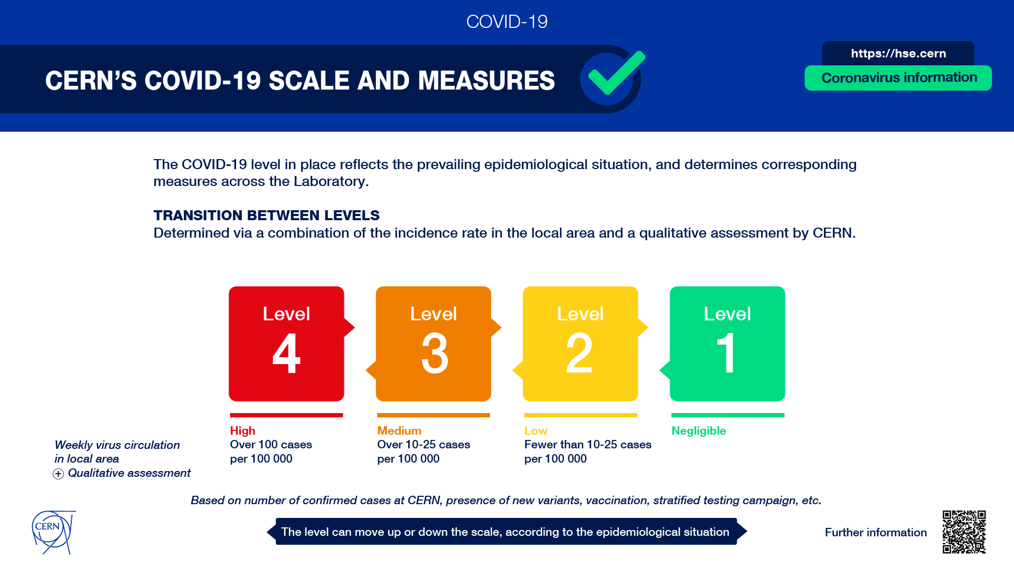

Slide 28
Long Shutdown 2 schedule prior to the Covid pandemic
Initially looking at a gradual beam commissioning of the injectors complex
from mid-April 2020 until early March 2021
Beam commissioning of the LHC was foreseen to start March 2021
…..a similar planning exists for the experimental facilities
EDMS: 1687788 Version 2.4 – released 8 January 2020

