Slide 1
Welcome to WAO’2021

Slide 2
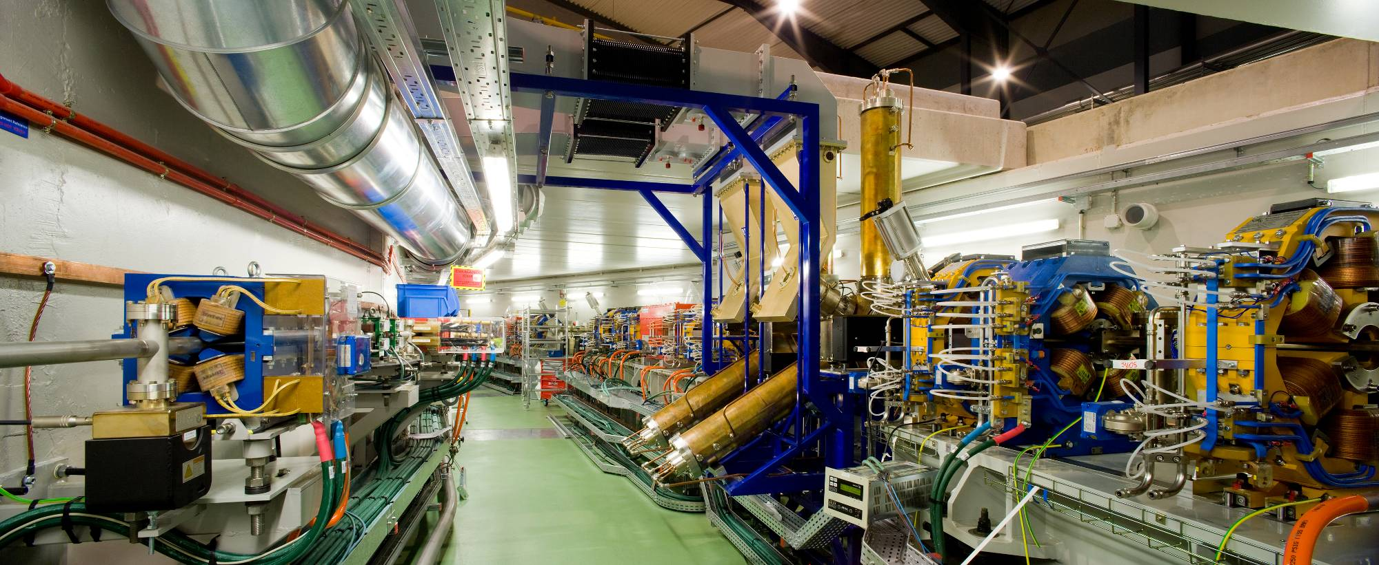
WAO’2021 hosted by the ALBA SYNCHROTRON
3 GeV Synchrotron Light Source
9 BL in operation, 4 under construction
In operation since 2012
Largest scientific installation in Spain

Slide 3
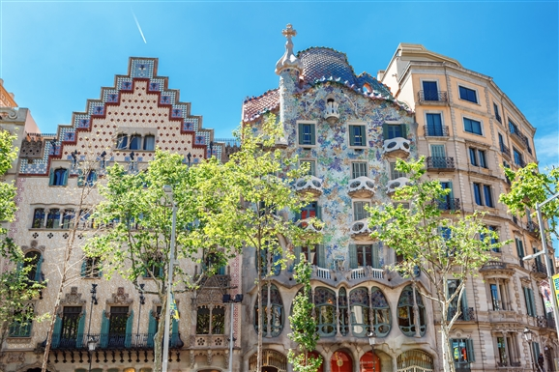
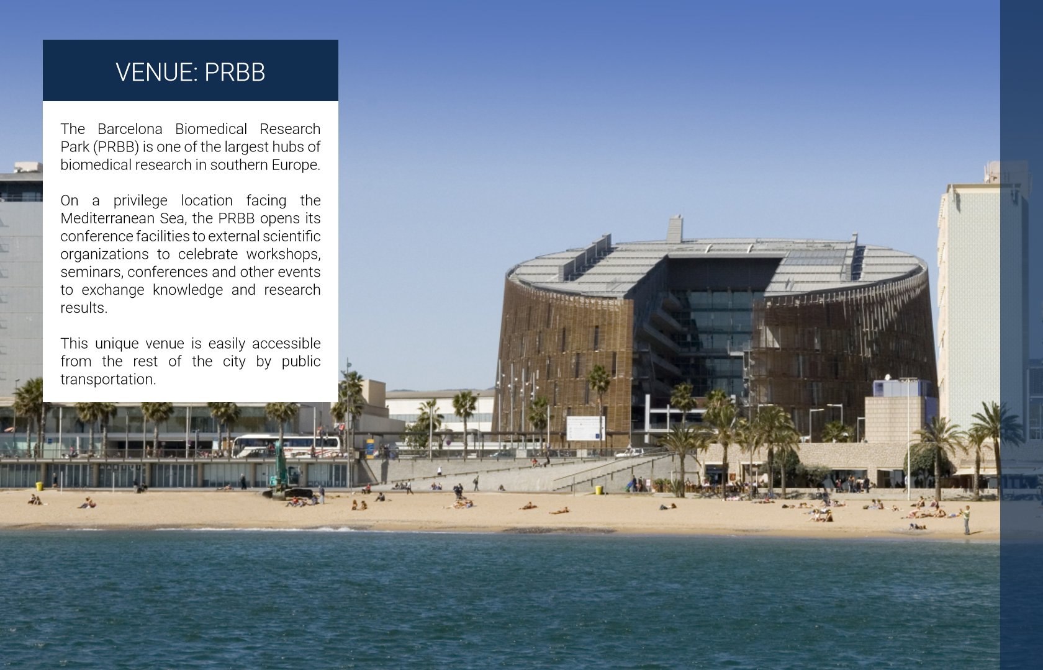
Back in 2018 ….
In front of a similar audience:
Welcome to WAO 2020 in Barcelona (Spain)
Barcelona downtown
Venue by the seaside

Slide 4
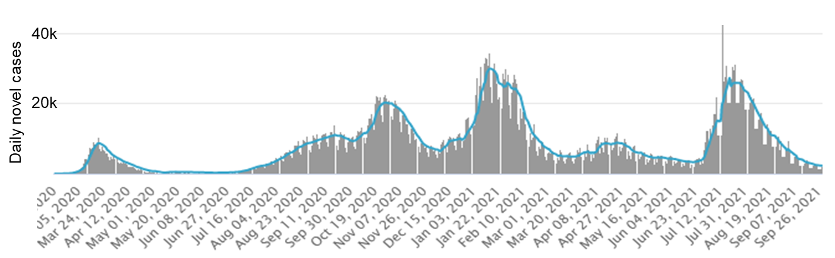
Preparations for a f2f meeting ongoing until March 2020
WAO’2020
WAO’2021
Delay registration
Postpone to 2021
IPC virtual meeting
Decide on a virtual event
Thanks to the IPC for being very supportive

Slide 5
International Program Committee
The International Program Committee (IPC) is tasked with the roles of:
Building and organizing the content of WAO
Selecting a host for future WAOs, and advising hosts during the planning stages
Forming topics of interest for the sessions, writing session abstracts
Chairing the sessions during the Workshop
Michael Bieler (DESY)
Jon Bonofiglio (NSCL)
Brian Freeman (JLAB)
Kazuro Furukawa (KEK)
Rossano Giachino (CERN)
Laurent Hardy (ESRF)
Yoshiyuki Iwata (NIRS)
Glen Johns (SNS)
Dan Johnson (FNAL)
Gregory Marr (BNL)
Montse Pont (ALBA)
Peter Schuh (SLAC)
Petra Schuett (GSI)
Violeta Toma (TRIUMF)
Jun Xing (IHEP)
Wenzhi Zhang (SINAP)

Slide 6
Local Organising Committee
Montse Pont, chair Operations
Ferran Fernandez Operations
Daimi Pérez Administrative support
Adara Carrión IT systems
Ana Martínez Communications
Laia Torres Communications
Sarah Moreira Communications
/co-host in most of the zoom meetings/
Contact us at wao2021@cells.es

Slide 7
Sponsors
We appreciate greatly the contributions from our sponsors towards WAO’2021, even though they cannot be present at the Workshop
Check on the video will be running during the break (when connected to the poster/parallel discussions sessions)
We encourage you to visit their web pages to learn what the Spanish industry can do for your accelerator

Slide 8
The program of the week

Slide 9
Welcome to WAO’2021
Looking forward to a fruitful workshop

