Slide 1
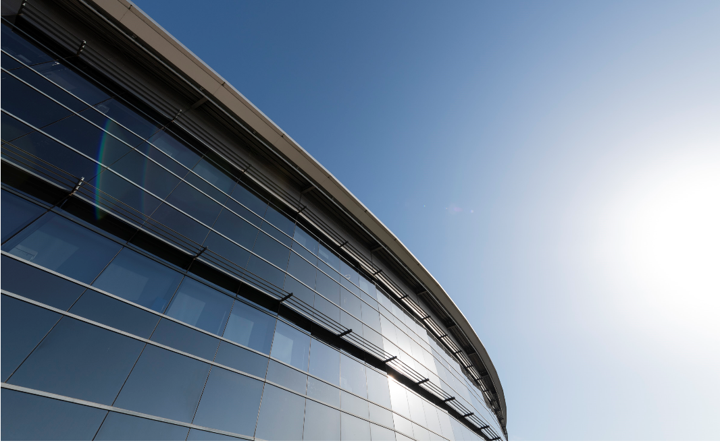


Welcome
Francis Perez
Head of Accelerators
October 5th, 2021
Foto Sergio Ruiz

Slide 2
Barcelona from approaching plane

Slide 3
ALBA from approaching plane

Slide 4
IBIC conference at Barcelona

Slide 5
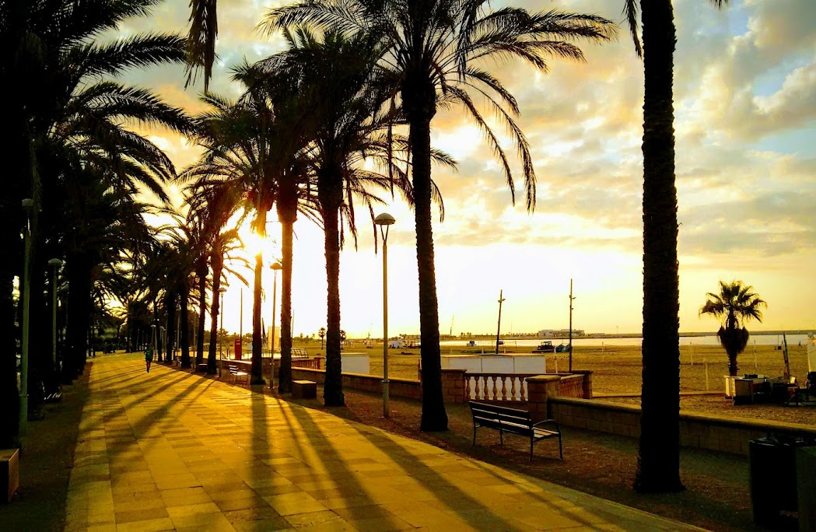
Vilanova beach

Slide 6
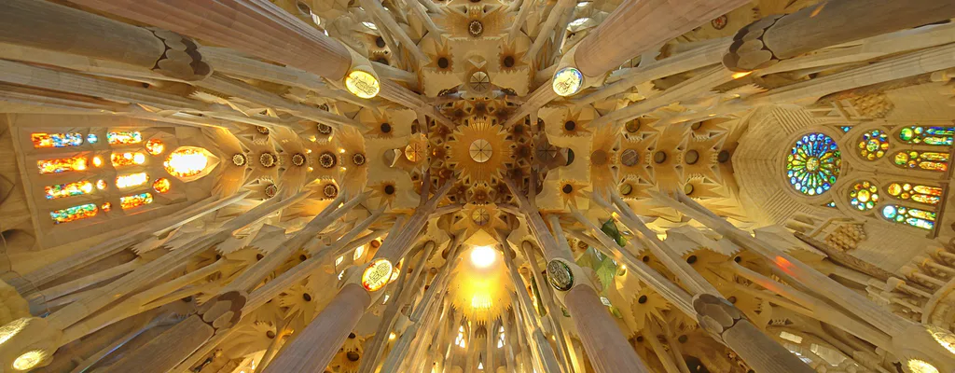
Sagrada Familia

Slide 7
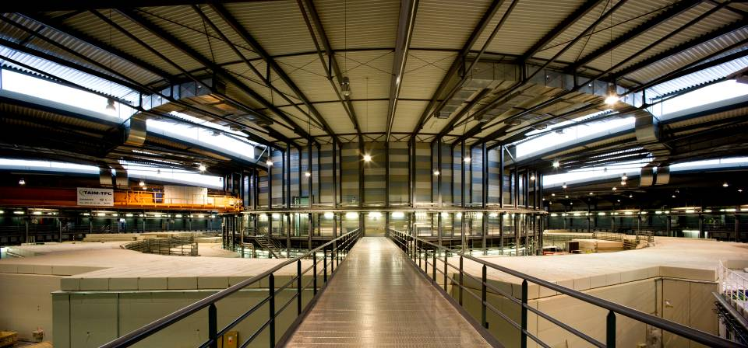


Welcome to ALBA Light Source
the Spanish Synchrotron Radiation Facility
28% international staff
35% international users
Spanish government
50/50
Catalan government

Slide 8
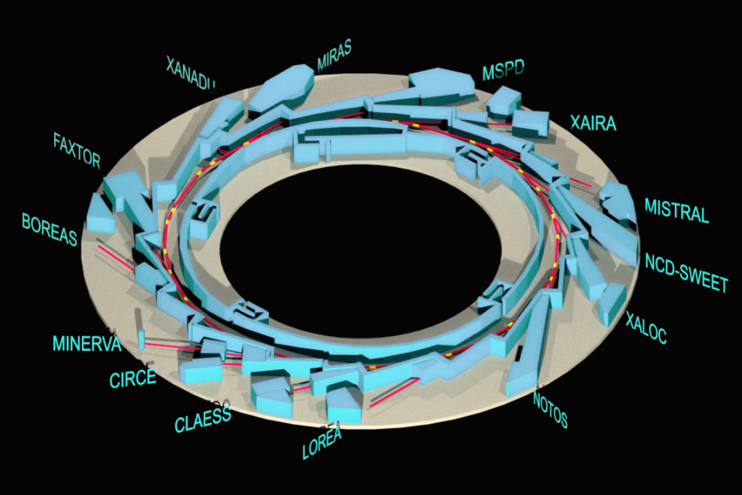
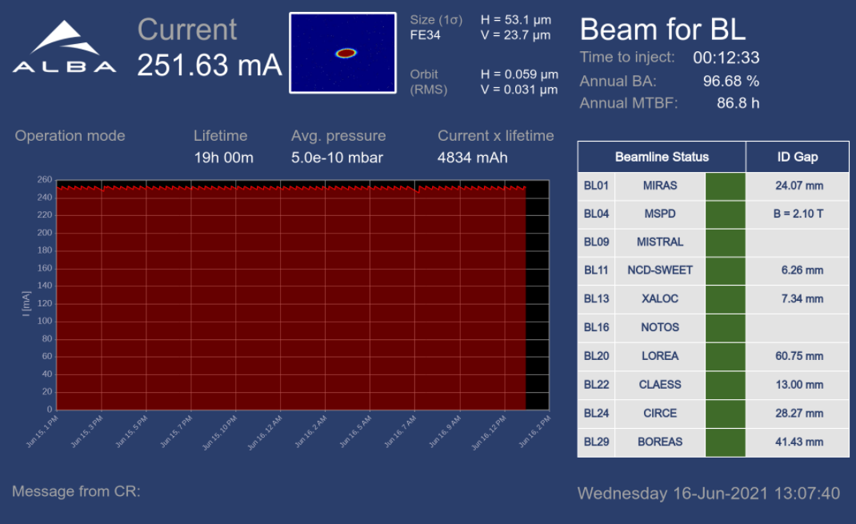
ALBA key parameters
e- Energy = 3 GeV
C = 270 m
Emittance = 4.4 nmrad
8 operating BLs
2 in commissioning
3 in construction
2 for acc. diagnostics
ALBA
Top-up operation

Slide 9
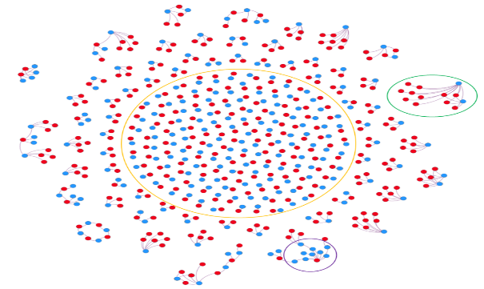
Our USERS
Joint academic and industrial
Private
Academic
ALBA
2000+ user visits
300+ yearly experiments
60+ companies using our instruments
15 patents
+ 337 citing ALBA experiments
Direct access covering operational costs
Results can be confidential
Competitive and free access
Public results

Slide 10
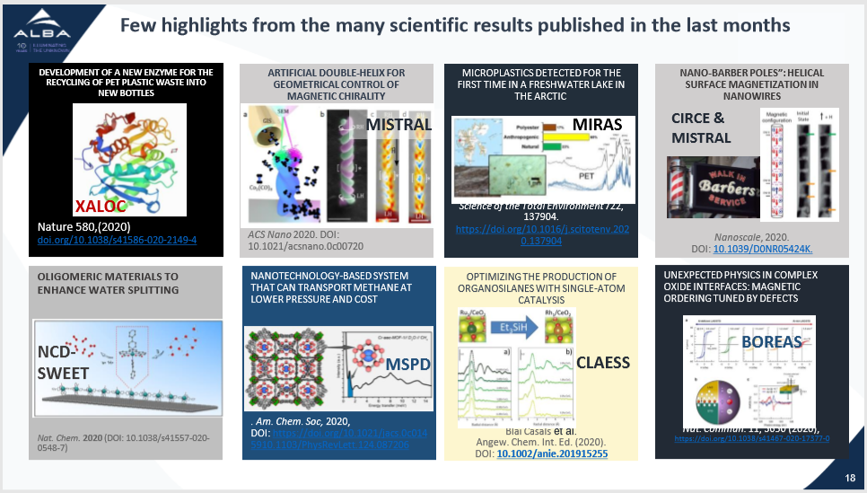
Biomolecular science
Magnetism
Environmental science
Nanoscience
Surface science
Nanotechnology
Catalysis
Material science

Slide 11


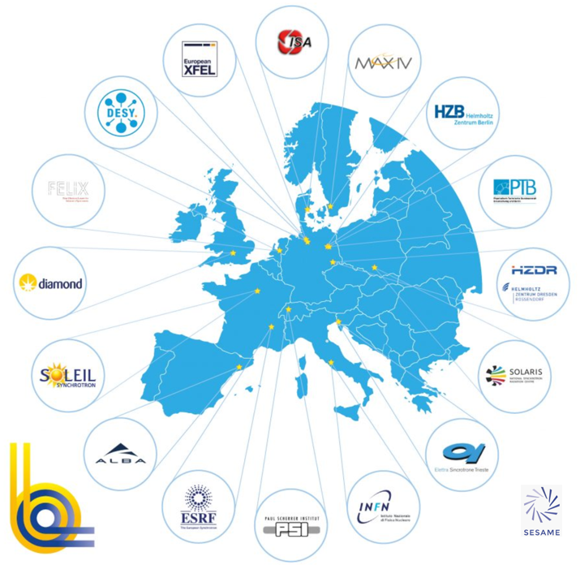

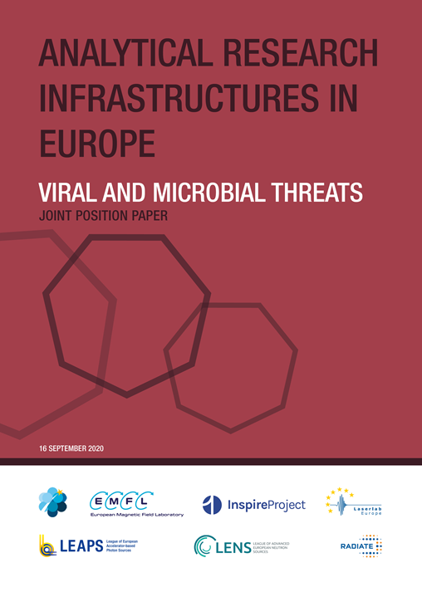
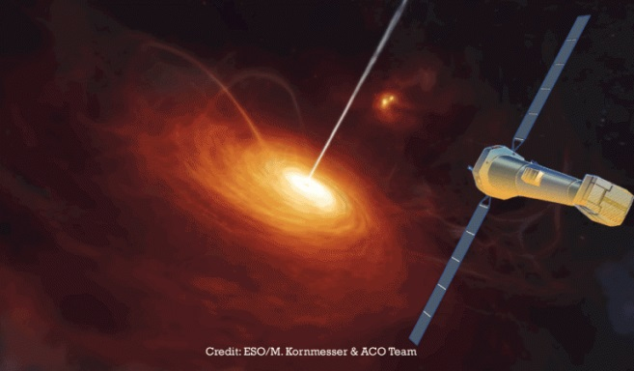
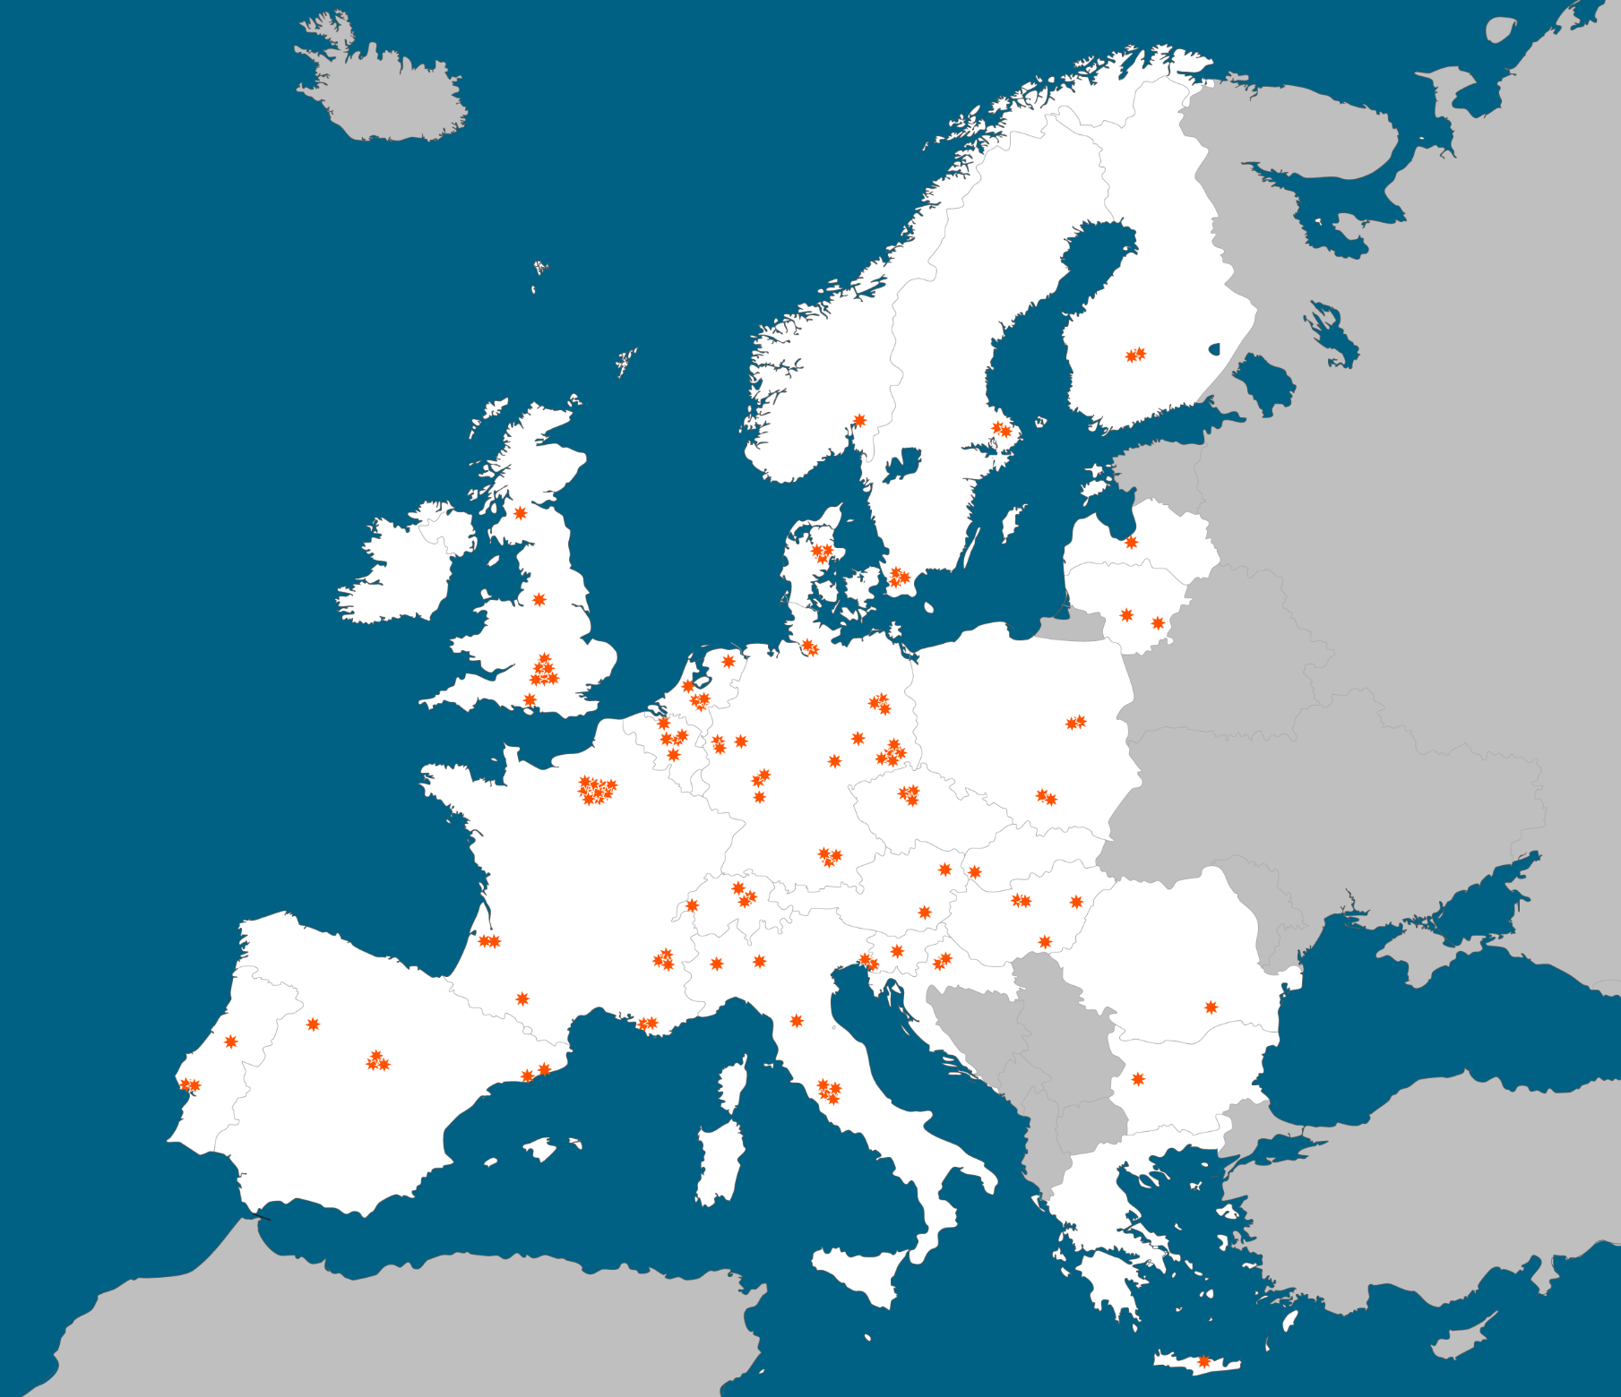
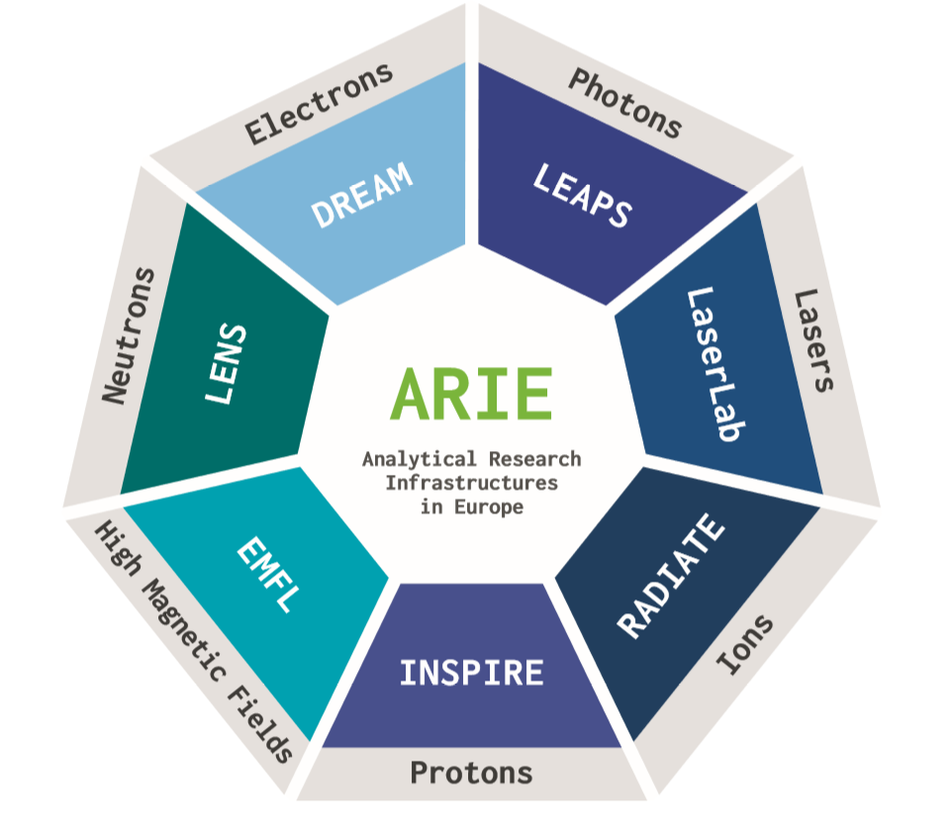
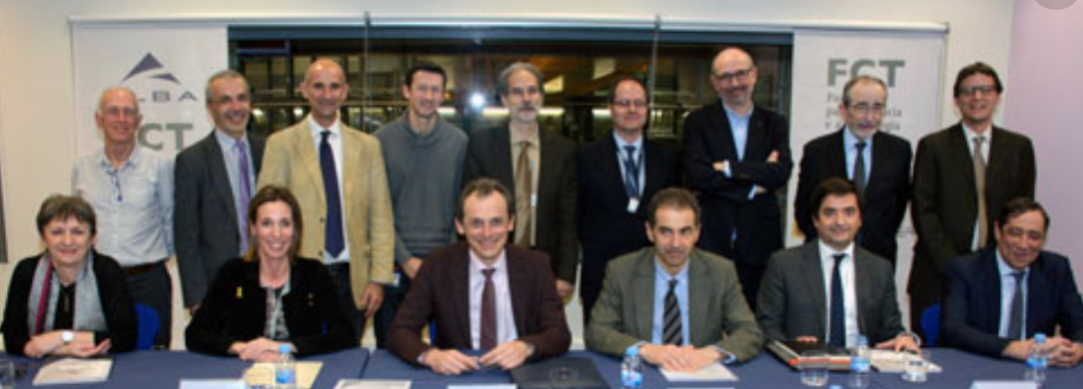
Today
European Commission
Increasing # of National collaboration projects
Chairing LEAPS (2020-21)
19 facilities
16 institutions
10 countries
Minerva: BL in collaboration with ESA
ALBA collaborations
ARIE spokesperson for start-up the collaboration
Agreement with Portugal

Slide 12
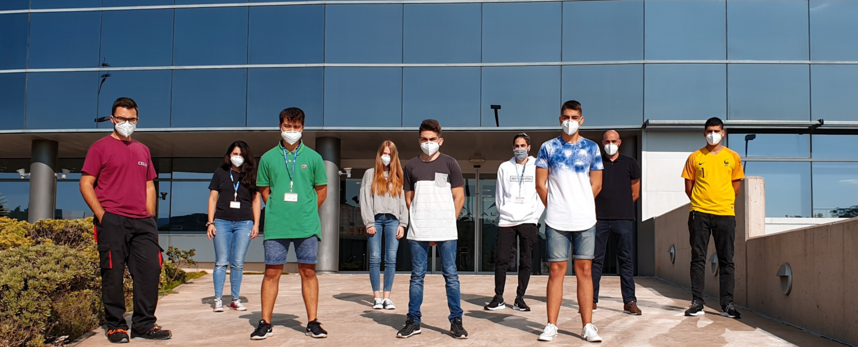

High-qualified job offers
Positive Economic return of investments
220+ staff
+200 students trained
Involvement in educational programs from schools to universities
ALBA & society
+7500 outreach visits per year
Organization of scientific and industrial workshops for pharma, chemistry,…
Contributing to
health, clean energy, advanced technologies, climate change, environment, food, agriculture, transport & mobility, security, cultural heritage,…
Academic and Industrial PhDs
Outreach projects for children

Slide 13


ALBA Future

Slide 14
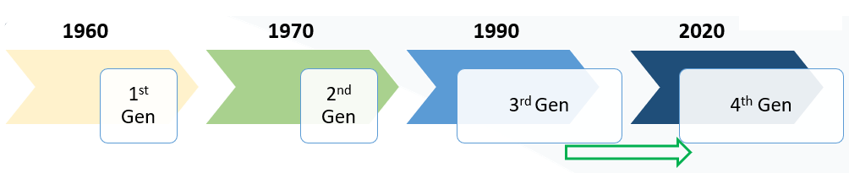
Following the evolution of Synchrotron Radiation Sources

Slide 15
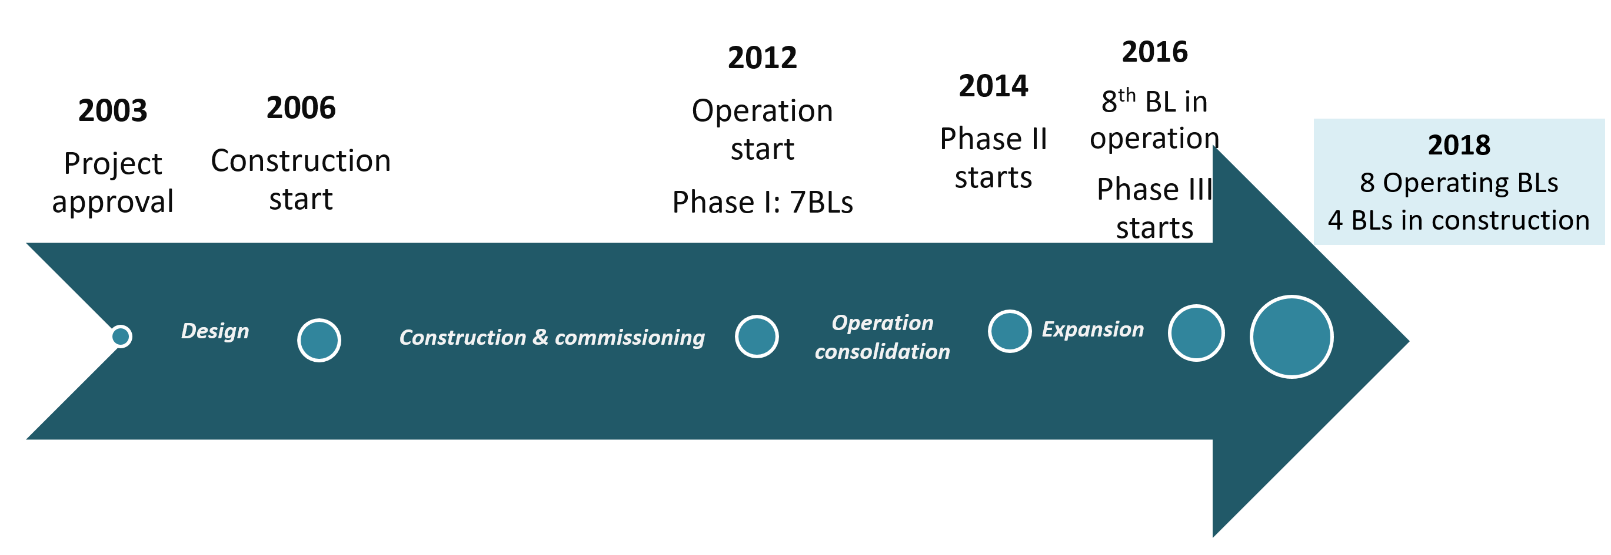
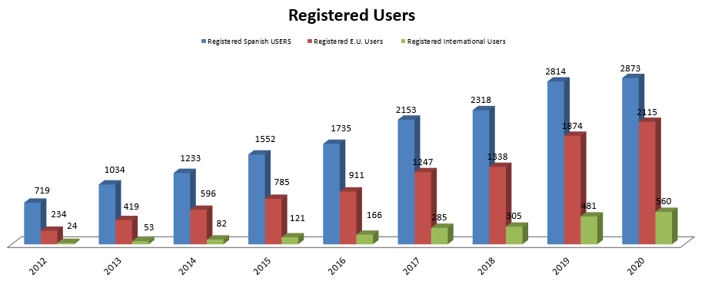
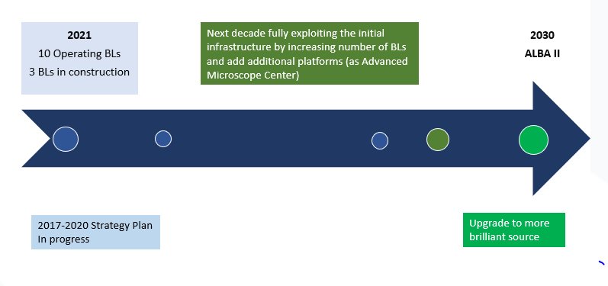
ALBA History and Future
2021
10 Operating BLs
3 BLs in construction
First proposal for building a synchrotron in Spain in the ’90s
10 years for the approval and 10 years up to the operation
2021-2024 Strategy Plan

Slide 16
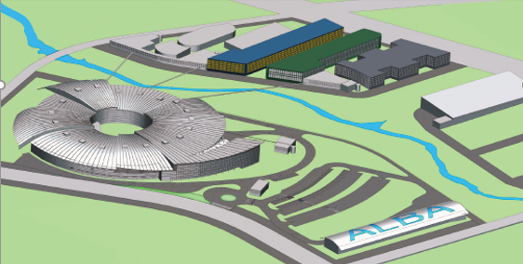
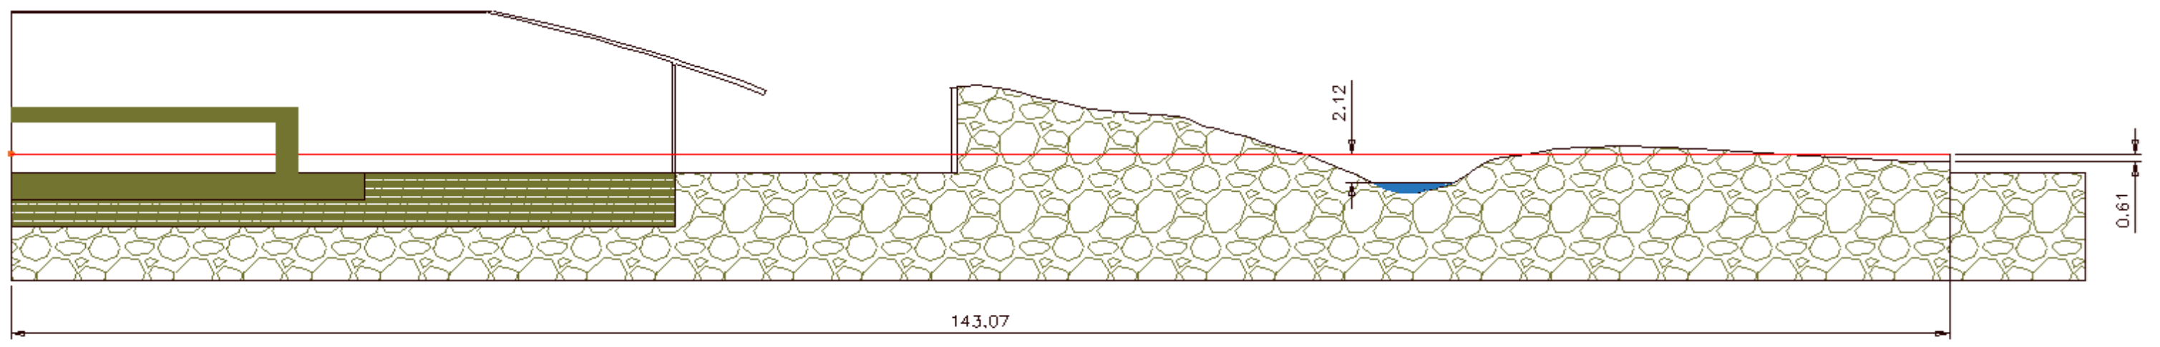
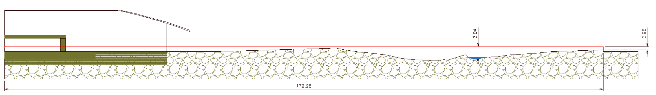
ALBA II: from 3rd to 4th generation light source
Building on existing infrastructures…
…and using adjacent land plots for long new beamlines
143 m
172 m

Slide 17
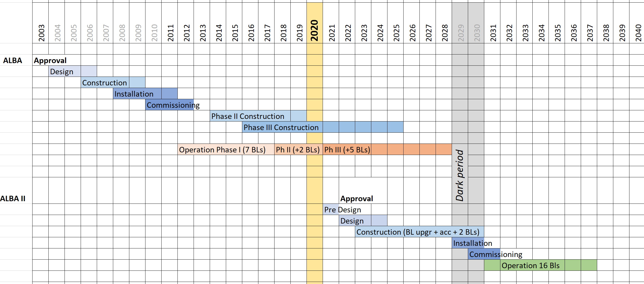
Science from ALBA to ALBA II
Building on ALBA strengths
Complementing ALBA instruments
Building new BLs
Upgrading existing BLs
Complementing existing techniques
Including the Microscope Platform in the full scenario

Slide 18
Thanks!
Foto Sergio Ruiz

Slide 19
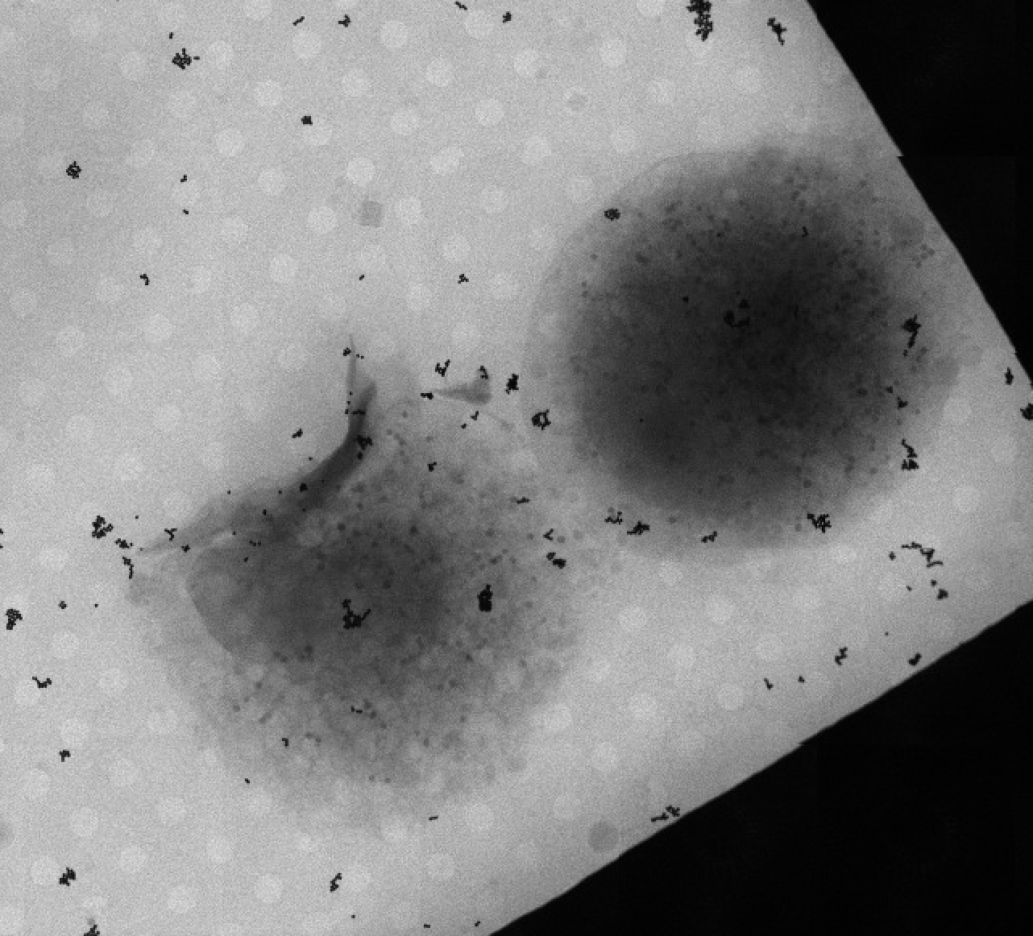
We operate science
Alveolar cell in late stage of infection
with SARS-Cov-2
Cell in early stage of infection
Infecting another cell
4 μm
A. Perez, ALBA y CNB-CSIC, Madrid

Slide 20
Enjoy the
Workshop!!
Foto Sergio Ruiz

