Slide 1
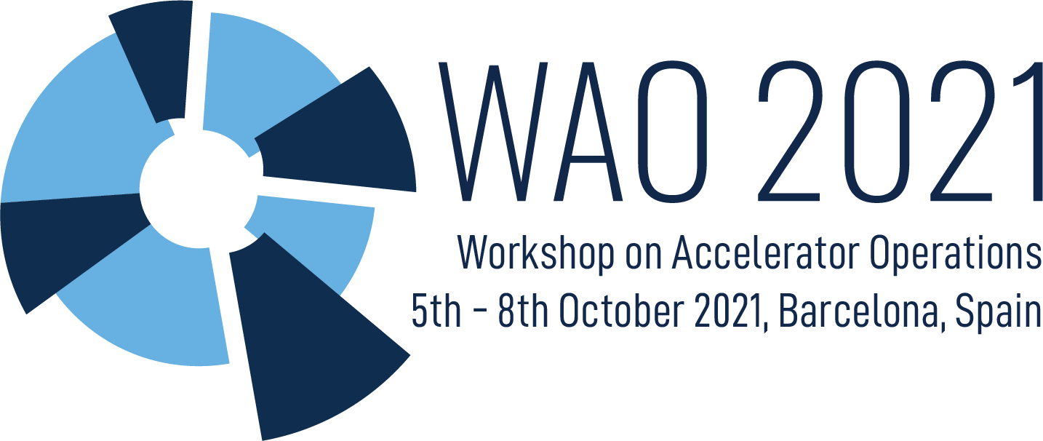
WAO’2021 summary
M.Pont, chair

Slide 2
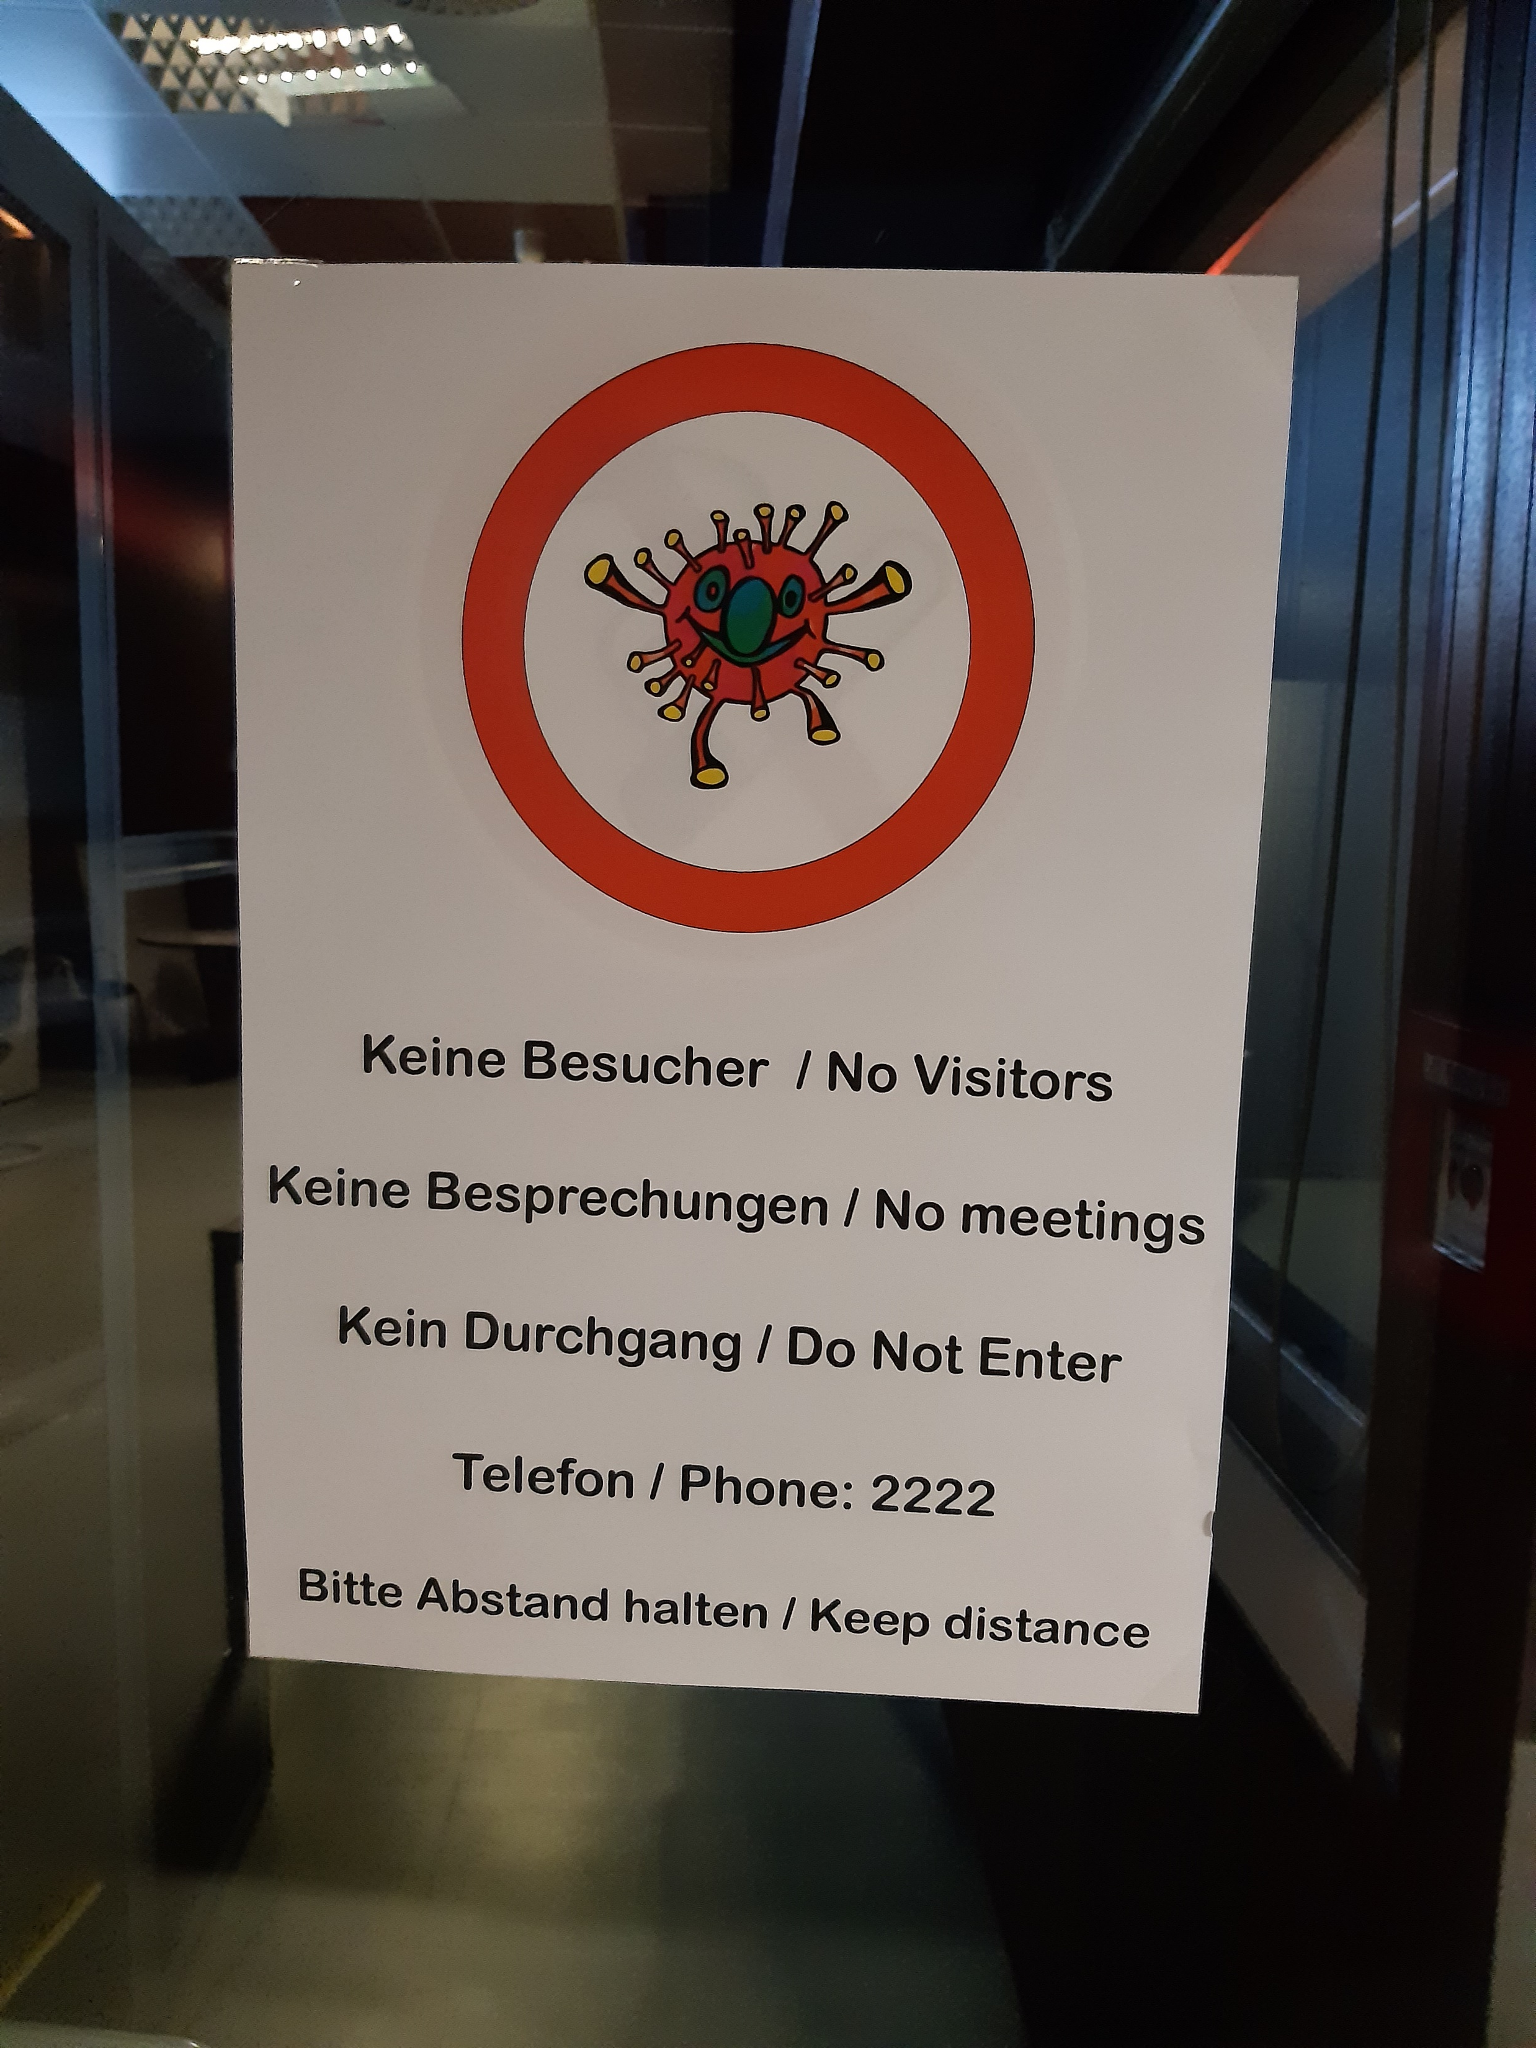
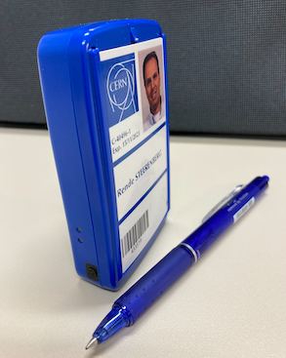
Reactions to the pandemic
All machines adapted to the rules allowed from each country
Bring machine down safely. Most of the machines move to shutdown like status
MCR becomes sacrosanct. Make the main control room the safest place to be.
Introduce distances, masks, limit occupancy, extra cleaning, proximeters

Slide 3
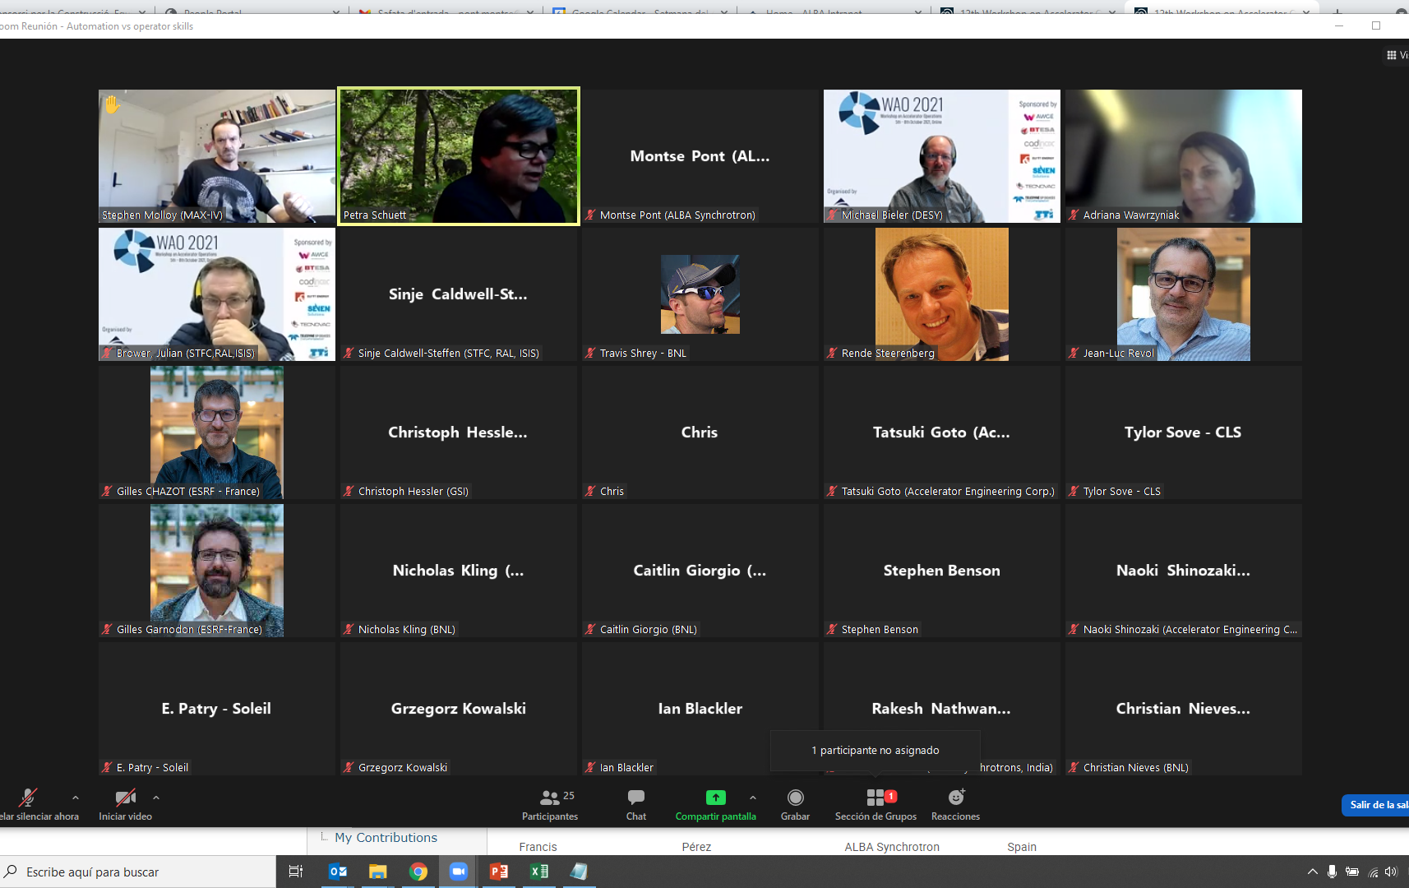
Living with the pandemic
Restart operation progressively as rules in each country allowed for it
Minimise contact between people in CR: move to 8h to 12h shift, cancel overlaps
Teleworking and remote control was heavily used
Important impact on operating schedules was due primarily to travel restrictions
Many labs provided support to the nations or local communities by performing COVID related research and/or donating PPEs

Slide 4
Living with the pandemic
Beam availability and MTTR have no really been affected by the teleworking
Operators have done a lot more of what’s normally their job
Some labs have put in place a back-up CR
Many labs have extensively tested their staff
Labs have adapted to this “new-normal” operation
Commissioning, complex re-starts, major installations have taken place

Slide 5
What are we going to keep
Possibility of videoconferences in CR
Remote operation, though introducing some strict control
Extensive use of online tools, developing twins
Improve hygiene in Control Room is also likely to stay
All our new friends: cats, dogs, family members…

Slide 6
Parallel discussions
Thanks to Greg for the summary

Slide 7
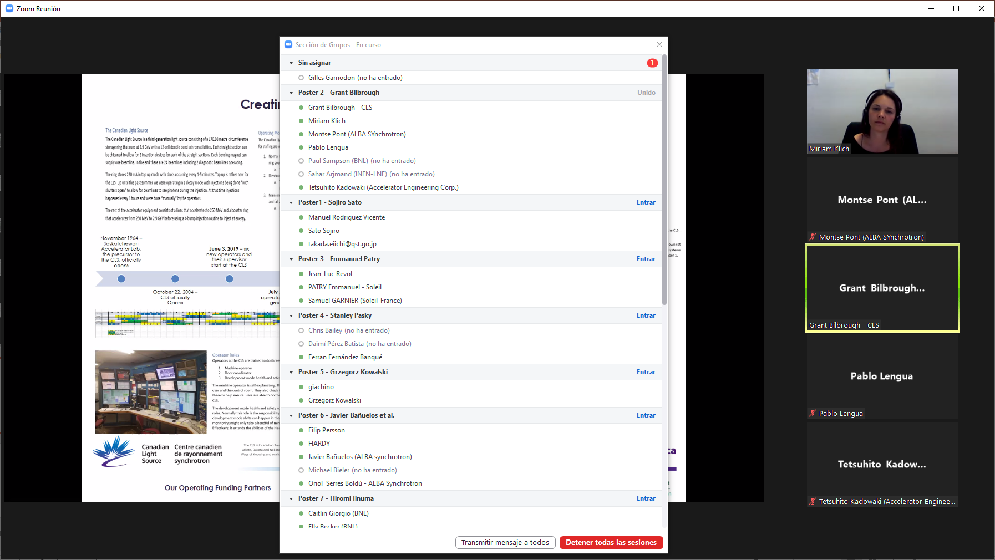
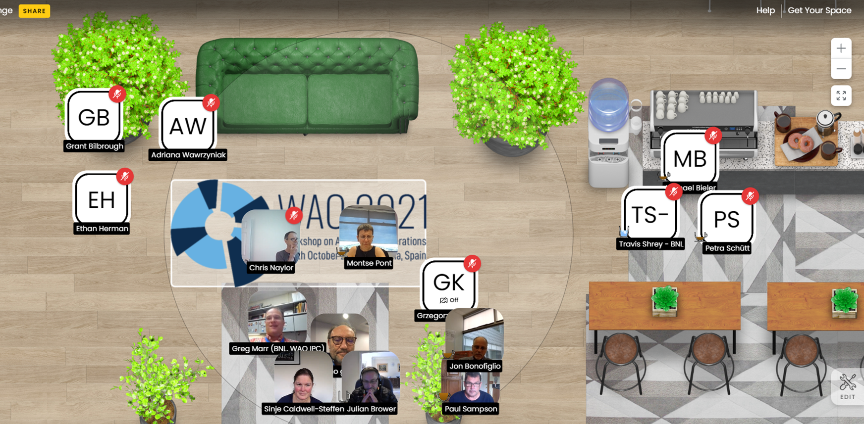
Poster session (12 posters to visit)
Well visited
Interesting discussions, that continue over kumospace

Slide 8
Statistics
155 registered participants in INDICO
85 typical attendance to the plenary sessions
60 typical attendance to the breakout rooms
45 different institutions represented
17 oral presentations
12 poster

Slide 9
Special thanks to
LOC
Speakers and Poster Presenters
Chairs and Moderators
IPC
Sponsors
You, the audience

Slide 10
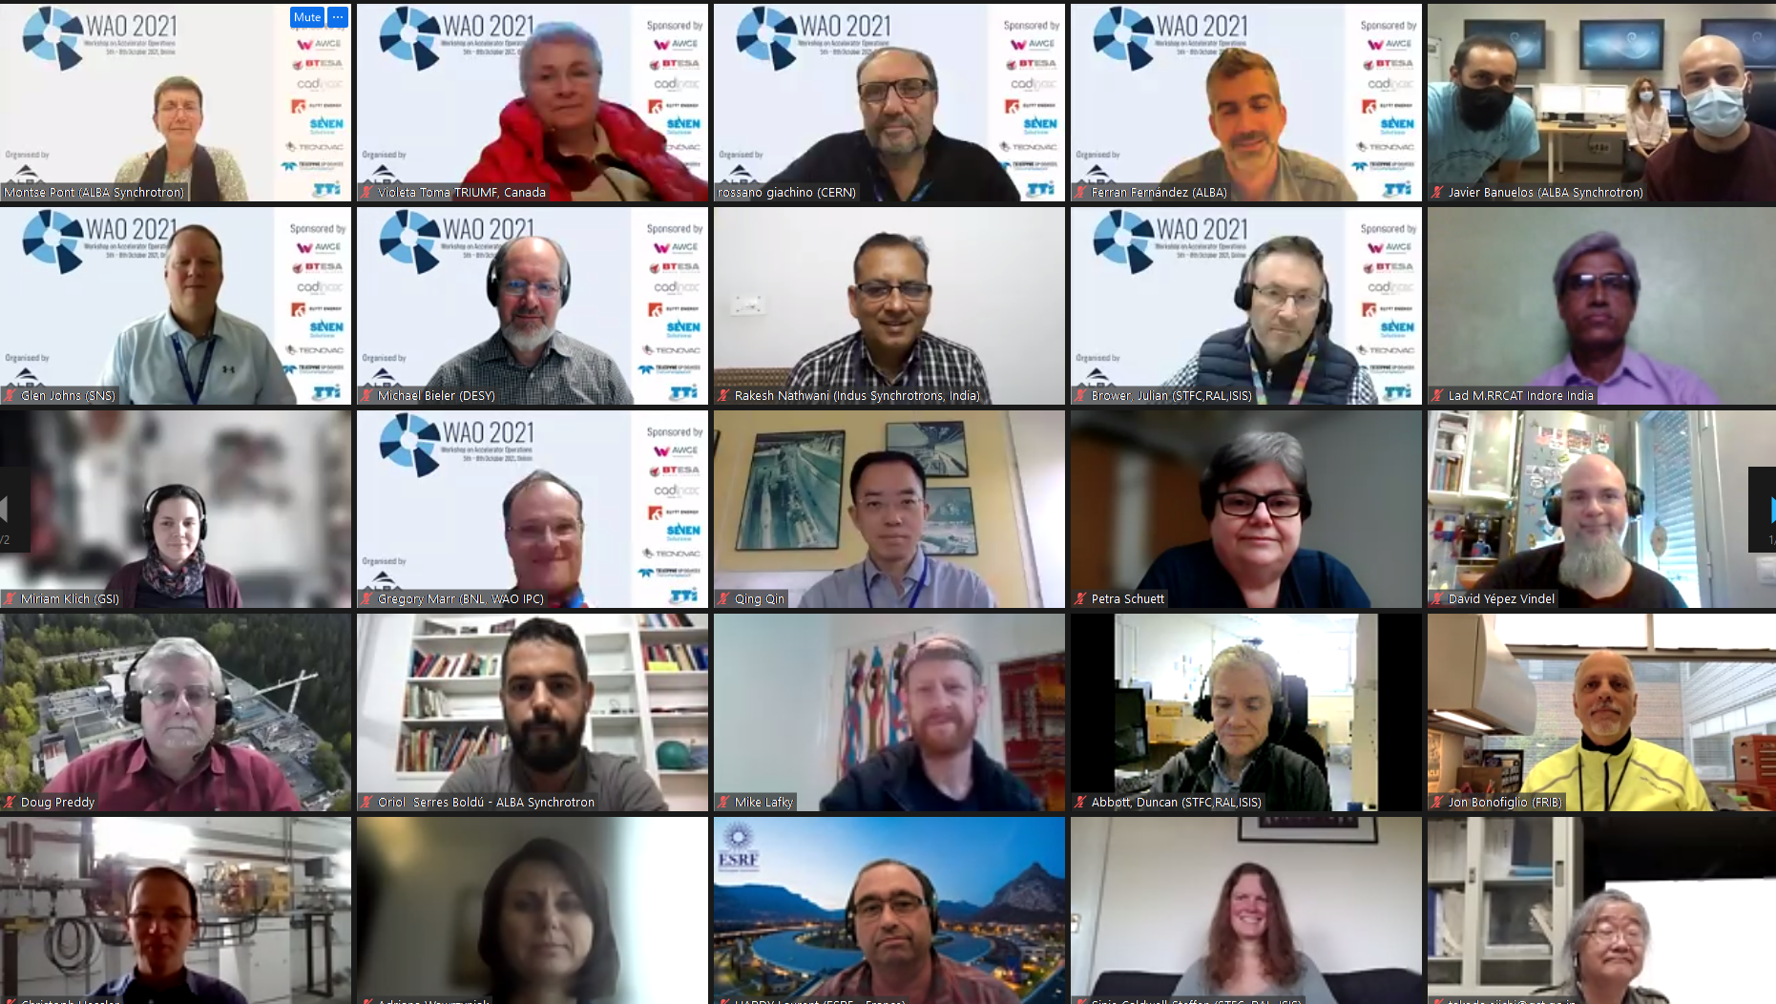
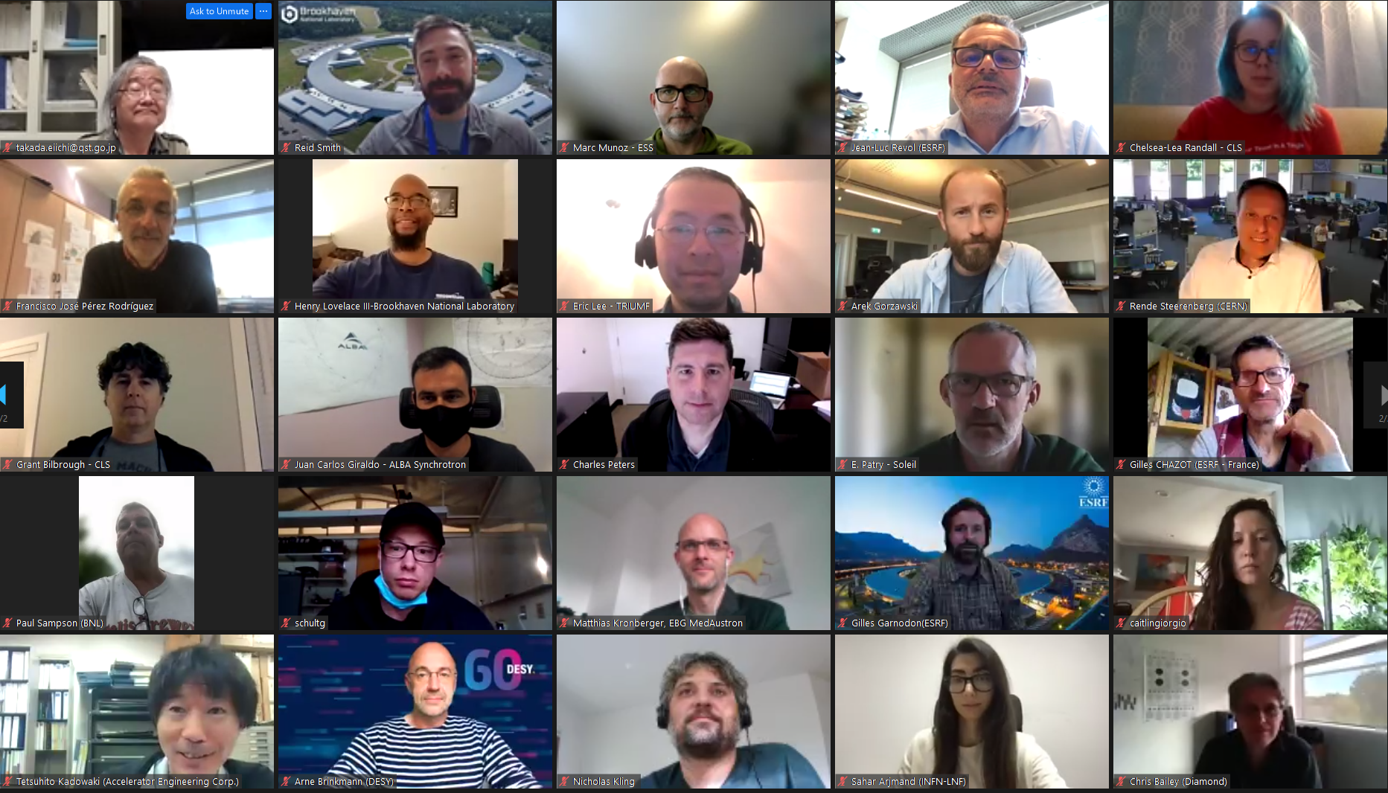
hope to see you f2f soon

